Slide 1
Introduction to eCYBERMISSION
Notes:
Hello and welcome to an introduction to eCYBERMISSION. My name is <NAME>, and I am <TITLE>. Today I am going to tell you a little bit about eCYBERMISSION. If you have any questions you can raise your hand or just wait until the end of the presentation. So, what is eCYBERMISSION?

Slide 2
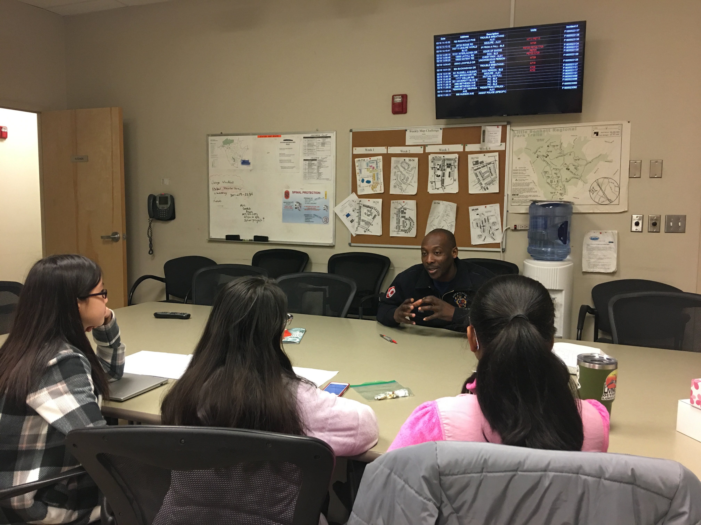
What is eCYBERMISSION?
Web-based STEM competition
FREE to students
Long Term Project
Working in Teams (2-4)
Problems in THEIR Community
Notes:
eCYBERMISSION is a web-based STEM competition that is free to students in grades 6, 7, 8 and 9. Students will work in teams of two – four, and they will choose a problem in their community to explore or try to solve. This is a long-term project, so they will be working on it over days and weeks, not just one class period. But since it is a competition, there are also prizes available.

Slide 3
Competition
What do they win?
Savings Bonds
1st Place state - $1000 (maturity value) 2nd Place State - $500 (maturity value)
Regional Finalist (top 3 scores in each region in each grade) - $1000 (maturity value)
Regional Winner (1 per region per grade) - $2000 (maturity value)
National Winner (1 per grade) - $6000 (maturity value)
More than just winning . . .
Notes:
In each state we award a first and second place prize in each grade. Each first-place winning team receives $1,000 per student in savings bonds, and each second-place winning team receives $500 per student. The bonds are purchased at half of the maturity value when they are awarded and then mature to those final values over time. If a team is one of the top three teams in their grade in their region, they would receive another $1,000 per student in savings bonds and the chance to participate in the regional judging. This takes place via a video conference with the judges. If a team is selected as the regional winner in their grade, the team would get another $3,000 per student in savings bonds and an all-expenses paid trip with their Team Advisor (an adult associated with the team, like a teacher or parent) to the Washington, DC area in June to compete in the National Judging and Educational Event. Here the team would present their project to judges face-to-face, and if they’re selected as their grade’s national winner, the team would get another $6,000 per student. But participating in eCYBERMISSION is about more than just winning money . . .

Slide 4
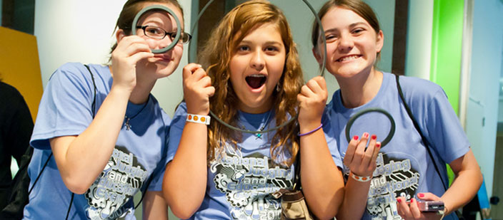
How Many Students Participate?
Between 10,000-20,000 registered
Chances of winning are low
Chances of LEARNING are high
Joining a NEW community
Helping their community
Notes:
Each year we have anywhere from 10 – 20,000 students register for eCYBERMISSION, and that number keeps going up. This means that the chances of winning, especially at the national level, are not very high. But the chances of learning something from the project are! Completing a project like this will help develop the skills to conduct complete and robust scientific investigations and engineering projects. It will also help students learn how to conduct research and to work well with a group. These are the types of skills that are invaluable in high school, college and beyond. Also, they get to join a new community online – a community of other students in grades 6 – 9 participating in eCYBERMISSION all across the country and even in other countries around the world. They get to interact with them on the eCYBERMISION website and via our social media channels like Facebook, Instagram, Twitter and YouTube. Getting to know these other students will help them form friendships with people they would otherwise never get the chance to know. And do not forget, they are helping THEIR community!

Slide 5
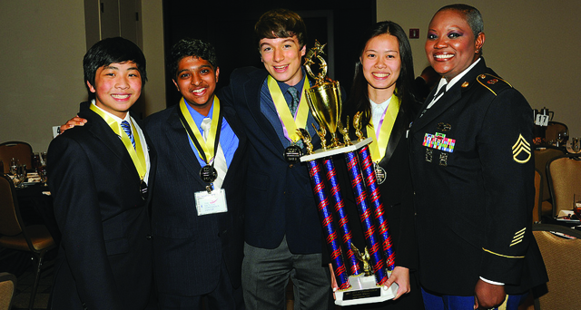
Community Problems
Different from Science Fair
Not just a science experiment or engineering project
Look around at what problems affect their community
Classroom
School
Town
State
Notes:
eCYBERMISSION projects are different from typical science and engineering fair projects because they are required to be community-based. This means they cannot just choose a random topic – no volcano models nor bridge building. Their projects for eCYBERMISSION need to be based on actual problems that they and others in their community face every day. They need to look around them to see what kinds of problems are out there to be explored or solved. They can look in the classroom, the school, the town, the state or maybe even in their own home or backyard! But how do they decide if they want to do a science project or an engineering one?

Slide 6
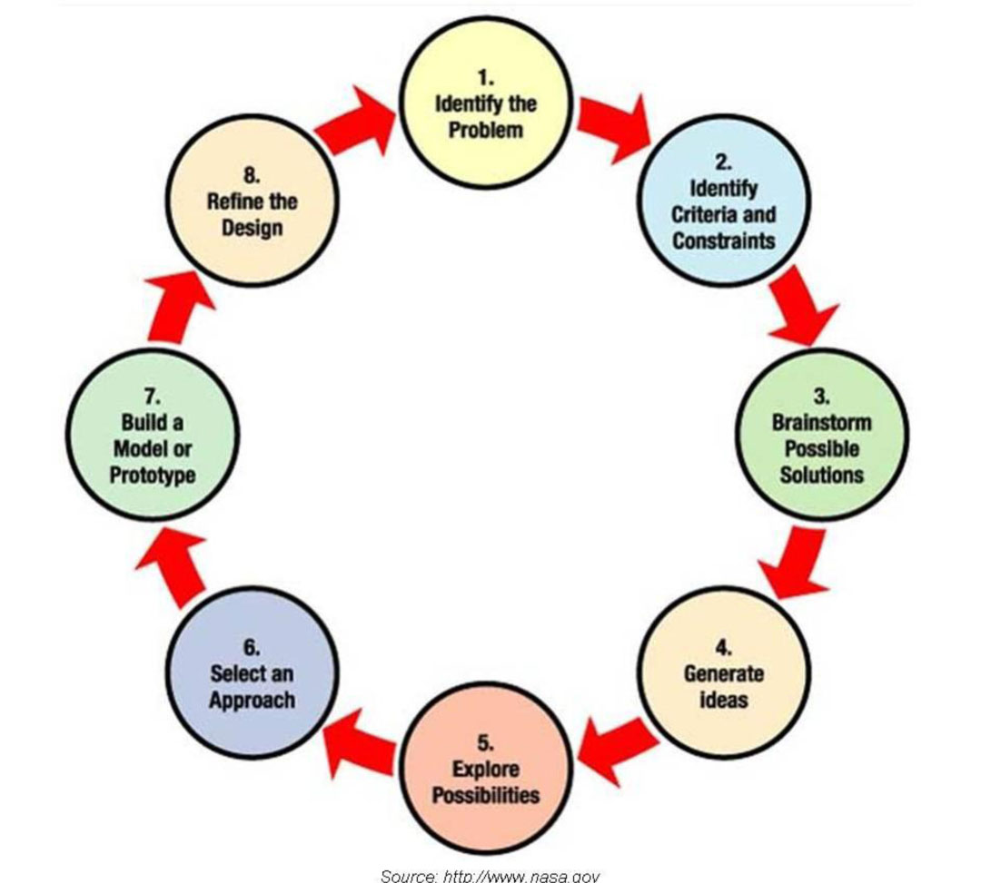
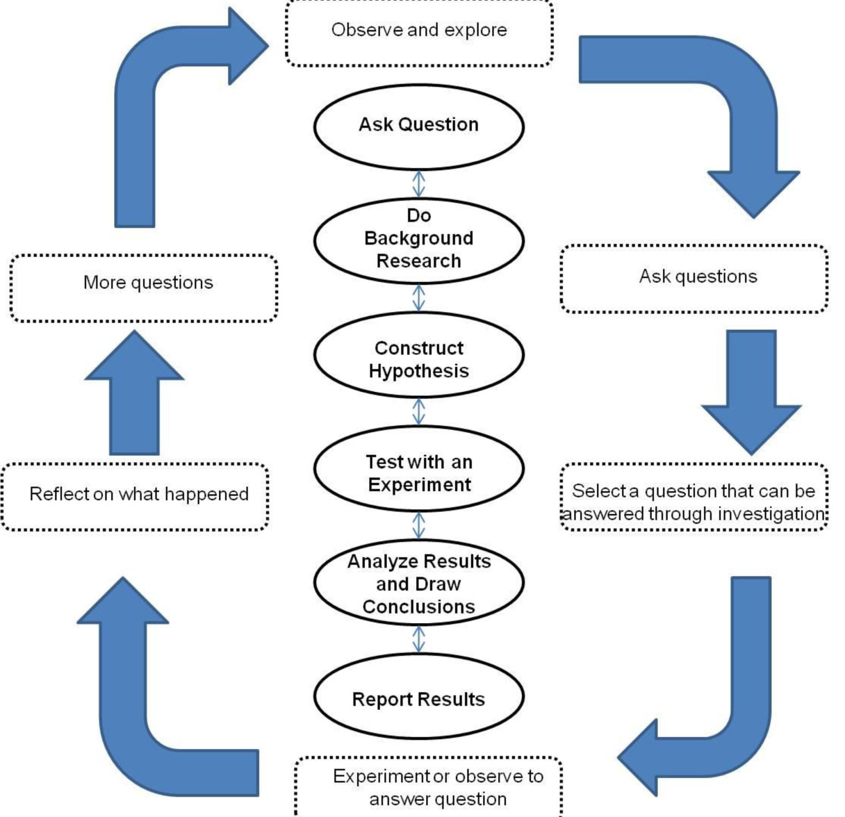
Engineering Vs. Science
Engineering
Design and test a prototype
SOLVING a problem
Science
Develop and test a hypothesis
ANSWERING a question
Notes:
You might already know this, but there is a simple way to tell the difference between science and engineering when it comes to what they are doing. If they are solving a problem (especially with a device of some kind) then they are doing engineering. If they are answering a question, it is science. So think about the different projects that you’ve had them do in your science classes. Some of them were science. If they had a hypothesis that they tested based on a question they asked (or you told them to ask). Some were engineering if they, instead, designed a prototype or any kind of solution to a problem. But whichever path they choose, they are going to be working in a team.

Slide 7
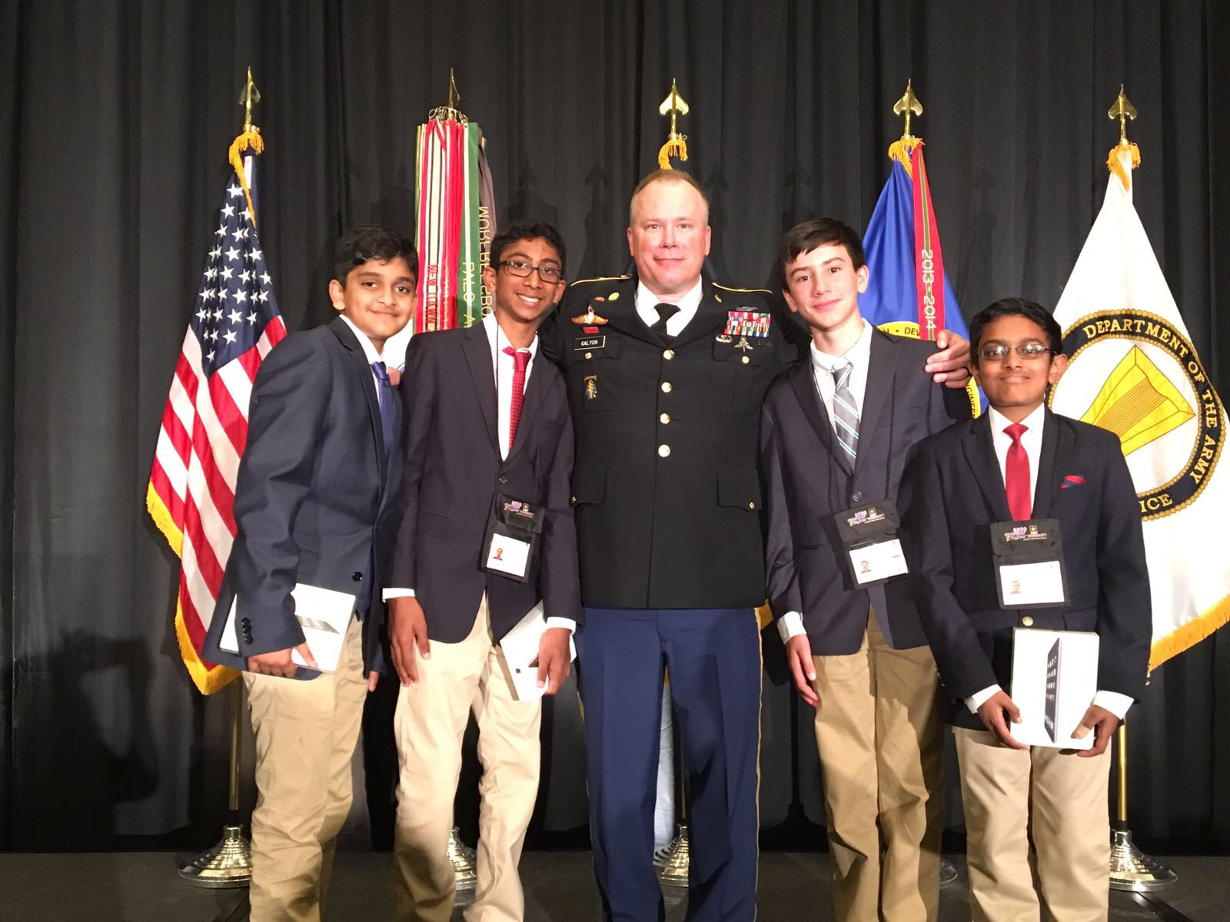
Team Work
Work in teams of 2 to 4
Friends?
Other students with common interests?
TA might select the teams
They need a team name!
Notes:
Each eCYBERMISSION team needs to be made up of two to four students. If they are alone, they need to find someone else. If they have five, they need to split into two teams! Working together in a team is something that scientists and engineers do all the time. It is helpful because sometimes different people have different ideas and also because they take something that would be a lot of work for one person and with three or four it becomes much easier to get done. Students can choose to make a team with some friends. Or maybe they will find someone else that is not their friend but shares an interest with them. It is possible that you will assign the students to teams. And they are going to need a team name. Student also need to think of a login name they want to use, but that login name cannot contain their first or last name. OK, so let’s talk about the kinds of projects teams have submitted in past years.

Slide 8
Past Projects
Reducing the number of infants dying in hot cars
Lower the number of car accidents involving deer at night
Reducing waste in the community
Reducing the amount of bacteria in local waterways
Limiting phosphorus runoff into local waterways
Generating clean energy
Reducing the impact of harmful algae blooms
Finding natural remedies for neurological diseases
Notes:
This is a list of some of the projects that have won eCYBERMISSION national prizes. You can see that they are very different subjects, but what they all had in common was that the teams completed their projects thoroughly and explained each and every thing they did to the judges. Not all of these projects were successful and not all of their hypotheses were proven correct, but that is not what doing a science or engineering project is about. It is about following the process even if it means it does not work the way you hope it will and learning from that failure. Scientists and engineers use their failures as ways to know what to try in the future, and your students should too! So how should they go about choosing a topic for your project?

Slide 9
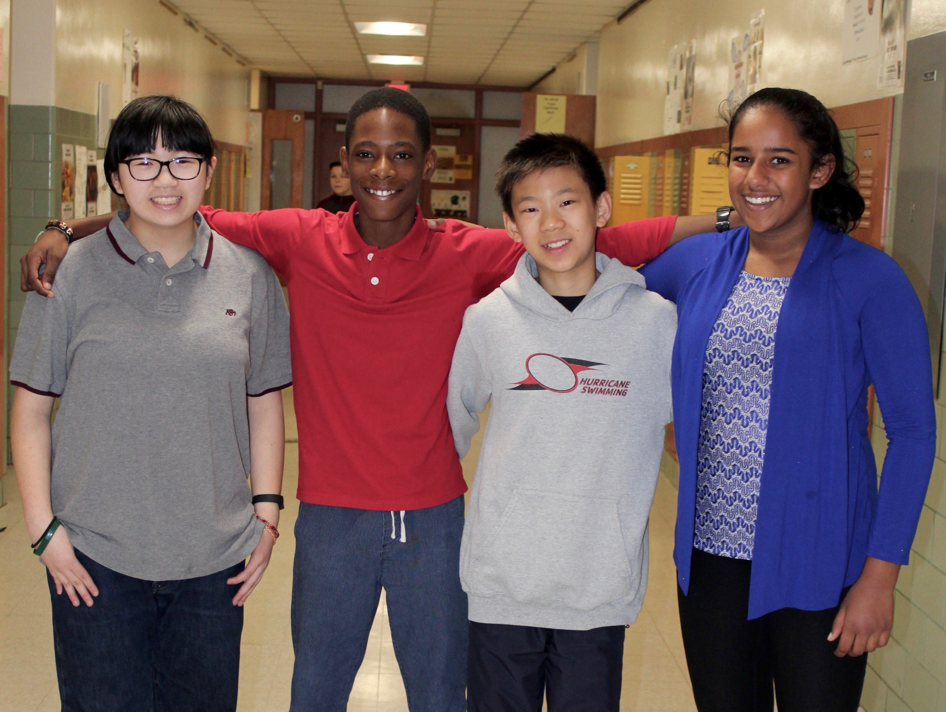
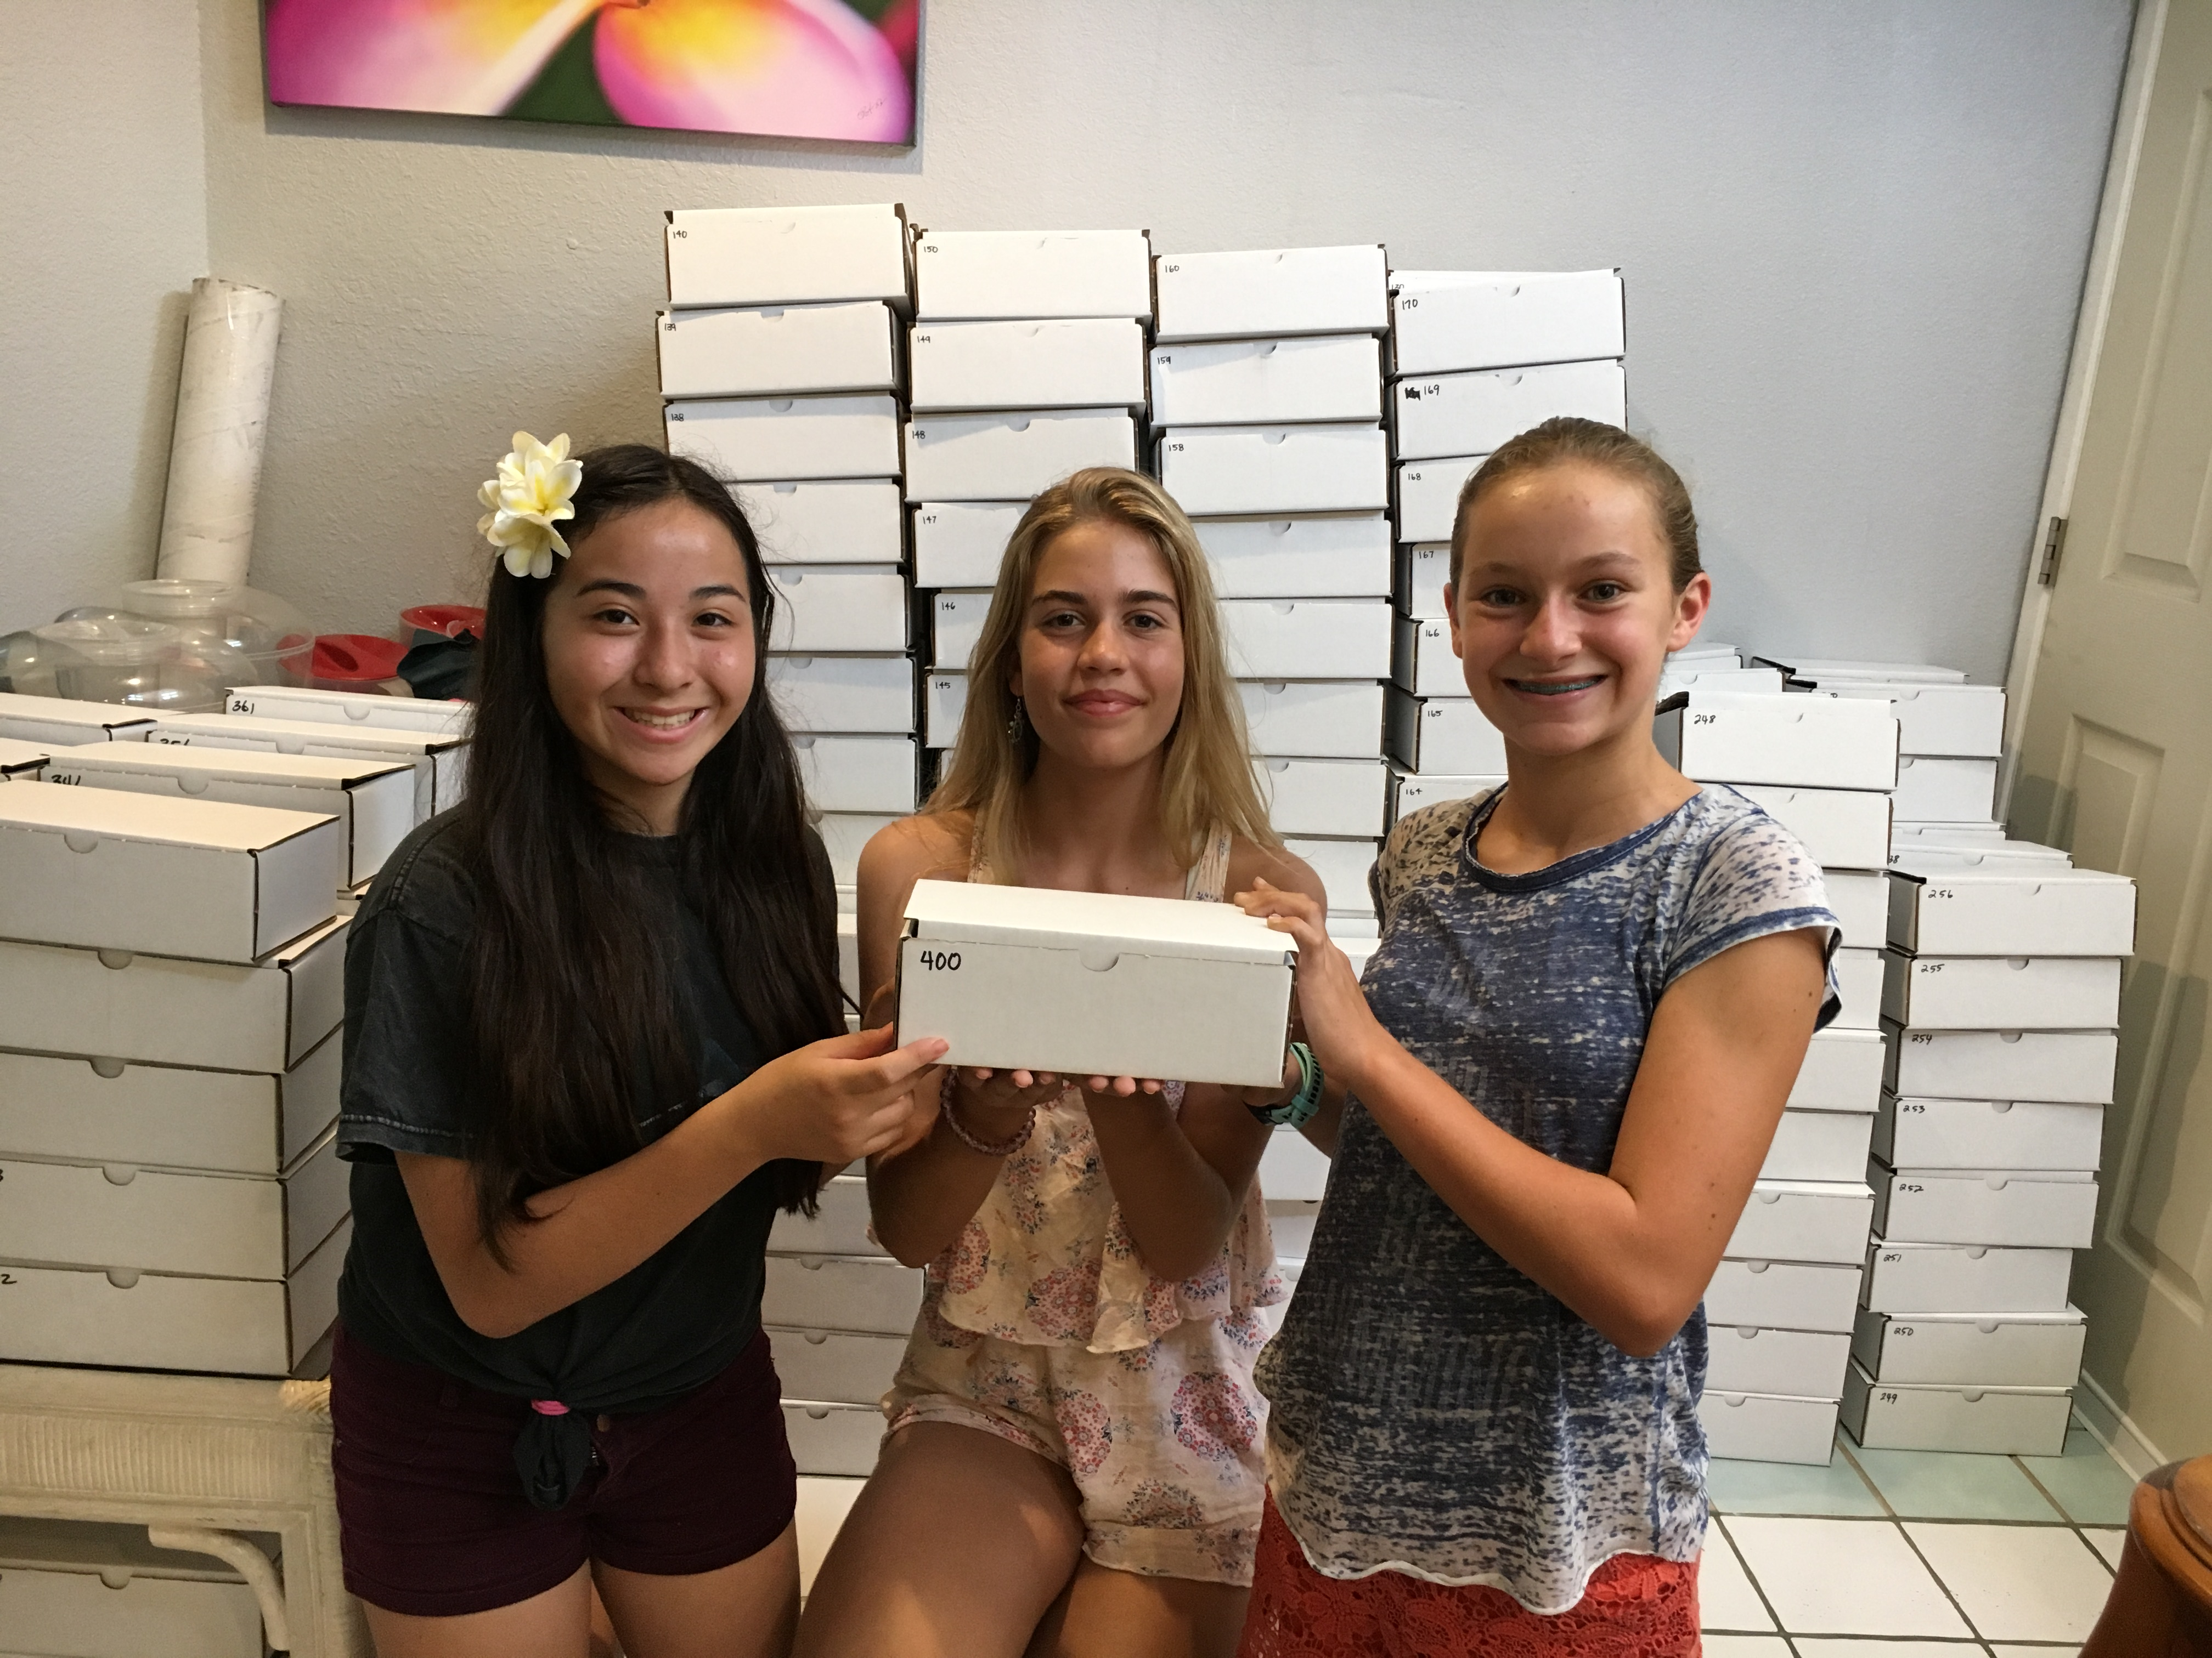
Picking a Topic/Problem
What interests you?
What problems do you see in your community?
Watch the news, read the paper, ask your friends, family, etc.
Notes:
Choosing a topic can be a real challenge, especially when you can choose anything you want. So have them take a moment to think about it. Have them ask themselves these questions: What interests you? What problems do you see in your classroom, school, town, etc.? Have them try watching the news, reading the newspaper, asking friends and family what they see as problems. Have them try to come up with a lot of different ideas, so if when they start exploring them they find that some are too big to tackle or they do not have the resources to explore them, they can move on to something else. But whatever they want to explore, you and they are going to need to be registered.

Slide 10
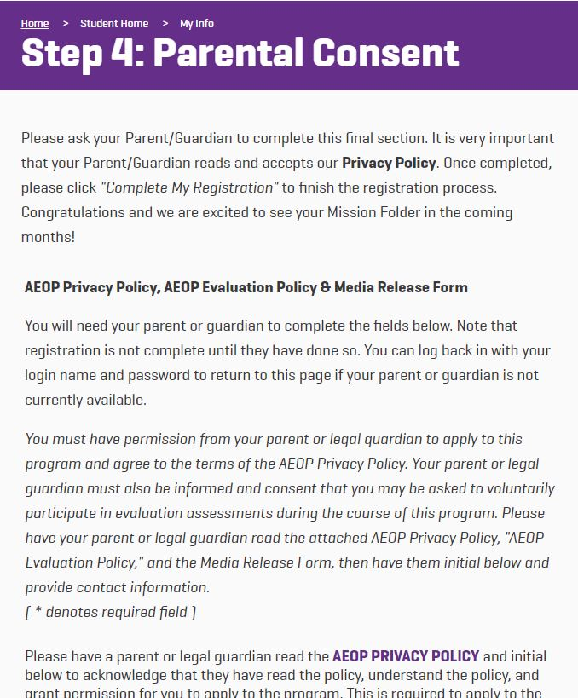
How to Register
Go to https://www.ecybermission.com
Click on “Register” in the top right
Select “Team Advisor”
Complete the registration
Step 4 for Students will need parent/guardian permission
They need to have a login name, but they don’t need to know what topic they’re doing before they register
Notes:
Registering is simple. All you need to do is head over to the eCYBERMISSION website, and click on “Register.” Then you will select “Team Advisor” from the drop down menu, and complete the registration. After you are registered your students will be able to register and link their account to yours. This way you’ll be able to put them on teams and monitor the work on the Mission Folder. When your students register, step 4 will need to be completed by their parent or guardian. After they are registered it will ask them to link with a Team Advisor, so make sure you are already registered before they are. Since you put them onto a team, make sure you know what they want their team name to be. Once you are registered, you will be able to log in on the eCYBERMISSION website.

Slide 11
Mission Folder
Notes:
As I mentioned, it is up to you to put them on a team. You also need to enter the team’s choice of method (science or engineering). Once you enter all of this the team will have access to their Mission Folder (what we call the submission for the competition). When you go in it to a specific team, it will look like this. You will see the four different sections at the bottom. Also, note the resources available on the right. Some of these are forms that the team may need to complete, and the Risk Assessment Form is one every team MUST complete. We recommend that teams do not have more than one team member in the Mission Folder at a time. The Mission Folder will not update in real time, so if two people are in at the same time, they might lose information they entered. They may even want to do all of your work on a separate document, like the Mission Folder Collaboration Document. This is a Google Doc that can be copied from our Google drive to their own and then the team can work together on. Once it’s complete they’d copy and paste their answers into the Mission Folder to submit. Note that the Mission Verification Section includes a checklist for the team as well as the place for them to write their abstract for their project.

Slide 12
Mission Folder
Notes:
When you click on “Team Collaboration” you will see the questions for that section. The team simply enters their answers in those text boxes. Also, note that there are question marks with some of the questions. If the team is having a tough time answering a particular question, they can click on that question mark to access a resource that will help them.
They do not need to complete the entire section in one sitting. They can always save what they have done by clicking the “Save” button at the bottom. But again, remember that if two people have the Mission Folder open at the same time, it will save the what the last person to click “Save” sees.

Slide 13
Mission Folder
Notes:
Once all of the sections are complete, the main Mission Folder page will look like this. I also want to point out that it is on this screen that they can upload files to the Mission Folder. These would be pictures, graphs, tables, etc. – really any resources they want to include with your Mission Folder to help the judges better understand what they did. They should always reference these files in your answers too, so the judges know what to look for in the attachments. They can do this at any time, not just when the sections are marked “Complete.”
Note the “REMINDERS” at the bottom here. The Mission Verification section includes questions about potentially hazardous biological agents, and testing on vertebrates. If they used any potentially hazardous biological agents or tested on vertebrates, they need to make sure they have the proper forms attached and of course ALWAYS complete and attach the Risk Assessment Form.

Slide 14
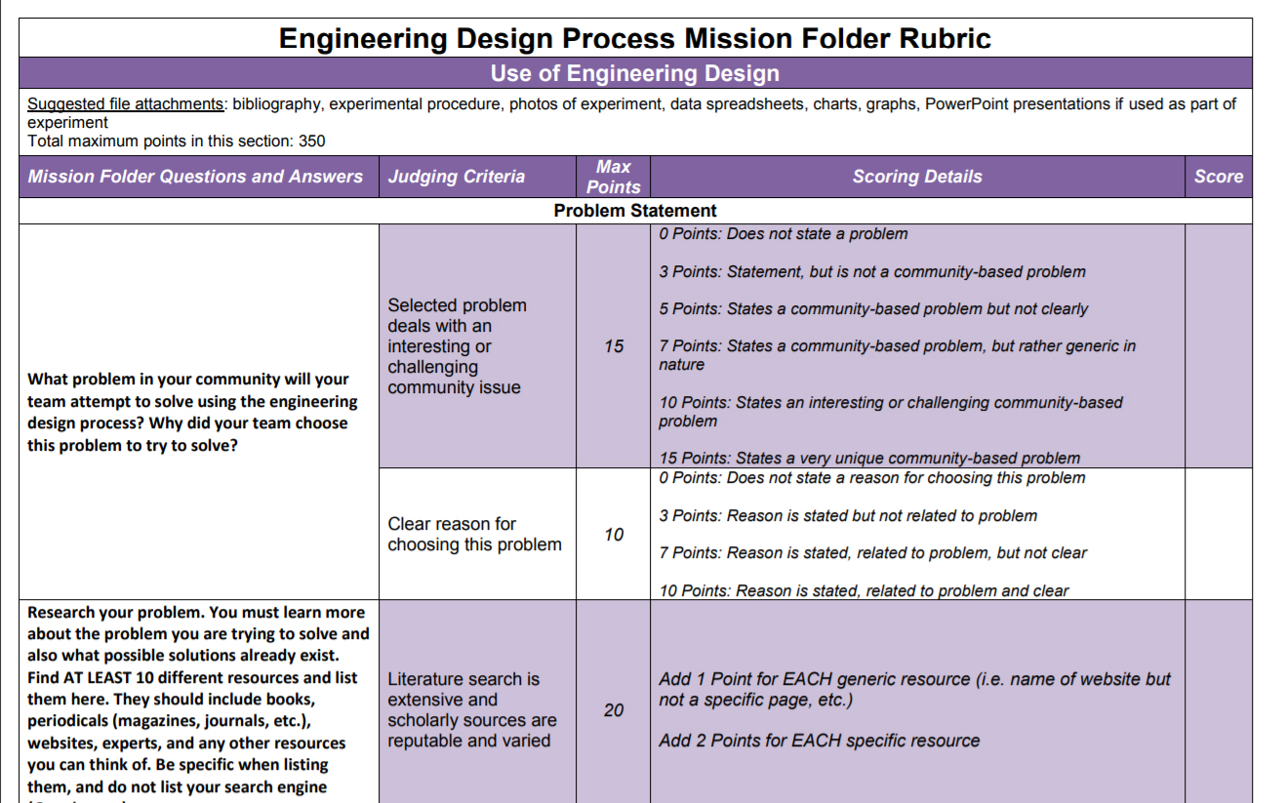
Rubrics
Engineering and Science Rubrics
Team Advisor Help Center
Same rubric used by the judges
Compare answers to the rubric
Notes:
Make sure that once they are done with the Mission Folder (or even while they are doing it), they review the rubrics that the judges use to score the folder. Knowing what the judges are looking for and how they score can help the team to get a better score and have an even better chance of winning. They can find these for both science and engineering in the Team Advisor Help Center on the website, so do not let them miss out on using this valuable resource!

Slide 15
Due Dates
The complete Mission Folder is due by the end of February/beginning of March
TAs can choose specific due dates for each section/question
The team can establish due dates for themselves
Notes:
You and the team will need to be sure that everything is done and submitted by the submission deadline. This changes each year so make sure you check the competition timeline on the website, but it is always around the end of February or the beginning of March. You may choose to make certain parts of the Mission Folder (or the Folder itself) due at specific times. Or maybe the team will set their own deadlines for themselves to make sure they are done on time. But when it is time to submit, that is up to you as the Team Advisor.

Slide 16
Mission Folder Submission
Notes:
When you log in to your account, you will be able to access your Mission Folder too. You can read, edit and submit it. You will use the button that says “Submit Mission.” When you click you will either see that the Mission Folder is not complete, or you will complete this checklist much like the one the students needed to complete in the Mission Verification section. If you complete this checklist they will be able to submit the folder. You can also UNsubmit folders if a team realizes they forgot to include something or needs to make a change, but you can only do that before the submission deadline, and once the team has made the changes they wanted to make, the you will need to resubmit.

Slide 17
Mission Folder Submission
Notes:
If students click on “Submit Mission” they will see a note that explains that their Team Advisor must submit the folder. Note that once it is submitted the folder becomes “Read Only,” so you will still be able to see it. If you think you have submitted a folder, but you or the team are still able to edit it, then you have not submitted it yet.

Slide 18
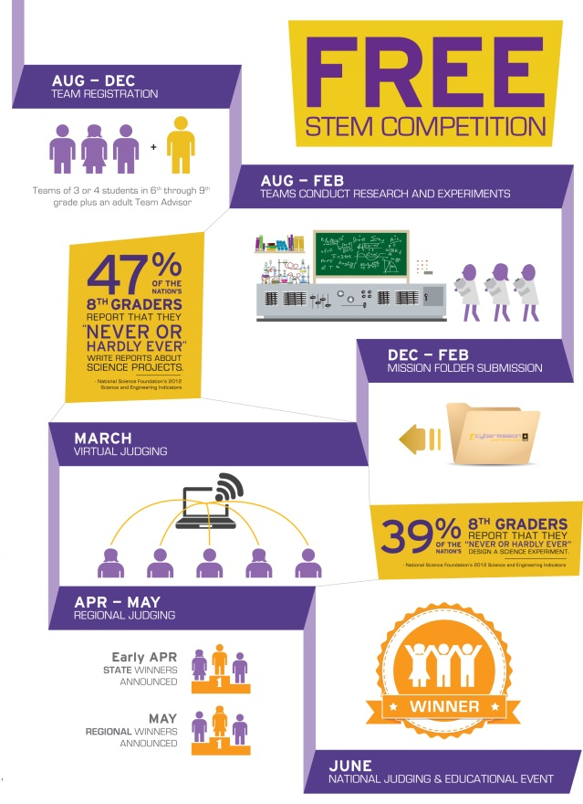
Timelines
eCYBERMISSION
Registration is open from early August
Early Registration mid-November
Registration closes late Dec/Early Jan
Projects due late Feb/early March
Notes:
And just a quick review of the important dates:
Each year, registration opens in early August, but teams can actually start working on a project before they register, in fact as early as April! Our early registration deadline is usually in mid-November, and if we are offering STEM kits that year, students will need to be registered and on a complete team (2-4 students) before then to get one (and each student gets their own!). Registration will usually close in mid-December/early January each year, and the projects are due again in late February/early March.

Slide 19
QUESTIONS?
Notes:
Hopefully you are excited about eCYBERMISSION. If you need help or have questions, you can contact Mission Control, our help center, by calling 1-866-GO-CYBER, or you can send them an email at missioncontrol@ecybermission.com. Good luck!

