Slide 1
Wrecking Ball
Problem-Based Enhanced Language Learning

Slide 2
Wrecking Ball
Students will use the language of analysis to identify ideal characteristics of a wrecking ball using a graphic organizer, sentence stems, and small group interaction.

Slide 3
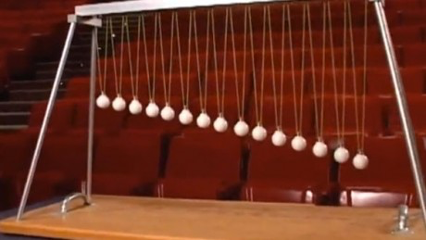
Pendulums

Slide 4
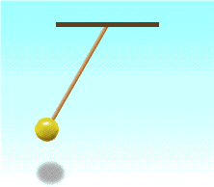
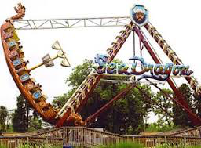
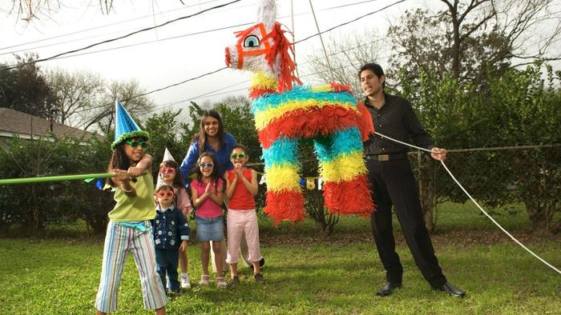
Pendulums
Columpio
Notes:
Characteristics of a pendulum

Slide 5
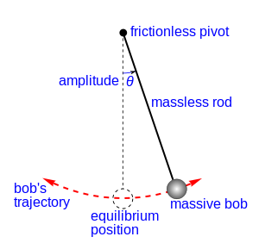
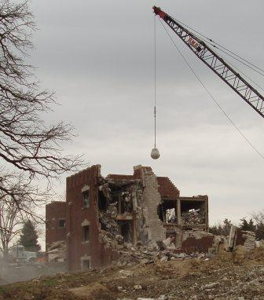
A Wrecking Ball is a Pendulum

Slide 6
Wrecking Ball Videos
Notes:
https://www.youtube.com/watch?v=isYHBr9TS28&t=57s

Slide 7
Analysis
We can interpret _____ as …
Given the evidence, we know that …
______ is related to _____ because…
______ is important because …
After careful examination of ... it looks like…
How do we know a wrecking ball is a pendulum?
Notes:
We know that when scientistis come together to analyze something they are going to speak in a different language.
Today we are going to be analyzing wrecking balls. Let’s practice the language we need to conduct and analysis by talking about these videos.
Model: Earlier we said that a wrecking ball is a type of pendulum, after watching these videos, how might we analyze the relationship between a wrecking ball and a pendulum.

Slide 8
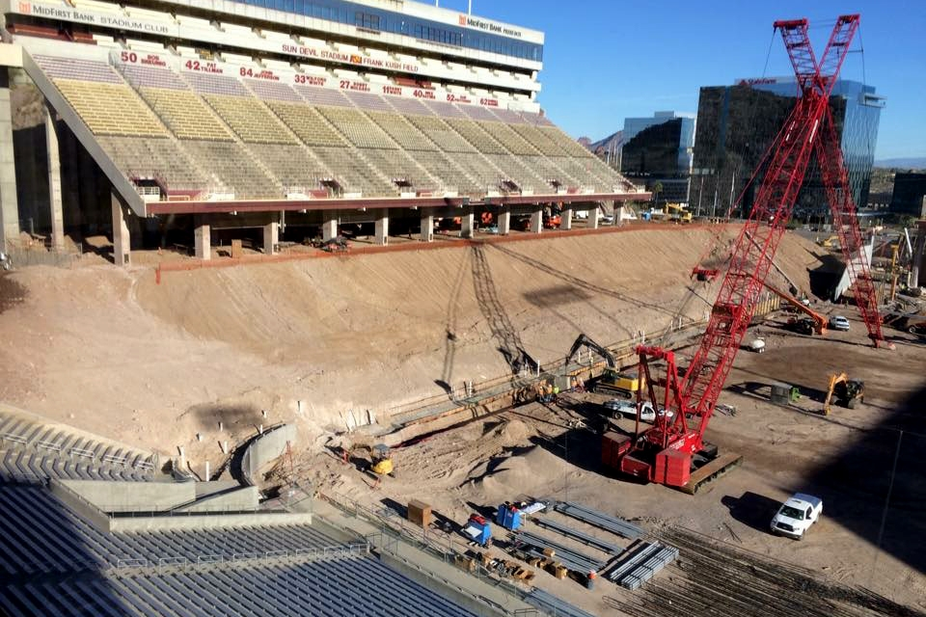
The Problem
A local football stadium needs to be torn down. As a company, we have been hired to demolish a portion of the current stadium. We need to design a wrecking ball that will complete this task in the most effective way possible.
How can we, as a company, design a wrecking ball with the most effective characteristics to demolish the football stadium?
Notes:
Approximately 10 minutes into lesson.
We need to recognize that it costs money and time the more we have to swing the wrecking balls, limit the damage…”WE NEED A VERY CONTROLLED DEMOLITION”
Make sentence stems to have at each table
I believe this model works best because...
My primary reason for thinking so is...
Perhaps the most convincing reason for this is...

Slide 9
Vocabulary
Height
Mass
Swing
Demolish
Pendulum

Slide 10
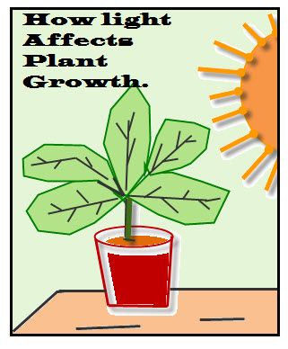
Independent vs. Dependent Variables
Notes:
I WANT YOU TO ANTICIPATE THREE THINGS THAT COULD HAPPEN BASED ON THE WAY YOU DESIGN OF YOUR WRECKING BALL
Independent Variable- starst with I… It’s what I can control. Dependent variable is what happens, what I can measure when I change the indepdnent variable.
Look at the cartoons… In the first the indepdnent variable is the toy.. I have control over it. What happened as a result of changing the toy?... the children’s reactions is the dependent variable.
The second picture.. Plants… what can I control with a plant… Those are possible independent variables… what would i be measuring.. What change would I expect? That’s the dependent variable.
Now let’s think about our wrecking ball… what can we control? What will we measure?

Slide 11
Independent vs. Dependent Variables
The independent variable is the factor in an experiment that the experimenter changes (i.e. the amount of sunlight)
The dependent variable is the variable that is affected by the changes made to the independent variable. (i.e. the height of the plant)

Slide 12
Independent Variable: Size of the bob
Your Task: Measure the demolition of three different sized bobs.
Small - # of blocks knocked down ___________
Medium - # of blocks knocked down ___________
Large - # of blocks knocked down ___________
Notes:
All other variables must be the same/ controlled…
Change: size of the bob
Same, the height it’s released from, the placement of the pivot

Slide 13
Discourse - Analysis
Which bob size is the most effective for demolishing a building?
What is your evidence?
Sentence Stems:
After experimenting, we found that ____________
______ is important/not important because ______
Given our experience, we can predict that _______

Slide 14
Analysis of Graphing Results
Trial 1:
What did you notice?
How does your data compare with other groups data?
What can you claim about the characteristics of the most effective wrecking ball?

Slide 15
Independent Variable: Height of the swing
Your Task: Measure the demolition of a chosen wrecking ball from three different heights.
45 degrees - # of blocks knocked down ___________
90 degrees - # of blocks knocked down ___________
135 degrees - # of blocks knocked down ___________
Notes:
As adults, we’re going to ask you to move right into the discussion.
Approximately 35 minutes into the lesson

Slide 16
Discourse - Analysis
Which height is the most effective for demolishing a building?
What is your evidence?
Sentence Stems:
After experimenting, we found that ____________
______ is important/not important because ______
Given our experience, we can predict that _______

Slide 17
Analysis of Graphing Results
Trial 2:
What did you notice?
How does your data compare with other groups data?
What can you claim about the characteristics of the most effective wrecking ball?

Slide 18
Independent Variable: Mass of the bob
Your Task: Measure the demolition of a chosen wrecking ball with three different masses
Light - # of blocks knocked down ___________
Medium - # of blocks knocked down ___________
Heavy - # of blocks knocked down ___________
Notes:
As adults, we’re going to ask you to move right into the discussion.
Approximately 35 minutes into the lesson

Slide 19
Discourse - Analysis
Which mass is the most effective for demolishing a building?
What is your evidence?
Sentence Stems:
After experimenting, we found that ____________
______ is important/not important because ______
Given our experience, we can predict that _______

Slide 20
Analysis of Graphing Results
Trial 3:
What did you notice?
How does your data compare with other groups data?
What can you claim about the characteristics of the most effective wrecking ball?

Slide 21
E-mail to Football Stadium Owner
Now that you know what the best size and mass of the wrecking ball and the best size of the swing, create an e-mail to the owner of the stadium explaining your findings and how you will be the most effective demolition team for his project.

Slide 22
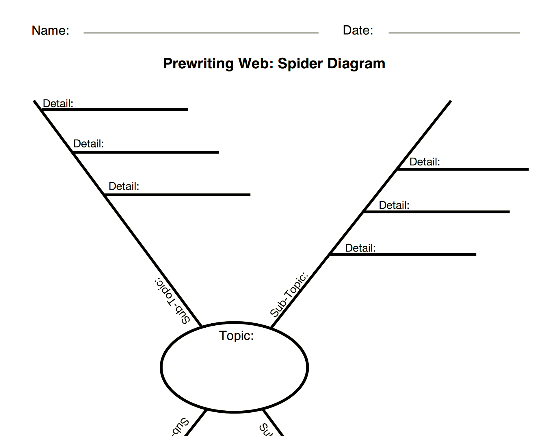
Let’s Make a Plan
Variable 2: Mass of Bob
Variable 1: Size of Bob
Most effective wrecking ball

