Slide 1
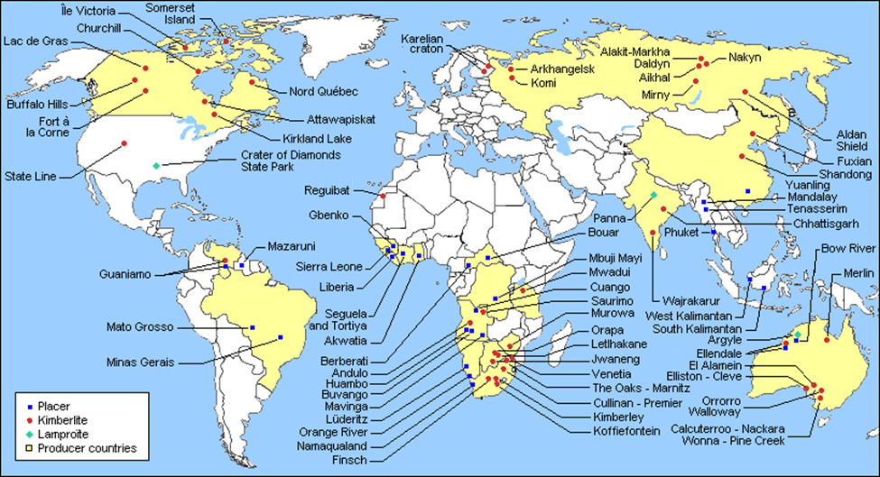
Distribution of Diamond Deposits
https://u.osu.edu/commodity2750/exploration/

Slide 2
Plate Tectonic Map
https://pubs.usgs.gov/gip/volc/tectonics.html

Slide 3
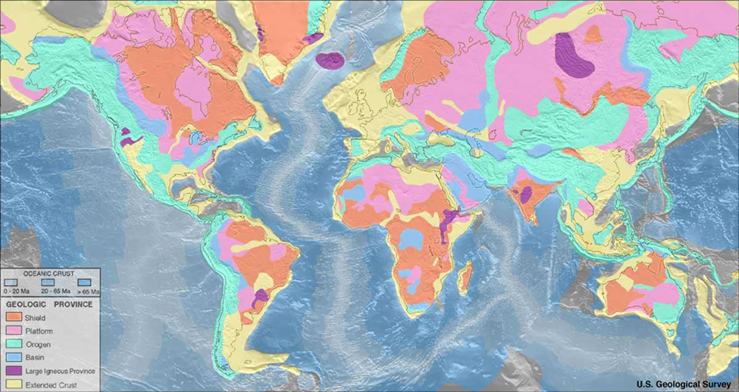
Geologic Provinces
https://pubs.usgs.gov/gip/99/pdf/gip99_ppt.pdf

Slide 4
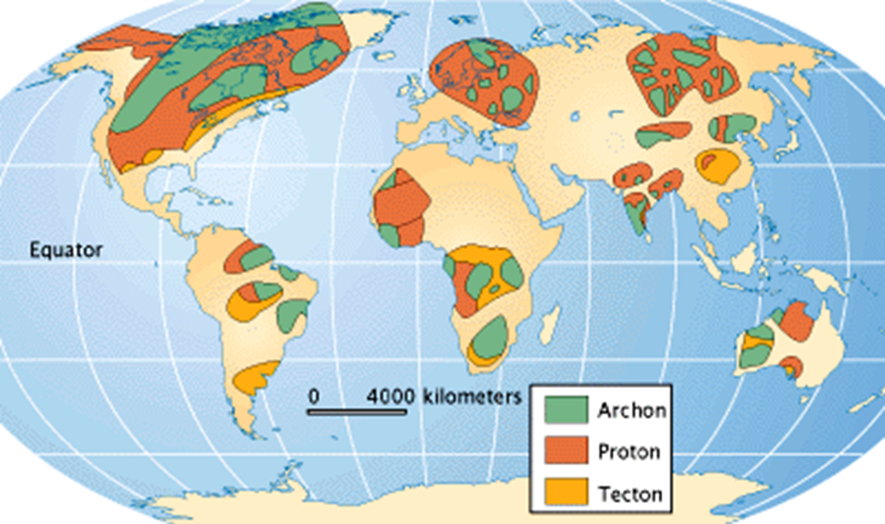
Age of Rocks
Cratons are the old, stable parts of continents. The map shows area of archon, rocks older than
2,500 million years and proton, areas where the rocks are 1,600 to 2,500 million years old.
From https://msu.edu/~jenki133/diamonds/world.html
Notes:
From https://msu.edu/~jenki133/diamonds/world.html

Slide 5
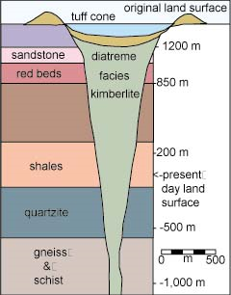
It’s a Volcano!
From http://volcano.oregonstate.edu/diamonds

Slide 6
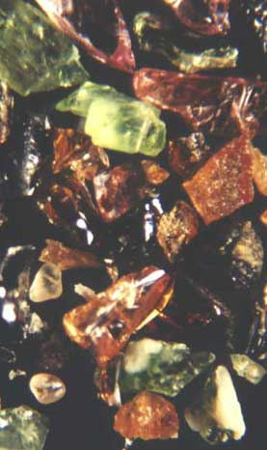
Indicator Minerals
“(Photo: concentrated heavies from gravel sometimes contain garnet (orange), pyroxene (green), ilmenites (black),magnification X 200.)”
“Picking kimberlitic indicators and diamond indicators is based on colour. Colour results from Fe, Mn, Cr content. Pyrope - pinkish red, crimson to purple; Chrome-Pyrope greenish violet to purplish. Almandine; deep red to brown-black. Grossular; colourless, pink, yellow-green depending on Fe and Mn present.(Deer,1993) Picking based on colour takes experience and a good eye for variations in colour. It is a difficult, subjective and inexact process. DIMs are .25 to 2 or 3 millimeters, so you need good eyes and a good microscope.”
http://www.landandminerals.com/diamond_indicators.html

Slide 7
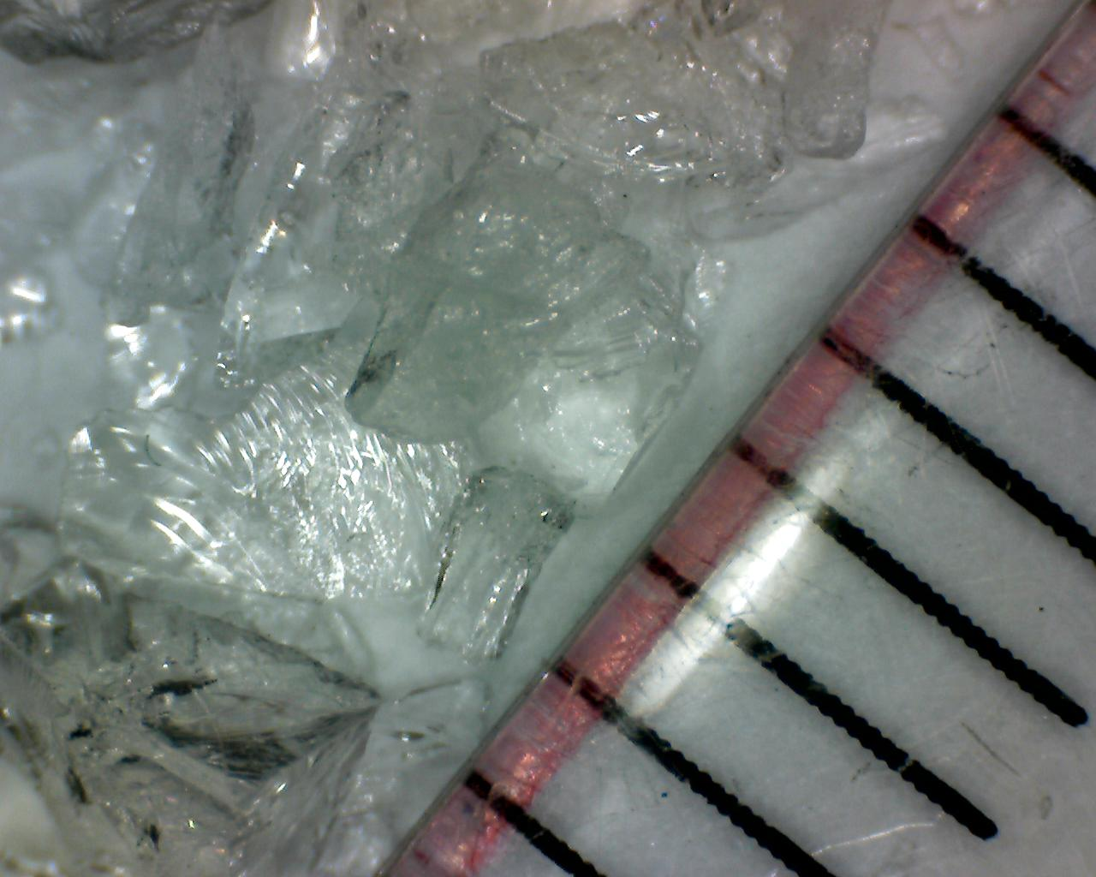
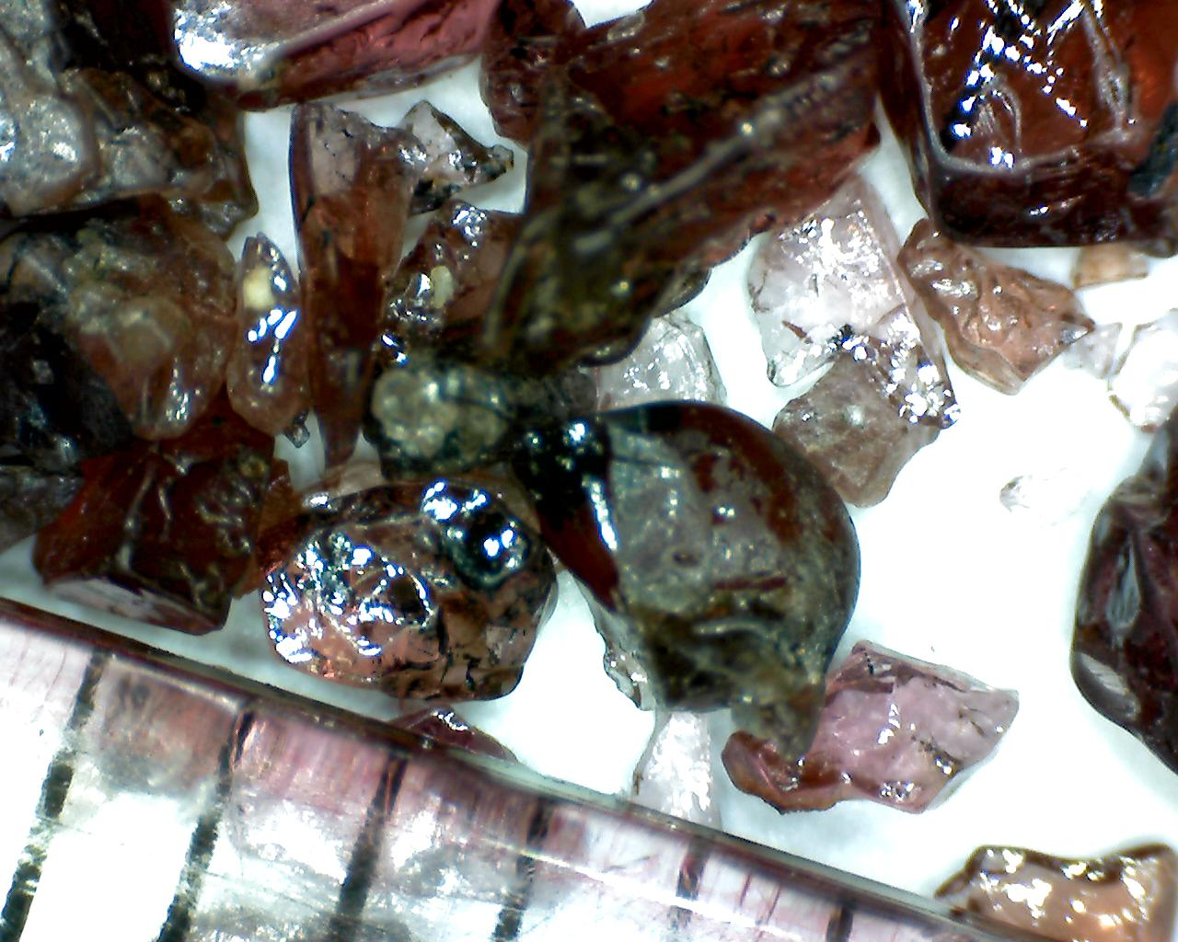
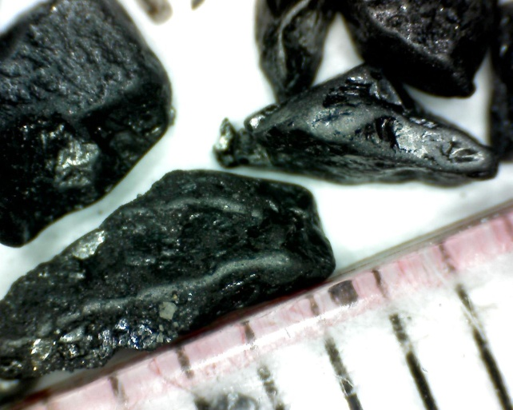
Mineral Properties
Color
Red, green, black, …
Colorless
Luster
Glassy
Metallic

Slide 8
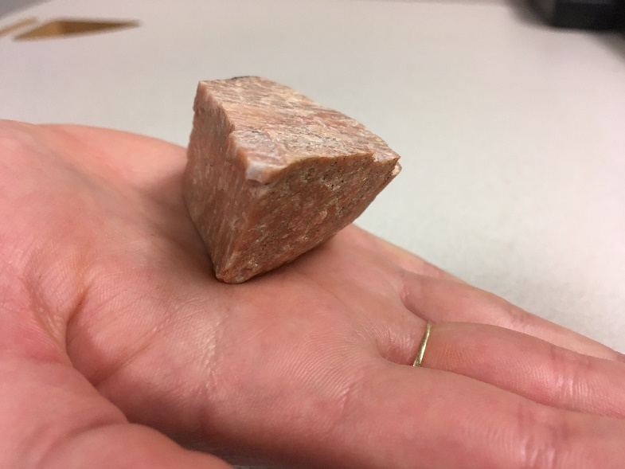
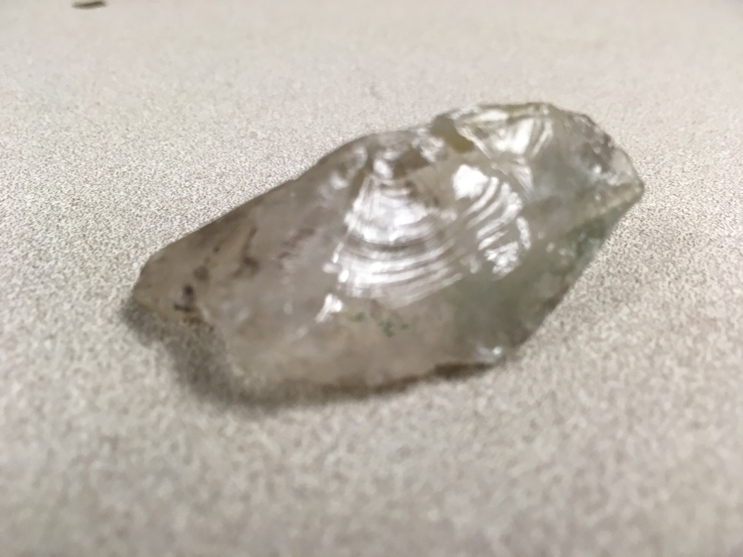
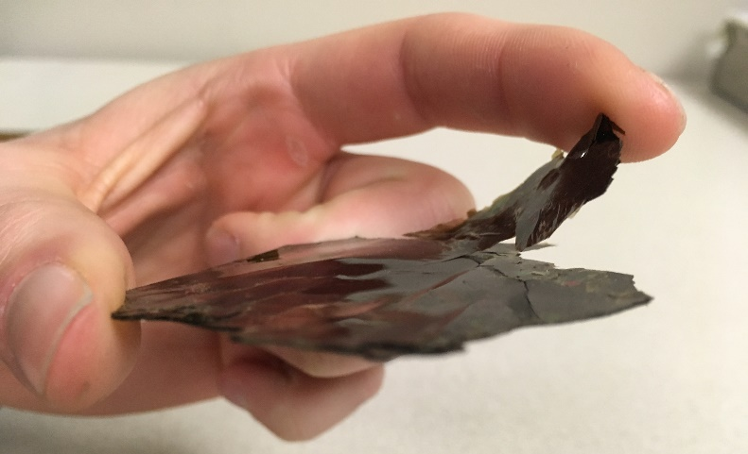
Mineral Properties
Cleavage
Fracture

Slide 9
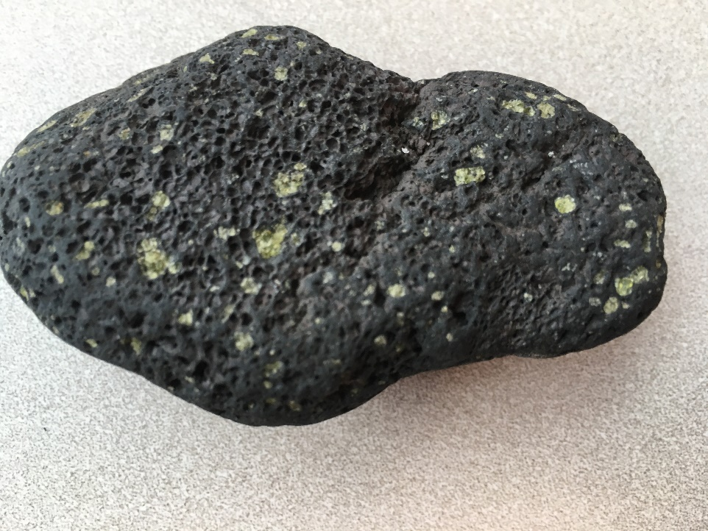
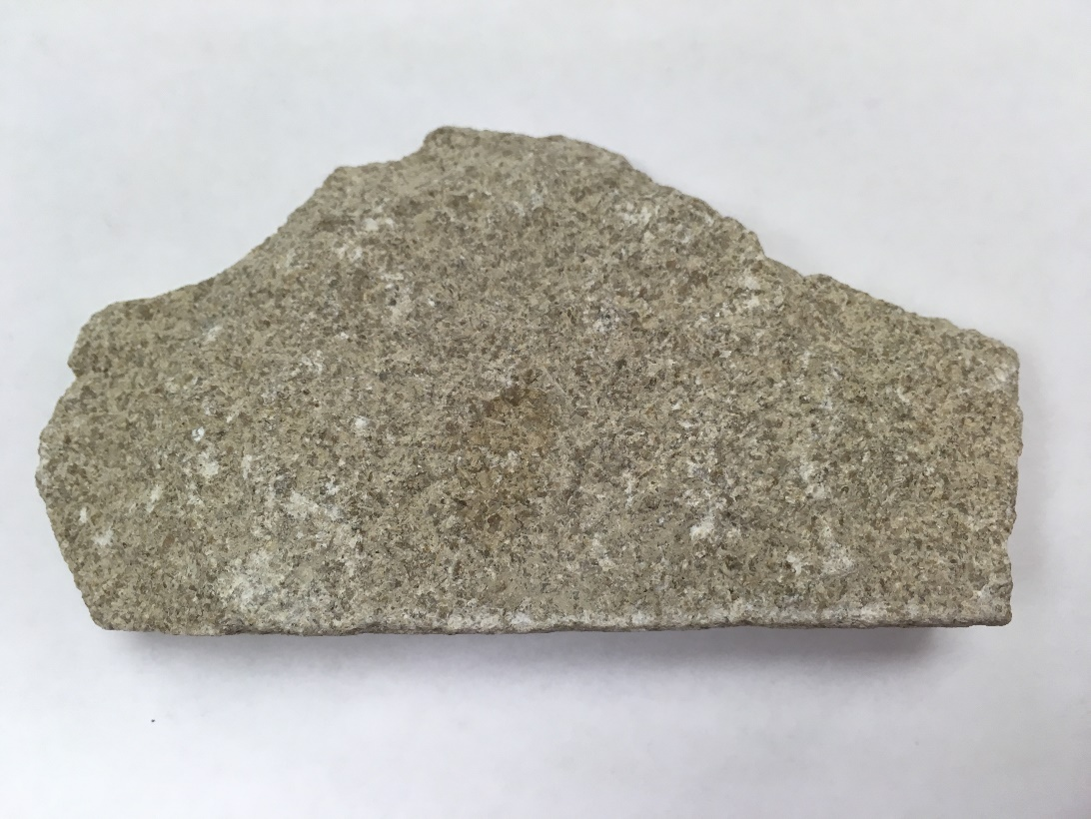
Rock Fragments
limestone
basalt

Slide 10
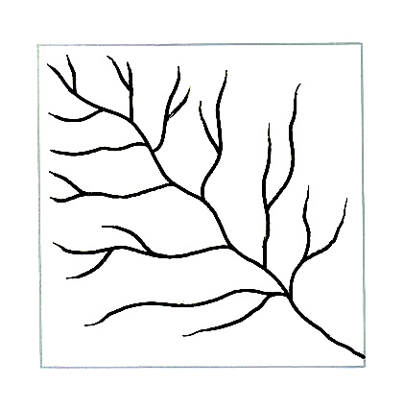
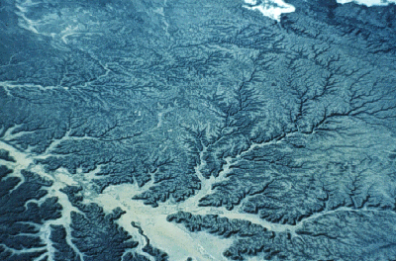
Reading the Map
http://golearngeo.wordpress.com/new-post/?page=stats&view=post&post=200&blog=12122768
http://resweb.llu.edu/rford/courses/essc500/fluvial/fluvial.html
Notes:
rocks erode, minerals and rock fragments get washed down stream

Slide 11
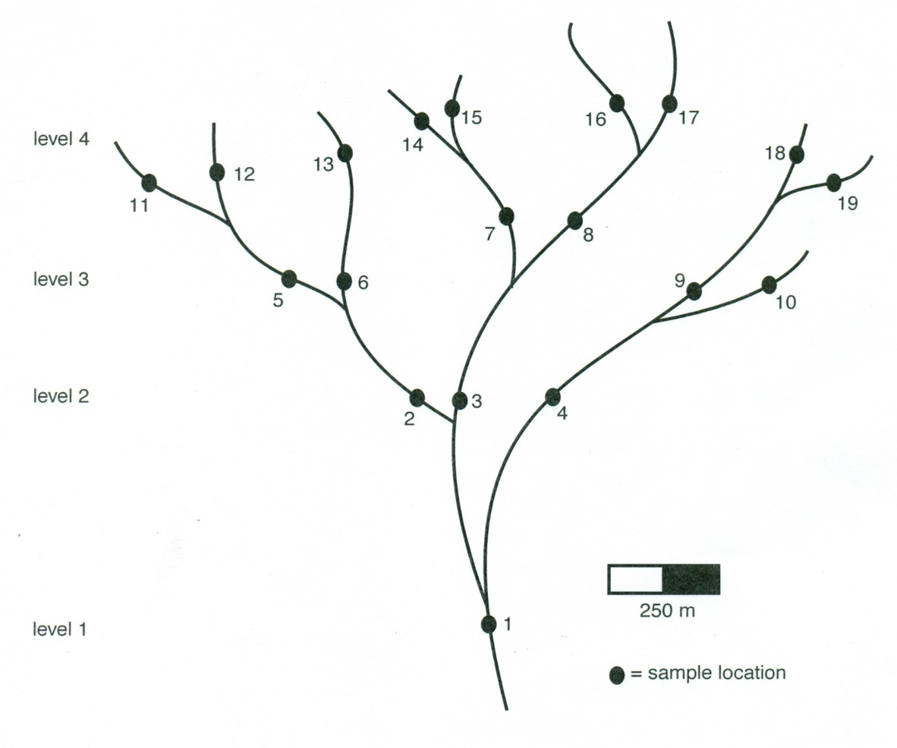
Your River Map & Guidelines

Slide 12
Careful, the next few pages have all the answers.

Slide 13
Rocks and Minerals at Locations
Sample/ Loc | Diamond | Diopside | Garnet | Ilmenite | K-feldspar | Olivine | Phlogopite | Quartz | Basalt | Limestone
1 |  | 1 |  |  | 1 |  |  | 1 | 5 | 2
2 |  |  |  |  | 3 |  |  | 4 | 3
3 |  |  |  | 1 | 1 | 1 |  |  | 3 | 4
4 |  |  |  |  |  |  |  |  | 3 | 7
5 |  |  |  |  | 7 |  |  | 3
6 |  |  |  |  | 5 |  |  | 5
7 |  |  |  |  | 2 |  |  | 3 | 3 | 2
8 |  | 1 | 1 | 1 |  | 1 | 1 |  |  | 5
9 |  |  |  |  |  |  |  |  |  | 10
10 |  |  |  |  |  |  |  |  |  | 10
11 |  |  |  |  | 4 |  |  | 6
12 |  |  |  |  | 8 |  |  | 2
13 |  |  |  |  | 5 |  |  | 5
14 |  |  |  |  | 9 |  |  | 1
15 |  |  |  |  | 3 |  |  | 7
16 | 1 | 2 | 3 |  |  | 1 | 2 |  |  | 1
17 |  |  |  |  |  |  |  |  |  | 10
18 |  |  |  |  |  |  |  |  |  | 10
19 |  |  |  |  |  |  |  |  |  | 10

Slide 14
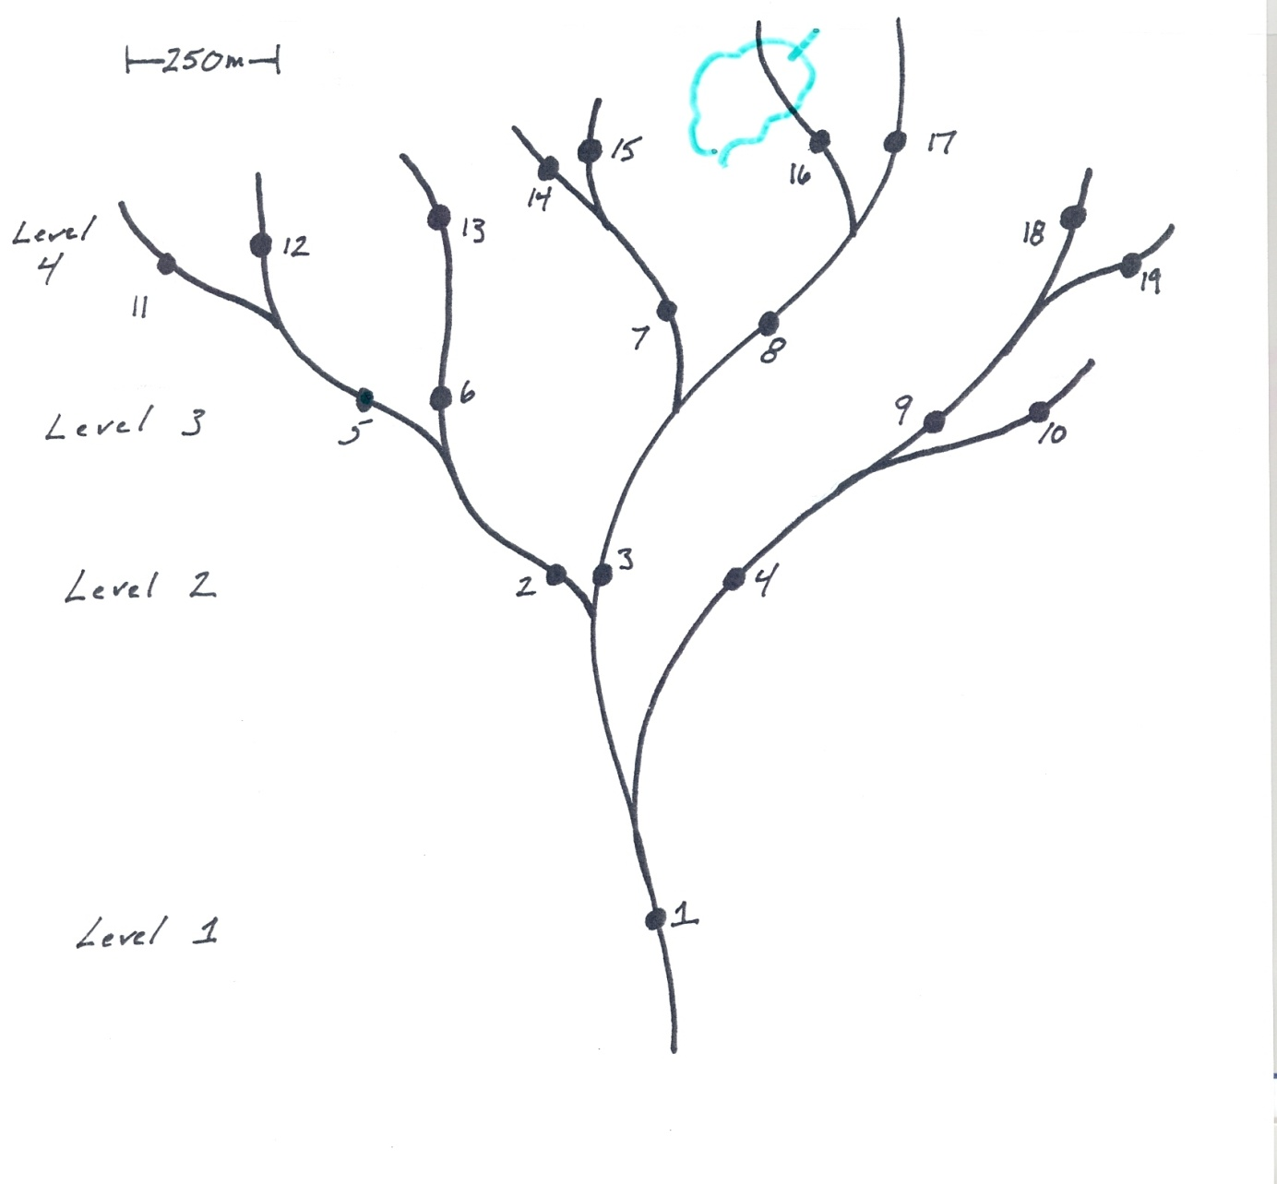
Location of Diamond Deposit

Slide 15
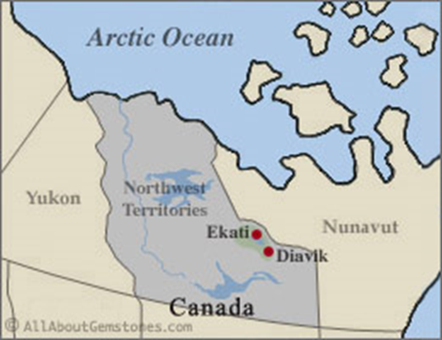
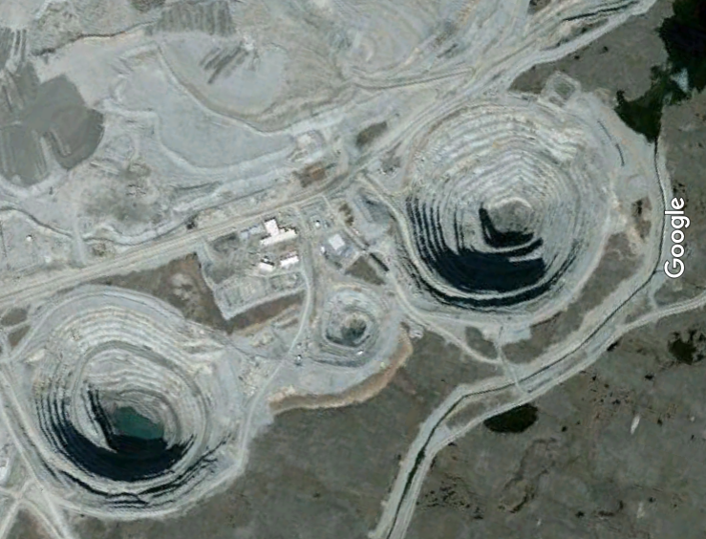
Extension 2
Search for “Ekati” in Canada in Google Earth.
64 42’ 44” N
110 35’03” W
http://www.allaboutgemstones.com/diamond_mines_canada.html
Notes:
The mines are about 550 and 725 m in diameter at the surface.

Slide 16
Extension 3 How much diamond do you need in your lifetime?
Consider that an average American uses 0.4 g. of diamond per year. Assuming an average life expectancy of 78 years, each American needs about __ g. of diamonds in their lifetime. If a penny weights about 2.5 g., placing __ pennies in your hand is equivalent to the amount of diamonds they will consume in a lifetime.
How much volume is this? Guess.
Notes:
Consider that an average American uses 0.4 g. of diamond per year. Assuming an average life expectancy of 78 years, each American needs about 31 g. of diamonds in their lifetime. A penny weights about 2.5 g., so placing 12 pennies in your students hands is equivalent to the amount of diamonds they will consume in a lifetime.

Slide 17
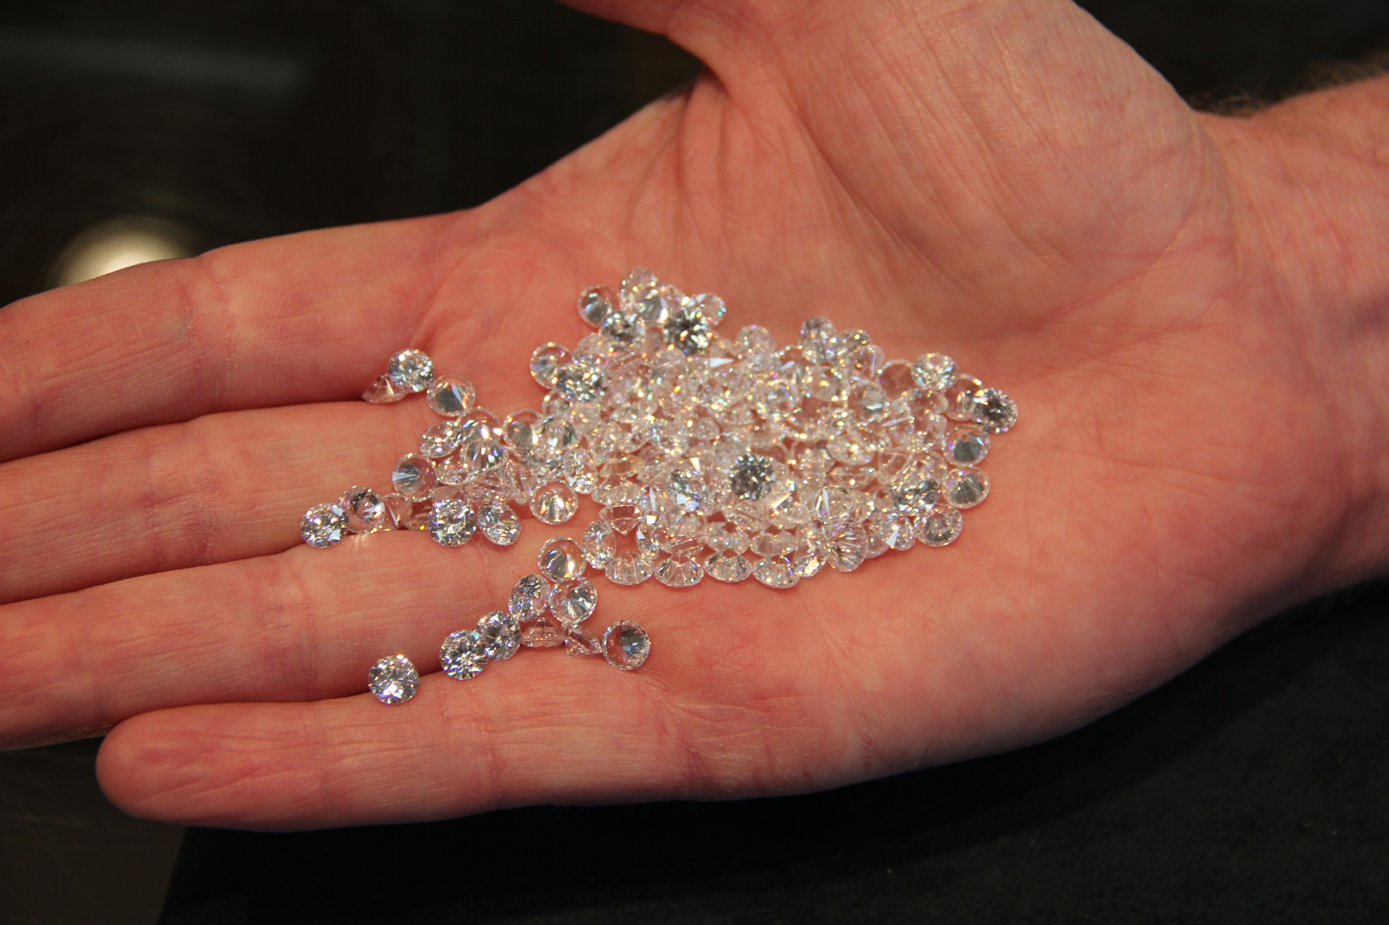
Extension 3
31 gm of synthetic diamond
Notes:
31 gm of synthetic diamond. Most jewelry stores do not carry this weight of unmounted natural stones.

