Slide 1
Glowing Plants Activity

Slide 2
Here’s a problem…
A small community wants to provide lighting on sidewalks and in parks for safety reasons.
The community does not have the resources to install traditional street lights (i.e., it is too small a community to raise funds to pay the electricity bill)
Several members have also complained that traditional streetlights are glaring and would be disruptive to private homes
The community is also very focused on making “green” decisions and doesn’t want to increase electricity generation at the power plants or use any questionable materials.

Slide 3
What would you do?
Take a few minutes to think about the problem and brainstorm a few solutions.
Remember- there are no “bad” solutions.

Slide 4
Here’s a wild solution…
Glowing plants! (0-50sec)
http://www.kickstarter.com/projects/antonyevans/glowing-plants-natural-lighting-with-no-electricit

Slide 5
How does it work?
The video mentioned fireflies and plants… how do we put them together?

Slide 6
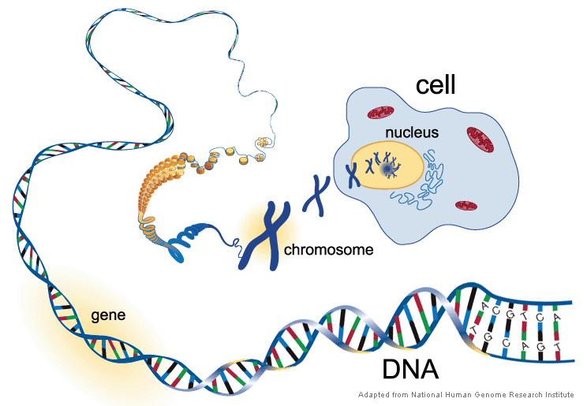
White
Fur!
Short Tail!

Slide 7
How do things change?
Mutations and natural selection…
pHet Simulation
This produces traits that are desirable for the organism

Slide 8
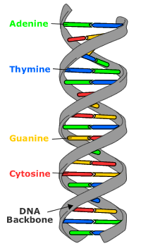
A | C | G | A | A | T | G | C | A | G | A | C | G | T | A | C | T | A
T | G | C | T | T | A | C | G | T | C | T | G | C | A | T | G | A | T

Slide 9
Working with Firefly DNA
CCCTGTATAAGCTTATGGCTACAGGCTCCCGGACGAAGCTTA
GGGACATATTCGAATACCGATGTCCGAGGGCCTGCTTCGAAT
If this is firefly DNA, we are looking for the following sequence, which is the gene for “glowing butt”:
Find it and circle or highlight it.
A T G G C T A C A G G C T C C C G G A C G
T A C C G A T G T C C G A G G G C C T G C

Slide 10
Working with Firefly DNA
CCCTGTATAAGCTTATGGCTACAGGCTCCCGGACGAAGCTTA
GGGACATATTCGAATACCGATGTCCGAGGGCCTGCTTCGAAT
Now that we’ve found it, how do we get it out?
We use a “cutting” enzyme
We’re going to use “HindIII” enzyme which makes a cut like this:
AAGCTT
TTCGAA
Find both places the enzyme will “cut” and mark them on your paper

Slide 11
Working with Firefly DNA
CCCTGTATAAGCTTATGGCTACAGGCTCCCGGACGAAGCTTA
GGGACATATTCGAATACCGATGTCCGAGGGCCTGCTTCGAAT

Slide 12
Working with Plant DNA
GGATCCTGACACCGGAACGTCAAGCTTCCC
CCTAGGACTGTGGCCTTGCAGTTCGAAGGG
How do we get the gene we just cut into our plant DNA?

Slide 13
Working with Plant DNA
GGATCCTGACACCGGAACGTCA AGCTTCCC
CCTAGGACTGTGGCCTTGCAGTTCGA AGGG
AGCTTATGGCTACAGGCTCCCGGACGA
ATACCGATGTCCGAGGGCCTGCTTCGA
Glowing DNA!

Slide 14
Think about it…
What makes this method difficult?
What problems could be associated with a glowing plant?
What other uses for combining DNA can you think of?

Slide 15
Firefly DNA:
CCCTGTATAAGCTTATGGCTACAGGCTCCCGGACGAAGCTTA
GGGACATATTCGAATACCGATGTCCGAGGGCCTGCTTCGAAT
Glowing Butt Gene:
ATGGCTACAGGCTCCCGGACG
TACCGATGTCCGAGGGCCTGC
Cutting Enzyme:
AAGCTT
TTCGAA
Plant DNA:
GGATCCTGACACCGGAACGTCAAGCTTCCC
CCTAGGACTGTGGCCTTGCAGTTCGAAGGG

