Slide 1
White Bear Lake:
NATIONAL CENTER FOR CASE STUDY TEACHING IN SCIENCE
A Presentation to Accompany the Case Study:
A Disappearing Lake and Efforts to Restore It
by
David W. Kelley
Geography and Environmental Studies
University of St. Thomas, St. Paul, MN

Slide 2
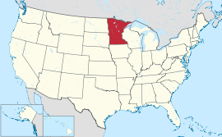
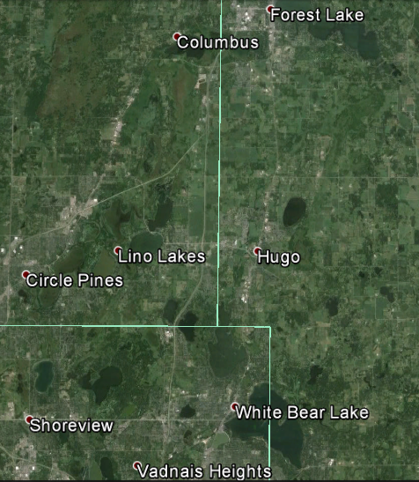
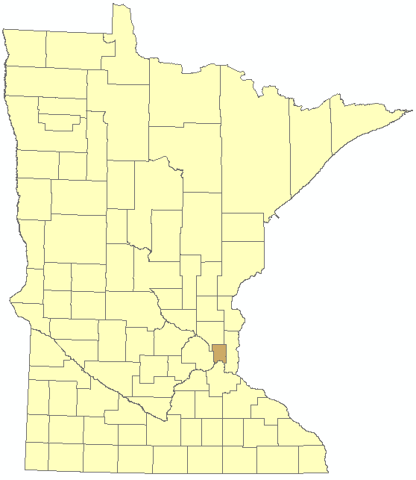
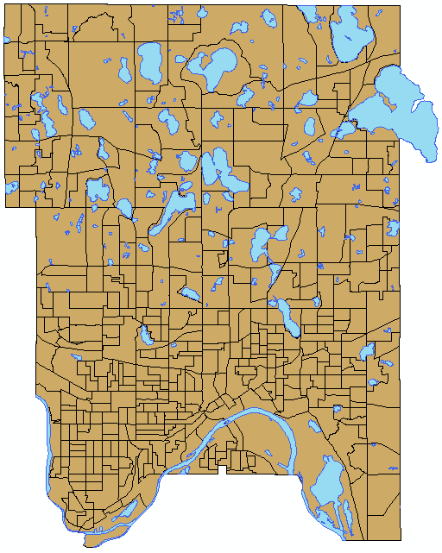
Location
State of Minnesota
Ramsey County
Source: Google Earth, accessed 3/28/2016

Slide 3
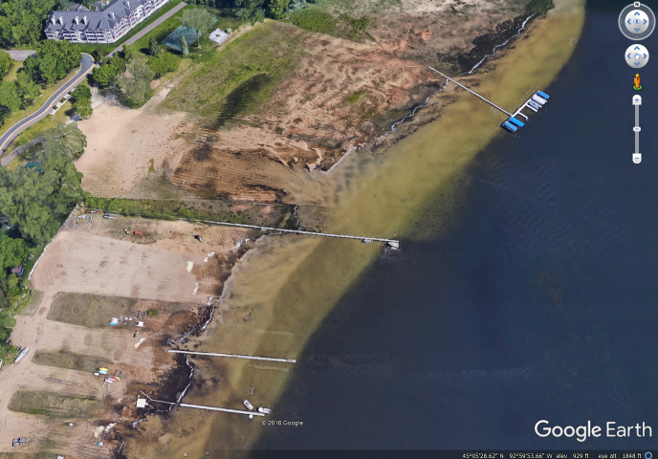
PROBLEM
Original shoreline
Dock
New dropoff
New shoreline
Source: Google Earth, accessed 10/12/2016

Slide 4
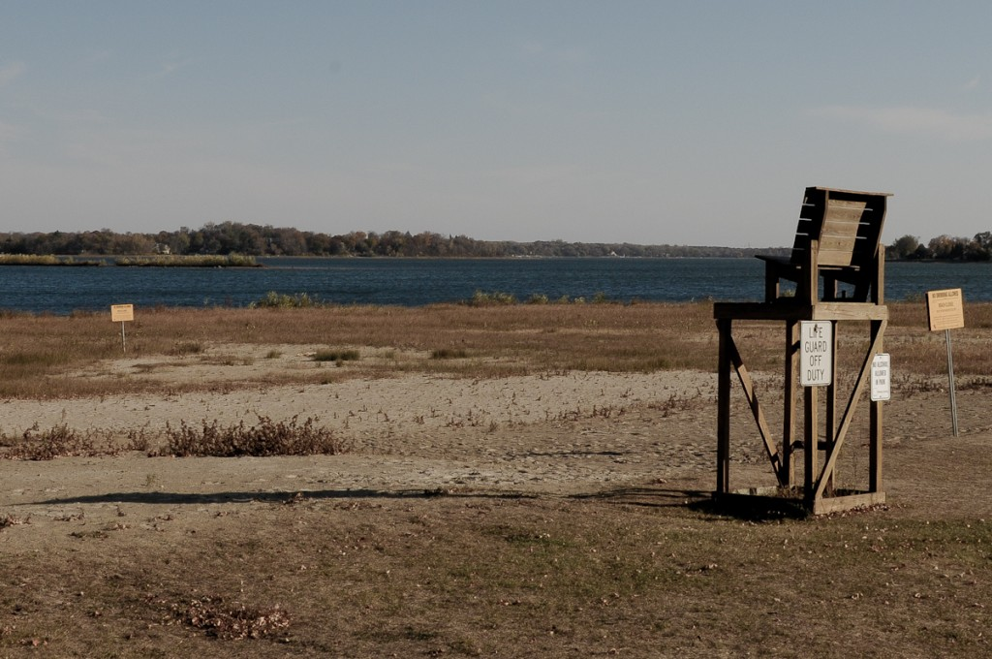
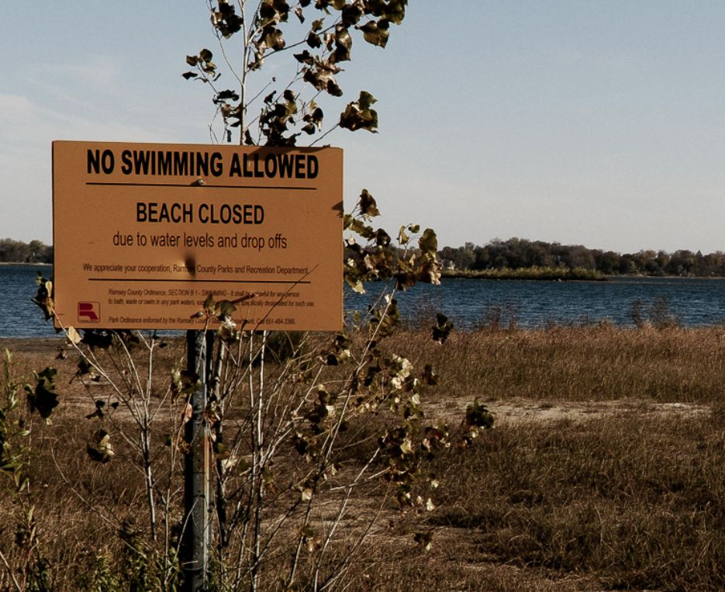
Shoreline
Photo credit: Oliver Din (White Bear Lake Restoration Association). Used with permission.
Photo credit: Oliver Din (White Bear Lake Restoration Association). Used with permission.
East

Slide 5
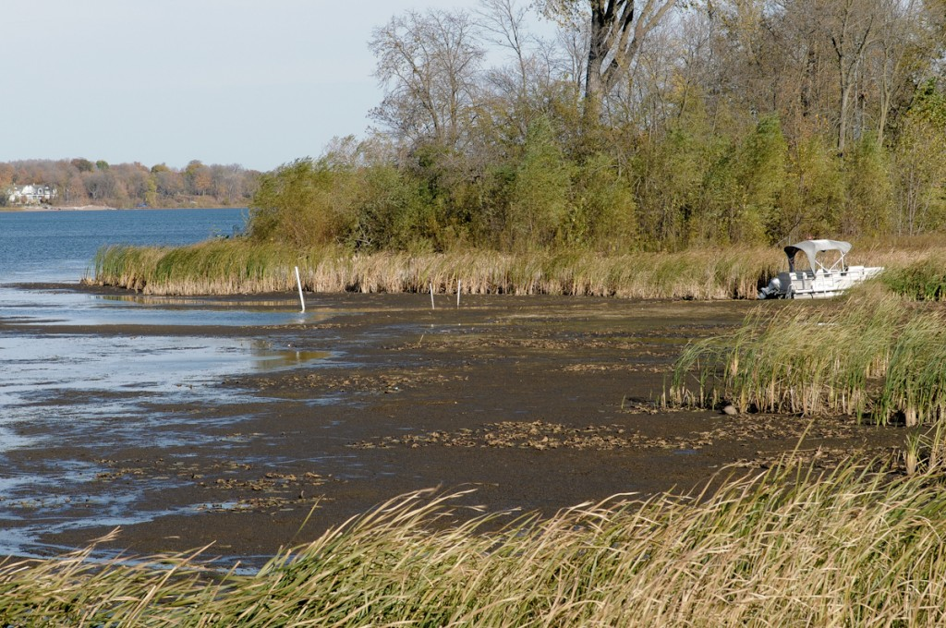
Shoreline
Southeast
Photo credit: Oliver Din (White Bear Lake Restoration Association). Used with permission.

Slide 6
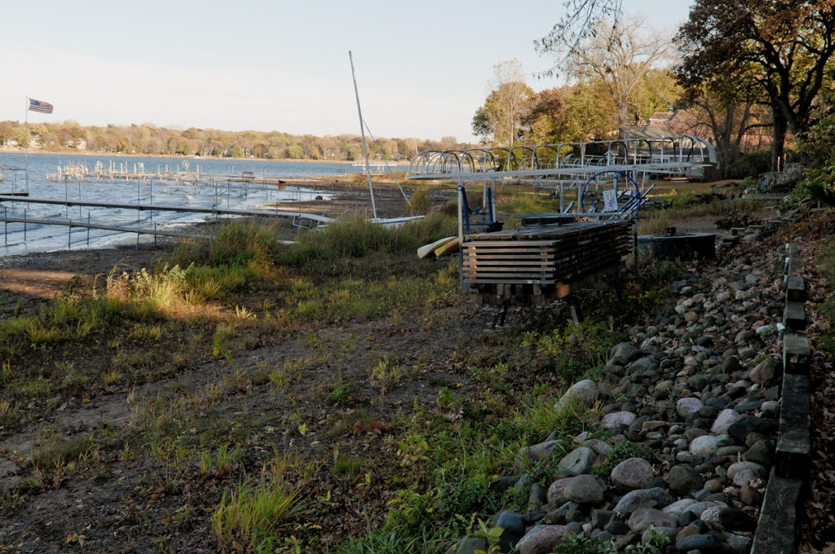
Shoreline
South
Photo credit: Oliver Din (White Bear Lake Restoration Association). Used with permission.

Slide 7
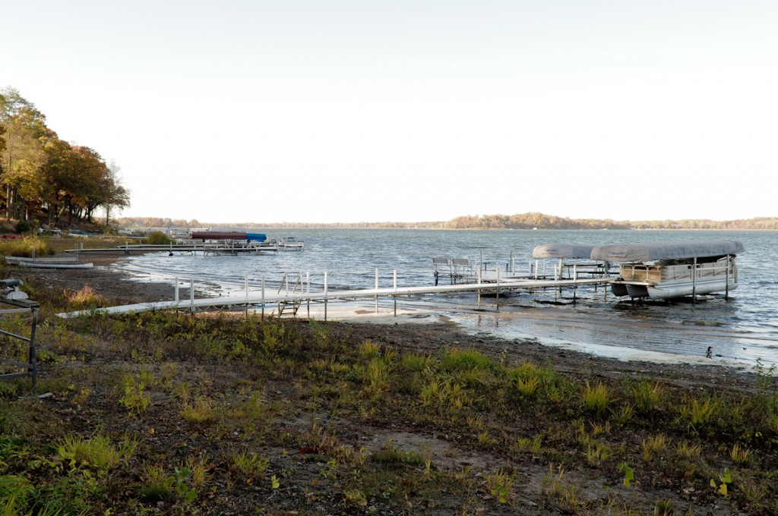
Shoreline
Southwest
Photo credit: Oliver Din (White Bear Lake Restoration Association). Used with permission.

Slide 8
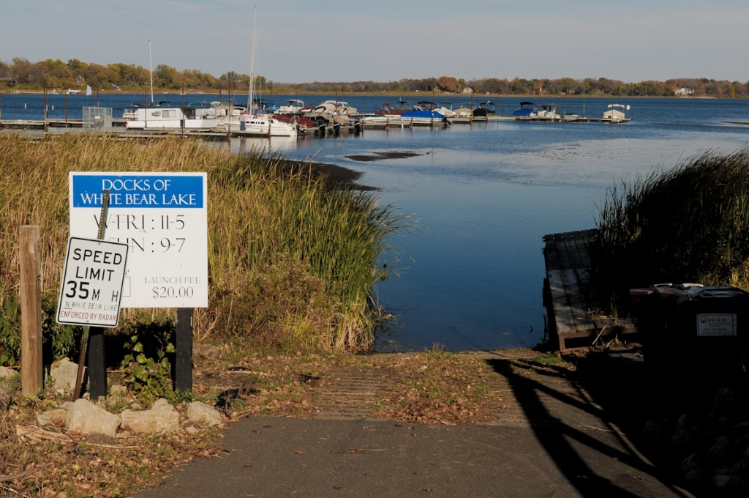
Shoreline
West
Photo credit: Oliver Din (White Bear Lake Restoration Association). Used with permission.

Slide 9
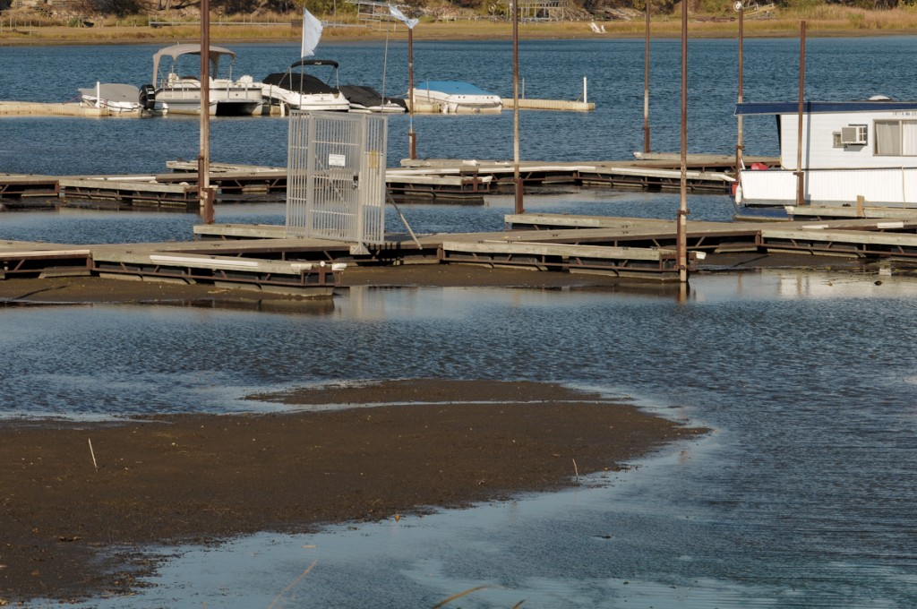
Shoreline
West
Photo credit: Oliver Din (White Bear Lake Restoration Association). Used with permission.

Slide 10
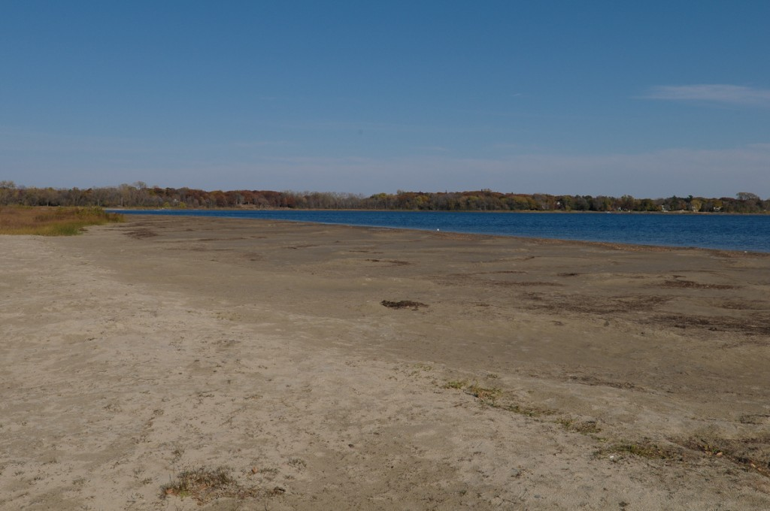
Shoreline
North
Photo credit: Oliver Din (White Bear Lake Restoration Association). Used with permission.

Slide 11
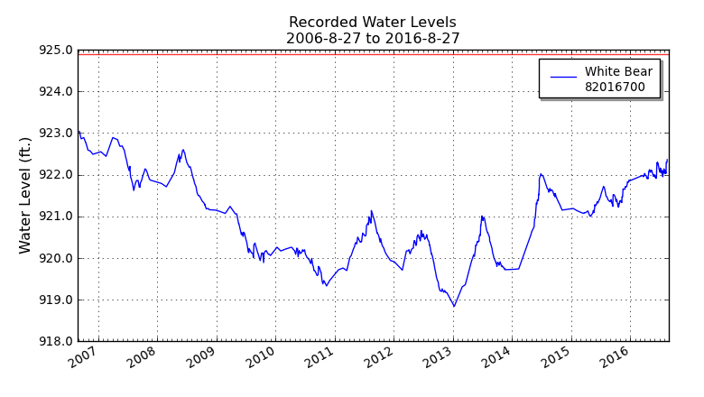
Data
Image credit: created by author. Data from MN DNR, 2014
http://www.dnr.state.mn.us/lakefind/showlevel.html?downum=82016700

Slide 12
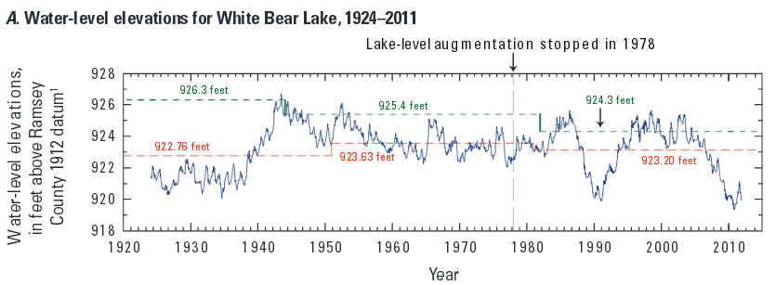
Data
USGS, Scientific Investigations Report 2013–5044.

Slide 13
Data
USGS, Scientific Investigations Report 2013–5044.

Slide 14
Data
USGS, Scientific Investigations Report 2013–5044.

Slide 15
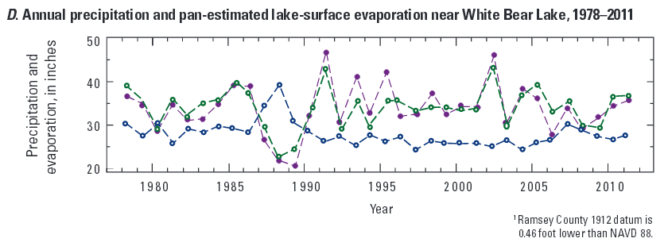
Data
USGS, Scientific Investigations Report 2013–5044.

Slide 16
Data
Regional Climate
Table credit: created by author. Data from Minnesota climatology working group, 2015

Slide 17
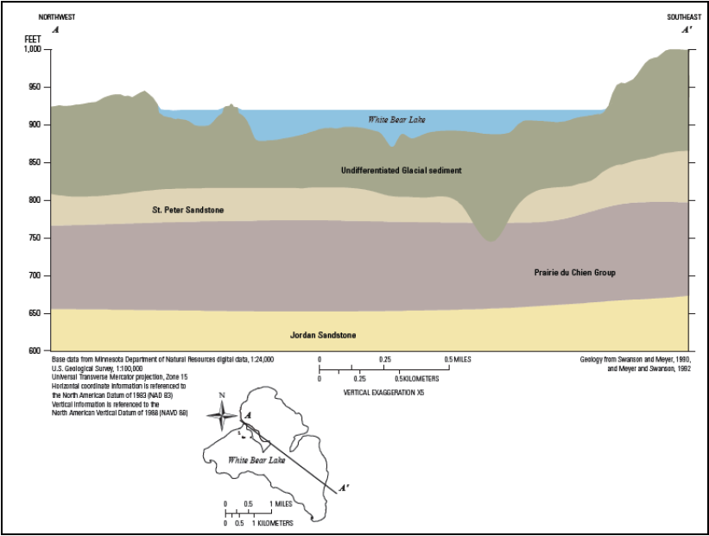
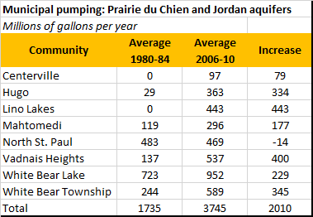
Data
Aquifers underlying the lake
Table credit: created by author. Data from MN DNR, 2012
Source: https://metrocouncil.org/Wastewater-Water/Publications-And-Resources/WATER-SUPPLY-PLANNING/Feasibility-Assessment-of-Approaches-to-Water-Sust.aspx

Slide 18
Data
Regional Population Changes
Table credits: created by author. Data from State Geodatabase for Minnesota (https://catalog.data.gov)

Slide 19
Data
Regional drinking water supply sources
Image credit: created by author. Data from MN DNR, 2012

Slide 20
credits
Slide 2. Google Earth, accessed 3/28/2016
Slide 3. Google Earth, accessed 10/12/2016
Slides 4-10. Photos by Oliver Din (White Bear Lake Restoration Association). Used with permission.
Slide 11. left Image: created by author. Data from MN DNR, 2014. right image: http://www.dnr.state.mn.us/lakefind/showlevel.html?downum=82016700
Slides 12-15. USGS, Scientific Investigations Report 2013–5044.
Slide 16. created by author. Data from Minnesota climatology working group, 2015
Slide 17. left image: https://metrocouncil.org/Wastewater-Water/Publications-And-Resources/WATER-SUPPLY-PLANNING/Feasibility-Assessment-of-Approaches-to-Water-Sust.aspx Right image: created by author. Data from MN DNR, 2012
Slide 18. created by author. Data from State Geodatabase for Minnesota (https://catalog.data.gov)
slide 19. created by author. Data from MN DNR, 2012

