Slide 1
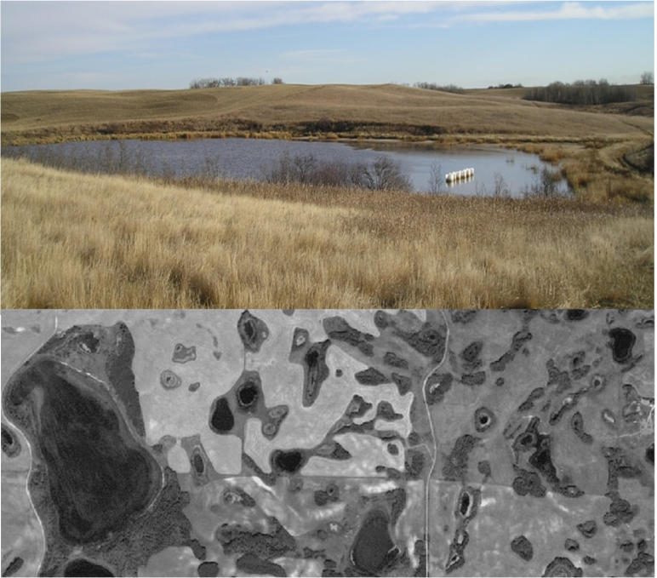
Typical wetland in Prairie Pothole Region. Tree bluffs in background are tree rings around other wetlands. Air photograph shows typical natural pattern of wetlands with tree rings.
Photo credit: Tom Yates
© Saskatchewan Geospatial Imagery Collaborative (2013)

Slide 2
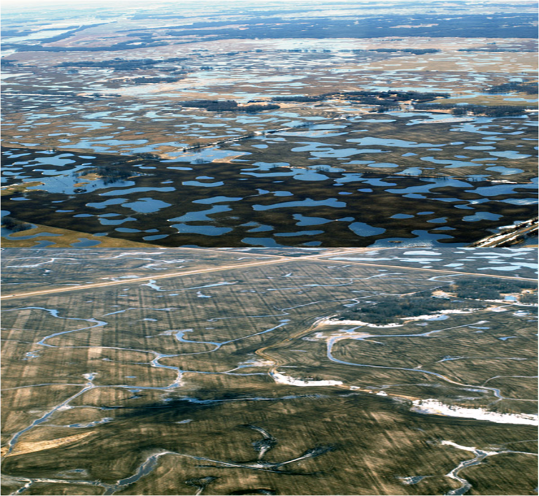
Typical wetland landscape at peak of spring snowmelt showing water storage potential. Lower image showing same landscape with imposed drainage system and significantly reduced water storage potential.
Ducks Unlimited Canada

Slide 3
Image Credits
Slide 1, top
Description: Photo showing a typical wetland in Prairie Pothole Region. Author: Thomas T. Yates. Source: Provided by author. Clearance: Used with permission.
Slide 1, bottom
Description: Photo showing typical natural pattern of wetlands with tree rings.
Author: Saskatchewan Geospatial Imagery Collaborative.
Source: SGIC Ortho Images. Web site: https://www.flysask2.ca
Clearance: Used with permission and in accordance with terms of use at http://www.flysask.ca/v13/public/terms.html.
Slide 2, top
Description: Typical wetland landscape (Smith Creek) showing water storage potential. Author: Ducks Unlimited Canada.
Source: http://www.usask.ca/water/research/water-management/index.php Clearance: Used with permission of Ducks Unlimited Canada.
Slide 2, bottom
Description: Landscape (Smith Creek) with drainage system and significantly reduced water storage potential.
Author: Ducks Unlimited Canada.
Source: http://www.usask.ca/water/research/water-management/index.php
Clearance: Used with permission of Ducks Unlimited Canada.

