Slide 1
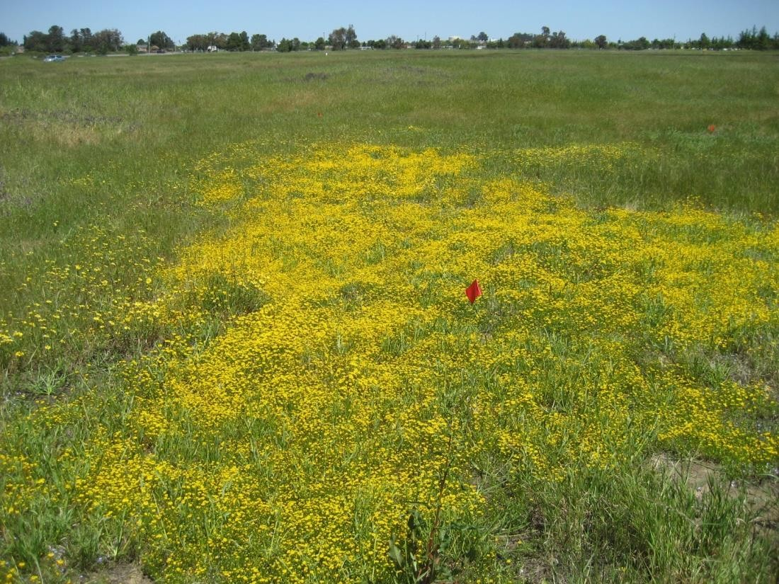
NATIONAL CENTER FOR CASE STUDY TEACHING IN SCIENCE
^{Grazing in Vernal Pools:}
Restoration Management Decisions
Day 2 Presentation
^{by}
^{Akasha M. Faist}
Department of Ecology and Evolutionary Biology
University of Colorado, Boulder, CO

Slide 2
Recap
Have a plot of land set for restoration.
--Our responsibility to determine grazing regime.
We identified ecological reasons in support of [your assigned grazing regime].
We addressed that the panel will have biases.
--Know your audience!

Slide 3
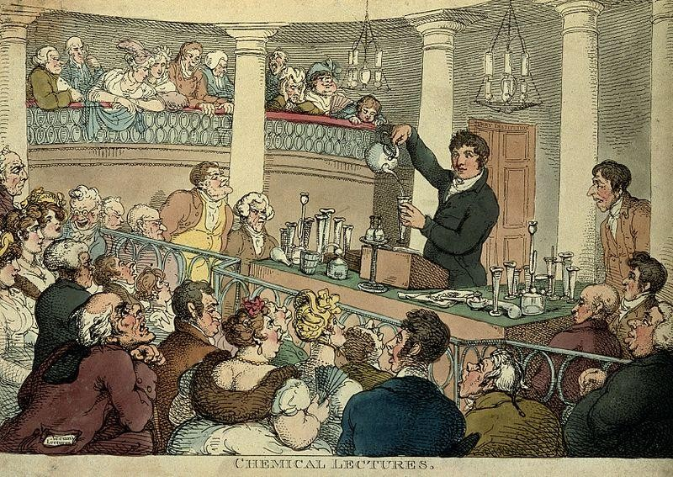
Presentations!
2-5 minutes
One take-home big picture
Two quantitative results
One graph (from articles)
One statistic
Two ecologically relevant results

Slide 4

Appropriate Detail
I’m good at lots of things!
vs
I have a wide variety of skills applicable to the job such as building excel spreadsheets and I am well versed on the endangered species act.

Slide 5
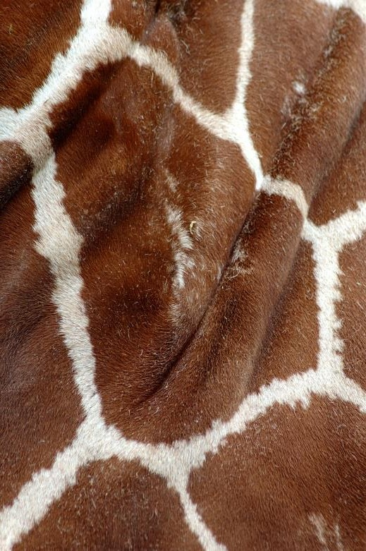
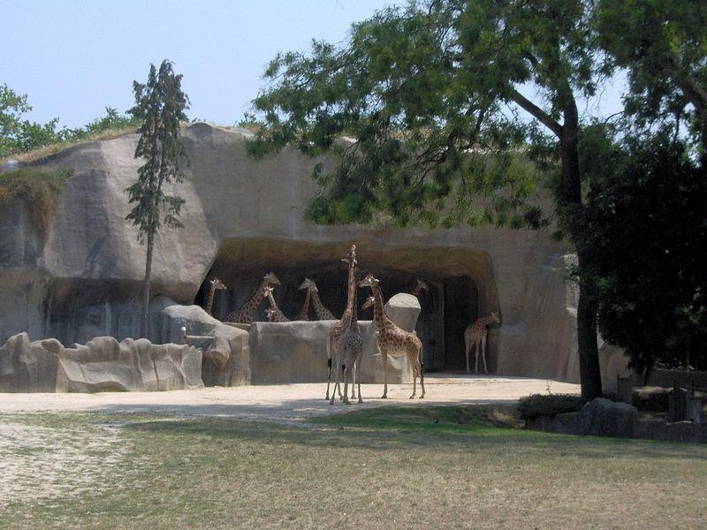
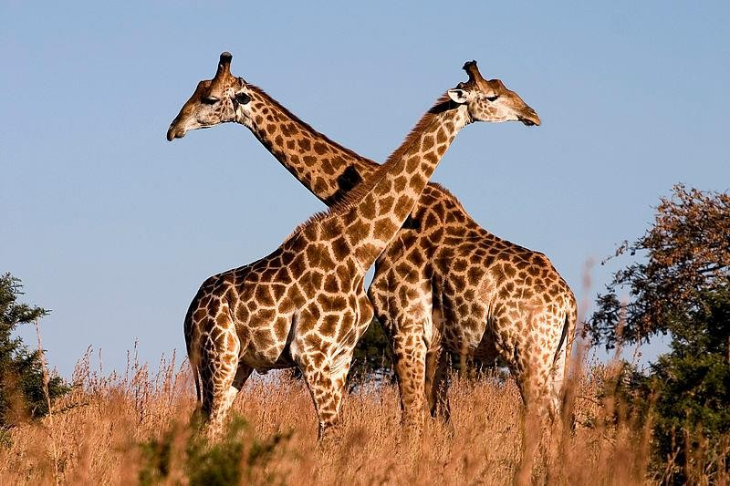
Details and Big Picture
Too close = Too much
detail and point is lost
Too far = Not enough
detail to understand point
Just right = Easy to interpret

Slide 6
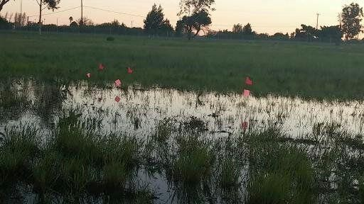
Questions?

Slide 7
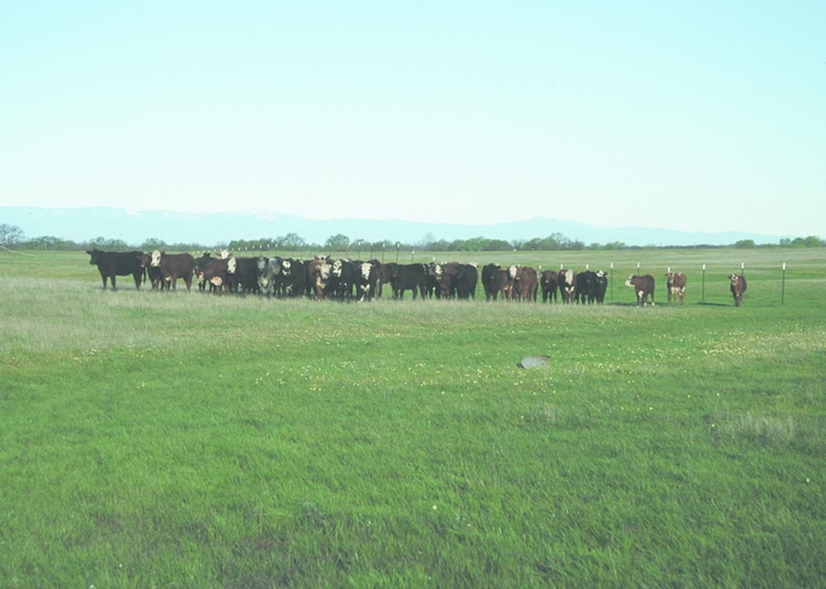
Now that we’ve decided how to include grazing into our restoration plan…

Slide 8
… what other considerations are needed with grazing?
Winter grazing, no grazing, summer grazing,
continuous grazing...
Timing isn't the only variable that matters.

Slide 9
Other Considerations
Stocking density?
Age of cow (bulls? calving cows?)
Not cattle (sheep? goats?)
Fencing around the pools?
Alternatives to grazing?
Burning to remove biomass
Mowing reduce invasive species input into pools
Raking once biomass has dropped but before natives grow

Slide 10
Learning Journal Entry
Learning goals:
Use evidence to construct an argument.
Compare and contrast ecological studies in a similar system with a similar question.
Use vernal pool ecological relationships to help make land management decisions.
Identify and work through biases to reach a management decision.
10

Slide 11
Things to Think About
Land management decisions are rarely straight forward.
Ecological studies can be conflicting, but still relevant.
Personal biases can search out what they want to see.
It is our job as scientists to pick the best option for our goal.

Slide 12
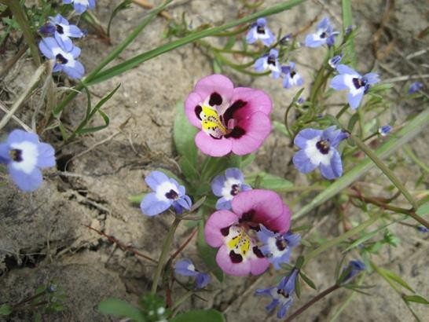
Thanks!

Slide 13
Image Credits
Slide 1: Photo credit: Akasha Faist Slide 2: Photo credit: Sharon Collinge
Slide 3: “A chemical Lecture at the surrey institution” See page for author [CC BY 4.0 (http://creativecommons.org/licenses/by/4.0)], via Wikimedia Commons.
https://upload.wikimedia.org/wikipedia/commons/5/5e/A_chemical_lecture_at_the_Surrey_Institution._Coloured_etchi_Wellco me_V0006722.jpg
Slide 5: “Giraffe markings” By Harlequeen (originally posted to Flickr as Giraffe markings) [CC BY 2.0 (http://creativecommons.org/licenses/by/2.0)], via Wikimedia Commons; https://upload.wikimedia.org/wikipedia/commons/8/8f/Giraffe_markings.jpg
“Giraffa camelopardalis antiquorum” By User:Mathae (Own work) [GFDL (http://www.gnu.org/copyleft/fdl.html), CC-BY-SA-3.0 (http://creativecommons.org/licenses/by-sa/3.0/) or CC BY 2.5 (http://creativecommons.org/licenses/by/2.5)], via Wikimedia Commons.
https://upload.wikimedia.org/wikipedia/commons/7/76/Giraffa_camelopardalis_antiquorum_%28Vincennes_Zoo%29_3.jpg
“Giraffe Ithala KZN Southa Africa”By Luca Galuzzi (Lucag) [CC BY-SA 2.5 (http://creativecommons.org/licenses/by-sa/2.5)], via
Wikimedia Commons.
https://upload.wikimedia.org/wikipedia/commons/0/02/Giraffe_Ithala_KZN_South_Africa_Luca_Galuzzi_2004.JPG Slide 6: Photo credit: Akasha Faist
Slide 7: “NRCSA01033-California” Gary Kramer / Photo courtesy of USDA Natural Resources Conservation Service., via Wikimedia Commons. https://upload.wikimedia.org/wikipedia/commons/a/ac/NRCSCA01033_-
_California_%28683%29%28NRCS_Photo_Gallery%29.tif
Slide 12: Photo credit: Akasha Faist

