Slide 1
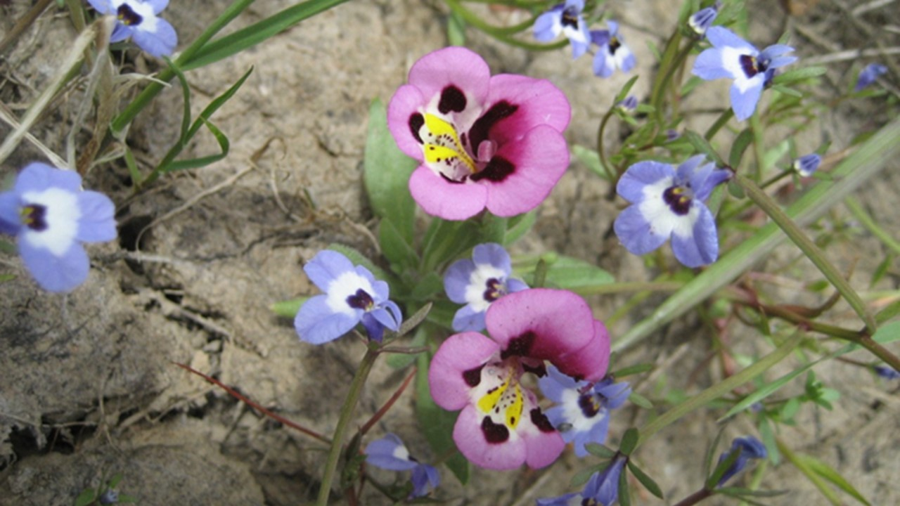
NATIONAL CENTER FOR CASE STUDY TEACHING IN SCIENCE
^{Grazing in Vernal Pools:}
Restoration Management Decisions
Day 1 Presentation
^{by}
^{Akasha M. Faist} Department of Ecology and Evolutionary Biology University of Colorado, Boulder, CO

Slide 2
Class Structure
Brief lecture on what vernal pools are and why they are important.
Work to identify the ecological pros and cons of grazing in vernal pools.
Develop an argument for or against grazing.
Present the argument.
Discuss what is happening in the “real world.”

Slide 3
Learning Goals
Use evidence to construct an argument.
Compare and contrast ecological studies asking similar questions in the same system.
Use vernal pool ecological relationships to help make land management decisions.
Identify and work through biases to reach a management decision.

Slide 4
Vernal Pools

Slide 5
What Are Vernal Pools?

Slide 6
California Vernal Pools
Spring
Winter
Summer-Fall
Annual cycle

Slide 7
Winter Wet Phase
Pools filled with water from precipitation; plants in small germinant state under water.

Slide 8
Spring Flowering Phase
Spring flowers follow the receding water line.

Slide 9
Summer Dry Phase
Plants are mostly dormant waiting for the winter rains.

Slide 10
Many Endangered and Endemic Species

Slide 11
California Population Densities
Common vernal pool habitat
11

Slide 12
Vernal Pool Habitat Loss
Agriculture
Land development
Climate change

Slide 13
Cattle Grazing

Slide 14
Restoration Needed

Slide 15
Should grazing be added to the management plan?
+
= ?

Slide 16
Image Credits
Slide 1: Photo Credit: Akasha Faist. Slide 4: Photo Credit: Sharon Collinge. Slide 5: Photo Credits: Sharon Collinge.
Slide 6: vernal pools 2” https://commons.wikimedia.org/wiki/File:Vernal_Pools_2.jpg
https://commons.wikimedia.org/wiki/File:Vernal_Pools_2.jpg#file
Slide 8: "Vernal pool in spring“ By USFWS [Public domain], via Wikimedia Commons https://commons.wikimedia.org/wiki/File:Vernal_pool_in_spring.jpg
“Vernal Pool” https://commons.wikimedia.org/wiki/File:VernalPool.jpg Slide 9: Photo credit: Sharon Collinge.
Slide 10: “Endangered species”: California tiger salamander, By John Cleckler [Public domain], via Wikimedia Commonshttps://upload.wikimedia.org/wikipedia/commons/c/ce/California_Tiger_Salamander.jpg;
“Pogogyne douglasii” By Stickpen (Own work) [CC0], via Wikimedia Commons, https://upload.wikimedia.org/wikipedia/commons/b/b0/Pogogyne_douglasii.jpg;
“Vernal Pool fairy shrimp” By Pacific Southwest Region (Flickr: Vernal Pool fairy shrimp) [CC BY 2.0 (http://creativecommons.org/licenses/by/2.0)], via Wikimedia Commons https://upload.wikimedia.org/wikipedia/commons/8/83/Vernal_Pool_fairy_shrimp.jpg
“Downingiayina” See page for author [Public domain], via Wikimedia Commons https://upload.wikimedia.org/wikipedia/commons/7/76/Downingiayina.jpg
Slide 11: “California Population map” See page for author [Public domain], via Wikimedia Commons https://upload.wikimedia.org/wikipedia/commons/a/ae/California_population_map.png
Slide 12: “California farm” Richard Croft [CC BY-SA 2.0 (http://creativecommons.org/licenses/by-sa/2.0)], via Wikimedia Commons, https://upload.wikimedia.org/wikipedia/commons/f/f4/California_Farm_-_geograph.org.uk_-_388051.jpg:
“Darnestown, MD farm panorama”, By Flickr user: Jeff Turner Grafton http://www.flickr.com/people/respres/ [CC BY 2.0 (http://creativecommons.org/licenses/by/2.0)], via Wikimedia Commons. https://upload.wikimedia.org/wikipedia/commons/d/d5/Darnestown%2C_MD_farm_panorama.jpg
Slide 13: “NRCSA01033-California” Gary Kramer / Photo courtesy of USDA Natural Resources Conservation Service., via Wikimedia Commons. https://upload.wikimedia.org/wikipedia/commons/a/ac/NRCSCA01033_-_California_%28683%29%28NRCS_Photo_Gallery%29.tif
Slide 14: Photo Credit: Akasha Faist
Slide 15: “NRCSA01033-California” Gary Kramer / Photo courtesy of USDA Natural Resources Conservation Service., via Wikimedia Commons. https://upload.wikimedia.org/wikipedia/commons/a/ac/NRCSCA01033_-_California_%28683%29%28NRCS_Photo_Gallery%29.tif;
Photo credit: Akasha Faist.

