Slide 1
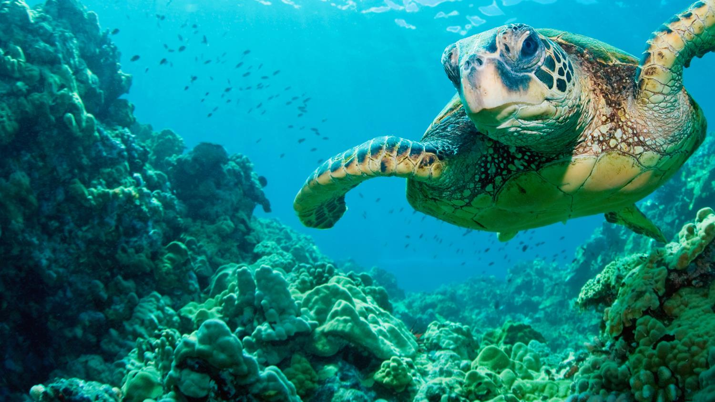
NATIONAL CENTER FOR CASE STUDY TEACHING IN SCIENCE
A Presentation to Accompany the Case Study:
Turtles in Turmoil
Implications of
Climate Change on the
Future of the Green Sea Turtle
by
Ruth S. Bowers-Sword, Jack C. Doss, and Bruce A. Wiggins
Department of Biology
James Madison University, Harrisonburg, VA
Notes:
A Presentation to Accompany the Case Study: Turtles in Turmoil: Implications of Climate Change on the Future of the Green Sea Turtle
By Ruth S. Bowers-Sword, Jack C. Doss, and Bruce A. Wiggins
Department of Biology
James Madison University, Harrisonburg, VA

Slide 2
Climate change
Human activities, largely in the form of CO₂ emissions, are causing global temperatures to rise.
Changes in temperature can also lead to rising sea levels, shifts in precipitation, weather patterns, and severe weather events

Slide 3
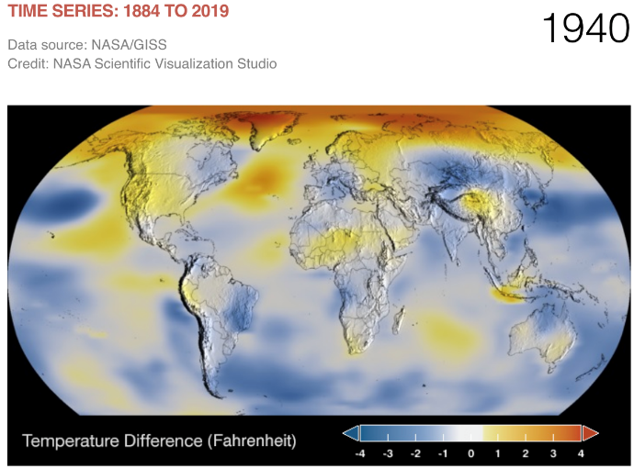
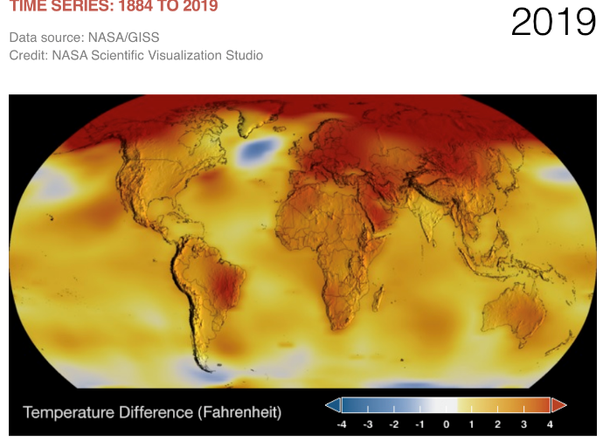
Climate change has been drastically increasing world temperatures over the past 80 years, on land and in oceans
Notes:
Photo source: https://climate.nasa.gov/vital-signs/global-temperature/

Slide 4
Reptiles
Lizards, snakes, crocodilians, and turtles
Ectothermic (cold blooded) - reptiles rely on environmental temperatures to maintain their body temperature
Many reptiles reproduce by laying eggs, although some groups give birth to live young

Slide 5
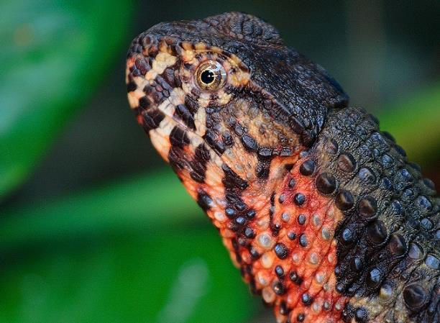
How climate change affects reptiles: Lizards
Many lizards reproduce at specific times of the year
Lizards may rely on specific temperatures and precipitation regimes
Shifts in temperature and precipitation patterns may shorten this period of reproduction
Shifts in temperatures may also allow for the introduction of invasive species
Endangered Chinese Crocodile Lizard (Shinisaurus crocodilurus)
Notes:
Photo credit: © Lai Wagtail (CC BY-NC-ND 2.0) https://creativecommons.org/licenses/by-nc-nd/2.0/

Slide 6
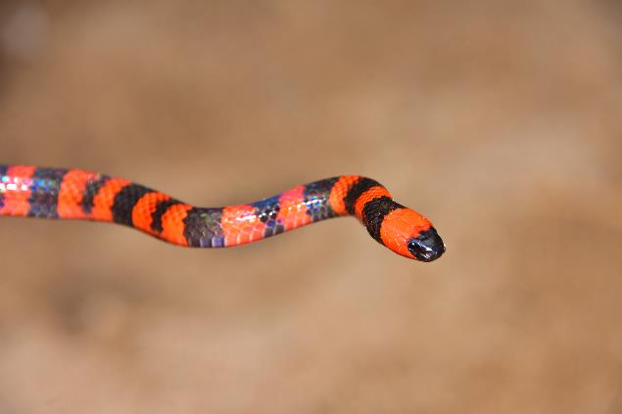
How climate change affects reptiles: Snakes
Many of the same reproductive traits hold true for snakes as well
Snakes may also experience reductions in range due to:
Temperature and precipitation changes
Competition from invasive species
Shifts in temperature may also alter periods of daily activity, affecting foraging time and ability
Critically Endangered Roatan Coral Snake (Micrurus ruatanus)
Notes:
Photo credit: © JoelAmaya (CC BY-SA 4.0) https://creativecommons.org/licenses/by-sa/4.0/?ref=ccsearch

Slide 7
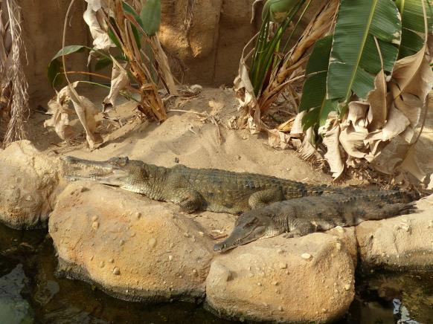
How climate change affects reptiles: Crocodilians
Crocodilians are primarily aquatic, and typically nest along shorelines
Rising sea levels threaten crocodilians by reducing or flooding nesting areas, fragmenting habitat
Critically Endangered Slender–snouted Crocodile
(Mecistops cataphractus)
Notes:
Photo credit: Flickr user Chriest, https://www.flickr.com/photos/christophlorse/23489910028, CC BY-NC-SA 2.0 (https://creativecommons.org/licenses/by-nc-sa/2.0/).

Slide 8
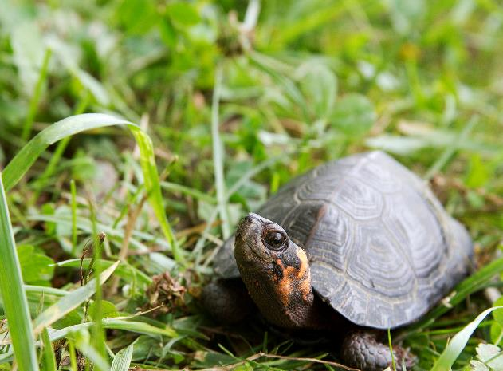
How climate change affects reptiles: Turtles
Turtles are also highly aquatic species
Many of the same climate threats apply to turtles
> 60% of all turtle species are extinct or threatened
Critically Endangered Bog Turtle (Glyptemys muhlenbergii)
(Lovich et al. 2018)
Notes:
Photo credit: Gary Peeples/USFWS, https://commons.wikimedia.org/wiki/File:Bog_turtle_(18120958593).jpg

Slide 9
Temperature dependent sex determination
Crocodilians and turtles also exhibit temperature dependent sex determination
Nest temperature during incubation will determine the sex of the offspring
Temperature gradients within the nest typically result in an even ratio of males and females
Warming nest temperatures may produce only one sex in offspring, leading to reduced reproductive capabilities

Slide 10
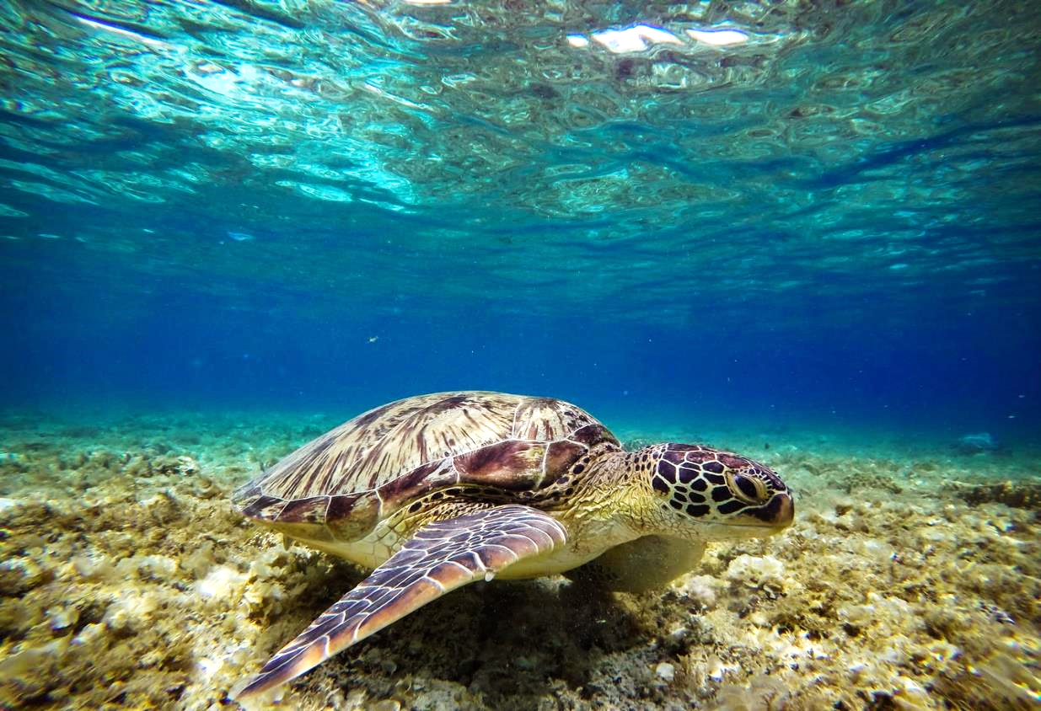
The Green Sea Turtle
(Chelonia mydas)
Aquatic turtle species
Currently listed as Endangered by the IUCN
Threats include climate change, habitat loss, pollution
Turtles are herbivorous and feed primarily on sea grasses
Travel long distances between feeding grounds and mating grounds
Notes:
Photo credit: Hitoshi Namura, https://unsplash.com/photos/IRzfQm79qxQ, Unsplash license (https://unsplash.com/license).

Slide 11
Why are sea turtles important?
Keystone species
Turtle nesting and hatchlings leave behind important nutrients for coastal vegetation
Green sea turtle grazing on seagrass keeps seagrass beds healthy (like aquatic lawnmowers)
Sea turtles provide habitat for “aquatic hitchhikers” like barnacles, small crustaceans, and algae
Play an integral role in their environments and influence on other species in their habitats
If removed major disruptions and impacts on habitat and wildlife
Healthy seagrass beds stabilize ocean floors and provide habitat, food, and protection for many fish species
(Heithaus et al. 2014; Wilson et al. 2010)
Notes:
Slide References:
Heithaus, M.R., Alcoverro, T., Arthur, R., Burkholder, D.A., Coates, K.A., Christianen, M.J.A., Kelkar, N., Manuel, S.A, Wirsing, A.J., Judson Kenworthy, W. and Fourqurean, J.W. (2014). Seagrasses in the age of sea turtle conservation and shark overfishing. Front. Mar. Sci. 1(28): doi: 10.3389/fmars.2014.00028
Wilson, E.G. Miller, K.L., Allison, D., and Magliocca, M. (2010). Why healthy oceans need sea turtles: the importance of sea turtles to marine ecosystems. OCEANA, Washington, D.C.

Slide 12
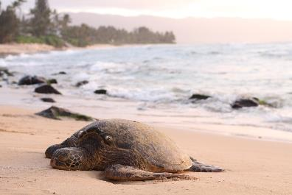
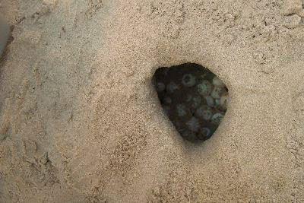
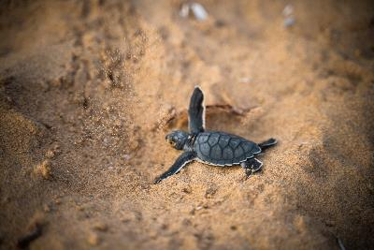
Green sea turtle nesting
Green sea turtles spend almost entire life in the sea
Only emerge for nesting on land
Eggs are deposited in holes dug into the sand
When hatching, young emerge from sand and crawl directly into the ocean
Also a temperature sex determination species
Notes:
Photos credits (left to right):
1. Jeremy Bishop, https://unsplash.com/photos/8iTugPNZ_As, Unsplash license (https://unsplash.com/license)
2. https://pixnio.com/fauna-animals/reptiles-and-amphibians/turtles-pictures/sea-turtle-pictures/sea-turtle-nest, USFWS, pd.
3. David Leveque, https://unsplash.com/photos/A9KmPND5o4g, Unsplash license (https://unsplash.com/license)

