Slide 1
A Delicate Balance: Resource Allocation, Immunity, and Disease
NATIONAL CENTER FOR CASE STUDY TEACHING IN SCIENCE
A Presentation to Accompany the Case Study:
^{by}
^{Emily Cornelius Ruhs} ^{Global and Planetary Health} University of South Florida, Tampa, FL
^{and}
^{Cynthia J. Downs} Environmental and Forest Biology SUNY College of Environmental Science and Forestry, Syracuse, NY
Notes:
Hello everyone!
Today we are going to discuss the immunity case study “A Delicate Balance: Resource Allocation, Immunity and Disease.”
The only thing you will need for this activity is the case study handout.
Image credit: Licensed photo © Joingate | Dreamstime.com, ID 9756264.

Slide 2
Overview
Three parts:
Why Are Resources Finite?
Resource Allocation Across Biological Systems
Applying Your Knowledge: Implications for Disease Susceptibility
For each part:
Questions
Notes:
In this case study we are going to be exploring how resource availability affects avian immune function and how that translates into disease spread. The case is divided into three parts. In each part there are “thought questions” in the text for you to consider as you read the background information. At the end of each part, there are “discussion questions” to be answered and turned in.

Slide 3
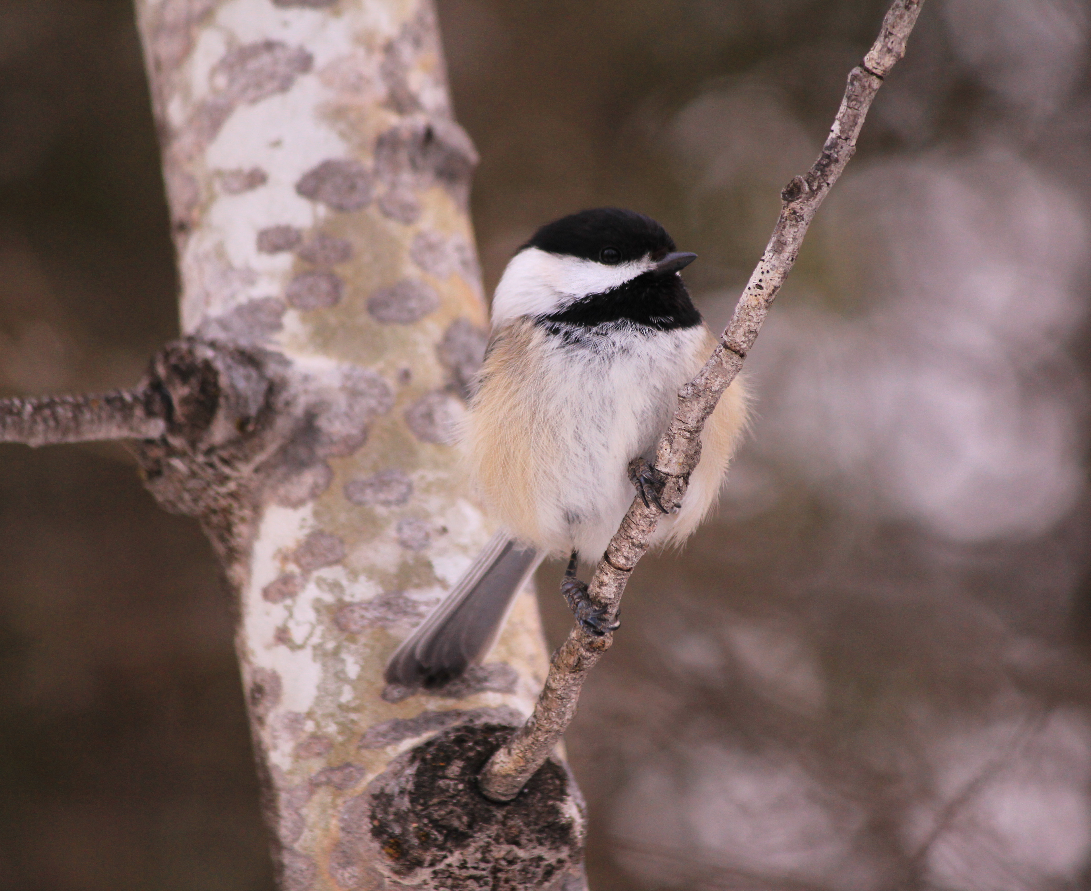
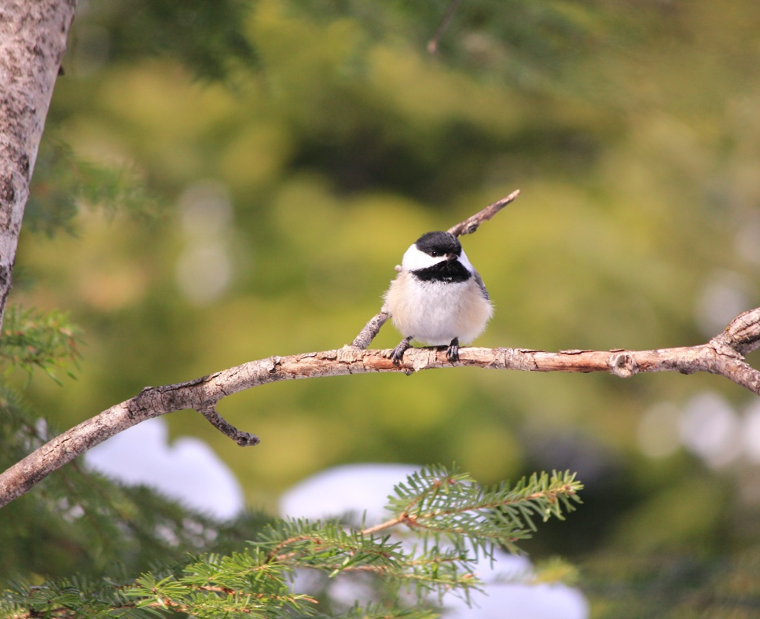
Part I: Why Are Resources Finite?
Introduce key concepts
Concepts to focus on:
Acquisition versus allocation
How allocation relates to energy usage
Identify the scenarios when resources might be limiting
Notes:
For Part I, we will be introducing key background concepts and discussing why resources are finite and what that means for a passerine bird, the black-capped chickadee.
The black-capped chickadee is a small bird weighing around 12g, which is slightly less than the weight of a soda pop can. Despite their small size, they do not migrate to warmer climates in the winter, but rather stay put and cope with the harsh winter temperatures. In the summer, they lay their clutches, or eggs, and usually care for around 3-5 nestlings. These are just two of the demanding portions of the annual cycle. In order to cope with these increasingly demanding periods, they must be able to acquire enough food resources to allocate energy to fuel all of their physiological processes from their heart rate to body temperature regulation to growth and production during the breeding season. If they are not able to acquire enough food there might be consequences.
At the end of this section, you should be able to:
Define and differentiate between acquisition versus allocation.
Understand how acquisition of resources relates to energy usage.
Discuss the scenarios in which resources might be limiting.

Slide 4
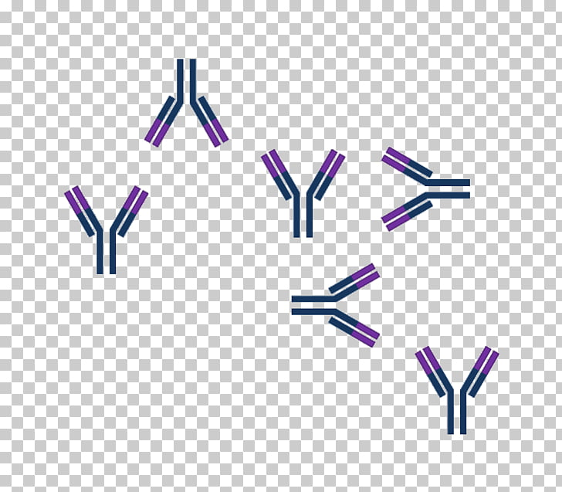
Part II: Resource Allocation Across Biological Systems
Explore real-life data
Concepts to focus on:
Explain why certain scenarios are more demanding
Identify the costs of trade-offs
Cornelius et al. 2017; Nordling et al. 1998
Notes:
For Part II, we will discuss the importance of fat reserves on survival in different portions of the annual cycle. We will also explore real-life data from studies that investigated how resource limitation impacted aspects of immune function.
When resources are limiting, the balance between physical systems might be strained. That means that birds might need to prioritize certain systems over others. Many times this comes in the form of a trade-off with immune function or fitness (i.e., the number or quality of offspring produced).
A lot of research has been completed on these life history trade-offs, but sometimes direct evidence in the non-breeding season is lacking. One example, in chickadees, showed that a gain in fat mass directly related to a decrease in the haptoglobin response, a protein involved in inflammation.
Most of the research has been completed during the breeding season. For example, if you focus on Figure 4 of the handout, researchers experimentally manipulated the number of offspring given to parents, either increasing or decreasing by two. When they did this, parents had decreased production of antibodies, meaning that they invested more in fitness than their own self-maintenance.
Overall, the physiological system or systems birds prioritize might vary depending on the portion of the annual cycle.
At the end of this section, you should be able to:
Debate why certain scenarios and portions of the annual cycle are more demanding
Identify the costs of trade-offs
And when animals might prioritize survival over fitness
-------References------
Cornelius, E.A., Vézina, F., Regimbald, L., Petit, M., Love, O.P. & Karasov, W.H. (2017) Chickadees faced with unpredictable food increase fat reserves but certain components of their immune function decline. Physiological and Biological Zoology, 90, 190-200.
Nordling, D., Andersson, M., Zohari, S., & Gustafsson, L. (1998) Reproductive effort reduces specific immune response and parasite resistance. Proceedings of the Royal Society of London: B, 265, 1291-1298.

Slide 5
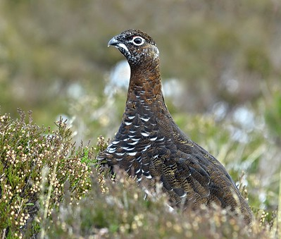
Part III: Implications for Disease Susceptibility
Learn to evaluate and interpret real-life data
Concepts to focus on:
Evaluate how resource availability and trade-offs might impact disease susceptibility
Demas et al. 1997; Hudson et al. 1998; Martínez-Padilla et al. 2013
Notes:
For Part III, we will introduce how resources impact immune function and the energetic costs of the immune response. We will also outline how population density impacts resource availability and thus disease susceptibility. Finally, we will ask you to interpret real-life data on infection with a gut nematode.
There are many aspects of immune function, and some of them are more costly than others. For example, maintenance of innate, baseline immune function is thought to be relatively low cost, whereas producing a response to infection, like inflammation or antibody production can increase metabolic costs by 25%!
Therefore you can probably guess that energetic resources are important for mounting an immune response. The quantity of resources available can be impacted by extreme weather events, like a harsh winter storm, but they are also impacted by population density. Simply put, if there are more birds on the landscape, there is a greater demand for those resources.
One interesting example of this concept is the well-studied red grouse population and how their population density is cyclical with gut nematode infection load.
At the end of this section, you should be able to:
Evaluate how resource availability and trade-offs might impact disease susceptibility.
Make predictions about red grouse populations in different resource-limited scenarios.
---------References---------
Demas, G.E., Chefer, V., Talan, M.I., & Nelson, R.J. (1997) Metabolic costs of mounting an antigen-stimulated immune response in adult and aged C57BL/6J mice. American Journal of Physiology- Regulatory, Integrative and Comparative Physiology, 273, R1631-R1637.
Hudson, P.J., Dobson, A.P. & Newborn D. (1998) Prevention of population cycles by parasite removal. Science, 282, 2256-2258.
Martínez-Padilla, J., Redpath, S.M., Zeineddine, M. & Mougeot, F. (2013) Insights into population ecology from long-term studies of red grouse Lagopus lagopus scoticus. Journal of Animal Ecology, 83, 85-98.

Slide 6
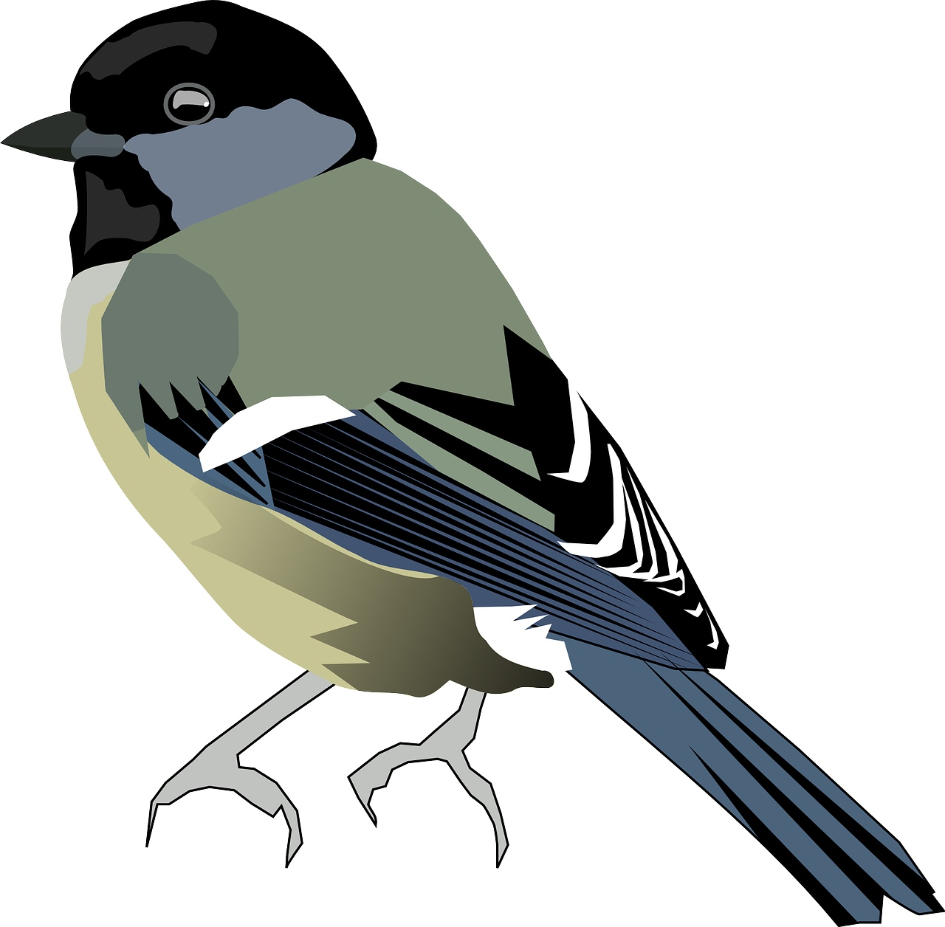
Summary
?
Basal metabolic rate
Reproduction
Immune function
Growth
Disease?
Thermoregulation
Lipid stores
Energetic costs of flying
Notes:
Just to reiterate some take-home points, we know there is a huge amount of variability in weather and temperature that can occur throughout the year. These climatic conditions can also cause a change in the amount of resources that are available to wildlife for food.
This decline in resources could come during an extreme weather event that causes a depletion in the amount of food or a bird not being able to forage adequately.
To conceptualize how resource limitation might put constraints on species, we can imagine an individual bird. That bird eats a certain amount of food, and thus acquires a given amount of energetic resources.
CLICK Based on the resources that the bird is able to consume, these get processed into energy that fuels the bird’s ability to maintain all of these key biological functions and thus fuels the life-history activities of the bird.
CLICK But what happens during times of extreme weather, or a severe winter? And what if that causes a change in the amount of food available to that bird or changes the predictability of when that bird will get adequate food stores?
If that bird is unable obtain adequate resources or more is demanded of them in terms of energetic requirements like reproduction or thermoregulation (CLICK)…they might need to prioritize something like fat gain over immune function
CLICK - This reduction in immune response can then have implications for disease susceptibility and spread.
Overall, we hope you’ve enjoyed this case study and learned something new about resource-based energetic trade-offs.

Slide 7
Credits and References
Photos
Part I: Audrey LePogam, used with permission
Part III: Red grouse. Photo by Mark Hope available on FlickR. Reproduced under a Creative Common license (CC-BY-NC-ND-2.0).
References
Cornelius, E.A., Vézina, F., Regimbald, L., Petit, M., Love, O.P. & Karasov, W.H. (2017) Chickadees faced with unpredictable food increase fat reserves but certain components of their immune function decline. Physiological and Biological Zoology, 90, 190-200.
Demas, G.E., Chefer, V., Talan, M.I., & Nelson, R.J. (1997) Metabolic costs of mounting an antigen-stimulated immune response in adult and aged C57BL/6J mice. American Journal of Physiology- Regulatory, Integrative and Comparative Physiology, 273, R1631-R1637.
Hudson, P.J., Dobson, A.P. & Newborn D. (1998) Prevention of population cycles by parasite removal. Science, 282, 2256-2258
Martínez-Padilla, J., Redpath, S.M., Zeineddine, M. & Mougeot, F. (2013) Insights into population ecology from long-term studies of red grouse Lagopus lagopus scoticus. Journal of Animal Ecology, 83, 85-98.
Nordling, D., Andersson, M., Zohari, S., & Gustafsson, L. (1998) Reproductive effort reduces specific immune response and parasite resistance. Proceedings of the Royal Society of London: B, 265, 1291-1298.

