Slide 1
Tougher Plants: Beating Stress by Protecting Photosynthesis in Genetically Modified Plants
Robin Pals-Rylaarsdam and Monica L. Tischler
Department of Biological Science
Benedictine University, Lisle, IL

Slide 2
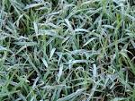
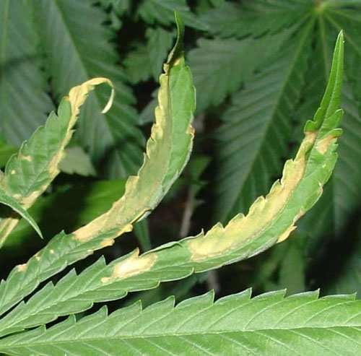
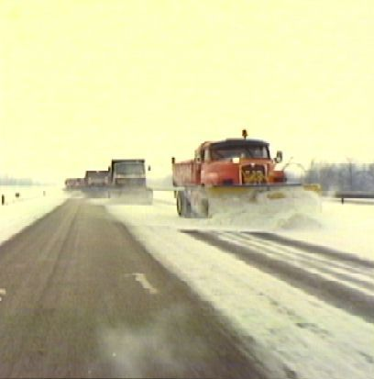
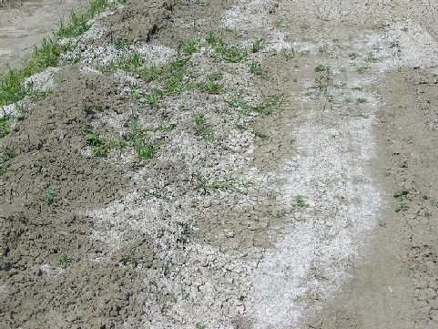
Plants are subject to many stresses
The main stressors are:
Cold Heat Salt
Frost damage
Heat damage
Irrigation evaporation
or drought
Road runoff

Slide 3
Glycine betaine is a molecule that moderates stresses in plants

Slide 4
Plants are subject to many stresses
The main stressors are:
Cold Heat Salt
Frost damage
Heat damage
Irrigation evaporation
or drought
Road runoff

Slide 5
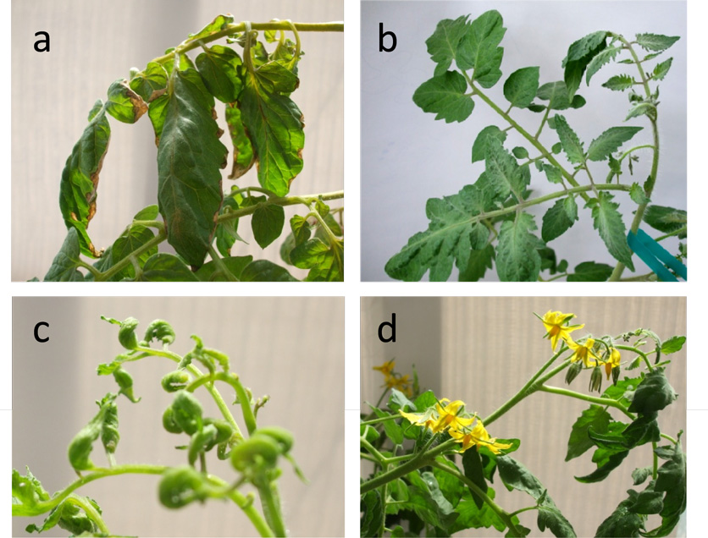
Plants were exposed to 3C for 7 days, then transferred to the warm greenhouse. What does wild type mean? What does glycine betaine do for the leaves, flowers and fruits in cold-exposed plants?
Wild type Transgenic
NB: This figure is a simulation of a figure in the original article.

Slide 6
What does glycine betaine do?
Figure 3. Effects of chilling on various growth parameters. Five-week-old greenhouse-grown wild type and independent homozygous transgenic lines (L1, L5) were chilled (3°C) for 5 days, then returned to greenhouse.
What is the X-axis measuring?
What is the Y-axis measuring?
What does “WT” mean?
What are L1-L9?

Slide 7
Which process of photosynthesis is most affected by ion leakage?
a. Whether the cells can capture light
b. Whether the Calvin Cycle will function
c. Whether ATP synthase will function
d. Whether electrons will transfer from PS II

Slide 8
What trends can you observe? (write down 2, share with your neighbor)
Figure 3. Effects of chilling on various growth paramaters. Five-week-old greenhouse-grown wild type and independent homozygous transgenic lines (L1, L5) were chilled (3°C) for 5 days, then returned to greenhouse.

Slide 9
Plants are subject to many stresses
The main stressors are:
Cold Heat Salt
Frost damage
Heat damage
Irrigation evaporation
or drought
Road runoff

Slide 10
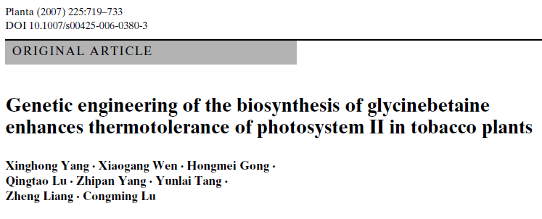
Figure 4. Changes in the oxygen-producing activity of PSII determined with thylakoid
membranes isolated from leaves after exposed to different temperatures 25, 30, 35, 40, 45, or 50°C in the chambers for 4 h, in wild type and transgenic plants. The values are mean + SE of three independent experiments.
What is the X-axis measuring?
What is the Y-axis measuring?
What are the two types of plants in this experiment?

Slide 11
Which process in photosynthesis produces O2?
PS I
PS II
ATP synthase
light capture

Slide 12
Make two observations from the data: Write them down, then share them with your neighbor.
Figure 4. Changes in the oxygen-producing activity of PSII determined with thylakoid membranes isolated from leaves after exposed to different temperatures 25, 30, 35, 40, 45, or 50°C in the chambers for 4 h, in wild type and transgenic plants. The values are mean + SE of three independent experiments.

Slide 13
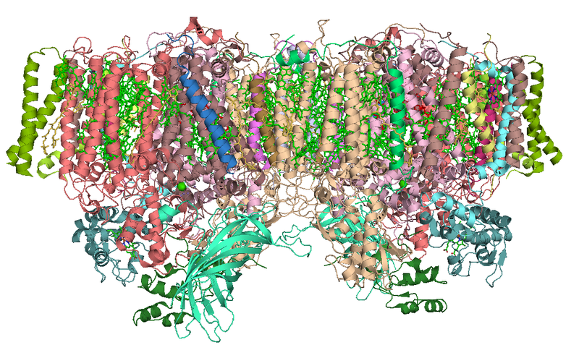
Photosystem II
Structure of Photosystem II, PDB 2AXT
http://en.wikipedia.org/wiki/File:PhotosystemII.PNG

Slide 14
Which part of the molecule goes through the membrane?
Blue box
Red oval
Trick question, this a big mess of squiggles!
Structure of Photosystem II, PDB 2AXT
http://en.wikipedia.org/wiki/File:PhotosystemII.PNG

Slide 15
So, the blue box is trans-membrane.
The part below the blue box is associated with the membrane.
Structure of Photosystem II, PDB 2AXT
http://en.wikipedia.org/wiki/File:PhotosystemII.PNG

Slide 16
Which of the following could explain why increased temperatures decrease PSII activity?
Thylakoid membranes become more permeable to ions
The chlorophyll breaks down
The peripheral proteins lose their ability to bind to the transmembrane proteins
Water cannot bind to PSII to form oxygen.
Structure of Photosystem II, PDB 2AXT
http://en.wikipedia.org/wiki/File:PhotosystemII.PNG

Slide 17
Plants are subject to many stresses
The main stressors are:
Cold Heat Salt
Frost damage
Heat damage
Irrigation evaporation
or drought
Road runoff

Slide 18
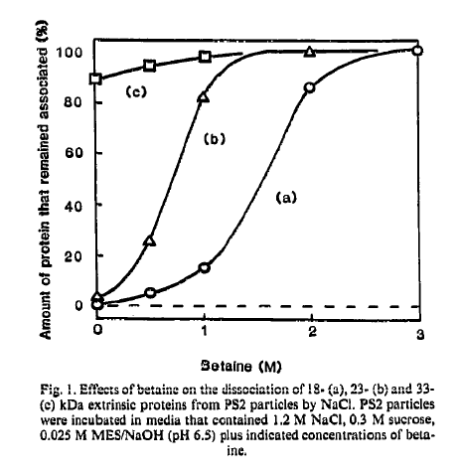
What is the X-axis measuring?
What is the Y-axis measuring?
What do lines a, b, and c refer to?

Slide 19
Make two observations, write them down, and share them with your neighbor.

Slide 20
Which subunit is most stable and likely to be in the membrane?
A
B
C

Slide 21
Which subunit is least stable and likely to be a peripheral subunit?
A
B
C

Slide 22
What does glycine betaine do to protect PSII activity?

Slide 23
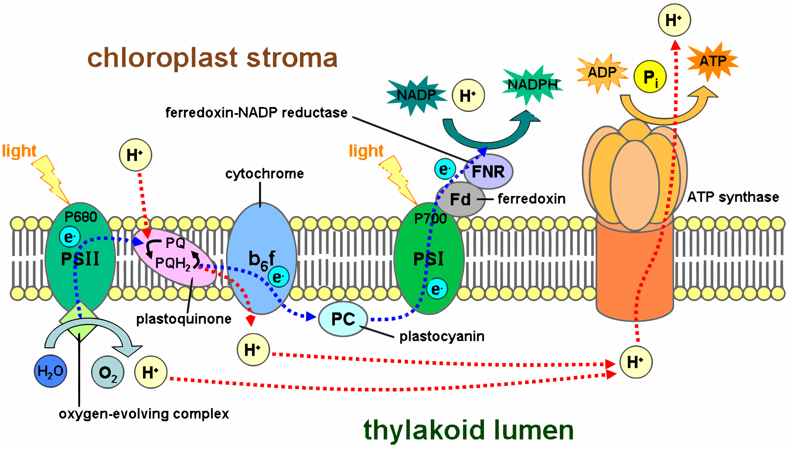
All the parts need to be together for photosynthesis!
PS II needs to work
Membrane can’t leak so ATP synthase works

Slide 24
Credits
Slide 5
Description: Susceptibility to cold stress at different plant stages.
Source: Photos by Robin Pals-Rylaarsdam. This figure is intended to simulate Figure 6 in Park, E.-J., Jeknić, Z., Sakamoto, A., DeNoma, J., Yuwansiri, R., Murata, N. and Chen, T. H. H. (2004), Genetic engineering of glycinebetaine synthesis in tomato protects seeds, plants, and flowers from chilling damage. The Plant Journal, 40: 474–487.
Slides 6 & 8
Description: Effects of chilling on various growth parameters.
Source: Redrawn and adapted from Figure 5(g) in Park, E.-J., Jeknić, Z., Sakamoto, A., DeNoma, J., Yuwansiri, R., Murata, N. and Chen, T. H. H. (2004), Genetic engineering of glycinebetaine synthesis in tomato protects seeds, plants, and flowers from chilling damage. The Plant Journal, 40: 474–487.
Slides 10, 11, & 12
Description: Changes in the oxygen-producing activity of PSII.
Source: Redrawn and adapted from Xinghong Yang, Xiaogang Wen, Hongmei Gong, Qingtao Lu and Zhipan Yang, et al. (2007), Genetic engineering of the biosynthesis of glycinebetaine enhances thermotolerance of photosystem II in tobacco plants, Planta, Volume 225, Number 3 (2007), 719–733.
Slides 13 – 16
Descriptionv: Photosystem II.
Source: Modifi ed from image by Curtis Neveus, used in accordance with the Creative Commons Attribution-Share Alike 3.0 License, from Wikipedia at http://en.wikipedia.org/wiki/File:PhotosystemII.PNG.
Slides 18 – 22
Description: Effects of betaine.
Source: FEBS Letters, 296(2), N. Murata, P.S. Mohanty, H. Hayashi, G.C. Papageorgiou, Glycinebetaine stabilizes the association of extrinsic proteins with the photosynthetic oxygen-evolving complex, 187–9. Copyright (1992), with permission from Elsevier. http://www.febsletters.org/.
Slide 23
Description: Photosynthesis
Source: Modified from a work released into the public domain by its author, Tameeria at the wikipedia project, http://commons.wikimedia.org/wiki/File:Thylakoid_membrane_2.svg.

