Slide 1

NATIONAL CENTER FOR CASE STUDY TEACHING IN SCIENCE
A Presentation to Accompany the Case Study:
Saving Trees to Save Cancer Patients
by
Reina Kim and Neva L. Laurie-Berry
Department of Biology
Pacific Lutheran University, Tacoma, WA
Notes:
Credit:
Licensed image © NetPix | Dreamstime.com, ID 339738953.

Slide 2
Part I – Saving Patients
Answer the questions in your case study handout as you follow along with this presentation.

Slide 3
Chemotherapy
Chemotherapy
  Uses cytostatic and cytotoxic drugs in combination with other forms of cancer therapies.
  Inhibit cell division → undergo apoptosis
Side effects with traditionally-synthesized drugs (lab-made) may include
  Hair loss, immunosuppression, digestive tract lining inflammation (mucositis), decreased blood production (myelosuppression), and cardiotoxicity, neurotoxicity, etc.
  May affect healthy cells → further side effects
Rapidly proliferating cancer cells →
  Lead to high mutation rate and render chemotherapy drugs ineffective

Slide 4
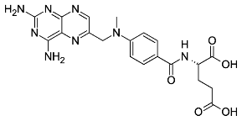
Methotrexate (Example of Traditionally Synthesized Drug)
Methotrexate
Used for | Rheumatoid arthritis, cancer of lung, neck, breasts, head, bone, blood
Function | Slow growth of cancer cells
Side effects | Serious/life-threatening skin reactions Bloody vomit Sores Stomach pain Significant reduction in your immune system function Development of serious infections, cancers
MOA | Blocks hydrofolate reductase (DHFR) - necessary for DNA synthesis. Prevents purine and pyrimidine synthesis
Pricing (June 2025) | GoodRx (healthcare company that tracks prescription drug prices in the US) 1 vial: 2 mL of 25 mg/mL (totaling 50 mg) - average price of $16.04 For an average adult, (1 vial) 2 mL of 25 mg/mL is ~1 dose but may vary greatly between cancers.
Notes:
Credit:
Methotrexate Molecule
File:Methotrexate Structure.svg. (2021, January 16). Wikimedia Commons. Retrieved July 4, 2025, from https://commons.wikimedia.org/w/index.php?title=File:Methotrexate_Structure.svg&oldid=526193772.

Slide 5
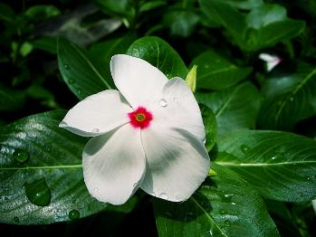
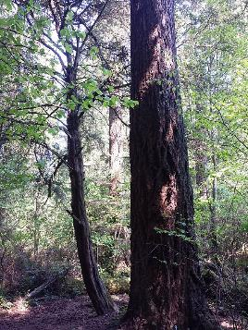
Alternatives to TSDs needed
Due to the major side effects of the anticancer drugs and the development of resistance by the cancer cells, an alternative method is needed to combat cancer!
There is an emphasis on the need for alternatives that are less toxic and more efficient.
Catharanthus roseus
Pacific yew tree (Taxus brevifolia)
Notes:
Credits:
Catharanthus Roseus
File:Catharanthus roseus white CC-BY-SA.jpg. (2024, February 14). Wikimedia Commons. Retrieved July 4, 2025, from https://commons.wikimedia.org/w/index.php?title=File:Catharanthus_roseus_white_CC-BY-SA.jpg&oldid=851510455.
Pacific Yew Tree
File:Taxus brevifolia (Pacific yew) - Flickr - brewbooks.jpg. (2024, July 13). Wikimedia Commons. Retrieved July 4, 2025, from https://commons.wikimedia.org/w/index.php?title=File:Taxus_brevifolia_(Pacific_yew)_-_Flickr_-_brewbooks.jpg&oldid=897978399.

Slide 6
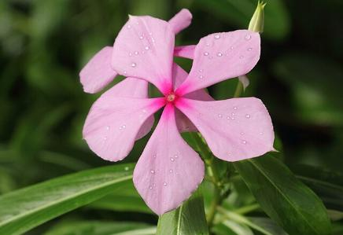
Looking to Plants for TSD Alternatives
What are phytochemicals?
  Any biologically active compounds found in plants.
  Can target the complex multistep process of carcinogenesis →
    Eliminate rapidly dividing cells
    Target molecular factors that encourage cancer phenotype
    Remove oxidative stress
    Modulate growth factors
    Inhibit angiogenesis in cancer tissue
    Induce apoptosis
How does this relate to cancer treatment?
  A plant-derived drug (PDD) has variable selectivity.
  Some PDDs can be non-toxic to normal cell-lines and cytotoxic towards cancer cells, causing them to be ideal for cancer therapy.
Catharanthus roseus
Notes:
Credit:
Catharanthus roseus
File:Catharanthus roseus-IMG 5432.jpg. (2025, February 7). Wikimedia Commons. Retrieved July 4, 2025, from https://commons.wikimedia.org/w/index.php?title=File:Catharanthus_roseus-IMG_5432.jpg&oldid=994803571.

Slide 7
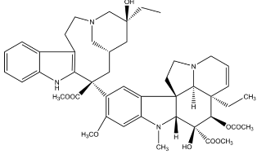
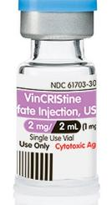
Vincristine (Example of a Plant-Derived Drug)
Used for | Cancers of the breast, ovary, cervix, lung, colon, rectum, testis, neuroblastoma, leukemia, rhabdomyosarcoma, malignant lymphoma, and hodgkin’s disease
Function | Inhibit cell proliferation/invasion, promote apoptosis by modulating cell signaling events.
Side effects | Pain, numbness, tingling in hands/feet Loss of appetite Nausea Constipation/diarrhea Dizziness/headaches
MOA | Bind to microtubules to prevent chromosome segregation during anaphase of mitosis, causing cell arrest and apoptosis.
Pricing (June 2025) | Good Rx 1 vial: 2 mg/mL totaling 2 mg - price ranges from $13.50 to $40.33 (average of $39) depending on the pharmacy (as of June 2025) For an average adult, 1 vial (2 mg/mL) is ~1 dose
Vincristine
Notes:
Vincristine Molecule
File:Structure of Vincristine.png. (2020, September 4). Wikimedia Commons. Retrieved July 4, 2025, from https://commons.wikimedia.org/w/index.php?title=File:Structure_of_Vincristine.png&oldid=448079536.
Vincristine
File:Drug-61703-309-16-Vincristine-Sulfate-Injection-USP tcm81-95339.jpg. (2024, December 12). Wikimedia Commons. Retrieved July 4, 2025, from https://commons.wikimedia.org/w/index.php?title=File:Drug-61703-309-16-Vincristine-Sulfate-Injection-USP_tcm81-95339.jpg&oldid=969492629.

Slide 8
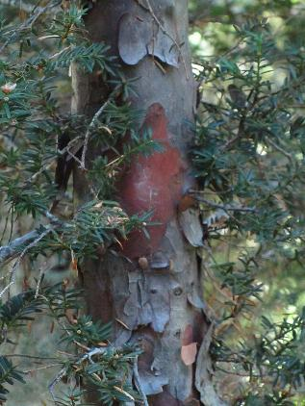
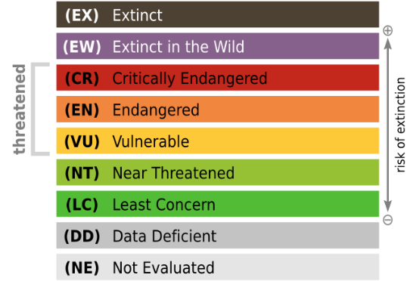
Yew Trees
Pacific yew trees
  Location: Native to the PNW (southern Alaska to northern California)
  Near threatened
Maire yew trees
  Location: Nepal
  Critically endangered
Ecological significance
  Produces food and shelter for woodland animals
  Nesting opportunities and protection for birds
Bark of Taxus Brevifolia
Notes:
Credits:
Yew Trees
File:Taxus brevifolia bark - Flickr - theforestprimeval.jpg. (2025, January 19). Wikimedia Commons. Retrieved July 4, 2025, from https://commons.wikimedia.org/w/index.php?title=File:Taxus_brevifolia_bark_-_Flickr_-_theforestprimeval.jpg&oldid=985327084.
Red List IUCN
File:IUCN Kategorien Rote Liste.svg. (2025, March 23). Wikimedia Commons. Retrieved July 4, 2025, from https://commons.wikimedia.org/w/index.php?title=File:IUCN_Kategorien_Rote_Liste.svg&oldid=1013054290.

Slide 9
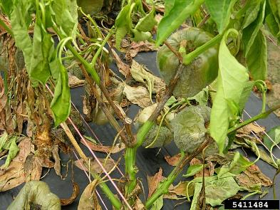
Paclitaxel Production from Yew Trees
Yew trees are well known for their production of the paclitaxel anticancer drug.
  Originally produced in yew trees as an immunity compound against
  wood-degrading fungi and oocmyetes
Mechanism of action - antifungal & antioomycete
High concentrations of paclitaxel inhibit nuclear division in germinating zoospores of phytophthora, a genus of plant damaging oomycetes.
Paclitaxel acts as a non-metabolizable fungistat that inhibits hyphae growth, which is important for nutrient absorption. Paclitaxel inhibits vesicle transport along microtubules. These vesicles carry necessary proteins, hormones, other substances that are necessary for hyphal growth.
Phytophthora blight
Notes:
Credit:
Phytophthora Blight
File:5411484-PPT-Phytophthora blight (Phytophthora capsici).jpg. (2025, April 25). Wikimedia Commons. Retrieved July 4, 2025, from https://commons.wikimedia.org/w/index.php?title=File:5411484-PPT-Phytophthora_blight_(Phytophthora_capsici).jpg&oldid=1024451339.

Slide 10
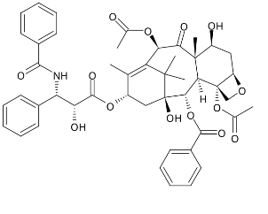
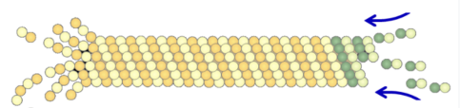
Paclitaxel from Yew Trees
Used for | Ovarian, breast, lung cancers
Function | Inhibit cell proliferation as an antimitotic agent
Side effects | Sores Joint and muscle pain Hair loss Fatigue Nausea Peripheral neuropathy
MOA | Stabilize and prevent depolymerization of microtubules Microtubules are heterodimers composed of tubulin (a-tubulin and B-tubulin). Polymerization leads to microtubule formation, which allows chromosome separation through microtubules’ dynamic instability (the growing/shortening of the tubules). Taxane bind to β-tubulin which prevents microtubules from disassembling. The stabilization interferes with chromosome segregation during mitosis, resulting in cell death.
paclitaxel
Polymerization and depolymerization of microtubules
Notes:
Credits:
Paclitaxel Molecule
File:Taxol structure.svg. (2021, June 2). Wikimedia Commons. Retrieved July 4, 2025, from https://commons.wikimedia.org/w/index.php?title=File:Taxol_structure.svg&oldid=566676193.
Microtubule structure
File:Microtúbulo. Dinamica.png. (2020, October 1). Wikimedia Commons. Retrieved July 4, 2025, from https://commons.wikimedia.org/w/index.php?title=File:Microt%C3%BAbulo._Dinamica.png&oldid=477254759.

Slide 11
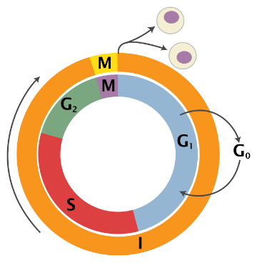
Why Is This Important?
A critical point in cancer development is rapid cell division, therefore mitotic arrest and apoptosis will prevent cell division and proliferation.
Paclitaxel has been showing great promise in better outcomes and life expectancy in patients due to its ability to target rapidly proliferating cells, including cancer cells.
Notes:
Credit:
Cell Cycle
File:Cell Cycle 2-2.svg. (2024, February 16). Wikimedia Commons. Retrieved July 4, 2025, from https://commons.wikimedia.org/w/index.php?title=File:Cell_Cycle_2-2.svg&oldid=852240660.

Slide 12
Part II – Saving Trees

Slide 13


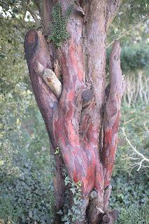
Limitations of Using Paclitaxel
Paclitaxel is an effective drug against cancer
  BUT the cost and efficacy of extracting the phytochemical concerning
  Around 3-10 trees are cut down for the use of 1 patient, depending on the dosage and amount
US Forest Service data 1992
  36,000 trees required to provide 327,200 kg of bark
  This yields 24 kG of paclitaxel → ~0.66 g per tree
An alternate method is needed!
  Either through designing a more sustainable method of agriculture/harvesting, enforcing political regulations, creating a microbial supply chain to produce greater amounts of the drug, etc.
Taxus brevifolia
Notes:
Credit:
Cartoon Tree
File:Green tree icon.svg. (2024, December 15). Wikimedia Commons. Retrieved July 4, 2025, from https://commons.wikimedia.org/w/index.php?title=File:Green_tree_icon.svg&oldid=970717793.

Slide 14
Saving the Cancer-Treating Maire’s Yew Tree in Nepal
Watch the video (watch up to 2:05)
  https://youtu.be/EeDWxQ1kCAY

Slide 15
Instructions!
Develop and present a strategy to hypothetically solve the shortage of paclitaxel without negatively impacting the yew tree abundance.
You will choose a primary research article in any of the following topics to help you create your solution.
  Conservation management
    Ecological guidelines / regulations to protect the species
  Finding alternative sources
    Finding phytochemicals with similar characteristics as paclitaxel
  Genetic alterations
    Modifying the genome of yew trees
  Biotechnology
    Increased production of bioactive compounds in phytochemicals in a lab setting

Slide 16
Image Credits
Methotrexate Molecule (Slide 4)
File:Methotrexate Structure.svg. (2021, January 16). Wikimedia Commons. Retrieved July 4, 2025, from https://commons.wikimedia.org/w/index.php?title=File:Methotrexate_Structure.svg&oldid=526193772.
Catharanthus Roseus (Slide 5)
File:Catharanthus roseus white CC-BY-SA.jpg. (2024, February 14). Wikimedia Commons. Retrieved July 4, 2025, from https://commons.wikimedia.org/w/index.php?title=File:Catharanthus_roseus_white_CC-BY-SA.jpg&oldid=851510455.
Pacific Yew Tree (Slide 5)
File:Taxus brevifolia (Pacific yew) - Flickr - brewbooks.jpg. (2024, July 13). Wikimedia Commons. Retrieved July 4, 2025, from https://commons.wikimedia.org/w/index.php?title=File:Taxus_brevifolia_(Pacific_yew)_-_Flickr_-_brewbooks.jpg&oldid=897978399.
Catharanthus Roseus (Slide 6)
File:Catharanthus roseus-IMG 5432.jpg. (2025, February 7). Wikimedia Commons. Retrieved July 4, 2025, from https://commons.wikimedia.org/w/index.php?title=File:Catharanthus_roseus-IMG_5432.jpg&oldid=994803571.
Vincristine Molecule (Slide 7)
File:Structure of Vincristine.png. (2020, September 4). Wikimedia Commons. Retrieved July 4, 2025, from https://commons.wikimedia.org/w/index.php?title=File:Structure_of_Vincristine.png&oldid=448079536.
Vincristine (Slide 7)
File:Drug-61703-309-16-Vincristine-Sulfate-Injection-USP tcm81-95339.jpg. (2024, December 12). Wikimedia Commons. Retrieved July 4, 2025, from https://commons.wikimedia.org/w/index.php?title=File:Drug-61703-309-16-Vincristine-Sulfate-Injection-USP_tcm81-95339.jpg&oldid=969492629.

Slide 17
Image Credits
Yew Trees (Slide 8)
File:Taxus brevifolia bark - Flickr - theforestprimeval.jpg. (2025, January 19). Wikimedia Commons. Retrieved July 4, 2025, from https://commons.wikimedia.org/w/index.php?title=File:Taxus_brevifolia_bark_-_Flickr_-_theforestprimeval.jpg&oldid=985327084.
Red List IUCN (Slide 8)
File:IUCN Kategorien Rote Liste.svg. (2025, March 23). Wikimedia Commons. Retrieved July 4, 2025, from https://commons.wikimedia.org/w/index.php?title=File:IUCN_Kategorien_Rote_Liste.svg&oldid=1013054290.
Phytophthora Blight (Slide 9)
File:5411484-PPT-Phytophthora blight (Phytophthora capsici).jpg. (2025, April 25). Wikimedia Commons. Retrieved July 4, 2025, from https://commons.wikimedia.org/w/index.php?title=File:5411484-PPT-Phytophthora_blight_(Phytophthora_capsici).jpg&oldid=1024451339.
Taxol Molecule (Slide 10)
File:Taxol structure.svg. (2021, June 2). Wikimedia Commons. Retrieved July 4, 2025, from https://commons.wikimedia.org/w/index.php?title=File:Taxol_structure.svg&oldid=566676193.
Microtubule structure (Slide 10)
File:Microtúbulo. Dinamica.png. (2020, October 1). Wikimedia Commons. Retrieved July 4, 2025, from https://commons.wikimedia.org/w/index.php?title=File:Microt%C3%BAbulo._Dinamica.png&oldid=477254759.
Cell Cycle (Slide 11)
File:Cell Cycle 2-2.svg. (2024, February 16). Wikimedia Commons. Retrieved July 4, 2025, from https://commons.wikimedia.org/w/index.php?title=File:Cell_Cycle_2-2.svg&oldid=852240660.
Cartoon Tree (Slide 13)
File:Green tree icon.svg. (2024, December 15). Wikimedia Commons. Retrieved July 4, 2025, from https://commons.wikimedia.org/w/index.php?title=File:Green_tree_icon.svg&oldid=970717793.

