Slide 1
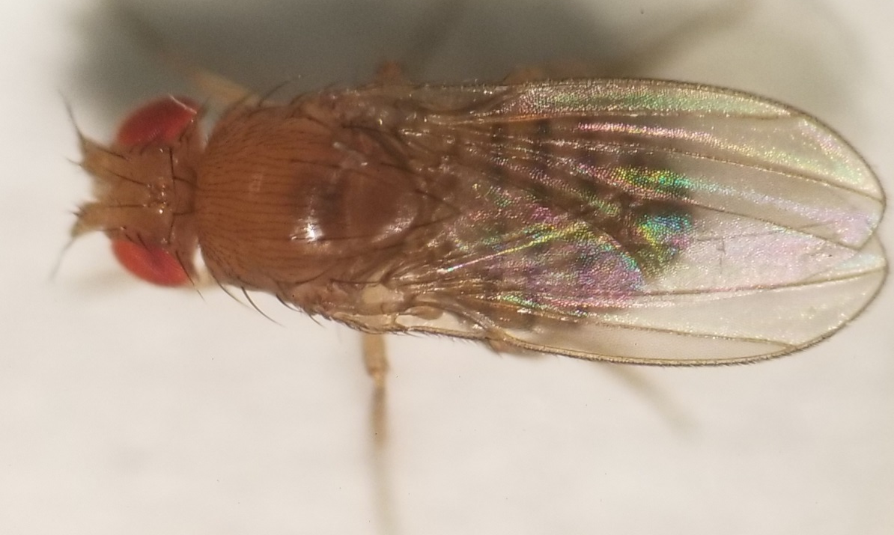
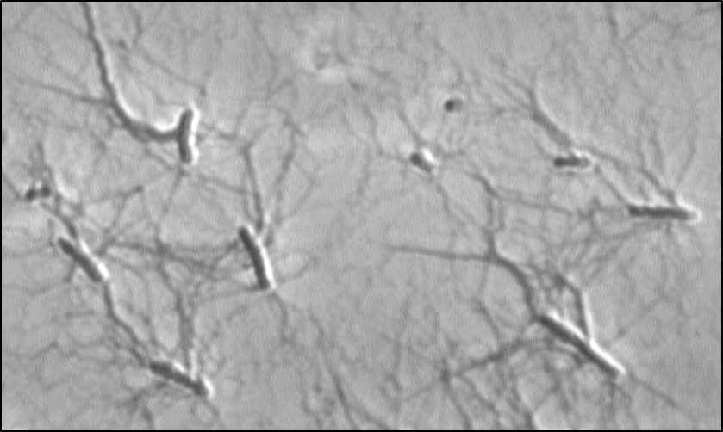
NATIONAL CENTER FOR CASE STUDY TEACHING IN SCIENCE
A Presentation to Accompany the Case Study:
Becoming a Friend Instead of a Foe:
An Attempt to Create Mutualistic Symbiosis
by
Melissa R. Eslinger and Cameron B. Marlow
Sodalis praecaptivus
Drosophila melanogaster
Image: Shinichiro Enomoto, University of Utah (used with permission)

Slide 2
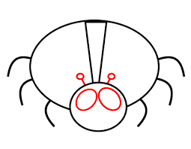




Hypothetical Origin of Insect-Bacteria Symbiotic Relationships
1
2
Insect and Bacteria exist
in same environment
3
Initial Vector Association:
(Consumption, Injury, STD)
*Proposed Step
Infection Transition:
(Pathogenesis, Parasitism)
4
Vertical transmission:
Mutualism
Time (Years)
Notes:
Hypothesis on the origin of symbiotic relationships:
The proposed process of symbiosis focuses on the evolutionary transition from pathogenesis to mutualism.
1. An insect and bacteria species co-exist in the same environment. This is to illustrate that insect and bacteria species co-exist together at a particular time in history and may not have evolved together before that time.
2. Initial Vector Association. This is to illustrate that while co-existing, there is some point that the insect and bacteria will come into contact, either through consumption, injury, or even through sexual transmission. This contact serves as the initial vector pathway for the bacteria to infect the insect.
3. Infection Transition. This is to illustrate that over time on an evolutionary scale, the bacteria may evolve and transition from pathogenesis to parasitism through natural selection. For instance, the bacteria may evolve and be selected because it becomes less toxic to the insect, but still draws nutritional resources from the host insect. Or, the insect itself may evolve and be selected because of a stronger innate immune response to the toxins of the bacteria and survive infection.
4. Mutualism and Vertical Transmission. The proposed final step is the evolutionary transition from pathogenesis/parasitism to mutualism. This is to illustrate that over time, the bacteria/insect relationship may evolve further to a point of mutualism. This may happen due to further evolutionary changes and natural selection. This final step provides benefits to both host and symbiont. Additionally, this relationship endures from generation to generation through vertical transmission, where the bacteria are transmitted maternally or paternally to each generational offspring.

Slide 3

Sodalis praecaptivus
Image Source:
Shinichiro Enomoto, University of Utah (used with permission)
Notes:
Sodalis praecaptivus Morphology:
Gram-negative, rod-shaped bacterium.
Motile in salt concentrated solutions.

Slide 4
Infection Mechanism of Sodalis praecaptivus
Initial Infection
Established Infection
Bacteria produce more toxins than OHHL
Bacteria produce OHHL to shut off toxin production
S. praecaptivus
Toxin
OHHL
Notes:
Infection Mechanism of Sodalis praecaptivus
This cartoon illustrates the Quorum Sensing (QS) mechanism of S. praecaptivus to regulate infectious toxins and a signaling molecule N-(3-oxohexanoyl) homoserine lactone (OHHL).
Initial Infection: When S. praecaptivus initially infects an insect, it immediately begins synthesizing toxins to eliminate competition. As the bacteria proliferates by cell division and its cell population density increases, the concentration of the QS molecule OHHL that downregulates the expression of the toxin genes will increase.
Established Infection: A larger cell population density of bacteria increases the concentration of OHHL, which then significantly downregulates the expression of toxins. The presence of the OHHL molecules regulates S. praecaptivus virulence until the bacterial cell density begins to decrease. Because there is a decrease in virulent toxins due to OHHL, S. praecaptivus is able to establish an infection for the duration of the host’s life.

Slide 5
Quorum Sensing Genes and Virulence Regulation
ypeI
OHHL
ypeR
yenR
- Virulence
- Virulence
Notes:
The Quorum Sensing Genes and Virulence Regulation:
This illustrates S. praecaptivus QS genes and the mechanism for virulence regulation used in this study.
The ypeI gene is responsible for the expression of the signaling molecule OHHL.
OHHL is a signaling molecule that regulates the expression of ypeR and yenR.
ypeR and yenR regulate the toxins responsible for the virulence of S. praecaptivus.
When these QS genes are intact and functional, virulence is downgraded as bacterial density increases upon infection.

Slide 6
Mutation of Quorum Sensing Genes and Virulence Regulation
ypeI
X
OHHL
ypeR
yenR
+ Virulence
+ Virulence
Notes:
Mutation of Quorum Sensing Genes and Virulence Regulation:
This slide illustrates what happens when the ypeI gene is mutated and OHHL cannot be expressed.
The ypeI gene is mutated and cannot express the QS signaling molecule OHHL.
Since OHHL is not expressed or at least functional, it cannot effectively downregulate the ypeR and yenR genes.
Without OHHL to downregulate the toxin expression by ypeR and yenR, toxins are still produced throughout infection and S. praecaptivus virulence continues.
Without any regulation, toxins continue to be produced and eventually kill the host organism.

Slide 7
Quorum Sensing Genes and Mutation of Virulent Genes
ypeI
OHHL
X
X
ypeR
yenR
+ Virulence
+ Virulence
Notes:
Quorum Sensing Genes and Mutation of Virulent Genes:
This slide illustrates what happens when the ypeI gene is still intact but the ypeR and yenR genes are mutated.
The ypeI gene leads to the expression of the QS molecule OHHL.
OHHL is expressed, but cannot regulate the mutated ypeR and yenR genes.
Because ypeR and yenR are mutated, these genes cannot regulate the expression of toxins.
Toxins are still produced and S. praecaptivus virulence continues. Without regulation, toxins continue to be produced and eventually kill the host organism.

Slide 8
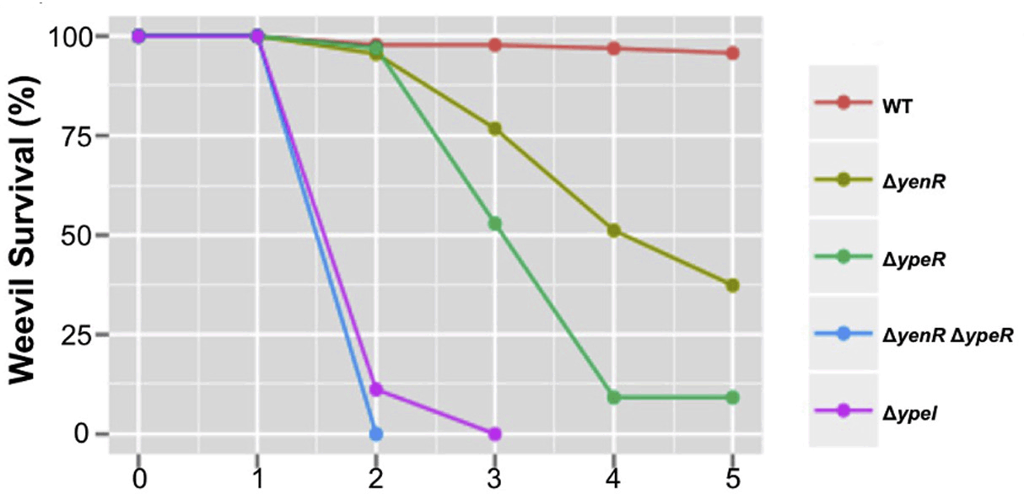
Mutation of QS and Virulent Genes Effect on Weevil Survival
Source: Quorum Sensing Attenuates Virulence in Sodalis praecaptivus (Enomoto et al., 2017). Figure 4A
Notes:
Mutation of QS genes effects on the Grain Weevil
The purpose of this slide is to showcase the effects of S. praecaptivus QS mutants on grain weevils and conduct comparative analysis with the results of D. melanogaster.
The Wild Type (WT) strain of S. praecaptivus did not kill the grain weevil population over 5 weeks.
The ypeR yenR double mutant had the most lethal effect on the grain weevil population.
The ypeI mutant had the second most lethal effect on the grain weevil.
The ypeR and yenR single mutants were significantly lethal to the grain weevil population, but not nearly as lethal as the ypeR yenR double mutant or the ypeI mutant.

Slide 9
Experimental Design Approach
What happens when S. praecaptivus is introduced to a novel host?
?
S. praecaptivus
Novel Host
D. melanogaster
Notes:
Experimental Design Approach
This slide is to introduce the concept of introducing S. praecaptivus into a novel host, D. melanogaster.
S. praecaptivus is genetically capable to transition into symbiosis with its QS genes.
What would be the results if S. praecaptivus infects an insect for the first time since its discovery?
S. praecaptivus is used to infect D. melanogaster, the novel host in this experiment.

Slide 10

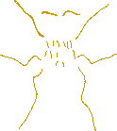


Host Insect: Drosophila melanogaster
Adult
Drosophila
melanogaster
Life Cycle
Pupa
Egg
Larva
Adult Female
Notes:
Host Model: Drosophila melanogaster
This slide illustrates the life cycle of D. melanogaster and the physical appearance of adult flies.
The life cycle image is to explain that the development of D. melanogaster can be observed at all stages of its life. Because these stages can be observed at all times, a researcher can introduce experimental variables into any stage of development.
Adults reproduce frequently and in high numbers, enabling researchers to collect reliable data due to high population numbers.
Maintaining D. melanogaster is very simple and inexpensive.

Slide 11
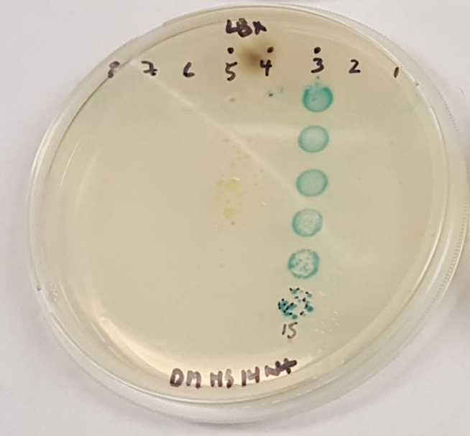
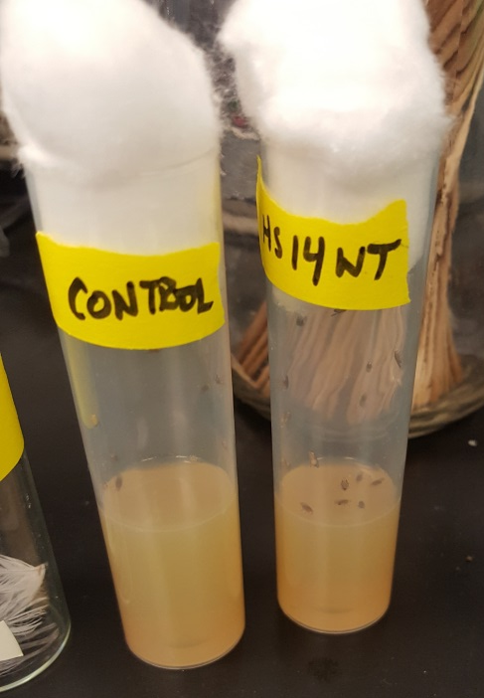
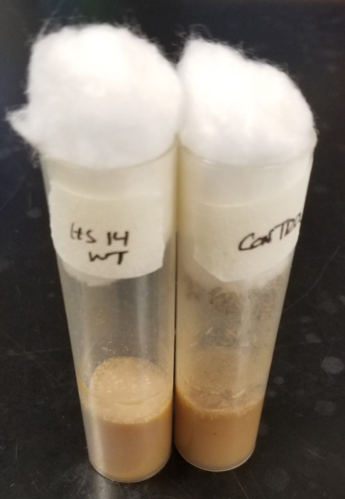
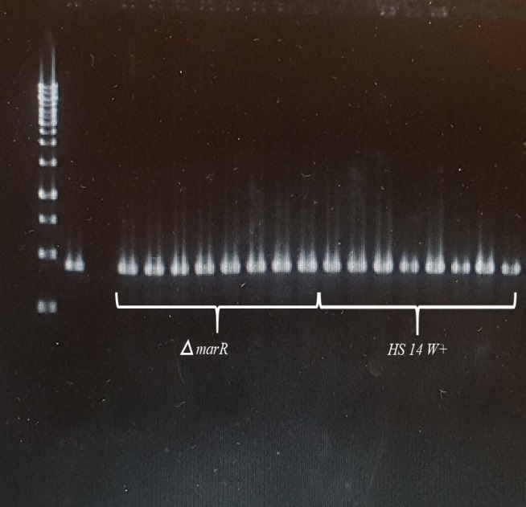
Infection via Oral Ingestion
2 Days
12 Days
2YT Agar
S. praecaptivus
D. melanogaster
Normal Yeast Media
D. melanogaster
Notes:
Infection via Oral Ingestion
This illustrates the methodology of infecting D. melanogaster with S. praecaptivus via oral ingestion.
The different strains of S. praecaptivus are grown on 2YT agar in separate vials. 2YT is a rich media agar with twice the amount of yeast extract and tryptone supplements as normally used. D. melanogaster are placed in those separate vials and allowed to ingest S. praecaptivus for 2 days.
After 2 days, the D. melanogaster are transferred to normal yeast media (fly food) with no S. praecaptivus present and allowed to eat for 12 days.
When being transferred from the 2YT agar vials to the normal yeast media vials, 20 flies from each population are separated and tested for infection. (Results not shown in this slide but in the case study, Figure 3)
At the completion of 12 days (14 days total), flies are washed in a solution of bleach water, dried, then homogenized (crushed) in 1.5 mL Eppendorf tubes with 100ul of sterile water. The aqueous solution containing their remains is further diluted on an agar plate to detect the presence of S. praecaptivus via PCR.
Figure 3 in the case study illustrates the outcome of this method.

Slide 12
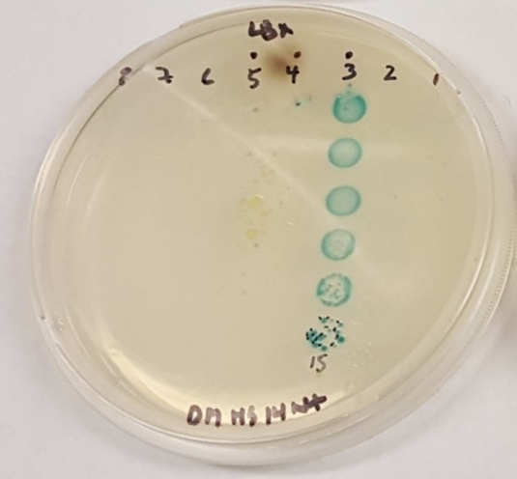
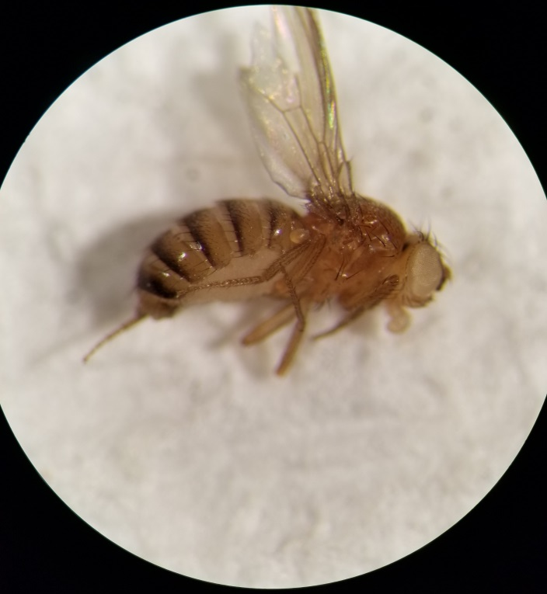

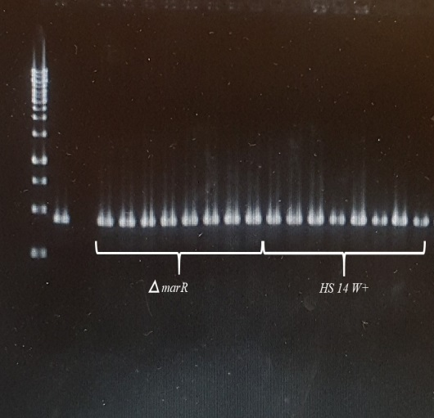
Infection via Microinjection
Immediately
14 Days
Thorax site of Microinjection
Normal Yeast Media
D. melanogaster
Injection
Ingestion
Notes:
Infection via Microinjection
This illustrates the methodology of infecting D. melanogaster with S. praecaptivus via microinjection.
Separate D. melanogaster populations (n=~45) are anesthetized and microinjected with wild-type and mutant strains of S. praecaptivus. The infected flies are then transferred immediately to vials with normal yeast media.
After 2 days, 20 flies from each population are separated and tested for infection. (Results not shown in this slide but are in the case study, Figure 4)
At the completion of 14 days, flies are washed in a solution of bleach water, dried, then homogenized (crushed) in 1.5 mL Eppendorf tubes with 100ul of sterile water. The aqueous solution containing their remains is further diluted on an agar plate to detect the presence of S. praecaptivus via PCR.
Figure 4 in the case study illustrates the outcome of this method.

