Slide 1
NATIONAL CENTER FOR CASE STUDY TEACHING IN SCIENCE
A Presentation to Accompany the Case Study:
Diagnosing and Treating Charlie’s Strange Spots
by
Joseph D.-C. Shih
Natural Sciences and Mathematics
University of Saint Mary, Leavenworth, KS
Notes:
Image credit: ©Huating | Dreamstime.com, licensed, ID 25930149.

Slide 2
Introducing Charlie
Charlie Xi
58 year-old Asian male
A week ago started to develop dark colored lesions in his inner thighs.
Weakness and fatigue in last 3 months, has gone from 170 to 155 pounds in that time.
Quit smoking 20+ years ago
Social drinker (1 – 2 with friends, used to be a heavy drinker (2 – 3 per night) until ~10 years ago; cut down due to a fatty liver (> 10% fat in liver)
Swims 5 days a week, has been doing so since he was 40. Takes 2 – 3 mile walks with wife on weekends.
Healthy son (30), wife has rheumatoid arthritis (54)
Father died of Alzheimer’s at 80, mother died of intestinal cancer at 68.
Over last 5 years has gone on annual 2 – 3 week summer cruises with wife:
In order →Japan/Taiwan, Scandinavia, Alaska, Bahamas, Greece/Turkey
Notes:
This slide is recommended for use for upper-level undergraduate courses. Alternatively the students can read handout sheet or the instructor could read the handout aloud.

Slide 3
What information could help you diagnose what is wrong with Mr. Xi? Organize the information into the following categories:
Signs (phenomena that can be detected by someone other than the patient)
Symptoms (phenomena experienced by the affected individual)
Medical history (personal and family)
Any other information
Notes:
To be presented after presentation initial presentation of case study

Slide 4
Based on the information you have categorized, create a differential diagnosis of the top three to five diseases/disorders that Mr. Xi might have. Rank them in order of likelihood, with one or two sentences justifying the likelihood for each cause.
Propose one to three diagnostic tests that could narrow the range of possible causes, with one or two sentences justifying why each test could narrow the range of possible causes.
Notes:
To be presented after question 1 has been discussed and answered.

Slide 5
Diagnostic Tests
Blood test
Hemocrit 45% (Normal 38.8% - 50%)
2,500 white-blood cells/mL (Normal 3,500 – 10,500)
Ratio of white-blood cells: Neutrophils 65%, Lymphocytes 25%, Other 10% (Normal)
Biopsy of a lesion→ Growth in cell culture → Malignant tissue
MRI reveals enlarged lymph nodes in area around skin lesion
DNA sequencing → Kaposi sarcoma
Notes:
This slide is recommended for use for upper-level undergraduate courses. Alternatively the students can read handout sheet or the instructor could read the handout aloud.

Slide 6
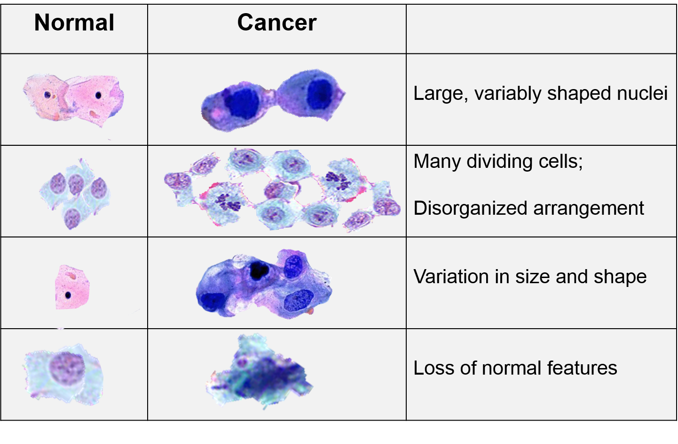
Wayne W. LaMorte, Boston University School of Public Health. ©2016. Used with permission.
Notes:
Visual examples of differences between normal and malignant (cancer) cells. The previous slide (Slide 5) mentions a biopsy of a lesion, so this slide can be used to help students visualize and differentiate between cancer and normal cells.
Image credit: created by Wayne W. LaMorte, MD, PhD, MPH, Boston University School of Public Health. ©2016. All Rights Reserved. Used with permission.
http://sphweb.bumc.bu.edu/otlt/mph-modules/ph/ph709_cancer/ph709_cancer7.html

Slide 7
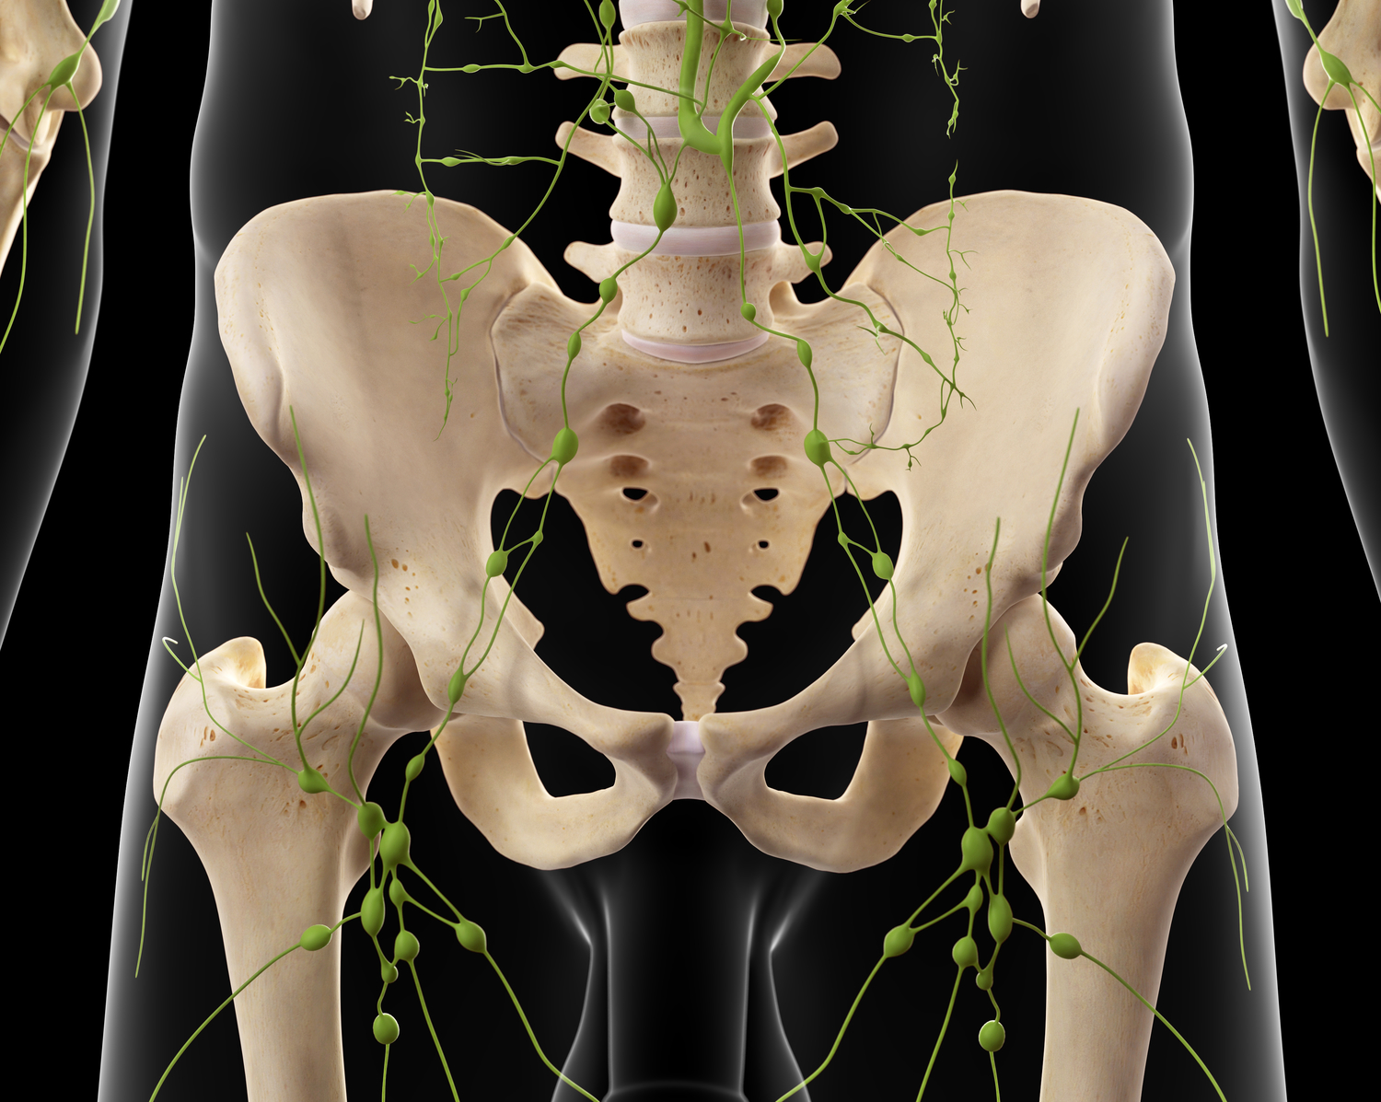
Notes:
Slide 5 mentions the MRI revealed enlarged lymph nodes in area around skin lesion. Swollen lymph nodes near malignant tumors are often a sign of metastasis, which often occurs through the blood and lymphatic systems. This slide shows the preponderance of lymph nodes in the inner thigh area and how the lymph nodes in that area are connected to the rest of the lymphatic system, enabling rapid potential metastasis.
Image credit: © Sebastian Kaulitzki | Dreamstime.com, licensed, ID 57000695.

Slide 8
Based on Mr. Xi’s diagnosis, come up with three to five treatment options, ranked in order from most to least likely to be effective, with one to three sentences justifying why each treatment would be effective. List potential risks and side effects for each of the treatment options.

Slide 9
Treatment
Test for HIV – negative.
Preventative surgery to remove enlarged lymph nodes around affected skin region.
Acute chemotherapy (every four weeks for 3 – 6 months) with liposomal doxorubicin (Doxil®)
After three months, lesions have disappeared, treatment discontinued.
Six months after last treatment, lesions reappear. Acute chemotherapy repeated, and lesions disappear after 3 months.
This cycle of treatment/recurrence repeats for five years.
After latest acute chemotherapy, preventative chemotherapy (every ten weeks permanently) prescribed.
Mr. Xi has been in remission for two years. He is currently a medical research subject at a major research university.
Notes:
This slide is recommended for use for upper-level undergraduate courses. Alternatively the students can read handout sheet or the instructor could read the handout aloud.

Slide 10
What parts of the real-life treatment for Mr. Xi do you agree and disagree with, and why? If you disagree with a particular treatment, what alternatives would you have proposed, and why?

