Slide 1
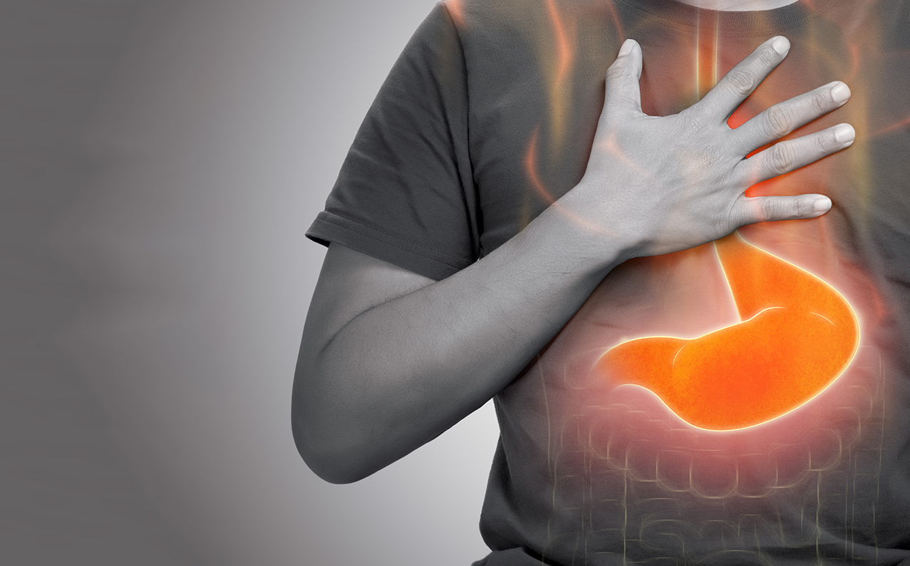
An Exploration of Stomach Acid Production
NATIONAL CENTER FOR CASE STUDY TEACHING IN SCIENCE
Images to Accompany the Case Study:
A Fiery Feeling:
by
Lacy M. Cleveland, Christine L. Savage, and Elizabeth M. Kashmitter
School of Science and Engineering
Colorado Christian University, Lakewood, CO
Notes:
Case copyright held by the National Science Teaching Association (NSTA). Originally published September 9, 2024. Please see our usage guidelines, which outline our policy concerning permissible reproduction of this work. Credit: Licensed image © Kowniewping | Dreamstime.com, ID 269563271. Images on Slides 2 and 3 by case study authors.

Slide 2
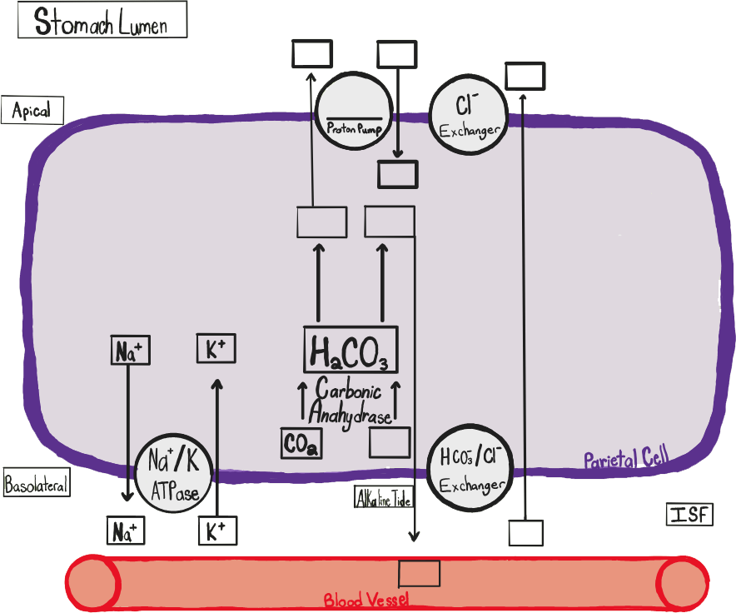

Slide 3
