Slide 1
Can Stem Cells Bring Magic to Medicine?
NATIONAL CENTER FOR CASE STUDY TEACHING IN SCIENCE
Images to Accompany the Case Study:
by
Ashleigh Garrett and Joni H. Ylostalo
Department of Biology
University of Mary Hardin-Baylor, Belton, TX
Notes:
Credit: Licensed photo ©Paul Topp | Dreamstime.com, id 34046383.

Slide 2
iPSCs
iPSCs
iPSCs
iPSCs
1
2
3
4

Slide 3
iPSCs
iPSCs
iPSCs
iPSCs
Induced Pluripotent Stem Cells or iPSCs were discovered by Yamanaka by using a differentiated cell and reverting it back to its embryonic state.
Extracting them is very easy because you could take any kind of differentiated cell and revert it back to its pluripotent state.
Yamanaka inserted 4 transcription factors: Oct ¾, Sox2, c-Myc, and Klf4 into a retrovirus. This virus makes reverse transcriptase, enabling the integration of the information into the host genome.
The efficiency of making iPSCs, however, is extremely low.
Can be autologous or allogeneic.
Induced Pluripotent Stem Cells or iPSCs were discovered by Yamanaka by using a differentiated cell and reverting it back to its embryonic state.
Extracting them is very easy because you could take any kind of differentiated cell and revert it back to its pluripotent state.
Yamanaka inserted 4 transcription factors: Oct ¾, Sox2, c-Myc, and Klf4 into a retrovirus. This virus makes reverse transcriptase, enabling the integration of the information into the host genome.
The efficiency of making iPSCs, however, is extremely low.
Can be autologous or allogeneic.
Induced Pluripotent Stem Cells or iPSCs were discovered by Yamanaka by using a differentiated cell and reverting it back to its embryonic state.
Extracting them is very easy because you could take any kind of differentiated cell and revert it back to its pluripotent state.
Yamanaka inserted 4 transcription factors: Oct ¾, Sox2, c-Myc, and Klf4 into a retrovirus. This virus makes reverse transcriptase, enabling the integration of the information into the host genome.
The efficiency of making iPSCs, however, is extremely low.
Can be autologous or allogeneic.
Induced Pluripotent Stem Cells or iPSCs were discovered by Yamanaka by using a differentiated cell and reverting it back to its embryonic state.
Extracting them is very easy because you could take any kind of differentiated cell and revert it back to its pluripotent state.
Yamanaka inserted 4 transcription factors: Oct ¾, Sox2, c-Myc, and Klf4 into a retrovirus. This virus makes reverse transcriptase, enabling the integration of the information into the host genome.
The efficiency of making iPSCs, however, is extremely low.
Can be autologous or allogeneic.

Slide 4
iPSCs
iPSCs
iPSCs
iPSCs
5
Extra if needed
Extra if needed
Extra if needed

Slide 5
iPSCs
iPSCs
iPSCs
iPSCs
Induced Pluripotent Stem Cells or iPSCs were discovered by Yamanaka by using a differentiated cell and reverting it back to its embryonic state.
Extracting them is very easy because you could take any kind of differentiated cell and revert it back to its pluripotent state.
Yamanaka inserted 4 transcription factors: Oct ¾, Sox2, c-Myc, and Klf4 into a retrovirus. This virus makes reverse transcriptase, enabling the integration of the information into the host genome.
The efficiency of making iPSCs, however, is extremely low.
Can be autologous or allogeneic.
Induced Pluripotent Stem Cells or iPSCs were discovered by Yamanaka by using a differentiated cell and reverting it back to its embryonic state.
Extracting them is very easy because you could take any kind of differentiated cell and revert it back to its pluripotent state.
Yamanaka inserted 4 transcription factors: Oct ¾, Sox2, c-Myc, and Klf4 into a retrovirus. This virus makes reverse transcriptase, enabling the integration of the information into the host genome.
The efficiency of making iPSCs, however, is extremely low.
Can be autologous or allogeneic.
Induced Pluripotent Stem Cells or iPSCs were discovered by Yamanaka by using a differentiated cell and reverting it back to its embryonic state.
Extracting them is very easy because you could take any kind of differentiated cell and revert it back to its pluripotent state.
Yamanaka inserted 4 transcription factors: Oct ¾, Sox2, c-Myc, and Klf4 into a retrovirus. This virus makes reverse transcriptase, enabling the integration of the information into the host genome.
The efficiency of making iPSCs, however, is extremely low.
Can be autologous or allogeneic.
Induced Pluripotent Stem Cells or iPSCs were discovered by Yamanaka by using a differentiated cell and reverting it back to its embryonic state.
Extracting them is very easy because you could take any kind of differentiated cell and revert it back to its pluripotent state.
Yamanaka inserted 4 transcription factors: Oct ¾, Sox2, c-Myc, and Klf4 into a retrovirus. This virus makes reverse transcriptase, enabling the integration of the information into the host genome.
The efficiency of making iPSCs, however, is extremely low.
Can be autologous or allogeneic.

Slide 6
ESCs
ESCs
ESCs
ESCs
1
2
3
4

Slide 7
ESCs
ESCs
ESCs
ESCs
Embryonic Stem Cells or ESCs can be derived from the inner cell mass (ICM) of the blastocyst stage embryo.
These cells are pluripotent.
In extracting them, one must inject a needle into the blastocyst to suck up the cells. However, the embryo dies in the process.
These stem cells are hard to obtain due to ethical issues.
Can only be allogeneic.
Embryonic Stem Cells or ESCs can be derived from the inner cell mass (ICM) of the blastocyst stage embryo.
These cells are pluripotent.
In extracting them, one must inject a needle into the blastocyst to suck up the cells. However, the embryo dies in the process.
These stem cells are hard to obtain due to ethical issues.
Can only be allogeneic.
Embryonic Stem Cells or ESCs can be derived from the inner cell mass (ICM) of the blastocyst stage embryo.
These cells are pluripotent.
In extracting them, one must inject a needle into the blastocyst to suck up the cells. However, the embryo dies in the process.
These stem cells are hard to obtain due to ethical issues.
Can only be allogeneic.
Embryonic Stem Cells or ESCs can be derived from the inner cell mass (ICM) of the blastocyst stage embryo.
These cells are pluripotent.
In extracting them, one must inject a needle into the blastocyst to suck up the cells. However, the embryo dies in the process.
These stem cells are hard to obtain due to ethical issues.
Can only be allogeneic.

Slide 8
ESCs
ESCs
ESCs
ESCs
5
Extra if needed
Extra if needed
Extra if needed

Slide 9
ESCs
ESCs
ESCs
ESCs
Embryonic Stem Cells or ESCs can be derived from the inner cell mass (ICM) of the blastocyst stage embryo.
These cells are pluripotent.
In extracting them, one must inject a needle into the blastocyst to suck up the cells. However, the embryo dies in the process.
These stem cells are hard to obtain due to ethical issues.
Can only be allogeneic.
Embryonic Stem Cells or ESCs can be derived from the inner cell mass (ICM) of the blastocyst stage embryo.
These cells are pluripotent.
In extracting them, one must inject a needle into the blastocyst to suck up the cells. However, the embryo dies in the process.
These stem cells are hard to obtain due to ethical issues.
Can only be allogeneic.
Embryonic Stem Cells or ESCs can be derived from the inner cell mass (ICM) of the blastocyst stage embryo.
These cells are pluripotent.
In extracting them, one must inject a needle into the blastocyst to suck up the cells. However, the embryo dies in the process.
These stem cells are hard to obtain due to ethical issues.
Can only be allogeneic.
Embryonic Stem Cells or ESCs can be derived from the inner cell mass (ICM) of the blastocyst stage embryo.
These cells are pluripotent.
In extracting them, one must inject a needle into the blastocyst to suck up the cells. However, the embryo dies in the process.
These stem cells are hard to obtain due to ethical issues.
Can only be allogeneic.

Slide 10
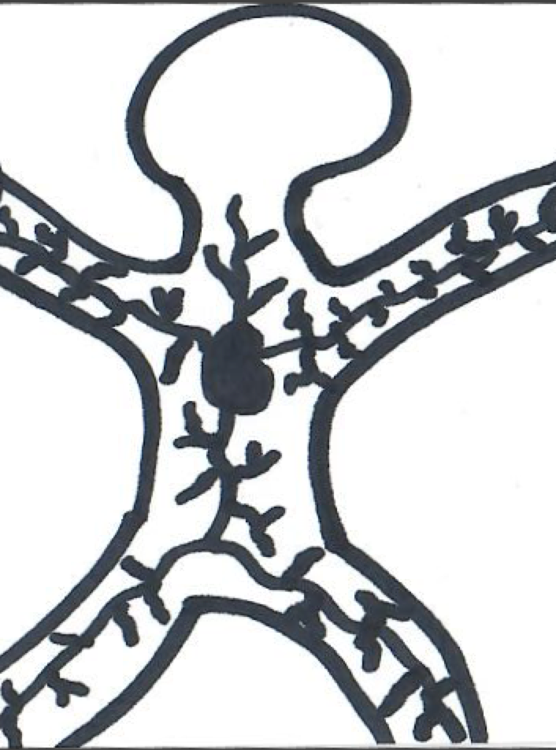
HSCs
HSCs
HSCs
HSCs
1
2
3
4

Slide 11
HSCs
HSCs
HSCs
HSCs
Hematopoietic Stem Cells or HSCs are found in the bone marrow, especially in the sternum, pelvis, and femur, but also in the umbilical cord.
These cells are multipotent.
Generate blood cells.
Extracting them is not too difficult, you just need to inject a needle into any of these places. Some people are paid to donate bone marrow.
Relatively easy to obtain.
Can be autologous or allogeneic.
Hematopoietic Stem Cells or HSCs are found in the bone marrow, especially in the sternum, pelvis, and femur, but also in the umbilical cord.
These cells are multipotent.
Generate blood cells.
Extracting them is not too difficult, you just need to inject a needle to any of these places. Some people are paid to donate bone marrow.
Relatively easy to obtain.
Can be autologous or allogeneic.
Hematopoietic Stem Cells or HSCs are found in the bone marrow, especially in the sternum, pelvis, and femur, but also in the umbilical cord.
These cells are multipotent.
Generate blood cells.
Extracting them is not too difficult, you just need to inject a needle to any of these places. Some people are paid to donate bone marrow.
Relatively easy to obtain.
Can be autologous or allogeneic.
Hematopoietic Stem Cells or HSCs are found in the bone marrow, especially in the sternum, pelvis, and femur, but also in the umbilical cord.
These cells are multipotent.
Generate blood cells.
Extracting them is not too difficult, you just need to inject a needle to any of these places. Some people are paid to donate bone marrow.
Relatively easy to obtain.
Can be autologous or allogeneic.

Slide 12
HSCs
HSCs
HSCs
HSCs
1
Extra if needed
Extra if needed
Extra if needed

Slide 13
HSCs
HSCs
HSCs
HSCs
Hematopoietic Stem Cells or HSCs are found in the bone marrow, especially in the sternum, pelvis, and femur, but also in the umbilical cord.
These cells are multipotent.
Generate blood cells.
Extracting them is not too difficult, you just need to inject a needle into any of these places. Some people are paid to donate bone marrow.
Relatively easy to obtain.
Can be autologous or allogeneic.
Hematopoietic Stem Cells or HSCs are found in the bone marrow, especially in the sternum, pelvis, and femur, but also in the umbilical cord.
These cells are multipotent.
Generate blood cells.
Extracting them is not too difficult, you just need to inject a needle to any of these places. Some people are paid to donate bone marrow.
Relatively easy to obtain.
Can be autologous or allogeneic.
Hematopoietic Stem Cells or HSCs are found in the bone marrow, especially in the sternum, pelvis, and femur, but also in the umbilical cord.
These cells are multipotent.
Generate blood cells.
Extracting them is not too difficult, you just need to inject a needle to any of these places. Some people are paid to donate bone marrow.
Relatively easy to obtain.
Can be autologous or allogeneic.
Hematopoietic Stem Cells or HSCs are found in the bone marrow, especially in the sternum, pelvis, and femur, but also in the umbilical cord.
These cells are multipotent.
Generate blood cells.
Extracting them is not too difficult, you just need to inject a needle to any of these places. Some people are paid to donate bone marrow.
Relatively easy to obtain.
Can be autologous or allogeneic.

Slide 14
MSCs
MSCs
MSCs
MSCs
1
2
3
4

Slide 15
MSCs
MSCs
MSCs
MSCs
Mesenchymal Stem Cells or MSCs .
These cells are multipotent.
Differentiate into bone, fat, cartilage, muscle, and perhaps neural cells.
To extract them, one can find them in bone marrow, umbilical cord blood, and Wharton's jelly.
Have immunomodulatory effects, meaning they can either suppress or enhance the immune system.
Fairly easy to obtain, but are not the easiest.
Can be autologous or allogenic.
Mesenchymal Stem Cells or MSCs.
These cells are multipotent.
Differentiate into bone, fat, cartilage, muscle, and perhaps neural cells.
To extract them, one can find them in bone marrow, umbilical cord blood, and Wharton's jelly.
Have immunomodulatory effects, meaning they can either suppress or enhance the immune system.
Fairly easy to obtain, but are not the easiest.
Can be autologous or allogenic.
Mesenchymal Stem Cells or MSCs.
These cells are multipotent.
Differentiate into bone, fat, cartilage, muscle, and perhaps neural cells.
To extract them, one can find them in bone marrow, umbilical cord blood, and Wharton's jelly.
Have immunomodulatory effects, meaning they can either suppress or enhance the immune system.
Fairly easy to obtain, but are not the easiest.
Can be autologous or allogenic.
Mesenchymal Stem Cells or MSCs.
These cells are multipotent.
Differentiate into bone, fat, cartilage, muscle, and perhaps neural cells.
To extract them, one can find them in bone marrow, umbilical cord blood, and Wharton's jelly.
Have immunomodulatory effects, meaning they can either suppress or enhance the immune system.
Fairly easy to obtain, but are not the easiest.
Can be autologous or allogenic.

Slide 16
MSCs
MSCs
MSCs
MSCs
5
Extra if needed
Extra if needed
Extra if needed

Slide 17
MSCs
MSCs
MSCs
MSCs
Mesenchymal Stem Cells or MSCs.
These cells are multipotent.
Differentiate into bone, fat, cartilage, muscle, and perhaps neural cells.
To extract them, one can find them in bone marrow, umbilical cord blood, and Wharton's jelly.
Have immunomodulatory effects, meaning they can either suppress or enhance the immune system.
Fairly easy to obtain, but are not the easiest.
Can be autologous or allogenic.
Mesenchymal Stem Cells or MSCs.
These cells are multipotent.
Differentiate into bone, fat, cartilage, muscle, and perhaps neural cells.
To extract them, one can find them in bone marrow, umbilical cord blood, and Wharton's jelly.
Have immunomodulatory effects, meaning they can either suppress or enhance the immune system.
Fairly easy to obtain, but are not the easiest.
Can be autologous or allogenic.
Mesenchymal Stem Cells or MSCs.
These cells are multipotent.
Differentiate into bone, fat, cartilage, muscle, and perhaps neural cells.
To extract them, one can find them in bone marrow, umbilical cord blood, and Wharton's jelly.
Have immunomodulatory effects, meaning they can either suppress or enhance the immune system.
Fairly easy to obtain, but are not the easiest.
Can be autologous or allogenic.
Mesenchymal Stem Cells or MSCs.
These cells are multipotent.
Differentiate into bone, fat, cartilage, muscle, and perhaps neural cells.
To extract them, one can find them in bone marrow, umbilical cord blood, and Wharton's jelly.
Have immunomodulatory effects, meaning they can either suppress or enhance the immune system.
Fairly easy to obtain, but are not the easiest.
Can be autologous or allogenic.

Slide 18
ADSCs
ADSCs
ADSCs
ADSCs
1
2
3
4

Slide 19
ADSCs
ADSCs
ADSCs
ADSCs
Adipose-Derived Stem Cells or ADSC.
These cells are multipotent.
Can generate fat, bone, cartilage, and muscle.
Have immunomodulatory effects, either suppressing or activating immune responses.
Can be extracted from adipose tissue in the body.
The most easily accessible.
Can be autologous or allogenic.
Adipose-Derived Stem Cells or ADSC.
These cells are multipotent.
Can generate fat, bone, cartilage, and muscle.
Have immunomodulatory effects, either suppressing or activating immune responses.
Can be extracted from adipose tissue in the body.
The most easily accessible.
Can be autologous or allogenic.
Adipose-Derived Stem Cells or ADSC.
These cells are multipotent.
Can generate fat, bone, cartilage, and muscle.
Have immunomodulatory effects, either suppressing or activating immune responses.
Can be extracted from adipose tissue in the body.
The most easily accessible.
Can be autologous or allogenic.
Adipose-Derived Stem Cells or ADSC.
These cells are multipotent.
Can generate fat, bone, cartilage, and muscle.
Have immunomodulatory effects, either suppressing or activating immune responses.
Can be extracted from adipose tissue in the body.
The most easily accessible.
Can be autologous or allogenic.

Slide 20
ADSCs
ADSCs
ADSCs
ADSCs
5
Extra if needed
Extra if needed
Extra if needed

Slide 21
ADSCs
ADSCs
ADSCs
ADSCs
Adipose-Derived Stem Cells or ADSC.
These cells are multipotent.
Can generate fat, bone, cartilage, and muscle.
Have immunomodulatory effects, either suppressing or activating immune responses.
Can be extracted from adipose tissue in the body.
The most easily accessible.
Can be autologous or allogenic.
Adipose-Derived Stem Cells or ADSC.
These cells are multipotent.
Can generate fat, bone, cartilage, and muscle.
Have immunomodulatory effects, either suppressing or activating immune responses.
Can be extracted from adipose tissue in the body.
The most easily accessible.
Can be autologous or allogenic.
Adipose-Derived Stem Cells or ADSC.
These cells are multipotent.
Can generate fat, bone, cartilage, and muscle.
Have immunomodulatory effects, either suppressing or activating immune responses.
Can be extracted from adipose tissue in the body.
The most easily accessible.
Can be autologous or allogenic.
Adipose-Derived Stem Cells or ADSC.
These cells are multipotent.
Can generate fat, bone, cartilage, and muscle.
Have immunomodulatory effects, either suppressing or activating immune responses.
Can be extracted from adipose tissue in the body.
The most easily accessible.
Can be autologous or allogenic.

