Slide 1
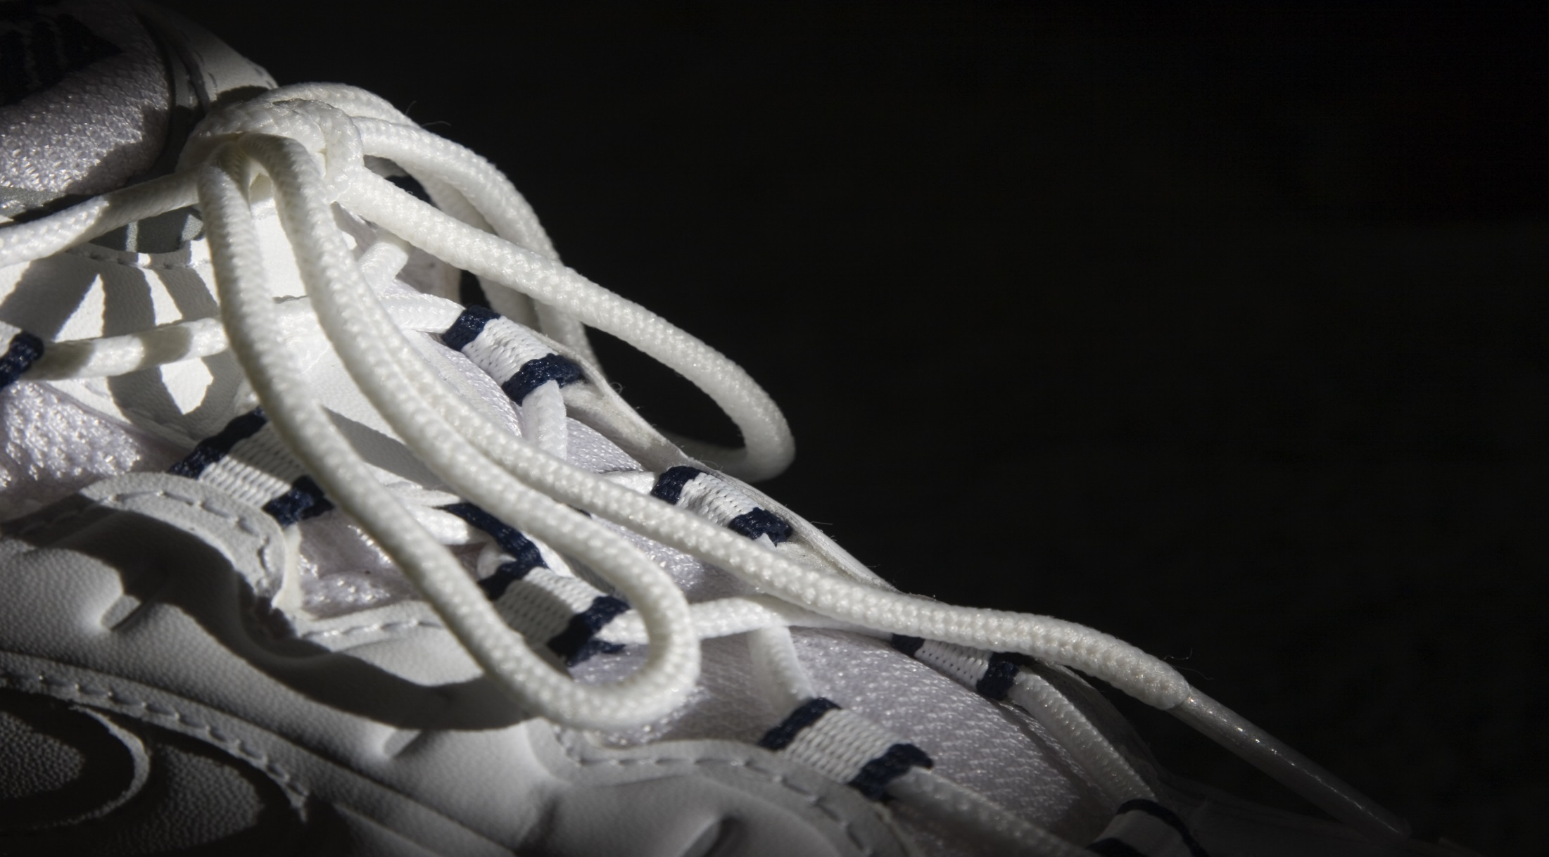
NATIONAL CENTER FOR CASE STUDY TEACHING IN SCIENCE
Slides to Accompany the Case Study:
^{I Almost Missed the Marathon}
Self-determination, Injury, and Sport Termination
^{by}
Andrew T. Johnson and Anna M. Jähn Department of Psychology and Sociology ^{Park University, Parkville, MO}
Notes:
Licensed image © Wally Stemberger | Dreamstime, ID 754910.

Slide 2
Self-impressions
Stress appraisal
Interpretations
Attributions
Self-perceptions
Optimistic or pessimistic beliefs
Anxiety, fear
Tension, burnout
Guilt, sadness
Frustration
Depression, grief
Vitality, boredom
Cognition
Interpretations
Appraisals
Beliefs
Affect
Emotions
Feelings
Mood
Integrated Sport Injury Model (Wiese-Bjornstal, 2010)
Outcome
Consequences
Effects
Results
Behavior
Activities
Actions
Efforts
Recovery
Healing
Relapse, injury
Return to training or play
Sport termination
Career transition
Addictions
Risky behavior
Substance use
Suicide, coping
Adherence or compliance
Social connection
Notes:
Wiese-Bjornstal, D.M. 2010. Psychology and socioculture affect injury risk, response, and recovery in high-intensity athletes: A consensus statement. Scandinavian Journal of Medicine and Science in Sports 20(2): 103–111. doi: 10.1111/j.1600-0838.2010.01195.x.

Slide 3
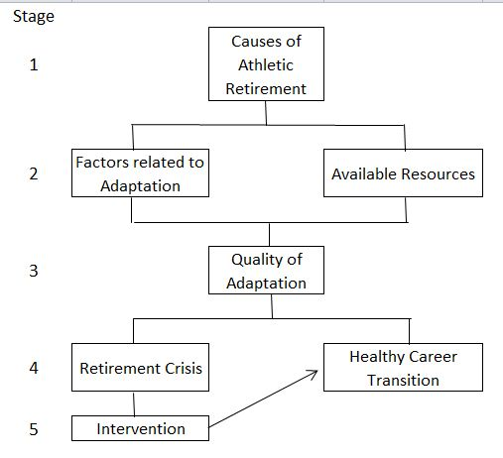
The Conceptual Model of Career Termination (Taylor and Ogilvie, 1994).
Notes:
Taylor, J., & B.C. Ogilvie. 1994. A conceptual model of adaptation to retirement among athletes. Journal of Applied Sport Psychology 6: 1–20.

