Slide 1
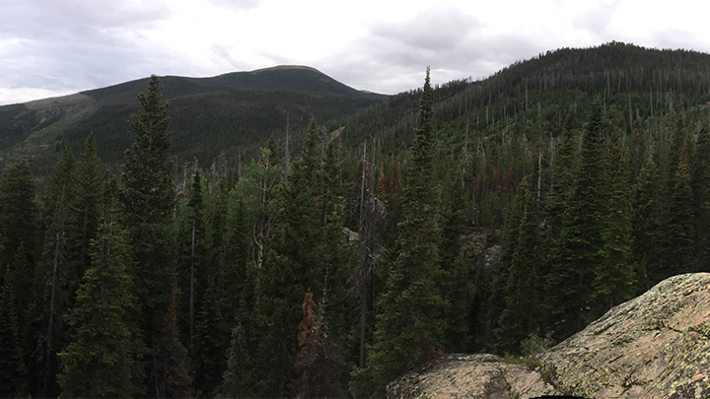
Boreal Forest Dynamics at the Hardwood Ecotone: Shade Tolerance and Functional Niche Differentiation
NATIONAL CENTER FOR CASE STUDY TEACHING IN SCIENCE
by
Charles J.W. Carroll and Miranda D. Redmond
Department of Forest and Rangeland Stewardship
Colorado State University, Fort Collins, CO
Notes:
Image credit: Author

Slide 2
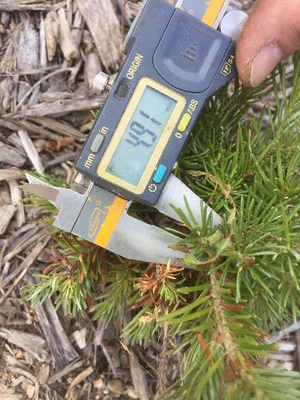
Summary of Content
Life history strategies
Niche analysis using functional traits
Ecotone shifts in future species performance
Hypothesis generation
Data interpretation
Study design
Skills to Enhance
Trait collection in action!
Notes:
Image credit: Author

Slide 3
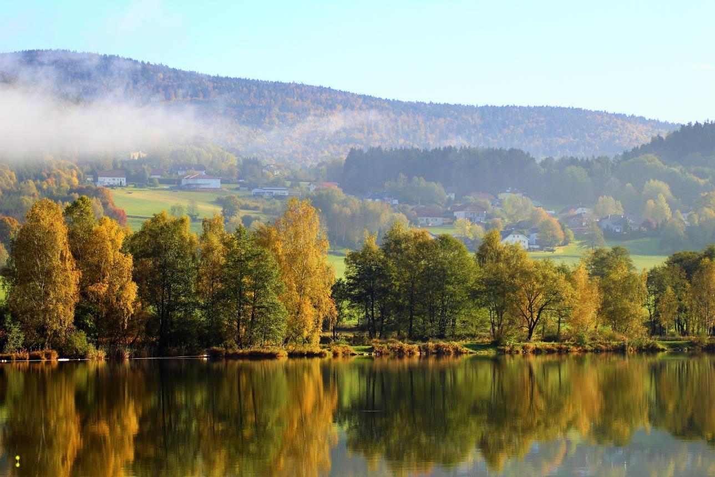
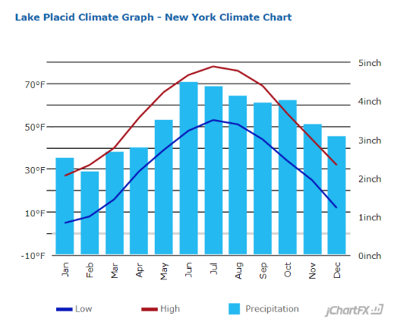
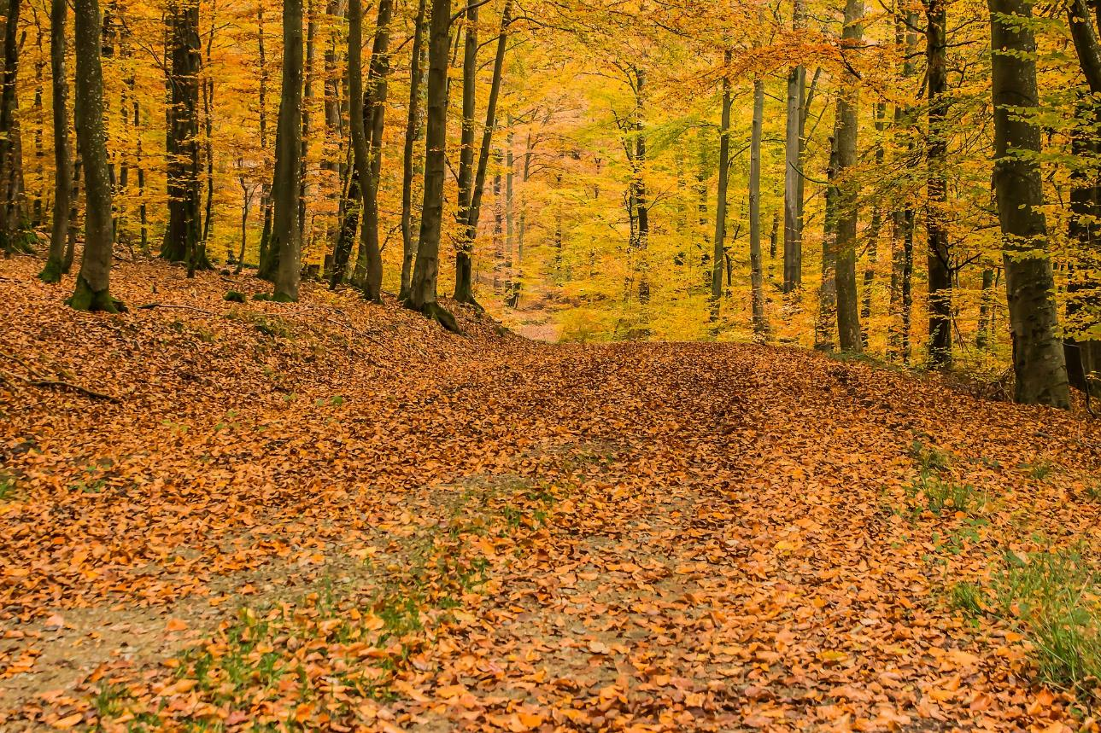
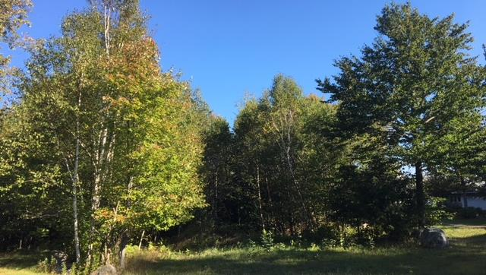
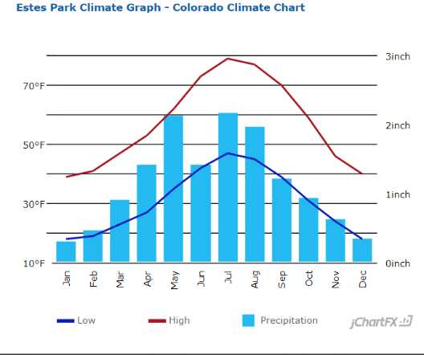
Notes:
Credit: https://pixabay.com/photos/deciduous-forest-beech-wood-trees-1798857/ (Free for commercial use, no attribution required.)

Slide 4
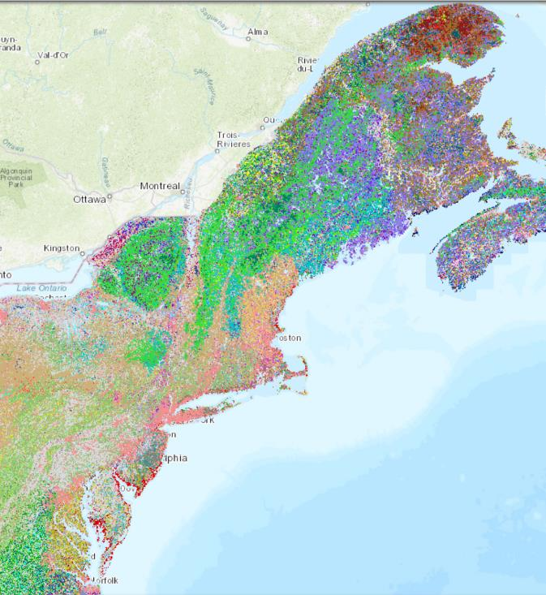
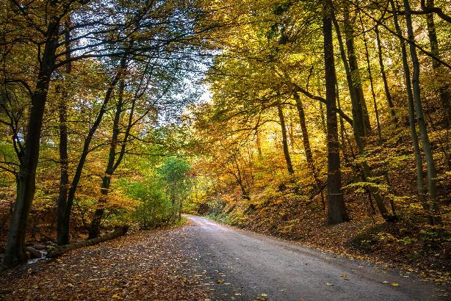
Map created by John Prince
Many land types
+ dozens of species
= many ecotones
Notes:
Credit: https://pixabay.com/photos/forest-fall-foliage-forest-path-2942592/
(Free for commercial use, no attribution required.)

Slide 5
CQ1 (clicker question): In which direction do we expect ecotones to shift as the climate warms?
East-west
Poleward/upslope
Towards equator/downslope
A and C
Notes:
Credit: https://pixabay.com/photos/deciduous-forest-beech-wood-trees-1798857/ (Free for commercial use, no attribution required.)

Slide 6
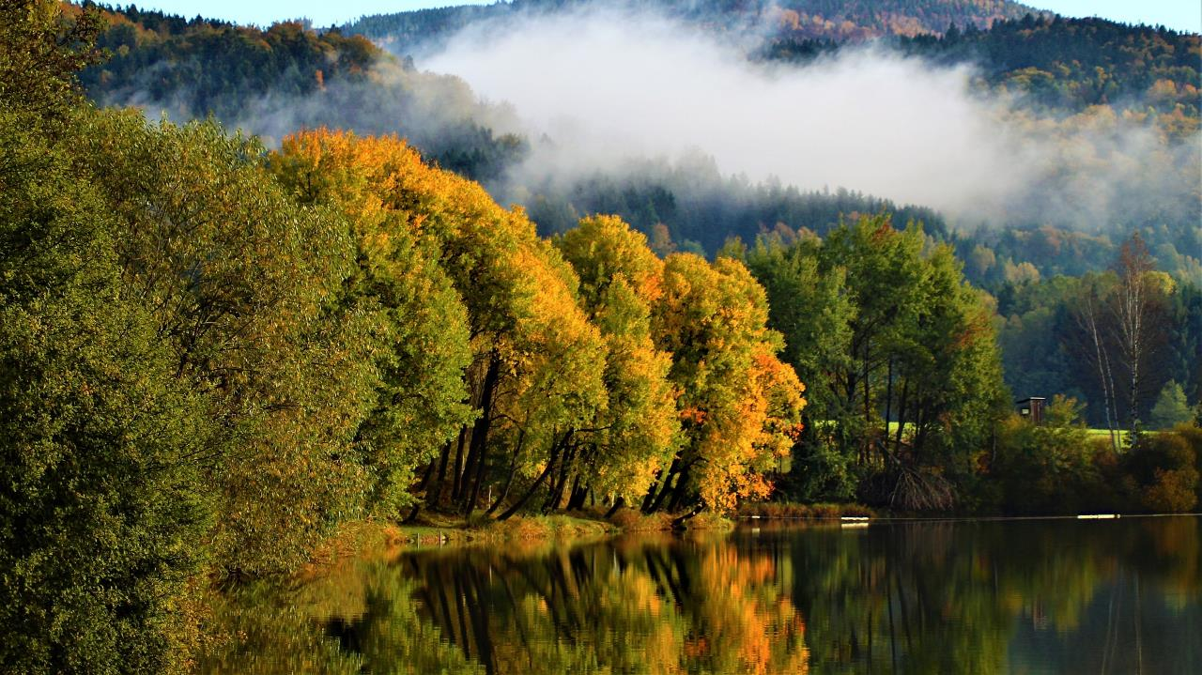
Future Implications
Based on the previous question, how do you expect boreal species will respond?
Notes:
Credit: https://pixabay.com/photos/klaffer-autumn-tree-2834636/
(Free for commercial use, no attribution required.)

Slide 7
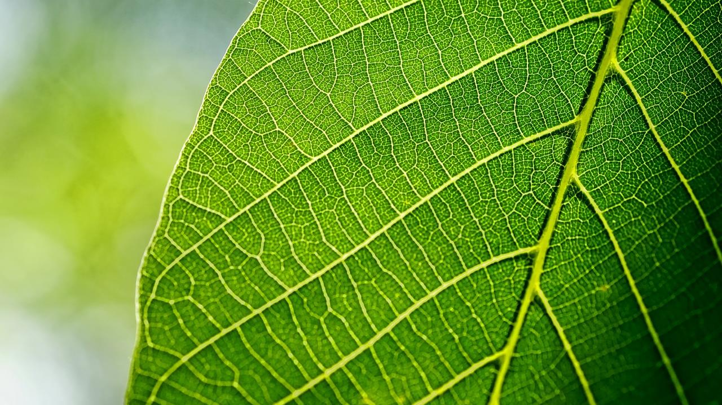
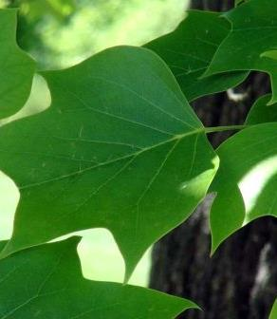
So what is a trait?
“Any morphological, physiological or phenological feature measurable at the individual level, from the cell to the whole‐organism level, without reference to the environment or any other level of organization”
—Violle et al., 2007

Slide 8
Traits Make Life History Strategies
A collection of traits are associated with general patterns of behavior we call life history strategies
Bark thickness
Canopy pruning
Serotiny
Fire Tolerance

Slide 9
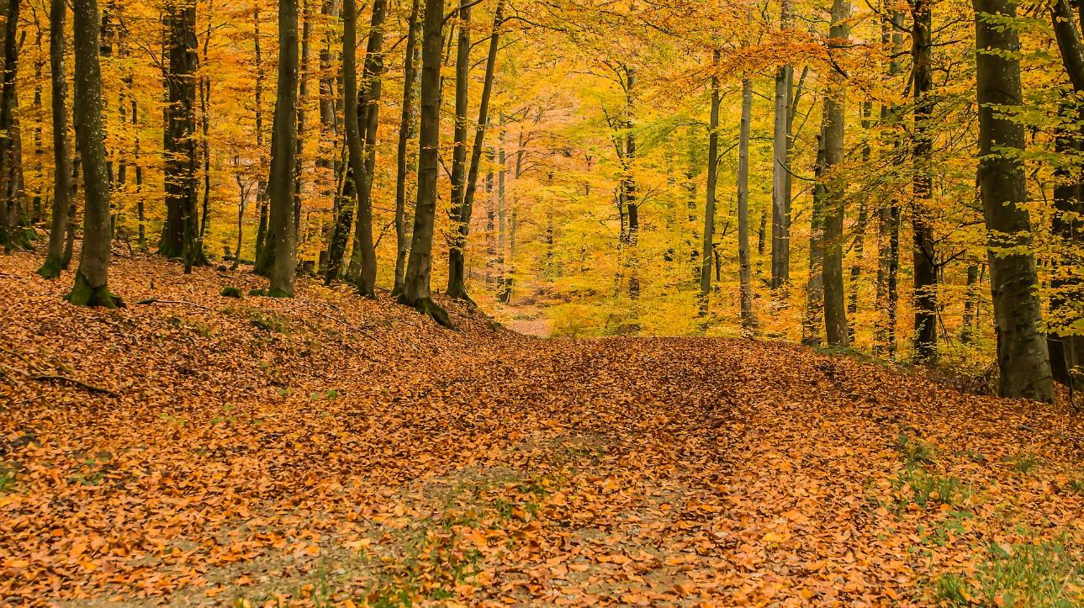
HQ1 (handout question): Which life history strategy(ies) would help trees survive understory conditions in an undisturbed forest?
Notes:
Credit: https://pixabay.com/photos/deciduous-forest-beech-wood-trees-1798857/ (Free for commercial use, no attribution required.)

Slide 10
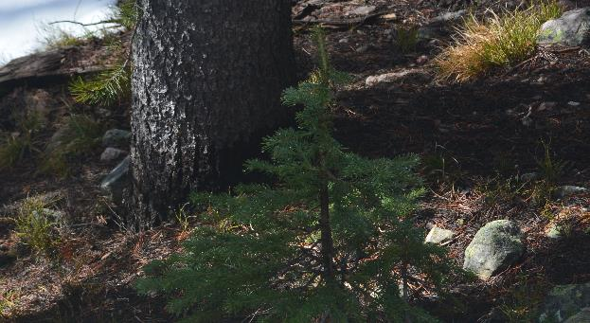
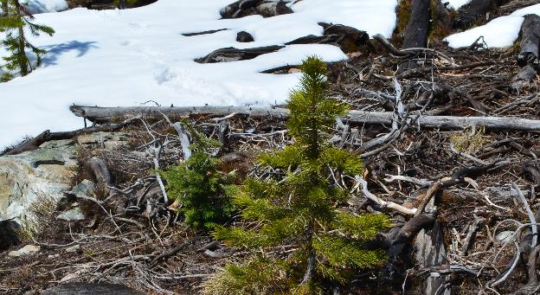
Shade
Tolerance
Notes:
Credit: Author

Slide 11
What can trees do to tolerate shady conditions?
What is net growth?

Slide 12
Leaf Mass Per Area
Leaf Dry Matter Content
Structural components of the leaf
e.g., ground tissue
$$LDMC=\frac{Dry Weight}{Fresh Weight}$$
High LMA
Wood Density
$$Density = \frac{mass}{volume}$$
Low LMA

Slide 13
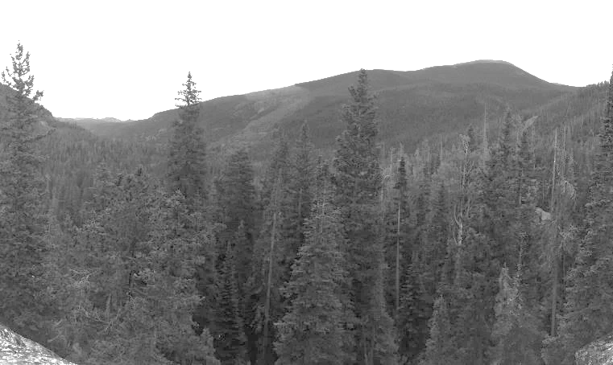
HQ2:
?
What do you predict a tree’s response to shade would be in terms of: a) LMA density,
b) LDMC, and c) wood density
Trait
High light
Low light
Notes:
Credit: Author

Slide 14
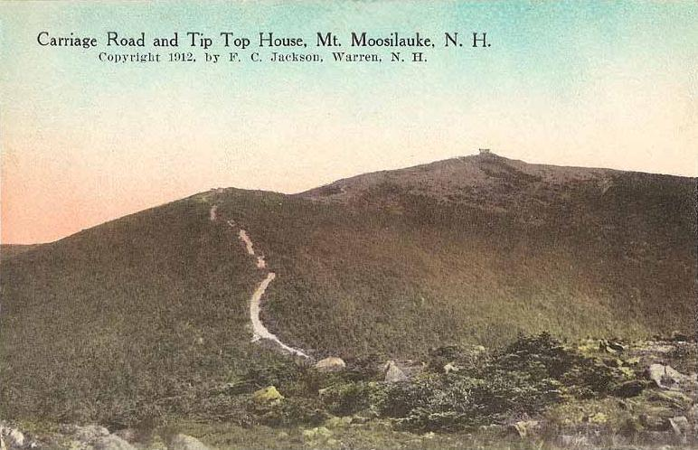
Mt. Moosilauke, NH

Slide 15
Red spruce (Picea rubens) and balsam fir (Abies balsamea)
Ecotone: boreal spruce/fir and northern hardwoods
Notes:
Credit: https://pixabay.com/photos/mountain-autumn-forest-fir-forest-62609/
(Free for commercial use, no attribution required.)

Slide 16
Ecotone

Slide 17
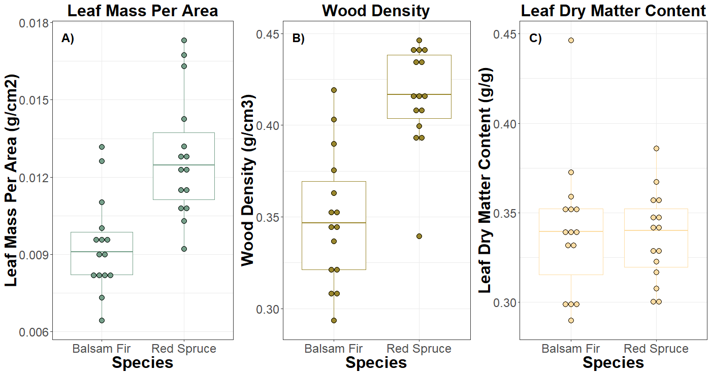

Slide 18
CQ2: Based on LMA which species appears to be more shade tolerant?
Balsam fir
Red spruce
Both

Slide 19
Balsam fir
Red spruce
Both
CQ3:
Based on wood density which of these species appears to be more shade tolerant?

Slide 20
CQ4: Based on LDMC which species appears to be more shade tolerant?
Red spruce
Balsam fir
Both

Slide 21
None of the traits agree – let’s think big picture
What is an ecological niche?

Slide 22
Resources
Functional Traits
Compare and contrast
resources vs.
functional traits
Soil Type
Nutrients
LMA
LDMC
Light availability
Wood Density

Slide 23
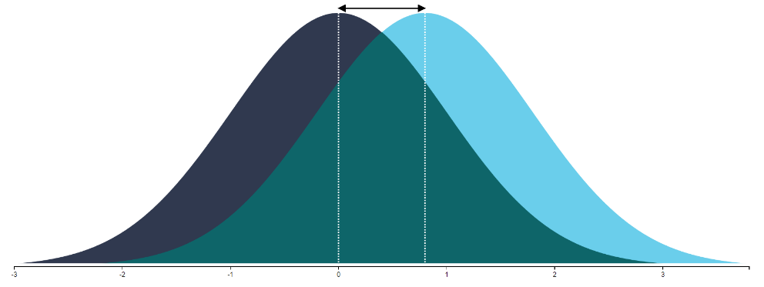
Combine all traits to realize the niche
Distribution of
balsam fir
traits
Distribution of
red spruce
traits
Trait overlap
Notes:
Credit: Image created with web app authored by K. Magnusson, R Psychologist, <https://rpsychologist.com/d3/cohend/>.

Slide 24
How might niche diversity impact competition among similar species?
Notes:
Credit: https://pixabay.com/photos/klaffer-autumn-tree-2834636/
(Free for commercial use, no attribution required.)

Slide 25
Sampled a second population
from the boreal forest upslope

Slide 26
Boreal upslope population
Ecotone population

Slide 27
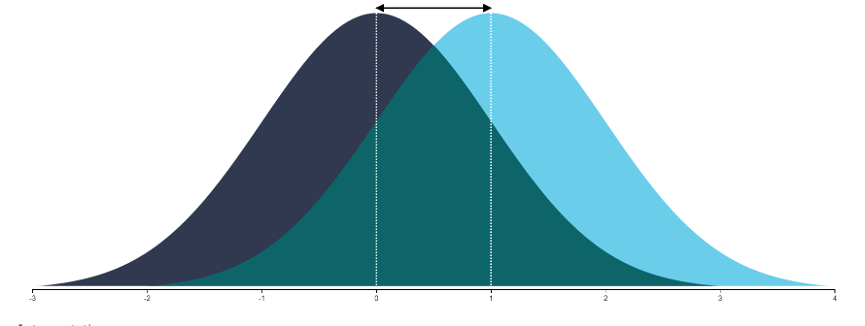
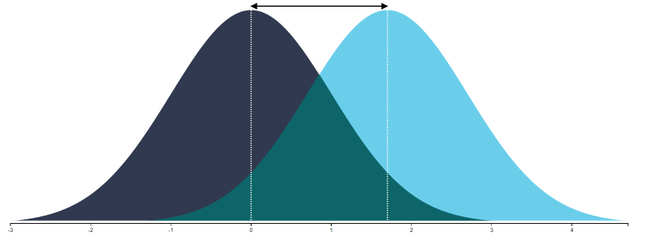
Boreal
niche overlap
= 0.6
Why is niche overlap
higher in the upslope population?
Ecotone
niche overlap
= 0.4

Slide 28
Overstory
niche overlap
= 0.6
HQ4: Based on these results, how do you expect the interactions of these two boreal
species to shift in the future at this ecotone?
Understory
niche overlap
= 0.4
HQ5: How confident do you feel about this?

Slide 29
Overstory
niche overlap
= 0.6
HQ6: What are two limitations
(and potential solutions) of this study?
Understory
niche overlap
= 0.4

Slide 30
Summary
Functional traits are helpful in understanding species’ life history strategies
But focusing on one trait does not always tell the whole story
Increased niche divergence predicts competition to decline between these species with climate change
Notes:
Credit: https://pixabay.com/photos/klaffer-autumn-tree-2834636/
(Free for commercial use, no attribution required.)

Slide 31
References
Landuse graph accessed using databasin.org Sept 2018. Terrestrial Habitat Map for the Northeast US and Atlantic Canada. http://nature.ly/NEhabitat
Magnusson, K. 2020. Interpreting Cohen's d effect size: An interactive visualization (Version 2.3.0) [Web App]. R Psychologist. https://rpsychologist.com/d3/cohend/
Niklaus, P.A., Baruffol, M., He, J., Ma, K., and Schmid, B. 2017. Can niche plasticity promote biodiversity-productivity relationships through increased complementarity? Ecology 98(4): 1104-1116.
Silvertown, J. 2004. Plant coexistence and the niche. Trends in Ecology & Evolution. 19(11): 605-611.
Schreyer, M., Trutschnig, W., Junker, R.R., Kuppler, J., Bathke, A. 2018. R package ‘dynRB’.
Voille, C., Navas, M.L., Vile, D., Kazakou, E., Fortunel, C., Hummel, I., and Garnier, E. 2007. Let the concept of trait be functional!. Oikos 116(5):882-892.
Weather graphs from usclimatedata.com accessed Sept. 2018.
Notes:
Credit: https://pixabay.com/photos/klaffer-autumn-tree-2834636/
(Free for commercial use, no attribution required.)

