Slide 1
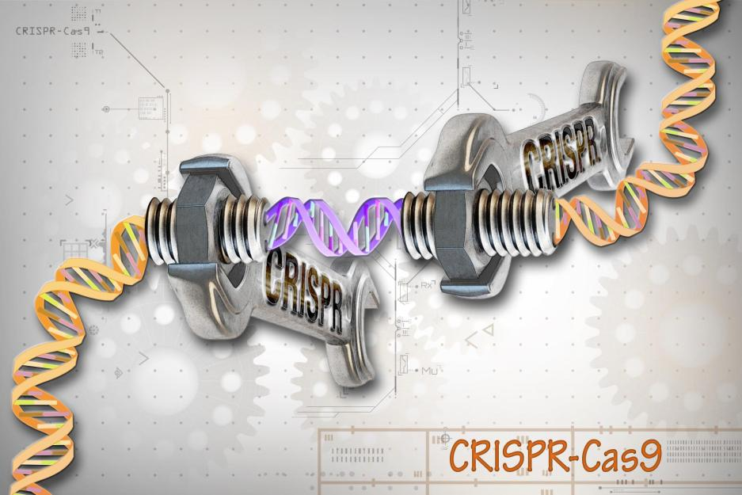
NATIONAL CENTER FOR CASE STUDY TEACHING IN SCIENCE
A Presentation to Accompany the Case Study:
Seq’ing The Cure: Standard Edition (Day 1)
High-Throughput Discovery!
CRISPR/Cas Genome Engineering,
Next Generation Sequencing,
and
Neurological Disease
^{by}
Heather B. Miller, Sabrina D. Robertson, and Melissa C. Srougi
Notes:
Image Source: Wikimedia commons
Description: “CRISPR-Cas9 Editing of the Genome (26453307604).jpg”
Author: National Human Genome Research Institute (NHGRI) from Bethesda, MD, USA
Source: https://commons.wikimedia.org/w/index.php?curid=52360100
Clearance: By - CRISPR-Cas9 Editing of the Genome, CC BY 2.0,

Slide 2
Part I – A Typical Day in the Clinic
While she waited for her patient samples, Amy reminisced about her college days and the time she received a surprise package from her parents. She fondly recalled tearing open the package with such anticipation, but being disappointed to find a plain brown box labeled “CRISPR DIY kit” attached with a note from Mom and Dad. “Have fun, my budding medical doctor!” What a letdown.
Oh, how she missed those carefree days back at Life Skills University as she reflected on the one gift that changed the trajectory of her life. Who knew that tinkering with a DIY science kit would one day lead her to become a budding expert in neurological genetic engineering?
Since graduating, Amy had obtained a coveted residency position at a prestigious medical school in the Department of Neurology and Neurological Sciences. Her advanced training was to begin that evening as she covered the last shift in the neurological disorders unit.
Buuuuzzz.... “Dr. Amy Li, you are requested for an emergency neuro consult.” Amy rushed down the hallway to meet a patient who had been brought to the ER a few minutes ago by his friend. The patient presented with blurred vision, slurred speech, uncontrollable laughing, difficulty swallowing and trouble walking. He reeked of alcohol. Since the attending physician, Dwayne, had run into the patient at a bar earlier that evening, he had assumed the patient was drunk and had ordered a blood alcohol test.
Triage Nurse Report:
Patient Description:
Gael R. Moreno
41 years old, Hispanic male
Patient transported from a bar to the ER after inability to communicate
Symptoms:
Blurred vision, slurred speech, uncontrollable laughing, trouble walking, difficulty swallowing
List of tests:
blood alcohol (0.01%)
Since the patient’s speech was still unclear, Amy asked to talk to Gael’s friend. He explained that Gael started complaining of blurred vision months ago. He also recalled a time they were playing basketball and could not control his running.
In fact, he recalled Gael complaining about a progressive deterioration in his basketball game and a feeling that he could not control his hands or feet like he used to when they had played basketball together years ago in the military.
Question
Given Gael’s symptoms, blood alcohol level, and history described by his friend, what neurological disorders may be at play here? Please explain your reasoning.
4 minutes
Notes:
LO: Analyze clinical data
LO: Discuss symptoms that can be shared by a variety of neurological disorders

Slide 3
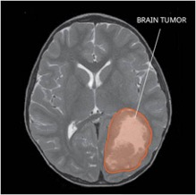
Neurological Disorders Share Symptoms
There are many possible causes of blurred vision, slurred speech, uncontrollable laughing, trouble walking and difficulty swallowing.
Here are a few neurological disorders that could result in similar symptoms:
ALS (amyotrophic lateral sclerosis)
MS (multiple sclerosis)
Brain tumor
Myasthenia gravis (MG)
Stroke
Brain infection
Thyroid dysfunction etc.
Notes:
Image Source: Wikimedia commons
Description: “MRI of PNET.jpg”
Author: NCI-CONNECT Staff
Source: https://commons.wikimedia.org/wiki/File:MRI_of_PNET.jpg
Clearance: This image is a work of the National Institutes of Health, part of the United States Department of Health and Human Services. As a work of the U.S. federal government, the image is in the public domain.

Slide 4
Part II – Uncovering the Patient’s Medical History
The report of progressive deterioration in Gael’s voluntary motor actions troubled Dr. Li. Given the symptoms and surprisingly low blood alcohol level, she performed a routine physical exam and took a full medical history directly from the patient.
Results:
Reports of blurred vision, progressive difficulty swallowing and playing basketball.
Military history in the Gulf War
Family history reveals a grandmother with Multiple Sclerosis (MS) and great grandmother who had amyotrophic lateral sclerosis (ALS).
Questions
Define MS and ALS. Identify some symptoms in each.
How are these diseases similar? How are they different?
Could there be other causes (not MS or ALS) for these neurological symptoms? Identify diagnostic tests commonly used.
10 minutes
Notes:
LO: Summarize the pathophysiology of neurological disorders
LO: Define MS and ALS
LO: Compare and contrast symptoms and pathology of MS and ALS
LO: Identify Diagnostic tests for MS and ALS
LO: Identify tests that could be used to rule out brain tumors and hyperparathyroidism

Slide 5
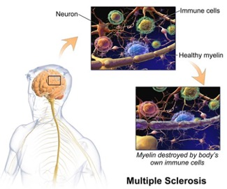
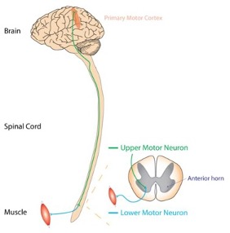
MS versus ALS
Motor neurons degenerate in ALS resulting in wasted muscle
Evidence of damage in at least two areas & diff times, ruling out other conditions.
No one test provides a definitive diagnosis!
Ruling out other conditions.
Symptoms include muscle weakness, stiffness, and paralysis. ALS targets primarily motor neurons so sensation is often spared (vision, touch, hearing, smell, taste).
Common symptoms include fatigue, vision problems, numbness, gait disruptions, weakness, pain, cognitive changes, sexual problems, bladder dysfunction etc.
Notes:
LO: Summarize the pathophysiology of neurological disorders
LO: Define MS and ALS
LO: Compare and contrast symptoms and pathology of MS and ALS
Left Image Source: Wikimedia commons
Description: Multiple Sclerosis.
Author: BruceBlaus
Source: https://commons.wikimedia.org/wiki/File:Multiple_Sclerosis.png
Clearance: This file is licensed under the Creative Commons Attribution-Share Alike 4.0 International license.
Right Image Source: Wikimedia commons
Description: Corticospinal tract demonstrating distinction between upper motor neuron and lower motor neuron.
Author: Rcchang16
Source: https://commons.wikimedia.org/wiki/File:UMN_vs_LMN.png
Clearance: CC BY-SA 4.0
This file is licensed under the Creative Commons Attribution-Share Alike 4.0 International license.

Slide 6
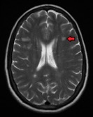
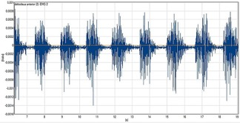
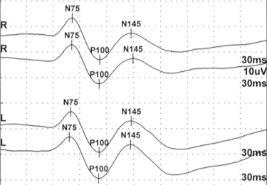
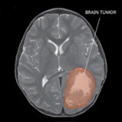
Diagnostic Tests MS ALS
MRI is used to identify lesion areas area
Electromyography (EMG)
Sensory Evoked potential tests
CSF analysis
Elevated levels of IgG antibodies, as well as
a specific group of proteins called oligoclonal bands.
Occasionally proteins that breakdown myelin.
MRI of brain and spinal cord to rule out tumors, herniated disks, etc.
Notes:
LO: Identify diagnostic tests for MS and ALS
Left Top Image Source: Wikimedia commons
Description: Multiple sclerosis as see on MRI
Author: James Heilman, MD
Source: Own work https://commons.wikimedia.org/wiki/File:MSMRIMark.png
Clearance: This file is licensed under the Creative Commons Attribution-Share Alike 4.0 International license.
Left Bottom Image Source: Wikimedia commons
Description:. Normal visual evoked potentials of an adult
Author: Medicus of Borg
Source: https://commons.wikimedia.org/wiki/File:VEP-normal.gif
Clearance: This file is licensed under the Creative Commons Attribution-Share Alike 4.0 International license.
Right Top Image Source: Wikimedia commons
Description: surface electromyography, sEMG
Author: StruskaM
Source: https://commons.wikimedia.org/wiki/File:EMG_muscle_deltant_-_milling.jpg
Clearance:. This file is licensed under the Creative Commons Attribution-Share Alike 4.0 International license.
Right Bottom Image Source: Wikimedia commons
Description: “MRI of PNET.jpg”
Author: NCI-CONNECT Staff
Source: https://commons.wikimedia.org/wiki/File:MRI_of_PNET.jpg
Clearance: This image is a work of the National Institutes of Health, part of the United States Department of Health and Human Services. As a work of the U.S. federal government, the image is in the public domain.
EMG Image source paper: Single-Channel EMG Classification With Ensemble-Empirical-Mode-Decomposition-Based ICA for Diagnosing Neuromuscular Disorders
MS Diagnosis: https://www.nationalmssociety.org/Symptoms-Diagnosis/Diagnosing-MS
MRI image figure legend and source: http://www.msdiscovery.org/news/news_synthesis/322-more-meets-eye
Fig. 1. Bright spots represent lesions on a T2 FLAIR (fluid-attenuated inversion recovery imaging) scan—a type of conventional T2-weighted image (left)—of an MS patient’s brain. Only those lesions marked by black arrows show up as persistent “black holes” or hypointensities on a T1 image (right), indicating a more severe degree of tissue destruction within them.
Evoked potentials in clinical diagnosis: https://tidsskriftet.no/en/2013/05/evoked-potential-tests-clinical-diagnosis
https://www.ninds.nih.gov/Disorders/Patient-Caregiver-Education/Fact-Sheets/Amyotrophic-Lateral-Sclerosis-ALS-Fact-Sheet#Diagnosis
How is ALS diagnosed?
No one test can provide a definitive diagnosis of ALS. ALS is primarily diagnosed based on detailed history of the symptoms and signs observed by a physician during physical examination along with a series of tests to rule out other mimicking diseases. However, the presence of upper and lower motor neuron symptoms strongly suggests the presence of the disease.
Physicians will review an individual’s full medical history and conduct a neurologic examination at regular intervals to assess whether symptoms such as muscle weakness, atrophy of muscles, and spasticity are getting progressively worse.
ALS symptoms in the early stages of the disease can be similar to those of a wide variety of other, more treatable diseases or disorders. Appropriate tests can exclude the possibility of other conditions.
Muscle and imaging tests
Electromyography (EMG), a special recording technique that detects electrical activity of muscle fibers, can help diagnose ALS. Another common test is a nerve conduction study (NCS), which measures electrical activity of the nerves and muscles by assessing the nerve’s ability to send a signal along the nerve or to the muscle. Specific abnormalities in the NCS and EMG may suggest, for example, that the individual has a form of peripheral neuropathy (damage to peripheral nerves outside of the brain and spinal cord) or myopathy (muscle disease) rather than ALS.
A physician may also order a magnetic resonance imaging (MRI) test, a noninvasive procedure that uses a magnetic field and radio waves to produce detailed images of the brain and spinal cord. Standard MRI scans are generally normal in people with ALS. However, they can reveal other problems that may be causing the symptoms, such as a spinal cord tumor, a herniated disk in the neck that compresses the spinal cord, syringomyelia (a cyst in the spinal cord), or cervical spondylosis (abnormal wear affecting the spine in the neck).
Laboratory tests Based on the person’s symptoms, test results, and findings from the examination, a physician may order tests on blood and urine samples to eliminate the possibility of other diseases.
Tests for other diseases and disorders Infectious diseases such as human immunodeficiency virus (HIV), human T-cell leukemia virus (HTLV), polio, and West Nile virus can, in some cases, cause ALS-like symptoms. Neurological disorders such as multiple sclerosis, post-polio syndrome, multifocal motor neuropathy, and spinal and bulbar muscular atrophy (Kennedy’s disease) also can mimic certain features of the disease and should be considered by physicians attempting to make a diagnosis. Fasciculations and muscle cramps also occur in benign conditions.
Because of the prognosis carried by this diagnosis and the variety of diseases or disorders that can resemble ALS in the early stages of the disease, individuals may wish to obtain a second neurological opinion.

Slide 7
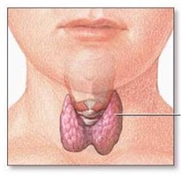
Brain Tumors & Hyperparathyroidism
Brain Tumors and Hyperparathyroidism: Other non-MS or ALS Potential Causes
Other non-MS or ALS potential causes
MRI and CT scans can be used to discover tumors in the brain or spinal cord
Thyroid
Gland
Screening of electrolytes can help eliminate hyperparathyroidism
Notes:
LO: Identify tests that could be used to rule out brain tumors and hyperparathyroidism
Left Image Source: Wikimedia commons
Description: Scheme of the thyroid gland
Author: The original uploader was Arnavaz at French Wikipedia., translated by Angelito7
Source:https://www.nlm.nih.gov/medlineplus/ Originally from fr.wikipedia; description page is/was here.
Clearance: This work is in the public domain in the United States because it is a work prepared by an officer or employee of the United States Government as part of that person’s official duties under the terms of Title 17, Chapter 1, Section 105 of the US Code
Right Image Source: Wikimedia commons
Description: “MRI of PNET.jpg”
Author: NCI-CONNECT Staff
Source: https://commons.wikimedia.org/wiki/File:MRI_of_PNET.jpg
Clearance: This image is a work of the National Institutes of Health, part of the United States Department of Health and Human Services. As a work of the U.S. federal government, the image is in the public domain.
Brain and spinal cord tumors can be confused with these diseases. MRI and CT scans can be done to discover tumors.
Hyperparathyroidism can also be confused with motor neuron disease. Screening of electrolytes can help eliminate these conditions.

Slide 8
Part III – Neurological Test Results
Based on family history and symptoms, Gael’s motor impairments could be the result of a variety of neurological conditions. To help decipher the exact cause for her patients ailments, Dr. Li orders a complete battery of neurological tests. She shared the patient’s test results with the rest of the attending physicians in the neurological disorders unit, shown below:
Results
MRI: No evidence of spinal cord tumors or cervical spondylosis. Evidence of cortical atrophy.
EMG: Abnormal, spontaneous electrical activity; tongue fasciculation and chronic partial denervation.
NCV: Normal motor and sensory nerve conduction in legs.
Spinal tap: No evidence of infection or elevated IgGs.
Blood and urine tests for thyroid function: Thyroid and parathyroid levels are normal; electrolyte levels are normal; higher than normal levels of p75ECD.
Muscle biopsy: Abnormal; evidence of denervation, muscle fiber necrosis, excessive NADH stain, inflammatory cell infiltration, and inclusions immunoreactive to TDP-43.
Question
After reviewing the results of Dr. Li’s diagnostic workup, what is the patient’s formal diagnosis? As a group, use resources from reliable sources (e.g., professional journals like Neurology, or reputable associations like ALS or National MS Society) to come to a consensus diagnosis supported by written evidence. Be prepared to discuss your opinion with the class and to hand in your written rationale.
10 minutes
Notes:
LO: Analyze clinical data
LO: Diagnose ALS based on the results of various neurological tests

Slide 9
Several Neurological Tests
MRI
Results: no evidence of spinal cord tumors or cervical spondylosis. Evidence of cortical atrophy
EMG and NCV
EMG Results: Abnormal, spontaneous electrical activity- tongue fasciculation and chronic partial denervation
NCV Results: Normal motor and sensory nerve conduction in legs
Spinal tap
Results: no evidence of infection
Blood and urine tests for thyroid function
Thyroid and parathyroid levels are normal
Electrolyte levels are normal
Higher than normal levels of p75ECD
Muscle biopsy
Results: Abnormal, evidence of denervation, muscle fiber necrosis excessive NADH stain, inflammatory cell infiltration and inclusions immunoreactive to TDP-43
Cortical Atrophy can occur in ALS and MS. Especially common in FTD/ALS
Abnormal fasciculations are a hallmark of ALS EMG recordings
Indicative of ALS
Conduction velocity is often altered in MS
Newly identified potential biomarker of ALS
Denervation & deterioration of the muscle fibers are indicative of ALS
Found in ALS tissue & genetically linked to ALS
Notes:
LO: Analyze clinical data
LO: Diagnose ALS based on the results of various neurological tests

Slide 10
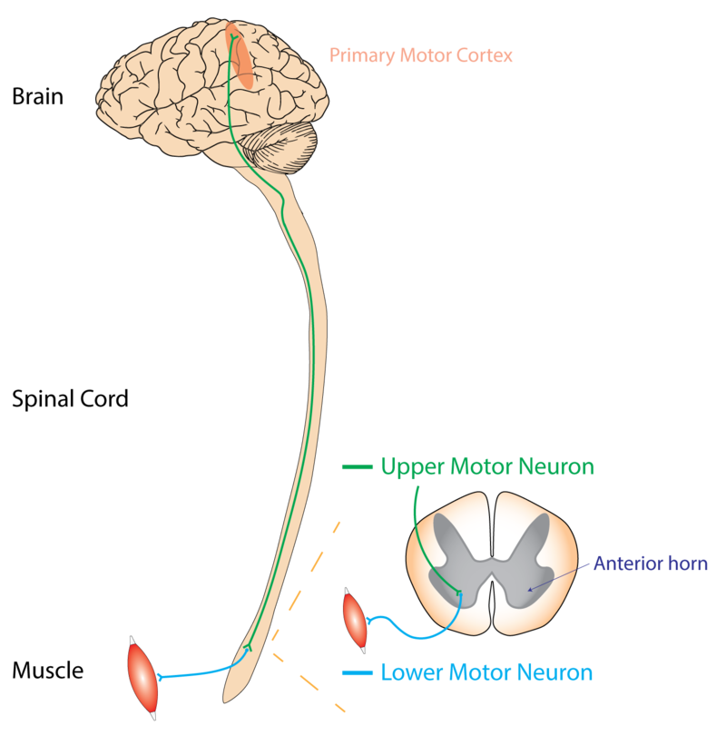
Amyotrophic Lateral Sclerosis (ALS)
Part IV – Diagnosis
The results pointed to a diagnosis of ALS. Dr. Li, however, adhered to standard practice and requested that Gael get a second opinion to diagnose ALS from an ALS association certified center or ALS clinic. The second opinion also came to the same conclusion. The patient was diagnosed with ALS. Given the patient’s family history, Dr. Li raised the possibility of genetic testing.
Motor neurons degenerate in ALS resulting in wasted muscle
Adult onset
Progressive neurodegenerative disease
Rapid paralysis and death from respiratory failure within 2 to 3 years from onset (variable).
Notes:
Image Source: Wikimedia commons
Description: Corticospinal tract demonstrating distinction between upper motor neuron and lower motor neuron.
Author: Rcchang16
Source: https://commons.wikimedia.org/wiki/File:UMN_vs_LMN.png
Clearance: CC BY-SA 4.0
This file is licensed under the Creative Commons Attribution-Share Alike 4.0 International license.

Slide 11
Educate Your Peers on Your Assigned Topic
10 minutes
10 minutes
Notes:
LO: Describe high-throughput (HT) sequencing technologies
LO: Discuss the molecular mechanism of CRISPR/Cas9
Image sources:
Left image:
Image Source: Wikimedia commons
Description: “CRISPR-Cas9 Editing of the Genome (26453307604).jpg”
Author: National Human Genome Research Institute (NHGRI) from Bethesda, MD, USA
Source: https://commons.wikimedia.org/w/index.php?curid=52360100
Clearance: By - CRISPR-Cas9 Editing of the Genome, CC BY 2.0
Right image:
Image Source: Wikimedia commons
Description: “DNA Nanoball Sequencing Flow Cell.jpg”
Author: Suspencewl [CC0]
Source:https://commons.wikimedia.org/wiki/File:DNA_Nanoball_sequencing_flow_cell.jpg
Clearance: Suspencewl [CC0]

Slide 12
Notes:
Which of the following is best classified as a high-throughput technique?
https://www.polleverywhere.com/multiple_choice_polls/bWO4tuAZ8NQvG4r6pkMSC
LO: Describe high-throughput (HT) sequencing technologies
LO: Compare and contrast Sanger and NGS technology
With each NGS run, massive amounts of data are generated:
up to billions of sequences per lane
depends on number of cycles per run, platform, and machine model/reagents.

Slide 13
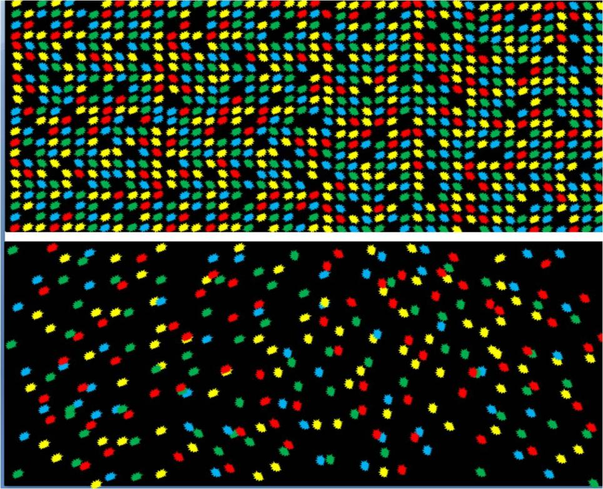
Next Generation Sequencing Technology
Transcriptome Sequencing (RNA)
Genome Sequencing (DNA)
Metagenome (bacterial DNA)
Generates BIG DATA (billions of sequences)
Notes:
LO: Describe high-throughput (HT) sequencing technologies
Image Source: Wikimedia commons
Description: “DNA Nanoball Sequencing Flow Cell.jpg”
Author: Suspencewl [CC0]
Source:https://commons.wikimedia.org/wiki/File:DNA_Nanoball_sequencing_flow_cell.jpg
Clearance: Suspencewl [CC0]
Applications of Next gen sequencing
Genome sequencing – to characterize an entire genome of any size/complexity; can be re-sequencing or de novo sequencing.
Metagenomics – to identify organisms within a complex population.
Exome sequencing – to sequence part of a genome through enrichment strategies to target coding regions.
Transcriptome sequencing or RNA-Seq – to identify and quantify RNA, including differential gene expression, identification of alternative splicing, and gene discovery.
Methylation analysis – to identify methylated nucleotides.
Chromosomal structure analysis

Slide 14
History of NGS
The Human Genome Project and genomes of several model organisms were produced largely by conventional Sanger-based sequencing.
Starting in 2005, several new platforms appeared.
High-throughput systems were introduced that detect pyrophosphate release on nucleotide incorporation rather than chain termination: “sequencing by synthesis”
See: https://youtu.be/nFfgWGFe0aA
Also known as deep sequencing or next-generation sequencing.
Notes:
LO: Describe sequencing by synthesis -[Click on pyrosequencing video] 2 minutes
is expensive but getting cheaper.
is commonly used for sequencing genomes and transcriptomes but typically not used to sequence small plasmids.
requires a library of DNA fragments but each platform will vary in terms of how sequencing is performed.

Slide 15
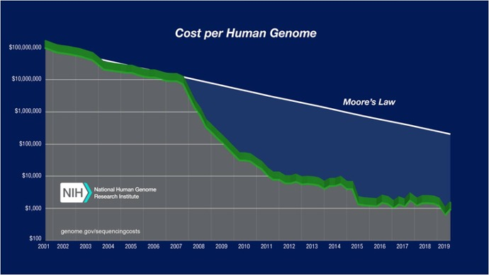
History of NGS
Notes:
LO: Describe high-throughput (HT) sequencing technologies
Image Source: National Human Genome Research Institute
Description: Cost per genome data
Author: no author provided
Source: https://www.genome.gov/about-genomics/fact-sheets/Sequencing-Human-Genome-cost
Clearance: This image is a work of the National Institutes of Health, part of the United States Department of Health and Human Services. As a work of the U.S. federal government, the image is in the public domain.
Over a decade ago, the first human genome was sequenced as a result of significant funding, time and collaboration across government and private sectors. The project cost $450 million and took over 10 years to complete¹. Due to the evolution of sequencing technology, today we can sequence a single human genome in a day for under $1,000, and we have moved way beyond the goal of revealing a single person’s DNA sequence. Scientists are using next-generation sequencing (NGS) technologies to explore virtually every niche of life sciences, from the microbiomes of patients with obesity² to symbiotic light organs of squid³ to the transcriptomes of individual tumor cells⁴ to the cataloging of arthropod diversity in human homes⁵. NGS tools are transforming the way modern molecular biologists conduct research. This evolution of NGS techniques is unlikely to slow, and our future holds a plausible reality where all newborns are sequenced⁶ and researchers work with “pocket sequencers” that can deliver massive amounts of sequencing data in real time⁷. Clearly, today’s life science students require new skills and knowledge to effectively use NGS technology and its resulting complex data to answer tomorrow’s important biological questions⁸. Programs that specifically generate a pipeline of diverse students to tackle these “Big Data” grand challenges of our future are crucial.

Slide 16
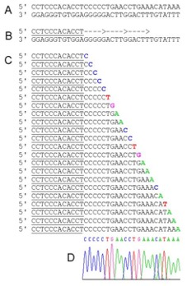
Comparison of Sequencing Platforms
Sanger-based sequencing
$
Confirm clones
Next-gen sequencing
$$$
Whole genome/transcriptome
Metagenomics
High-throughput
Notes:
LO: Compare and contrast Sanger and NGS technology
Image Source: Wikimedia commons
Description: “Sanger-DNA-seq.png”
Author: Enzo
Source: https://commons.wikimedia.org/wiki/File:Sanger-DNA-seq.png
Clearance: Enzo [CC BY-SA 3.0 (http://creativecommons.org/licenses/by-sa/3.0/)]
Great video:
https://www.thermofisher.com/blog/behindthebench/when-do-i-use-sanger-sequencing-vs-ngs-seq-it-out-7/
Sanger sequencing known as “chain termination method” is a tool used to determine nucleotide sequence of DNA of about 800-900 nucleotides in length.
NGS sequencing is a term used to describe a number of high-throughput sequencing technologies.
NGS has four main advantages to Sanger sequencing:
-speed. Sanger sequencing only allows for one read at a time, whereas NGS can take ~ 300Gb parallel DNA reads on a single run on single chip.
-cost. Reduced time, manpower and reagents in NGS make it more cost effective for larger DNA reads.
-sample size. Sanger sequencing requires a large amount of template DNA. NGS only needs a single strand
-accuracy/read length. Sanger sequencing can only one read ~1 kb of DNA, while NGS allows for ~300 Gb of DNA to be read on a single run on a single chip. NGS relies on short overlapping reads, so each section of DNA or RNA is read multiple times leading to more accurate and reliable coverage as longer reads can be created from many short contiguous short reads.
The Illumina sequencing method (aka Reversible Terminator Sequencing) is similar to Sanger sequencing, but it uses modified dNTPs containing a terminator, which blocks further DNA polymerization. This method allows for only a single base to be added by DNA polymerase to each growing DNA copy strand. The sequencing reaction is conducted simultaneously on a very large number of different template molecules spread out on a solid surface. The terminator also contains a fluorescent label, which can be detected by a camera. Only a single fluorescent color is used, so each of the four nucleotide bases must be added in a separate cycle of DNA synthesis and imaging. Following the addition of the four dNTPs to the templates, the images are recorded and the terminators labels are removed, washed and then ready for the next cycle of DNA synthesis using reverse terminator dNTPs.

Slide 17
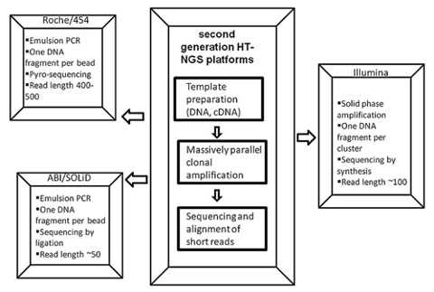
Comparison of Sequencing Platforms
NGS is not one technology!
Be sure to watch these short videos as homework:
Illumina Sequencing Video (5 min):
https://youtu.be/fCd6B5HRaZ8
Oxford Nanopore Sequencing Video (2 min):
https://youtu.be/GUb1TZvMWsw
Pac Bio SMRT Sequencing Video (4 min): https://youtu.be/v8p4ph2MAvI
Source: Noman and Pallen 2015. Nature Reviews Microbiology.
Notes:
LO: Compare and contrast the scale and general chemistry of Ion torrent, SMRT sequencing, and nanopore sequencing
Image Source: Wikimedia commons
Description: “2nd Generationg Sequencing.png”
Author: Chandra Shekhar Pareek, Rafal Smoczynski, and Andrzej Tretyn
Source: https://commons.wikimedia.org/wiki/File:2nd_Generation_Sequencing.png
Clearance: [CC BY-SA 3.0 (https://creativecommons.org/licenses/by-sa/3.0)]
Note the length of the reads produced, the number of reads per run, and how the sequencing occurs (sequencing by synthesis and now single-molecule synthesis).
With each run, massive amounts of data are generated:
up to billions of sequences per lane
depends on number of cycles per run, platform, and machine model/reagents.
Limitation: for most sequencers, each sequence read is relatively short (50-300 bp), except for single molecule systems (read lengths >20 Kb).
Ion torrent (ThermoFisher): is a type of sequencing by synthesis that relies on the detection of hydrogen ions that are released during the DNA polymerization reaction.
SMRT sequencing (PacBio): another type of sequencing by synthesis. It utilizes SMRT flow cells that contain thousands of tiny pores called zero-mode waveguides (ZMWs). Each ZMW represents one reaction chamber where the DNA polymerase machinery is immobilized at the bottom of the chamber. The pore size of the chamber is too small for light to pass through, but allows for the resolution of a single fluorescently labeled incorporated dNTP. The fluorescent tags are cleaved-off the dNTP after the incorporation of the nucleotide. Every time a different nucleotide gets incorporated into the parental template, a different color can be detected. Thousands of reactions in each ZMW can be detected simultaneously.
Nanopore sequencing (Oxford): utilizes a protein nanopore that is set in an electrically resistant polymer membrane. An ionic current is passed through the nanopore by setting a voltage across this membrane. If an analyte passes through the pore or near its aperture, this event creates a characteristic disruption in current. Measurement of that current makes it possible to identify G, A, T, and C nucleotides.

Slide 18
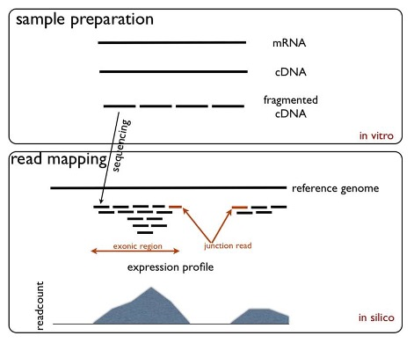
RNA-Seq
Method to look at all the genes expressed in a cell, group of cells or tissue
(think back to characterization of the Rosehip neuron)
Enables discovery of novel diagnostic biomarkers
Microarrays only look at a predetermined list of genes
Video: https://youtu.be/PisqV9cyfoA
Notes:
LO: Discuss the clinical potential of RNA-seq technology
LO: Compare and contrast RNA-seq and microarray technology
Image Source: Wikimedia commons
Description: “RNA seq experiment.png”
Author: Boraas [Public domain]
Source:“https://commons.wikimedia.org/wiki/File:RNA_Seq_Experiment.png
Clearance: Public domain
Ion torrent- detection of hydrogen ions that are released during normal synthesis of DNA
Video does an excellent job of illustrating the strengths of RNA sequencing (hypothesis free approach) over microarray technology.
RNA-seq is a high resolution approach that enables the identification and discovery of novel diagnostic biomarkers that would normally go undetected at the genetic level due to its high level of sensitivity.
RNA-seq is an open and versatile platform. It can be used to quantify known RNA transcripts and detect and quantify rare and novel RNA variants within a single sample due to its large dynamic range. Conversely, microarray technology while also able to detect changes in gene expression can do so for only a finite number of known genes within one microarray slide. Furthermore, quantification of gene expression is possible, but within a smaller dynamic range compared to RNA-seq.
GEX is in-house Illumina arrays
Video is 2-3 min long.
Image Source: https://upload.wikimedia.org/wikipedia/commons/d/db/RNA_Seq_Experiment.png

Slide 19
Notes:
CRISPR can be used to accomplish which of the following?
https://www.polleverywhere.com/multiple_choice_polls/l33jfOEMf55b0aYMNnJna
LO: Identify other uses of CRISPR/Cas9 outside of genome editing
Other uses…
CRISPR/Cas9 can be used to alter epigenetic marks such as histone modifications and/or 5-methyl cytosine. It can be used to manipulate RNA molecules by a number of mechanisms including: selective RNA cleavage, enhancing translation, isolating specific RNA:protein complexes, and/or specifically modifying RNA to understand its regulation.

Slide 20
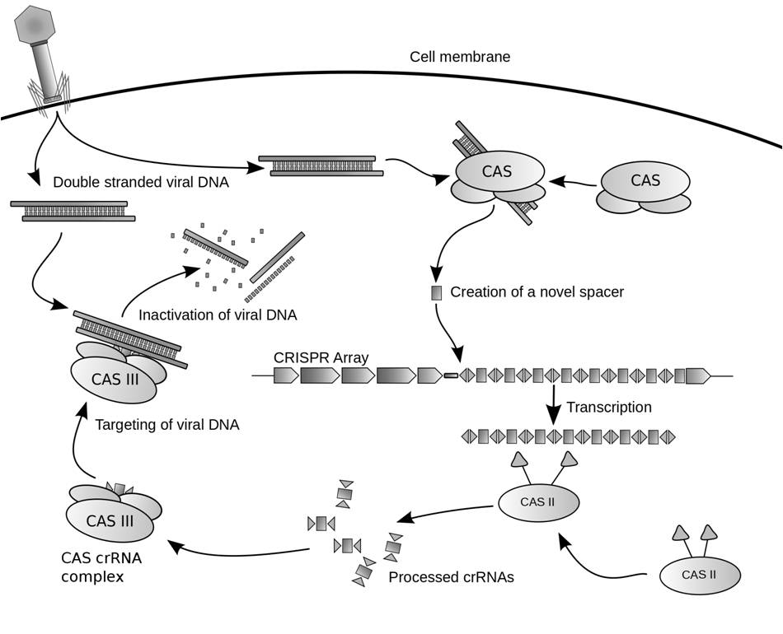
Mechanism of CRISPR-Cas9
15 min Video:
https://youtu.be/SuAxDVBt7kQ
Bacterial Cas genes allowed it to store a “record” of invading bacteriophage and destroy them upon re-exposure!
Notes:
LO: Discuss the molecular mechanism of CRISPR/Cas9 for genome editing
Image Source: Wikimedia commons
Description: “Crispr.png”
Author: James atmos - Own work, CC BY-SA 3.0
Source: https://commons.wikimedia.org/w/index.php?curid=7821536
Clearance: Wikimedia commons public domain
CRISPR-Cas9 is a Type II system. In the endogenous system, the CRISPR locus is transcribed as one long RNA. The RNA molecule is processed into smaller CRISPR RNAs (crRNA) by RNase III and a tracrRNA (trans-acting antisense RNA). The tracrRNA that is complementary to the CRISPR sequence and directs RNase III cutting. The processed crRNA along with the tracrRNA is then incorporated into the nuclease complex (Cas9). Binding of the complex to target DNA is mediated primarily by the recognition of a protospacer adjacent motif (PAM) present in the genome and by complementarity between the crRNA and the target DNA. Cas9 has intrinsic nuclease activity and cuts the DNA sequence.
From wikipedia:
Protospacer adjacent motif (PAM) is a 2-6 base pair DNA sequence immediately following the DNA sequence targeted by the Cas9 nuclease in the CRISPR bacterial adaptive immune system. [1] PAM is a component of the invading virus or plasmid, but is not a component of the bacterial CRISPR locus. Cas9 will not successfully bind to or cleave the target DNA sequence if it is not followed by the PAM sequence.[2][3][4][5] PAM is an essential targeting component (not found in bacterial genome) which distinguishes bacterial self from non-self DNA, thereby preventing the CRISPR locus from being targeted and destroyed by nuclease.

Slide 21
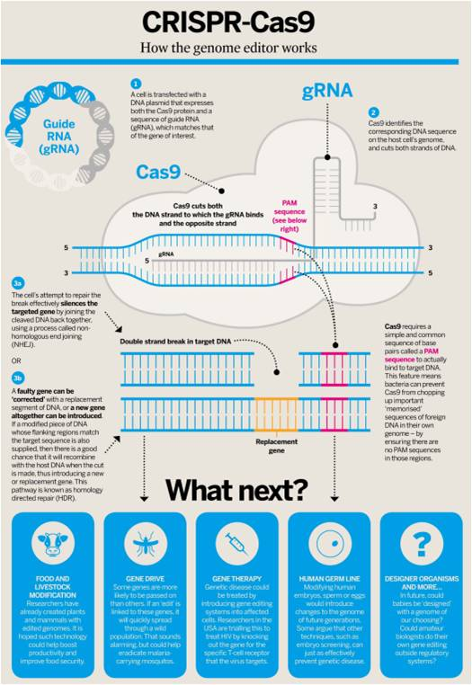
Mechanism of CRISPR-Cas9
Experimental
system
1. Cas9 binds gRNA
2. Complex binds to target DNA upstream of PAM site (NGG)
3. Cas9 undergoes a conformational change
Positions nuclease domains to cleave both strands of the target DNA, creating a double stranded break
~3-4 nt upstream of PAM site
4. The resulting DSB is then repaired by: The less efficient but high-fidelity Homology Directed Repair (HDR) pathway
efficient but error-prone Non- Homologous End Joining (NHEJ) pathway
Nature Biotech. 2014. 32: 347-55.
Notes:
LO: Discuss the molecular mechanism of CRISPR/Cas9 for genome editing
Image Source: Wikimedia commons
Description: “CRISPR-Cas9-biologist.jpg”
Author: J LEVIN W - Own work, CC BY-SA 4.0
Source: https://commons.wikimedia.org/w/index.php?curid=64373831
https://commons.wikimedia.org/wiki/File:CRISPR-Cas9-biologist.jpg#/media/File:CRISPR-Cas9-biologist.jpg
Clearance: Wikimedia commons public domain
These notes come from the CRISPR/Cas video link on the previous slide by Jennifer Doudna:
The power of CRISPR Cas 9 for genome editing 🡪 programmable DNA cutting enzyme
Program it with a short piece of RNA
To cleave essentially ANY dsDNA sequence
Why is it useful to be able to cleave dsDNA anywhere?
For a long time we’ve known that cells have ways of repairing dsDNA breaks that leads to changes in the DNA
Homology directed repair 🡪 donor DNA molecule that has sequences that match those flanking the site of the dsDNA break can be integrated into the genome at the site of the break to introduce new genetic information INTO the genome
With the ability to introduce a break anywhere now with all our genetic information, if we know where a disease causing mutation is we could fix it! Or as you will see in the our paper related to this cause, you can generate mutations in thousands of genes to do a high-throughput gene KO screen.
(2) NHEJ 🡪 ends of the DNA are ligated back together usually with introduction of small insertion or deletion

Slide 22
Gene knockout workflow with CRISPR-Cas9 in eukaryotic cells
Day 1: Transfect cells with Cas9 mRNA and crRNA tracrRNA
Day 2-3: Analyze gene editing
Weeks 3-6: Clonal cell line isolation and expansion. Analyze phenotypes
Remember: Cas9 has to be “added” to a eukaryotic system
We will see how this system is used for a genome wide knock out screen to identify genes that may influence ALS
http://dharmacon.gelifesciences.com/gene-editing/crispr-cas9/#workflow
Notes:
LO: Discuss the molecular mechanism of CRISPR/Cas9 for genome editing

Slide 23
Notes:
What type of molecule complexes with Cas9 to target DNA for editing?
https://www.polleverywhere.com/multiple_choice_polls/3ZUymTRVVXaanRCSlXh6b
LO: Discuss the molecular mechanism of CRISPR/Cas9 for genome editing
ssRNA

Slide 24
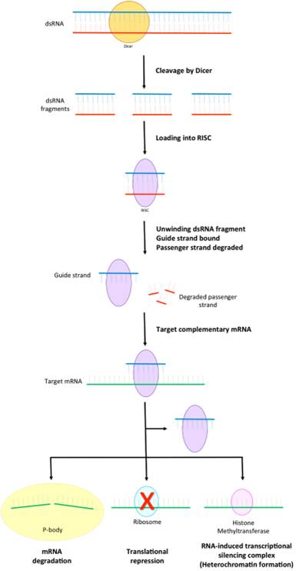
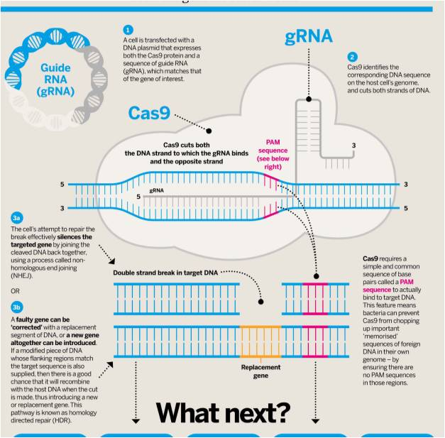
Side-by-side comparison
CRISPR-Cas 9
RNAi
Source
RNA Biogenesis
RNA guided interference
Cleave any dsDNA sequence
KO, Replace and edit
Any mRNA can be targeted & prevent expression to protein
mRNA is degraded or ribosome blocked from translation
Notes:
LO: Compare and contrast CRISPR/Cas9 to other gene expression or editing tools (RNAi and TALENS)
Left image:
Image Source: Wikimedia commons
Description: “CRISPR-Cas9-biologist.jpg”
Author: J LEVIN W - Own work, CC BY-SA 4.0
Source: https://commons.wikimedia.org/w/index.php?curid=64373831
https://commons.wikimedia.org/wiki/File:CRISPR-Cas9-biologist.jpg#/media/File:CRISPR-Cas9-biologist.jpg
Clearance: Wikimedia commons public domain
Right image:
Image Source: Wikimedia commons
Description: “Part of the RNA interference pathway focusing on RISC.png”
Author: Lonugget - Own work, CC BY-SA 3.0,
Source: https://commons.wikimedia.org/w/index.php?curid=39185845
Clearance: Wikimedia commons public domain
Similarities and differences between CRISPR-Cas systems and RNAi
Similarities: same basic steps – foreign nucleic acids are recognized by cellular machinery. RNA molecules are processed, and incorporated into complexes that will guide interference by target digestion.
Differences:
CRISPR handles foreign DNA, RNAi handles foreign RNA
In bacteria, viral DNA gets incorporated into the genome at CRISPR loci. CRISPR loci are transcribed to generate guide RNA molecules. Cas proteins or RNase III process the RNA, and the processed RNA is loaded on to Cas proteins to mediate DNA destruction. While RNA is important for targeting, binding to the PAM sequence is essential for target degradation
Guide RNAs for RNAi can come from endogenous and exogenous sources. RNA processing is carried out by Dicer, and processed RNAs are loaded onto Argonaute proteins. Target recognition is mediated by the RNA molecule itself and is limited to mRNA molecules.

Slide 25
Seq’ing The Cure: Standard Edition (Day 2)
High-Throughput Discovery!
CRISPR/Cas Genome Engineering,
Next Generation Sequencing,
and
Neurological Disease
Notes:
~20 minutes of intro lecture, then data analysis
Image Source: Wikimedia commons
Description: “CRISPR-Cas9 Editing of the Genome (26453307604).jpg”
Author: National Human Genome Research Institute (NHGRI) from Bethesda, MD, USA
Source: https://commons.wikimedia.org/w/index.php?curid=52360100
Clearance: By - CRISPR-Cas9 Editing of the Genome, CC BY 2.0,

Slide 26
Learning Objectives
You should be able to…
RNA-seq Analysis outcomes
Utilize Microsoft Excel to analyze RNA-seq data
Draw conclusions based on published data
Compare fold change and log2fold change
Describe how p values are used to determine statistical significance
Explain false positive and negative results and how p values can be adjusted based on false discovery rates
Evaluate biochemical pathways enriched in differentially expressed genes using bioinformatic tools
Notes:
Much of what we will discuss today (many of the Learning Objectives) is review from your case study and homework for the case study. If you are confused by content discussed, please be sure to look back at our previous case sessions and discussions/answers to homework questions.

Slide 27
Amyotrophic Lateral Sclerosis (ALS)
Adult onset
Progressive neurodegenerative disease
Rapid paralysis and death from respiratory failure within 2 to 3 years from onset (variable).
Nature Video ALS
Cellular processes: Disrupted RNA metabolism, mitochondria dysfunction, excitotocisity, neuroinflammation, transport defects
Notes:
Right Image Source: Wikimedia commons
Description: Corticospinal tract demonstrating distinction between upper motor neuron and lower motor neuron.
Author: Rcchang16
Source: https://commons.wikimedia.org/wiki/File:UMN_vs_LMN.png
Clearance: CC BY-SA 4.0
This file is licensed under the Creative Commons Attribution-Share Alike 4.0 International license.
LOs from your homework:
Summarize core clinical features and diagnosis of human ALS
Discuss cellular processes that are disrupted in ALS – covered in nature video
ALS
Statistics - 2 per 100,000 people; 60% in ALS database are men; 93% caucasian; 40 and 70 ages; 55 average age of diagnosis; increased incidence in military veterans, particularly Gulf war veterans; increased incidence in retired professional football players
Symptoms- progressive muscle weakness and paralysis (speech, swallowing, hands, arms, legs, feet)
Criteria for diagnosis discussed above
Cellular processes involved in ALS from Nature video: Disrupted RNA metabolism, Mitochondiral dysfunction, impaired proteostasis, excitotoxicity, neuroinflammation and astrogliosis, oligodendrocyte dysfunction, transport defects, impaired DNA repair
Review from our case study day 1:
ALS diagnosis requires..
lower motor neuron degeneration which can be documented through electrophysiological, clinical or neuropathologic approaches.
Upper motor neuron degeneration demonstrated by clinical examination
Progressive spread of signs of degeneration
Neuroimaging evidence that rules out other disease processes (ex. Brain tumor)
Electrophysiological evidence that supports LMN and UMN degeneration and rules out other conditions
Diagnosis requires ruling other neurological disease out. Certified ALS Centers
Among the conditions that resemble ALS are some forms of muscular dystrophy, the neurologic conditions known as spinal-bulbar muscular atrophy and adult-onset spinal muscular atrophy, the nerve-to-muscle transmission disorder known as myasthenia gravis, and various causes of compression of the spinal cord or brainstem, such as tumors and malformations.
Here is supplementary reading from what is ALS…
http://www.alsa.org/about-als/what-is-als.html
ALS, or amyotrophic lateral sclerosis, is a progressive neurodegenerative disease that affects nerve cells in the brain and the spinal cord. A-myo-trophic comes from the Greek language. "A" means no. "Myo" refers to muscle, and "Trophic" means nourishment – "No muscle nourishment." When a muscle has no nourishment, it "atrophies" or wastes away. "Lateral" identifies the areas in a person's spinal cord where portions of the nerve cells that signal and control the muscles are located. As this area degenerates it leads to scarring or hardening ("sclerosis") in the region.
Motor neurons reach from the brain to the spinal cord and from the spinal cord to the muscles throughout the body. The progressive degeneration of the motor neurons in ALS eventually leads to their demise. When the motor neurons die, the ability of the brain to initiate and control muscle movement is lost. With voluntary muscle action progressively affected, people may lose the ability to speak, eat, move and breathe. The motor nerves that are affected when you have ALS are the motor neurons that provide voluntary movements and muscle control. Examples of voluntary movements are making the effort to reach for a smart phone or step off a curb. These actions are controlled by the muscles in the arms and legs.
There are two different types of ALS, sporadic and familial. Sporadic which is the most common form of the disease in the U.S., is 90 – 95 percent of all cases. It may affect anyone, anywhere. Familial ALS (FALS) accounts for 5 to 10 percent of all cases in the U.S. Familial ALS means the disease is inherited.
Symptoms
The initial symptoms of ALS can be quite varied in different people. One person may have trouble grasping a pen or lifting a coffee cup, while another person may experience a change in vocal pitch when speaking. ALS is typically a disease that involves a gradual onset.
The rate at which ALS progresses can be quite variable from one person to another. Although the mean survival time with ALS is three to five years, many people live five, 10 or more years. Symptoms can begin in the muscles that control speech and swallowing or in the hands, arms, legs or feet. Not all people with ALS experience the same symptoms or the same sequences or patterns of progression. However, progressive muscle weakness and paralysis are universally experienced.
Gradual onset, painless, progressive muscle weakness is the most common initial symptom in ALS. Other early symptoms vary but can include tripping, dropping things, abnormal fatigue of the arms and/or legs, slurred speech, muscle cramps and twitches, and/or uncontrollable periods of laughing or crying.
When the breathing muscles become affected, ultimately, people with the disease will need permanent ventilatory support to assist with breathing.
Since ALS attacks only motor neurons, the sense of sight, touch, hearing, taste and smell are not affected. For many people, muscles of the eyes and bladder are generally not affected.
Diagnosis
ALS is a difficult disease to diagnose. There is no one test or procedure to ultimately establish the diagnosis of ALS. It is through a clinical examination and series of diagnostic tests, often ruling out other diseases that mimic ALS, that a diagnosis can be established. A comprehensive diagnostic workup includes most, if not all, of the following procedures:
Electrodiagnostic tests including electomyography (EMG) and nerve conduction velocity (NCV)
Blood and urine studies including high resolution serum protein electrophoresis, thyroid and parathyroid hormone levels and 24-hour urine collection for heavy metals
Spinal tap
X-rays, including magnetic resonance imaging (MRI)
Myelogram of cervical spine
Muscle and/or nerve biopsy
A thorough neurological examination
For more information on the importance of a second opinion, click here.
These tests are done at the discretion of the physician, usually based on the results of other diagnostic tests and the physical examination. There are several diseases that have some of the same symptoms as ALS, and most of these conditions are treatable. It is for this reason that The ALS Association recommends that a person diagnosed with ALS seek a second opinion from an ALS expert - someone who diagnoses and treats many ALS patients and has training in this medical specialty. The ALS Association maintains a list of recognized experts in the field of ALS. See The ALS Association Certified Centers and ALS Clinics. Also contact your local ALS Association chapter or the National Office.

Slide 28
Part V – Back in the Transcriptomics Lab
With this dire diagnosis, Dr. Li was desperate to help her patient, as there is no known cure for ALS. The patient’s genetic testing revealed that he had a common form of the disease characterized by alterations in the C9ORF72 gene. In particular, this gene contains a massive expansion of a six-nucleotide sequence (GGGGCC) called a hexanucleotide repeat. These repeats are found in a significant proportion of patients with familial forms of ALS and frontotemporal dementia (FTD), ranging from 22.5 to 46% and 12 to 29.3% respectively. When these repeats occur in the C9ORF72 gene, an unusual translation event happens. This can result in dipeptide protein repeat (DPR) products that tend to aggregate and lead to neuronal cell death (cytotoxicity).
Time was of the essence, so Dr. Li quickly turned to her lab for help, exploiting their area of specialty: CRISPR. This advancement in genomic editing had enabled her lab to quickly and accurately knock out human genes in a high-throughput fashion. So far, her team had used what is called a CRISPR screen to identify genes that help human cells survive in the presence of these repetitive sequences (suppressors of toxicity), as well as genes that lead to increased cell death (enhancers of toxicity) (Kramer et al., 2018). After knocking out over twenty-thousand genes in human K562 cells, half of these cells were exposed to neurotoxins (e.g., DPRs) and half were left untreated as a negative control group. The synthetic repetitive sequences were used to mimic DPR in human ALS patients. Finally, the surviving cells were analyzed to see which genes that were knocked out provided protective or sensitizing effects to the DPR treatment. Given this large data set, they next looked for commonalities among the genes to help make sense of the biology. Dr. Li’s lab found many genes whose products were involved in how cells respond to intracellular stress, such as when protein aggregates are formed by DPRs. Perhaps this was the key to unlocking an effective therapy for the disease?
With the CRISPR screens complete, Dr. Li’s group set out to measure changes in RNA levels in response to a particular DPR, PR20. The scientists either treated K562 cells with PR20 or left them untreated as a negative control group. RNA was purified and sent for RNA-seq analysis to look for differential gene expression between the two groups (Figure 1).
As they nervously waited for the NGS data to return, Dr. Li reminisced about her early days experimenting with an at-home gene editing kit ordered online. Never did she imagine just how powerful this tool could be in changing lives…
JUST IN: The results of the Li lab’s efforts have arrived, but the amount of differential gene expression (DGE) data is too great to interpret alone. They turn to their in-house transcriptomic experts (you) for help in deciphering their data. Will this be the next step in Seq’ing the Cure?!?

Slide 29
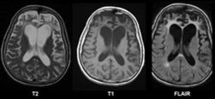
Frontotemporal Dementia (FTD)
Second most common cause of dementia in patients younger than 65.
Degeneration of neurons in frontal and temporal lobes of the brain.
Range of cognitive and behavioral symptoms
Changes in personality
Poor Judgement
Loss of Empathy
Socially inappropriate behavior
Lack of inhibition
Compulsive behavior
Inability to concentrate
Mood changes
Speech difficulties
Balance & movement issues
Memory loss
Supporting Image suggestion: https://www.nature.com/articles/nrneurol.2016.14
“Parkinsonism, movement disorders and genetics in frontotemporal dementia”
Figure 1
Notes:
LO: Summarize the symptoms and pathological features associated with ALS and FTD
Image Source: Wikimedia commons
Description: Brain MRI of a female 65 y.o. white patient with Pick's disease. Cortex and white matter atrophy of the frontal lobes is clearly visible. The MRI was done without contrast enhancement utilizing Magnetom Vision 1.5 Tesla with superconductive magnet..
Author: Mikhail Kalinin
Source: https://commons.wikimedia.org/wiki/File:Pick%27s_disease.png

Slide 30
Overlap of FTD and ALS
Clinical, pathological and genetic overlap!
FTD/ALS – loss of cortical neurons in the frontal and temporal lobes in addition to upper and lower motor neuron loss
20% of people with ALS meet the clinical criteria for diagnosis of FTD (as many as 50% experience cognitive impairment)
RNA binding protein TDP-43 accumulates in nearly all ALS cases and almost half of FTD cases
Mutations in C9ORF72 are the most common cause of ALS and FTD!
Notes:
LO: Discuss how FTD and ALS overlap from the clinical, pathological and genetic perspectives.
See the following image, which could not be included for reasons of copyright:
Image Source: Nature
Description: “Figure 4”Three non-exclusive mechanisms have been proposed for C9-ALS/FTD
Author: Taylor et al. Nature 2016
Source: https://www.ncbi.nlm.nih.gov/pmc/articles/PMC5585017/
Careful observation of people with ALS over the past 30 years has revealed clinical, pathological and genetic overlap with several other neurodegenerative disorders. In particular, the loss of motor neurons may be accompanied by the loss of cortical neurons in the frontal and temporal cortices of the brain. This correlates clinically with FTD, a condition of impaired judgment and executive skills, which often leads to behavioural disturbances. About 20% of people with ALS meet the clinical criteria for a concomitant diagnosis of FTD, although as many as 50% of people with ALS experience cognitive impairment. Similar to ALS, FTD is characterized by inclusions of TDP-43 and related RNA-binding proteins. The relationship between ALS, FTD has been extended though genetic evidence, which potentially places them in the continuum of a broader degenerative disorder.
The curious case of C9orf72-related ALS and FTD
Although the identification of ALS-causing mutations that affect SOD1 and RNA-binding proteins highlighted pathophysiological pathways through which disease might arise, most of the genetic burden of ALS remained unaccounted for until 2011. Genetic linkage studies94,95 followed by several large genome-wide association studies96–99 identified the location of a gene in the chromosome 9p21 locus in which mutations cause both ALS and FTD. During sequencing of the non-coding regions of candidate genes in chromosome 9p21, a pathogenic expansion of a hexanucleotide repeat in C9orf72 was identified as the basis for C9orf72-related ALS and FTD (C9 ALS–FTD)8. In healthy individuals, the sequence GGGGCC was present as 2–23 repeats but in affected individuals it was expanded to hundreds or thousands of repeats. In parallel, an independent study also discovered a pathogenic expansion of GGGGCC repeats in C9orf72 (ref. 77).
Figure 4 | Proposed mechanisms for the development of C9 ALS–FTD. Expansion of an intronic hexanucleotide repeat (GGGGCC) in C9orf72 from fewer than 23 copies to hundreds or thousands of copies causes C9 ALS–FTD. This mutation results in a modest reduction in the levels of C9orf72 protein (left) that seems insufficient to cause disease but might contribute to its progression through abnormal microglial responses. Meanwhile, the expression of sense and antisense RNA transcripts that contain the expanded repeat probably drive a toxic gain of function (right). The two main gain-of-function modes that are implicated are: toxicity through the sequestration of RNA-binding proteins in RNA foci by the expanded GGGGCC repeat RNA transcript; and the production of DPR proteins through RAN translation, leading to toxicity through several cellular targets such as membraneless organelles and nuclear pores.

Slide 31
Genetic Screens: Scientific Fishing Expeditions
Genetic screens in simple model organisms (flies, yeast, worms) have yielded fundamental discoveries including mechanisms of human disease.
While useful, similar screens of the human genome could yield novel insights.
The powerful, new genome editing tool CRISPR-Cas9 now makes this possible!
Used CRISPR-Cas9 to perform genome-wide
(KO) screen in human cells.
GOAL: Identify modifiers of C9orf72 DPR toxicity
Can we discover Genes that may protect against the DPR toxicity or genes that enhance toxicity
These genes are potential new therapeutic
targets for ALS and FTD!
Notes:
LO: Identify the goal of the researchers experiments and why a genome wide, gene-knockout CRISPR screen was used to achieve this goal
Image Source: Wikimedia commons
Description: “CRISPR-Cas9 Editing of the Genome (26453307604).jpg”
Author: National Human Genome Research Institute (NHGRI) from Bethesda, MD, USA
Source: https://commons.wikimedia.org/w/index.php?curid=52360100
Clearance: By - CRISPR-Cas9 Editing of the Genome, CC BY 2.0,

Slide 32
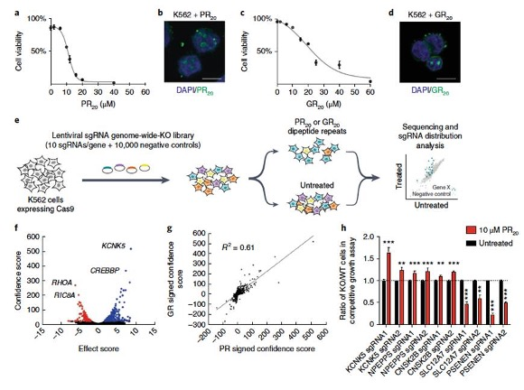
Overview of the genome wide, CRISPR-Cas9 KO screen in human cells
FIGURE 1
High throughput screen!
20,500 human genes KO and tested for sensitivity to DPR toxicity!
Red = genes identified that when knocked out, increase the cell’s sensitivity to DPR toxicity
Blue = genes that increase resistance when KO
Validation
Not high-throughput
Independently generated single gene KOs
Notes:
Figure 1 CRISPR–Cas9 screens in human cells and primary
neurons identify modifiers of C9ORF72 dipeptiderepeat-
protein toxicity
Image Source: Nature
Description: “Figure 1” Kramer et al 2018 Nature Genetics.
Author: Kramer et al. 2018
Source: https://www.nature.com/articles/s41588-018-0070-7
Clearance: Permission granted by Nature Publishing

Slide 33
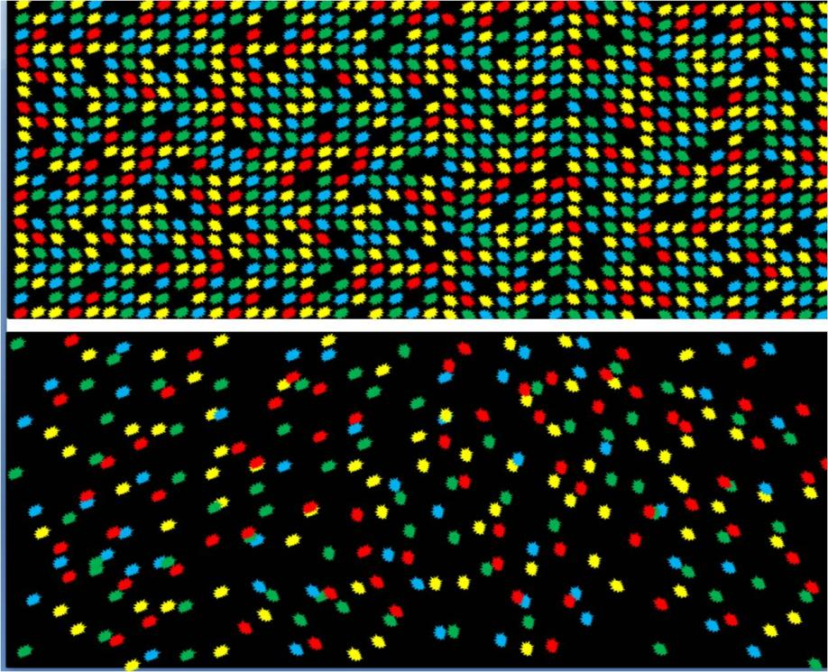
Next Generation Sequencing Technology
Part V – Back in the Transcriptomics Lab
Start your RNA sequencing analysis!
Notes:
LO: Describe high-throughput (HT) sequencing technologies
Image Source: Wikimedia commons
Description: “DNA Nanoball Sequencing Flow Cell.jpg”
Author: Suspencewl [CC0]
Source:https://commons.wikimedia.org/wiki/File:DNA_Nanoball_sequencing_flow_cell.jpg
Clearance: Suspencewl [CC0]

Slide 34
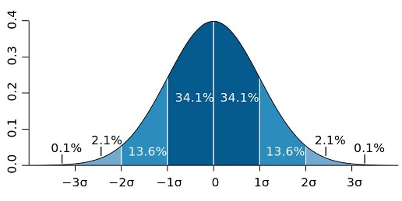
Standard Error
The relationship between the standard error and the standard deviation is such that, for a given sample size, the standard error equals the standard deviation divided by the square root of the sample size. In other words, the standard error of the mean is a measure of the dispersion of sample means around the population mean.
Notes:
Image Source: Wikimedia commons
Description: “Standard deviation diagram.svg”
Author: M. W. Toews - Own work, based (in concept) on figure by Jeremy Kemp, on 2005-02-09, CC BY 2.5,
Source: https://commons.wikimedia.org/w/index.php?curid=1903871
Clearance: M. W. Toews - Own work, based (in concept) on figure by Jeremy Kemp, on 2005-02-09, CC BY 2.5,

Slide 35
Conclusions
FIG1- Genome-wide KO screen using CRISPR/CAS9 technology to identify modifiers of DPR induced toxicity
Screened 20,500 human genes!
215 modifiers of PR toxicity and 387 modifiers of GR toxicity
KO of some genes increases sensitivity to DPR toxicity while KO of others protects cells from DPR toxicity
Notes:
Figure 1 CRISPR–Cas9 screens in human cells and primary
neurons identify modifiers of C9ORF72 dipeptiderepeat-
protein toxicity
Kramer et al. 2018

Slide 36
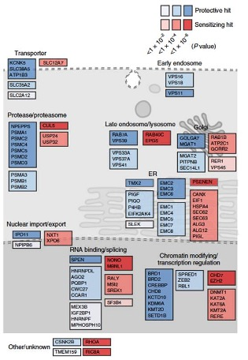
Conclusions
FIG2-CRISPR-Cas9 screen identified many genes in different cellular pathways that can modify DPR toxicity. Pathways include…
RNA processing, ER-associated degradation, proteasome, cellular transport, cell trafficking and transcriptional regulation pathways
Notes:
Figure 2 CRISPR–Cas9 screens in human cells and primary
neurons identify modifiers of C9ORF72 dipeptiderepeat-
protein toxicity
Image Source: Nature
Description: “Figure 2” Kramer et al 2018 Nature Genetics.
Author: Kramer et al. 2018
Source: https://www.nature.com/articles/s41588-018-0070-7
Clearance: Permission granted by Nature Publishing

Slide 37
Part VI – Bioinformatic Analysis of RNA-seq Data
When scientists are faced with analyzing high-throughput data like Dr. Li’s RNA-seq data set, they must look for commonalities and patterns to help make sense of it. There are many identified pathways that go awry in ALS. In order for Dr. Li and her team to determine if any cellular locations or processes are enriched with genes that came up in their hit list after treatment with the toxic dipeptide protein repeat, they turned to online bioinformatic tools.

