Slide 1
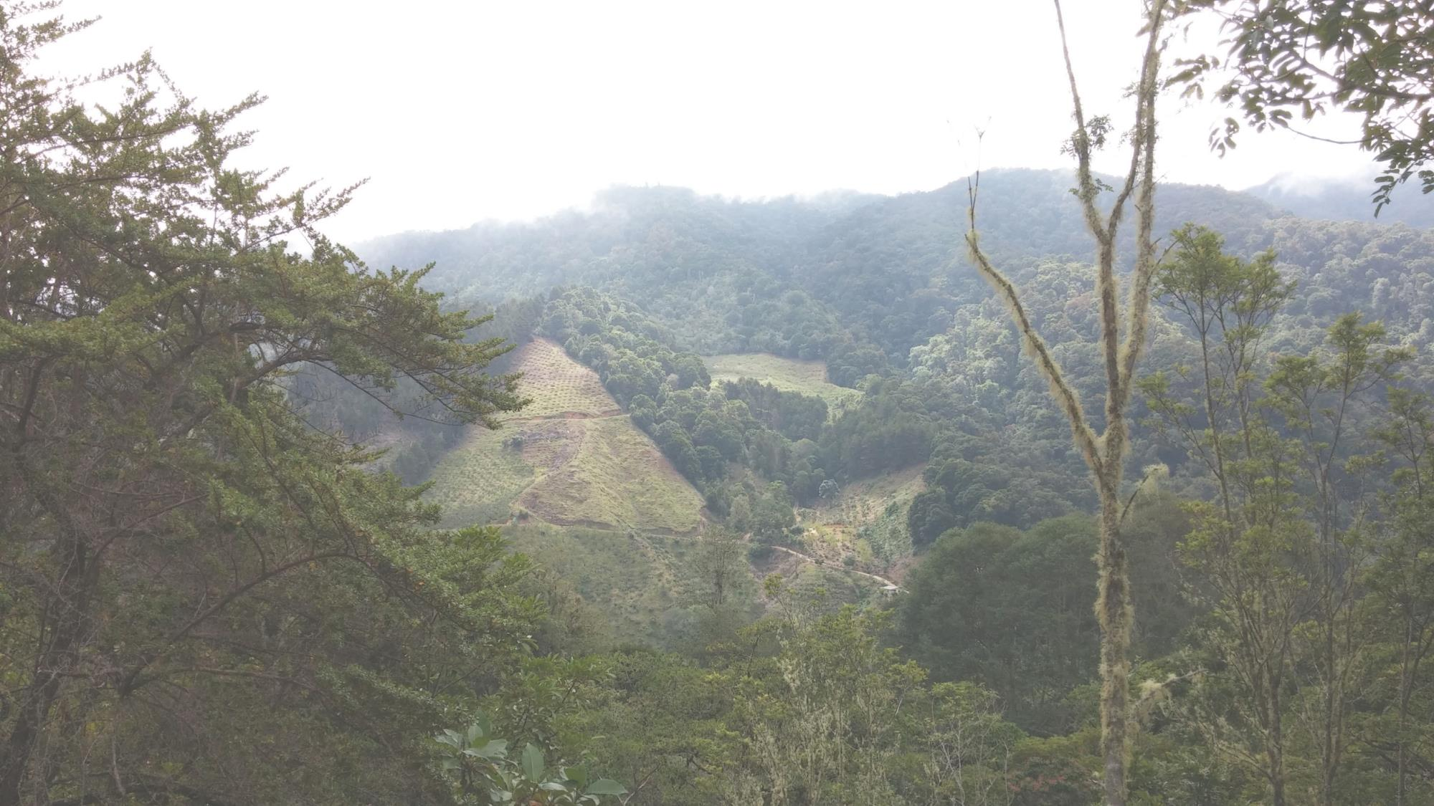
The Savegre: A Model of Sustainability
NATIONAL CENTER FOR CASE STUDY TEACHING IN SCIENCE
A Presentation to Accompany the Case Study:
by
Aggie Veld and Emilie R. Janes
Department of Biology
Olivet Nazarene University, Bourbonnais, IL
Notes:
Please see the teaching notes for this case study for more detailed information pertaining to this PowerPoint presentation.
Background:
This photo was taken on a hike through the trails at the Savegre Hotel. At one point along the hike, there is a gap in the trees that opens up to the valley below. The cleared, triangular section of land that you see on the opposite side of the valley is the family’s orchards, where they grow apples, peaches and plums. The slope is very steep, and a special planting method is used to ensure that the trees are securely rooted in the mountainside.
Planting fruit orchards are just one of the many economically viable, sustainable practices that the Chacon family uses in the Savegre.

Slide 2
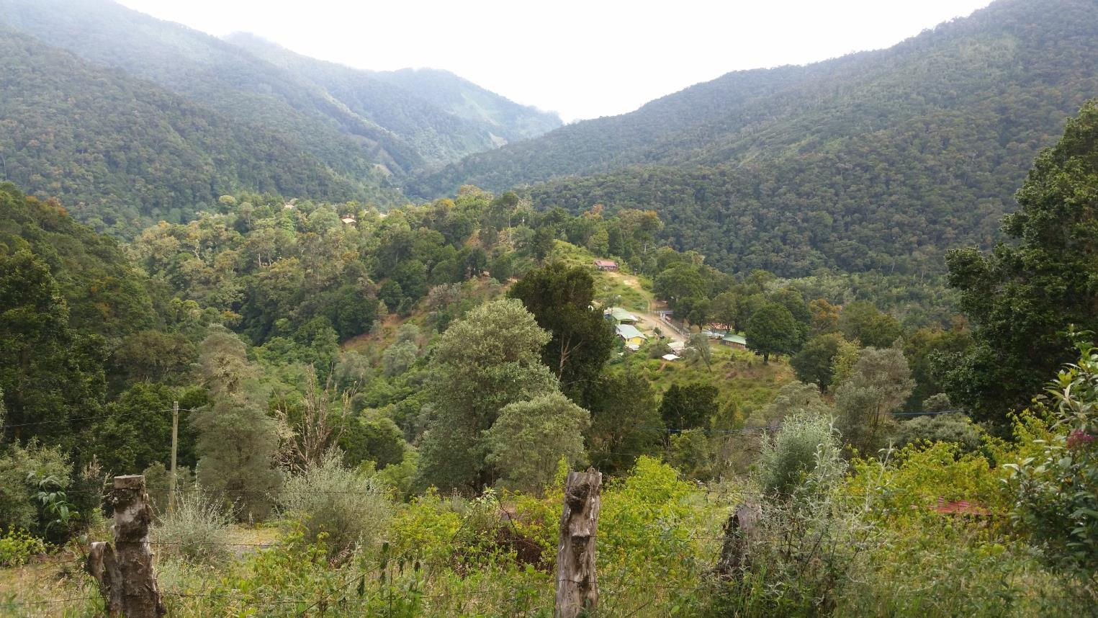
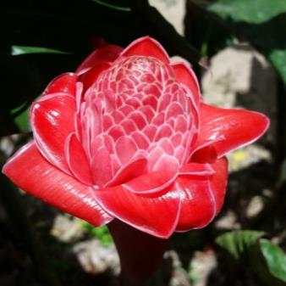
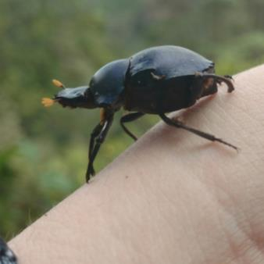
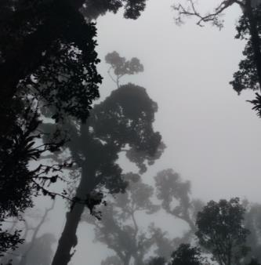
Welcome to Costa Rica!
Costa Rica is home to upwards of 6% of the world’s biodiversity, and covers approximately 0.03% of the earth’s surface! It’s only about the size of West Virginia, but has many different ecosystems.
Why?
Location
Global Wind Patterns
Topography
Notes:
Large, central photo: A view of the Savegre Valley driving down the Cerro de la Muerte (Mountain of Death).
Assorted, smaller photos: a pink flower, a dung beetle found along the trails at the Savegre, the mist rolling through the tree canopy

Slide 3
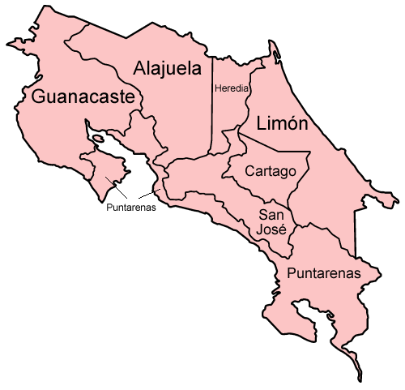
Location, Location, Location!
Located in Central America
GPS coordinates
Northernmost Point: ~ 11°13'15"N 85°36'36"W
Southernmost Point: ~ 8°02'16"N 82°54'02"W
Between the equator and Tropic of Cancer
Notes:
Map: Costa Rica is divided into seven provinces: San Jose, Heredia, Alajuela, Cartago, Puntarenas, Guanacaste and Limon. The Savegre Hotel is located in the province of San Jose, in the town of San Gerardo de Dota, huddled up against the Talamanca Mountain range (see star on map for general location).
Teacher can copy and paste GPS coordinates into Google Maps.

Slide 4
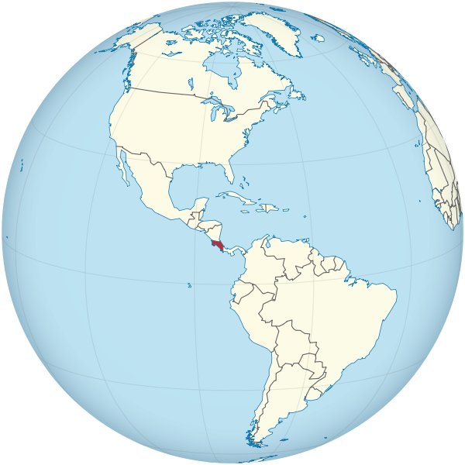
Global Wind Patterns
Driven by intense heating of the sun.
Hot air rises and cool air sinks, and due to the rotation of the earth the northeast trade winds and westerlies result.
The northeast trade winds pass from the northeast to the southwest, sweeping across Costa Rica.
Notes:
See teaching notes for explanation.
Global Wind Patterns, map from Wikimedia Commons, by TUBS, 2011, CC BY-SA 3.0, retrieved from https://commons.wikimedia.org/wiki/File:Costa_Rica_on_the_globe_(Americas_centered).svg

Slide 5
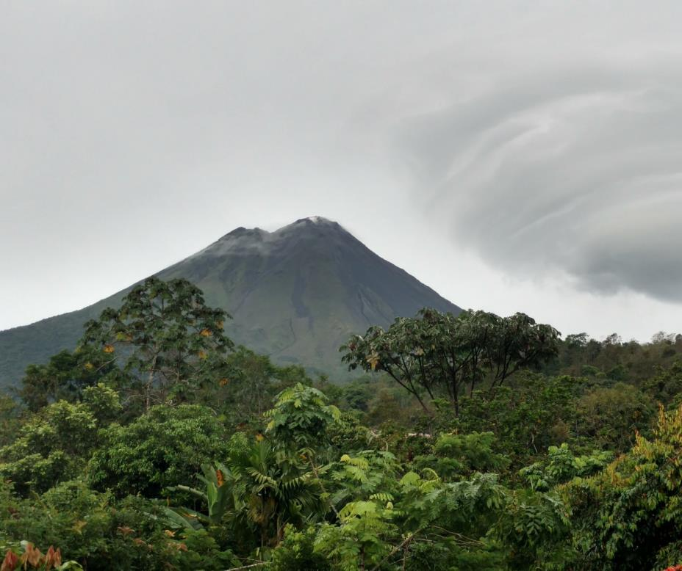
Topography
Costa Rica is split down the middle by mountains formed by volcanic activity.
Elevation spans from 790 feet below sea level to 12,500 feet above sea level
Lowest: caves at Barra Honda National Park
Highest: Chirripo Mountain
Pacific on the west coast, Caribbean on the east coast
Arenal Volcano, located in the province of Alajuela.
Notes:
See teaching notes for explanation.

Slide 6
Costa Rica’s Variable Climate
Location, global wind patterns, and topography come together.
Northeast trade winds carry air from the Caribbean up the central mountain range and across to the Pacific Ocean, causing:
Rainy, humid Caribbean coast with violent waters (Tortuguero)
Cold, wet cloud forests in high elevation mountains (San Gerardo de Dota)
Dry, hot northwest region (Guanacaste)
Rainfall, depending on elevation, can be 50-160 inches per year.
Temperatures range from 50 °F to 95 °F.
… allows for many ecosystems, creating rich biodiversity!
Notes:
See teaching notes for explanation.
Visit https://costa-rica-guide.com/travel/weather/why-does-it-rain/ to read more about Costa Rica’s climate and contributing factors.

Slide 7
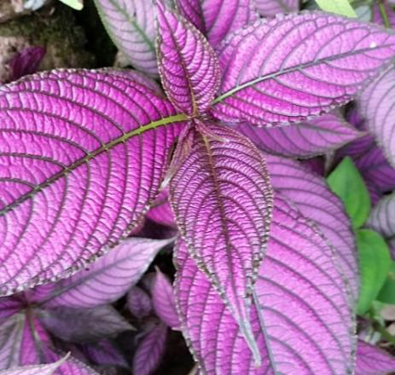
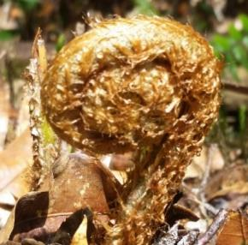
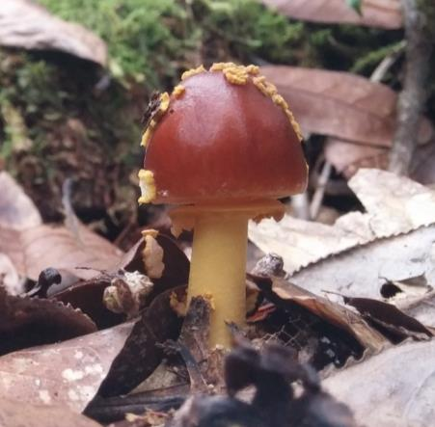
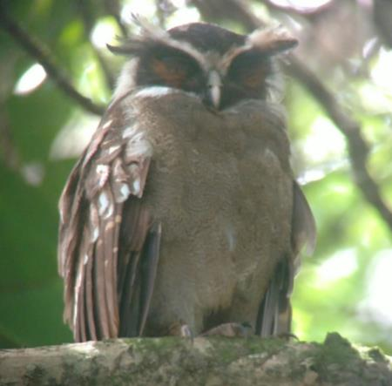
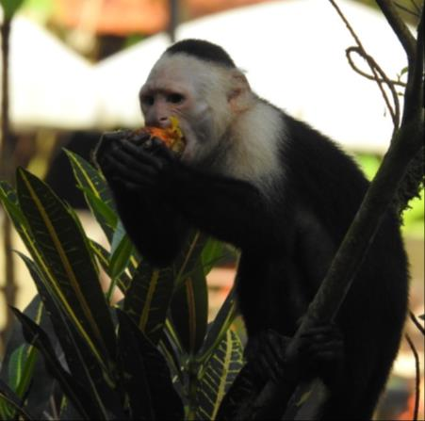
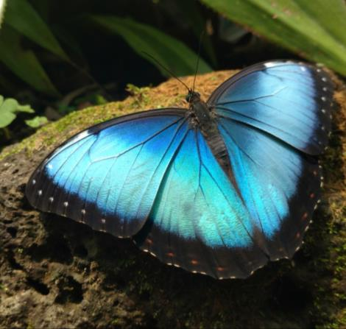
Biodiversity
Biodiversity – the variety of living species in any given area
Examples of biodiversity in Costa Rica
Speciation – the process in which new species are formed
Ecosystems – including 6 major types of forests
Notes:
Photos (left to right): Amanita muscaria mushroom, Crested Owl (Lophostrix cristat) spotted in Corcovado National Park, White-headed Capuchin monkey (Cebus capucinus) , Blue Morpho butterfly seen at Café Brit
Photo (top right): Notice drip tip, plant adaptation in cloud forest
Small photo: a fiddlehead emerging from the forest floor
See Teaching Notes and Blocks of Analysis for more information on biodiversity, speciation, and ecosystems.
From Beletsky: “Owing to its geographic location, rich biodiversity, educated people, stable politics, emerging commitment to preservation of wild areas, and openness toward science and ecology, Costa Rica long ago became a country of choice for many ecological, agricultural, and conservation research programs.” p.7

Slide 8
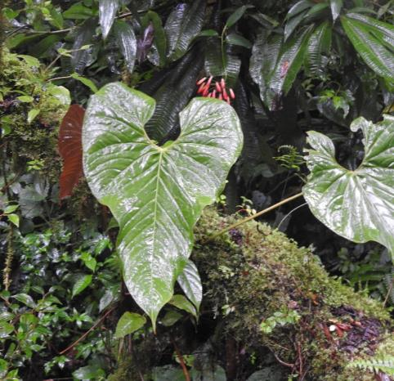
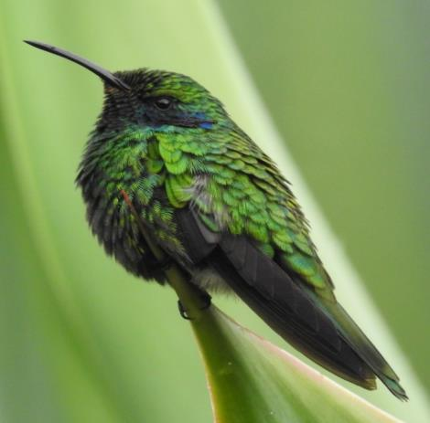
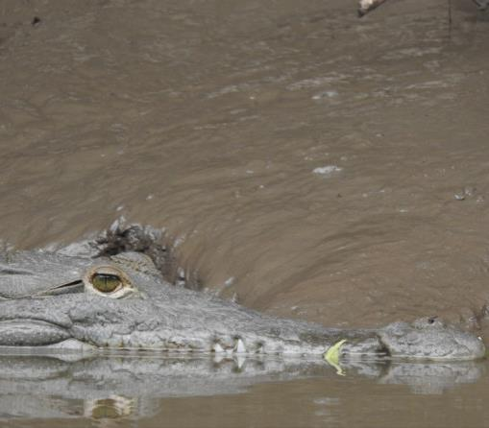
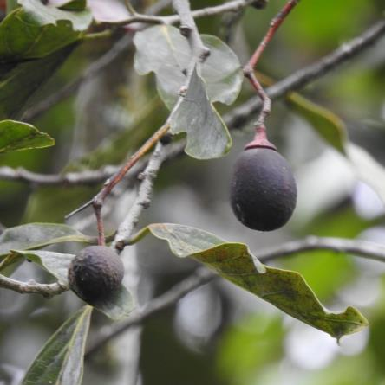
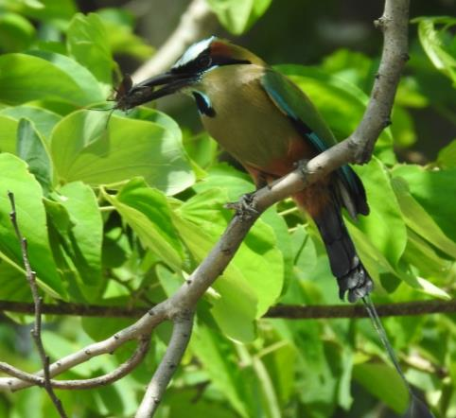
First Law of Ecology
“Everything is connected to everything else!”
~Barry Commoner
Notes:
Photos (top left to right): Philodendron sp. found along riparian forest in San Gerardo de Dota, Lesser Violetear Hummingbird (Colibri cyanotus) found in San Gerardo de Dota
Photo (bottom left to right): American Crocodile (Crocodylus acutus) spotted in the canals at Tortuguero, Avocado sp. growing outside of the QERC, Turquoise-browed Motmot (Eumomota superciliosa) spotted in Guanacaste, Blue Morpho butterfly
The first law of ecology states that everything is connected. This ecological paradigm sets the stage for multiple relationships between biotic and abiotic factors. If one component of an ecosystem, be it related to animals, plants or physical factors, changes, it sets in motion a cascade of alterations in the surrounding environment. This is one of four laws of ecology penned by Barry Commoner in the first chapter of his book, “The Closing Circle”.
“There is one ecosphere for all living organisms and what affects one, affects all.”
http://webs.wofford.edu/whisnantdm/Sixties/Environment/FourLaws.pdf

Slide 9
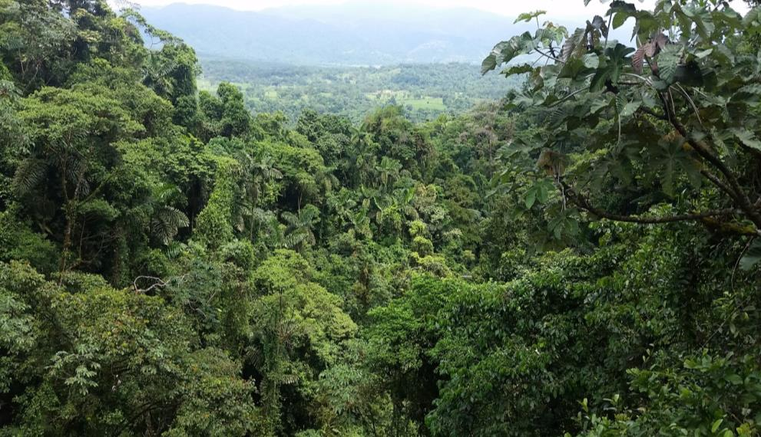
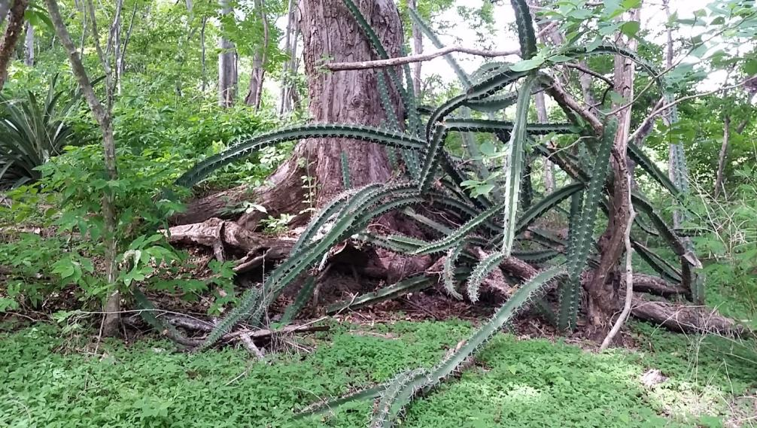
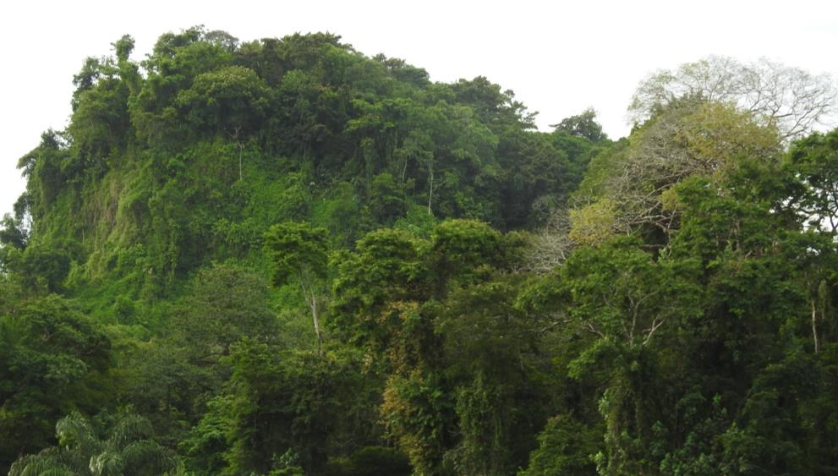
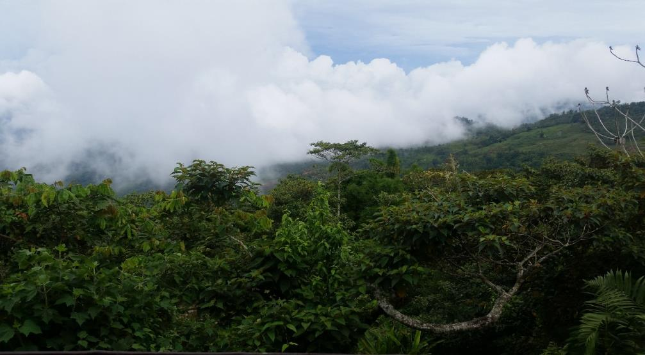
Tropical Moist Forest
Arenal Region
Tropical Dry Forest
Guanacaste
Lowland Tropical Rainforest
Tortuguero
Cloud Forest
San Gerardo de Dota
Notes:
See Teaching notes and/or Blocks of Analysis for more information on each forest.

Slide 10
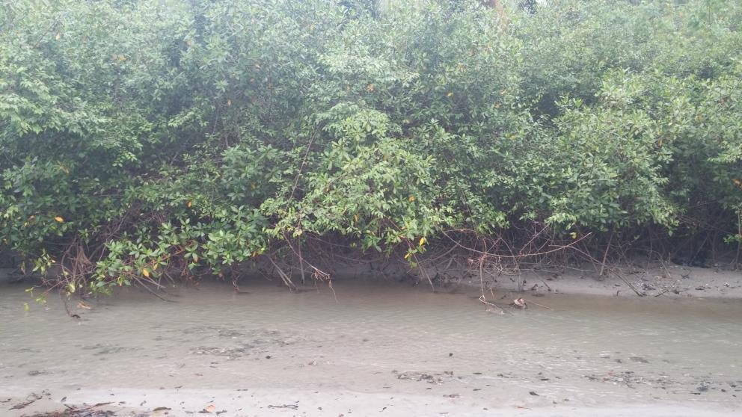
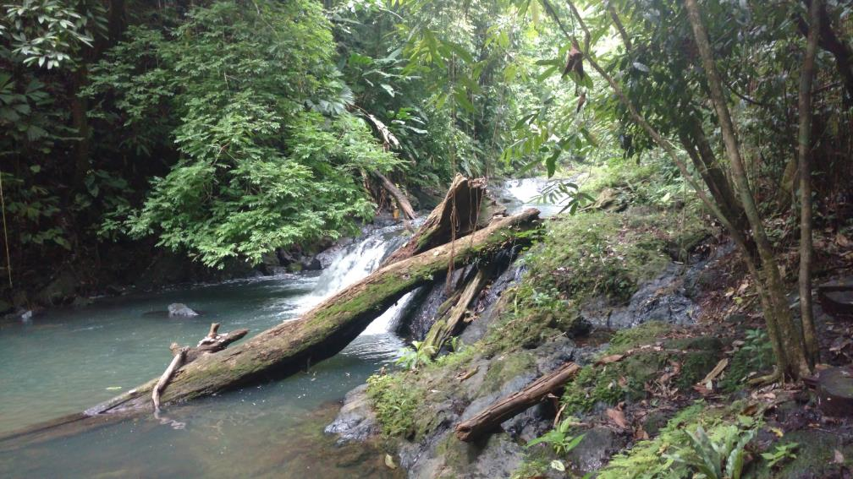
Mangroves
Manuel Antonio
Riparian Forest
Arenal Region
Notes:
See Teaching notes and/or Blocks of Analysis for more information on each forest.

Slide 11
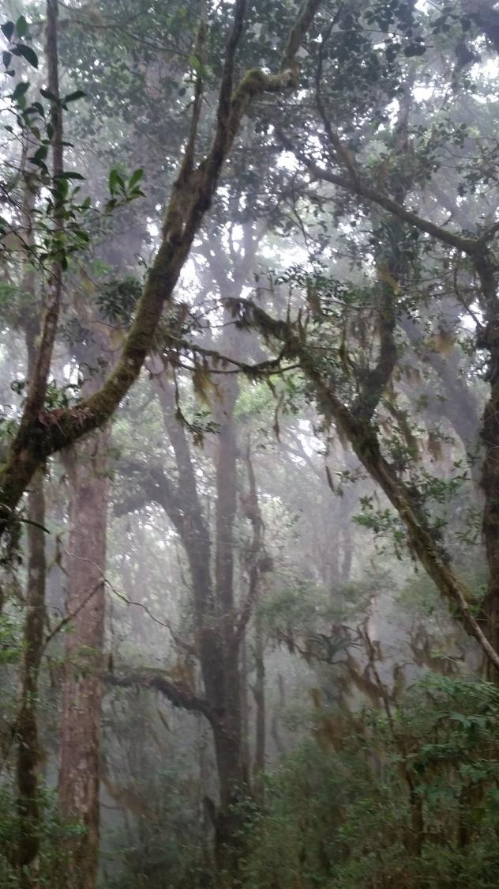
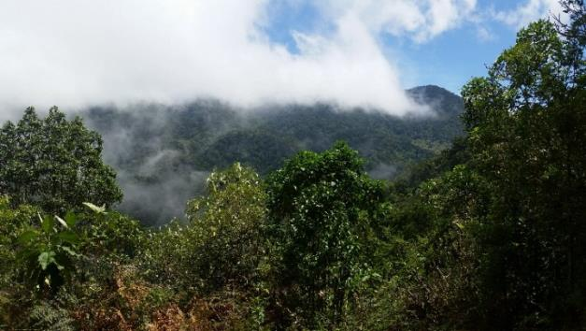
The Cloud Forest
Tropical Montane Cloud Forest – between 1000 and 3000 m elevation & between latitudes 23°N and 23°S
Water Cycle – tree crowns trap water, large droplets form, water travels downward to the understory and the forest floor.
Water in the clouds condenses and is cycled through the canopy occupants.
As much as 40 % of the water in montane cloud forest comes from mist of the clouds.
Notes:
Photos: clouds rolling through the forest canopy in the Savegre Valley

Slide 12
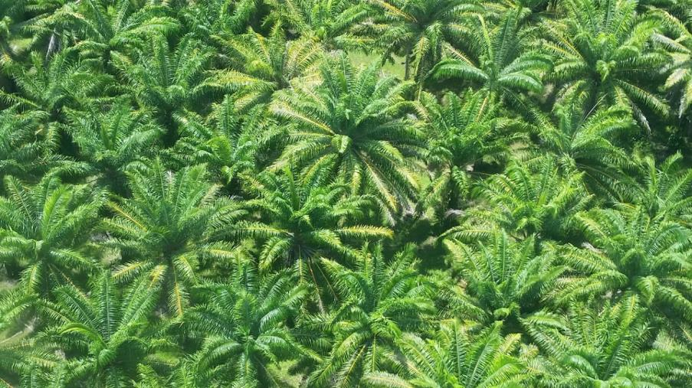
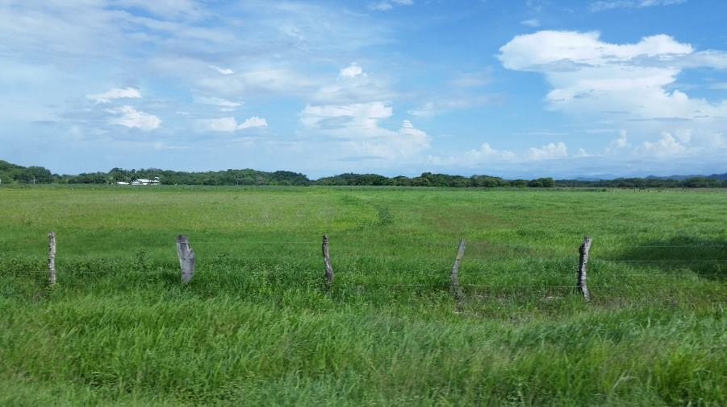
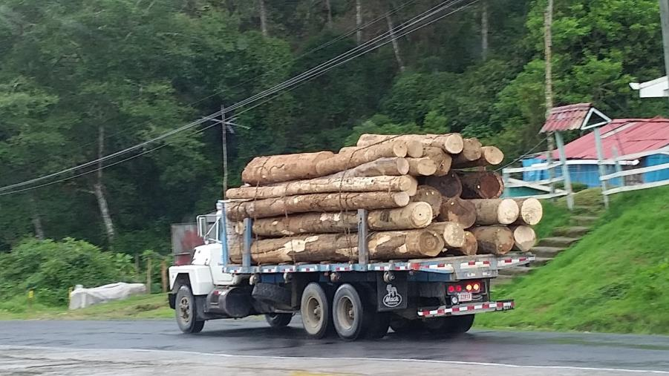
Costa Rica is an agricultural society, yet some practices pose threats to biodiversity.
Farming – land is cleared for agriculture
Logging – deforestation
Monocultures – oil palms
Notes:
Photos: (bottom left) land cleared for cattle grazing, (bottom right) a log truck carrying felled trees, (top right) a monoculture of oil palms – This aerial photo was taken from a plane, where acres and acres of oil palms can be seen stretching across the landscape!

Slide 13
What is Sustainability?
Form small groups and use the next few minutes to discuss your understanding of sustainability.
Notes:
Prompt students to break into small discussion groups, each group coming up with one idea about what sustainability means to them.

Slide 14
What is Sustainability?
Social acceptability
Environmental suitability
Economic viability
What is social acceptability?
What is economic viability?
What is environmental suitability?
As a group, define these concepts.
Notes:
Bosari’s Model of Sustainability (used with permission)

Slide 15
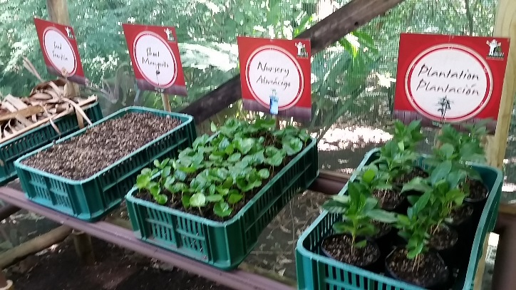
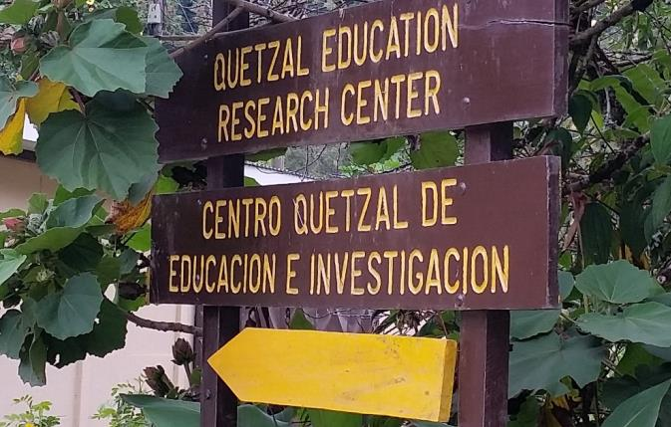
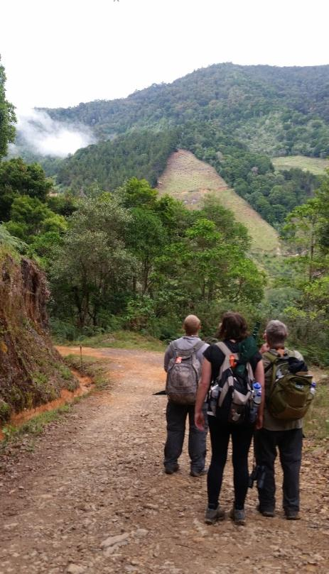
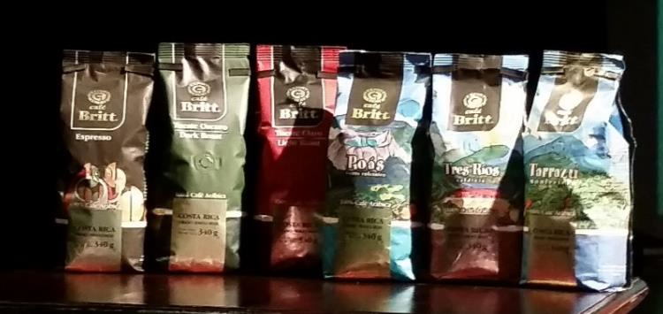
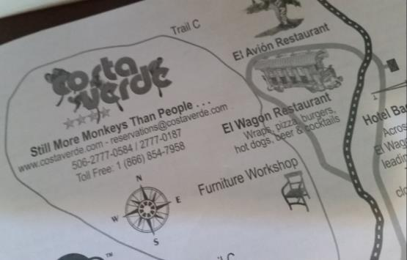
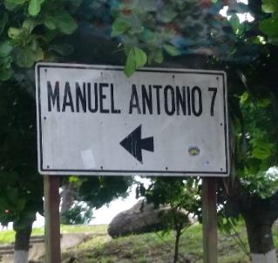
Sustainable Methods in Costa Rica: Ecotourism
Notes:
Photos – Top left: On a tour at Café Brit, the stages of sustainable coffee cultivation are on display for tourists to see.
Top center: A sign at the Savegre Hotel points tourist and researchers to the QERC.
Right: Researchers and tourists alike can hike along the trails at the Savegre Hotel Natural Reserve.
Bottom left: Sustainably grown coffee is produced at Café Brit.
Bottom center: A map from Costa Verde hotel at Manuel Antonio – their motto is “still more monkeys than people!”
Bottom right: A sign leading to a popular ecotourism location on the central Pacific coast, Manuel Antonio.

Slide 16
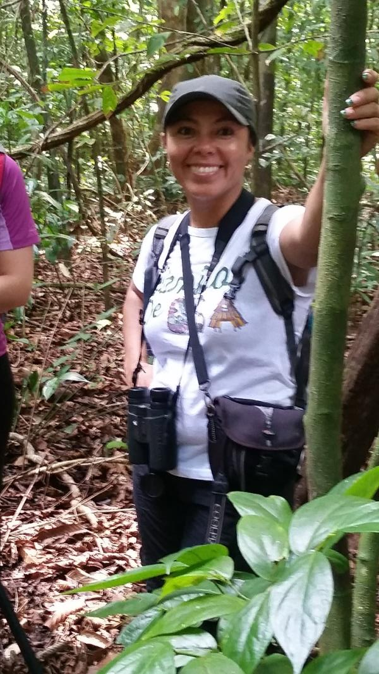
Sustainable Methods in Costa Rica: Parataxonomists
Notes:
Photos: Parataxonomists are trained to explain the local ecology and biodiversity of Costa Rica at the Arenal Hanging Bridges Park (left) and Corcovado National Park (right) as well as other parks around the country.

Slide 17
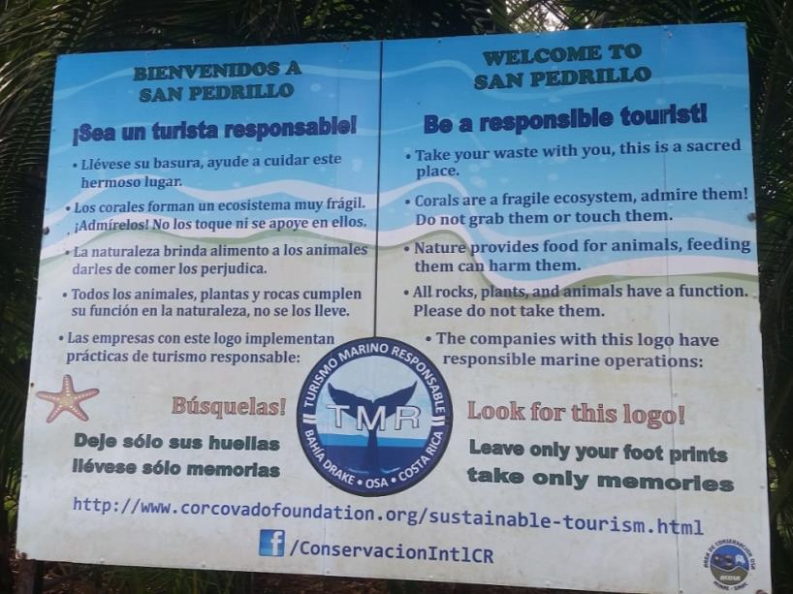
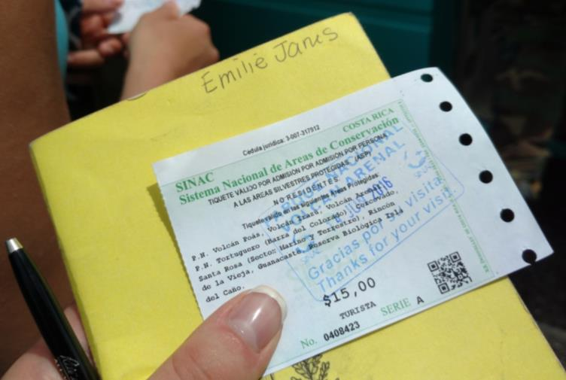
Sustainable Methods in Costa Rica:
Parks
Notes:
Photos – Left: A sign at San Pedrillo in Corcovado National Park explains to tourists how to be environmentally responsible eco-travelers.
Center: The Arenal Hanging Bridges Park arch frames the Arenal Volcano (Volcan Arenal) in the background.
Right: Emilie holds her entrance ticket to visit the Arenal Volcano, and other areas of conservation.

Slide 18
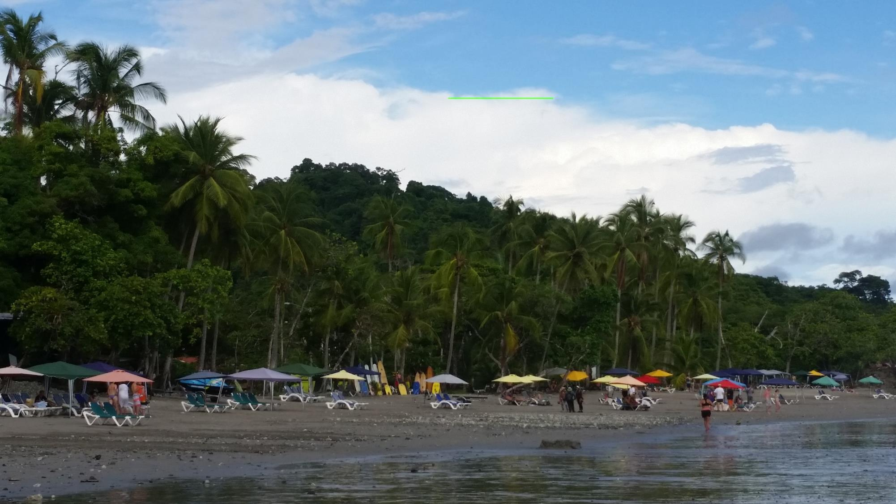
Alternatives to Ecotourism
Although ecotourism has proven successful in some areas, it may not be the best fit in every situation.
Why might ecotourism not be the best alternative for sustainability?
What are some situations in which it may not work, and why?
What are some alternatives to ecotourism?
Notes:
Ecotourism may lead to an influx of tourists in an area, leading to the destruction of the area’s flora and fauna. For example, tourists may interact with animals (feeding, etc.) and alter their natural behavior. Visitors may also take “natural souvenirs” like shells, plants, rocks, feathers, etc. that should remain within the ecosystem. Even simple things like creating paths can have far reaching implication on the ecosystem. Ecotourism also relies on disposable income from tourists. If there is a recession, and people travel less, areas dependent on ecotourism may suffer. It is vital to be an educated and conscientious eco traveler.
Alternatives to ecotourism may include eco-friendly industries, being open to upstart industries who have studied the area..

Slide 19
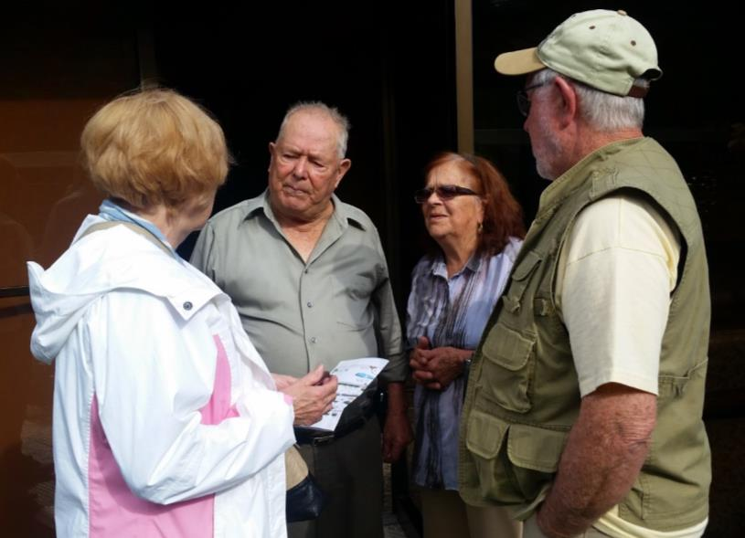
Sustainability is Achievable!
Through
Respect of cultures
Education of indigenous people
Understanding the ecology of the area
Consideration of finances, so that families can survive by making a living through sustainable practices
Can you add anything to the changing definition of sustainability above?
Notes:
Students should be encouraged to think of ways to maximize learning opportunities while preserving the native flora and fauna.
Photo shows Dr. Leo Finkenbinder and wife Zana with the matriarch and patriarch of the valley, Efrain and Caridad Chacon.

Slide 20
Exit Slip Answer the following question on the 3x5 card provided for you:
How was the decision of the Chacón family and their influence in the area an example of sustainability? How did it embody environmental suitability, social acceptability and economic viability? Be specific.
Notes:
Prompt students to break into small discussion groups, each group coming up with one idea about what sustainability means to them.

Slide 21
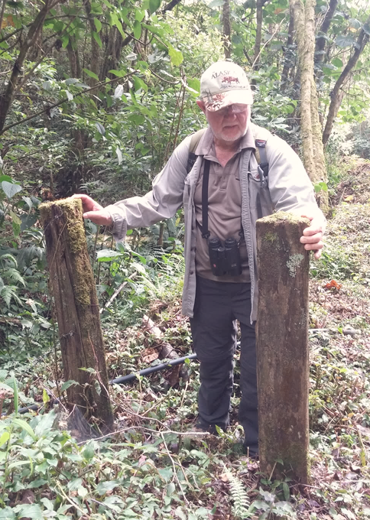
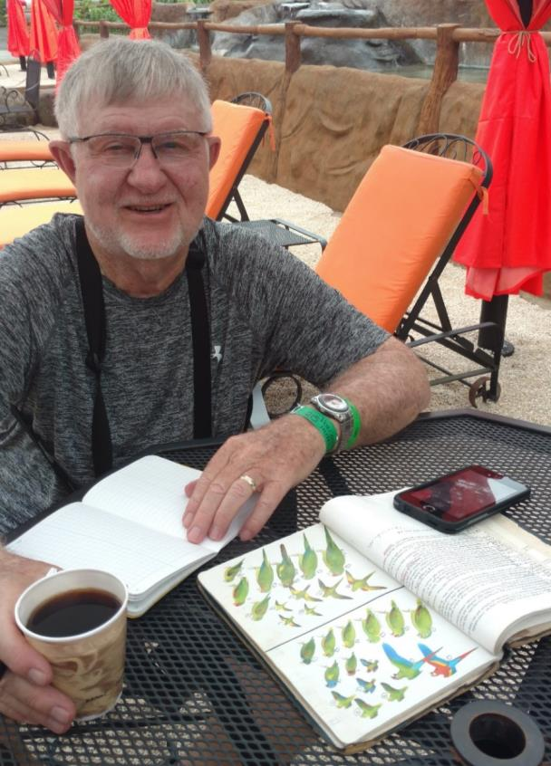
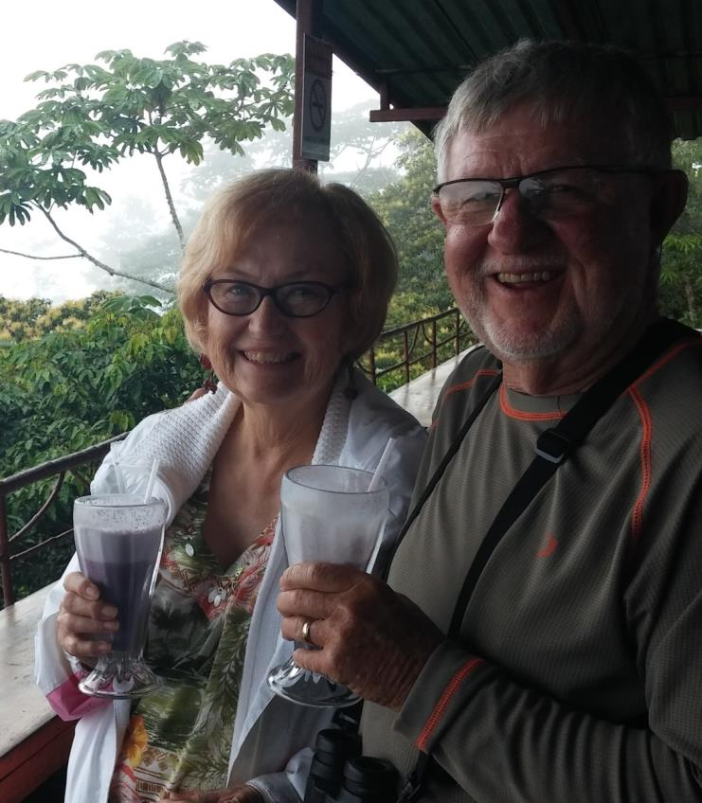
The Rest of the Story…
Notes:
Pictures (left to right):
1. Dr. Leo Finkenbinder at the last gate that was removed when the last of the dairy cattle were sold.
2. Dr. Finkenbinder in 2016 doing the tropical field studies course with Olivet Nazarene University. Here he is seen doing two of his favorite things, drinking coffee and birdwatching.
3. Dr. Finkenbinder and his wife, Zana, enjoy a mora con leche (a delicious smoothie made of blackberries and milk) on the balcony of Mirador Valle del General, 2015.

Slide 22
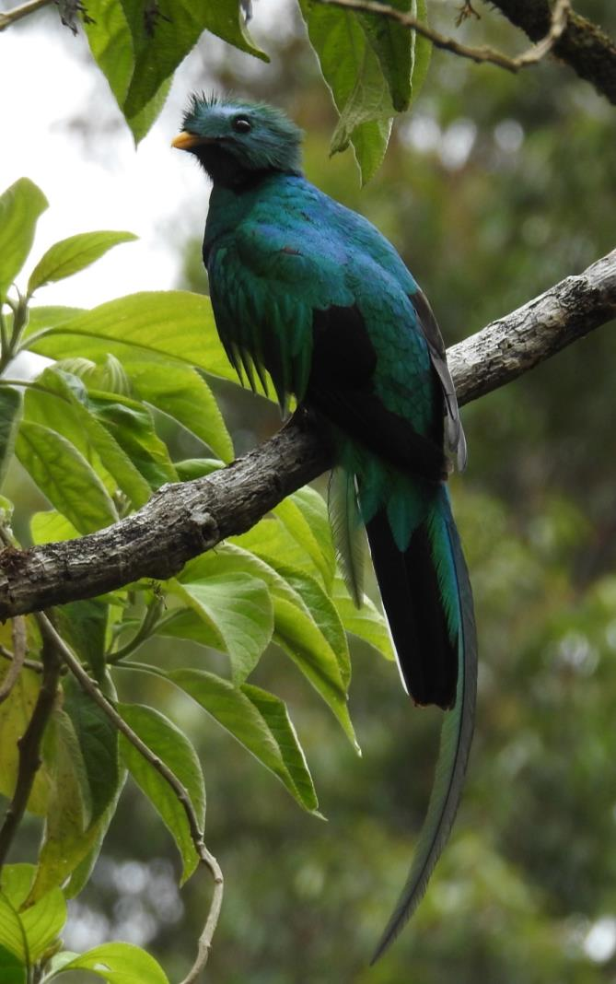
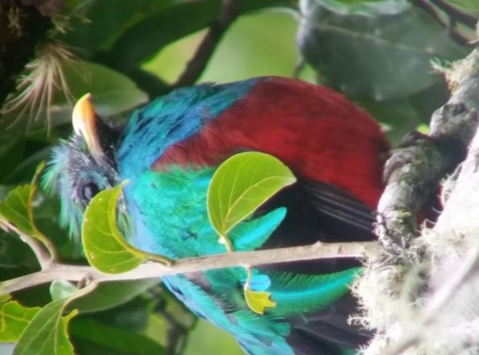
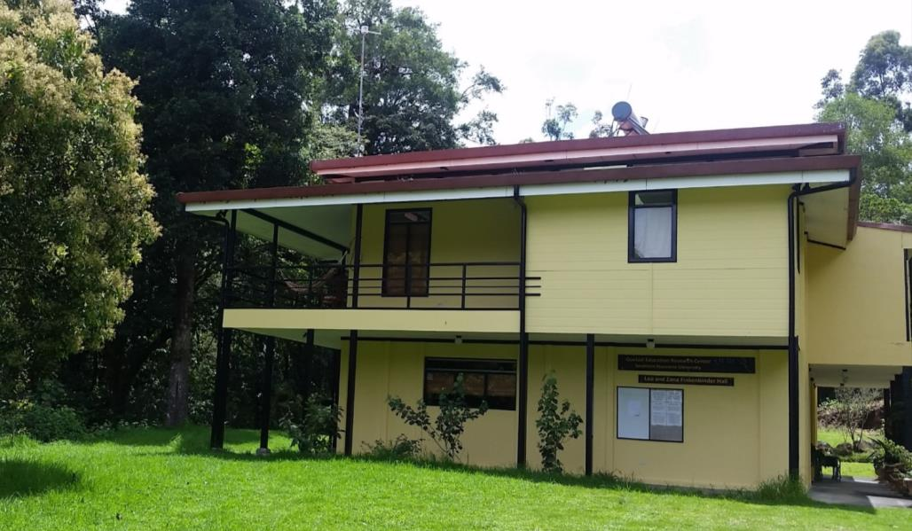
The Resplendent Quetzal & Leo and Zana Finkenbinder Hall (QERC)
Notes:
Photos (left to right):
1. The Resplendent Quetzal seen at the Quetzal Education Research Center (QERC)
2. The QERC, renamed The Leo and Zana Finkenbinder Hall in honor of their commitment to and hand in transforming the Savegre.

Slide 23
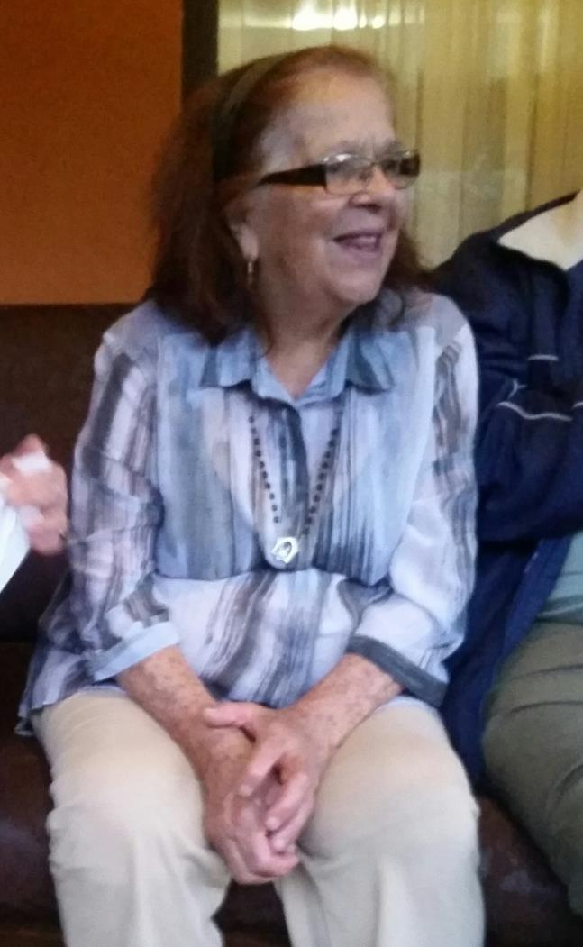
In Loving Memory of Caridad
Notes:
Photo:
Caridad: the matriarch of San Gerardo de Dota

Slide 24
Photo Credits
All pictures, with the exception of the map of Costa Rica on Slide 3 and the diagram on Slide 8, have been taken by Dr. Aggie Veld and Emilie Janes.
Outside Sources:
Slide 3 – retrieved from https://commons.wikimedia.org/wiki/File:Costa_Rica_provinces_blank.png#filelinks
Slide 4 – retrieved from https://commons.wikimedia.org/wiki/File:Costa_Rica_on_the_globe_(Americas_centered).svg
Slide 8 – visual used with permission from Bruno Borsari

Slide 25
References
Beletsky, L., & Barrett, P. (1998). Costa Rica: The Ecotravellers Wildlife Guide. San Diego: Natural world, Academic Press.
Borsari, Bruno. The Ecological Footprint Dilemma, Biology Department Winona State University, 2009
Janzen, D. H. (1983). Costa Rican Natural History. Chicago, IL: The University of Chicago Press.
Neuenschwander, Dwight E., and Leo R. Finkenbinder. "The Chainsaw and the White Oak: From Astrobiology to Environmental Sustainability." Radiations Spring, 2001: 5-11.
Interviews with Chacons, Summer 2015, San Gerardo de Dota, Costa Rica
Interviews with Finkenbinders, Summer 2015, San Gerardo de Dota, Costa Rica
http://www.canopyintheclouds.com/learn/ May 4, 2017
http://www.konacloudforest.com/tropical-cloud-forest/ May 9, 2017
www.costarica-embassy.org/?q=node/12/ May 10, 2017
http://www.vivacostarica.com/costa-rica-information/costa-rica-deforestation.html May 10, 2017
http://www.greateasternranges.org.au/about-the-corridor/threats/unsustainable-practices/ July 14, 2018
http://www.plunderingappalachia.org/theissue.htm July 14, 2018
https://www.cengage.com/biology/discipline_content/animations/global_circ_v2.html August 1, 2018
https://www.youtube.com/watch?v=Ye45DGkqUkE August 1, 2018
https://costarica.org/volcanoes/ August 1, 2018
https://costa-rica-guide.com/travel/weather/why-does-it-rain/ August 1, 2018
http://webs.wofford.edu/whisnantdm/Sixties/Environment/FourLaws.pdf August 1, 2018

