Slide 1
NATIONAL CENTER FOR CASE STUDY TEACHING IN SCIENCE
A Presentation to Accompany the Case Study:
^{To List or Not to List?}
^{What to Do About the}
^{Greater Sage-Grouse}
^{by}
Dachin N. Frances and Sanja Hinic-Frlog
^{Department of Biology}
University of Toronto at Mississauga, Canada
Notes:
Credit: ©Cjchiker | Dreamstime.com, ID#93230549, licensed.

Slide 2
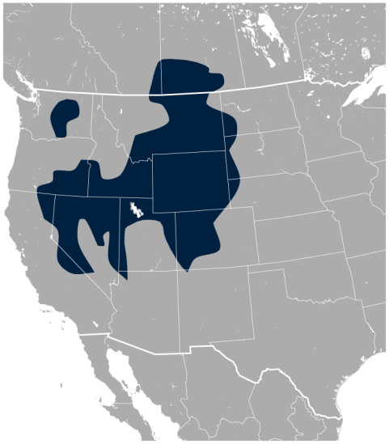
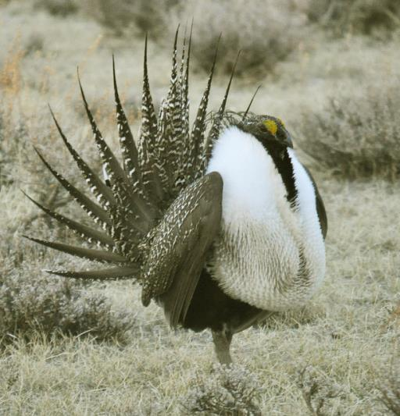
Greater Sage-Grouse
Sage-grouse current range
Centrocercus urophasianus
Family: Phasianidae
Current range: Western U.S. and Southern Alberta and Saskatchewan
Male sage-grouse
Notes:
Credits:
Left: Male greater sage-grouse struts to attract females at a lek (breeding or dancing ground) near Bodie, California in April. Photo by Jeannie Stafford/USFWS, CC BY 2.0. https://www.flickr.com/photos/usfws_pacificsw/6928668188
Right: Geographical distribution of the sage-grouse Centrocercus urophasianus. Map by Darekk2 using the IUCN Red List spatial data,
https://commons.wikimedia.org/wiki/File:Sage_Grouse_Centrocercus_urophasianus_distribution_map.png.

Slide 3
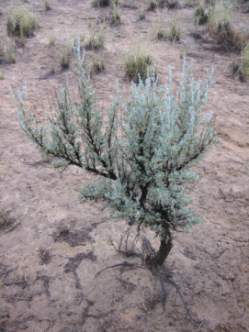
Sage-Grouse Habitat
Sagebrush steppe
Located in the Intermountain West.
Hundreds of endemic plant and animal species.
Artemisia tridentata
Notes:
Credit: Sagebrush plant in San Juan County, New Mexico. Photo by Peemus, CC BY-SA 3.0, https://commons.wikimedia.org/wiki/File:Sagebrushsjc.jpg.

Slide 4
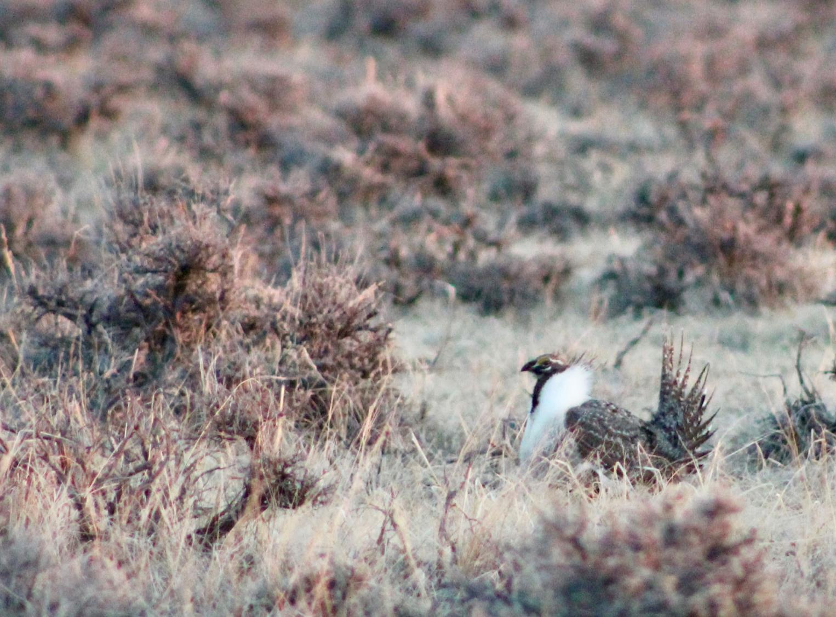
Sage-Grouse Habitat
Greater sage-grouse
Dependent on the sagebrush habitat.
Long-lived with low reproductive rates.
Eats the leaves of the sagebrush.
Uses the sagebrush as nesting area and for shelter.
Mating displays, or leks, occur in close proximity to nest sites.
Notes:
Credit: On the Wind River Reservation in Wyoming. Photo by Angela Burgess, USFWS. Public domain. https://www.flickr.com/photos/usfwsmtnprairie/34876450320/

Slide 5
What Is a Lek?
Video link
Notes:
https://youtu.be/cLnbiTkj1TQ
Body-popping sage grouse. Running time: 2:37 min. Produced by BBC, 2015.

Slide 6
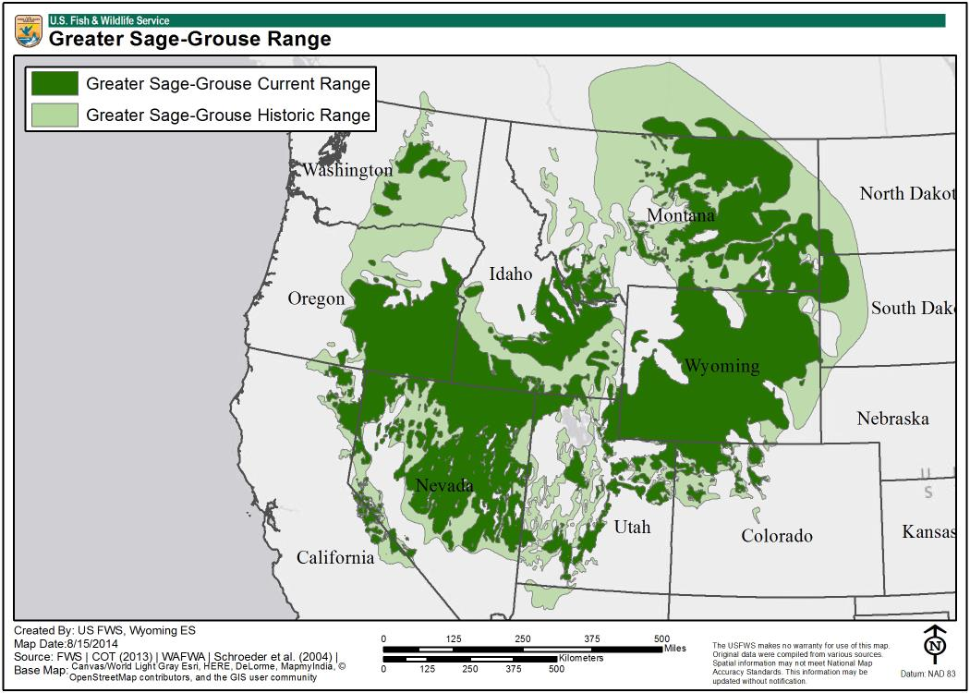
Population Declines
Sage-grouse populations have declined by 98% from 1988 to 2012.
The largest threat to greater sage-grouse is habitat loss and fragmentation.
Sagebrush habitat used to cover 150 million acres in North America.
Fire suppression, invasive species, and overgrazing have degraded the sagebrush habitat.
Notes:
Credit: Map created by US FWS, Wyoming ES. Map Date: 8/15/2014. https://www.fws.gov/greatersagegrouse/maps/20140815_GRSG_Range.jpg

Slide 7
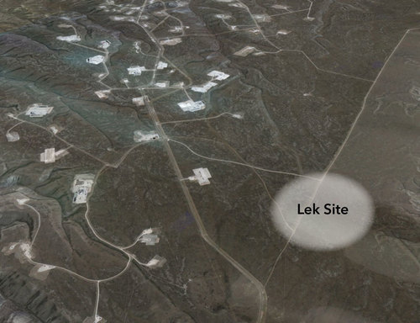
Greater Sage-Grouse in the U.S.
In 2010: US Fish and Wildlife Services (USFWS) began to review whether the sage-grouse should be protected by the Endangered Species Act.
Based on a petition asking that the greater sage-grouse be protected under the ESA citing habitat loss and fragmentation as well as lack of regulations to stem future habitat loss.
Well pads for oil extraction
Notes:
Credit: Axelson, G., M. Dantzker, and G. Vyn. 2015. Last grouse standing: can birds and industry coexist in the western sage lands? Living Bird Magazine. The Cornell Lab of Ornithology. Educational use. https://www.allaboutbirds.org/last-grouse-standing-birds-industry-sage/.

Slide 8
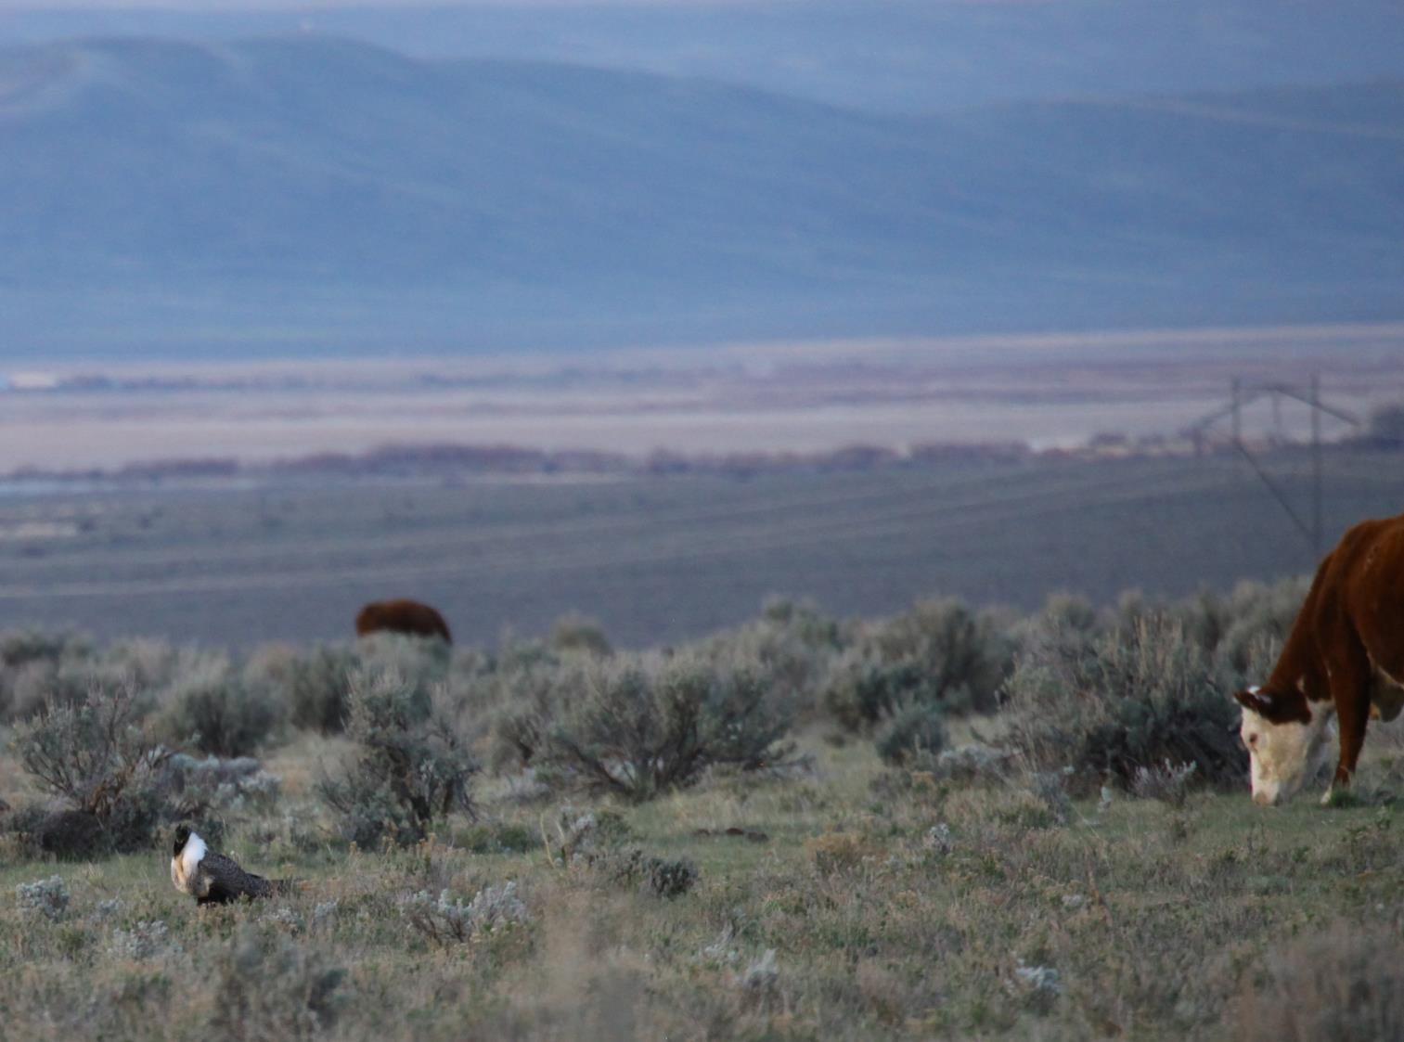
Greater Sage-Grouse in the U.S.
September 2015, the US Fish and Wildlife and Department of the Interior declined a petition to list greater sage-grouse as an “Endangered Species.”
Sage-grouse will not be protected by the Endangered Species Act.
Notes:
Credit: Sage-grouse lek and grazing cattle. Photo by K. Theule/USFWS, CC BY 2.0, https://www.flickr.com/photos/usfwsmtnprairie/20232643934/.

Slide 9
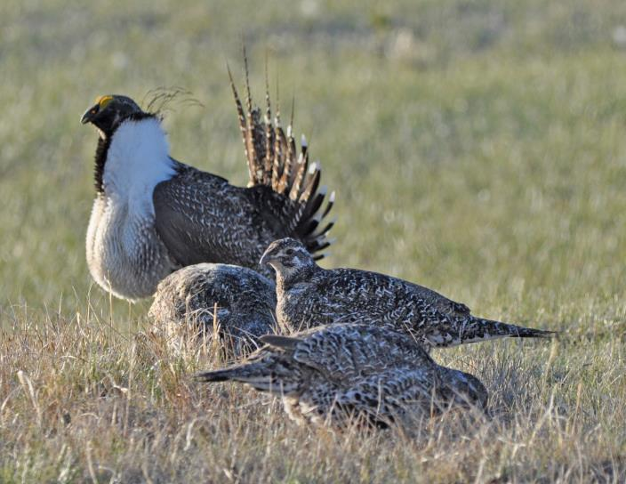
Greater Sage-Grouse in the U.S.
“…We have determined that the greater sage-grouse is not in danger of extinction now or in the foreseeable future throughout all or a significant portion of its range and that listing the species is no longer warranted.” USFWS
Notes:
Credit: Male and females. Photo by Jeannie Stafford/USFWS, CC BY 2.0, https://www.flickr.com/photos/usfws_pacificsw/8694401662/.

Slide 10
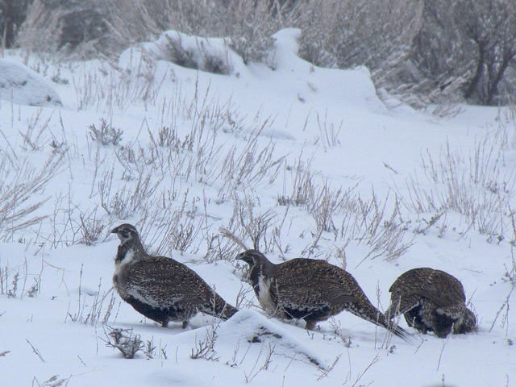
Greater Sage-Grouse in the U.S.
How did they decide?
Determined that the bird remains relatively abundant and well-distributed across their range.
Federally and state-enacted management plans reduced the biggest threats to the greater sage-grouse.
Notes:
Credit: Females in winter. Photo by Bryant Olsen, CC BY-NC 2.0, https://www.flickr.com/photos/bryanto/4492067176/.

Slide 11
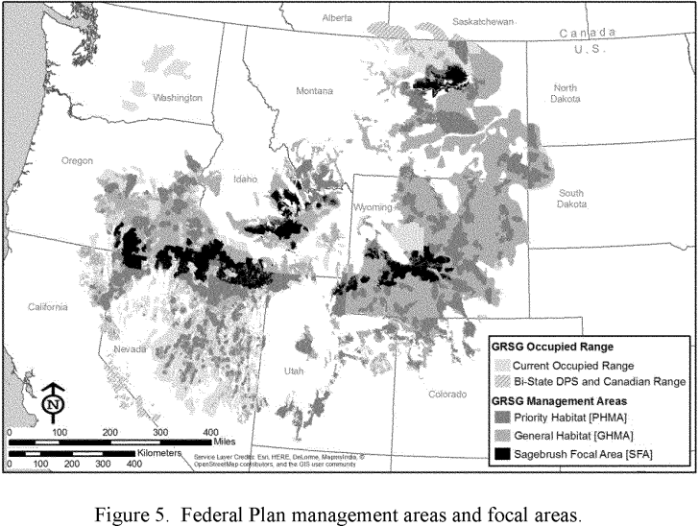
Land Management Strategy in the U.S.
Notes:
Source: DEPARTMENT OF THE INTERIOR Fish and Wildlife Service. 50 CFR Part 17 [Docket No. FWS–R6–ES–2015–0146]; [4500030113]
Endangered and Threatened Wildlife and Plants; 12-Month Finding on a Petition To List Greater Sage-Grouse (Centrocercus urophasianus) as an Endangered or Threatened Species. Federal Register/Vol. 80, No. 191/Friday, October 2, 2015/Proposed Rules.
https://www.gpo.gov/fdsys/pkg/FR-2015-10-02/pdf/2015-24292.pdf

Slide 12
Land Management Strategy in the U.S.
Oil, gas and mining companies, ranchers and farmers can continue to use sage-grouse habitat

Slide 13
Greater Sage-Grouse in Canada
Listing in Canada?
In 1998, the Ministry of the Environment listed the sage-grouse as endangered under the Species at Risk Act.
What does this mean?
Sagebrush habitat is conserved.
Cannot make new roads or fences.
Cannot operate loud machinery or vehicles at sunrise or sunset.

Slide 14
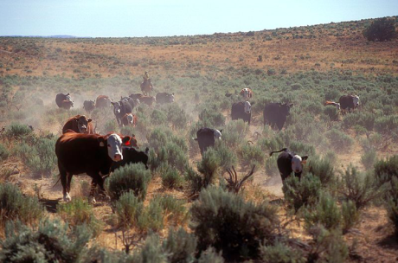
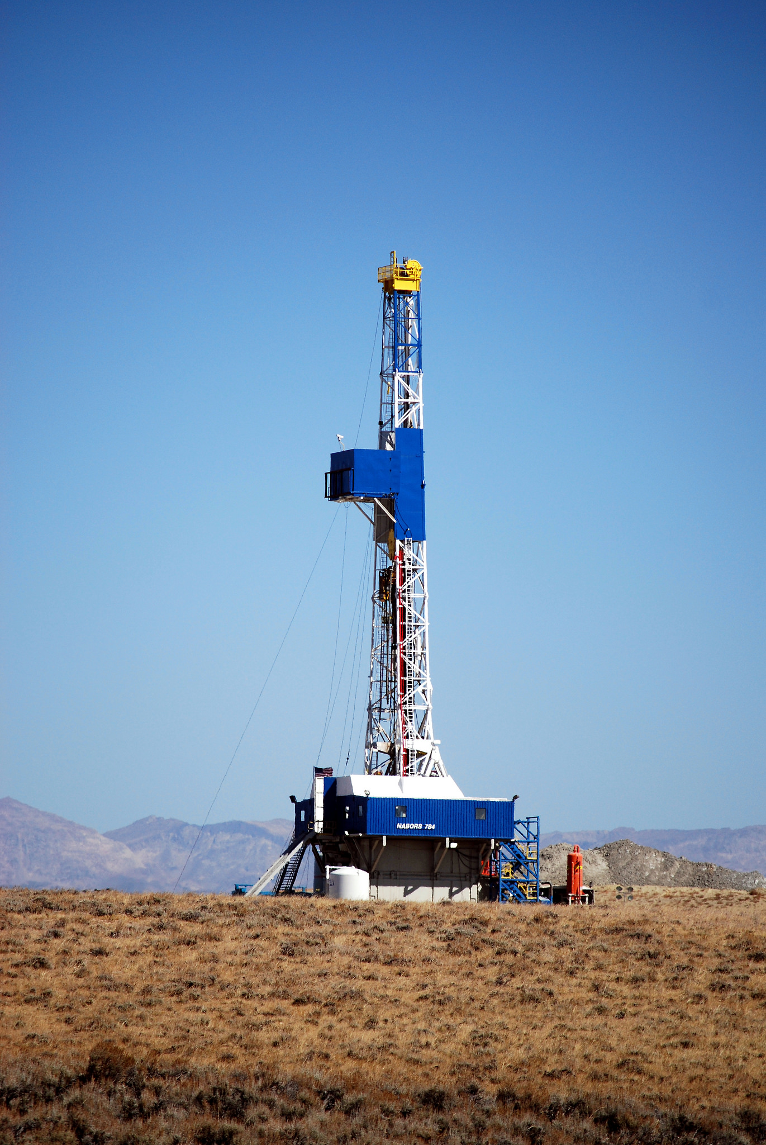
Sage-Grouse: Endangered?
Should the sage-grouse have more or less federal protection?
Should economic developments such as ranching, mining, and oil extraction occur in sage-grouse habitat?
Notes:
Credits:
Left: Running cattle on a ranch in a sagebrush habitat. Photo by Oregon State University, CC BY-SA 2.0, https://www.flickr.com/photos/oregonstateuniversity/33477509045/.
Right: Drill rig in Wyoming. Photo by BLM Wyoming, CC BY 2.0, https://www.flickr.com/photos/mypubliclands/33661102776.

Slide 15
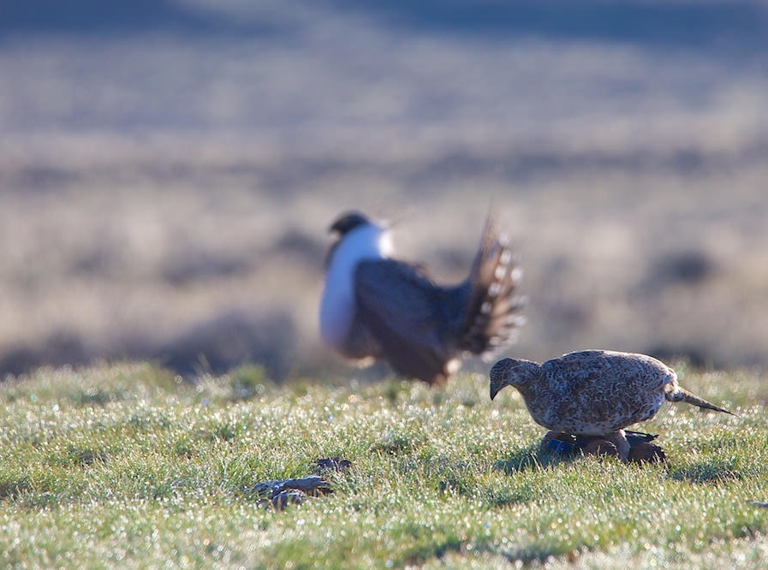
Biological Factors to Consider
Habitat
Where do they lek? Where do they nest? How large is their home range?
Diet
What do they eat? Does this change throughout the year? What about the chicks?
Population sizes
Birth and death rates, clutch sizes, etc.
Genetic diversity and landscape genetics
Connectivity between populations
Notes:
Credit: Robotic female sage-grouse are used at leks to elicit courtship behaviors from males. Photo by Dr Alan Krakauer, CC BY-NC 2.0, https://www.flickr.com/photos/usfwspacific/29689858004.

Slide 16
The Sagebrush Sea Documentary by the Cornell Lab of Ornithology
Full movie:
http://www.pbs.org/wnet/nature/sagebrush-sea-full-episode/12341/

