Slide 1
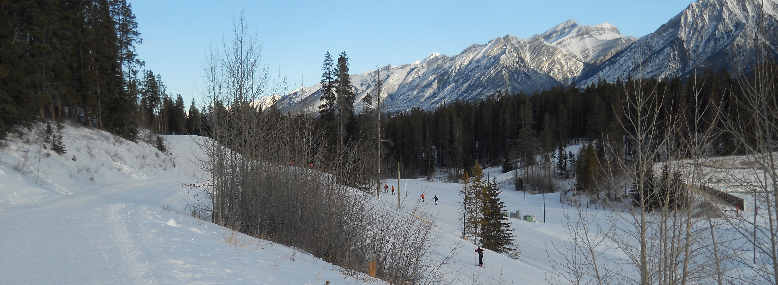
NATIONAL CENTER FOR CASE STUDY TEACHING IN SCIENCE
A Presentation to Accompany the Case Study:
^{Double Black Diamond Slopes:}
^{Risky Business?}
^{by}
^{Janice P. Wittstrom} Earth and Environmental Sciences Mount Royal University, Calgary, AB, Canada

Slide 2
What is your risk tolerance? What do you consider to be an “acceptable risk”?
Would you bungee jump?
Have you ever skied out of bounds?
Why or why not?

Slide 3
What exactly is risk?
Risk: the probability of an event occurring multiplied by the consequences (cost) of it actually happening
Risk = Probability x Cost
May be referred to as recurrence interval
Can be assessed or understood with proper evaluation and investigation

Slide 4
Hazards
Geological processes have been ongoing for millions of years (earthquakes, floods).
A hazard is a geological event that has negative consequences for humans (destruction of property, injury, loss of life).

Slide 5
Why do humans ignore geological hazards? (Why do they accept risk?)
Short memories/short attention spans
Lack of education or understanding
Denial mentality
Perception of time
Assumption that technology has “fixed” it
“Acceptable risk” mentality

Slide 6
When there is a longer time between events, humans tend to:
Develop casual attitudes about hazards
Think “technology” has fixed or at least mitigated past problems
Forget the past and the consequences of an event
(People play the “blame game” when something does happen)

Slide 7
Probability of Hazards
Averages, likelihood, statistics
Statistical predictions – “refinement” of past recorded events.
Data based
Do we have enough “recorded” earthquake events to make predictions? Do we have enough geological information?

Slide 8
Probability
Probability of 50% means an event has an equal chance of happening or not.
Probability of 10% means a 1 in 10 chance.
Example: the Bay area of California has a 70% chance of a 6.7 magnitude earthquake in the next 30 years. Meaning…?
(it could be anytime in next 30 years……or not)

Slide 9
Another example of probability is the “100 year event”
The largest, highest or most unusual event to be recorded in 100 years (most data not available for much more than that anyway).
Example: the chances of a flood reaching the highest level ever recorded in 100 years is 1% each year or once every 100 years.
However, it is possible to have two or three “100 year” events in a 10 year time span.

Slide 10
Geological Risk Assessment
The process of determining potential adverse “environmental effects” (physical and social) for a particular geological event.
Example: coastline changes due to hurricanes. Where should buildings be? How should coastline be developed if at all?

Slide 11
Geological Risk Management
The process of integrating risk assessment with legal, social, political, economical and technical issue to develop a plan of action for a particular hazardous area.
Example: evacuation route plans for Vancouver area after a shallow earthquake that may have triggered a tsunami.

Slide 12
Impact of a Natural Disaster
Depends on a variety of factors:
Population of the area
Climate
Geology
Vegetation
Recurrence interval
Perception and communication
How does the media influence this?

Slide 13
Evaluation of Geologic Hazards: disaster prediction risk assessment
Location – geological & geographical
Probability – statistics & geology
Precursor event recognition
Forecasting and evidence from past
Warnings

