Slide 1
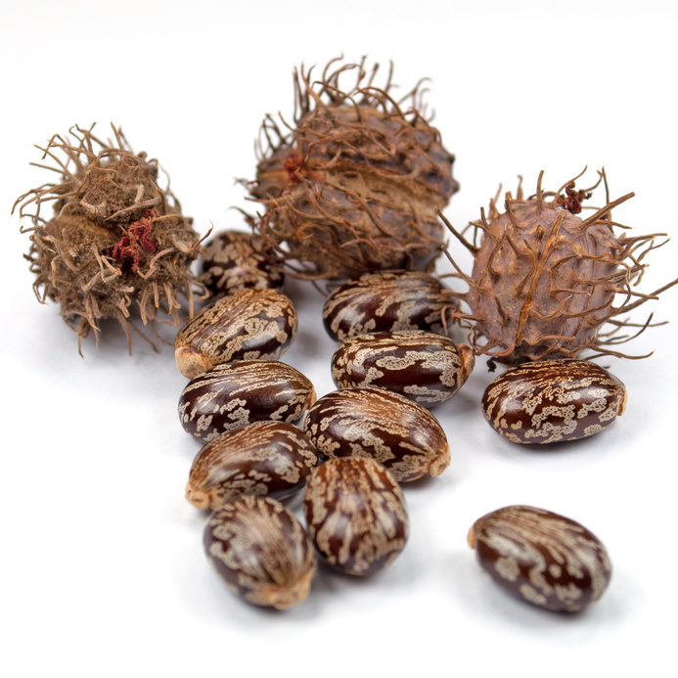
National Center for Case Study Teaching in Science
^{Rice ’n Beans or Ricin Beans?}
^{A Deadly Swap}
Supplemental Presentation
^{by}
^{Ann T.S. Taylor} ^{Department of Chemistry} Wabash College, Crawfordsville, IN
Notes:
Licensed photo of castor beans © M. Schuppich | Fotolia, id 79402463.

Slide 2
http://abcnews.go.com/GMA/video/ricin-letters-mailed-obama-elvis-impersonator-suspect-released-19029161
Notes:
Link to the news clip where Paul Kevin Curtis, who was accused of sending poison to politicians, says he'd never heard of ricin, he thought they said rice.

Slide 3
Goals for today
Understand the types of experiments that can be used to monitor translation, including radionucleotide tracers, polyribosome isolation, and modification.
Apply and extend the concepts of translation to predict and explain inhibitor effects.
Form hypothesis and logical experimental techniques to explore translation.

Slide 4
Figure 1. Incorporation of tritiated reagents in tumor cells (Lin et al., 1971).

Slide 5
Group report out: Ways to inhibit translation
Notes:
Have groups brainstorm different ways that translation could be inhibited. Compile answers here (have a group representative come up and record their answers; add a + to ideas they also had that are already posted.

Slide 6
Components for an in vitro translation system
Notes:
Have groups report out their answers (see case study answer key).

Slide 7
Phosphocreatine and creatine kinase
Notes:
The inclusion of creatine kinase and phosphocreatine allows for energy stores to be replenished during translation without having to add so much ATP or GTP that it is inhibitory.

Slide 8
Figure 2. Effect of ricin on polyphenylalanine synthesis. Redrawn from Figure 2 of Olsnes and Phl, 1972.

Slide 9
How would you separate free ¹⁴C- phenylalanine from poly-¹⁴C-Phe?
Size exclusion chromatography
TCA precipitation

Slide 10
Polyribosome fractionation
Unincorporated labeled
amino acids
5% Sucrose
Centrifuge
55% Sucrose
Notes:
In polyribosomal fractionation, a mixture that has been undergoing translation is centrifuged on a sucrose gradient. The top of the tube contains unincorporated radioactive (and non-radioactive) amino acids; as you move to higher density, the density of the particles increases, from 40S subunits, 60S subunits, 80S empty ribosomes, 80S mRNA loaded ribosomes, ribosomes with short peptides, ribosomes with longer peptides, and polysomes.

Slide 11
Figure 3. Ribosome sucrose gradients upon treatment with ricin or a translation inhibitor, ATA. Olsnes and Pihl, 1972.
Notes:
Walk through the four panels, the double axes (A260 = ribosome and nucleotide presence; radioactivity = peptide or unincorporated amino acid presence) and the application of the polyribosomal fractionation assay.

Slide 12
Figure 4. Table 2 and caption in Sperti et al., 1973.

Slide 13
Figure 5. Poly(U)-directedpolyphenylalanine synthesis catalysed by isolated control subunits and by isolated subunits treated with ricin. Detail of Panel A, Figure 3, in Endo et al., 1987.

Slide 14
EF interaction changes
Figure 6. Binding of radioactively labelled elongation factors to ribosomes. Based on Nilsson and Nygard, 1986.

Slide 15
Figure 7. Release of ³²PO₄³⁻ from ribosomes treated with γ ³²P-GTP and EF-1 in the presence and absence of Phe-tRNA. Based on Nilsson and Nygard, 1986.

Slide 16
Ricin itself
http://www.proteopedia.org/wiki/index.php/Ricin

