Slide 1
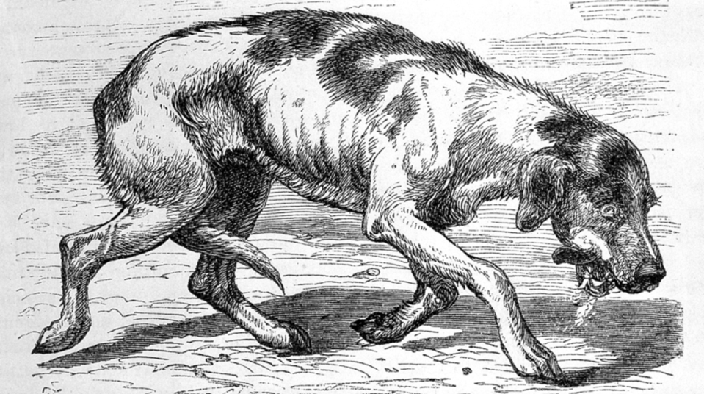
Mad Dogs and Chicken Heads
NATIONAL CENTER FOR CASE STUDY TEACHING IN SCIENCE
A Presentation to Accompany the Case Study:
Modelling Disease Outbreaks and Vaccination Campaigns
by
Thomas S. Nühse
School of Biological Sciences
The University of Manchester, United Kingdom
Notes:
(Image: Furious rabies, late stage , from “Rabies and hydrophobia…” by George Fleming (1872). Wellcome Images (CC BY 4.0) )
Rabies is one of those diseases that have been known for so long and show such characteristic symptoms that they have entered the English language as adjectives in their own right. “Rabid” is synonymous with “extremely violent, fanatical, radical”; the original Latin noun rabies means madness, ferocity, fury, frenzy, rage. Dogs (and humans!) in the final “furious” stage of rabies are agitated and salivate copiously.

Slide 2
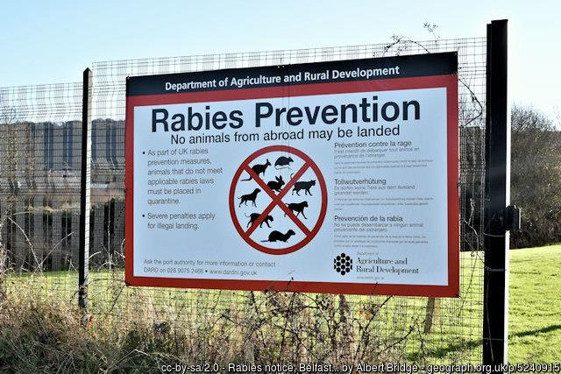
Part I – Introduction
Notes:
Most developed countries have declared themselves rabies-free. The United Kingdom (see image) and other countries therefore strictly control the import of pets and wild animals.
However, the disease continues to claim tens of thousands of human lives in resource-poor countries in Africa and Asia. Rabies is considered a neglected tropical disease whose elimination is one of the United Nations’ Sustainable Development goals.
Human-to-human transmission of rabies, unlike most other viral diseases, is extremely rare. Instead, most infections happen through animal bites. In Asia and Africa, the most likely animals to carry rabies are dogs, but infections from bats are not uncommon. For the 20th century outbreaks in Europe, foxes played a central role. Joining up insight from wildlife ecology with human healthcare is central to the One Health concept and the way it deals with zoonotic diseases.
We will later use a mathematical model to follow how rabies spreads and stabilises in a fox population, following one of the first examples of modelling in epidemiology. We will then assess what proportion of foxes needs to be vaccinated to eradicate the disease from the population.
However, we first need to understand how the transmission of a virus, bacterium or other disease agent can be represented in a model in the first place.

Slide 3
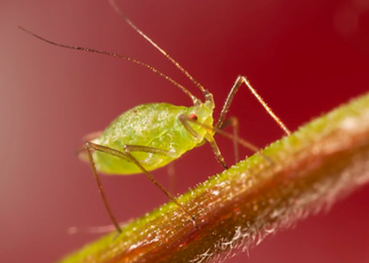
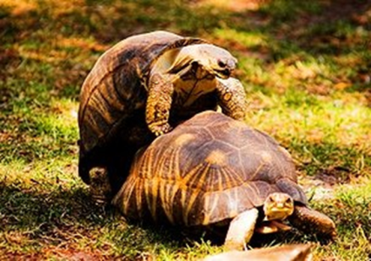
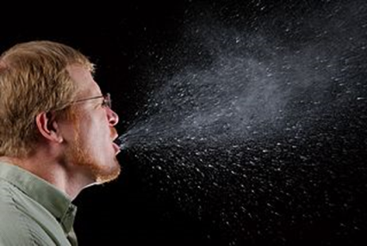
Aphid, Caramosca via Flickr (CC BY-NC 2.0); Puffball spore dispersal, Kalyanvarma via Wikimedia (CC BY-SA 3.0); Mating of Radiated tortoises, Fabien Dany via Wikimedia (CC BY-SA 2.5); Sneeze, James Gathany via CDC Public Health Image library ID 11162 (public domain)
Notes:
Parasites and pathogens have evolved many ways of moving from one host to the next. Some have stable dispersal structures such as long-lived spores. Fungal spores, for example, are produced in enormous amounts and can be dispersed by the wind. Other microorganisms are much more sophisticated and use two different organisms: a host that is parasitised and a vector that acts as carrier to spread the pathogen from one host to the next. All plant viruses have sap-sucking vectors like aphids, and many human and animal viruses and parasites are transmitted by mosquitoes, sandflies and other insects.
Another very common mode of transmission is via direct host to host contact: during sexual or other social contact, by biting, or via aerosols when we sneeze. Unless the infectious agent survives outside of a host for some time, the chance of disease transmission increases the closer potential hosts are to each other (in other words, population density) and the more frequent contact they have.
Images: Aphid, Caramosca via Flickr (CC BY-NC 2.0); Puffball spore dispersal, Kalyanvarma via Wikimedia (CC BY-SA 3.0); Mating of Radiated tortoises, Fabien Dany via Wikimedia (CC BY-SA 2.5); Sneeze, James Gathany via CDC Public Health Image library ID 11162 (public domain)
Let’s see how we can describe this mathematically.

Slide 4
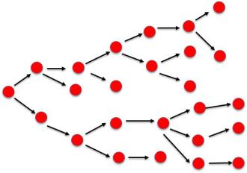
At the basis of disease modelling are these questions:
How many new infections does each infected individual cause?
For how long is an infected individual able to do this before it recovers or dies?

Slide 5
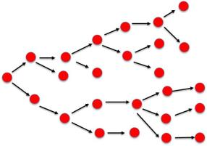
In a given population,
the rate of production of new infections
per infectious individual is proportional to…
…the probability p that contact between infectious and susceptible individuals results in successful transmission of an infectious agent.
That probability depends on a number of factors:
the infectivity of the pathogen/ parasite: how easily is it transmitted from an infected to a susceptible individual upon contact?
the susceptibility of the host (as determined by age, health, genetics, …)
….and similar factors.

Slide 6
In a given population,
the rate of production of new infections
per infectious individual is proportional to…
…the contact rate k between susceptible hosts and the infectious agent (virus, spore, …). This means in practice
the rate of contact (per individual per day) between susceptible and infected hosts, or
the rate of contact between a susceptible host and a long-lived infectious agent in the environment, or
for vector-transmitted agents, the “bite/sting rate” at which a susceptible host is bitten/stung by the vector.

Slide 7
…The contact rate k itself can be broken down:
the normal contact rate c between individuals of that population, and
the proportion of infected individuals in that population, I/N
$$k=c∗\frac{I}{N}$$
I/N = 0.19

Slide 8
It may be difficult to describe the complete time course and number of infected individuals over the entire course of a disease outbreak, but we now have a simple model to describe the rate at which new infected individuals are produced.
The slope of this graph: new infected individuals per unit time.
The probability that any contact leads to transmission of the disease.
The proportion of diseased individuals I in the population (total size N).
I
$$\frac{dI}{dt} =p∗ c∗\frac{I}{N}∗S$$
Infected individuals
Time
The contact rate between any two individuals within the population.
The number of susceptible hosts in the population.
Notes:
Note the units of each component: p and I/N are dimensionless variables; c has the unit time⁻¹, and S the unit “individuals”. That makes sense: the equation should describe infected individuals per unit time.
This rate is sometimes called incidence.

Slide 9
OK, so that wasn’t all that simple.
Let’s consider one more thing to make it slightly tidier. We will assume (very simplistically!) that the individuals move around randomly (!) and that the frequency of “bumping into” another individual depends on nothing but the population density (N/area) and the animals’ behavioural patterns, encapsulated in a new constant c’.
I
$$\frac{dI}{dt} =p∗ c∗\frac{I}{N}∗S$$
Infected individuals
Time
The contact rate is directly proportional to population density (total population N per area A)
$$c=c^{′}∗\frac{N}{A}$$
Notes:
Some diseases, especially those that are spread by sexual contact, do not particularly depend on population density. Individuals may need more time to search for a mate, but are ultimately not less likely to make contact (in the sense of enabling disease transmission) when the population density is low, except perhaps at extremely low densities. Different models (frequency-dependent rather than density dependent) can be constructed for such diseases, but are not considered here.

Slide 10
Looking even more complicated for now…
But we can simplify: first cancel out N.
Then consider all variables that do not change over time: the probability of transmission p, the density –independent contact rate c’, and the area inhabited by the population, A.
I
$$\frac{dI}{dt} =p∗c^{′}∗\frac{N}{A}∗\frac{I}{N}∗S$$
Infected individuals
Time
For the sake of simplicity, we consider all these variables constant over time and group them together as a new variable, the transmission coefficient β.

Slide 11
So here we have a much simpler description that depends only on the numbers of infected (I) and susceptible (S) individuals. After all, these two need to bump into each other for disease to be transmitted.
Let’s remember that we have assumed that this contact depends on density. This model is therefore called density-dependent transmission.
I
$$\frac{dI}{dt} =β∗I∗S$$
Infected individuals
Transmission coefficient
Time

Slide 12
Part II – Influenza in a Boarding School
Notes:
Bangor St. Bd. School, Manchester. Sixth Standard (1894). Pellethepoet via Flickr, CC BY-NC 2.0
There are limitations to the realism of epidemic models, but some cases are described very well with simple models. We will be build one for a flu outbreak in a boarding school.

Slide 13
We have described the rate at which susceptible individuals become infected as
$$\frac{dI}{dt} =β∗I∗S$$
with β the transmission coefficient, I the current number of already infected individuals and S the number of susceptible individuals.
To understand the population dynamics of e.g., an influenza outbreak, we need to know the numbers and/or dynamics of susceptible and infected individuals, as well as those who have recovered and are no longer susceptible.
The simplest model we can build assumes that all individuals in the population belong to one of three “bins” or compartments: they can only be susceptible, infected or recovered. This is called a compartment model.

Slide 14
S
I
R
Susceptible
Infected
Recovered
Individuals in the population can only move between “bins” by two mechanisms: they can get infected or recover.
We are making a whole series of simplifying assumptions:
The rate of infection and recovery is much faster than the time scale of births and deaths*, meaning we ignore the latter two for modelling.
That all individuals are equally susceptible.
That all individuals move from the infected to the recovered class.
That there is no latency period when an individual is infected but is not yet infectious. *
Immunity is life long. (The “R” bin is therefore sometimes called “removed.”)
*(N.B. There are models which include these; we will use one later).

Slide 15
S
I
R
$$βIS$$
$$γI$$
Susceptible
Infected
Recovered
Let’s describe the rate at which individuals move from one bin to the next:
We’ve already described the rate of infection of susceptible individuals:
$$\frac{dI}{dt} =β∗I∗S$$
Infected individuals recover at a rate γ (gamma) that is determined by the pathogen’s virulence and the host’s immune system. It does not depend on any contact between individuals. Therefore, the rate at which recovered individuals R “emerge” depends only on the number of infected individuals and γ.
$$\frac{dR}{dt} =γ∗I$$

Slide 16
S
I
R
$$βIS$$
$$γI$$
Susceptible
Infected
Recovered
We can now describe the dynamics of all three compartments. To do that, we need to bear in mind that $βIS$also describes the rate at which S drops. Likewise, while I grows at the rate $βIS$, it reduces at the rate $γI$.
The full description of the dynamics of the three compartments S, I and R is:
$$\frac{dS}{dt} =− βIS$$
$$\frac{dI}{dt} = βIS −γI$$
$$\frac{dR}{dt} = γI$$
With β=transmission coefficient, γ=recovery rate, and S, I and R the size of the susceptible, infected and recovered populations.
Notes:
Take some time to really make sense of these equations.
We have not mentioned this explicitly, but since we assume no deaths or births in this model, and no immigration into or emigration out of this population, the sum of the three rates must be zero: there is no net change in the total population; only individuals moving from one bin to the other. Between the start and the end of the epidemic modelled here, the entire population moves from S (susceptible) to R (Recovered).

Slide 17
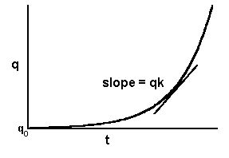
But why differential equations instead of a regular function?
If we can describe the slope of a graph in a simple form,
$$\frac{dq}{dt} =qk$$
the rules of calculus allow us to find an exact solution:
$$q=q0∗ ekt$$
slope =
$$βIS −γI$$
However, the sets of differential equations behind the SIR model have no exact solution.
The best we can do is to use computer algorithms to find numerically a solution that is good enough.
t

Slide 18
While the best way to model disease dynamics is via a programming language like R, an approximation can be done via Excel spreadsheets and the Euler method. This is a simple numerical approach for solving differential equations in a small steps, starting from a chosen start value.
The differential equation
$$\frac{dI}{dt} = βIS −γI$$
I₁
describes the slope of the graph. Multiply it with the time Δt to calculate the step size.
Then add that step to the previous value:
I₀
t₀
t₁
Δt
$$I1 =I0+ \left(βI0S −γI0\right)∗Δt$$

Slide 19
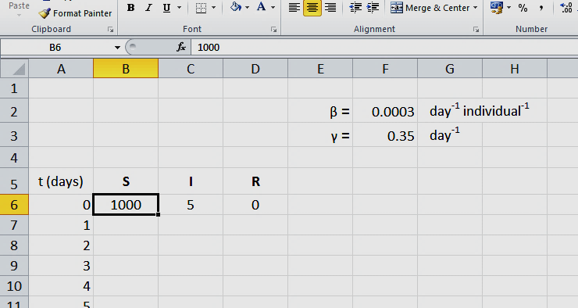
Among the diseases that best match the simple SIR model is influenza. We will look at a 1978 outbreak in a boys’ boarding school.
Open the file “rabies_epidemiology_1.xlsx”. The spreadsheet tab “introduction” explains how the models that you will work with were built in Excel.
Arbitrarily chosen values for the total population (initially all susceptible: S=1000 at t=0) and the number of infected individuals (I=5).

Slide 20
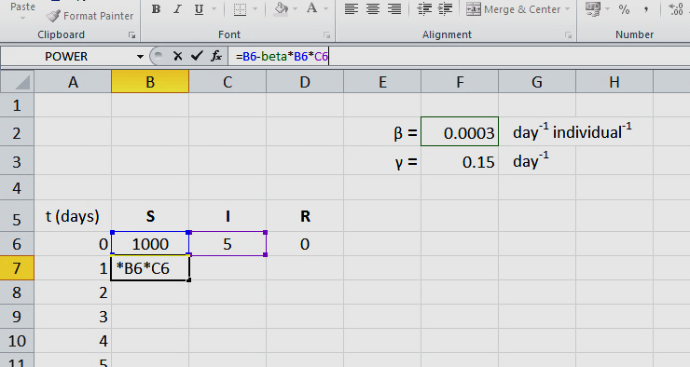
We calculate S₁ (susceptible individuals on day 1) from S₀ using the differential equation
To keep it simple, we simply add one day, so that S₁ = S₀ – $βSI$ *1 day
Here: B7 = B6 – (beta*B6*C6)
$$\frac{dS}{dt} =− βSI$$

Slide 21
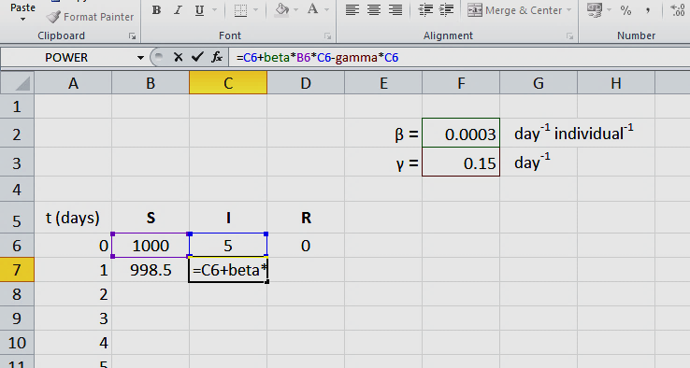
Likewise, we calculate I₁ (infected individuals on day 1) from I₀ using the differential equation:
Again, we simply add one day, so that
Here: C7=C6+(beta*B6 –gamma) *C6*1 day
$$\frac{dI}{dt} =βSI− γI$$
$$I1 =I0+\left(βSI− γI\right)∗1day$$

Slide 22
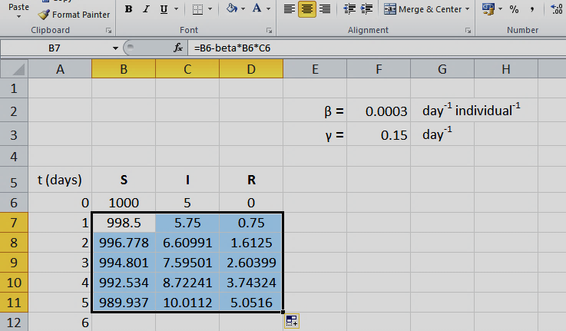
We do the same for R₁, using the formula R₁ = R₀ + $γI$*1 day .
The rest of the table can then be filled in by highlighting the three fields for S₁, I₁ and R₁ and “dragging” the bottom right corner down to copy the formulas (one of the most useful Excel tricks!).
See notes for an explanation how the exercise spreadsheets are different from this simple demo.
+
Notes:
The Euler method lets you calculate the curve that was described by the differential equations, one little step at a time, without “solving” the equations. There is a catch though: it is only an approximation, and the error per step is proportional to the square of the step size.
In the simplistic demo, we have taken a step size of 1 day. Turns out that this crude approximation is so wrong it is almost no use. Thankfully, our computers are quite fast, and it is almost no problem to take much smaller steps, i.e., have many many rows in the spreadsheet. In the example that follows, we follow a flu outbreak over just over two weeks. To get the modelling right, a step size of 1 day was too crude. Instead, steps of 1/100 day were taken. It is important to change the transmission coefficient and recovery rate by the same factor.
For another model we will use later, fox rabies is modelled over 50 years in step sizes of 1 day.

Slide 23
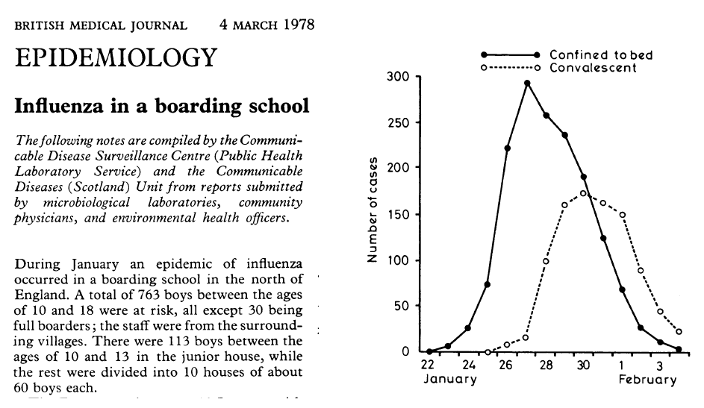
Open the second spreadsheet tab, “boarding school.” The graph on this slide (black dots and continuous line) corresponds to the purple dots on your spreadsheet; these are the reported numbers of boys confined to their beds.
Notes:
NEWS AND NOTES. (1978). British Medical Journal, 1(6112), 586–590.
Available at https://www.ncbi.nlm.nih.gov/pmc/articles/PMC1603269/?page=2

Slide 24
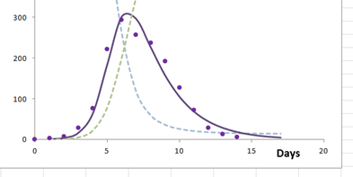
Here is your first task:
Adjust beta (the transmission coefficient) and gamma (the recovery rate) until your prediction for the number of ill boys matches the real-world data!
Sliding control for adjusting beta
Sliding control for adjusting gamma
This is what a decent fit looks like, but probably you can do better!

Slide 25
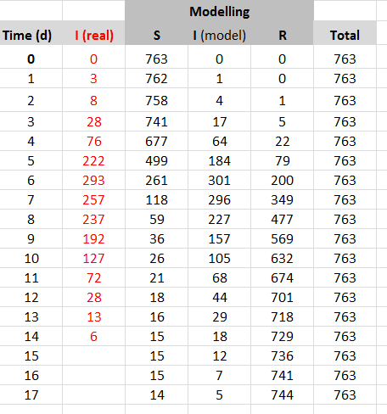
How do you know if you’ve found the best fit, other than just that it “looks good”?
You could do a manual “least square analysis”:
For each day, you have one real value for I and one from your model. The smaller the difference between the two, the better your fit.
You could calculate the difference between I_{real} and I_{model}, square it and sum up the values for days 0-17. While adjusting β and γ, your task is to minimise this sum of squares.

Slide 26
Here are the first two tasks of three:
Adjust β (the transmission coefficient) and γ (the recovery rate) until your prediction for the number of ill boys matches the real-world data well.
Report your values for β and γ, include a screenshot of your curve (crop it to show just the curve), and if you have done a least square analysis, report your sum of squares.

Slide 27
Notes:
Throughout history, the speed at which an epidemic can spread has terrified people. This has not really changed even now that we understand the microbial basis of disease and have modern diagnostic tools at our disposal. Not all infectious diseases are the same; some spread much more quickly than others. In this section, we are going to learn about a key parameter that describes this difference: the basic reproductive rate.
(Images: Left, Prayer to be spared from the plague; Hamburg, Germany, ca. 1700. VD17 database, http://www.gbv.de/vd/vd17/23:687887A; cover via https://commons.wikimedia.org/wiki/File:Gebeht_um_Abwendung_der_Contagion_001.jpg.
Right, Contagion by Wolf Gang via Flickr: https://live.staticflickr.com/6046/6277201493_7437192704_z_d.jpg. CC BY-SA 2.0)

Slide 28
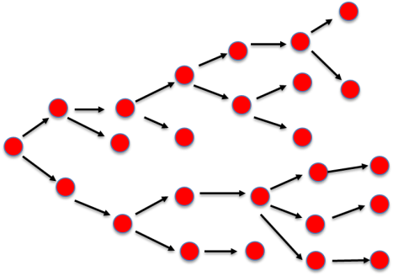
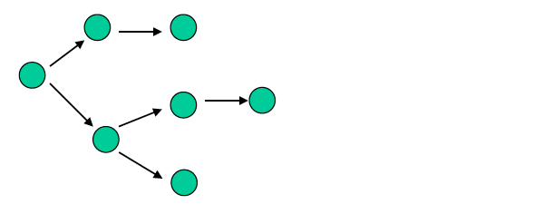
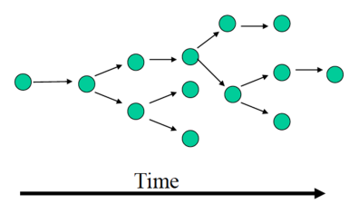
“For every person who gets sick,
how many other people are they likely to infect?”

Slide 29
The basic reproductive number R₀ (“R naught”)
is the average number of secondary (new) infections from one infected individual in a population of fully susceptible hosts.

Slide 30
The basic reproductive number R₀ (“R naught”)
is the average number of secondary (new) infections from one infected individual in a population of fully susceptible hosts.
R₀ < 1
R₀ > 1
R₀ = 1 represents the transmission threshold.
R₀ must be > 1 for a disease to spread.
R₀ ≈ 1

Slide 31
For density-dependent transmission of microbial disease agents, R₀ depends on three factors:
The length of time for which an infected host remains infectious. This period of infectiousness or L is the reciprocal value of the recovery rate γ that we have defined earlier: if the recovery rate is γ = 0.1 day⁻¹, hosts remain infectious for L = 10 days.
The transmission coefficient β.
The population density- or rather (since we have decided in part I to include the inhabited area into the constant β) the number of susceptible individuals, S.
Put simply: R₀ = SβL

Slide 32
Give that the number of susceptible individuals is part of the equation, we can see how there is a threshold population size for an epidemic:
Starting from R₀ = SβL
We require that R₀ ≥ 1. For R₀ = 1 = SβL,
We get the critical population size
$ST = \frac{1}{β L}$ $= \frac{γ}{β}$
(You are now ready for the last question!)

Slide 33
Here is the final one of the three tasks:
From your values of β and γ, calculate the basic reproductive rate R₀ and the critical population size S_{T} for influenza.

Slide 34
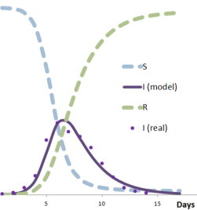
There are a few important things to consider:
R₀ relates to a fully susceptible population. Once the epidemic starts, the number of susceptible individuals goes down rapidly and soon dips below S_{T}.
Go back to your flu model- you should see that the number of infected boys (I)
stops growing as S approaches S_{T}.
S = S_{T}

Slide 35
Disease | R₀
Ebola (2014, West Africa) | 1.5 to 2.5
AIDS | 2 to 5
Smallpox | 3 to 5
Measles | 16 to 18
Malaria | > 100
The danger posed by a disease is not described by R₀ alone, though.
Ebola has a relatively low R₀, but of course is dangerous because of its very high mortality and rapid disease progression. Relatively simple hygienic and population health measures have succeeded in slowing it.
Measles has a high R₀ and is extremely infectious, but an efficient immune response also means fast recovery. The S_{T} for measles is around 300,000, which means that historically measles were hardly an issue before major urban centres grew past that population size.
Malaria cannot easily be modelled by simple approaches because vectors and intermediate hosts are involved, but the equivalent of R₀ is very high. Infected hosts can sometimes remain infectious for life without building resistance, and the parasite is transmitted very efficiently. Together this makes S_{T} very small- the parasite can persist in a very small population.

Slide 36
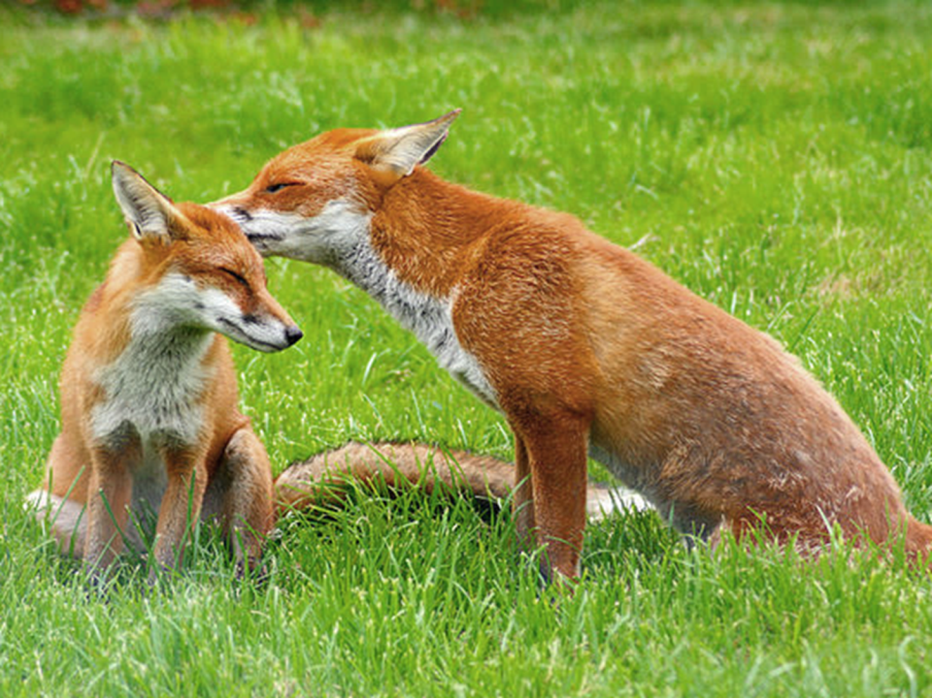
Photo: Red foxes at the British Wildlife Centre, Surrey. Keven Law via Flickr. CC BY-SA 2.0
Part III – Modelling Rabies in Foxes

Slide 37
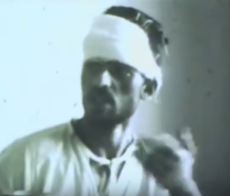
Rabies has been one of the most infamous infectious diseases known since antiquity. Hippocrates described how it is spread to humans by “mad dogs.”
While in Europe the disease has become rare even among dogs and wild carnivores (and officially eradicated in the UK since 1922), there are still tens of thousands of human deaths in the developing world.
To illustrate the debilitating effect of rabies in humans, a 1961 (?) UC Berkeley/NSF-produced teaching film shows the case history of an Iranian patient bitten by a rabid wolf. The patient shows clinical symptoms of restlessness and agitation, difficulty in swallowing, rejection of liquids, copious foaming, excessive perspiration, dilation of pupils, convulsions, delirium, paralysis, apathy and coma followed by death.
WARNING: This is quite distressing to watch.
http://www.worldcat.org/title/rabies-in-a-human-patient/oclc/220258689
Notes:
OCLC WorldCat entry: http://www.worldcat.org/title/rabies-in-a-human-patient/oclc/220258689

Slide 38
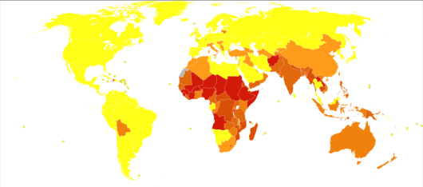
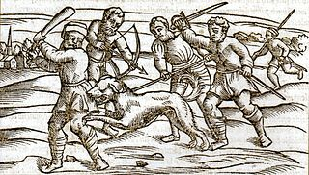
Without vaccines, hundreds of thousands of people would die annually. Post-exposure prophylaxis can save lives, but the cost is often problematic in the developing world. (See WHO factsheet rabies)
Deaths from rabies per million persons in 2012
By far the most cost-effective preventative measure is the vaccination of dogs.
Notes:
Deaths from Rabies in 2012 per million persons. Statistics from WHO, grouped by deciles. Image by Chris55, available at https://commons.wikimedia.org/wiki/File:Rabies_world_map-Deaths_per_million_persons-WHO2012.svg CC BY-SA 4.0
Rabies: Slaying a mad dog. Credit: Wellcome Collection. CC BY 4.0

Slide 39
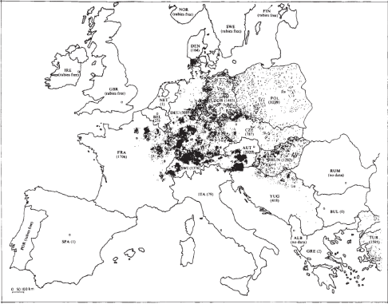
While most infections of humans are caused by dog bites, wild animals are an important reservoir for the disease. In Europe, this is mainly the red fox; in North America, raccoons, skunks and bats are also carriers.
In areas with originally high population density, it was observed that introduction of rabies led to oscillations of both fox density and rabies epidemics with 3, 4 or 5 year periods.
A particularly large number of rabies cases were reported in central Europe in 1979.
Anderson et al. used the data to test one of the first successful compartmental models for an infectious disease. An “exposed” category is needed now because infected foxes are not immediately infectious.
Notes:
Fig. 1, Andersen et al. (1981) Geographic distribution of reported European cases of rabies, both in wildlife and domestic animals, during 1979. Each dot denotes one reported case, except a few dots in northern Switzerland and southern Germany which represent between one and four cases.

Slide 40
Note how the influenza model is different from the one for rabies:
Susceptible
Infectious
Recovered
Influenza
We assume that infected schoolboys are immediately infectious, too. (Oversimplified but not too wrong.)
All infected schoolboys will recover.
Susceptible
Latent
Infectious
Rabies
Infected foxes are not immediately infectious; this is very important for how the epidemic unfolds. Only after a latent period (2-15 weeks) will rabies-infected foxes become infectious.
All infected foxes will die; there is no “recovered” class in this model.
Dead

Slide 41
bS
βSI
σL
Susceptible
Latent
Infectious
dS
dL
(d+α)I
These details went into the model:
The natural birth rate b is 1 yr⁻¹ and the natural death rate d is 0.5 yr⁻¹. Only the latter is density-dependent.
The transmission coefficient β was estimated to be ca. 80 km⁻² yr⁻¹.
Infected foxes (“exposed” or latent compartment) became rabid (infectious) at a rate σ of 3-30 yr⁻¹, which corresponds to a latent period (1/σ) of 12 to 110 days, with an average of 30 d.
Rabid foxes have a per capita death rate α of ca. 73 yr⁻¹, corresponding to an infected life expectancy (1/α) of 5 days.

Slide 42
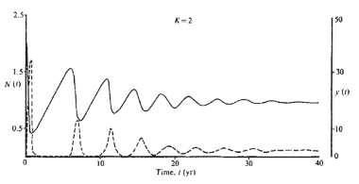
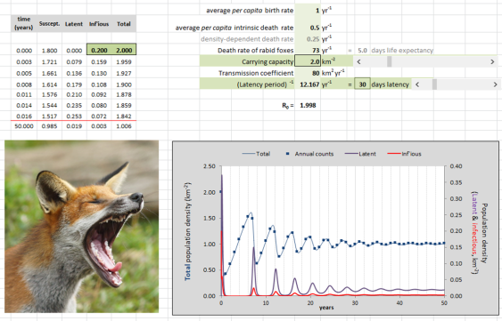
From Andersen et al. (1981), Nature 289:765-771
Even this relatively complicated model can be approximated in Excel (compare published graph and screenshot).
Feel free to eventually try out all variables, but for the next exercise leave the original settings and vary only the latency period σ and the carrying capacity K.

Slide 43
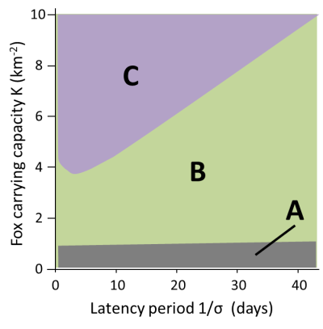
Open the file: rabies_epidemiology_2.xlsx.
The model predicts different types of long-term outcomes for different combinations of latency periods (1/σ) and carrying capacities K.
Describe these outcomes for combinations of K and (1/σ) that fall within areas A, B and C of the plot.
Some extra help here: Adjust the sliders in the model so you arrive at combinations of latency periods 1/σ and carrying capacities K that lie in the regions A, B or C. Try to interpret what the curves for total and infectious populations mean. Predict what will happen in the long term by extrapolating the trend you see. Compare total population size at extrapolated “t = ∞” with the carrying capacity. Check R₀ to see if the disease spreads or comes to a halt.

Slide 44
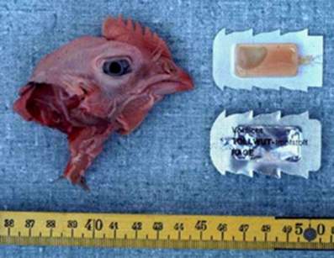
Back to the real world.
When in the 1970s a wave of rabies cases swept Switzerland , initially from Eastern Europe but later also from France, an innovative vaccination campaign saved the day.
Read the story by Ed Yong, “That Time Europe Air-Dropped Vaccine-Loaded Chicken Heads to Bait Rabid Foxes.”
Notes:
Image from https://www.kora.ch/index.php?id=190&L=1
http://www.theatlantic.com/science/archive/2015/12/that-time-europe-air-dropped-vaccine-loaded-chicken-heads-to-bait-rabid-foxes/417951/

Slide 45
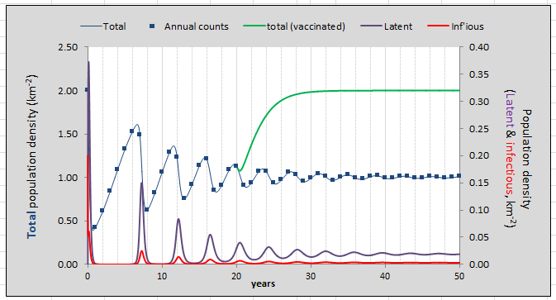
A crucial question in all vaccination campaigns is this:
What proportion of the population needs to be vaccinated to eradicate the disease (at least temporarily)?
Intriguingly, the model can answer that too.
Open the second tab “with vaccination” in the file fox rabies modelling.xlsx
Start vaccination

Slide 46
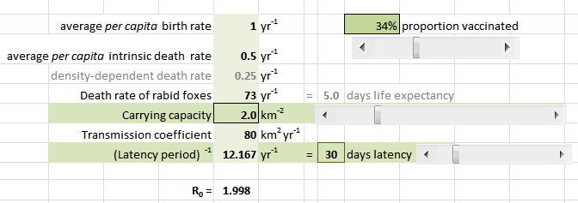
In the second version of the model, we will vaccinate a given proportion of the fox population at t = 20 years.
As before, you’ve got a slider to do that:
For this exercise, leave all parameters as found and vary only the carrying capacity and the proportion vaccinated.
Only these
sliders

Slide 47
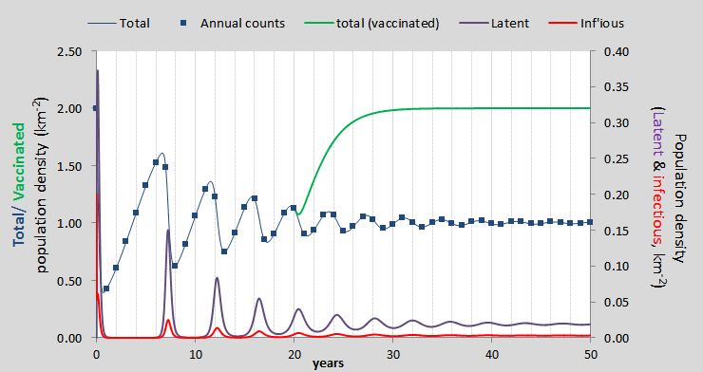
Your task is to find out what proportion of the fox population needs to be vaccinated to eradicate the virus.
Here’s how the model helps you with that:
If R₀ drops below 1, there is no spread.
with or without vaccination.
If vaccination brings down the density of infectious foxes below 10⁻⁹ km⁻² by year 50, the population is also safe long-term.
A successful vaccination campaign looks like this (green curve):

Slide 48
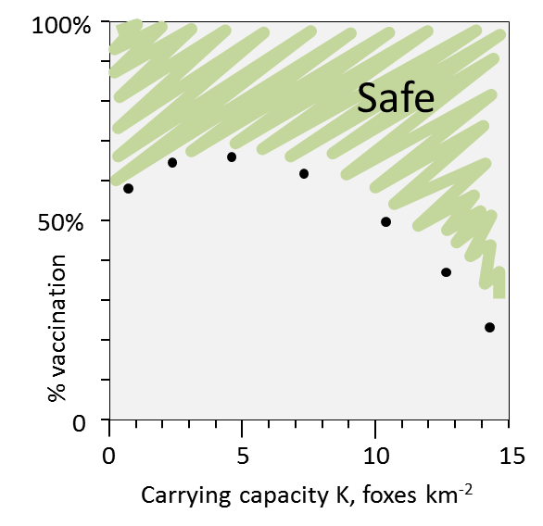
2. For a range of carrying capacities from 0 - 15 km⁻², find out “empirically” what minimum percentage of the population needs to be vaccinated to wipe out rabies.
In a diagram, plot those points and indicate which is the “safe” area.
3. Considering that the density of foxes in Europe is in the range of 1-4 foxes per km², what does the plot tell you?
(The actual plot looks nothing like this; it’s just to illustrate the idea.)

