Slide 1

Precision
Over Presumption:
NATIONAL CENTER FOR CASE STUDY TEACHING IN SCIENCE
A Presentation to Accompany the Case Study:
Connecting Pharmacogenomics
and Genetic Ancestry
by
Erica L. Gerace^{1,2}, Alexa Wnorowski¹, and Sarah Wojiski¹
¹Genomic Education, The Jackson Laboratory for Genomic Medicine, Farmington, CT
²Department of Genetics, Yale School of Medicine, New Haven, CT
Notes:
Credit: Licensed image © Maksim Borbut | Dreamstime.com, ID 360994827.

Slide 2
Migraine
Symptoms
Treatments
Throbbing head pain
Nausea
Sensitivity to light, noise, or other stimuli
Aura
Identify and eliminate triggers
Medications

Slide 3
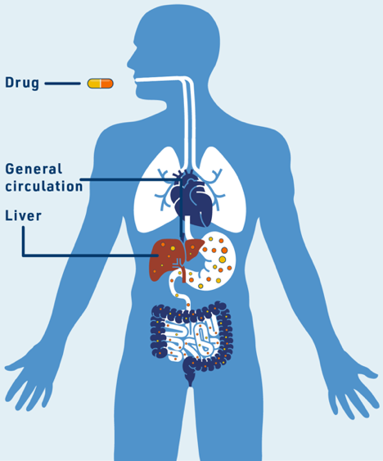
Drug Metabolism
Factors Impacting Drug Metabolism
Genetics
Biological factors
  body size/weight
  age
  hormones
  other medical conditions
Environmental factors
  diet
  smoking
  alcohol use
  use of other medications
  exposure to certain chemicals
Figure 1

Slide 4
Pharmacogenomics
Pharmaco + genomics
Using an individual’s genetics or genomics to gauge response to a medication
Variants in certain genes affect the metabolism of certain drugs

Slide 5
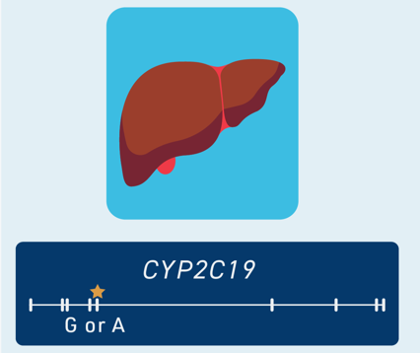
CYP2C19
Cytochrome P450 family
Encodes enzyme
Variant G or A affects enzyme function
Figure 2

Slide 6
CYP2C19 Variants
CYP2C19 Allele | Consequence on Protein | Functional Consequence | Phenotype
Allele G | Proline at amino acid 227 | Enzyme with full function | Fast metabolism
Allele A | Aberrant splicing | Enzyme with no function | Slow metabolism

Slide 7


Aims:
Generate knowledge for disease risk factors
Identify treatments that work best
Inspire technologies that contribute to human health
Connect individuals with clinical studies

Slide 8
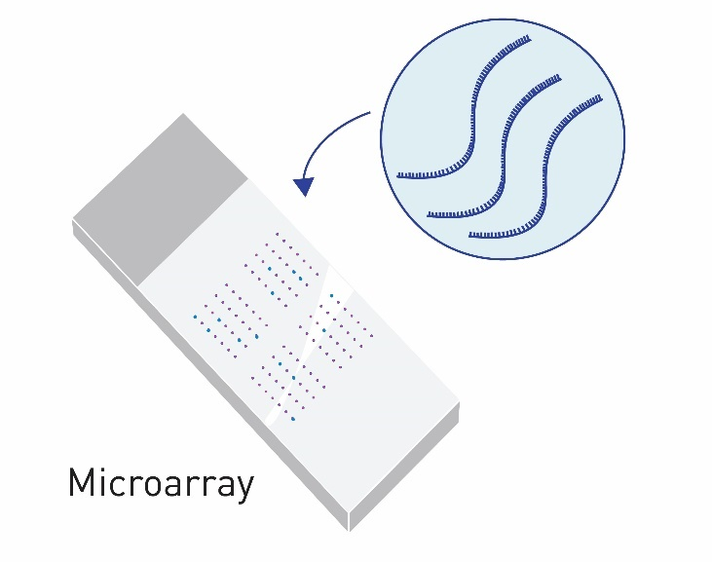

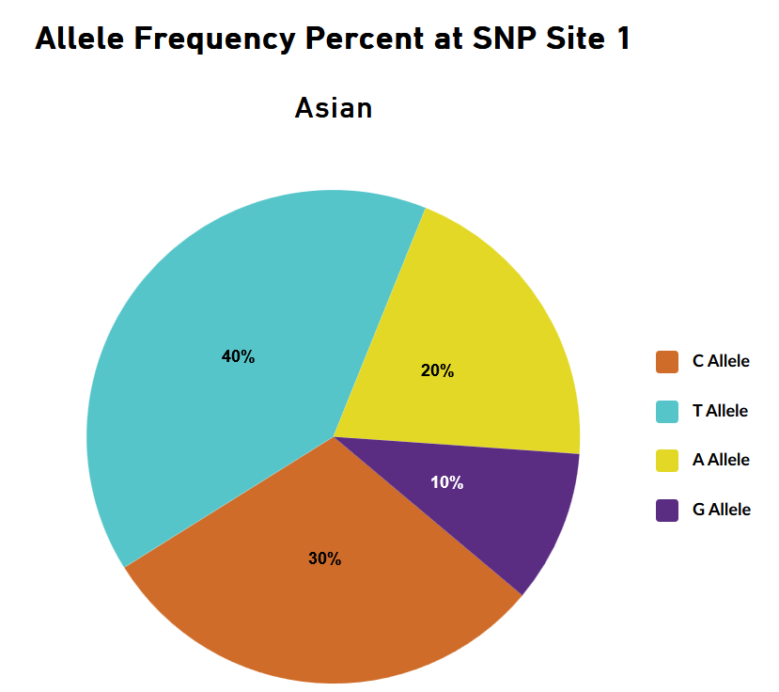
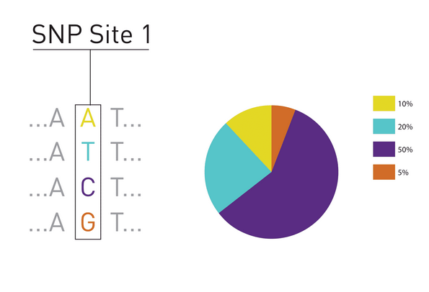
Determining Genetic Ancestry
DNA Sequencing: determine genotype at 1000s of SNPs across the genome
Statistical Analysis: compare SNPs with known DNA sequences from individuals with a long history living in specific regions in the world

Slide 9
CYP2C19 Alleles in the Population
Table 1.
 | Allele Count | Total Allele Number | Allele Frequency
CYP2C19 allele G | 702,473 | 829,554 | 0.8468
CYP2C19 allele A | 127,081 | 829,554 | 0.1532

Slide 10
Allele A by Genetic Ancestry
Figure 3

Slide 11
Calculating Allele Frequencies
Table 2.
 | Allele A Count | Total Allele Number | Allele Frequency
African | 28,393 | 159,636 | 0.1779
East Asian | 5,826 | 18,878
European | 65,107 | 446,634
Latin American | 16,851 | 143,690
Middle Eastern | 158 | 1,620
South Asian | 2,781 | 8,092
Remaining | 7,965 | 51,004
Total | 127,081 | 829,554 | 0.1532

Slide 12
Final Discussion
What are the dangers of assuming someone’s genotype based on their reported racial/ethnic identity?

