Slide 1
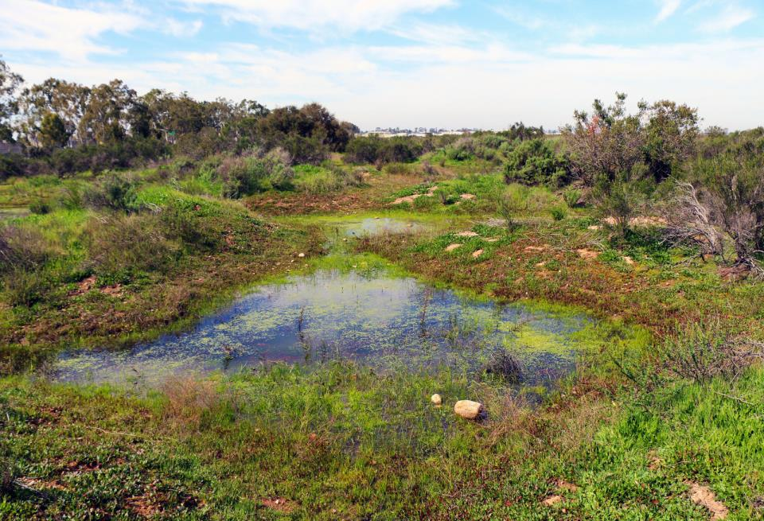
NATIONAL CENTER FOR CASE STUDY TEACHING IN SCIENCE
A Presentation to Accompany the Case Study:
Responding to a Changing Climate:
How Vernal Pool Plant Communities React
^{by}
^{Christopher J. Javornik} Department of Ecology and Evolutionary Biology University of Colorado, Boulder, CO
^{and}
^{Akasha M. Faist}
Department of Animal and Range Sciences
New Mexico State Universtiy, Las Cruces, NM
Notes:
Credit: Pacific Southwest Region USFWS, CC BY 2.0, https://www.flickr.com/photos/usfws_pacificsw/32515945633/in/photostream/

Slide 2
Learning Objectives
Understand plant responses to climate change:
Elevational range shifts: attrition and community shifts.
Phenological shifts: over extended time periods.
Community shifts: novel competition and species response.
Changes in biodiversity: resistance and resilience.
Assess how specific vernal pool plant communities have responded to fluctuations in annual weather patterns.
Predict how specific vernal pool plant communities may respond to future climatic events.

Slide 3
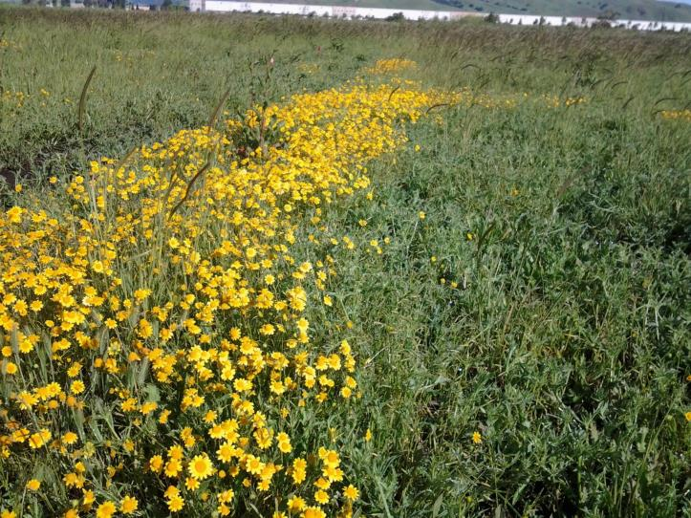
Outline
Vernal Pools
Defined
Ecological value
Decline
Exploring the wet season
Results

Slide 4
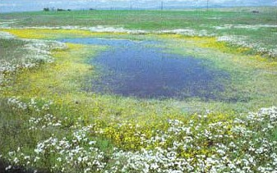
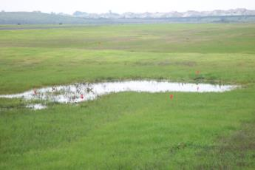
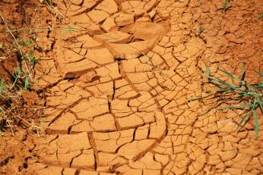
Vernal pools
Spring
Winter
Summer/ Fall

Slide 5
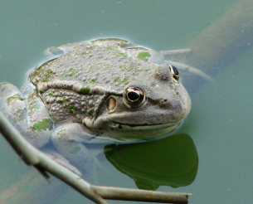
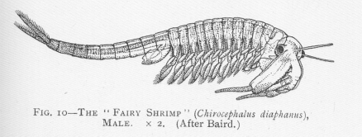
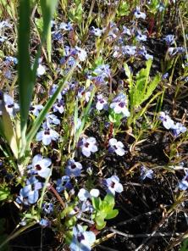
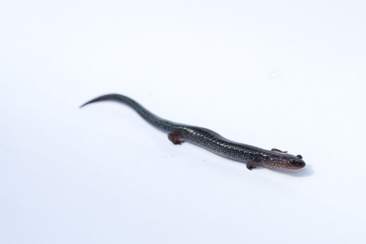
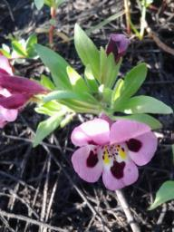
Vernal pools play a key role in ecosystem function and provide ecosystem services.

Slide 6
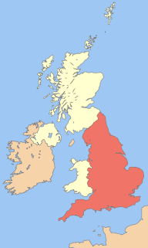
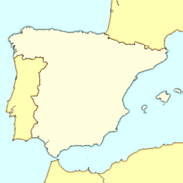
Vernal pool loss worldwide

Slide 7
Vernal pool loss in California

Slide 8
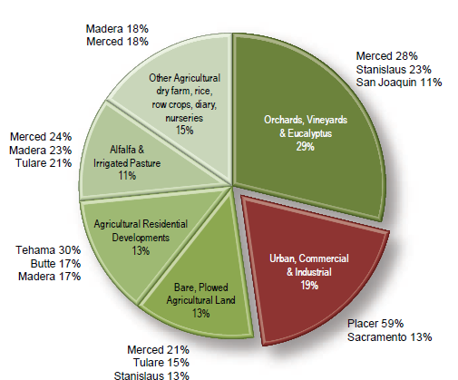
Vernal pool habitat loss in the Central Valley
(Modified from AECOM, 2009)

Slide 9
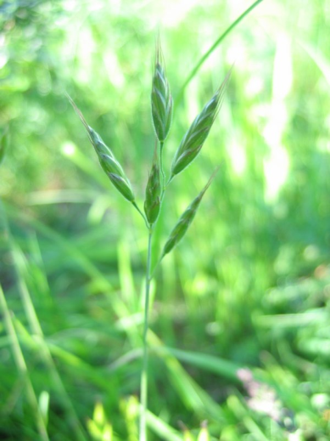
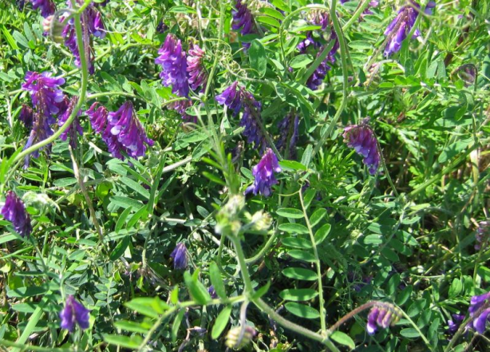
Non-native and invasive species
www.nps.gov

Slide 10
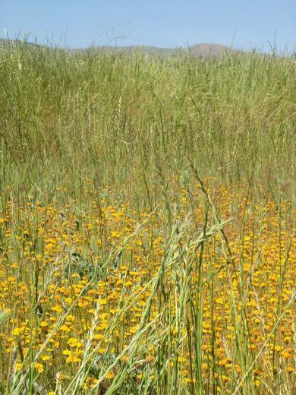
Exotic plants in vernal pools

Slide 11
Is weather variability, resulting from climate change, threatening vernal pool viability?

Slide 12
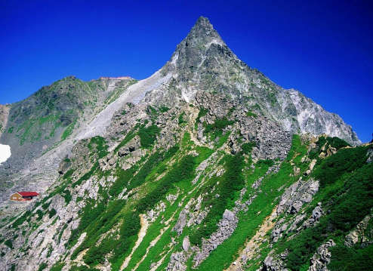
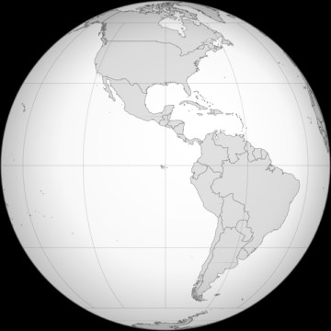
Plants have already been documented responding to climate change

Slide 13
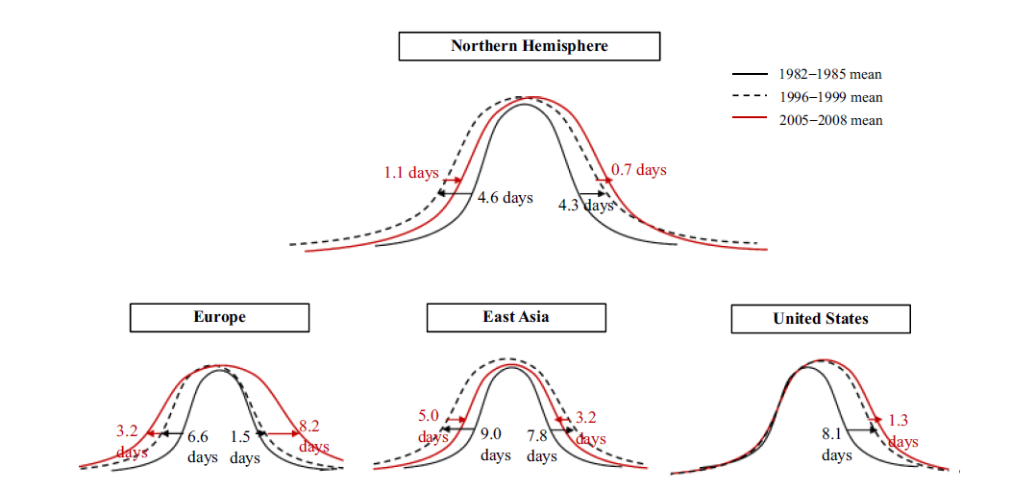
Plants have already been documented responding to climate change
(Jeong, S., Ho, C., Gim, H., & Brown, M., 2011)

Slide 14
Focal species used in this study
Native Species
Species | Family | Common Name
Deschampsia danthonioides | Poaceae | Annual hairgrass
Downingia concolor | Campanulaceae | Maroonspot calicoflower
Hemizonia pungens | Asteraceae | Common spikeweed
Lasthenia conjugens | Asteraceae | Contra Costa goldfields
Plagiobothrys stipitatus var. micranthus | Boraginaceae | Stalked popcornflower
Bromus hordeaceus | Poaceae | Soft brome
Erodium botrys | Geraniaceae | Longbeak stork's bill
Hordeum marinum | Poaceae | Mediterranean barley
Lolium multiflorum | Poaceae | Italian ryegrass
Vicia villosa | Fabaceae | Winter vetch
Vulpia bromoides | Poaceae | Brome fescue
Non-native Species
(Modified form Javornik & Collinge, 2016)

Slide 15
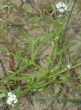
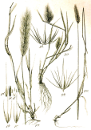
Focal species used in this study
Native Species
Downingia
concolor
Hemizonia
pungens
Lasthenia
conjugens
Plagiobothrys
stipitatus var.
micranthus
Deschampsia
danthonioides
Non-native Species
Erodium
botrys
Vicia
villosa
Bromus
hordeaceus
Vulpia
bromoides
Hordeum
marinum
Lolium
multiflorum

Slide 16
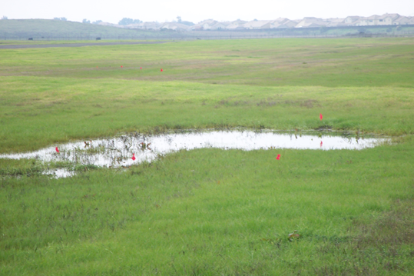
Climate variability
www.californiachaparral.com

Slide 17
Home Group Reminder…

Slide 19
Wet season division
(Gerhardt & Collinge, 2007)

Slide 20
Wet season division
Early growing season
Late growing season

Slide 21
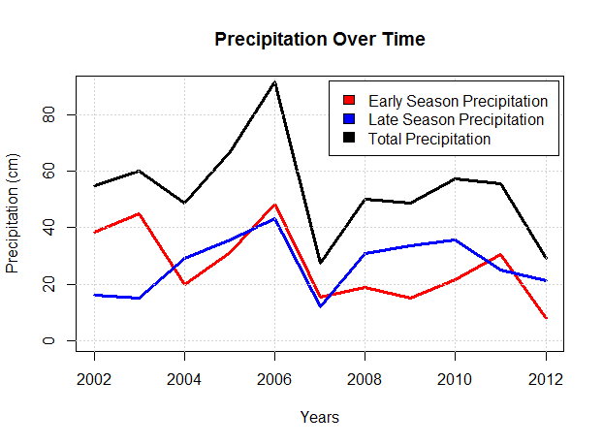
Precipitation
(Modified form Javornik & Collinge, 2016)

Slide 23
Results
Species | Early precipitation totals | Late Precipitation totals
D. danthonioides | NS | NS
D. concolor | + | NS
H. pungens | + | _
L. conjugens | + | _
P. stipitatus var. micranthus | + | NS
B. hordeaceus | NS | NS
E. botrys | NS | NS
H. marinum | _ | NS
L. multiflorum | _ | _
V. villosa | NS | NS
V. bromoides | NS | NS
Native Species
Non-native Species
(Modified form Javornik & Collinge, 2016)
NS represents a non statistical relationship

Slide 24
Summary
Heavy precipitation events occurring during the early growing season (October-December) tend to promote an increase in native plant frequency while hindering non-native plant frequency.
Heavy precipitation events occurring during the early growing season (January-March) tend to result in decreased frequency values for both native and non-native plant species.

Slide 25
Review
Understand plants responses to climate change:
Elevational range shifts: attrition and community shifts
Phenological shifts: over extended time periods
Community shifts: novel competition and species response
Changes in Biodiversity: resistance and resilience
Assess how specific vernal pool plant communities have responded to fluctuations in annual weather patterns
Predict how specific vernal pool plant communities may respond to future climatic events

Slide 27
Credits
Slide 1 : "VernalPool". Licensed under Public Domain via Wikimedia Commons - https://commons.wikimedia.org/wiki/File:VernalPool.jpg#/media/File:VernalPool.jpg
Slide 3: Photo credit: Christopher Javornik
Slide 4: (From top clockwise) "VernalPool". Licensed under Public Domain via Wikimedia Commons - https://commons.wikimedia.org/wiki/File:VernalPool.jpg#/media/File:VernalPool.jpg
"Dry Ground" by Max Wolfe from Birmingham, AL, USA - Dry Ground. Licensed under CC BY 2.0 via Wikimedia Commons - https://commons.wikimedia.org/wiki/File:Dry_Ground.jpg#/media/File:Dry_Ground.jpg
Photo credit: Christopher Javornik
Slide 5: ( From left to right; top to bottom) "Frog in Water" by fa:User:Juybari - fa:File:Frog in Water.jpg. Licensed under CC BY-SA 3.0 via Wikimedia Commons - https://commons.wikimedia.org/wiki/File:Frog_in_Water.jpg#/media/File:Frog_in_Water.jpg
"FMIB 46395 Fairy Shrimp (Chirocephalus diaphanus), Male" by William Thomas Calman - Calman, W. T. (1911) Life of Crustacea, New York City: the MacMillan Company. Licensed under Public Domain via Wikimedia Commons - https://commons.wikimedia.org/wiki/File:FMIB_46395_Fairy_Shrimp_(Chirocephalus_diaphanus),_Male.jpeg#/media/File:FMIB_46395_Fairy_Shrimp_(Chirocephalus_diaphanus),_Male.jpeg
Photo credit: Christopher Javornik
"Lead-backed phase of red-backed slamander Plethodon cinereus" by Brian Gratwicke - originally posted to Flickr as Lead-backed phase of red-backed slamander Plethodon cinereus. Licensed under CC BY 2.0 via Wikimedia Commons - https://commons.wikimedia.org/wiki/File:Lead-backed_phase_of_red-backed_slamander_Plethodon_cinereus.jpg#/media/File:Lead-backed_phase_of_red-backed_slamander_Plethodon_cinereus.jpg
Photo credit: Christopher Javornik
Slide 6:"Uk map england" by UKPhoenix79 - Image:British Isles United Kingdom.svg. Licensed under CC BY-SA 3.0 via Wikimedia Commons - https://commons.wikimedia.org/wiki/File:Uk_map_england.png#/media/File:Uk_map_england.png
"Spain map modern" by Minestrone - , Reference map provided by Demis Mapper 6, enhanced using Corel Photo-Paint 12. Licensed under Public Domain via Wikimedia Commons - https://commons.wikimedia.org/wiki/File:Spain_map_modern.png#/media/File:Spain_map_modern.png

Slide 28
Credits
Slide 7: "Digital-elevation-map-california". Licensed under Public Domain via Wikimedia Commons - https://commons.wikimedia.org/wiki/File:Digital-elevation-map-california.png#/media/File:Digital-elevation-map-california.png
Slide 8: Image credit: AECOM, 2009. Loss of Central Valley Vernal Pools Land Conversion, Mitigation
Requirements, and Preserve Effectiveness -- Summary Report. With Assistance from: Vollmar
Consulting and Robert F. Holland, Ph.D. 15pp.
Slide 9: “Vicia villosa.jpeg” by Kristian Peters. Licensed under Creative Commons Attribution-Share Alike 3.0 Unported - https://upload.wikimedia.org/wikipedia/commons/3/33/Vicia_villosa.jpeg
"Bromus hordeaceus.jpeg" by Kristian Peters. Licensed under Creative Commons Attribution-Share Alike 3.0 Unported – https://upload.wikimedia.org/wikipedia/commons/1/1b/Bromus_hordeaceus.jpeg
Slide 10: Photo credit: Christopher Javornik
Slide 11: "VernalPool". Licensed under Public Domain via Wikimedia Commons - https://commons.wikimedia.org/wiki/File:VernalPool.jpg#/media/File:VernalPool.jpg
Slide 12: "05 Yarigatake from Higashikamaone 2000-8-16" by Alpsdake - Own work. Licensed under Public Domain via Wikimedia Commons - https://commons.wikimedia.org/wiki/File:05_Yarigatake_from_Higashikamaone_2000-8-16.jpg#/media/File:05_Yarigatake_from_Higashikamaone_2000-8-16.jpg
https://commons.wikimedia.org/wiki/File:Blankmap-ao-090W-americas.png#/media/File:Blankmap-ao-090W-americas.png
"Carpobrotus edulis Ice Plant, Pigface კარპობროტუსი" by Lazaregagnidze - Own work. Licensed under CC BY-SA 3.0 via Wikimedia Commons –
https://commons.wikimedia.org/wiki/File:Carpobrotus_edulis_Ice_Plant,_Pigface_%E1%83%99%E1%83%90%E1%83%A0%E1%83%9E%E1%83%9D%E1%83%91%E1%83%A0%E1%83%9D%E1%83%A2%E1%83%A3%E1%83%A1%E1%83%98.JPG#/media/File:Carpobrotus_edulis_Ice_Plant,_Pigface_%E1%83%99%E1%83%90%E1%83%A0%E1%83%9E%E1%83%9D%E1%83%91%E1%83%A0%E1%83%9D%E1%83%A2%E1%83%A3%E1%83%A1%E1%83%98.JPG
Slide 13: Image credit: Jeong, S., Ho, C., Gim, H., & Brown, M. (2011). Phenology Shifts at Start vs. End of Growing Season in Temperate Vegetation Over the Northern Hemisphere for the Period 1982–2008. Global Change Biology, 17, 2385–2399.
Slide 14: Adapted from: Javornik, C.J., Collinge, S.K., 2016. Influences of annual weather variability on vernal pool plant abundance and community composition. Aquat. Bot., 134, 61-67.

Slide 29
Credits
Slide 15: (From left to right; top to bottom) “Deschampsia danthonioides NRCS-1.jpg” by Robert H. Mohlenbrock. Licensed under public domain via Wikimedia Commons- https://upload.wikimedia.org/wikipedia/commons/b/b6/Deschampsia_danthonioides_NRCS-1.jpg
“Downingia concolor 2.jpg” by Stan Shebs. Licensed under the terms of the GNU Free Documentation License via Wikimedia Commons- https://upload.wikimedia.org/wikipedia/commons/thumb/f/f5/Downingia_concolor_2.jpg/183px-Downingia_concolor_2.jpg
“Hemizoniapungenspungens.jpg” by Stephen Laymon. Licensed under public domain via Wikimedia Commons-
https://commons.wikimedia.org/wiki/Category:Centromadia_pungens#/media/File:Hemizoniapungenspungens.jpg
“Lasthenia conjugens.jpg” by the Bureau of Land Management, US Department of the Interior. Licensed under public domain via Wikimedia Commons-
https://commons.wikimedia.org/wiki/Category:Lasthenia_conjugens#/media/File:Lasthenia_conjugens.jpg
Photo credit: Akasha Faist
“Bromus hordeaceus.jpeg” by Kristian Peters. Licensed under the Creative Commons Attribution-Share Alike 3.0 Unported via Wikimedia Commons-
https://upload.wikimedia.org/wikipedia/commons/1/1b/Bromus_hordeaceus.jpeg
“Erodium botrys EnfoqueFlor 2011-4-08 CampodeCalatrava.jpg” by Javier Martin. Licensed under public domain via Wikimedia Commons-
https://commons.wikimedia.org/wiki/File:Erodium_botrys_EnfoqueFlor_2011-4-08_CampodeCalatrava.jpg
“Hordeum spp Sturm55.jpg” by Johann Georg Sturm (Painter: Jacob Sturm). Licensed under public domain via Wikimedia Commons-
https://commons.wikimedia.org/wiki/Hordeum_marinum#/media/File:Hordeum_spp_Sturm55.jpg
“Italiaans raaigras Lolium multiflorum.jpg” by Rasbak. Licensed under the terms of the GNU Free Documentation License via Wikimedia Commons-
https://commons.wikimedia.org/wiki/Lolium_multiflorum#/media/File:Italiaans_raaigras_Lolium_multiflorum.jpg
“Vicia villosa.jpeg.” Licensed under the terms of the GNU Free Documentation License via Wikimedia Commons-
https://commons.wikimedia.org/wiki/Vicia_villosa#/media/File:Vicia_villosa.jpeg
“Festuca spp Sturm42.jpg” by Johann Georg Sturm (Painter: Jacob Sturm). Licensed under public domain via Wikimedia Commons-
https://commons.wikimedia.org/wiki/Vulpia_bromoides#/media/File:Festuca_spp_Sturm42.jpg

Slide 30
Credits
Slide 16: Photo credit: Christopher Javornik
Slide 19: Photo credit: Gerhardt, F., Collinge, S.K., 2007. Abiotic constraints eclipse biotic resistance in
determining invasibility along experimental vernal pool gradients. Ecol. Appl. 17, 922-933.
Slide 21: Adapted from: Javornik, C.J., Collinge, S.K., 2016. Influences of annual weather variability on vernal pool plant abundance and community composition. Aquat. Bot., 134, 61-67.
Slide 23: Adapted from: Javornik, C.J., Collinge, S.K., 2016. Influences of annual weather variability on vernal pool plant abundance and community composition. Aquat. Bot., 134, 61-67.

