Slide 1
The Perilous Plight of the Pika
^{by}
^{Fleur M. Ferro} Department of Biology, Center of Math and Science Community College of Denver, Denver, CO
Video available at: https://youtu.be/US_Hy_eGPtg

Slide 2
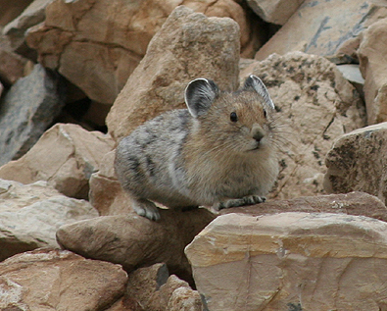
What Are Pikas?
Small rabbit-like animals (same family)
About the size of a potato
Round body with small round ears and no tail

Slide 3
Facts About Pikas
25 Species worldwide
2 found in North America

Slide 4
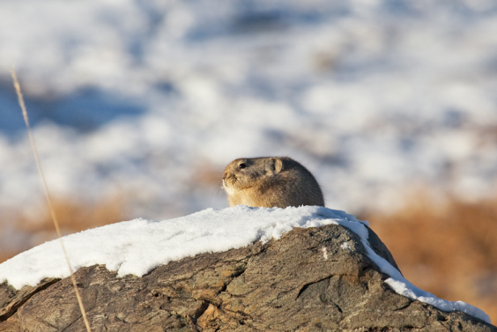
Facts About Pikas
Live in alpine tundra
Don’t migrate or hibernate

Slide 5
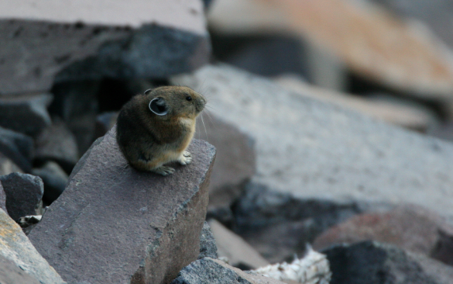
How Do They Handle This?
High metabolism (body T° of 104° F)
Behavioral adaptations

Slide 6
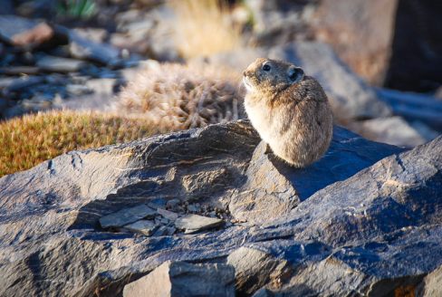
What Do Pikas Look Like?
About the size of a potato
Round body with small round ears and no tail
Gray-brown fur

Slide 7
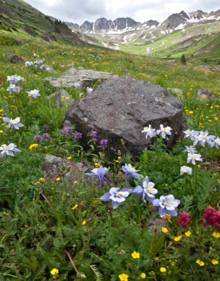
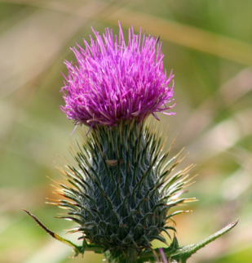
Pika Diet
Grasses, wildflowers, and forbs
Water sources

Slide 8
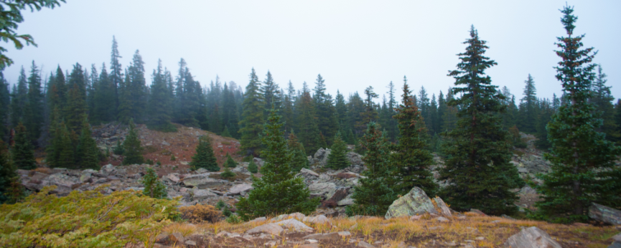
Pika Habitat
Talus (rockfalls)

Slide 9
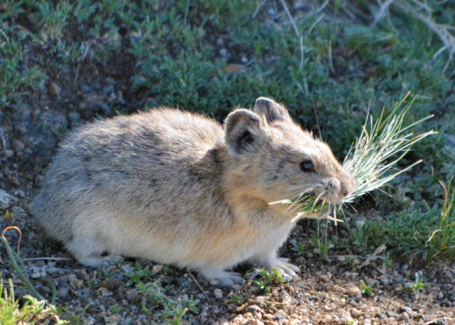
Haypiles
Collections of plants pikas store to eat year round.
Wildflowers, grasses, moss

Slide 10
Life History
Can reproduce around 1 year old
Have 2 litters per year
2-3 offspring per litter
Kick babies out at young age

Slide 11
Temperature Issues
Can’t handle temps above 26C or below -10C

Slide 12
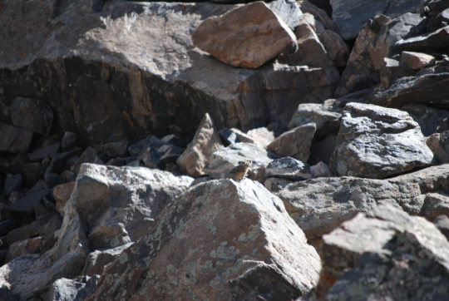
How do they protect themselves from heat?
Limit activity to dawn and dusk
Crawling deeper into talus

Slide 13
How do they protect themselves from cold?
Use snowpack as protective blanket to insulate themselves

Slide 14
Lowest Elevation
836 m in Colorado

