Slide 1
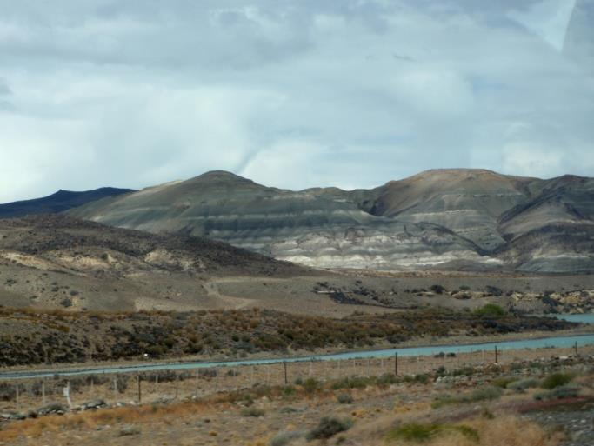
Supplement to Restoring Resilience: Changing the Landscape Legacy in Patagonia
by Dawn R. Tanner and Jim A. Perry Department of Fisheries, Wildlife and Conservation Biology University of Minnesota, St. Paul, MN
NATIONAL CENTER FOR CASE STUDY TEACHING IN SCIENCE

Slide 2
Building a new protected area
Your budget = $50 million (U.S.)
Where will you build your PA?
Will you expand at the park border?
Will you build a separate PA?
How will you consider landscape connectivity?
Land is cheaper where degraded and lacking stunning views
Native wildlife populations reduced in these areas
Research shows that wild populations may rebound quickly
How will you consider climate change and projected impacts?

Slide 3
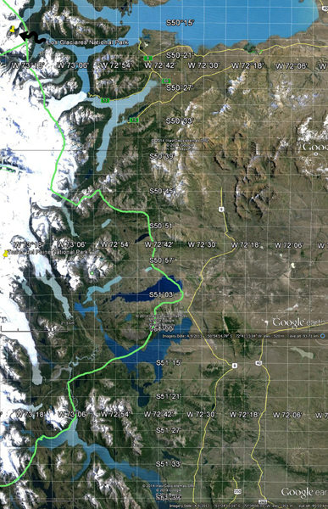
Map 1
Torres del Paine National Park. The park boundary is shown in green. Major roads are yellow. Torres del Paine boundary is adjacent to the Los Glaciares boundary on the northern edge.
Budget to purchase new PA land = $50 million U.S.

Slide 4
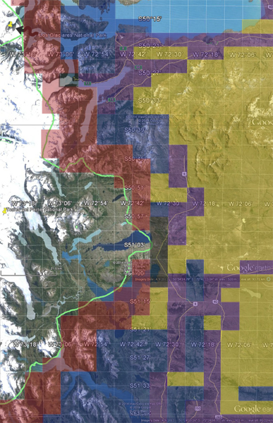
Map 2
Land prices are shown on this map. You may purchase only whole cells. Cells are equally sized and each is approximately 25 km². Land prices are expressed per cell. Note that some cells overlap slightly with the current park boundary and some contain water. On the northern edge, cells that are completely water are not filled in with a price color because they are not for sale.

Slide 5
Legend
Black = $16 million: Cells located on the edge of the park boundary with major Highway access.
Red = $11 million: Cells located on the edge of the park, high-quality habitat and mountain views.
Blue = $6.5 million: Cells that contain high-quality access but have no major road access.
Purple = $4.0 million: Cells that have low-quality habitat and major Highway access.
Gold = $2.3 million: Cells that have low-quality habitat and no major road access.

Slide 6
Draw your PA digitally on this map. Send this slide to your instructor.

Slide 7
Use the following questions to help you build your class presentation:
What is the final size of your PA (in hectares)?
What is the final cost?
How far is your park boundary from the boundary of Torres del Paine?
What 3 variables did you consider most important in your site selection?

Slide 8
Landscape-scale Questions
How did you consider issues of habitat connectivity in the design of your PA?
How did you incorporate future climate scenarios in the design of your PA?

Slide 9
Stakeholder Questions
List 5-8 stakeholders that you feel will be important to include as you work to accomplish conservation objectives in your new PA.
Which stakeholders would be the most likely to be pleased with your PA design? Why?
Which stakeholders would be least likely to be satisfied with your PA design? Why?

