Slide 1
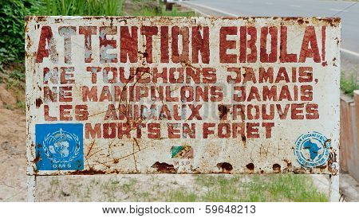
NATIONAL CENTRE FOR CASE STUDY TEACHING IN SCIENCE
BSL-4: AUTHORIZED PERSONNEL ONLY
by NICOLE MARIE ANTHONY
Biological Sciences Teacher
Toronto District School Board
Notes:
Image source: ©SURZ – Big Stock Photo ID: 59648213.

Slide 2
Group Brainstorming
Based on the information presented in the case so far, address the following questions in your groups:
What problem is presented?
What do we know about the problem?
What is still unknown about the problem?

Slide 3
CQ#1: What does “BSL-4” stand for?
Bachelor of Science in Law (4-year degree)
Biological Space Laboratories (Unit 4)
Biosafety Level (Category 4)
Breed-specific legislation (Section 4)

Slide 4
CQ#2: BSL-4 category agents are:
not associated with disease in healthy humans.
associated with human disease that is rarely serious and for which preventative or therapeutic interventions are often available.
associated with serious or lethal disease for which preventative or therapeutic interventions may be available.
associated with serious or lethal human disease for which preventative or therapeutic interventions are not usually available.

Slide 5
CQ#3: Which type of pathological agent(s) is/are classified under the BSL-4 category?
Viral agents
Fungal agents
Bacterial agents
Parasitic agents
All of the above

Slide 6
CQ#4: Based on the information revealed in the story so far, what type of pathogenic agent do you think Claire and Dr. Preston have contracted?
Viral agent
Fungal agent
Bacterial agent
Parasitic agent
Difficult to determine with the given information

Slide 7
CQ#5: Based on the information revealed in the story so far, do you think Claire and Dr. Preston will survive?
Yes
No
Difficult to determine with the given information
Notes:
Answer: Any
Purpose: Opinion question – students make a prediction at the beginning of the case and will revisit this in the progression of the case as new information is revealed.

Slide 8
Disease Detective
Rewind back to December of 2013; the time of the onset of the outbreak in West Africa. Imagine that you are a medical health official and that a cluster of illnesses have appeared at your clinic, all of which present with similar symptoms. Many of the cases have been fatal and you need to make a diagnosis immediately in order to stop the spread and to properly treat the sick patients. Consider these questions and discuss them within your group.
What steps would you take to make a diagnosis?
What are some ways to determine which pathogen is responsible for the outbreak?
What measures would you employ to prevent further spread of the disease?

Slide 9
CQ#6: Do all three of the pathogens that you selected appear in the list below?
Lassa Fever
Ebola Hemorrhagic Fever
Malaria
Marburg Hemorrhagic Fever
Crimean-Congo Hemorrhagic Fever
Typhoid Fever
Yes
No

Slide 10
CQ#7: Which grouping consists of the three best matched pathogens to this case?
LF, Malaria, TF
MHF, Malaria, TF
CCHF, MHF, EHF
TF, EHF, MHF
EHF, Malaria, MHF
LF, TF, CCHF
TF, MHF, CCHF

Slide 11
Recognizing the Biosafety Levels
After completing the Quick Learn Lesson, you should be able to correctly identify BSLs.
http://www.cdc.gov/training/quicklearns/biosafetyce/biosafetyCE.html
Select the biosafety level described by the conditions in the following examples.

Slide 12
CQ#8: A microbiology graduate student is working on a project under the following conditions:
Work is conducted on a standard laboratory table or bench.
A nonpathogenic laboratory strain of E. coli is being used.
Minimal PPE, such as a lab coat, gloves, and eye protection might be worn but are not necessary.
BSL - 1 C. BSL - 3
BSL - 2 D. BSL - 4

Slide 13
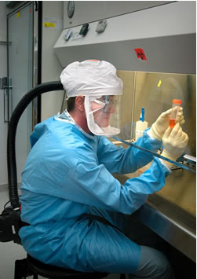
CQ#9: Select the biosafety level shown in the photo.
BSL - 1 C. BSL - 3
BSL - 2 D. BSL - 4

Slide 14
CQ#10: Select the biosafety level described by the conditions of the following example. Levels are listed below.
Work is conducted on a standard laboratory bench in a contained area.
PPE, including a lab coat, gloves, and eye protection are being used to reduce accidental infection.
BSL - 1 C. BSL - 3
BSL - 2 D. BSL - 4

Slide 15
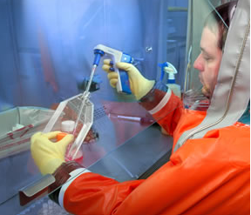
CQ#11: Select the biosafety level shown in the photo.
BSL - 1 C. BSL - 3
BSL - 2 D. BSL - 4

Slide 16
CQ#12: Which ELISA format is the most suitable for this case? (Lab Activity A, Question 1)
Direct
Indirect
Sandwich
Competition/Inhibition

Slide 17
CQ#13: Based on the test results from patient zero’s sample, which virus caused the outbreak? (Lab Activity A, Question 2)
Ebola hemorrhagic fever virus
Marburg hemorrhagic fever virus
Crimean-Congo hemorrhagic fever virus
Test results are inconclusive

Slide 18
A sign warns visitors that area is a Ebola infected.
MAKOUA CONGO AFRICA - SEPTEMBER 27 2013
Notes:
Attention Ebola. Makoua Congo Africa – September 27 2013: A sign warms visitors that area is Ebola infected.
Source: ©SURZ – Big Stock Photo ID: 59648213 - http://www.bigstockphoto.com/image-59648213/stock-photo-attention-ebola

Slide 19
CQ#14: Based on the phylogenetic tree, which strain is the virus isolated from patient zero’s sample most closely and least closely related to? (Lab Activity B, Question 1)
Zaire; Sudan (respectively)
Zaire; Bundilbugyo (respectively)
Bundilbugyo; Zaire (respectively)
Sudan; Reston (respectively)
Zaire; Cote d’Ivoire (respectively)
Results from the tree are inconclusive

Slide 20
Supplemental Material

Slide 21
1. Average Fatality Rate by Ebola Virus Strain
2. How Ebola is Transmitted
3. Fruit Bat Territory Overlay of Outbreaks
http://www.huffingtonpost.com/2014/07/30/ebola-map_n_5632280.html
4. Ebola Virus Structure and Genome Organization
http://journal.frontiersin.org/Journal/10.3389/fmicb.2012.00034/full
5. Filovirus Replication in a Cell
http://journal.frontiersin.org/Journal/10.3389/fmicb.2012.00034/full
6. Ebola Virus Phylogeny, including Guinea Strains
http://www.nejm.org/doi/pdf/10.1056/NEJMoa1404505
7. Zaire Ebola Virus Phylogeny
http://currents.plos.org/outbreaks/article/phylogenetic-analysis-of-guinea-2014-ebov-ebolavirus-outbreak-2/
8. Haemorrhagic Manifestations in Monkeys
http://www.ncbi.nlm.nih.gov/pubmed/21084112

Slide 22
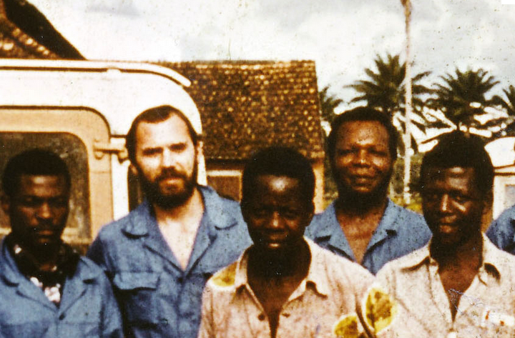
Yambuku, 1976 - Ebola Virus Discovery Team
Notes:
Peter Piot in Yambuku, northern Congo (the Zaire), in 1976, where he was part of the original team to discover the Ebola virus.
Suggested for use with Question 5 in Analysis Activity E.
Image credit (edited from): http://news.sciencemag.org/africa/2014/08/part-one-virologists-tale-africas-first-encounter-ebola

Slide 23
Image Credits
Slide 1 & 18
Description: Attention Ebola. Makoua Congo Africa – September 27 2013: A sign warms visitors that area is Ebola infected.
Source: ©SURZ- Stock Photo ID: 59648213 - http://www.bigstockphoto.com/image-59648213/stock-photo-attention-ebola
Clearance: License to be purchased by the author of this case pending NCCSTS approval.
Slides 13 and 15
Description: Biosafety equipment and practices.
Source: CDC, Recognizing the Biosafety Levels http://www.cdc.gov/training/quicklearns/biosafetyce/biosafetyCE.html
Clearance: Images are in the public domain.
Slide 22
Description: Photo of Peter Piot, circa 1976.
Source: American Association for the Advancement of Science. Accessed from: http://news.sciencemag.org/africa/2014/08/part-one-virologists-tale-africas-first-encounter-ebola
Clearance: Permission for use has not been obtained.

