Slide 1
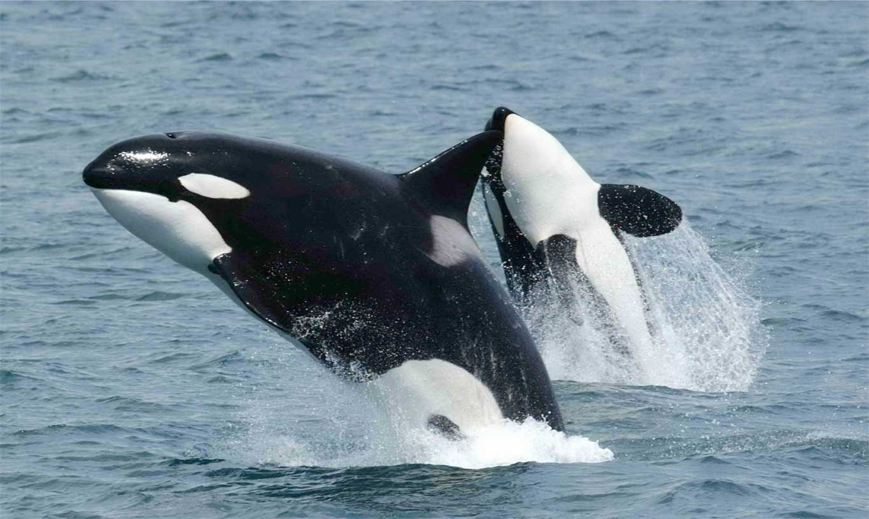
NATIONAL CENTER FOR CASE STUDY TEACHING IN SCIENCE
A Presentation to Accompany the Case Study:
One Whale or Two or …?
The Speciation of Orca Whales
by
Celeste A. Leander and Pamela Kalas, Department of Biology and Zoology, University of British Columbia
Notes:
Two mammal-eating "transient" killer whales photographed off the south side of Unimak Island, eastern Aleutian Islands, Alaska. Photo by Robert Pittman (NOAA), https://www.afsc.noaa.gov/Quarterly/amj2005/divrptsNMML3.htm.

Slide 2
What are some of the differences between transient and resident orcas?
Transient orcas live in the same costal waters year-round and eat fish while resident orcas travel along the coast and eat marine mammals.
Transient orcas live in the same costal waters year-round and eat marine mammals, while resident orcas travel along the coast and eat fish.
Transient orcas travel along the coast and eat fish while resident orcas live in the same costal waters year-round and eat marine mammals.
Transient orcas travel along the coast and eat marine mammals while resident orcas live in the same costal waters year-round and eat fish.

Slide 3
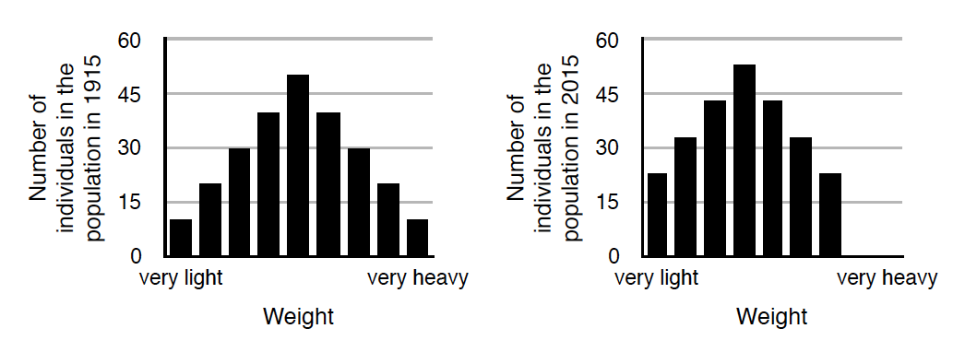
2. The graphs below show the weight distribution in a particular population of insects in 1915 and in 2015, respectively. Some researchers think that the change in the trait distribution is entirely due to a selection event in the early 1920s. If this is true, what individuals were most likely selected for by this event?
The medium-weight individuals.
The very heavy individuals.
The very light individuals.
The very heavy and the very light individuals.

Slide 4
3. Blobites are imaginary (but useful!) animals that live on ocean shores. Their body length is variable, and is inherited from parents to children. The graph below shows the initial size distribution in a population of blobites.
A sudden change in the environment causes the blobite population to undergo stabilizing selection for body length. Which of the graphs on the next slide best illustrates the expected body length distribution in the population of blobites after the selection event?

Slide 5
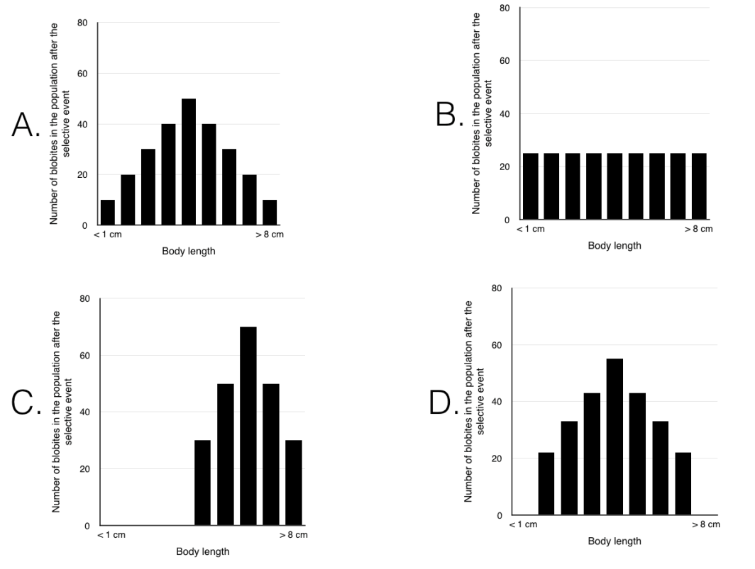
3. (cont)

Slide 6
4. Eastern grey squirrels (Sciurus carolinensis) can have different fur colors; the darkest is jet black and the lightest is grey. There is also an intermediate color, dark brown. This trait is genetically controlled. Surveys conducted in 1960, 1985, 2000, and 2015 revealed a change in fur color distribution in a population of Eastern grey squirrels.
Assuming that the change in fur color distribution is due to selection, which of the following hypotheses best explains the survey results?
A. Initially the environment favored jet black squirrels. Then, sometime between 1985 and 2000 there was a change in the environment and grey squirrels had to adapt to it to avoid extinction. This resulted in squirrels’ fur becoming lighter in color, shifting the population towards the grey fur extreme.
B. Initially the environment favored jet black squirrels. Then, sometime between 1985 and 2000 there was a change in the environment that gave an advantage to squirrels with a brown fur phenotype, decreasing the proportion of squirrels with the extreme fur colors (grey and jet black).
C. Initially there were many more jet black squirrels than grey or brown ones. Then, sometime between 1985 and 2000 there was a change in the environment that gave an advantage to squirrels with a lighter fur color, shifting the population towards the grey fur extreme.
D. Initially there were many more jet black squirrels than grey or brown ones. Then, sometime between 1960 and 1985 there was a change in the environment and brown squirrels had to adapt to it to avoid extinction. This resulted in squirrels’ fur becoming more brown, which caused stabilizing selection around a brown fur phenotype.

Slide 7
5. Some researchers hypothesize that the transient and the resident
orca ecotypes originated from a single population. The graphs below
show the distribution of the trait ‘jaw morphology’ along a continuum, from very gracile (i.e., very fine bones and weak jaw) to very thick (i.e., very thick bones and strong jaw) for transient orcas, resident orcas, and for the hypothesized population from which they originated.

Slide 8
5. (continued)
If both ecotypes of orcas originated from the hypothesized population, which of the following processes most likely gave rise to the two ecotypes?
A. The original population underwent disrupting selection and then split into two groups that formed their own pods and started developing their own cultures. This resulted in two ecotypes with different ranges of jaw morphology.
B. The original population underwent directional selection that shifted the jaw morphology range towards more gracile jaws, as well as directional selection that shifted the jaw morphology range towards more thicker jaws, resulting in two ecotypes with different ranges of jaw morphology.
C. The original population included very few individuals with thick or very thick jaws, so the orcas with this trait had to beak off from the original population and start their own population, where most individuals have thick or very thick jaws. This resulted in two ecotypes with different ranges of jaw morphology.
D. The more gracile-jawed orcas in the original population were selected for, but the environment changed favouring the thicker-jawed individuals, which resulted in two ecotypes with different ranges of jaw morphology

Slide 9
In your groups, designate:
1 or 2 Phylogenetic experts
1 or 2 Ecological experts
1 or 2 Biological experts
1 or 2 Morphology experts

Slide 10
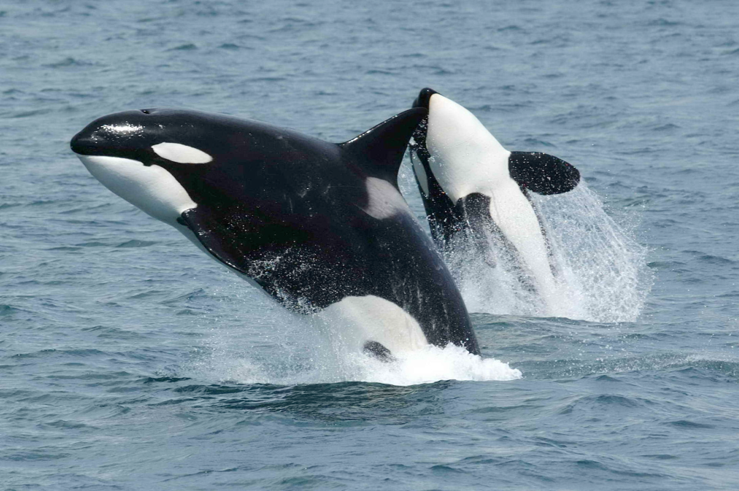
Expert consensus: Are orca whales one species or several species?

Slide 11
Working group consensus:
Are orca whales one species or several species?
Which species concept(s) did you value most? Why?

Slide 13
Lolita’s Retirement Plan, Stage 1
Lolita will be trained to position
herself in a stretcher, where she will be
evaluated physically by a team of veterinarians .
Lolita in her pen at Miami Seaquarium.
Used with permission from orcanetwork.org

Slide 14
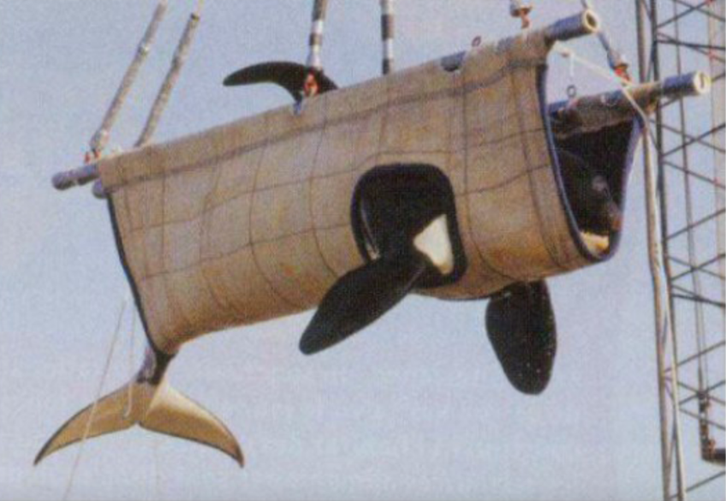
Lolita’s Retirement Plan, Stage 2
Lolita will be craned into a truck filled with ice water and driven to Miami-Dade airport, where she will be flown by chartered plane to Bellingham International airport.
Lolita’s transport harness.
Used with permission from orcanetwork.org

Slide 15
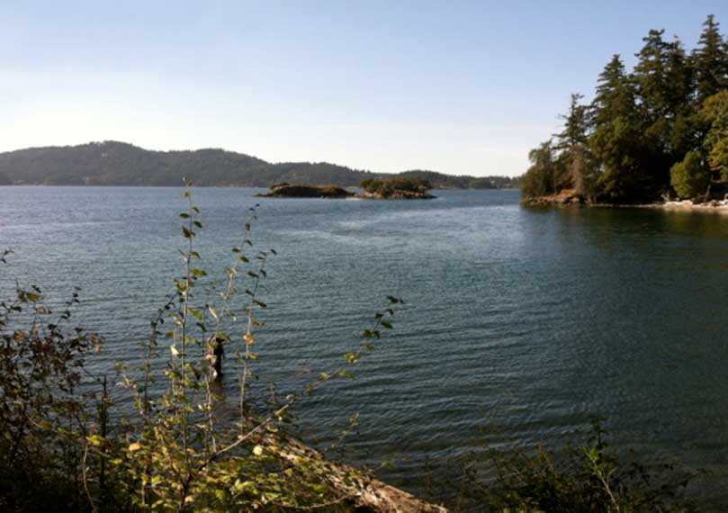
Lolita’s Retirement Plan, Stage 3
Lolita will be kept in a sea-pen near her family.
She will be released for short periods once re-call has been established, with a goal of permanent release. Her care team will be available to her for the rest of her life should she choose to return for food or companionship.
The site of Lolita’s proposed Sea-pen
Used with permission from orcanetwork.org

Slide 16
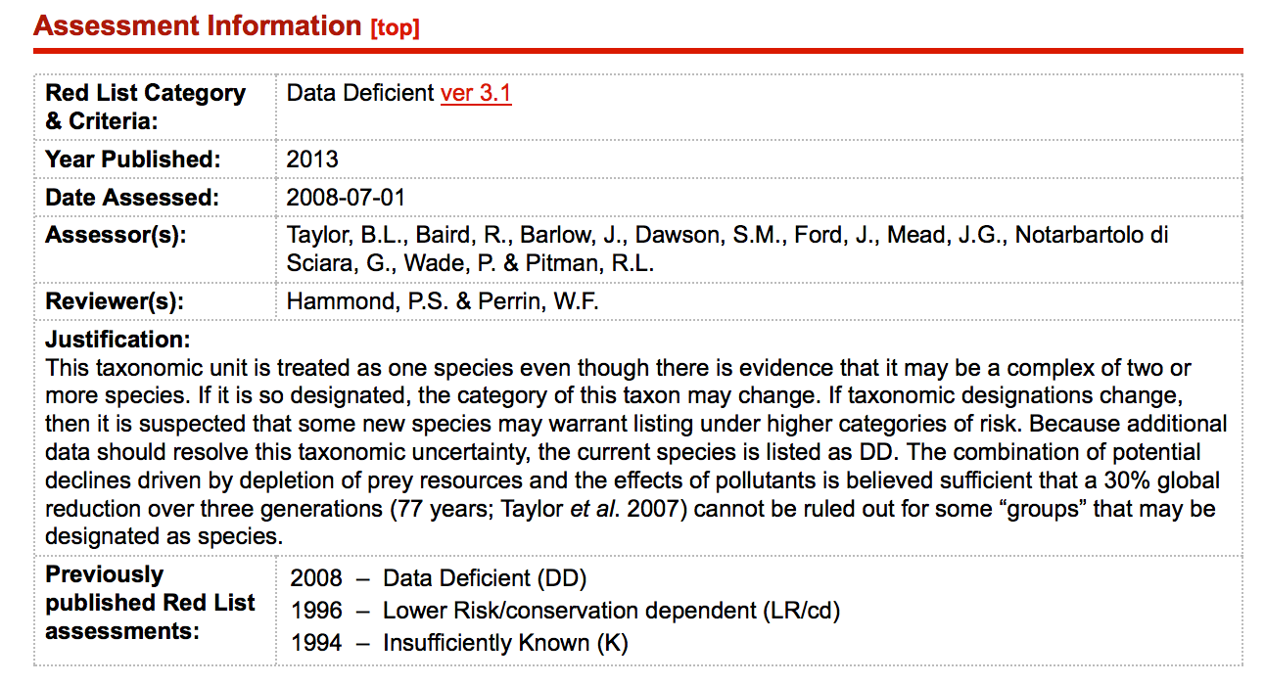

Slide 17
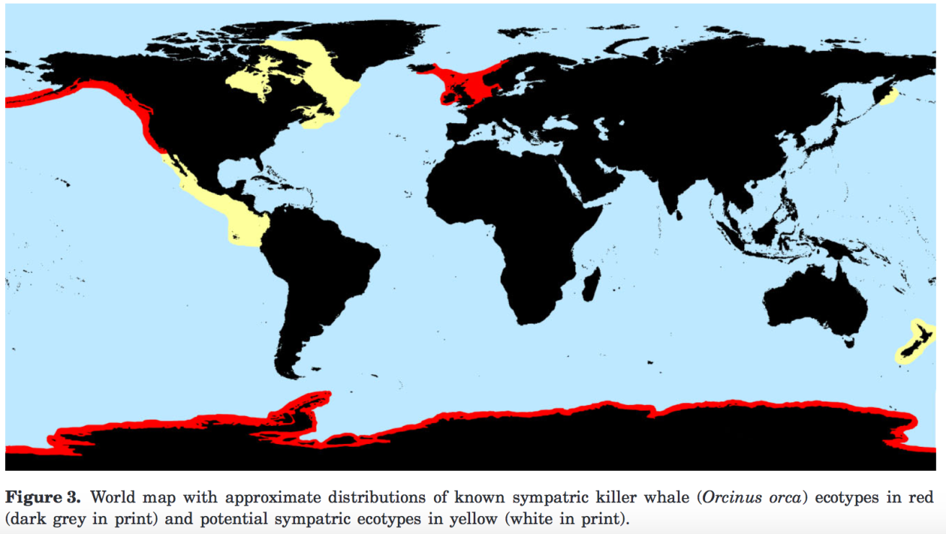
^{Credit:} Riesch, R., et al. Cultural traditions and the evolution of reproductive isolation: ecological speciation in killer whales? 2012, 106: 1–17, used by permission of Oxford University Press.

Slide 18
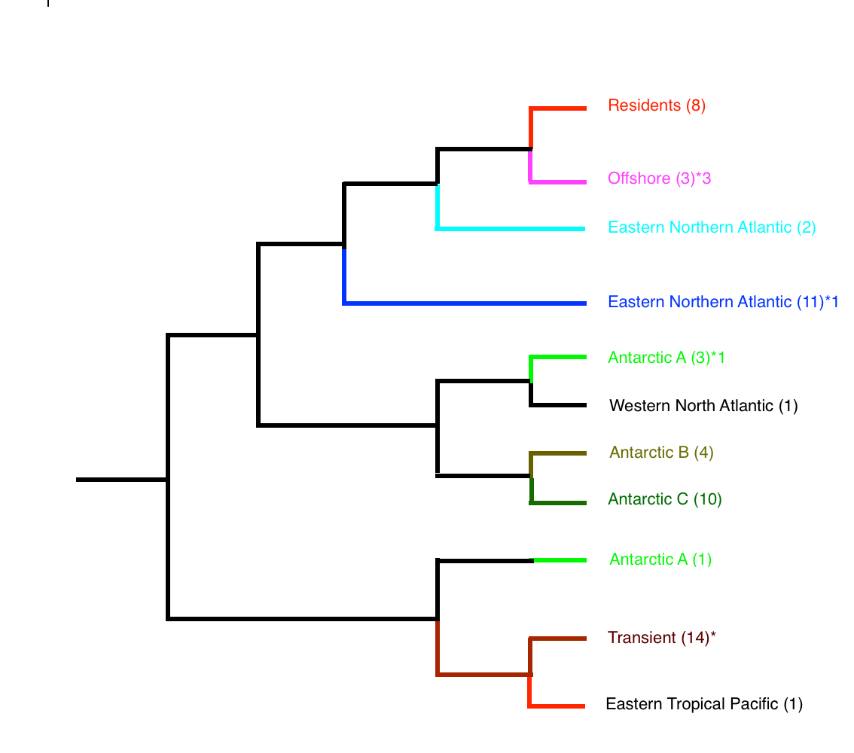
Notes:
Modified from Foote, 2011

Slide 19
Eastern N.A.
Resident, Offshore
and Transient
Western N.A.
Eastern Tropical
Pacific
Antarctic A,B, and C
^{Credit:} Riesch, R., et al. Cultural traditions and the evolution of reproductive isolation: ecological speciation in killer whales? 2012, 106: 1–17, used by permission of Oxford University Press.

