Slide 1
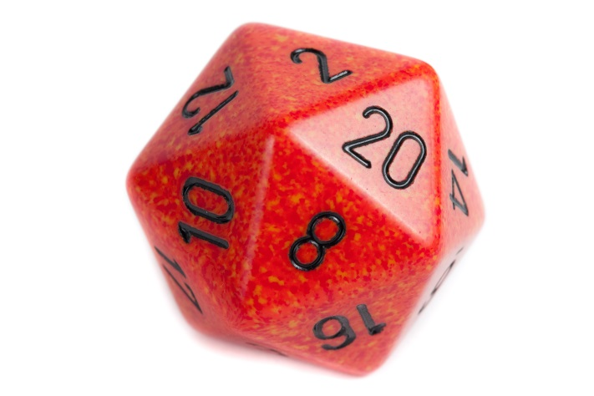
^{Oncologic:}
NATIONAL CENTER FOR CASE STUDY TEACHING IN SCIENCE
A Presentation to Accompany the Case Study
^{A Knowledge-Building Game for} Exploring the Diagnosis of Cancer
^{by}
^{Eric R. Sandhurst}
^{Jevin G. Meyerink}
^{Steven Powell}
^{Brooklyn K. VanDerWolde}
^{Adison A. Kleinsasser}
^{Thomas R. Vierhout}
^{Jessica L.S. Zylla}
^{Madeline A. Valentin}
Notes:
Licensed image © Excessmind | Dreamstime, IDD 11301604.

Slide 2
Background: Cancer Definition
Cancer is a genetic disease.
Genes responsible for controlling cell division become damaged or mutated.
Instead of dying, cancerous cells continue growing.
These damaged/mutated cells grow and divide uncontrollably, forming tumors or spreading throughout the body.
Cancer
Cancer can be benign or malignant.
Benign cancerous tumors do not spread while malignant cancer does, often causing more cancer to form throughout the body.
https://www.cancer.gov/about-cancer/understanding/what-is-cancer

Slide 3
Background: Normal Cells vs. Cancer Cells
Normal cells
Controlled, systematic growth and division
Old/damaged cells are capable of apoptosis
Apoptosis signal stops cell division
Dead cells are replaced by new cells
Cancer cells
Old/damaged and abnormal cells survive
Cell division occurs uncontrollably
Clusters of cells can then form tumors
These cells do not have specialized functions
Ignore apoptosis signals
Disguise themselves to avoid being destroyed
Tumor Formation
Normal Cell Division
Damaged Cell
Uncontrolled Cell Division
Apoptosis

Slide 4
Background: Cancer Risk Factors
Risk factors that lead to damage of cell DNA:
Environmental Radiation
Sunlight and ionizing radiation
Air and water pollution
Bacteria and viruses
i.e. human papillomavirus, hepatitis B & C, Epstein-Barr virus
Inherited Genetics
Family history of cancer
Hormone Therapy
Carcinogenic Chemicals
Dioxins and dioxin-like compounds, benzene, kepone, EDB, and asbestos
Alcohol, Smoking
Diet, obesity, and age
(36)
(37)

Slide 5
Background: Cancer - Preventative Measures
General ways to minimize risk:
Avoid carcinogens
E.g., dangerous chemicals and cigarettes
Wear sunscreen & limit radiation exposure
Regularly exercise
Eat a healthy diet
Variety of fruits and vegetables
Minimize or eliminate alcohol consumption
(38)
(37)

Slide 6
Learning Objectives
Identify types of cancers and the signs and symptoms of each cancer.
Recall typical demographics for various cancers.
Distinguish between different cancer types.
Relate the responsibilities of hospital staff to their correct roles.
Compare typical hospital roles and responsibilities.

Slide 7
Oncologic Game Rules

Slide 8
Game Synopsis
Goal
Gather patient information and diagnose a specific type of cancer
Information is collected from medical professionals by rolling a 20-sided die
The value of the roll determines the amount of information received in a single turn
Gain information by talking to colleagues
Nurses
Pathology
Radiology

Slide 9
Player Roles
3+ players
(1 person) Cancer: The Emperor of All Maladies- “EM” for the game
Chooses which information clues to read to the other players (after each player roll); each clue is shared with all players
(2+ people) Players: people acting as medical oncologists
Gather information by rolling the die
At the beginning of each turn, a player must first choose which field of colleagues to ask for information and then rolls the die to determine how much information is collected
On subsequent turns, players may select a field (nursing, pathology, radiology) and roll the die or choose to end the game and diagnose the patient.

Slide 10
Gathering Information
Players roll a 20-sided die to collect information from supporting medical fields
Nursing provides Tier 1 information
Contains up to clues
After 5 of the 10 clues are collected, pathology and radiology are available
Pathology provides Tier 2 information
Contains up to 10 clues
Radiology provides Tier 2 information
Contains up to 10 clues
Once a total of 5 clues from pathology AND/OR radiology are collected, players can attempt to diagnose the cancer by identifying the type and location(s)
Key clue is revealed once any player is able to diagnose the cancer
Roll Values for Nursing, Pathology, and Radiology
1: Failure to communicate/ some issue
2-7: 1 clues
8-13: 2 clues
14-19 : 3 clues
20: 4 clues
+1 Key clue during diagnosis phase

Slide 11
Successful Diagnosis
A successful diagnosis requires:
The correct cancer classification.
The location(s) of benign tumors.
Presence of a malignant cancer.
Once the cancer has been classified and the location(s) known, each team will read through the doctor-patient mock dialogue.

Slide 12
Non-Hodgkin's lymphoma (Walkthrough Example)

Slide 13
Nursing
N1: Caucasian Male
N2: 60 years old
N3: Type 2 diabetes
N4: History of high blood pressure
N5: Recent unexpected weight loss
Pathology and Radiology are now available!
N6: Experiencing fatigue for about 3 months
N7: Significant night sweats
N8: Loss of appetite
N9: Swollen neck
N10:Temp is 100.1, HR is 110, BP 100/60, RR 20

Slide 14
Pathology
P1: Physical exam: Swollen lymph nodes in neck, armpit, and abdomen
P2: Neck exam: enlarged lymph nodes (2cm dia) in the patient’s neck
P3: Oropharynx exam shows enlarged tonsils bilaterally
P4: Abdominal exam: fullness over Traube’s space and a palpable spleen tip
P5: Axillary nodal and inguinal nodal exam reveal rubbery, non-tender, mobile lymph nodes
P6: Blood test performed: show Anemia (HGB 10.2), with a mildly elevated WBC (11,000, normal diff) and moderately low platelet count (80,000). LDH is elevated at 480, Renal and hepatic function are normal. ESR is elevated >90.
P7: Biopsy is recommended: Needle and core biopsy of lymph node are performed
P8: Results from needle and core are non-informative
P9: Excisional biopsy of a lymph node is performed
P10: Excisional biopsy shows abnormal appearing lymphocytes staining positive for CD20

Slide 15
Radiology
R1: CT scan is performed on the neck
R2: CT scan shows enlarged lymph nodes throughout the cervical lymphatic area
R3: CT scan shows enlarged lymph nodes throughout the supraclavicular lymphatic area
R4: CT scan is performed on the chest
R5: CT scan shows enlarged lymph nodes throughout the axillary, mediastinal, and hilar
R6: CT scan is performed on the abdomen/pelvis
R7: CT scan shows enlarged lymph nodes throughout the iliac.
R8: CT scan shows enlarged lymph nodes throughout the inguinal chains
R9: A markedly enlarged spleen with hepatomegaly is also identified
R10: Recommend performing biopsy (pathology) on a lymph node.

Slide 16
Unlocked Key Information
Key information:
Positive CD20 & flow cytometry data is supportive for a diffusive cancer type
Enlarged lymph nodes are located all throughout the lymphatic system

Slide 17
Diagnosis Phase
Cancer classification: Non-Hodgkin's Lymphoma (specifically, large b-cell lymphoma)
Location(s): Throughout the lymphatic system
Benign or Malignant Cancer: Malignant

Slide 18
After Successfully Diagnosing the Cancer
Select one person to be the patient and one person to be the doctor and read through the mock dialogue

