Slide 1
An Investigation into Ocean Acidification
NATIONAL CENTER FOR CASE STUDY TEACHING IN SCIENCE
A Presentation to Accompany the Case Study:
by
Diara D. Spain and Vanessa M. Mendoza
Natural Sciences and Mathematics
Dominican University of California, San Rafael CA
Notes:
Strict restrictions apply to use of this PowerPoint presentation. Only registered NCCSTS subscribers are permitted to present it in their classrooms for their students. Any further transmission, downloading, printing, re-posting, saving, or modifying and publishing is strictly forbidden. Violations of this policy will be investigated and vigorously pursued. If you have questions, contact permissions@sciencecases.org.
Copyright held by the National Center for Case Study Teaching in Science, University at Buffalo, State University of New York. Originally published November 16, 2020.
Credit: Image by apasciuto, CC BY 2.0, <https://www.flickr.com/photos/apasciuto/32632336250/in/photostream/>.

Slide 2
Part I – Ocean Acidification 101
Read the article “Oceans Turn More Acidic Than Last
800,000 Years” from Scientific American
https://www.scientificamerican.com/article/acidic-oceans/

Slide 3
Question 1: What are the major ions and gases found in ocean water?
Sodium (Na⁺), magnesium (Mg²⁺), sulfate (SO₄²⁻), chlorine (Cl⁻), calcium (Ca²⁺), and potassium (K⁺) are the major ions found in ocean water. The gases in ocean water include nitrogen (N₂), oxygen (O₂), and carbon dioxide (CO₂)
Calculations of seawater salinity are made of the parts per thousand of the sodium chloride ion present in one kilogram of seawater. Typically, seawater has a salinity of 35 parts per thousand.

Slide 4
Question 2: Give examples of different natural events and man-made activities that can affect ocean chemistry.
Typical examples include: runoff from rivers, agricultural runoff from crops and animals, sewage, industrial waste, ocean dumping, and air pollution.
Some examples that do not occur as often include: natural disasters (floods and hurricanes), man-made disasters (oil spills from offshore drilling and tanker accidents), and high levels of biological activity from marine organisms (algal, phytoplankton, and jellyfish blooms).

Slide 5
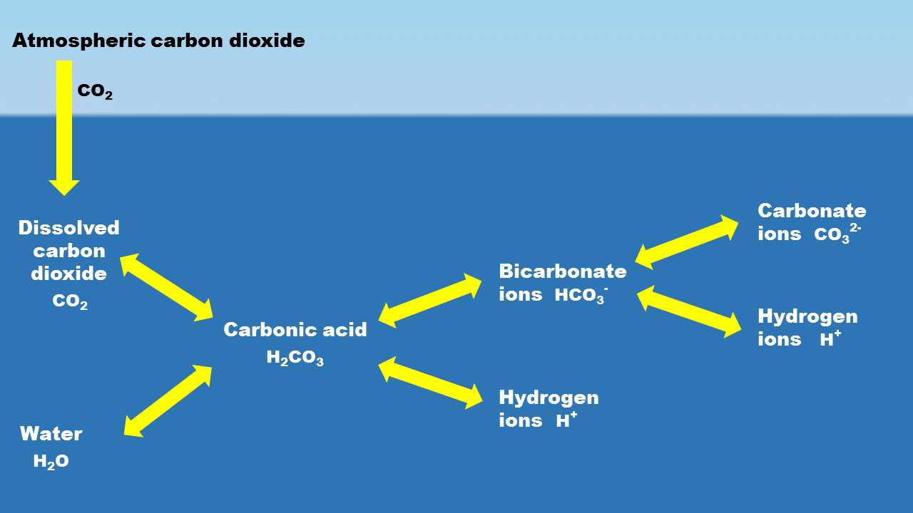
Question 3: Referring to Figure 1, what kind of reactions are happening that affect ocean chemistry?
*Hint: The elements found in the ocean combine in different forms to create biologically active compounds such as HCO₃⁻
Atmospheric carbon dioxide (CO₂) dissolves into water (H₂O) to form carbonic acid (H₂CO₃).
Carbonic acid separates to form bicarbonate ions (HCO₃⁻) and hydrogen ions (H⁺).
Bicarbonate ions (HCO₃⁻) further can dissociate into carbonate ions (CO₃²⁻) and more hydrogen ions (H⁺).
Figure 1: Basic Ocean Chemistry

Slide 6
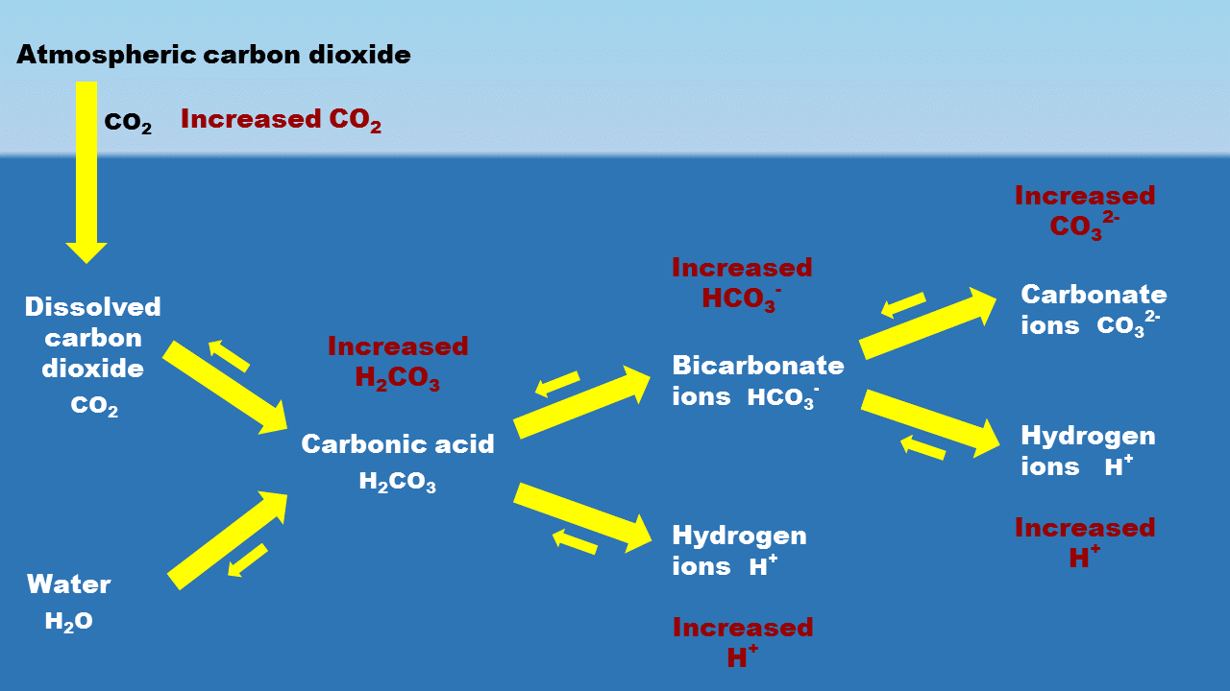
Question 4: Describe ocean acidification in your own words.
Figure 2: Ocean Chemistry with Increased CO₂ Emission
Ocean acidification = a decrease in ocean pH because too much CO₂ in the atmosphere is being absorbed by ocean water
The net effect is more free H⁺ ions in water, lowering pH

Slide 7
Question 5: On the pH scale, what is considered acidic, basic, and neutral? What is the pH of freshwater and saltwater? What are some examples of items that are acidic?
Typically the pH scale ranks substances from 0 to 14
Acidic: pH < 7
Neautral: pH = 7
Basic: pH > 7
Freshwater pH = 7.0 and saltwater pH = 8.1
Acidic examples: battery acid, lemon juice, and vinegar

Slide 8
Part II – How Do Humans Affect Ocean Acidification?
Question 1: How are ocean acidification and carbon dioxide linked?
CO₂ from atmosphere dissolves in ocean
Greater CO₂ emissions = more CO₂ dissolves in ocean = more reactions with water = H⁺ ion increase = lower pH = acidic ocean

Slide 9
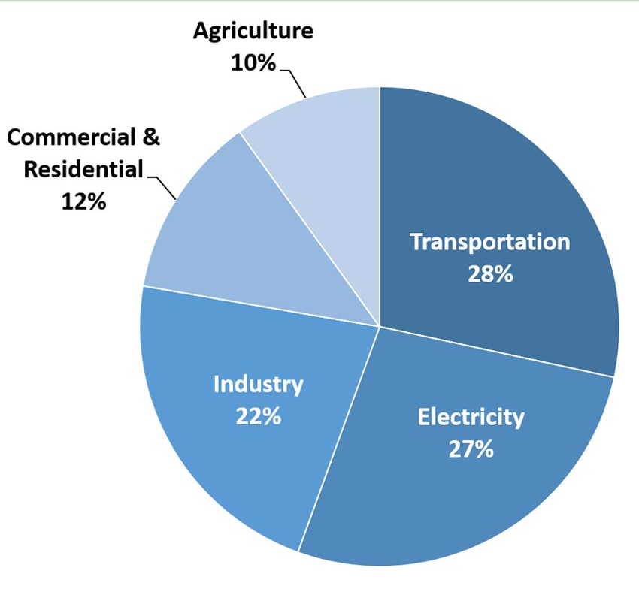
Question 2: What are the most common causes of greenhouse gases attributing to ocean acidification?
*Hint: Use Figure 3.
Figure 3: Total U.S. Greenhouse Gas Emissions by Economic Sector in 2018
Increased human CO₂ emissions: transportation, generation of electricity, production and maintenance of crops and livestock, sewage, industrial processes, commercial and residential property
U.S. Environmental Protection Agency (2020). Inventory of U.S. Greenhouse Gas Emissions and Sinks: 1990-2018
https://www.epa.gov/ghgemissions/sources-greenhouse-gas-emissions

Slide 10
http://www.earth-policy.org/data_center/C23

Slide 11
(a) How would you describe CO₂ emissions from 1750-1825?
(b) How would you describe CO₂ emissions from 1850-1900?
(c) How would you describe CO₂ emissions from 1950-2000?
Question 3: Look at Figure 4 and circle the most appropriate answer for the following questions:
No change
Small increase
Large increase

Slide 12
http://www.earth-policy.org/data_center/C23

Slide 13
Question 4: Fill in the correct answer after examining Figure 5.
In the 1900s the primary contributor to global emissions was . This trend continued and by 1920 another major contributor emerged, ____. Emissions from became the third contributor after the 1950’s. After 1950 the total amount of carbon dioxide emissions began to more rapidly. By 1970 the top contributor was clearly with as the second major source. has steadily increased from 1940 to 2013. In contrast, there has been a sharp increase in the contributor, , since 2000.
coal
oil
natural gas
increase
oil
coal
Natural gas
coal

Slide 14
Question 5: Can you connect the changes seen in the 18th and 19th centuries to another historical event? Explain your answer. *Note: Additional research may be needed
Industrial Revolution began in Britain ~late 1700’s
More CO₂ after 1875, which was around the time of North America’s Industrial Revolution
As a result, between 1800-1900 CO₂ began to increase
Since North America is a large landmass, more CO₂ emitted into air as Industrial Revolution continued

Slide 15
Question 6: What is the Keeling curve? *Note: Refer to Scripps Keeling Curve website
The Keeling Curve is a measurement of the CO₂ concentration in the atmosphere.
How is it relevant for tracking CO₂ emissions, and how long have emissions been recognized as an issue?
It is a record of seasonal fluctuations of CO₂ levels seen during the fall and spring. The reflected increase is thought to be attributed to human activities. Measurements began in 1958, however in the 1970’s it began to get more recognition as an issue.
http://scrippsco2.ucsd.edu/history_legacy/keeling_curve_lessons

Slide 16
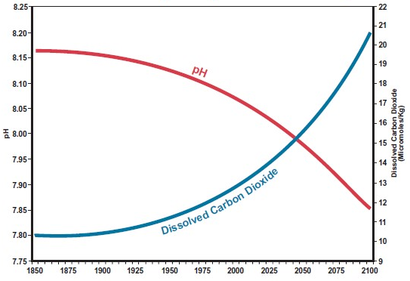
Question 7: Use Figure 6 to complete the following table.
year | 1875 | 1925 | 1975 | 2000 | 2025 | 2050 | 2075
pH value
CO₂
year | 1875 | 1925 | 1975 | 2000 | 2025 | 2050 | 2075
pH value | 8.16 | 8.14
CO₂ | 10.3 | 10.7
year | 1875 | 1925 | 1975 | 2000 | 2025 | 2050 | 2075
pH value | 8.16 | 8.14 | 8.11
CO₂ | 10.3 | 10.7 | 11.8
year | 1875 | 1925 | 1975 | 2000 | 2025 | 2050 | 2075
pH value | 8.16 | 8.14 | 8.11 | 8.07
CO₂ | 10.3 | 10.7 | 11.8 | 12.8
year | 1875 | 1925 | 1975 | 2000 | 2025 | 2050 | 2075
pH value | 8.16 | 8.14 | 8.11 | 8.07 | 8.03
CO₂ | 10.3 | 10.7 | 11.8 | 12.8 | 13.9
year | 1875 | 1925 | 1975 | 2000 | 2025 | 2050 | 2075
pH value | 8.16 | 8.14 | 8.11 | 8.07 | 8.03 | 7.98
CO₂ | 10.3 | 10.7 | 11.8 | 12.8 | 13.9 | 15.5
year | 1875 | 1925 | 1975 | 2000 | 2025 | 2050 | 2075
pH value | 8.16 | 8.14 | 8.11 | 8.07 | 8.03 | 7.98 | 7.92
CO₂ | 10.3 | 10.7 | 11.8 | 12.8 | 13.9 | 15.5 | 17.5
year | 1875 | 1925 | 1975 | 2000 | 2025 | 2050 | 2075
pH value | 8.16
CO₂ | 10.3
Figure 6: Historical & Projected pH & Dissolved CO₂
*Note the following: 1) scale on the left is pH, 2) the right scale shows dissolved carbon dioxide, and 3) each mark on the date axis represents 5 years

Slide 17
Question 8: Describe the relationship between the values by circling the correct word.
(a) What has been happening to pH values since 1850?
(b) What has been happening to the amount of dissolved CO₂?
Decrease
Increase

Slide 18
Question 9: Complete the paragraph to help explain how pH has changed over time.
The pH level of the ocean has over time. Since atmospheric is , the amount of CO₂ that the water takes in as well. When there is more CO₂ in ocean water, this changes ocean chemistry. The ending chemical reaction in the ocean results in an increase in ions, which will result in a pH decrease, thus causing the ocean to become more .
decreased
carbon dioxide/ CO₂
increasing
increases
hydrogen
acidic

Slide 19
Question 10: If humans continue to emit CO₂ at the amount we do right now, what does that mean for the future?
The atmospheric CO₂ level will continue to rise.
The pH of the ocean will decrease, becoming more acidic.
This has implications for the oceans as a natural resource that we use for recreation, commerce, and food.

Slide 20
Question 11: What are some things that you can do to decrease your carbon footprint and help decrease the overall emission of CO₂? *Note: Answers may vary
Any answer that refers to energy conservation or energy efficiency would be appropriate.
For example, when traveling consider public transportation, carpooling, bicycling, or walking.
In addition, we can lessen energy usage in our households through energy efficient appliances or “green electricity” (solar and wind power).

Slide 21
Part III – Ocean Acidification and Marine Snails
Please read over the article “Acidification Eating Away
at Tiny Sea Snails” from The Seattle Times
Answer the following questions based on the article.
http://apps.seattletimes.com/reports/sea-change/2014/apr/30/pteropod-shells-dissolving/

Slide 22
Question 1: Why is this marine snail called a sea butterfly? *Hint: Search online for answer
A sea butterfly is a type of marine snail also referred to as a pteropod. These snails have winglike extensions that can be used for swimming.

Slide 23
Question 2: Contrast a healthy pteropod shell with a shell damaged by OA. *Hint: Refer to diagram in article
A healthy shell is smooth and nearly transparent, while a shell damaged from ocean acidification would have holes/pits and be opaque in color.

Slide 24
Question 3: Identify two ways damaged shells can affect their biology?
Answers may include the following:
More energy used to maintain and repair their shell
Decreased ability to avoid being eaten by predators
Metabolic effects relating to growth rate, maturity and reproduction
Increased physiological stress

Slide 25
Question 4: What would likely happen if the sea butterfly population were to decrease dramatically?
A wide variety of animals eat these pteropods, which would likely affect the food chain. A scenario of this would be:
decrease in pteropods decrease in numbers of herring, mackerel, squid, large shrimp, and some seabirds decrease in larger fish (salmon, tuna, and pollock)

Slide 26
Question 5: What are the broader impacts of increased ocean acidification on marine organisms, the ocean ecosystem, and humans?
Marine organisms are likely to experience population changes resulting from decreased survivorship, growth, and reproduction. This effects multiple species at different levels in the food web, destabilizing the ocean’s ecosystems. This cascade of events will impact sustainability for human usage as a natural resource. For example, a decrease in larger fish will mean lower human consumption and less profits for fishermen/fisheries.

Slide 27
Copyright and Terms of Use
Strict restrictions apply to use of this PowerPoint presentation. Only registered NCCSTS subscribers are permitted to present it in their classrooms for their students. Any further transmission, downloading, printing, re-posting, saving, “sharing,” or modifying and publishing is strictly forbidden. Violations of this policy will be investigated and vigorously pursued. If you have questions, contact permissions@sciencecases.org.
Copyright held by the National Center for Case Study Teaching in Science, University at Buffalo, State University of New York. Originally published November 16, 2020.

