Slide 1
A Nervous Night in the ER: Stings, Poisonings, and More
NATIONAL CENTER FOR CASE STUDY TEACHING IN SCIENCE
Images to Accompany the Case Study:
by
Breanna N. Harris, Department of Biological Sciences, Texas Tech University, Lubbock, TX
Heidi Schutz, Department of Biology, Pacific Lutheran University, Tacoma, WA

Slide 2
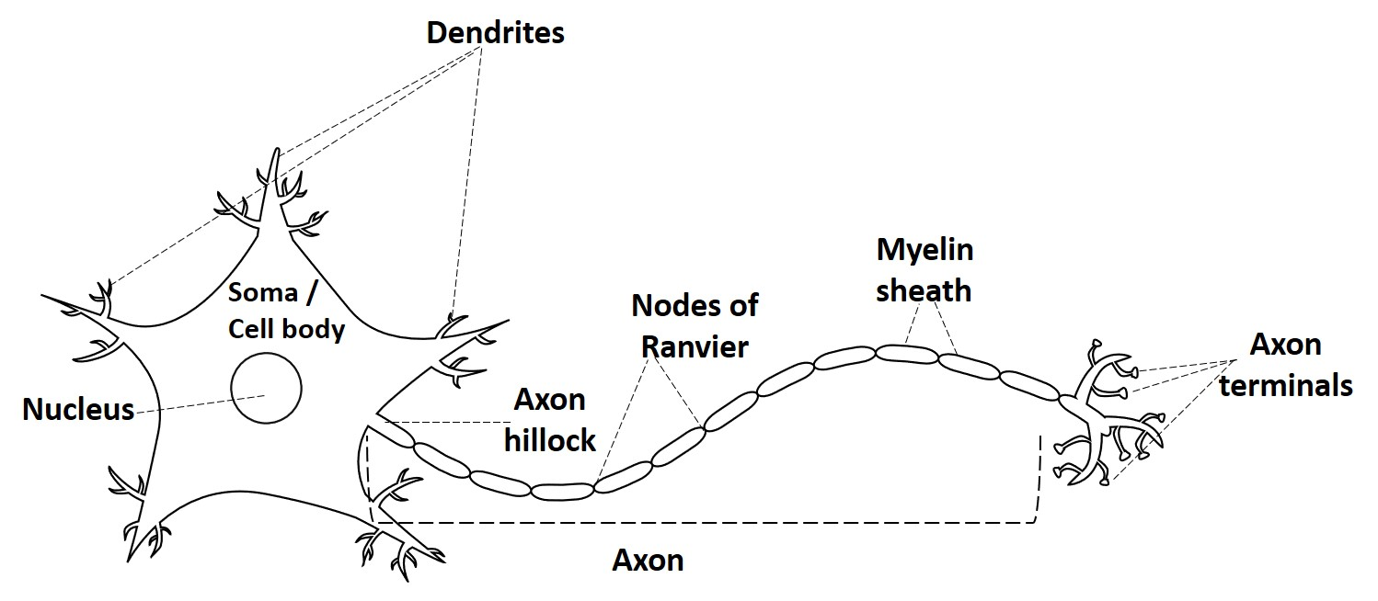
Notes:
Question 1

Slide 3
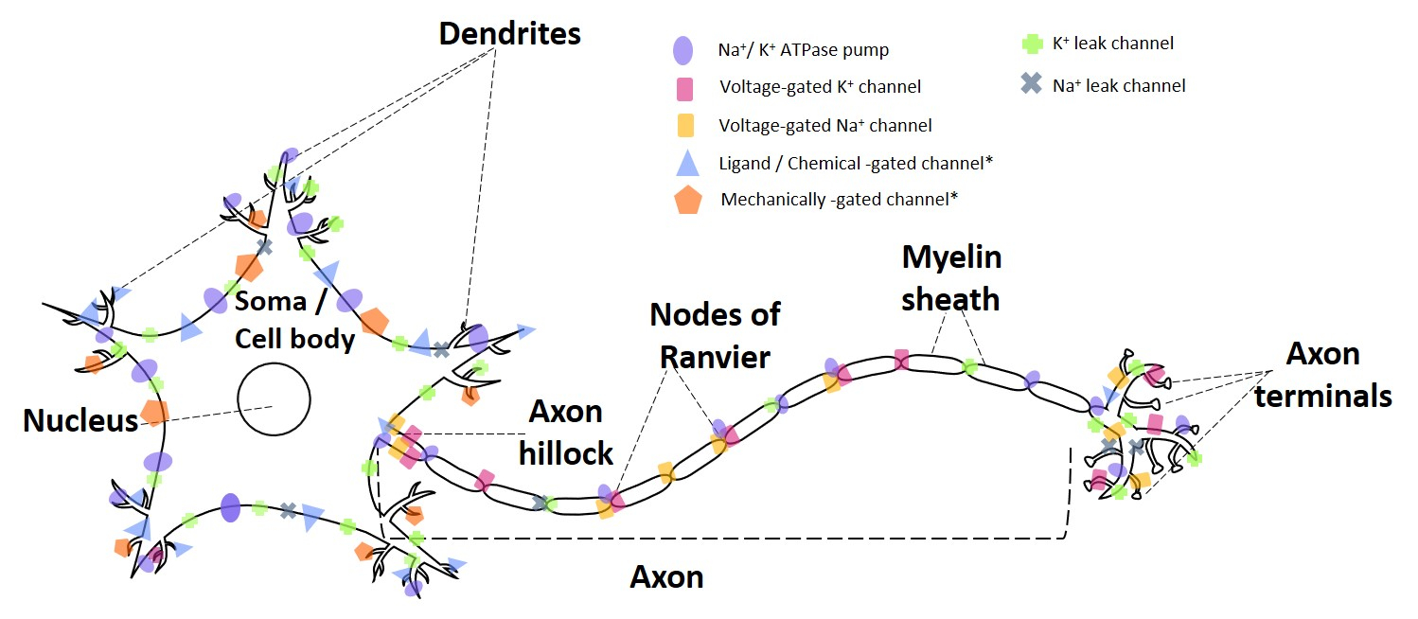
Notes:
Question 2

Slide 4
Neuron axon at rest.
Extracellular side
0 mV
Name:
State: open or closed
Name:
State: open or closed
3Na+
K+
Gate 1
ATPase
Na+
2K+
Name:
State: open or closed
Gate 2
Name:
State: Active or Inactive
Name:
Gate 1 State: open or closed
Gate 2 State: open or closed
Intracellular side
-70 mV
Notes:
Question 3. Blank

Slide 5
Neuron axon at rest.
Extracellular side
0 mV
Name: Vg K+
State: open or closed
Name: K+ leak
State: open or closed
3Na+
K+
Gate 1
ATPase
Na+
2K+
Name: Na+ leak
State: open or closed
Gate 2
Name: Na+/K+ Pump
State: Active or Inactive
Name: Vg Na+
Gate 1 State: open or closed
Gate 2 State: open or closed
Intracellular side
-70 mV
Notes:
Question 3 key

Slide 6
Notes:
Question 5

Slide 7
Gate 1 is closed at rest; Gate 2 is open at rest
Gate 1
Gate 1
Gate 1
Gate 2
Gate 2
Gate 2
Notes:
Question 5

Slide 8
Membrane Potential (units:______)
TIME (units:_____)
Notes:
Question 6 handout

Slide 9
Vg Na+ channel inactivation gates close
+30-40
-70
Vg K+ channels open
Membrane Potential V_{m} (units: mV_)
Na+ in
K+ out
Vg Na+ channel activation gates open
Depolarization from graded potentials
Threshold potential
K+ channels close
0 1 2
Time (units: __mSec___)
Notes:
Question 6 key

Slide 10
Stimulus from pre-synaptic neuron
mV
- 40
-55
-70
Post-synaptic neuron
time
mV
- 40
-55
Electrode recordings following application of pre-synaptic neuron stimulus
-70
time
mV
- 40
Axon hillock (trigger zone)
-55
-70
time
Re-drawn from image in Human Physiology by Silverthorn

Slide 11
+30-40
-55
-70
Option 1: flat, no change
Membrane Potential (units:_mV_)
Option 2: reach threshold, no response
Option 3: reach threshold, response from Vg K+ only
Threshold potential
TIME (units:_mSec_)
Notes:
Question 6 handout

Slide 12
+30-40
-55
-70
Membrane Potential (units:_mV_)
Option 1: depolarization to peak and slow drift
alternate: sinusoidal pattern
Threshold potential
TIME (units:_mSec_)
Notes:
Question 6 handout

Slide 13
+30-40
-55
-70
Lower peak, extended peak
Membrane Potential (units:_mV_)
Threshold potential
Possibly more hyperpolarized
TIME (units:_mSec_)
Notes:
Question 6 handout

