Slide 1
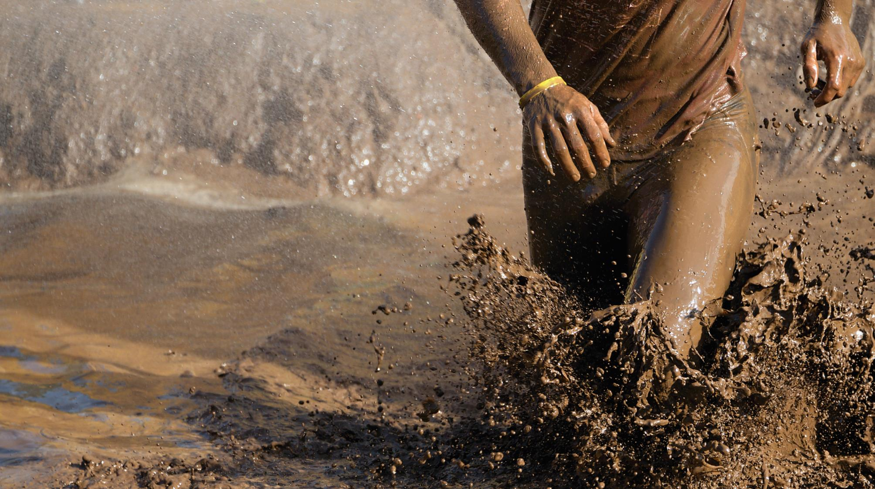
NATIONAL CENTER FOR CASE STUDY TEACHING IN SCIENCE
A Presentation to Accompany the Case Study:
One Tough Mudder: Exploring Infectious Disease Transmission
by
Kristiann M. Dougherty
Department of Biology
Palm Beach Atlantic University, West Palm Beach, FL
Notes:
Credit: Licensed image © Pavol Stredansky | Dreamstime, ID 79536795.

Slide 2
Should Sam participate in the mud run?
Need two volunteers to read: Sam and her mom.
Follow along with the conversation.
As you listen, note some of the points each is using in her argument.

Slide 3
Discussion Questions
Answer Questions 1 and 2 and be prepared to share your ideas with the class.
Vote: Based on what you have heard so far, if you were Sam, would you run or not mud run?

Slide 4
What is a Mud Run?
http://youtu.be/3074OTsuIGE
As you watch, be on the look out for possible:
Reservoirs of infectious agents
Portals of entry
Routes of transmission

Slide 5
What did you identify?
Reservoirs?
Portals of entry?
Routes of transmission?

Slide 6
Discussion Questions
Answer Questions 3-6 and be prepared to share your ideas with the class.
Final Vote: Based on what you have learned, if you were Sam, would you run or not mud run?

