Slide 1
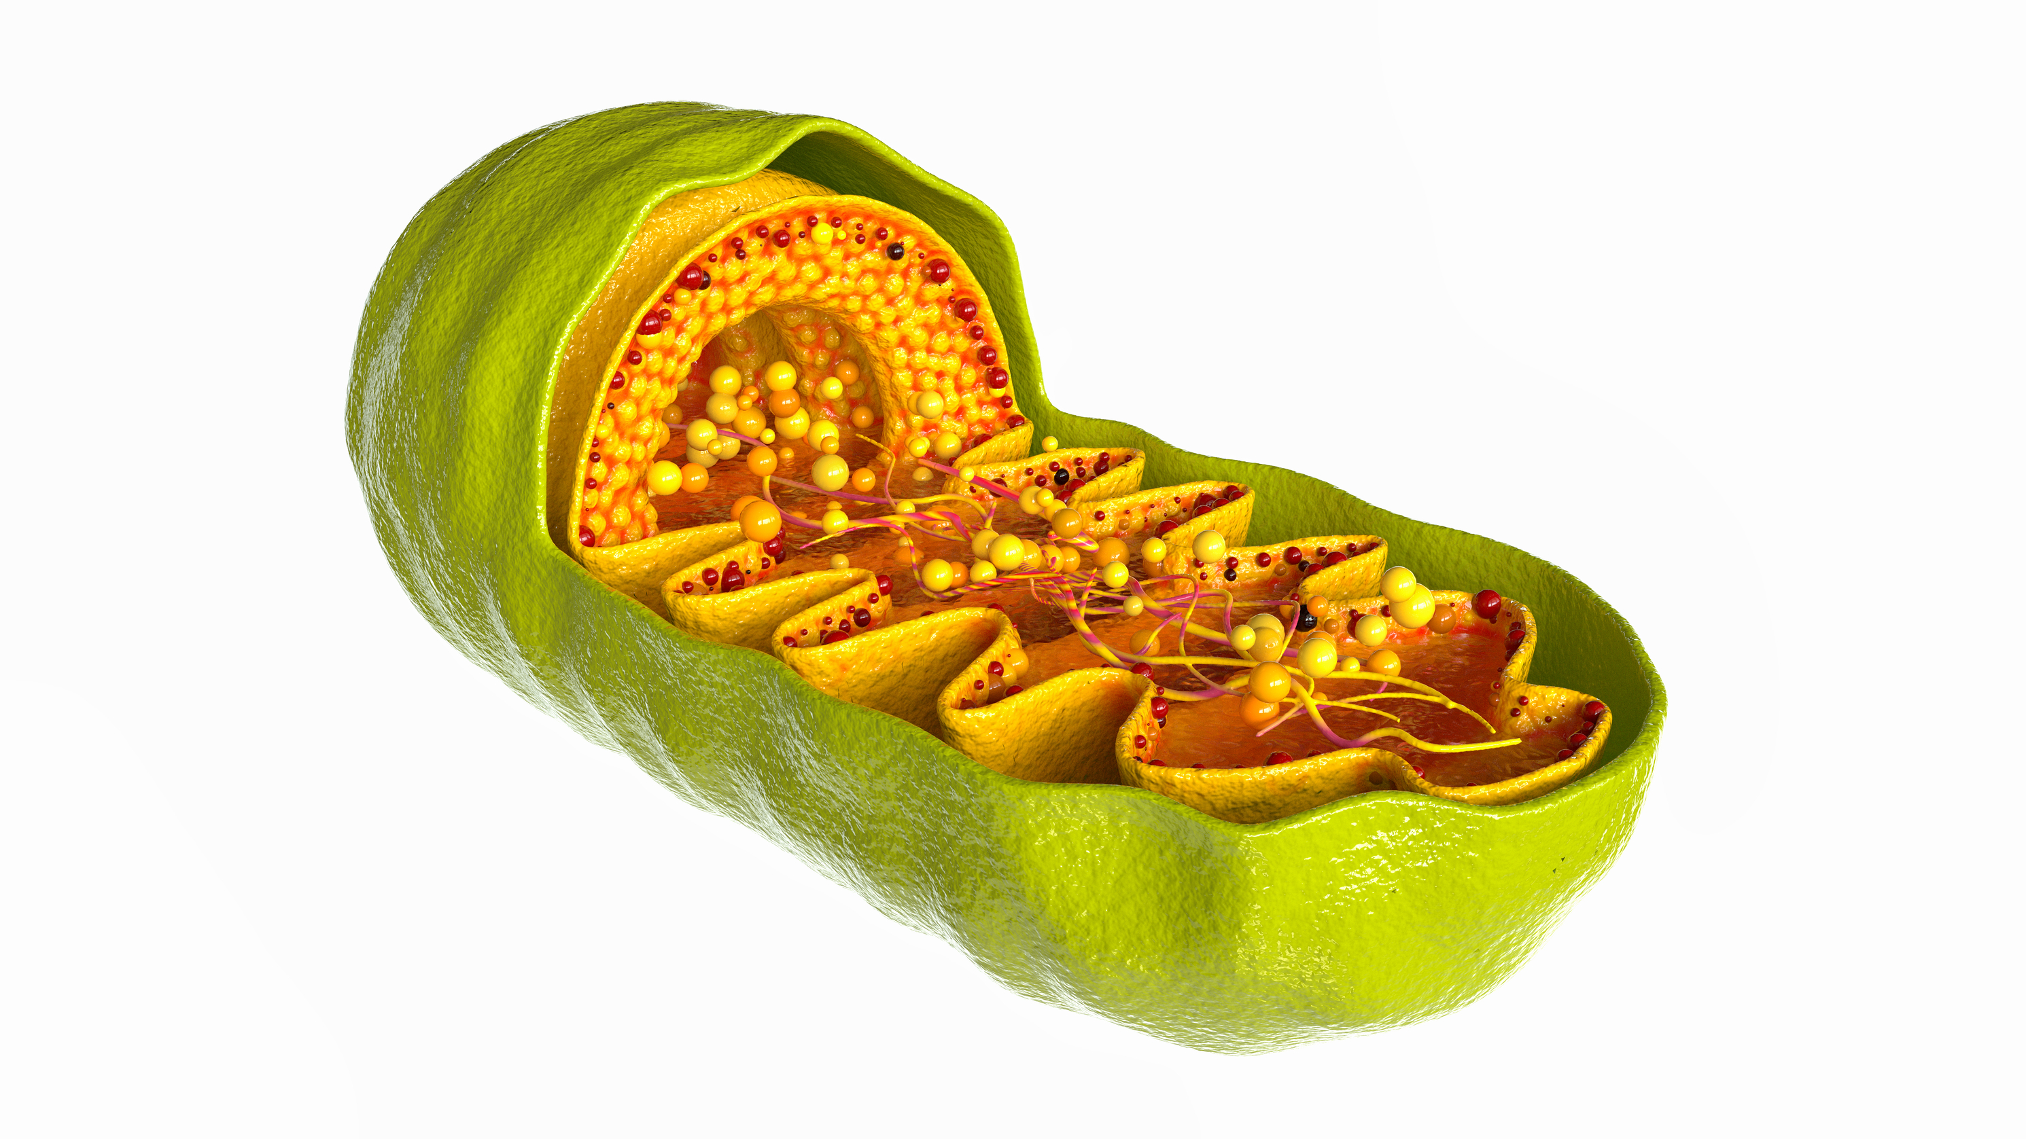
Mitochondrial Mysteries
NATIONAL CENTER FOR CASE STUDY TEACHING IN SCIENCE
A Presentation to Accompany the Case Study:
by
Anna K.S. Jozwick and Megan Lee
Biological Sciences
Goucher College, Baltimore, MD
Notes:
Credit: Licensed image © Futurer | Dreamstime.com, id 165312954.

Slide 2
Module – Origins of Organelles
Goals:
Provide evidence to support the endosymbiotic theory explaining the acquisition of mitochondria and chloroplasts by eukaryotic cells.
Write and revise testable hypotheses using new information learned.

Slide 3
Part I – The Diagnosis
CQ1: List any past knowledge you have about the mitochondria.

Slide 4
Part I – The Diagnosis cont.
CQ2: Based on the information in Part I, a deletion in the DNA of the mitochondria would result in:
death of the individual with this mutation.
a loss of specific proteins.
changes in how quickly a cell can transport proteins.
mitochondria do not have DNA.

Slide 5
Part II – An Unexpected Visitor
CQ3: Ivy should consider going to dinner with Ali.
Yes
No

Slide 6
Part II – An Unexpected Visitor cont.
CQ4: Report out possible origins for organelles.
If your answer has not been reported, please submit it! There are no wrong answers.

Slide 7
Part III – Information Overload
CQ5: Based on the information in this section, mitochondria and bacteria share all of the following characteristics EXCEPT:
They both have two separate phospholipid membranes.
They both have the same ribosome size and structure.
They both can grow and function in isolation (away from other cells).
They both harbor DNA in a circular chromosome.

Slide 8
Part IV – Mitochondrial Relatives
CQ6: Based on what you’ve learned about the mitochondria, which statement do you support at this point?
The eukaryotic cell developed mitosomes or hydrogenosomes, which evolved into mitochondria.
An aerobic bacterium infected a cell, which later evolved into mitochondria.

Slide 9
Part V – Connecting the Dots
CQ7: Based on what you’ve learned about the mitochondria, which statement do you support at this point?
The eukaryotic cell developed mitosomes or hydrogenosomes, which evolved into mitochondria.
An aerobic bacterium infected a cell, which later evolved into mitochondria.

Slide 10
Wrap-up
You should now be able to:
Provide a list of evidence to support the endosymbiotic theory explaining the acquisition of mitochondria and chloroplasts by eukaryotic cells.
For review:
How We Think Complex Cells Evolved. Running time: 5:41 min. Produced by Adam Jacobson, animation by Camilla Gunborg Pedersen, TED-Ed, 2015.
https://youtu.be/9i7kAt97XYU

Slide 11
Module – Cellular Respiration
Goals:
Describe the function of the mitochondria in the eukaryotic cell.
Explain the role of electron carriers, oxygen, protons, and protein complexes

Slide 12
Part I – Exam Preparation
CQ8: Based on the information in this part of the case, the numbers of NADH, FADH₂ and ATP (Table 1) are:
NADH: 2, FADH₂: 4 and ATP: 4
NADH: 8, FADH₂: 2 and ATP: 4
NADH: 10, FADH₂: 2 and ATP: ~29
NADH: 6, FADH₂: 2 and ATP: ~29

Slide 13
Part I – Exam Preparation cont.
CQ9: The process that removed electrons (i.e., oxidizes) from the electron carriers is:
Glycolysis
Pyruvate processing
Citric acid cycle
Electron transport chain
Oxidative phosphorylation

Slide 14
Part II – Where the Magic Happens
CQ10: Oxidative phosphorylation is the energy payoff phase because the majority of ATP is produced during this process.
TRUE
FALSE

Slide 15
Part II – Where the Magic Happens cont.
CQ11: The intermembrane space is inside the inner membrane.
TRUE
FALSE

Slide 16
Part III – Putting It All Together
CQ12: Glycolysis occurs in:
A. The cristae
B. The intermembrane space
C. The mitochondria
D. The cytoplasm

Slide 17
Part III – Putting It All Together cont.
CQ13: Protons build up in the __________________ and move back into the ________________________ to drive ATP synthesis
Intermembrane space, mitochondrial matrix
Mitochondrial matrix, intermembrane space
Cytoplasm, mitochondria
Mitochondria, cytoplasm
Inner membrane, outer membrane

Slide 18
Part IV – The Dinner
CQ14: This case study helped me learned why mitochondria are called the “powerhouse” of the cell.
A. TRUE
B. FALSE

Slide 19
Part IV – The Dinner cont.
CQ15: Do you agree with the following statement?
The case study was an effective way of learning about endosymbiosis theory and cellular respiration.
Yes
No

Slide 20
Wrap-up
You should now be able to:
Describe the function of the mitochondria in the eukaryotic cell.
Describe where each of the processes of cellular respiration occur.
Explain the role of electron carriers, oxygen, protons, and protein complexes.
For review:
Cellular Respiration. Running time: 2:47 min. Produced by RicochetScience, 2016. https://youtu.be/eBl3U-T5Nvk
Cellular Respiration and the Mighty Mitochondria. Running time: 7:48 min. Produced by Amoeba Sisters, 2014. https://youtu.be/4Eo7JtRA7lg

