Slide 1

NATIONAL CENTER FOR CASE STUDY TEACHING IN SCIENCE
A Presentation to Accompany the Case Study:
Menstrual Cycle Misfire:
When Biochemistry Meets Burnout
by
Megna Tiwari and Erin L. Dolan
Department of Biochemistry and Molecular Biology
University of Georgia, Athens, GA
Notes:
Image credit: © Mikhail Dudarev | Dreamstime.com, ID 45604348, licensed.

Slide 2
Learning Objectives
Differentiate between hormone concentration and bioactivity and explain why standard assays can misrepresent physiological function.
Interpret biochemical or physiological data to infer how hormone variation affects endocrine function.
Explain the biochemical role of glycosylation in modulating LH structure, half-life, and receptor activity.
Predict how lifestyle factors (stress, exercise, nutrition) could alter LH glycosylation and influence reproductive function.
Integrate structural, functional, and hormonal data to propose mechanistic explanations for endocrine dysregulation.

Slide 3
Learning Objectives Day 1
Differentiate between hormone concentration and bioactivity and explain why standard assays can misrepresent physiological function.
Interpret biochemical or physiological data to infer how hormone variation affects endocrine function.
Explain the biochemical role of glycosylation in modulating LH structure, half-life, and receptor activity.
Predict how lifestyle factors (stress, exercise, nutrition) could alter LH glycosylation and influence reproductive function.
Integrate structural, functional, and hormonal data to propose mechanistic explanations for endocrine dysregulation.

Slide 4

Case Narrative
Maya is a medical student and long-distance runner.
She hasn’t had her period in over 3 months, but she shrugs it off and says, “It’s probably the marathon training.”
Dr. Morales notes that Maya trains six days a week, running a total of 60–70 miles, and maintains a strict “clean eating” regimen heavy in protein, but light on overall calories.
She’s balancing medical coursework, tutoring shifts, and late-night study sessions. Sleep is short. Stress is high.
Maya mentions fatigue, irritability, and occasional lightheadedness.
She insists she is “fine” — if anything, she feels stronger than ever
Dr. Morales is concerned and orders a standard hormonal panel. Missing periods can be common in endurance athletes, yet Maya’s case feels less straightforward.
Her physical fitness appears excellent, but her physiological signals may be telling a different story.
Through Maya’s story, you will explore how subtle biochemical shifts can disrupt communication between the brain and reproductive system and how a simple “missed period” reveals a deeper layer of biological regulation.
Notes:
Image credit: © Michal Sanca | Dreamstime.com, ID 97962094, licensed.

Slide 5

HPO Axis
The Hypothalamic-Pituitary-Ovarian (HPO) axis is the primary endocrine system controlling female reproduction.
It regulates the menstrual cycle, ovulation, and hormone production via a complex feedback loop.
This occurs when:
  hypothalamus releases GnRH.
  GnRH signals the pituitary to produce FSH/LH.
  FSH/LH stimulate the ovaries to produce estrogen and progesterone.
Notes:
Image credit: Screen grab from recommended short video: The Hypothalamic- Pituitary- Ovarian Axis, produced by Adu Med- Dr Derek, 2023. Run time: 0:32 min. <https://youtube.com/shorts/1SUiU4efpDI>
Negative feedback (most of the cycle): Lower, steady levels of estradiol and progesterone inhibit the hypothalamus from releasing GnRH and the pituitary from releasing FSH and LH, keeping levels low during the follicular and luteal phases. Amplify to change our growth.
Positive feedback (pre-ovulation): High, sustained levels of estradiol produced by the mature follicle cause a switch, stimulating the pituitary to release a rapid burst of LH (the LH surge), which causes ovulation. Regulate to balance and stability

Slide 6
Part I – The Disrupted Rhythm
Maya returns to the clinic to review her test results.
She scans the page, everything looks… normal.
Most values sit comfortably within reference ranges.
But she has missed three consecutive periods.
If the numbers are normal, why isn’t her body?
Dr. Morales pauses at the report, sensing something doesn’t add up.
When physiology and lab values conflict, the clinic consults the university research lab.
Maya is referred for deeper endocrine analysis.
Hormone | Maya’s Value | Reference Range | Interpretation
Follicle-stimulating Hormone (FSH) | 6.1 IU/L | 3 – 10 IU/L | Normal
Luteinizing Hormone (LH) | 19.0 IU/L | 2 – 15 IU/L | Slightly elevated
Estradiol | 20 pg/mL | 30 – 400 pg/mL | Low
Progesterone | 3 ng/mL | 5 – 20 ng/mL (luteal) | Slightly Low

Slide 7
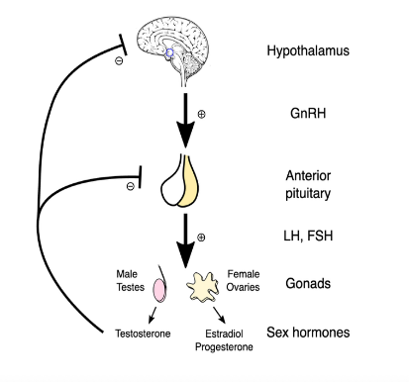
Questions
Hormone | Maya’s Value | Reference Range | Interpretation
Follicle-stimulating Hormone (FSH) | 6.1 IU/L | 3 – 10 IU/L | Normal
Luteinizing Hormone (LH) | 19.0 IU/L | 2 – 15 IU/L | Slightly elevated
Estradiol | 20 pg/mL | 30 – 400 pg/mL | Low
Progesterone | 3 ng/mL | 5 – 20 ng/mL (luteal) | Slightly Low
Examine Maya’s hormone panel. Which results stand out and what patterns do you notice?
Using the HPO axis schematic provided, how would you describe the communication among the hypothalamus, pituitary, and ovaries based on these data?
If Maya’s hormone concentrations appear mostly normal, what factors could interfere with how these hormones actually work in the body? Brainstorm some ideas (hypotheses).
Notes:
Image credit: The hypothalamic-pituitary-ovarian (HPO) axis. Credit: Wikimedia Commons | Artoria2e5, cc by 3.0.

Slide 8
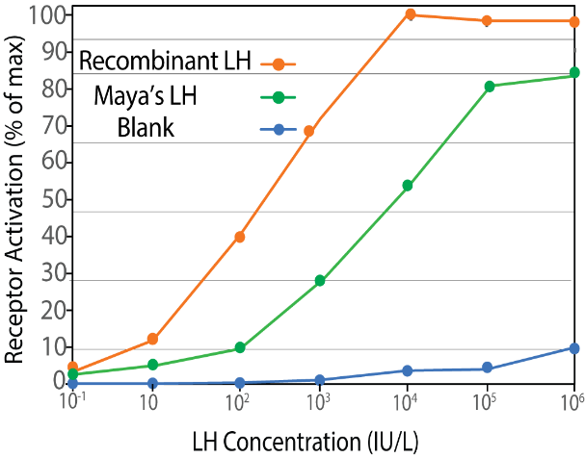
Part II – The Bioactivity Puzzle
Maya visits the endocrinology research lab for further evaluation.
Noah from the team measures LH bioactivity, not just LH concentration.
A functional assay tests how strongly Maya’s LH activates LH receptors in cultured ovarian cells.
Her sample is analyzed alongside recombinant (reference) LH.
Receptor activation data are generated and plotted as response curves.
The curves are compared side-by-side.
Noah notes the results are “interesting.”
How can you measure bioactivity (i.e., when a receptor is activated in cells)?
How do we analyze the activation data?

Slide 9
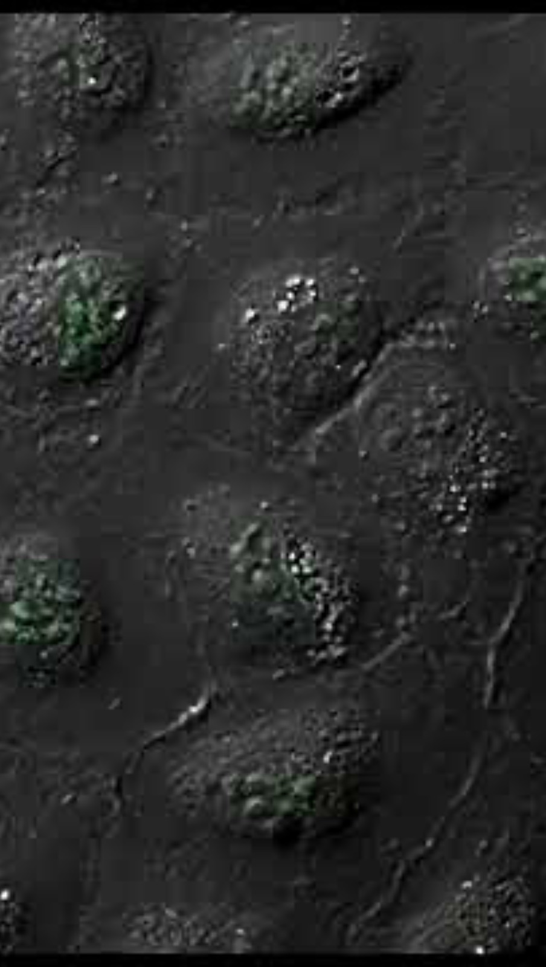
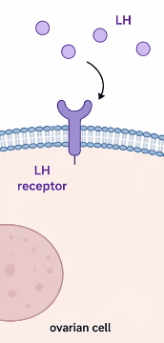
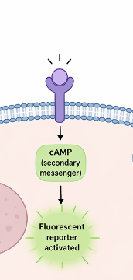
How do you measure bioactivity (i.e., when a receptor is activated in cells)?
LH is added to ovarian cells that have LH receptors on their surface. If LH binds the receptor, it turns the receptor “on.”
When the receptor is turned on, the cell produces a fluorescent signal. More fluorescence means lots of receptor activation.
This assay does not directly measure how much LH binds the receptor; it measures what happens after binding.
It tells us how well LH can trigger a cellular response.
Notes:
Image credit: Screen grab from video Detection of Oxidative Stress with Invitrogen CellROX Green Reagent in U2OS Cells, produced by ThermoFisher Scientific, https://www.thermofisher.com/us/en/home/life-science/cell-analysis/cell-viability-and-regulation/oxidative-stress.html

Slide 10
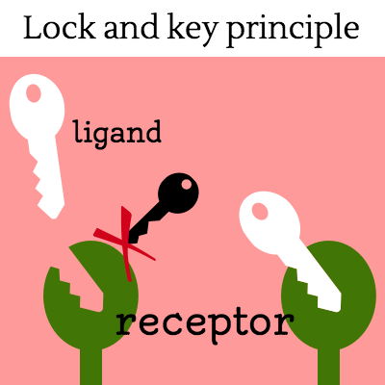
Ligand receptor-activation data
This graph shows how receptor activation changes as ligand concentration increases
To consider:
How much ligand do you need to bind the receptor to activate it?
Is the ligand the perfect fit?
Notes:
It’s not as definitive as lock and key.
Why? If a ligand binds, that’s just the first step. Some questions to consider after the ligand bind …
Sometimes the ligand might not bind at all and sometimes a ligand will bind but …
This graph is helping you answer these questions.

Slide 11
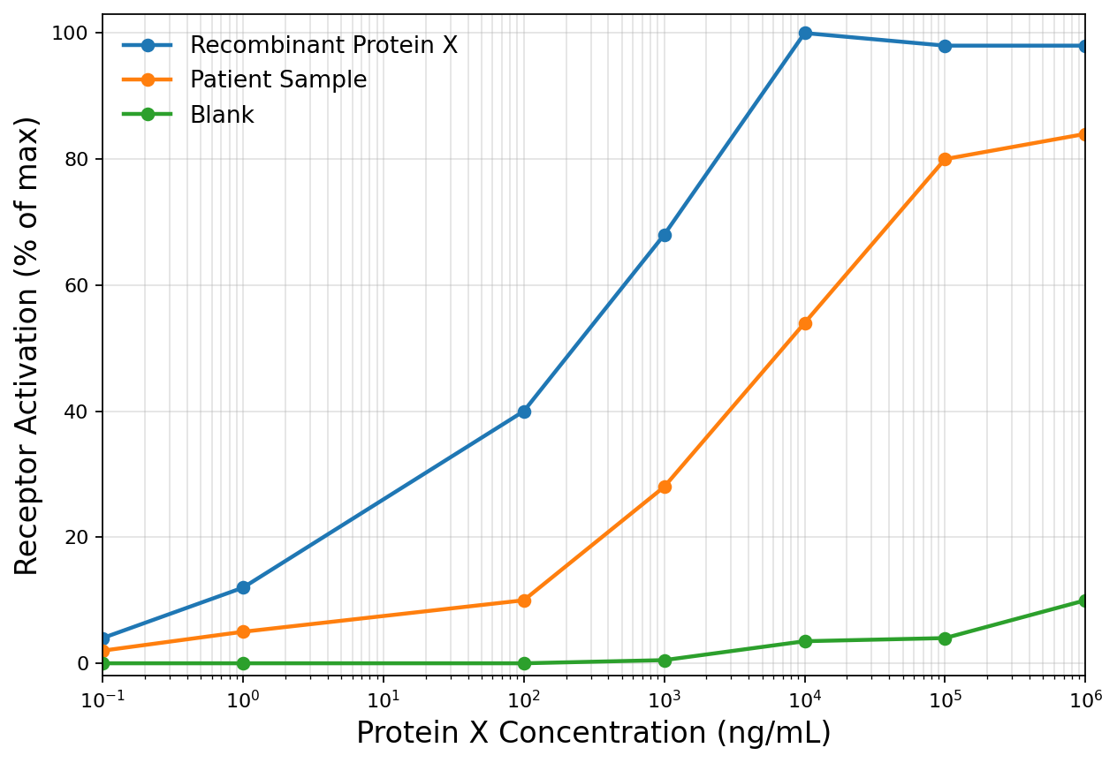
Analyzing Activation Data: Step 1-X and Y axes
Y axis:
tells us the amount of receptor activation upon addition of ligand aka a cellular response
X axis: tells us how much of the ligand is being added to achieve activation of its respective receptor

Slide 12
Analyzing Activation Data: Step 2-understanding controls and samples
We always compare our patient samples to our control samples.
Recombinant protein: refers to commercially produced and fully functional. Protein X is a positive control.
Blank: refers to cells exposed to the assay buffer, BUT with no protein added. Blank is your negative control.
Think of positive:
you know it’s right.
Think of negative:
you know it’s wrong.

Slide 13
Analyzing Activation Data: Step 3-analyzing line graphs
Recombinant protein:
Nearly 100% activation reached at 10^4
Now we will determine the difference in activation for each sample.

Slide 14
Analyzing Activation Data: Step 3-analyzing line graphs
Patient sample:
80% activation max reached at 10^5
Now we will determine the difference in activation for each sample.

Slide 15
Analyzing Activation Data: Step 3-analyzing line graphs
Now we will determine the difference in activation for each sample.
Blank sample:
Less than 10% activation max reached

Slide 16
Analyzing Activation Data: Step 3-intreperting results
Recombinant protein:
Nearly 100% activation reached at 10^4
Patient sample:
80% activation max reached at 10^5
We can interpret from this data set that the patient sample produces less receptor activation than Recombinant Protein X at the same concentration. This suggests that the patient sample protein does not behave like a fully functional protein, making the protein less effective at activating the receptor.
Blank sample:
Less than 10% activation max reached

Slide 17
Analyzing Adhesion Data: Cheat sheet
Y axis:
tells us how much of the ligand is binding to its receptor and activating it for downstream signaling
We always compare our patient samples to our control samples.
Recombinant protein:
Nearly 100% activation reached at 10^4
Think of positive:
you know it’s right.
Think of negative:
you know it’s wrong.
Patient sample:
80% activation max reached at 10^5
We can interpret from this data set that the patient sample produces less receptor activation than Recombinant Protein X at the same concentration. This suggests that the protein does not behave as a fully functional protein, making the protein less effective at activating the receptor.
Blank sample:
Less than 10% activation max reached
X axis: tells us how much of the ligand is being added to achieve activation of its respective receptor

Slide 18

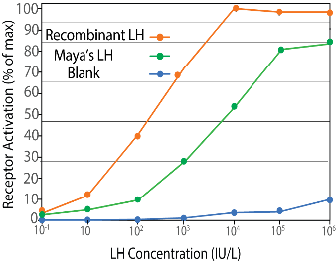
Big Picture for Clues So Far
Part I: Maya goes to the clinic for a hormone panel
Part II: Maya goes to endocrinology lab to see if her LH is functioning
Hormone | Maya’s Value | Reference Range | Interpretation
Follicle-stimulating Hormone (FSH) | 6.1 IU/L | 3 – 10 IU/L | Normal
Luteinizing Hormone (LH) | 19.0 IU/L | 2 – 15 IU/L | Slightly elevated
Estradiol | 20 pg/mL | 30 – 400 pg/mL | Low
Progesterone | 3 ng/mL | 5 – 20 ng/mL (luteal) | Slightly Low
Normal FSH and LH levels, but low estradiol and progesterone = Ovaries are not responding to LH
Maya’s LH shows reduced receptor activation compared to healthy donor LH, requiring a higher concentration to approach saturation and never achieving full receptor binding—hormone concentration does not equal potency, as function depends on effective receptor interaction!
Endocrine function is not determined by concentration alone! Depends on how effectively a hormone works once released!

Slide 19
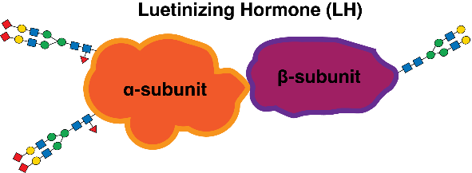
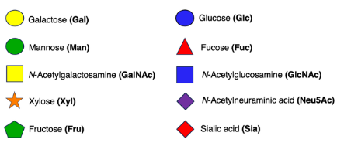
Part III – The Architecture of LH
Noah explains that LH is not just a hormone-it is a glycoprotein decorated with branching sugar chains.
These glycans contribute to LH’s overall shape and may influence how it circulates and interacts with its receptor.
The β-subunit binds the LH receptor; the α-subunit stabilizes the hormone’s structure.
Small structural differences can change how strongly a hormone signals.
He also explains that hormone half-life depends on both protein structure and attached sugars.
Structure can influence how long LH stays in circulation and how effectively it works.
Symbol Nomenclature for Glycans (SNFG) Key:
What are glycans?
How might they influence LH’s activity?

Slide 20
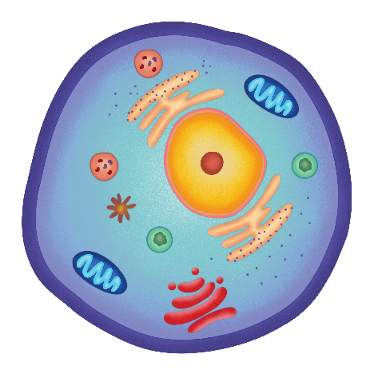






From blueprint to function: central dogma
Cell
DNA
Protein
RNA
Genome
Transcriptome
Proteome
Depending on how RNA is processed we get a variety of proteins with different functions.

Slide 21










Are all proteins created equally?
Protein
Different variations of the original protein
DNA
RNA
A
B
C
A
B
C
A
B
A
B
A protein starts as a “basic model,” but cells can add upgrades or adjustments to the protein.
These modifications are known as post-translational modifications (PTMs).

Slide 22
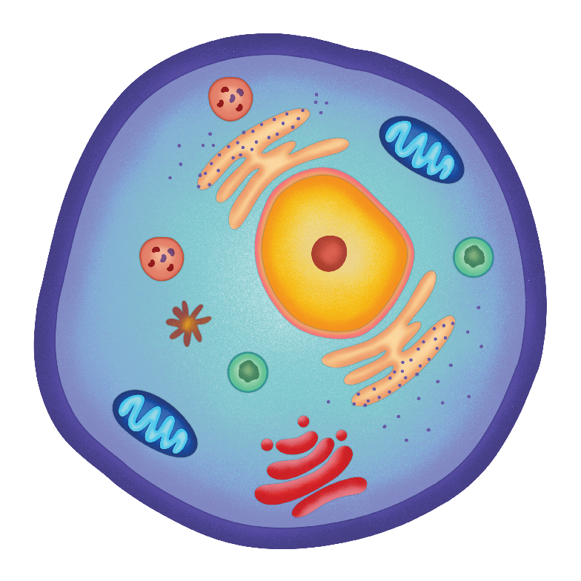
Post-translational modifications (PTMs) increase the functional diversity of a cell’s proteome.
“Post-it-notes of the cell”
Help carry important messages about what the cell is, needs, and how to protect itself.
Phosphorylation
Methylation

Slide 23
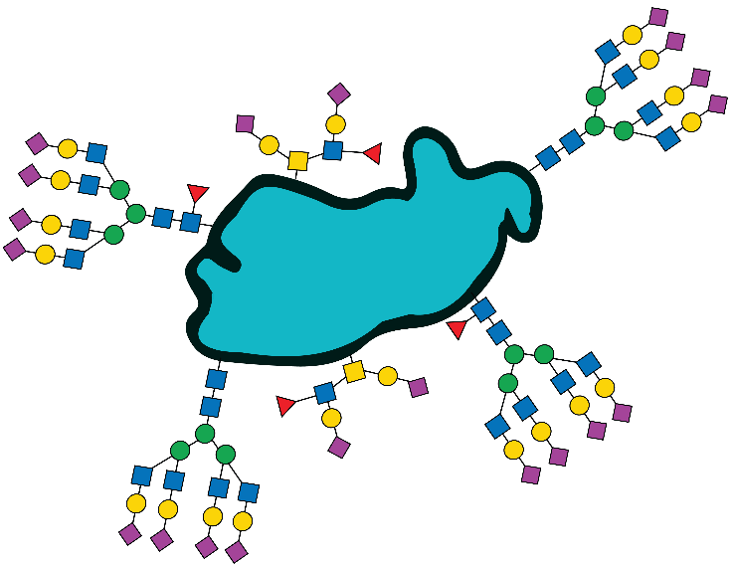

The creativity behind PTMs
PTMs are not just small atoms or chemical groups.
Proteins can have larger modifications, like whole sugars (glycans).
Sugars can even be added on top of other sugars, creating branched structures.
There is no limit to how big a sugar chain or branch can be!

Slide 24

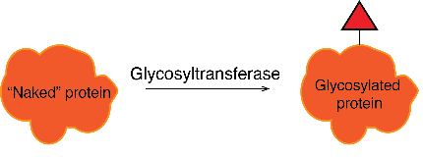


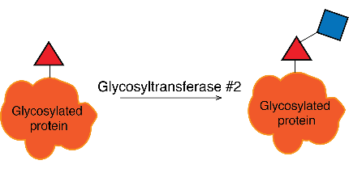

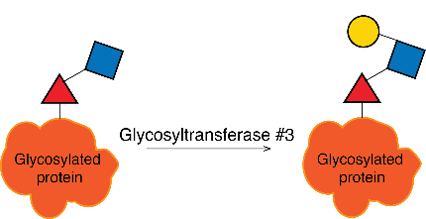
Glycosylation: a key post translational modification
Glycans (sugars) are transferred to a protein by a glycosyltransferase.
Glycosylated proteins (glycoproteins) can be:
Notes:
External
Membrane bound
In the cell-nucleus, cytoplasm and mito

Slide 25
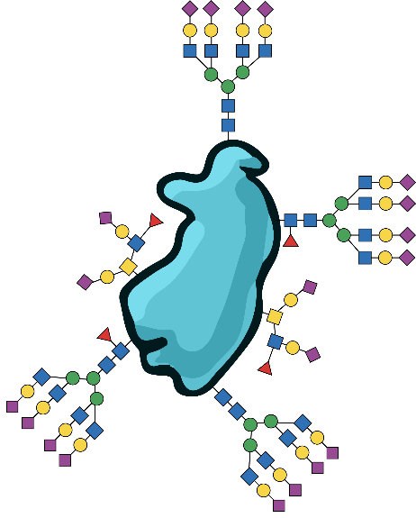



How do we make them?
DNA
RNA
PROTEIN
Template driven
NO!!! Double edged sword: Glycobiology is hard to study due to the lack of a template and glycoprotein diversity, but this same complexity makes it a vital field of research.
Notes:
It’s not like there is one single blueprint for how this works.
Protein that then carries out a function…
but the central dogma is kind of a lie …
because these proteins can be decorated with sugars which then changes the function of the protein.
so that brings me back to the title of this slide is there a blue print for glycoproteins
Where in the genetic code does it tell you when and where to add a sugar: surprise it doesn’t

Slide 26

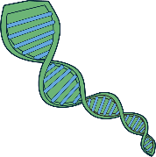









Why is there no blueprint for glycoproteins?
DNA
RNA
PROTEIN
Cookbook
Recipe
Cake
Following a recipe from a cookbook step-by-step, the outcome is predictable.
Glycosylation is like decorating a cake: no recipe tells you exactly where or how much frosting/sprinkles go on
Different bakers (enzymes/cells) make different versions of the same cake (protein).
Notes:
Glycosylation depends on:
Available enzymes
Cellular environment
Sugar building blocks

Slide 27

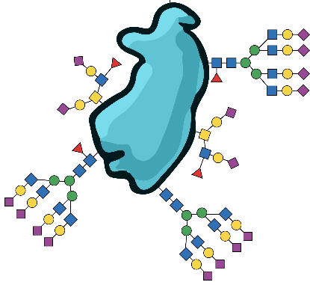


How do glycoscientists communicate?
DNA
RNA
Protein
Glycosylated
Protein
Nucleotide sequences (4):
A/T/G/C (DNA) and A/U/G/C (RNA)
Codon tables for
(20) amino acids:
UGA is a _______ codon?
Symbol Nomenclature for Glycans (SNFG):
Geometric shapes and colors
(Over a 100 glycans!)
Notes:
Those weren’t random shapes that I was showing you-we have a system for this.
Reintroduce slide with the components, i.e., 4 dna, 4 rna, 20 amino acids … segue to SNFG.
So for each sugar we have a specific shape and color combo to help decode the arrangement of these glycan decorations.

Slide 28
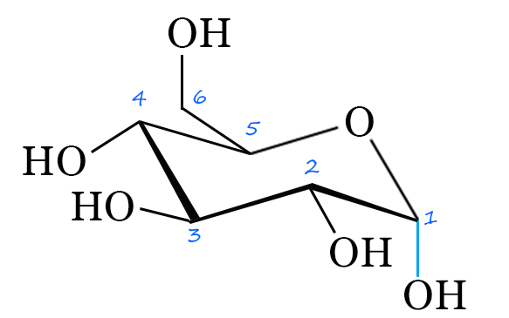
How did scientists produce the SNFG code?
Carbon # = shape
Glucose
Galactose (Gal)
Gulose (Gul)
Allose (Gul)
Mannose (Man)
Altose (Gul)
Talose (Tal)
The number of carbons gives you the shape (mostly).
Notes:
It started with numbers of carbon... The SNFG system also includes rules for modifying the core shapes and colors to represent changes to the sugar.
#C gives shape (mostly).

Slide 29
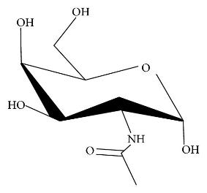
How did scientists produce the SNFG code?
N-Acetylglucosamine
Glucose
6 carbons with an amine and a derivative of glucose
Galactose
N-Acetylgalactosamine
Mannose
N-Acetylmannosamine
Gulose
N-Acetylguosamine
Color tells you what the starting point of the sugar was.
Notes:
another slide on derivatives, color tells you what the starting point was

Slide 30


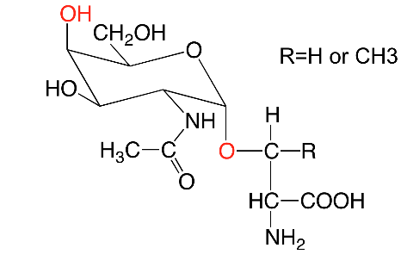
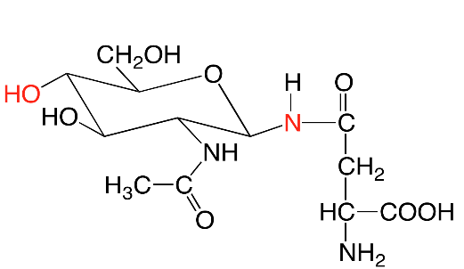
Major types of glycosylation: O-linked vs. N-linked
O-linked glycosylation occurs on serine (Ser) and threonine (Thr) residues of proteins.
N-linked glycosylation occurs on asparagine (Asn) residues of proteins.
Fuc
GlcNAc
Fuc
GlcNAc
Fuc
GlcNAc
Ser
Asn
Asn
Ser
Thr
Thr
Glycans are attached to the hydroxyl (OH) on Ser/Thr.
Glycans are attached to the nitrogen (N) on ASN.

Slide 31
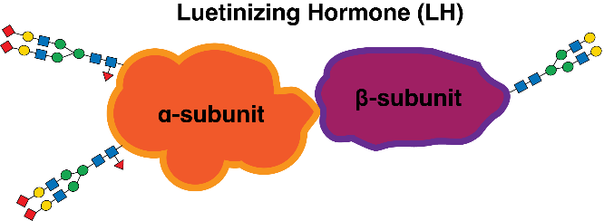

Questions
Use the symbol nomenclature for glycans (SNFG) key in Figure 2, list the glycans linked to the alpha subunit and beta subunit in order. Are there any structural differences between the alpha and beta subunit glycan chains?
How might the addition or removal of glycans influence measurable properties such as mass of a protein even though the protein sequence stays the same?
LH’s half-life refers to how long it stays in the bloodstream before being cleared. Propose and justify two hypotheses why glycosylation might affect LH’s half-life (a general explanation is enough).
Symbol Nomenclature for Glycans (SNFG) Key:

Slide 32
Learning Objectives Day 2
Differentiate between hormone concentration and bioactivity and explain why standard assays can misrepresent physiological function.
Interpret biochemical or physiological data to infer how hormone variation affects endocrine function.
Explain the biochemical role of glycosylation in modulating LH structure, half-life, and receptor activity.
Predict how lifestyle factors (stress, exercise, nutrition) could alter LH glycosylation and influence reproductive function.
Integrate structural, functional, and hormonal data to propose mechanistic explanations for endocrine dysregulation.

Slide 33
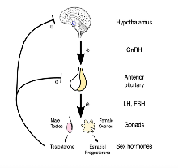


Big Picture So Far
Part I: Maya goes to the clinic for a hormone panel
Hormone | Maya’s Value | Reference Range | Interpretation
Follicle-stimulating Hormone (FSH) | 6.1 IU/L | 3 – 10 IU/L | Normal
Luteinizing Hormone (LH) | 19.0 IU/L | 2 – 15 IU/L | Slightly elevated
Estradiol | 20 pg/mL | 30 – 400 pg/mL | Low
Progesterone | 3 ng/mL | 5 – 20 ng/mL (luteal) | Slightly Low
Normal FSH and LH levels, but low estradiol and progesterone = Ovaries are not responding to LH
Part III: Maya and Noah dive into the structure of LH
Endocrine function is not determined by concentration alone! Depends on how effectively a hormone works once released!
Part II: Maya goes to endocrinology lab to see if her LH is functioning
Maya’s LH shows reduced receptor activation compared to healthy donor LH-highlighting that hormone concentration does not equal potency, as function depends on effective receptor interaction!
LH is decorated with glycans and comprised of a β-subunit that binds the LH receptor, and an α-subunit that provides stability.
Notes:
\

Slide 34
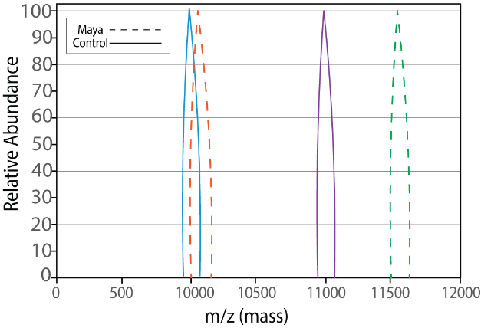
Part IV – The Hidden Differences
Noah introduces mass spectrometry to analyze LH at the structural level.
The goal is to compare Maya’s LH with a healthy reference sample.
Each peak represents a population of LH molecules with similar mass and charge.
The focus is on overall pattern differences, not exact structures.
When compared side-by-side, the spectra look noticeably different.
Several peaks shift in position and relative intensity.
Even small structural changes appear clearly in this type of analysis.
Maya leaves knowing her LH follows an unusual structural pattern, but what that means remains unclear.
What is mass spec (M/S)?
How do we analyze M/S data?

Slide 35
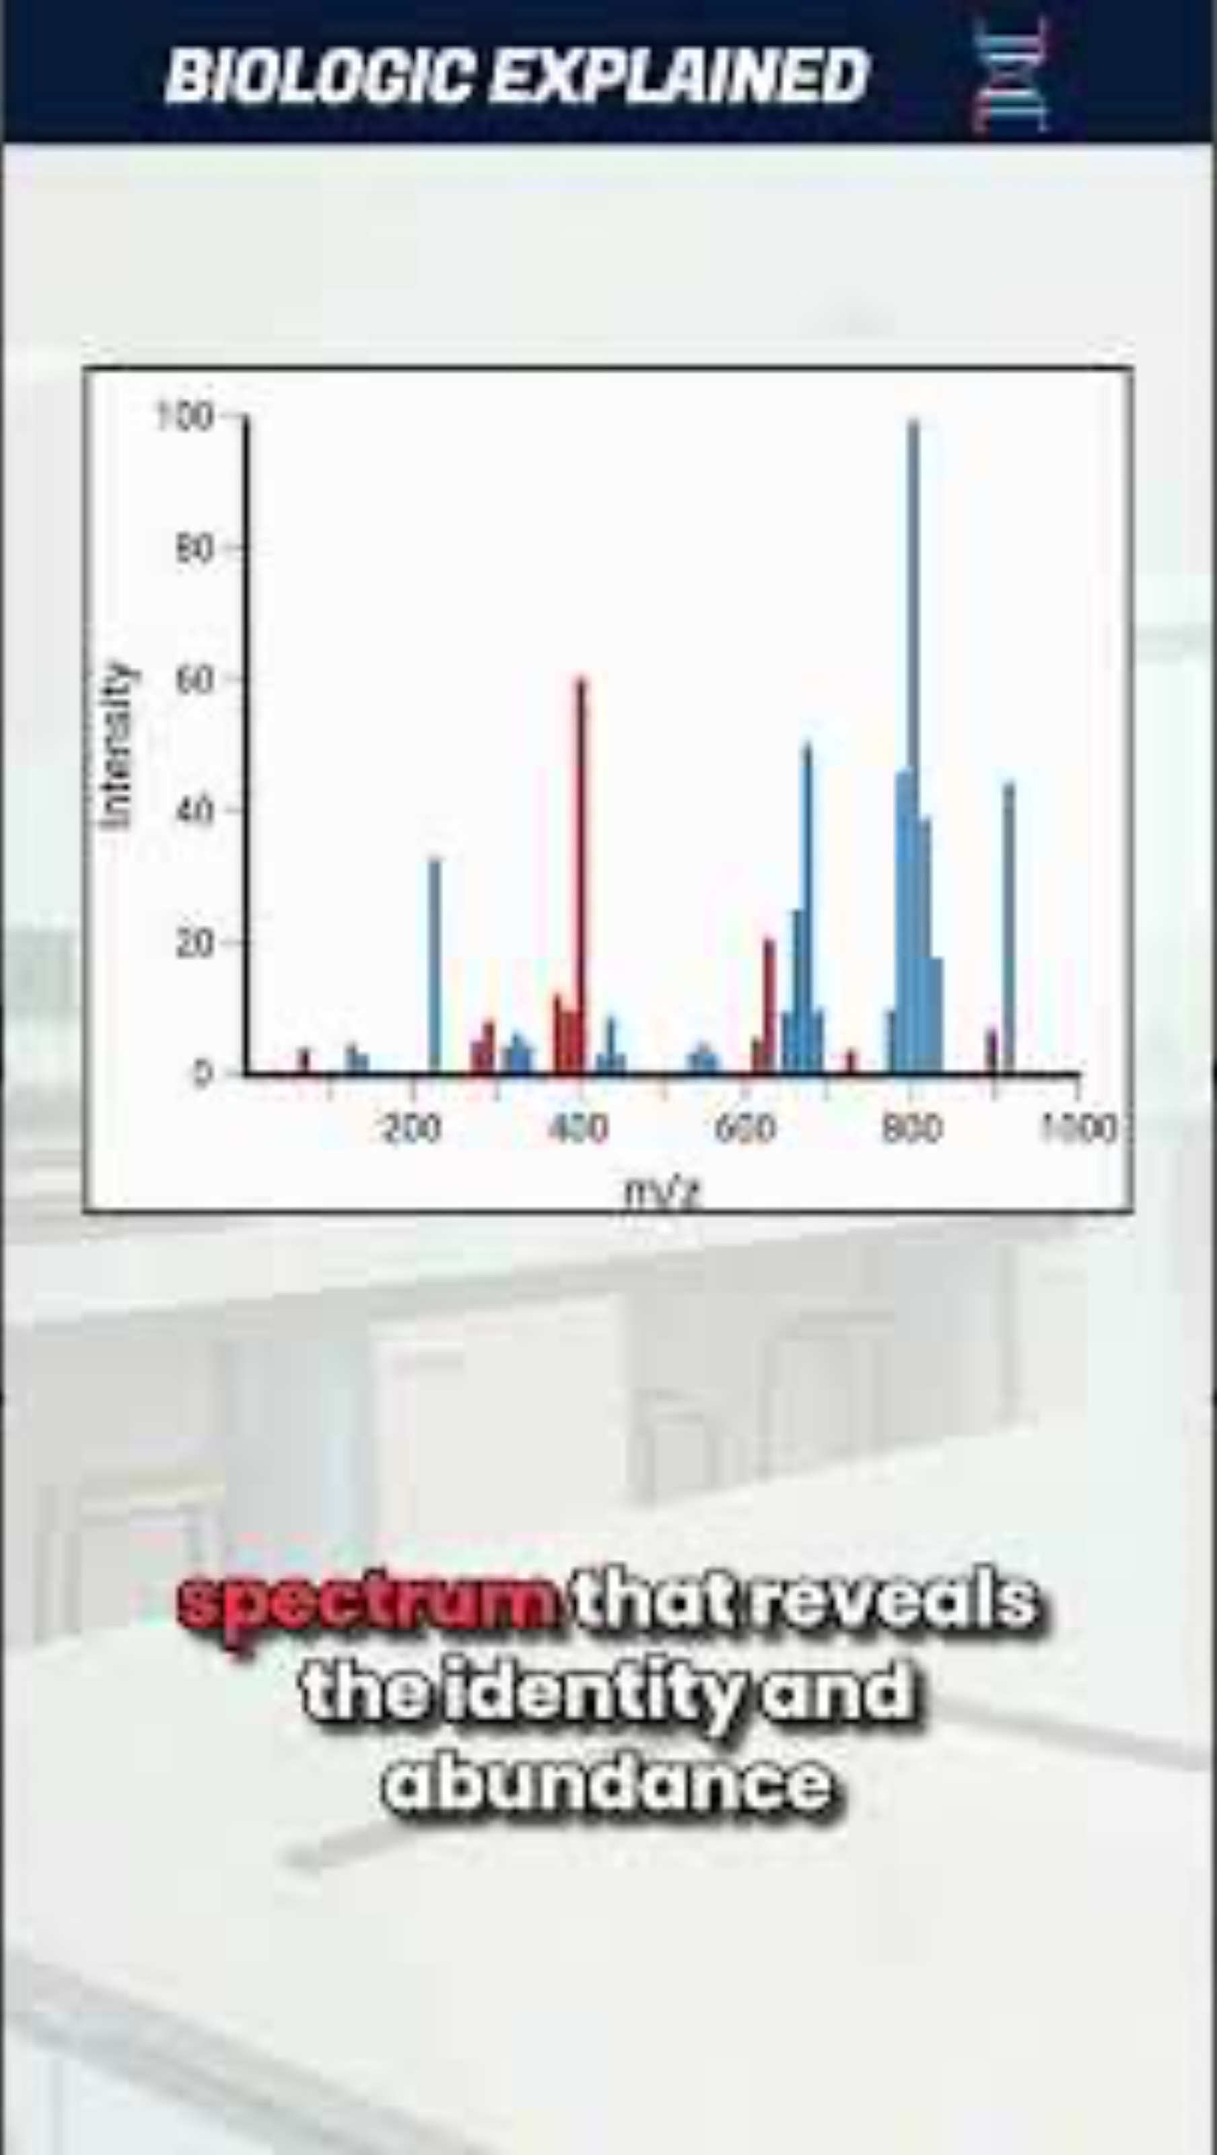
Why do scientists conduct mass spec and how?
Mass spectrometry (MS) is a powerful analytical technique used to identify, quantify, and determine the structure of molecules by measuring their mass-to-charge ratio.
Notes:
Image credit: Screen grab from video How Does Mass Spectrometry Work? Produced by BioLogic Explained, 2024. Run time: 0:50 min. https://youtube.com/shorts/satzzHnECl0

Slide 36
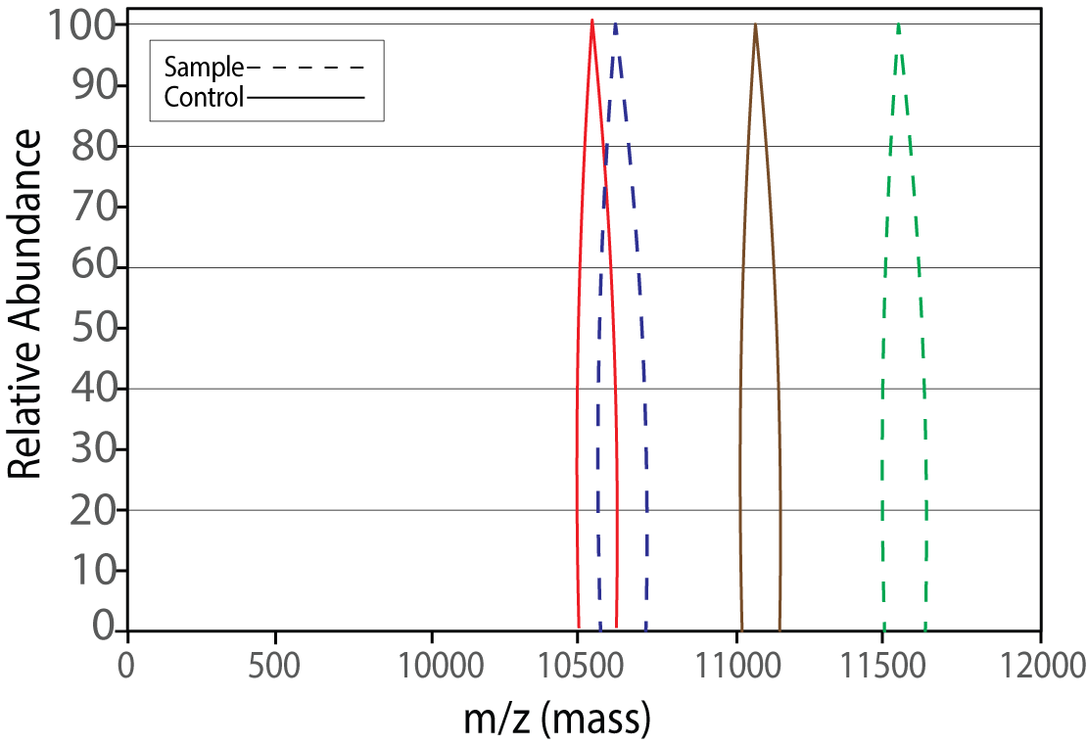
Analyzing Mass Spec Data: Step 1-X and Y axes
Y axis:
tells us how much of that form is present
We care about where the peak sits horizontally, not how tall it is
(for this analysis).
X axis: tells us the mass of each protein form.

Slide 37
Analyzing Mass Spec Data: Step 2-understanding controls and samples
Solid line = Control
Dashed line = Sample
We always compare peak position between these two lines.

Slide 38
Analyzing Mass Spec Data: Step 3- find the main peak for each sample
Sample 1
Control peak ≈ 10,500
Sample peak ≈ 10,600
We are not interpreting results yet, just locating peaks!

Slide 39
Analyzing Mass Spec Data: Step 3- find the main peak for each sample
Sample 2
Control peak ≈ 11,000
Sample peak ≈ 11,600
We are STILL not interpreting results yet, just locating peaks!

Slide 40
Analyzing Mass Spec Data: Step 3- analyzing peaks
Now we will look at how far apart peaks are for each sample:
Sample 1
Sample 2
Sample 1:
Small shift and lots of overlap (~100 m/z)
Sample 2
Large rightward shift (~600 m/z)
Rightward shift = heavier protein form

Slide 41
Analyzing Mass Spec Data: Interpreting results
In this simplified dataset:
±25–100 m/z → expected minor variation (background)
~200-300 m/z → ~one added glycan
Larger shifts → multiple glycans
*You will be given glycan sizes to interpret*
Sample 2:
11,600-11,000= 600
Large rightward shift (~600 m/z)
Rightward shift = heavier protein form
Sample 1:
10,600-10,500= 100
Small shift and lots of overlap (~100 m/z)
So we can interpret from this data set:
Sample 1: Small shift = no change between sample and control
Sample 2 Large shift = substantial glycan mass increase

Slide 42
Analyzing Mass Spec Data: Cheat Sheet
Y axis:
tells us how much of that form is present
Solid line = Control
Dashed line = Sample
We always compare peak position between these two lines
In this simplified dataset:
±25–100 m/z → expected minor variation (background)
~200-300 m/z → ~one added glycan
Larger shifts → multiple glycans
*You will be given glycan sizes to interpret*
We care about where the peak sits horizontally, not how tall it is
(for this analysis)
Sample 2:
11,600-11,000= 600
Large rightward shift (~600 m/z)
Rightward shift = heavier protein form
Sample 1:
10,600-10,500= 100
Small shift and lots of overlap (~100 m/z)
So we can interpret from this data set:
Sample 1: Small shift = no change between sample and control
Sample 2 Large shift = substantial glycan mass increase
X axis: tells us the mass of each protein form

Slide 43
Part V – Resolution and Recovery
Working in groups of 3–4, you will assign yourselves one role below. From your assigned perspective, you should discuss how Maya’s LH can appear “normal” in amount but produces a different physiological response
Hormone Detective should use Maya’s symptoms and hormone panel to determine why reproductive signaling appears abnormal despite normal LH levels
Protein Biologist should use the LH structure and mass spectrometry data to decide whether the change is in the protein itself or its attached glycans.
Receptor Analyst should use the receptor activation data to explain how Maya’s LH functions differently from control LH.
Glycan Specialist should explain how altered glycosylation could connect Maya’s LH structure, function, and physiology.
Hint: Use all your evidence from earlier clues in the case to build a single “big picture” explanation that connects structure, function, and physiology. Is Maya’s condition reversible? If so, how?

Slide 44
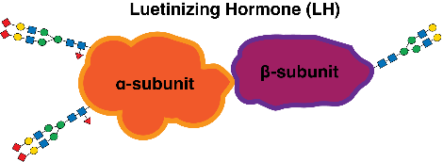

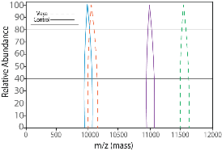
The Big Picture
Part I: Maya goes to the clinic for a hormone panel
Part III: Maya and Noah dive into the structure of LH
Hormone | Maya’s Value | Reference Range | Interpretation
Follicle-stimulating Hormone (FSH) | 6.1 IU/L | 3 – 10 IU/L | Normal
Luteinizing Hormone (LH) | 19.0 IU/L | 2 – 15 IU/L | Slightly elevated
Estradiol | 20 pg/mL | 30 – 400 pg/mL | Low
Progesterone | 3 ng/mL | 5 – 20 ng/mL (luteal) | Slightly Low
Normal FSH and LH levels, but low estradiol and progesterone = Ovaries are not responding to LH
LH is decorated with glycans and comprised of a β-subunit that binds the LH receptor, and an α-subunit that provides stability.
Endocrine function is not determined by concentration alone! Depends on how effectively a hormone works once released!
Part II: Maya goes to endocrinology lab to see if her LH is functioning
Part IV: Maya and Noah assess her LH structure with Mass Spectrometry
Maya’s LH shows reduced receptor activation compared to healthy donor LH-highlighting that hormone concentration does not equal potency, as function depends on effective receptor interaction!
Maya’s LH β-subunit shows a peak shift from 11,000 to 11,600 m/z, indicating a heavier protein form consistent with additional sialic acids and suggesting that her LH differs structurally from healthy control LH.
Notes:
\

Slide 45
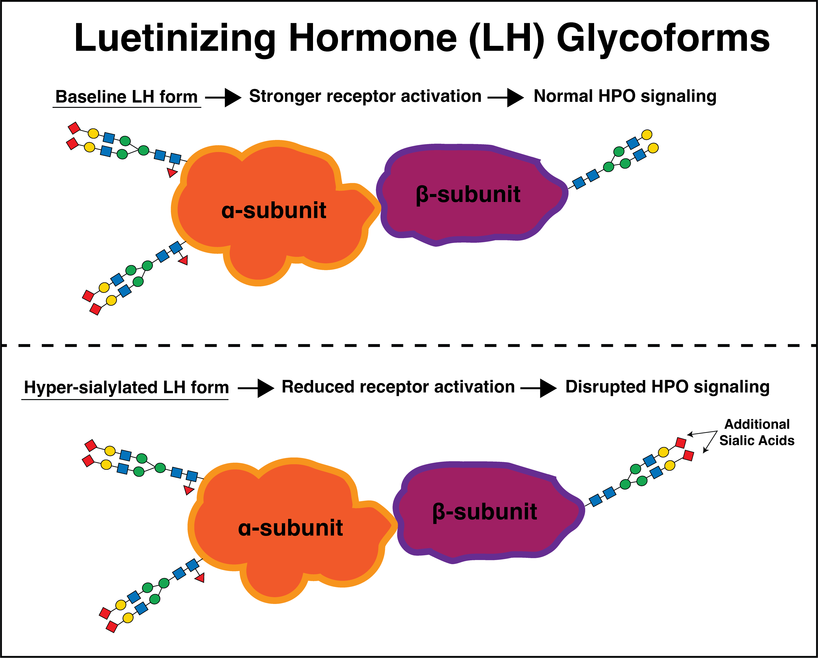
REVEAL-glycosylation is key!
Changes in glycans reduce downstream signaling: Maya’s LH is structurally modified.
Sialic acids matter: This modification keeps LH production normal and circulation longer, but weakens receptor activation, resulting in reduced biological signaling.
So you have normal LH levels, but weak biological signaling to the brain!
Why this matters: Maya’s cycle disruption results from low-potency LH glycoforms due to stress and poor lifestyle habits, not low hormone production.
This condition is reversible.
Notes:
Intravaneous (right away) and subcutaneous (absorbed slowly) …
The glycosylation of EPO is the key:
N- and O-linked glycans stabilize the protein, prevent aggregation, and extend half-life by shielding EPO from clearance receptors in the liver.
Sialic acids are essential “end caps” on the glycans-without them, the protein is rapidly cleared.
Therapeutically, glycoengineering allows scientists to design longer-lasting drugs, but the same biochemical principles can be used to gain unfair advantage.

Slide 46
Acknowledgments
This work was supported by the U.S. National Science Foundation under Grant No. 2400220 BioFoundry: Glycoscience Research, Education, and Training (BioF:GREAT). BioF:GREAT (https://biofgreat.org/) aims to democratize glycoscience by increasing accessibility to glycoscience research, education and training.

