Slide 1
Three Cases from the Membrane Files: Pre-class Information to Learn
by
Eric Ribbens
Western Illinois University
Department of Biology

Slide 2
Remember:
We will be applying these concepts in class. You need to know this material to understand the cases we will be doing. It is your responsibility to learn this information, and if you have any difficulties or questions to contact me and ask for help.
Do well!

Slide 3
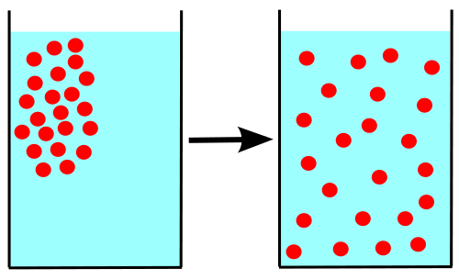
Principle
Diffusion: A chemical will spread out and become completely the same concentration wherever it can go (unless some other force is acting on it).

Slide 4
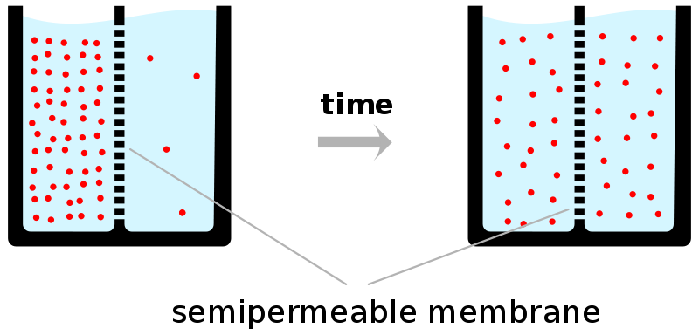
What about across a membrane?
If it can cross the membrane, it will attempt to diffuse.

Slide 5
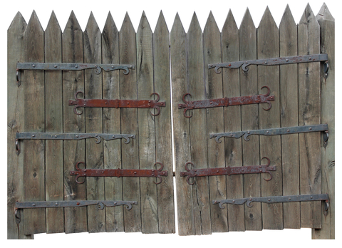
So a semipermeable membrane will allow some chemicals to diffuse across it, and prevent other chemicals from diffusing across it, and proteins can act as gates.

Slide 6
Another tricky piece of diffusion
The chemical tries to achieve equal concentration OF IT RELATIVE TO THE TOTAL SOLUTION
So if there are equal amounts of water on each side of the membrane, but on one side the solution is only water while on the other side it is a mixture, water will still keep moving to the mixture side

Slide 7
Water Diffusing

Slide 8
The Preceding Diagram
Can sucrose cross the membrane?
Can water cross the membrane?
What direction will water tend to move?

Slide 9
A solution is 90% water on the left, and 80% water on the right, of a membrane that only water can cross. Assuming no other forces are operating, which direction will water move?
Water will move from left to right.
Water will move from right to left.
It depends.
It is impossible to tell.

Slide 10
Remember it is important to think about the concentration of the substance that can move. Consider this question: The solution on the left is 10% salt. On the right it is 5% salt. Salt cannot cross the membrane, but water can. Which way will water move?
Water will move from left to right.
Water will move from right to left.
It depends.
It is impossible to tell.

Slide 11
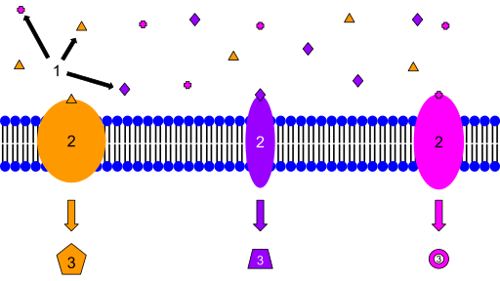
Hmm. What is a membrane, anyhow?
Membranes, while very thin, are important barriers.
They consist of a double layer of phospholipids, arranged with the tails pointing in and the heads pointing out.
The head region is attracted to water, while the tail region is repelled by water.
A
A
A

Slide 12
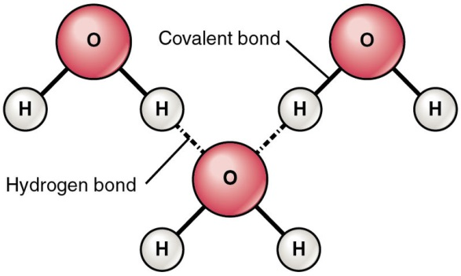
What is polarity, and why do we care?
It seems a bit of a love story, two hydrogens mated with an oxygen. But the oxygen was greedy, hogging the electrons. That left the hydrogens deprived, and the oxygen negative. Oh, the imbalance was weak compared to the passion of their union. But the hydrogens would hook up with passing oxygens, at least for a moment of electrical connection.

Slide 13
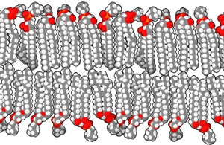
Wikipedia’s Picture:
Notes:
https://www.google.com/search?q=phospholipid+bilayer&oe=utf-8&aq=t&rls=org.mozilla:en-US:official&client=firefox-a&um=1&ie=UTF-8&hl=en&tbm=isch&source=og&sa=N&tab=wi&ei=FMkRUdzfAaaZyAH7kIDQDw&biw=1280&bih=659&sei=F8kRUaGBGeOeywHi6YGgDA#imgrc=R9UnbR6fjKLzhM%3A%3Bbgyipp3YvEHsMM%3Bhttp%253A%252F%252Fupload.wikimedia.org%252Fwikipedia%252Fcommons%252Ff%252Ff0%252FLipid_bilayer_section.gif%3Bhttp%253A%252F%252Fen.wikipedia.org%252Fwiki%252FLipid_bilayer%3B300%3B195

Slide 14
What chemicals can get through a membrane?
Not many. Any charged chemical cannot slip through a membrane, so ions cannot cross. Larger chemicals also cannot pass.
Gases (such as O₂, N₂, or CO₂) can cross membranes.
Small uncharged particles (such as urea or water) can cross as well.
But all other chemicals can only cross with the aid of proteins floating in the membrane.

Slide 15
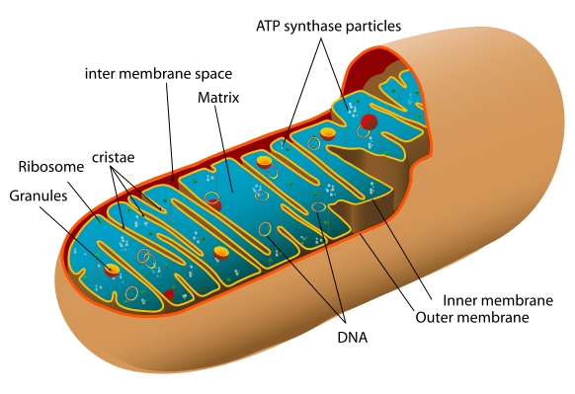
Mitochondria
Two membranes, inner one highly folded.
Have their own DNA.
Make ATP for all sorts of uses for energy.
Notes:
http://www.google.com/search?q=part+i&hl=en&tbo=d&source=lnms&tbm=isch&sa=X&ei=OekTUfnKArOMyAHQjYEQ&ved=0CAcQ_AUoAA&biw=1680&bih=946#hl=en&tbo=d&tbm=isch&sa=1&q=mitochondria+man&oq=mitochondria+man&gs_l=img.3..0i24.104.11024.14.11217.17.4.13.0.5.0.82.227.4.4.0...0.0...1c.1.2.img.w9mFYyylydU&bav=on.2,or.r_gc.r_pw.r_qf.&bvm=bv.42080656,d.aWc&fp=8b3ccabeaf5ce617&biw=1680&bih=946&imgrc=WFvAJQ9TeDruFM%3A%3Bm9u_vMwhl1p-HM%3Bhttp%253A%252F%252Fchristinemarsh.com%252Fwp-content%252Fuploads%252F2010%252F01%252FMitochondria_Man1.jpg%3Bhttp%253A%252F%252Fchristinemarsh.com%252Findex.php%252Fstore%252Fmitochondria-man%252F%3B1086%3B1456

Slide 16
Mitochondria
Break sugar down (eventually into water and carbon dioxide).
Convert the energy from sugar to ATP:
Pump protons into the intermembrane space, creating a pH gradient.
The protons push back inside through an ATP synthase pump.
The pump uses the force to attach a phosphate to adenosine diphosphate.

Slide 17
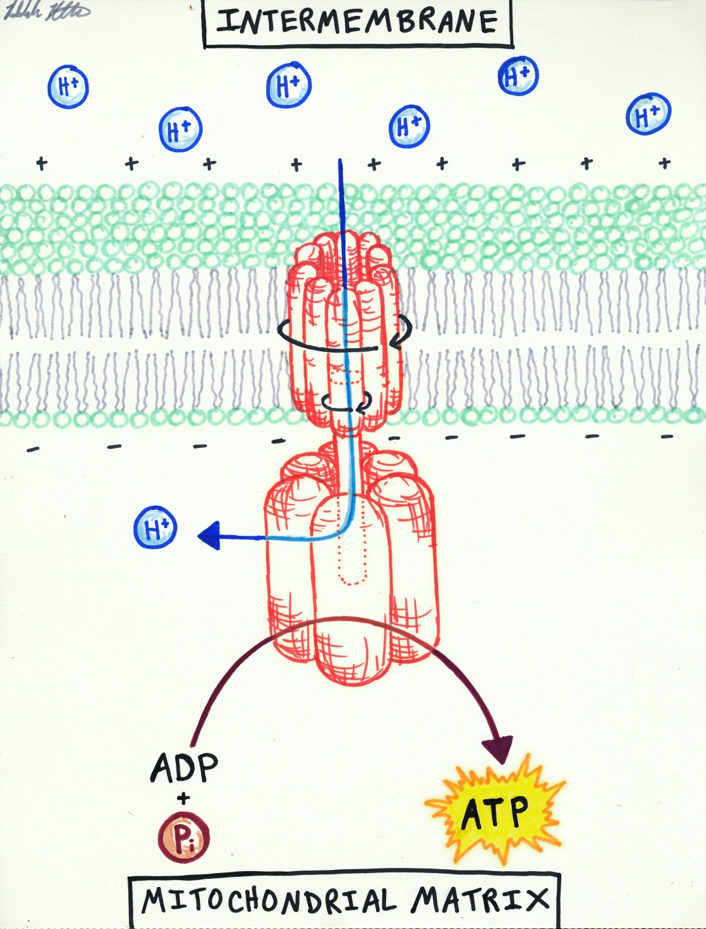
ATP pump
ADP and P+ and push produce ATP (with more energy).
Notes:
http://www.google.com/search?q=part+i&hl=en&tbo=d&source=lnms&tbm=isch&sa=X&ei=OekTUfnKArOMyAHQjYEQ&ved=0CAcQ_AUoAA&biw=1680&bih=946#hl=en&tbo=d&tbm=isch&sa=1&q=atp+synthase&oq=atp+synthase&gs_l=img.3..0l8j0i5l2.78.5877.11.6052.13.10.1.2.2.0.59.547.10.10.0...0.0...1c.1.2.img.q_HR5yyZol0&bav=on.2,or.r_gc.r_pw.r_qf.&bvm=bv.42080656,d.aWc&fp=8b3ccabeaf5ce617&biw=1680&bih=946&imgrc=vpzMZoZ3FWvg5M%3A%3B_mibCDTxFoJGEM%3Bhttp%253A%252F%252Ffiles.myopera.com%252FKYren%252Falbums%252F638725%252FATP%252520synthase.jpg%3Bhttp%253A%252F%252Fmy.opera.com%252FKYren%252Falbums%252Fshowpic.dml%253Falbum%253D638725%2526picture%253D42418081%3B796%3B958

Slide 18
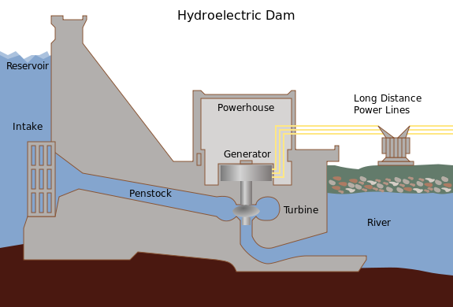
Compare it to a hydroelectric dam
Notes:
http://en.wikipedia.org/wiki/File:Hydroelectric_dam.svg

Slide 19
Using the analogy of a dam: in mitochondria what is the equivalent?
The dam is?
The turbine makes?

Slide 20
Image Credits
Slide 1: Licensed image, ©Art3D | Fotolia, ID#62321821.
Slide 3: Illustration of diffusion by Wikimedia Commons user JrPol, CC BY 3.0, http://commons.wikimedia.org/wiki/Diffusion#mediaviewer/File:Diffusion.svg
Slide 4: Schematic drawing of diffusion over a semipermeable membrane, by Quasar Jarosz, p.d., http://commons.wikimedia.org/wiki/File:Diffusion.en.svg
Slide 5: Licensed image, ©Ivx267 | Dreamstime.com, ID#30027532.
Slide 7: Rebekah Ribbens, used with permission.
Slide 11: Illustration of membrane receptors by Isaac Webb, CC BY-SA 3.0, http://commons.wikimedia.org/wiki/File:Membrane_Receptors.svg
Slide 12: Diagram of hydrogen bonds between water molecules, OpenStax College, CC BY 3.0, http://commons.wikimedia.org/wiki/File:210_Hydrogen_Bonds_Between_Water_Molecules-01.jpg
Slide 13: Lipid bilayer section, p.d., https://commons.wikimedia.org/wiki/File:Lipid_bilayer_section.gif
Slide 15: Mitochondrion diagram, p.d., http://commons.wikimedia.org/wiki/Category:Mitochondria#mediaviewer/File:Animal_mitochondrion_diagram_en.svg
Slides 17: Diagram of ATP pump by Rebekah Ribbens, used with permission.
Slide 18: Illustration of hydroelectric dam, p.d., http://commons.wikimedia.org/wiki/File:Hydroelectric_dam.png

