Slide 1

NATIONAL CENTER FOR CASE STUDY TEACHING IN SCIENCE
A Presentation to Accompany the Case Study:
Mayhem in May
Susceptibility, Symptoms, Progression, and Complications of COVID-19
^{by}
Jayashree Sarathy, Faith Donner, Tiara G. Pérez Morales, Daniyal Mehmood, and Gerda Simkeviciute

Slide 2
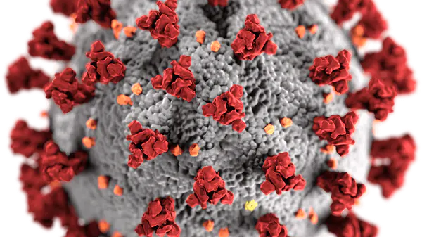
Background
Notes:
This presentation is designed for students in upper-level biology electives and health science courses, such as pathophysiology. They will learn pathophysiological terminology and research the symptoms, susceptibility, mechanism of action of SARS-CoV-2, COVID-related pulmonary distress and extra-pulmonary complications.

Slide 3
SARS-CoV-2
Single-stranded RNA virus
genome = ~30kb in length
RNA Viral Genome
S2
Chilamakuri,R.;Agarwal, S. Cells 2021, 10, 206.
S1
Notes:
SARS-CoV-s is a single stranded RNA virus with a genome length of 30 kb.
It codes for multiple proteins that include enzymes such as proteases and membrane proteins such as spike protein

Slide 4
SARS-CoV-2
- Spike protein (S)
- Membrane protein (M)
- Envelope protein (E)
ssRNA
Nucleocapsid protein (N)
Notes:
Enzymes such as proteases and membrane proteins click, including spike protein. click

Slide 5

How does SARS-CoV-2 infect our cells?
CoV
CoV
S2
S2’
- S
S1/S2
cleavage
S1
S2'
cleavage
FURIN
Protease
TMPRSS2
Protease
S1
FURIN
Protease
ACE2
TMPRSS2
Protease
HOST CELL
Notes:
These spike proteins (click) contain two subunits, S1 & S2. S1 contains a receptor binding domain that binds to angiotensin converting enzyme-2 receptor or ACE2 found on human cells. Our body’s cells also contain two proteases, (click) furin and (click) TMPRSS2 are needed for the virus to infect our cells. Particularly (click), the Furin protease acts by cleaving the S1 & S2 subunits to remove S1 and expose S2 to be primed by, TMPRSS2 protease, which allows S2 to fuse with the host cell membrane, so (click) the virus can enter the cell.

Slide 6
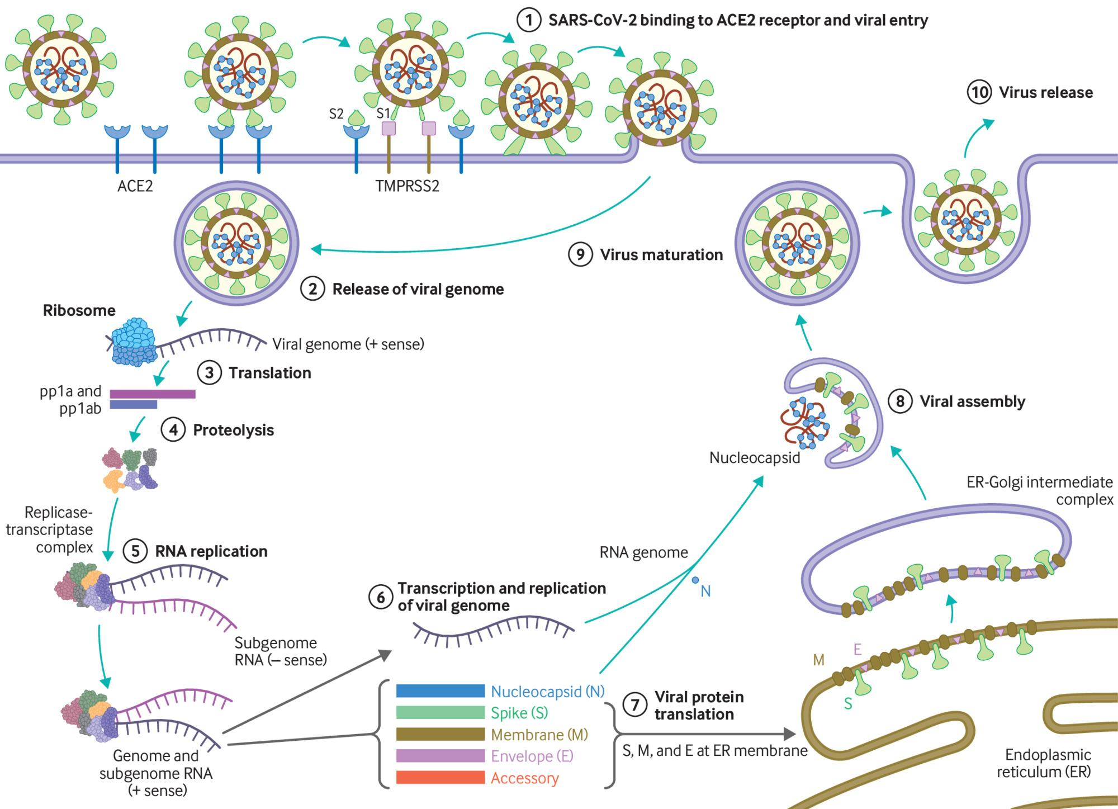
How does SARS-CoV-2 infect our cells?
Muge Cevik et al. BMJ 2020;371:bmj.m3862
Notes:
(1) The virus binds to ACE 2 as the host target cell receptor in synergy with the host’s transmembrane serine protease 2 (cell surface protein), which is principally expressed in the airway epithelial cells and vascular endothelial cells. This leads to membrane fusion and releases the viral genome into the host cytoplasm (2). Stages (3-7) show the remaining steps of viral replication, leading to viral assembly, maturation, and virus release

Slide 7
SARS-CoV-2 and Cardiovascular System
Angiotensinogen
Renin
Angiotensin I
ACE
Angiotensin II
Blood Pressure
regulation
Angiotensin 1 - 7
FURIN
Protease
ACE2
ACE2
HOST CELL
TMPRSS2
Protease
Notes:
ACE2 expression is highest in the​ airway epithelium and alveolus (air sacs) of the lungs! SARS-CoV2 readily infects the cells causing air sacs to collapse. Hence the drop in oxygen levels in our blood stream. ​
​
ACE2 is also expressed in gastrointestinal (GI) epithelial cells and that is how SARS-CoV-2 infects and replicates in the GI tract leading to symptoms such as abdominal pain, nausea, vomiting and diarrhea.
​
Virus enters host cells via ACE2. ACE1 is angiotensin converting enzyme which results in ANGII which regulates blood pressure by increasing blood volume and vasoconstriction. AngII is kept within normal levels by ACE2 which helps clear it by breaking it down to Ang 1-7, a vasodilator. Binding of virus to ACE2 causes a dysregulation of the above pathway, accumulation of ANG II leading to vasoconstriction, reabsorption of salt and water in the kidney and hence increase in blood pressure.​
Primarily seen in late phase of infection, COVID-19 patients showed​ diffuse alveolar damage with the formation of hyaline membranes, mononuclear cells, and macrophages infiltrating air spaces, and a diffuse thickening of the alveolar wall. The cytokines released at this time can cause an increase in capillary permeability, and vasodilation resulting in a drop in blood pressure and fluid accumulation in the lungs.

Slide 8
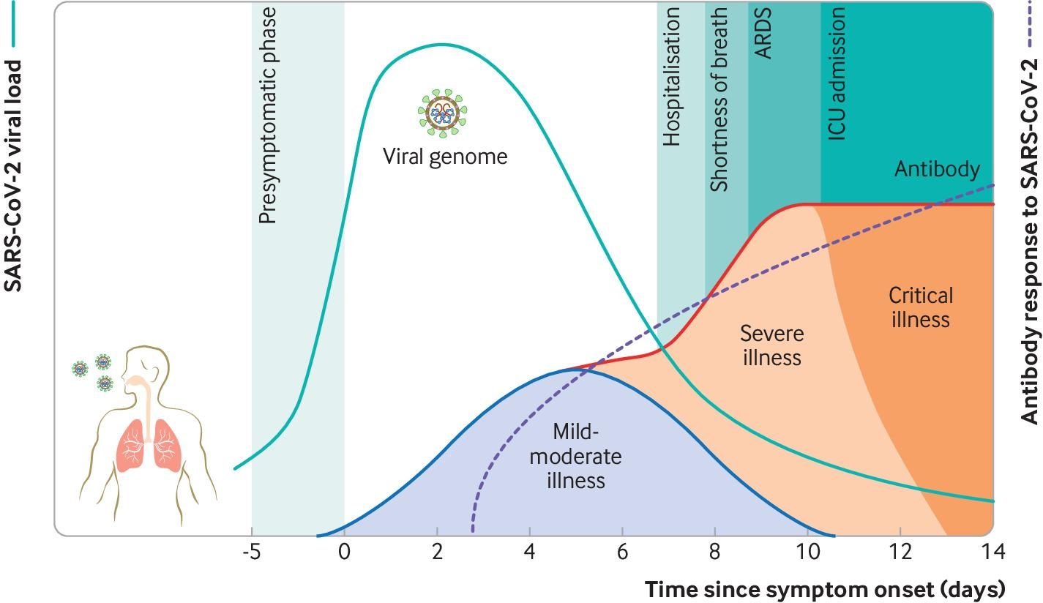
After the initial exposure, patients typically develop symptoms within 5-6 days (incubation period).
Muge Cevik et al. BMJ 2020;371:bmj.m3862
Notes:
After the initial exposure, patients typically develop symptoms within 5-6 days (incubation period). SARS-CoV-2 generates a diverse range of clinical manifestations, ranging from mild infection to severe disease accompanied by high mortality. In patients with mild infection, initial host immune response is capable of controlling the infection. In severe disease, excessive immune response leads to organ damage, intensive care admission, or death. The viral load peaks in the first week of infection, declines thereafter gradually, while the antibody response gradually increases and is often detectable by day 14 (figure adapted from https://www.sciencedirect.com/science/article/pii/S009286742030475X; https://www.thelancet.com/journals/lanres/article/PIIS2213-2600(20)30230-7/fulltext)‏

Slide 9
Case Presentation

Slide 10



Pedigree and Family History of 50M
Cardiac stent
Glaucoma
80F
85M
80F
85M
Ulcers
Healthy
50M
50M
45F
45F
13F
13F
Colitis
Notes:
The storyline follows a 50-year-old healthy male and his family during the present coronavirus outbreak in the United States. 50M is healthy with no medical history of preexisting conditions, except occasional ulcers. His father, 85M, has a pre-existing cardiac condition and mother, 80F, has no other condition except glaucoma. His wife, 45F, is healthy and his daughter, 13F, was recently diagnosed with colitis and is on immunosuppressants. 50M is infected possibly when he tested …

Slide 11
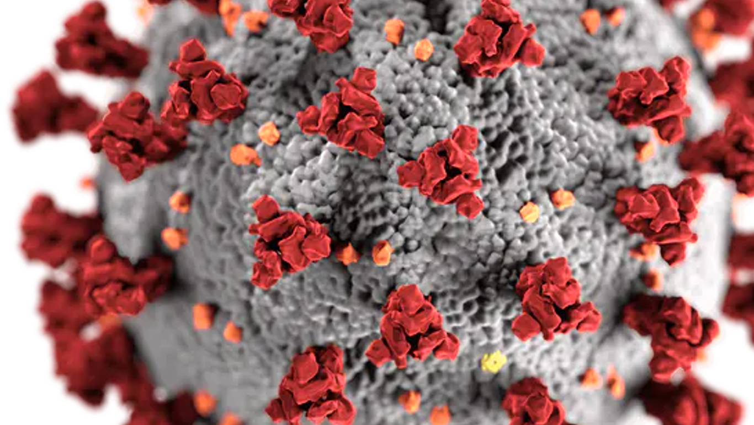

50M
Sx
Symptoms
• Abdominal pain
• Nausea
• Hematochezia (Bloody diarrhea)
• Hematemesis (Vomiting blood)
• Pyrexia (fever)
• Dyspnea (shortness of breath)
Notes:
positive for COVID.
He continues to have the digestive symptoms, which is not commonly associated with COVID. His dyspnea worsens. His family members are tested and ….

Slide 12
Cardiac stent
Glaucoma
85M
80F
Ulcers
Healthy
50M
45F
13F
Colitis
Notes:
His parents 85 M and 80F test positive while his wife and daughter test negative. It is important to highlight that his wife quarantines herself and her daughter the moment 50M is sick. Her daughter is immunocompromised as she is getting treatment for colitis.
85M starts showing symptoms.

Slide 13
Sx
85M
Symptoms
• Pyrexia (fever)
• Cough/sore throat
• Dyspnea (shortness of breath)
• Tachycardia (fast heartbeat)
Notes:
He also develops tachycardia and is hospitalized. His wife also exhibits similar symptoms …

Slide 14
80F
Sx
Symptoms
• Pyrexia (fever)
• Dyspnea (shortness of breath)
Notes:
on May 8. So comparing the initial symptoms,

Slide 15
 | Patient 50M | Patient 85M | Patient 80F | 45F | 13F
Relationship to 50M | Self | Father | Mother | Wife | Daughter
Health History | None | Cardiac | Glaucoma | None | Colitis
COVID Test | + | + | + | - | -
Fever | + | ++ | ++ | - | -
Cough | - | + | ++ | - | -
Dyspnea | ++ | +++ | ++ | - | -
GI symptoms | +++ 3 days | - | - | - | +
Sore Throat | - | ++ | ++ | - | -
Pneumonia | +++++ | ++++ | + | - | -
Ventilation | YES | NO | NO | - | -
O2 supplementation | YES | YES | YES; 2 days | - | -
Quarantine
Table 1. Symptoms and history of Patient 50M and his family
Presence or absence of symptoms is expressed using + or –, with additional + indicating increasing severity of symptoms
Notes:
Though they are different initially, they all eventually experience dyspnea! Let us first follow 80F as she had milder symptoms.

Slide 16
Patient (80F)
Day of illness |  | 1-3 | 4-6 | 7-9 | 10-12 | 13-15 | 16-18 | 19-21
Fever (°F)
Dyspnea
Hematochezia
Diarrhea/emesis
Tachycardia
Bacterial Infection
Fungal Infection
Electrolyte/pH imbalance
Renal Failure
Treatments & Procedures |  | Symptom starts | Hospitalization Imaging Acetominophen & Remdesivir |  | Negative SARS-CoV-2 test | Sent home with Enoxaparin
 | Apr 29- May 1 | May 2-4 | May 5-7 | May 8-10 | May 11-13 | May 14-16 | May 17-19 | May 20-22
-Light
- Moderate
- Severe
Notes:
She is treated with acetaminophen to reduce her fever and antiviral remdesivir. She has two negative tests consecutively and is sent home on May 14 with an anticoagulant. Red arrows in the bottom indicate beginning of symptoms or treatment or change in their health status.

Slide 17
Patient (85M)
Day of illness |  | 1-3 | 4-6 | 7-9 | 10-12 | 13-15 | 16-18 | 19-21
Fever (°F)
Dyspnea
Hematochezia
Diarrhea/emesis
Tachycardia
Bacterial Infection
Fungal Infection
Electrolyte/pH imbalance
Renal Failure
Treatments |  | Symptom starts | Hospitalization Imaging/ICU/ HFNO
 | May 1 | May 2-4 | May 5-7 | May 8-10 | May 11-13 | May 14-16 | May 17-19 | May 20-22
-Light
- Moderate
- Severe
Death at 6:00 PM
Remdesivir
Notes:
Her husband 85M's dyspnea continues, he is started on remdisivir, shifted to ICU, and placed on high flow nasal oxygen at 30 L per minute. He could not be treated with positive pressure ventilation due to his cardiac condition.
His O2 saturation at 65%, he is disoriented, develops respiratory alkalosis, and dies of cardiac arrest on May 16.
Let us look at what is happening with 50M:

Slide 18
Patient (50M)
Day of illness | 1-3 | 4-6 | 7-9 | 10-12 | 13-15 | 16-18 | 19-21 | 21-24
Fever (°F)
Dyspnea
Hematochezia
Diarrhea/emesis
Tachycardia
Bacterial Infection
Fungal Infection
Electrolyte/pH imbalance
Renal Failure
Treatments & Procedures | Symptom starts
Visited aunt's farm – April 22nd | Apr 29 - May 1 | May 2-4 | May 5-7 | May 8-10 | May 11-13 | May 14-16 | May 17-19 | May 20-22
-Light
- Moderate
- Severe
Hospitalization
Imaging
Oxygen
ICU/NPPV
Cefazolin
MRI
Fluconazole
Dialysis
Death at 11:30 PM
Remdesivir
Notes:
To correct the pH and electrolyte imbalance, they prep him for dialysis. This means that they have to move him from prone to supine position for the procedure. Click X2 50M dies due to septic shock and hypoxia during the procedure.
Similar to the patients in our case, people of all walks of life seem to be susceptible to mild, moderate or severe infections. Why is this so? To answer this question let us first see what causes COVID.

Slide 19
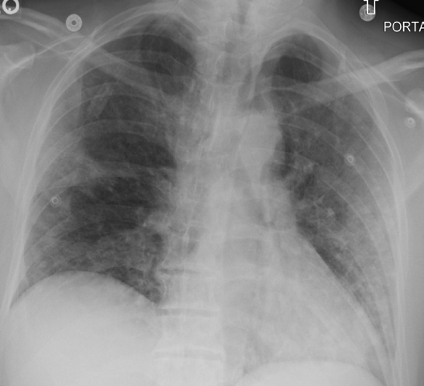
A
50M
B
85M
C
80F
Notes:
Mild multifocal ground glass opacity seem in right and left lobes and posterior right lower lobe - most likely representing multifocal pneumonia.
Heterogeneous ground glass density seen through out the lungs, predominantly within the bilateral lobes as well as upper lobes, right greater than left. Moderate ultifocal pneumonia with moderate to severe involvement of lower lobes. Findings consistent with known viral pneumonia.
No remarkable abnormalities seen, Findings: normal and healthy lungs.

Slide 20
Laboratory Parameters for 50M, 85M, 80F
 | Normal Range |  | 50M |  | 85M | 80F
Date | Male | Female | May 6th | May 18th | May 8th | May 8th
ALT (U/L) | 10-40 |  | 146 | 279 | 84 | 14.4
LDH (U/L) | 80-225 |  | 756 | 959 | 432.6 | 152.6
Albumin (g/dL) | 3.5-5.5 |  | 3.24 | 2.8 | 3.4 | 4.0
Lymphocytes (Ux10³/µL) | 1.0-4.8 |  | 0.50 | 0.41 | 0.84 | 1.39
Neutrophils (Ux10³/µL) | 1.8-7.7 |  | 9.4 | 14.3 | 7.0 | 2.87
Red blood cells (Ux10⁶/µL) | 4.7-6.1 | 4.2-5.4 | 4.5 | 4.6 | 4.6 | 4.21
Hemoglobin (g/dL) | 14-18 | 12-16 | 12.0 | 13.9 | 11.6 | 12.8
BUN (mg/dL) | 6-20 |  | 5.6 | 16 | 7 | 13
Creatinine, serum (mg/dL) | 0.6-1.3 | 0.5-1.1 | 0.75 | 3.2 | 0.85 | 0.7
Notes:
All these parameters are within normal range in 80F, who has mild infection.

Slide 21
Laboratory Parameters – Inflammatory Markers
 | Normal Range |  | 50M |  | 85M | 80F
Components | Male | Female | May 6th | May 18th | May 8th | May 8th
C-reactive protein (mg/L) | <5 |  | 150.6 | 219.6 | 120.5 | 7.93
Serum ferritin (ng/mL) | 24-336 | 11-307 | 1965.3 | 2250.7 | 1094 | 113.5
ESR (mm/h) | <15 | <20 | 83 | 95 | 82 | 8
IL-6 (pg/mL) | 0.1-2.9 |  | 25.28 | 29.52 | 18.4 | 4.27
D-dimer (ng/mL) | <=0.50 |  | 0.86 | 1.06 | 0.74 | 0.4
SAA (mg/L) | 0-10 |  | 170.6 | 215.3 | 125.2 | 3.5
FIB (mg/dL) | 200-400 |  | 581 | 727 | 576 | 371
IL-1 (pg/mL) | 0-5 |  | - | 26.78 | - | -
TNF-alpha (pg/mL) | 0-16 |  | - | 47.1 | - | -
Notes:
Similarly the inflammatory markers are high for 50M and 85M indicating severe infection and these were slightly elevated for 80F indicating mild infection.
There is a cytokine storm and in the case of 50M there is a marked increase in cytokines(click) IL-6, (click) IL-1 and TNF-a as he continues to fight the infection. This “cytokine storm” signifies the second phase of infection which resulted in his multiorgan failure.

Slide 22
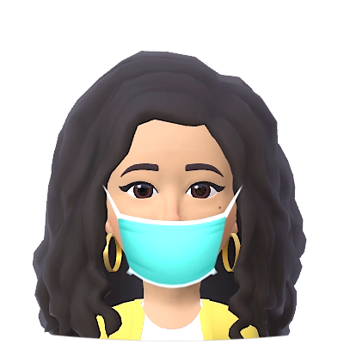

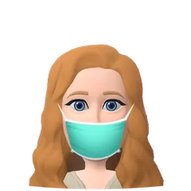
Stay Safe and Science on!

