Slide 1
A Ticket to Nowhere: Lysosomal Storage Disorders
NATIONAL CENTER FOR CASE STUDY TEACHING IN SCIENCE
Images and Questions to Accompany the Case Study:
by
Rachel A. Hirst and Tracy R. Rosebrock
Department of Biology
Stonehill College, Easton, MA
Notes:
Credit: Licensed image ©Pixelrobot | Dreamstime.com, id 83219488.

Slide 2
Preliminary – The Path of a Lysosomal Hydrolase

Slide 3
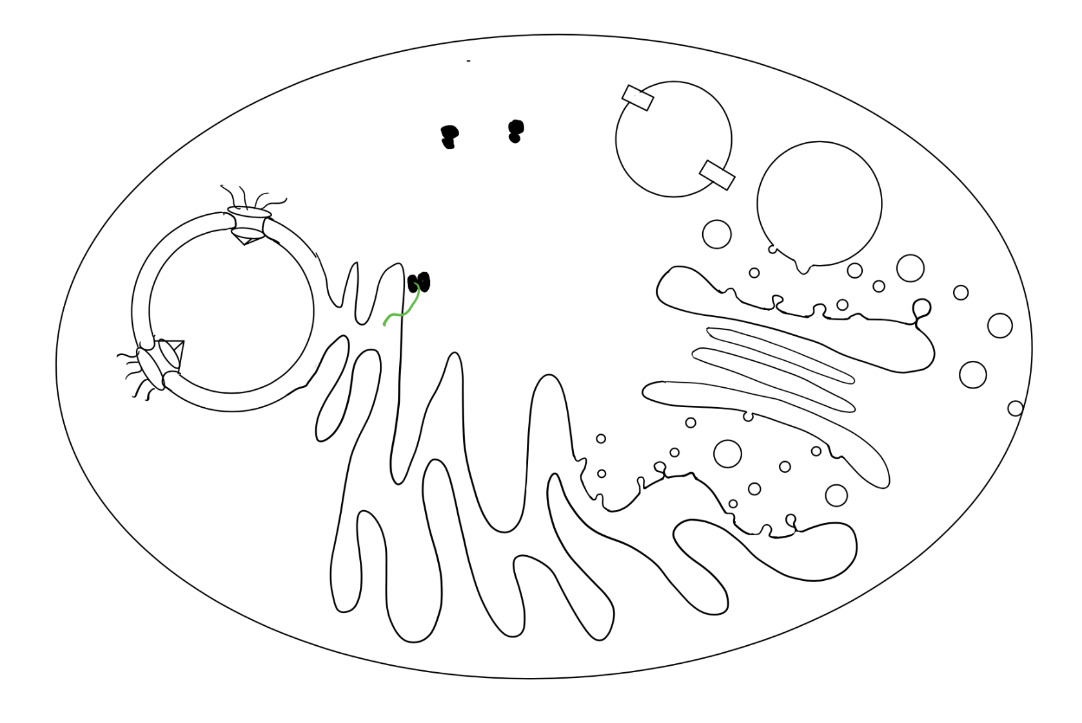
metabolites
functional hydrolase
1. Free ribosomes synthesizing hydrolase moves to ER
lysosome
pH ~4.5
H+
8. The mannose-6-phosphate receptor will be recycled from the endosome to the trans-Golgi via vesicles
endosome
7. The hydrolase is delivered to the endosome, which will mature into a lysosome
2. Hydrolase is synthesized at rough ER
trans
6. The mannose-6-phosphate transmembrane receptor, at the trans-Golgi, binds the modified hydrolase and the hydrolase is package into a transport vesicle bound for the endosome
nucleus
Golgi apparatus
medial
cis
3. Core oligosaccharide added to the hydrolase protein in the ER lumen
5. The core oligosaccharide on the hydrolase is further modified with mannose-6-phosphate in the lumen of the cis-Golgi
ER
4. Transport vesicles move hydrolase with covalently-bound core oligosaccharide to the cis-Golgi

Slide 4
Part I – Meet the Silva Family

Slide 5
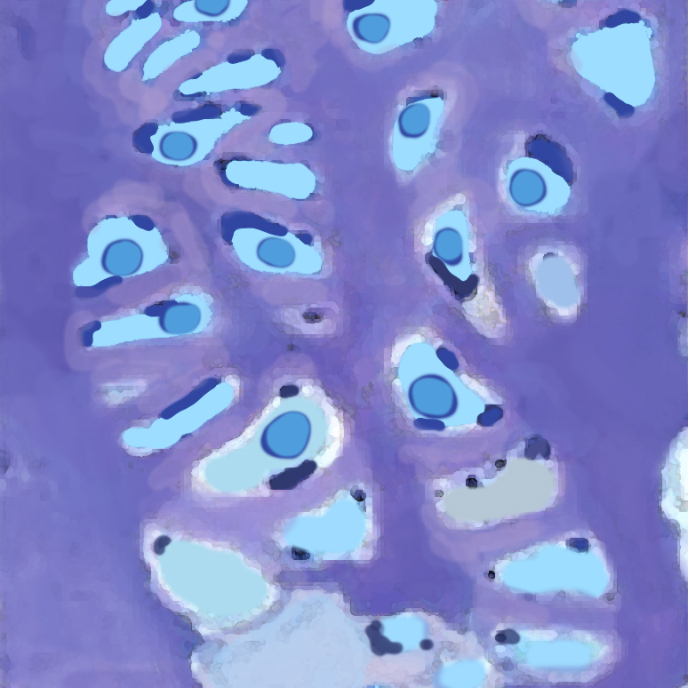
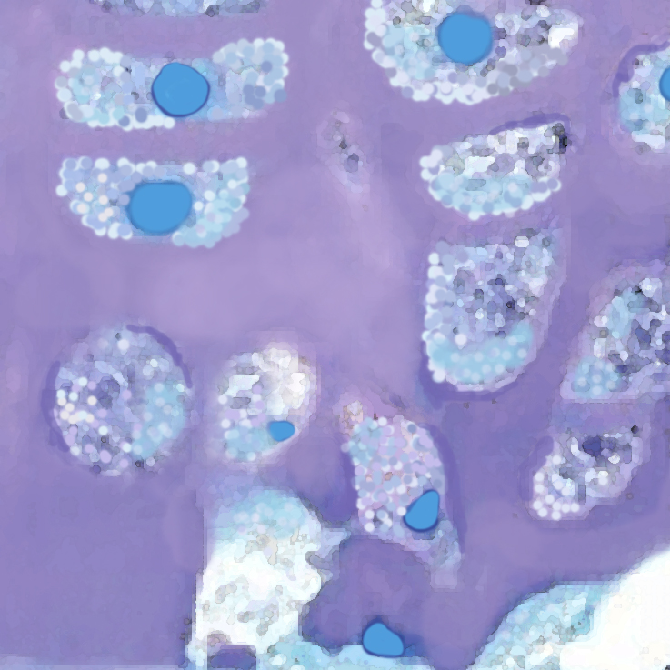
Figure 1.
Cartilage from a patient without an LSD
Cartilage from a patient with an LSD
Chondrocytes
Chondrocytes in Cartilaginous Tissue
Extracellular Cartilage Matrix
Vesicles with undigested substrates
Notes:
Figure 1. Illustration of chondrocytes in touline-blue stained cartilaginous tissue. Left: normal chondrocytes (nuclei are dark blue, cytoplasm is light blue) with normal production and secretion of extracellular cartilaginous matrix (purple). Right: larger chondrocytes with enlarged vesicles containing undigested substrates (punctate intracellular areas that appear white) with reduced extracellular cartilaginous matrix (light purple and pink) are features indicative of LSDs. Image credit: Tracy Rosebrock and Rachel Hirst.

Slide 6
Figure 2.
Patient without Gaucher’s Disease
Patient with Gaucher’s Disease
Lysosome
pH ~4.5-5.5
Lysosome
pH ~4.5-5.5
Glucose
Glucocerebrosidase
Glucocerebrosidase
Metabolites for export are not made from Glucocerebroside
Glucocerebroside
+
Glucocerebroside
Ceramide
H+
H+
Metabolites exported to the cytoplasm for anabolism
ATP → ADP + Pi
ATP → ADP + Pi
Notes:
Figure 2. Illustration of glucocerebroside catabolism in the lysosome in a patient without Gaucher’s disease (left) compared to a patient with Gaucher’s disease (right). Glucocerebroside is catabolized to the metabolites glucose and ceramide by the lysosomal hydrolase, glucocerebrosidase. Glucose and ceramide are exported to the cytoplasm for anabolism by the cell. In those with Gaucher’s disease, glucocerebrosidase is not present or partially inactive, which stops or slows the catabolism of glucocerebroside. Image credit: Tracy Rosebrock and Rachel Hirst.

Slide 7
CQ1. Check your knowledge: Which of the following statements is/are true of lysosomes? Select all that apply.
Lysosomal enzymes are optimally active in the acidic conditions maintained within the lysosomes.
Lysosomes have a pH that is higher than that of the cytosol.
The products of digestion (metabolites) created in lysosomes are secreted into the extracellular space by transport vesicles that pinch off and merge with the plasma membrane.
The lumen of the lysosome is maintained at an acidic pH by an ATP-driven H+ pump in the membrane that hydrolyzes ATP to pump H+ into the lumen.
Lysosomes contain hydrolases that are only able to break down nucleic acid.

Slide 8
CQ2. Check your knowledge: Which of the following statements is/are true of lysosomal storage disorders (LSDs)? Select all that apply.
LSDs are common inherited metabolic disorders.
An LSD can be caused by mutations in genes that encode specific lysosomal proteins, such as hydrolases, that disrupt protein function.
An LSD can be caused by mutations that prevent lysosomal proteins, such as hydrolases, from being delivered to the lysosome.
In LSDs, substrates normally degraded by hydrolases within the lysosome begin to accumulate in the lysosome leading to cellular dysfunction and pathological consequences to affected organs.

Slide 9
CQ 3. Make a prediction: Based on what you know about the function of lysosomes and Elizabeth’s signs and symptoms, what is a logical explanation for why lysosomal dysfunction could result in Elizabeth’s reduced hip and knee mobility?
The build-up of undigested substrates in chondrocytes leads to increased bacterial infections of the knee and hips.
The build-up of undigested substrates in chondrocytes disrupts the cell’s ability to produce and secrete cartilage (an extra-cellular matrix), which is necessary for normal function of hip and knee joints.
The build-up of undigested substrates in chondrocytes disrupts chloride transporters in the cell/plasma membrane causing a build of Cl− ions in the cell.
The build-up of undigested substrates in chondrocytes reduces cell/plasma membrane permeability.

Slide 10
CQ4. Expand your knowledge: Gaucher’s disease is the most common of the lysosomal storage diseases, which are caused by a failure of lysosomes to degrade substances that they normally break down. Gaucher’s disease is caused by deficiency of the lysosomal enzyme glucocerebrosidase, which catalyzes the hydrolysis of glucocerebroside to glucose and ceramide. Based on this information, which of the following statements is true regarding Gaucher’s disease?
Glucose will build up in lysosomes.
Ceramide will build up in lysosomes.
Glucose and ceramide will build up in lysosomes.
Glucocerebroside will build up in lysosomes.
Glucocerebrosidase will build up in lysosomes.

Slide 11
Part II – The Test Results

Slide 12
Figure 3. Lysosomal hydrolase activity in fibroblasts (intracellular)
****
****
****
****
****
****
Healthy Control
Ana Sophia Silva
Notes:
Figure 3. Quantification of Ana’s intracellular lysosomal hydrolase activity. The figure shows the average percent lysosomal hydrolase activity in Ana’s fibroblasts compared to a healthy control patient. Error bars equal standard deviation. β-Hex = β-hexosaminidase, α-Man = α−mannosidase, β-GCND = β-glucuronidase, β-Gal = β-galactosidase, a-Fuc = α-fucosidase, GSA = Glycosylasparaginase. **** = p<0.0001; ***=p<0.001.

Slide 13
Figure 4. Lysosomal hydrolase activity in blood sera (extracellular)
****
****
***
***
Healthy Control
***
***
Ana Sophia Silva
Notes:
Figure 4. Quantification of Ana’s extracellular lysosomal hydrolase activity. The figure shows the average fold change of lysosomal hydrolase activity in Ana’s blood compared to a healthy control patient. Error bars equal standard deviation. β-Hex = β-hexosaminidase, α-Man = α−mannosidase, β-GCND = β-glucuronidase, β-Gal = β-galactosidase, a-Fuc = α-fucosidase, GSA = Glycosylasparaginase. **** = p<0.0001; ***=p<0.001.

Slide 14
CQ5. Check your knowledge: Why did Dr. Crumpler buffer the cell lysates and blood sera to an acidic pH to test the function of lysosomal hydrolases that are outside of the lysosome?
To create an acidic environment; these enzymes function at low pH.
To create an acidic environment; these enzymes will not function at low pH.
To create an alkaline environment; these enzymes function at low pH.
To create an alkaline environment; these enzymes will not function at low pH.

Slide 15
CQ6. Data analysis: Based on Figure 3 in the case study, which of Ana’s lysosomal hydrolases had lower activity levels in the fibroblast extracts compared to the healthy control patient? Select all that apply.
beta-Hex = beta-hexosaminidase
alpha-Man = alpha-mannosidase
beta-GCND = beta-glucuronidase
beta-Gal = beta-galactosidase
alpha-Fuc = alpha-fucosidase
GSA = glycosylasparaginase

Slide 16
CQ7. Data analysis: Based on Figure 4 in the case study, which of Ana’s lysosomal hydrolases had higher activity levels in the blood sample compared to the healthy control patient? Select all that apply.
beta-Hex = beta-hexosaminidase
alpha-Man = alpha-mannosidase
beta-GCND = beta-glucuronidase
beta-Gal = beta-galactosidase
alpha-Fuc = alpha-fucosidase
GSA = glycosylasparaginase

Slide 17
CQ8. Make a prediction: Compare the results obtained in the fibroblast extract assay (Figure 3) to the blood assay (Figure 4). Which of the following hypotheses is more likely to be true:
All of Ana’s hydrolases are present within the lysosome of the fibroblasts but lack enzymatic activity.
All of Ana’s lysosomal hydrolases are present in the extracellular space (blood sera) and have retained enzymatic activity.
Some of Ana’s hydrolases are present within the lysosome of the fibroblasts and are functional enzymes, and some of Ana’s hydrolases are present in the extracellular space (blood sera) and are functional enzymes.

Slide 18
CQ9. Check your knowledge: Which of the following is the correct order of protein sorting for a protein destined for the lysosome?
RER → cis-Golgi → trans-Golgi → plasma membrane → lysosome
RER → trans-Golgi → cis-Golgi → endosome → lysosome
RER → cis-Golgi → trans-Golgi → endosome → lysosome
cytosol → plasma membrane → trans-Golgi → cis-Golgi → endosome → lysosome

Slide 19
CQ10. Check your knowledge: Which of the following steps are required for lysosomal hydrolases to be properly targeted to the lysosome? Select all that apply.
Synthesis on ribosomes found on the RER.
The addition of a core oligosaccharide modification within the RER lumen.
Addition of mannose-6-phosphate in the Golgi lumen.
Binding of the modified lysosomal protein to the mannose-6-phosphate receptor in the trans-Golgi membrane.
Transport to the endosome (which matures into a lysosome) from the trans-Golgi via a vesicle.
Recycling of the mannose-6-phosphate receptor to the plasma membrane.

Slide 20
CQ11. Check your knowledge: Which of the following is the correct order of protein sorting for a protein destined for secretion into the extracellular space?
RER → cis-Golgi → trans-Golgi → plasma membrane
RER → trans-Golgi → cis-Golgi → plasma membrane
RER → cis-Golgi → trans-Golgi → endosome → lysosome → plasma membrane
cytosol → plasma membrane

Slide 21
CQ 12. Make a prediction: Which of the following reasons below would best explain why Ana’s lysosomal hydrolases are found in the blood instead of the lysosome?
Ana’s lysosomal hydrolases were degraded by the proteasome before reaching the lysosome.
Ana’s lysosomal hydrolases were not properly “tagged” in the Golgi with mannose-6-phosphate. Without the proper “tag” they were secreted from the cell, eventually reaching the bloodstream.
Ana’s lysosomal hydrolases were retained in the ER after synthesis, the unfolded protein response was triggered, and all protein contents from the ER were secreted from the cell, eventually reaching the bloodstream.
Ana’s lysosomal hydrolases were targeted to the nucleus after synthesis on cytoplasmic ribosomes where they entered the endomembrane system and were secreted from the cell, eventually reaching the bloodstream.

Slide 22
Part III – Putting It All Together

Slide 23
CQ 13. Putting it all together: True or false? Ana Sophia’s chondrocytes are unable to digest many nutrients and macromolecules in the lysosome. These cells have a build-up of waste and do not have the required building blocks needed to synthesize and secrete cartilaginous matrix.
True
False

Slide 24
CQ14. Putting it all together: Given the data in Part II, which of the following are reasonable hypotheses to explain Ana’s LSD? Select all that apply.
Mutations occurred in each of the genes that encode Ana’s lysosomal hydrolases, and these mutations preventing their activity.
A disruptive mutation occurred in the gene that encodes the phosphotransferase, which is required for Ana’s lysosomal hydrolases to be “tagged” with mannose-6-phosphate in the Golgi.
A disruptive mutation in the gene that encodes the mannose-6-phosphate receptor, which normally binds mannose-6-phosphate-tagged lysosomal proteins in the trans-Golgi network and delivers them to lysosomes.
A mutation occurred in the COP protein that prevents vesicle formation from the ER.

Slide 25
CQ15. Putting it all together: True or false? Given that there are many forms of LSDs and they are inherited disorders, the next logical step would be to conduct a genetic test to determine which LSD is causing Ana Sophia’s symptoms.
True
False

