Slide 1
Nia’s Painful Breast: Breast Anatomy, Lactation, and Mastitis
NATIONAL CENTER FOR CASE STUDY TEACHING IN SCIENCE
Images to Accompany the Case Study:
by
Jenna Ridlen¹, Sharifah Albraiki ², Sarah Ellis³, Jocelyn A. Moore¹,
and Anusree Mukherjee²
Jacksonville State University, Jacksonville, AL
¹Department of Biology, ²Department of Chemistry and Geosciences,
³Department of Art and Design
Notes:
Case copyright held by the National Science Teaching Association (https://www.nsta.org/case-studies). Originally published July 29, 2024. Please see our usage guidelines (https://www.nsta.org/case-studies/guidelines), which outline our policy concerning permissible reproduction of this work.
Credit: Licensed photo ©Ittipat Wongchaikul | Dreamstime.com, ID 91522318.

Slide 2
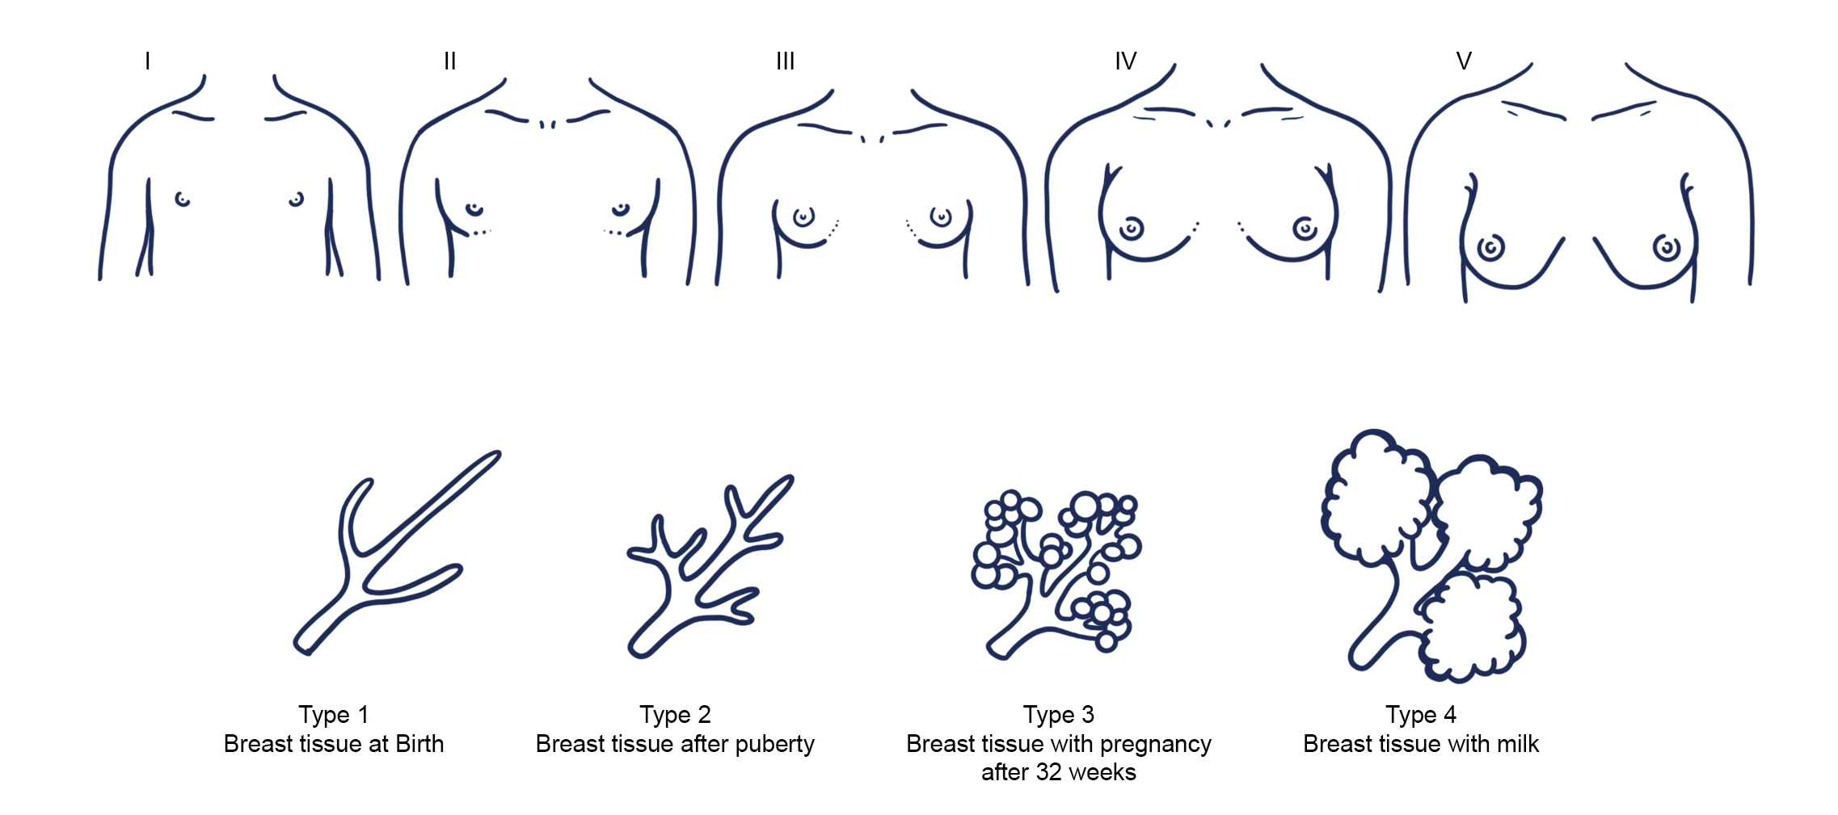
Notes:
Figure 1. Breast development. Credit: Illustration by Sarah Ellis.

Slide 3
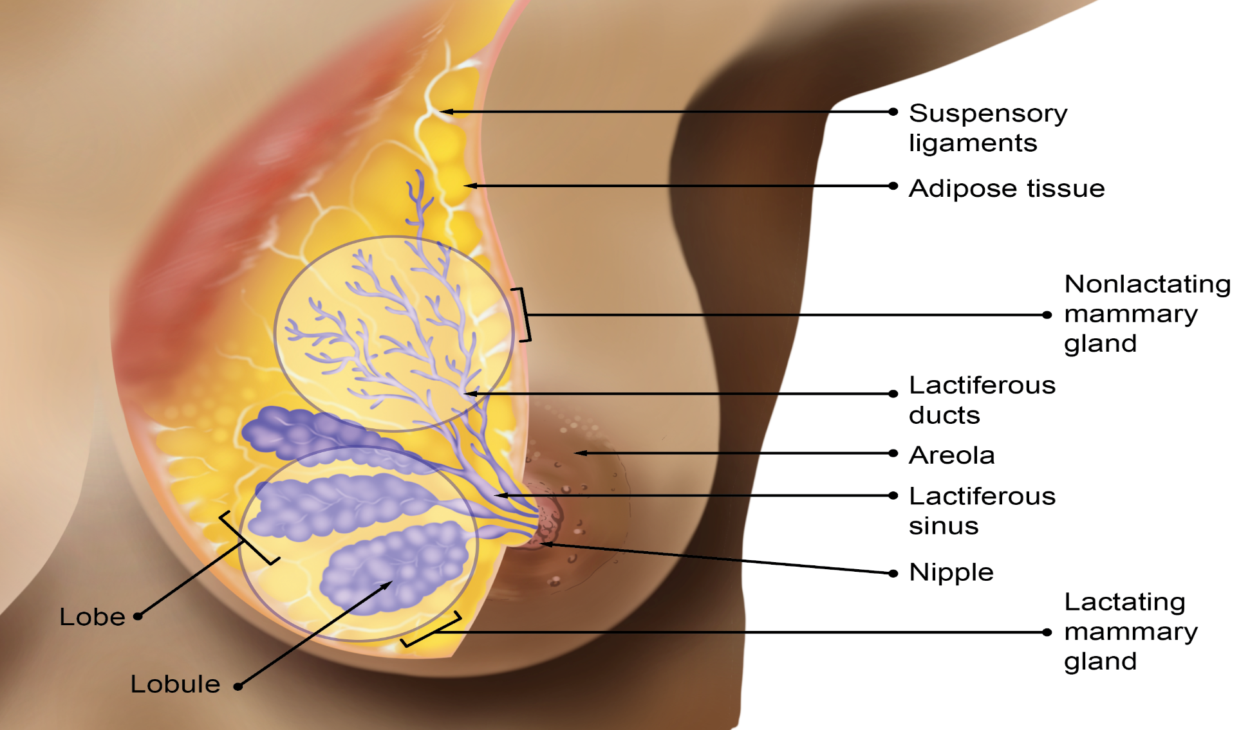
Notes:
Figure 2. Breast anatomy. Credit: Illustration by Sarah Ellis.

Slide 4
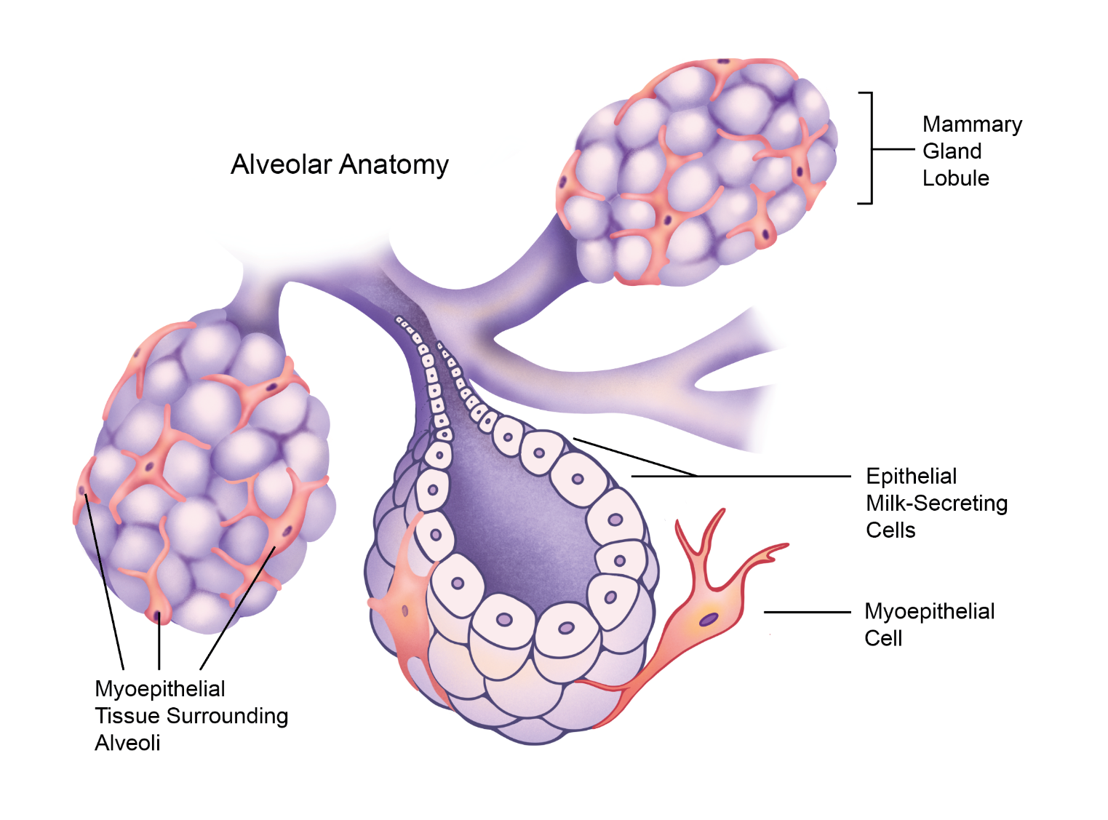
Notes:
Figure 3. Alveolar anatomy. Credit: Illustration by Sarah Ellis.

Slide 5
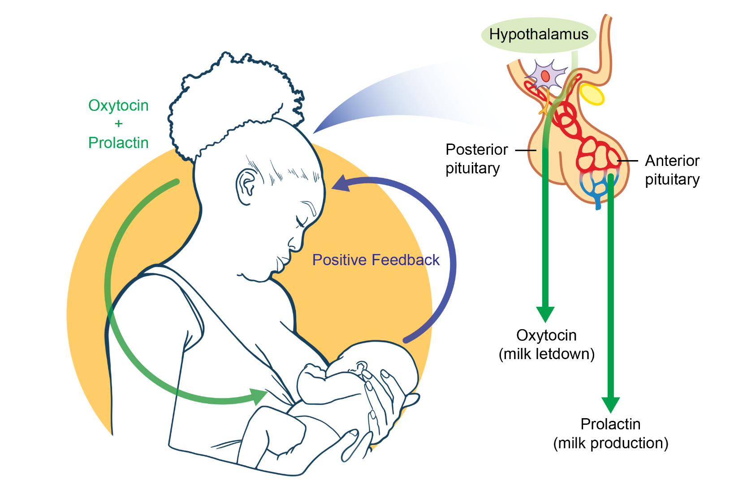
Notes:
Figure 4. Neurohormonal control of lactation, positive feedback loop. Credit: Illustration by Sarah Ellis.

Slide 6
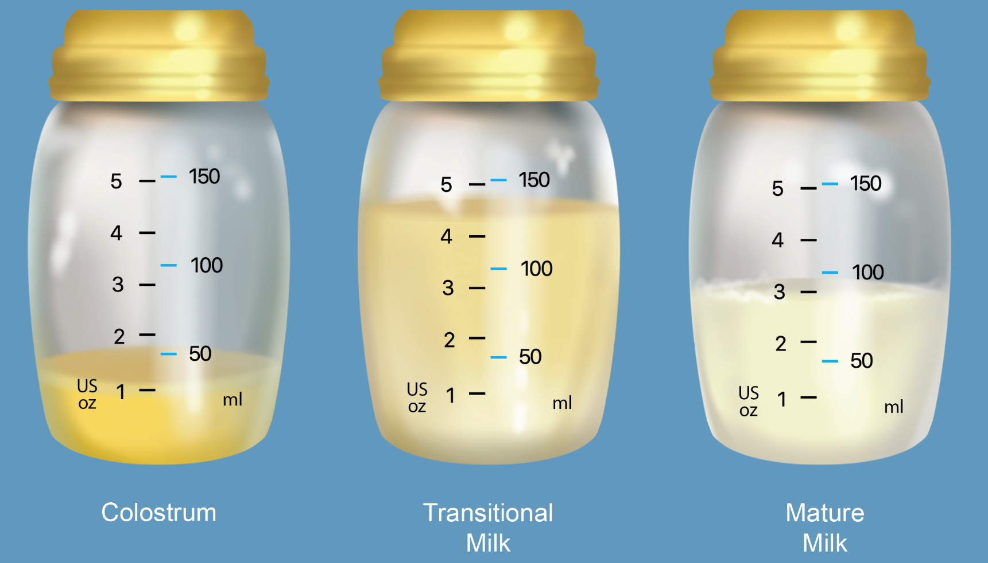
Notes:
Figure 5. Colostrum, transitional milk, and mature milk. Credit: Illustration by Sarah Ellis.

Slide 7
^{Mastitis}
Notes:
Figure 6. Examples of mastitis. Credit: Illustrations by Sarah Ellis.

