Slide 1
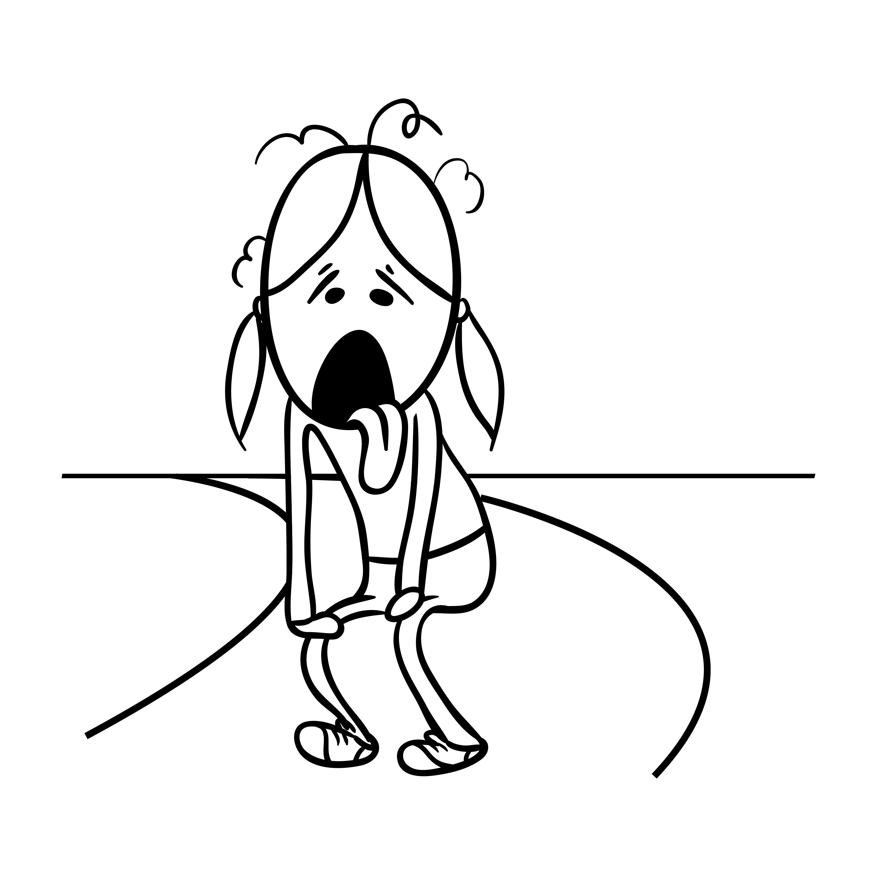
I Hate Running! And Lactate Is to Blame, Right?
NATIONAL CENTER FOR CASE STUDY TEACHING IN SCIENCE
A Presentation to Accompany the Case Study:
by
Ashley E. Rhodes, Timothy G. Rozell, and Abigail R. Wilson
Kansas State University, Manhattan, KS
Notes:
Credit: Licensed image ©Anastasia Sorokina | Dreamstime.com, ID56940386.

Slide 2
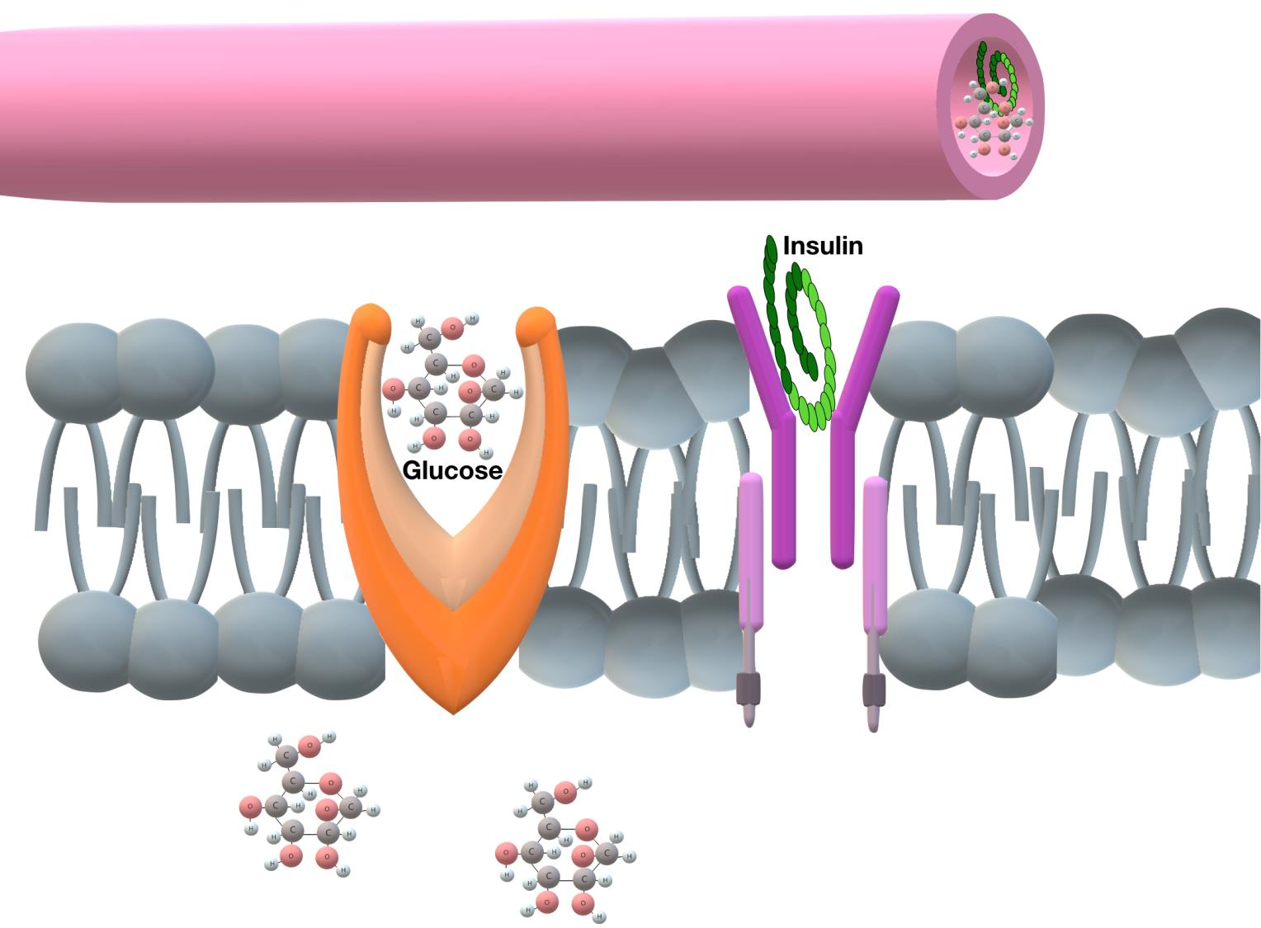
Figure 2.

Slide 3
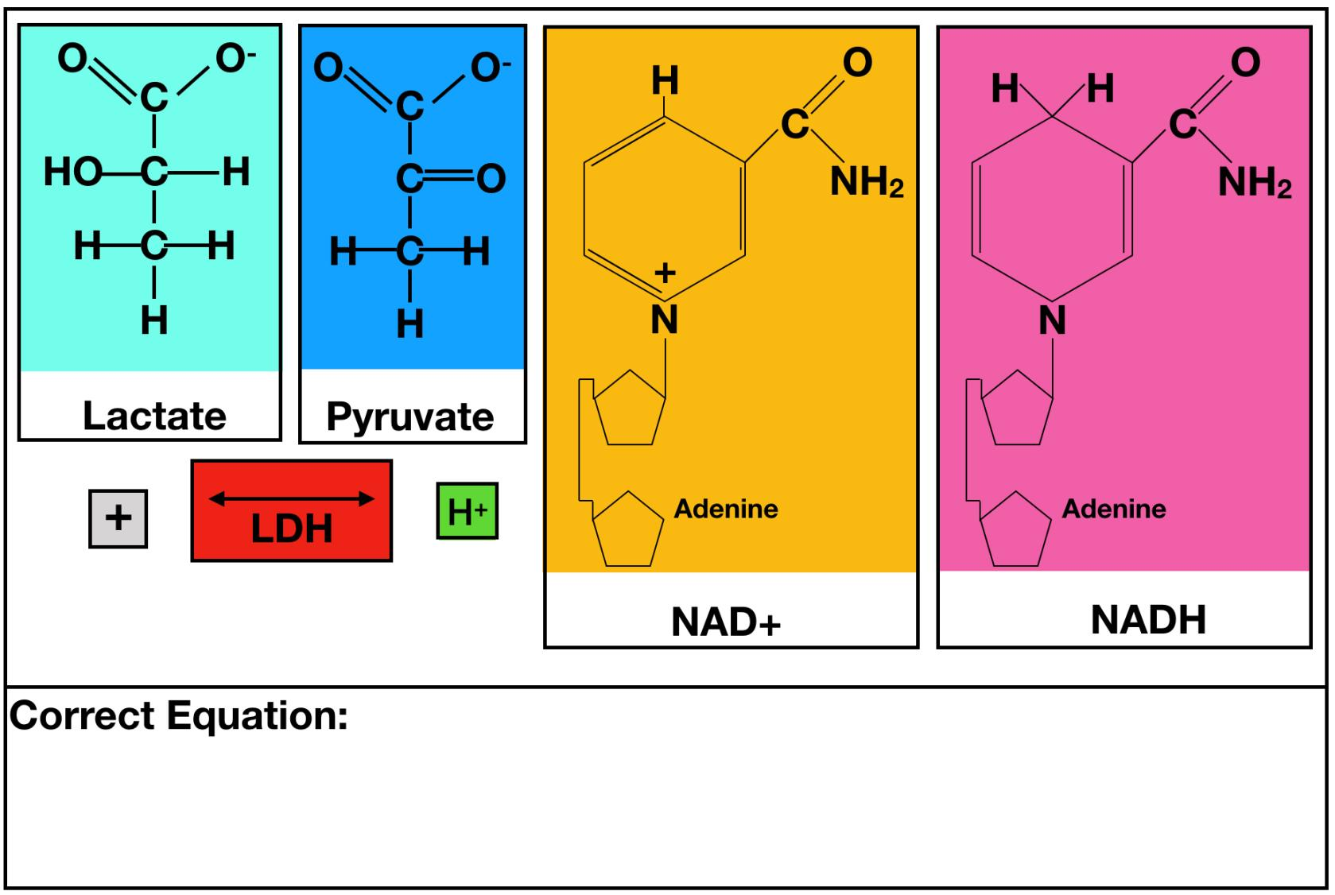
Figure 4.

Slide 4
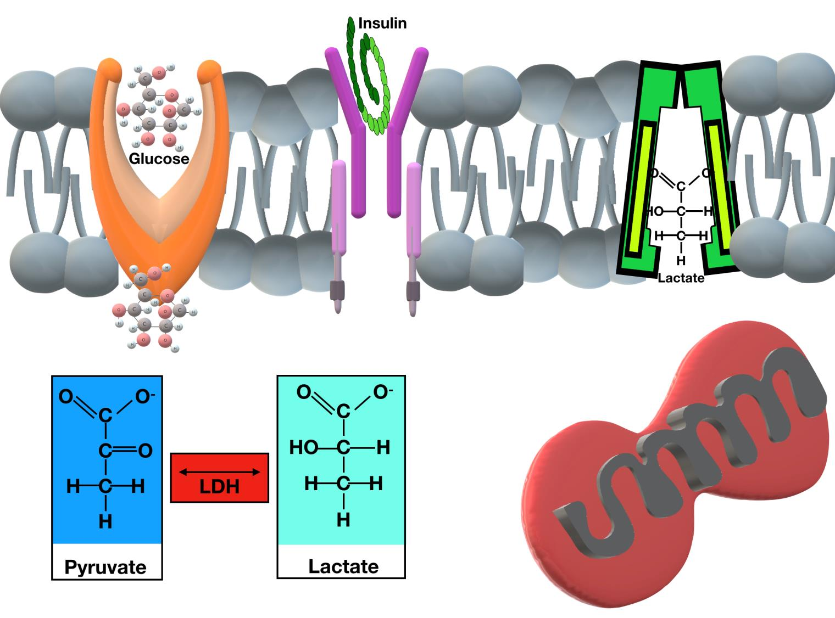
Figure 5.

Slide 5
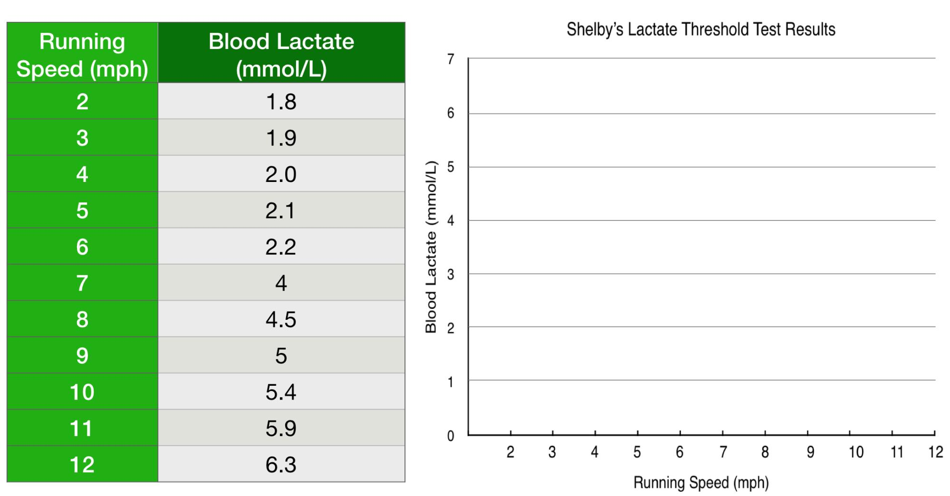
Figure 6.

Slide 6
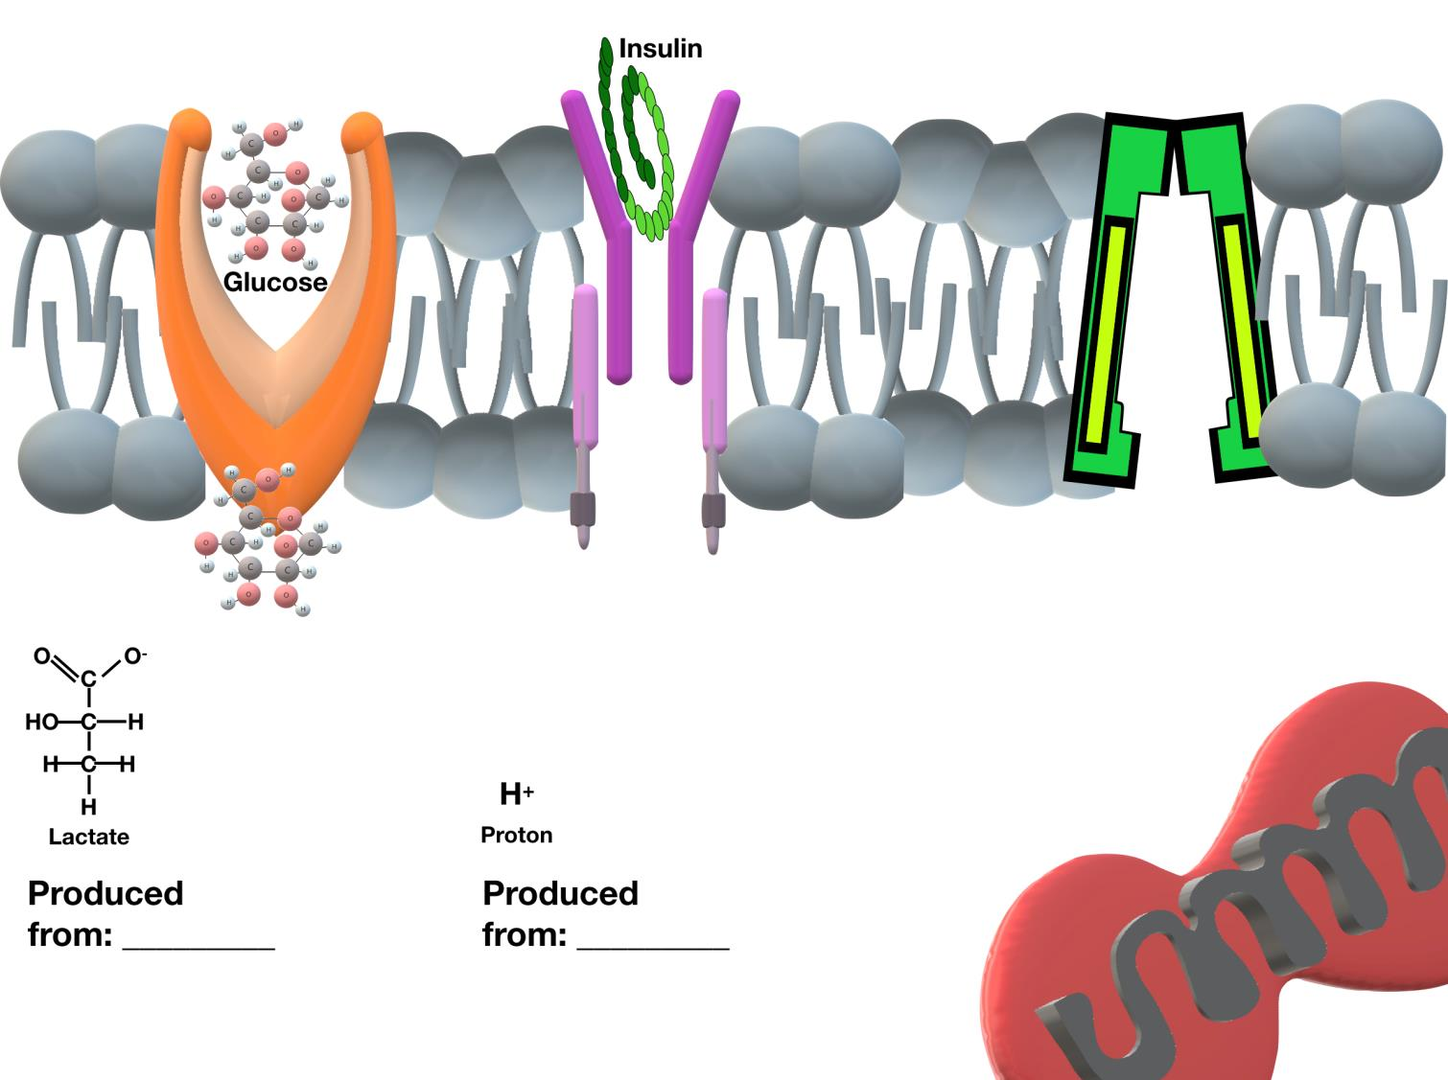
Figure 8.

