Slide 1
Tremors in the Nerves: Investigating Kuru Deena E. Afana, Autreen Golzar, Andrew Q. Dong, Johnny D. Nguyen, Vanessa G. Delgado, Laura B. Morel, Jaclene A. Torres, David A. Beshai, and Andrea C. Nicholas University of California, Irvine
NATIONAL CENTER FOR CASE STUDY TEACHING IN SCIENCE
A Presentation to Accompany the Case Study:

Slide 2
What is Kuru?
A rare neurodegenerative disease caused by prions.
Found among the Fore people in Papua New Guinea.
The last known case of Kuru disease was in 2004.

Slide 3
Before you can understand Kuru disease, you must understand prions!

Slide 4
What Are Prions?
The “central dogma” of biology states that DNA makes RNA, which makes proteins.
When proteins are made, they must fold in a specific orientation to carry out their intended function.

Slide 5
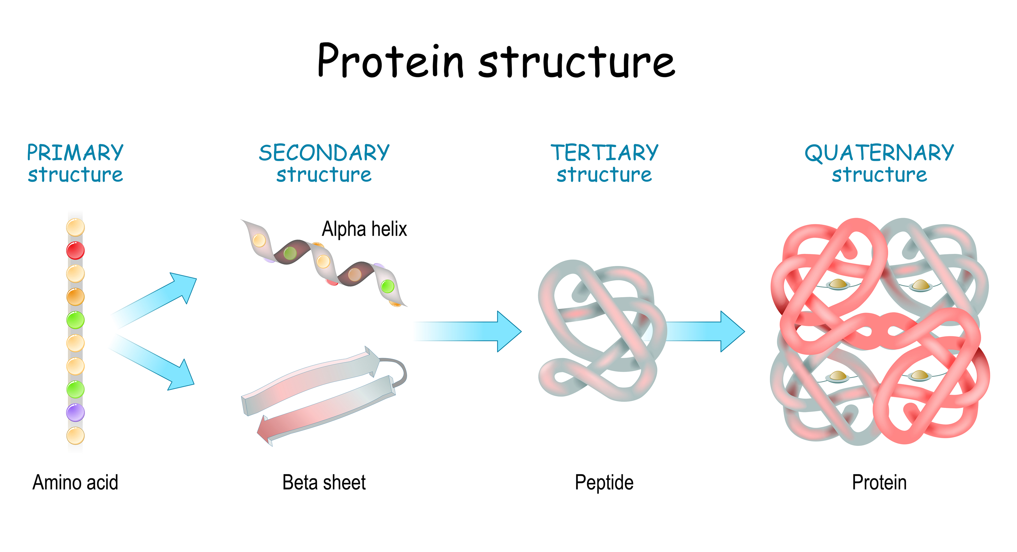
Protein Structures
Proteins consist of four levels of structures:
(1) - Amino acid sequence
(2) - Alpha (α) helices and beta (β) sheets
(3) - Folding of one protein
(4) - Folding of multiple proteins together
Notes:
Licensed illustration © Designua | Dreamstime.com, ID 196885939.

Slide 6
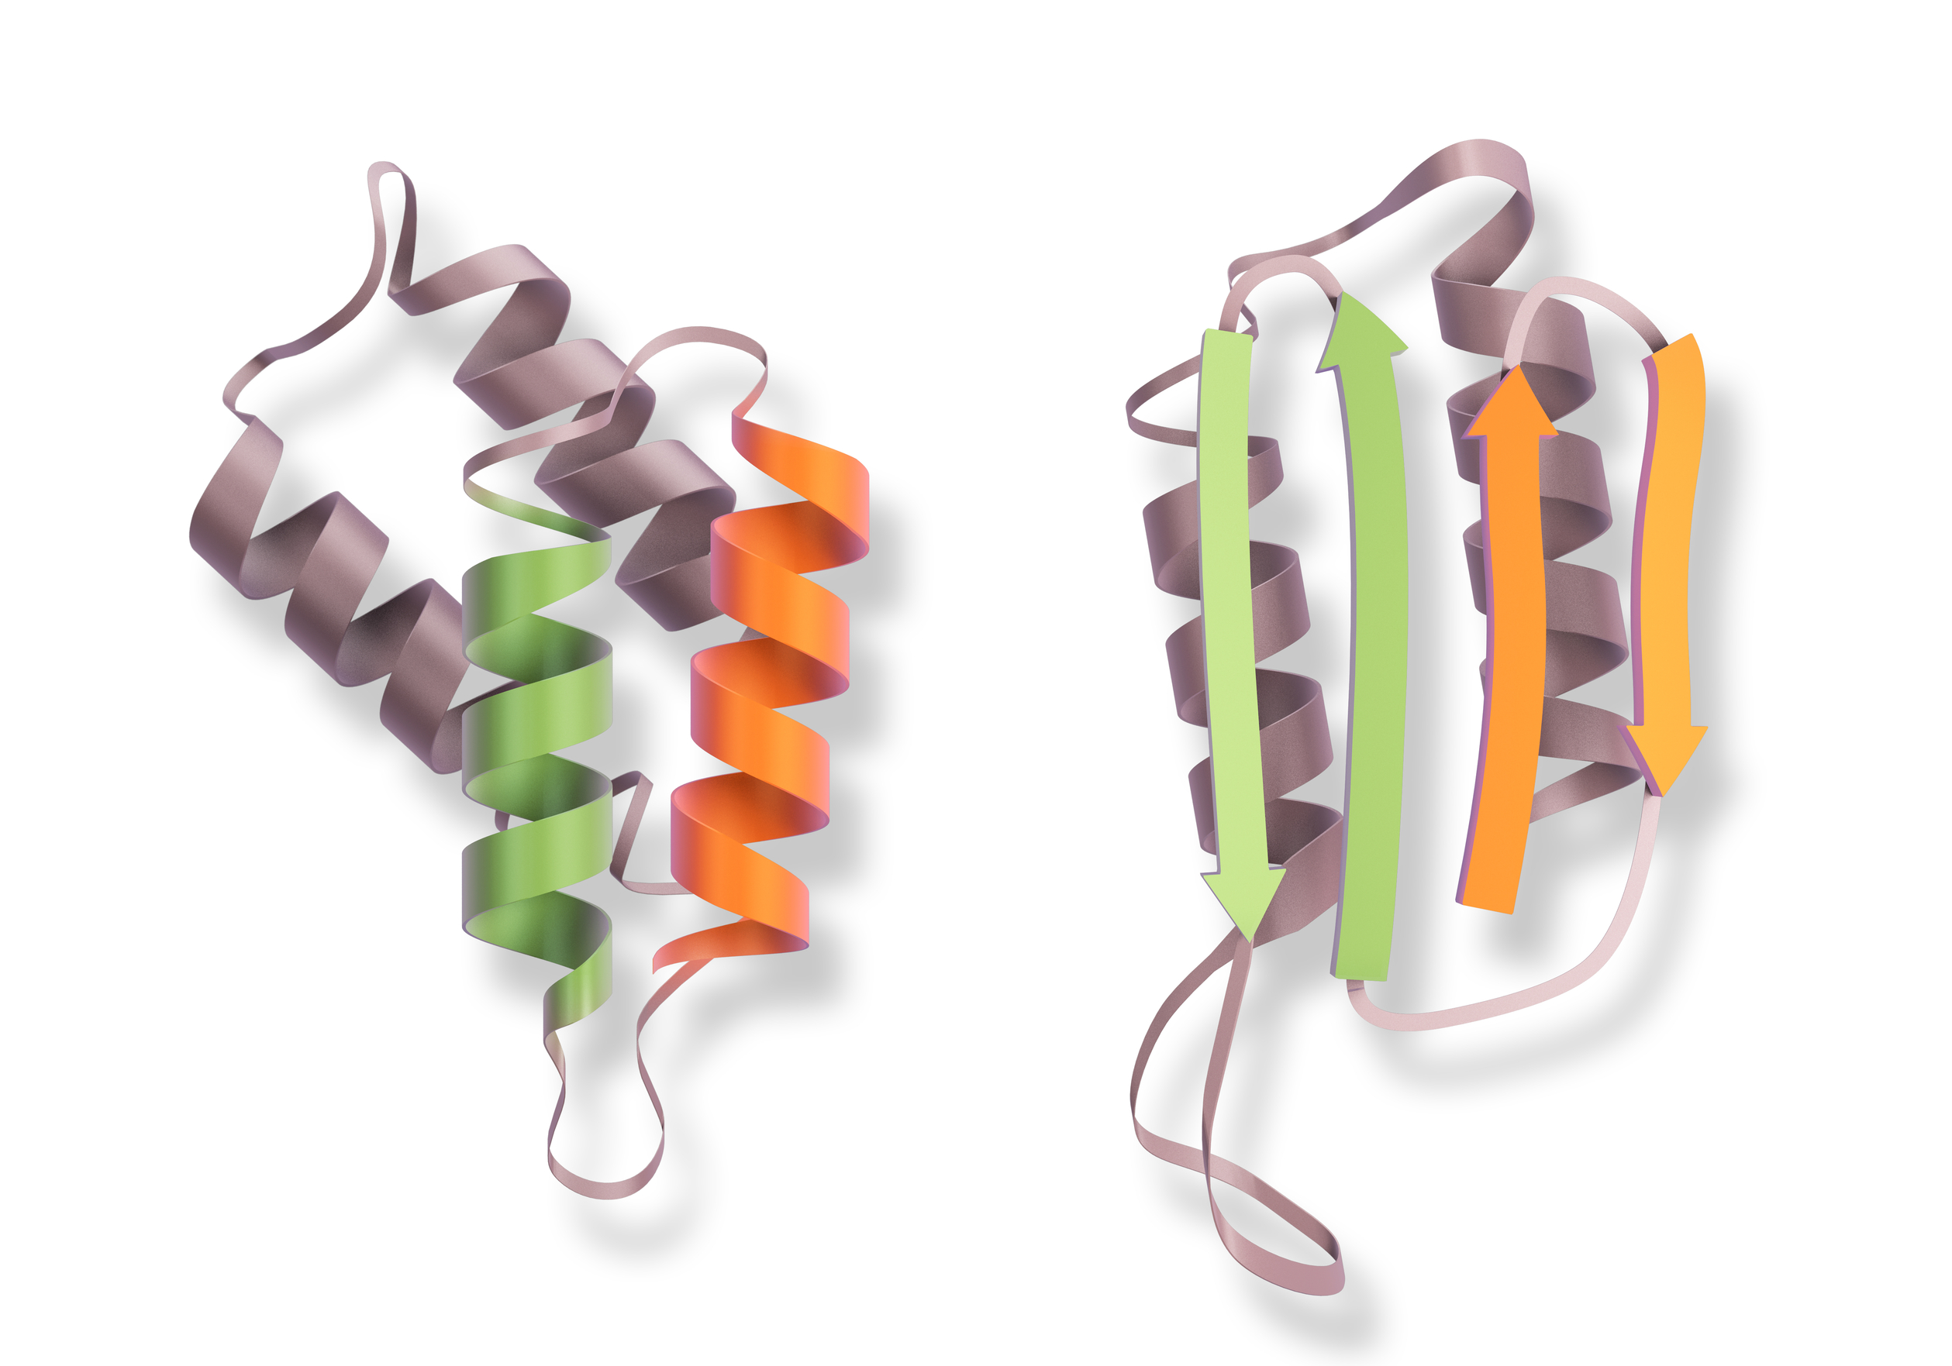
What Are Prions?
Prion proteins exist in two different forms:
Normal Form (PrP^{C})
Has more alpha helices
Infectious Form (PrP^{Sc})
Has more beta sheets
Kuru infected patients contain both PrP^{C} and PrP^{Sc}
The two forms do not differ in amino acid sequence
PrP^{C}
PrP^{Sc}
Notes:
Licensed illustration © Oscar Collica | Dreamstime.com, ID 176711652.

Slide 7
Mechanism
The normal prion protein (PrP^{C}) can be converted into the infectious form (PrP^{Sc}).
When this happens, PrP^{Sc} can convert more PrP^{C} into its infectious form.
This allows more misfolded proteins to aggregate, or “clump together.”

Slide 8
Mechanism
When the protein aggregates get too big, the body cannot break them down through proteolysis.
Proteolysis is the degradation of proteins by enzymes from the endoplasmic reticulum.
Enzymes for proteolysis are specific to different proteins.
The body does not contain the necessary enzymes to break down the PrP^{Sc} protein.

Slide 9
Mechanism
Due to this, PrP^{Sc} can convert the normal PrP^{C} protein into the infectious form.
Thus, PrP^{Sc} continues to spread throughout the brain, specifically the surface of the neurons.
This is associated with the symptoms seen in Kuru disease

Slide 10
Symptoms of Kuru
Stage 1 (ambulant)
Headache and joint pain
Tremors or body shaking
Cannot properly pronounce words
Loss of balance and posture
However, the patient can still walk.

Slide 11
Symptoms of Kuru
Stage 2 (sedentary)
(includes stage 1 symptoms)
Cannot walk without support
Difficulty controlling muscles
Depression and/or erratic emotions
Tremors are more violent
However, the patient still has natural reflexes in their tendons.

Slide 12
Symptoms of Kuru Disease
Stage 3 (recumbent)
(includes stage 1 and 2 symptoms)
Loss of reflexes in tendons
Cannot sit without support
Cannot swallow properly
Lack of speech and responsiveness
Prone to infection and wounds

Slide 13
Transmission/Causes
The transmission of Kuru disease is still heavily debated.
Some believe it is due to rituals carried out by the Fore people, involving cannibalism of their deceased loved ones.
Direct consumption of the brain could lead to consuming the infectious PrP^{Sc} protein.

Slide 14
Transmission/Causes
Direct contact with wounds or sores of someone with Kuru can also cause infection.
Kuru can be associated with damage to the cerebellum, a part of the brain responsible for regulating motor movement.

Slide 15
Extra Facts on Kuru
Can be easily mixed up with other neurodegenerative disorders due to similarities in symptoms.
No standard protocol on diagnosing Kuru.
Can use U.S. protocol for other prion-related neurodegenerative diseases as follows:

Slide 16
Diagnosis of Kuru
Kuru is classified as a neurological disorder, which is initially screened through a neurological assessment.
After assessment, Kuru patients can be tested through four different diagnostic tests:
Blood Test
Electroencephalography (EEG)
Magnetic Resonance Imagining (MRI)
Spinal Tap

Slide 17
Diagnosis of Kuru
Test | Looking for? | Drawbacks
Blood Test | Presence of the infectious prion protein (PrP^{Sc}) | Not many prions appear in blood stream
EEG | Disruptions in neurological function | Cannot give a definitive diagnosis
MRI | Structural damages in the brain | Cannot give a definitive diagnosis
Spinal Tap | Presence of PrP^{Sc} in the cerebrospinal fluid (CSF); gives definitive diagnosis | Invasive procedure that can cause trauma to the nerves

Slide 18
Treatment of Kuru
There is neither a current successful treatment, nor a cure for Kuru disease.
Attempted methods of bloodletting (not recommended), pain medications and herbal medicines have reportedly alleviated symptoms. However, these are ineffective for long term use.

Slide 19
Prevention of Kuru
Refrain from cannibalistic practices or coming into contact with infected brain tissue.
Avoid contact with open wounds or sores of Kuru-infected individuals.
Since Kuru is extremely rare, active prevention is not necessary.

Slide 20
Patient Scenario

Slide 21
Patient Scenario
Your patient arrives and says that she has experienced random tremors for a few weeks after her trip to Papua New Guinea. Recently, her friends have said that they cannot understand her pronunciation. She is having some muscle pain but she can still walk properly.

Slide 22
Patient Scenario
If she were to have Kuru disease, what stage would she be in?

Slide 23
Patient Scenario: Answer
If she were to have Kuru disease, what stage would she be in?
Stage 1; this is associated with patients who can still walk properly.

Slide 24
Patient Scenario
You assume that she has anxiety and prescribe anxiety medications. After some time, she returns in a wheelchair and says she no longer can walk. She is crying uncontrollably in hysterics and begins to yell at you at random moments.

Slide 25
Patient Scenario
If she were to have Kuru disease, what stage would she be in?

Slide 26
Patient Scenario: Answer
If she were to have Kuru disease, what stage would she be in?
Stage 2; this is associated with patients who cannot walk properly, however she can still talk.

Slide 27
Patient Scenario
Her inability to walk alarms you and you decide to order a full blood test to determine the source of the symptoms. The results come back completely normal, including no presence of the PrP^{Sc} protein. You begin to assume that there is nothing wrong with her and it must be a side effect of her medication.
What is wrong with this initial diagnosis?

Slide 28
Patient Scenario: Answer
Her inability to walk alarms you and you decide to order a full blood test to determine the source of the symptoms. The results come back completely normal, including no presence of the PrP^{Sc} protein. You begin to assume that there is nothing wrong with her and it must be a side effect of her medication.
What is wrong with this initial diagnosis?
PrP^{Sc} protein doesn’t always appear in the bloodstream, so she could still have a prion-related disease.

Slide 29
Patient Scenario
The intern in the office has recently finished studying about prion diseases, specifically Kuru. He notices she returned from Papua New Guinea and the symptoms she is experiencing align with Kuru. Thus, he suggests you conduct an MRI to see if there is any structural damage in the brain.

Slide 30
Patient Scenario
You conduct the MRI and notice there is a lot of structural damage throughout her brain. Is it safe to diagnose her with Kuru disease?

Slide 31
Patient Scenario: Answer
You conduct the MRI and notice there is a lot of structural damage throughout her brain. Is it safe to diagnose her with Kuru disease?
No, there are many neurological diseases associated with structural damage; you must find evidence of the PrP^{Sc} protein.

Slide 32
Patient Scenario
This alarms you, so you conduct a spinal tap and you find presence of the PrP^{Sc} protein. What method of treatment should you give to your patient?

Slide 33
Patient Scenario: Answer
This alarms you, so you conduct a spinal tap and you find presence of the PrP^{Sc} protein. What method of treatment should you give to your patient?
You cannot treat her, nor can you cure her. You may possibly prescribe pain medications to alleviate symptoms.

Slide 34
References
“Prion Diseases.” Centers for Disease Control and Prevention, Centers for Disease Control and Prevention, 17 Aug. 2017.
“Transmissible Spongiform Encephalopathies (TSE).” 2019. WHO, World Health Organization.
Colby DW, Prusiner SB. 2011. Prions. Cold Spring Harb Perspect Biol. Jan; 3(1): a006833.
Liberski PP, Sikorska B, Brown P. 2012. Kuru: the first prion disease. Adv Exp Med Biol;724:143-53.
Imran M, Mahmood S. 2011. An overview of human prion diseases. Virol J; 8: 559.
Concha-Marambio L, Pritzkow S, Moda F, Tagliavini F, Ironside JW, Schulz PE, Soto C. 2016. Detection of prions in blood from patients with variant Creutzfeldt-Jakob disease. Sci Transl Med. 8(370):370.
Ramanathan, Anita. “New Method Accurately Detects Prions in Blood.” National Institutes of Health, U.S. Department of Health and Human Services, 31 Jan. 2017.
Brandner S, Whitfield J, Boone K, Puwa A, O'Malley C, Linehan JM, Joiner S, Scaravilli F, Calder I, P Alpers M, Wadsworth JD, Collinge J. 2008. Central and peripheral pathology of kuru: pathological analysis of a recent case and comparison with other forms of human prion disease. Philos Trans R Soc Lond B Biol Sci; 363(1510):3755-63.
Wadsworth JD, Joiner S, Linehan JM, Asante EA, Brandner S, Collinge J. 2008. Review. The origin of the prion agent of kuru: molecular and biological strain typing. Philos Trans R Soc Lond B Biol Sci;363(1510):3747-53.

Slide 35
References
Alpers MP. 2007. A history of kuru. P N G Med J. Mar-Jun; 50(1-2):10-9
Alpers MP. 2008. The epidemiology of kuru: monitoring the epidemic from its peak to its end. Philos Trans R Soc Lond B Biol Sci; 363(1510): 3707-3713.
Whitfield JT, Pako WH, Collinge J, Alpers MP. 2008. Mortuary rites of the South Fore and kuru. Philos Trans R Soc Lond B Biol Sci;363(1510):3721-4.
Rehman I, Botelho S. Biochemistry, Secondary Protein Structure. [Updated 2019 Jun 3]. In: StatPearls [Internet]. Treasure Island (FL): StatPearls Publishing; 2019 Jan-.
Collinge J, Whitfield J, McKintosh E, Frosh A, Mead S, Hill AF, Brandner S, Thomas D, Alpers MP. 2008. A clinical study of kuru patients with long incubation periods at the end of the epidemic in Papua New Guinea. Philos Trans R Soc Lond B Biol Sci.;363(1510):3725-39.
Aaron D. Gitler, Paraminder Dhillon, and James Shorter. 2017. Neurodegenerative disease: models, mechanisms, and a new hope. Dis Model Mech; 10(5): 499–502.
Nicholl DJ, Appleton JP. 2015. Clinical neurology: why this still matters in the 21st century. J Neurol Neurosurg Psychiatry; 86(2): 229–233.
Brule B, Spieser L, Roger C, Casini L, Hasbroucq T, and Vidal F. 2015. Spatial and temporal resolutions of EEG: Is it really black and white? A scalp current density view. Int J Psychophysiol; 97(3): 210–220.
Wang F, Wang X, Yuan CG, and Ma J. 2010. Generating a Prion with Bacterially Expressed Recombinant Prion Protein. Science; 327(5969): 1132–1135.

