Slide 1
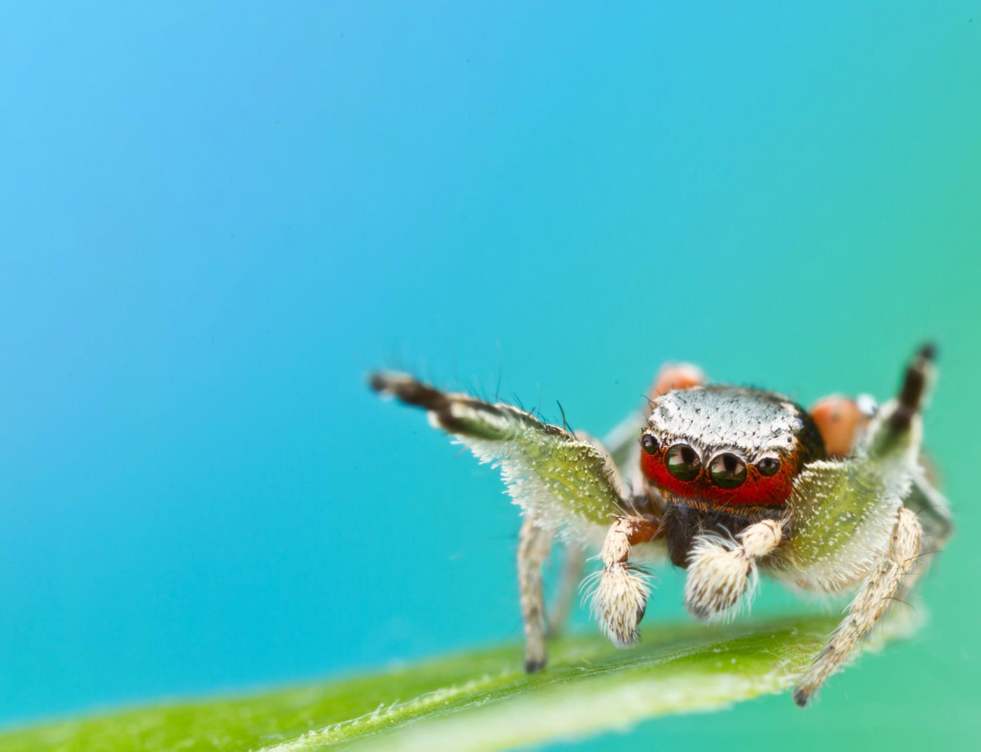
NATIONAL CENTER FOR CASE STUDY TEACHING IN SCIENCE
A Presentation to Accompany the Case Study:
Using the Scientific Method to Understand the Brilliant Colors of Male Jumping Spiders
^{by}
Michael E. Vickers and Lisa A. Taylor
Entomology and Nematology Department
University of Florida, Gainesville, FL
Notes:
Credit: Photo by Colin Hutton, used with permission.

Slide 2
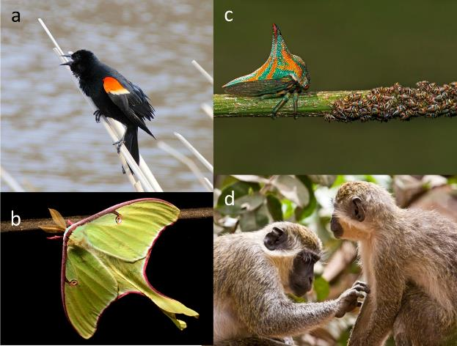
Notes:
Credits:
(a) red-winged blackbird by ritavida, CC BY-NC-SA 2.0, https://www.flickr.com/photos/30336501@N03/3599915960.
(b) luna moth by weanders, CC BY-NC-ND 2.0, https://www.flickr.com/photos/29032798@N05/3766344704.
(c) treehopper by Carlos De Soto Molinari, CC BY-NC-ND 2.0, https://www.flickr.com/photos/33005514@N04/14047158233.
(d) vervet monkeys by Andrew Burrows, CC BY-NC-SA 2.0, https://www.flickr.com/photos/78033600@N00/2417092758.

Slide 3
Notes:
Credits:
(a) peacock by MTSOfan, CC BY-NC-SA 2.0, https://www.flickr.com/photos/8628862@N05/8727563323.
(b) chameleon by neeravbhatt, CC BY-NC-SA 2.0, https://www.flickr.com/photos/74601184@N00/7738582570.
(c) monarch by shell game, CC BY-NC-ND 2.0, https://www.flickr.com/photos/36409008@N00/3780480957.

Slide 4
Notes:
Credits: Photos by Lisa A. Taylor.

Slide 5
Notes:
Credit: Taylor, L., and K. McGraw. 2013. Male ornamental coloration improves courtship success in a jumping spider, but only in the sun. Behavioral Ecology 24(4): 955–67. <https://doi.org/10.1093/beheco/art011>

Slide 6
Notes:
Credit: Taylor, L., and K. McGraw. 2013. Male ornamental coloration improves courtship success in a jumping spider, but only in the sun. Behavioral Ecology 24(4): 955–67. <https://doi.org/10.1093/beheco/art011>

Slide 7
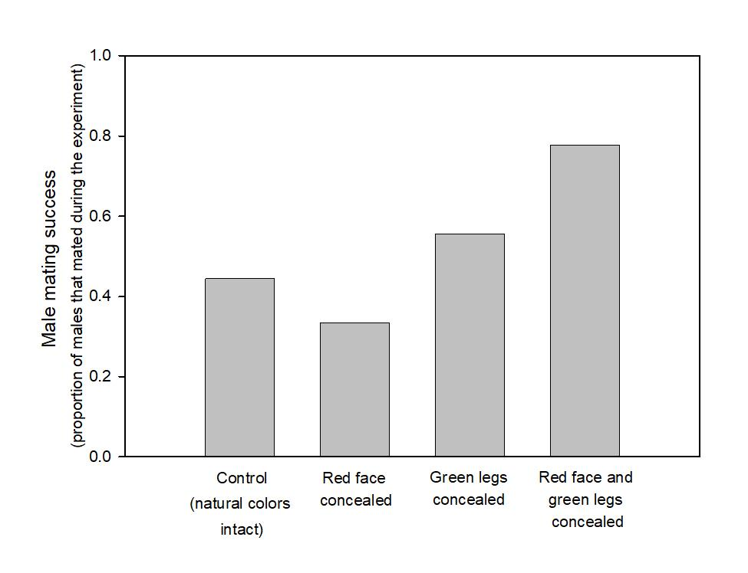
Notes:
Credit: Taylor, L., and K. McGraw. 2013. Male ornamental coloration improves courtship success in a jumping spider, but only in the sun. Behavioral Ecology 24(4): 955–67. <https://doi.org/10.1093/beheco/art011>

Slide 8
Notes:
Credit: Taylor, L., and K. McGraw. 2013. Male ornamental coloration improves courtship success in a jumping spider, but only in the sun. Behavioral Ecology 24(4): 955–67. <https://doi.org/10.1093/beheco/art011>

Slide 9
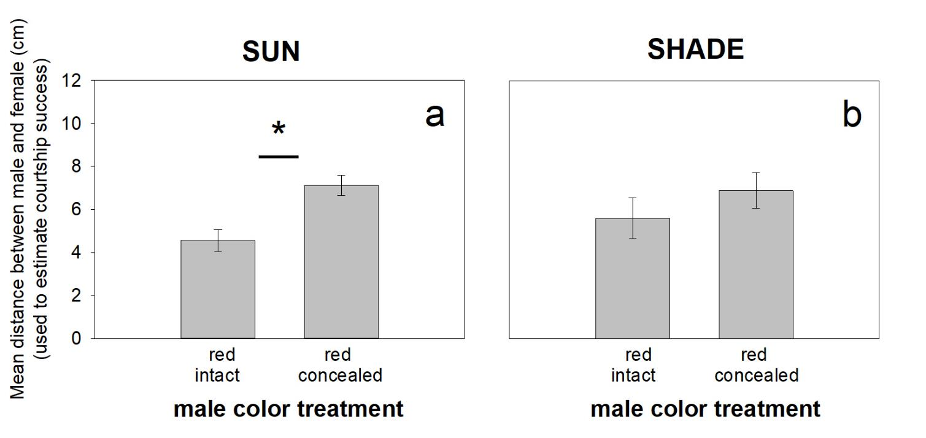
Notes:
Credit: Taylor, L., and K. McGraw. 2013. Male ornamental coloration improves courtship success in a jumping spider, but only in the sun. Behavioral Ecology 24(4): 955–67. <https://doi.org/10.1093/beheco/art011>

Slide 10
Notes:
Credits: Photos by Lisa A. Taylor.

