Slide 1

NATIONAL CENTER FOR CASE STUDY TEACHING IN SCIENCE
A Presentation to Accompany the Case Study:
A Misdiagnosed Odyssey:
Identifying the Origin of
Chronic Joint Instability
by
Marian Leal
Department of Biology
Sacred Heart University, Fairfield, CT
Notes:
Credit: Licensed image © Socrates | Dreamstime.com, id 1652775.

Slide 2
What Causes Ehler Danlos Syndrome?
Ehler Danlos Syndrome is an inherited connective tissue disorder.
Defective connective tissue leads to very flexible joints and an increased risk to injury.
Ehler Danlos Syndrome involves problems with how your tendons attach to your bones as the tendons are too lax.
Patients tend to have velvety skin that is highly elastic with poor wound healing.
There are 13 different types of EDS.

Slide 3
Types Of EDS
13 kinds of EDS that involve complex issues with joint stability.
The most serious form of EDS is vascular EDS (vEDS).
Patients with vEDS have weakened blood vessel walls that can rupture, which can lead to internal bleeding & be life threatening.
The least serious type of EDS is hypermobility of the shoulder.
Other types may cause problems specific to a patient’s cornea or create skeletal abnormalities depending on the type of EDS.
Classical EDS affects multiple organ systems over time.

Slide 4
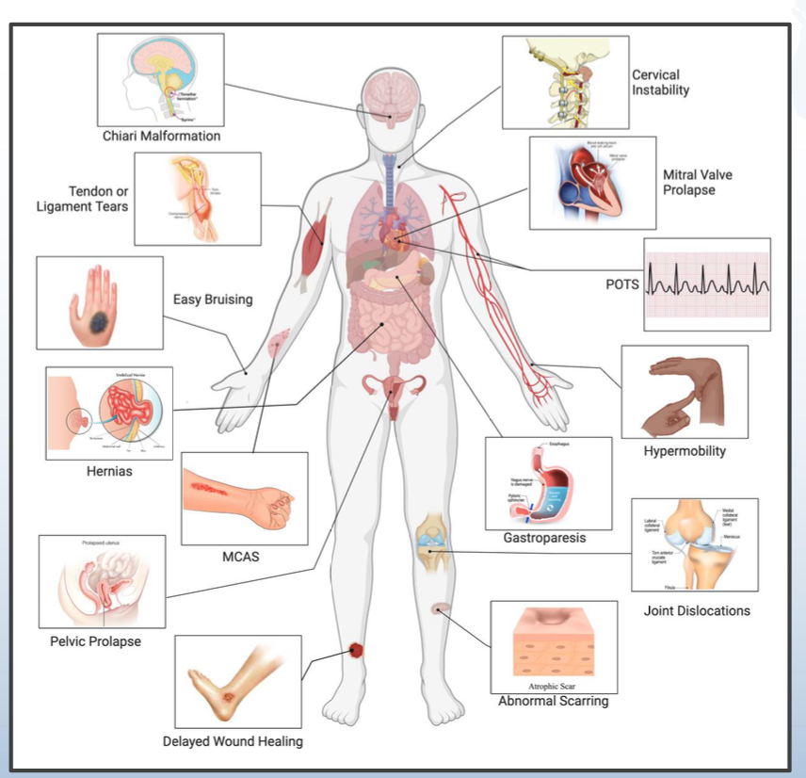
Ehler Danlos Syndrome can present in a variety of different ways.
It weakens connective tissue and can frequently occur in multiple areas of the body, which makes diagnosis challenging.

Slide 5
How Common is it for Patients to Have Pain with EDS?
PAIN SURVEY –
2768 people with EDS
Do you have chronic pain?
(Pain that lasts for longer
than 3 months).
Yes (2689, 97.1%)
No (79, 2.9%)
Pain is present in approximately 90% of people with joint instability.
Pain can extend beyond the joints to include organs that are affected.
EDS occurs on a spectrum of severity and presentation, and is likely to worsen overtime.

Slide 6
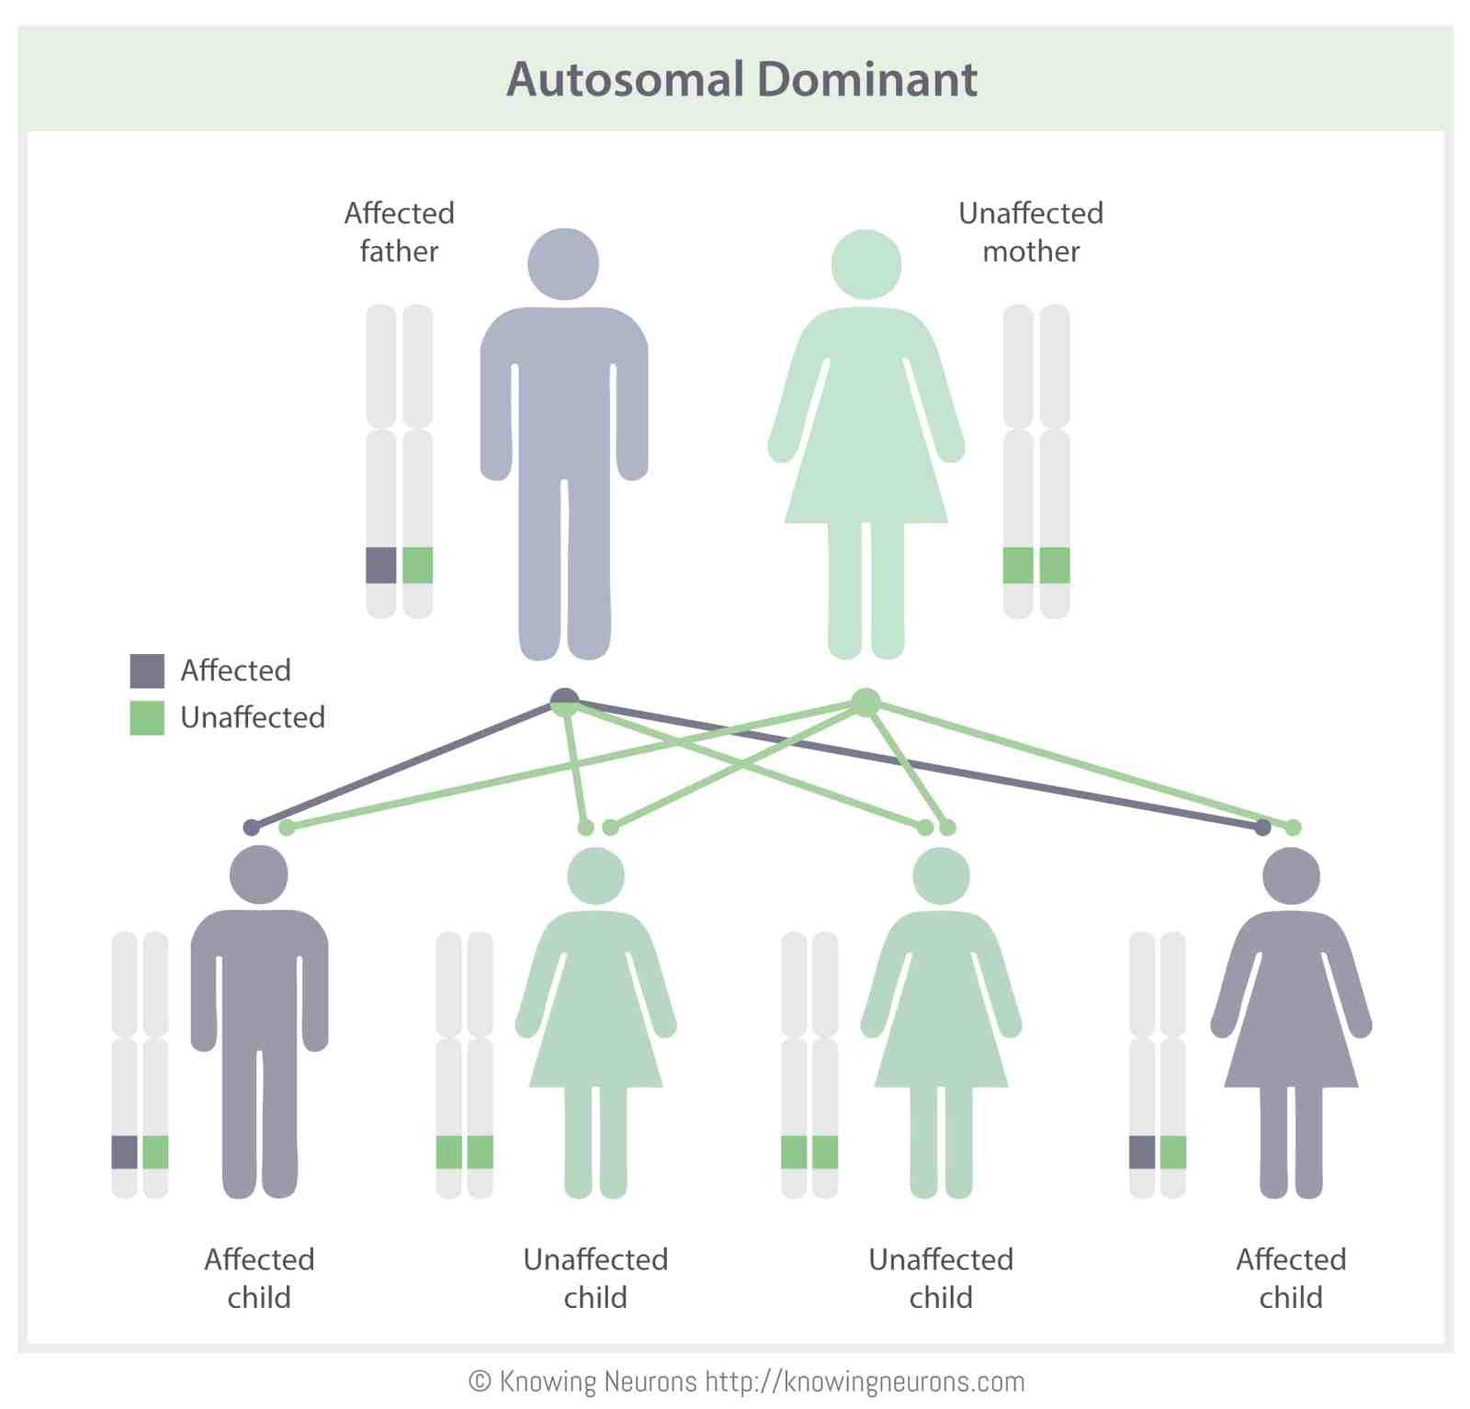
EDS is a Genetic Mutation that Can Be Inherited
This figure shows that some forms of EDS are inherited via autosomal dominance.
Some forms of EDS have a different recessive pattern.
This Photo by Unknown Author is licensed under CC BY-NC-ND

Slide 7
Genetic Testing Can Help Diagnosis Each Type of EDS
All subtypes of EDS have a known genetic mutation except hypermobility of the shoulder.
EDS can be inherited in an autosomal recessive manner or autosomal dominant; it can also occur due to reasons unknown.

Slide 8
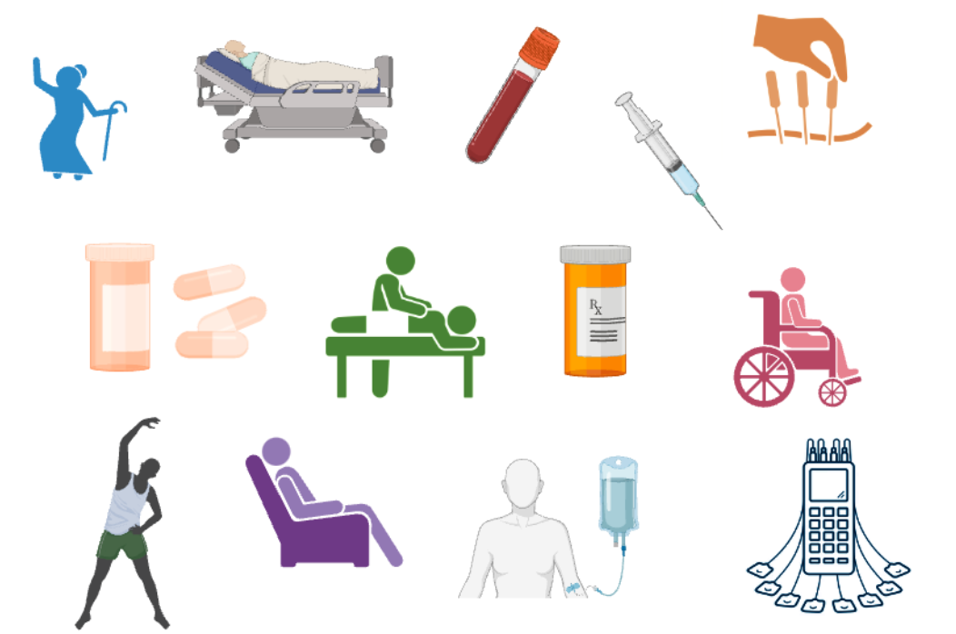
How Can Individuals with Ehler Danlos Syndrome Alleviate Pain?
Tailored exercise programs designed for hypermobility.
Consider working with a dietician for managing GI symptoms.
Pain can be managed with medications, but some of these pain medications can become addictive.
MRI and CT scan can be used to identify the source of pain.
In advanced stages patients may need oxygen, braces on the limbs, and long periods of rest.

Slide 9
Video
Video on shoulder hypermobility
www.facebook.com/ehlers.danlos/videos/12-24/10155826213020336/

