Slide 1
Environmental Disaster in Honolulu Harbor:
NATIONAL CENTER FOR CASE STUDY TEACHING IN SCIENCE
A Presentation to Accompany the Case Study:
Knowing and Doing the Right Thing
by
Prescott C. Ensign
Lazaridis School of Business and Economics
Wilfrid Laurier University, Waterloo, Ontario, Canada

Slide 2
Notes:
Airport runway on left. North into harbor is a kayak and paddleboard rental. Islands are bird sanctuaries. Sailing programs for kids occur in the vicinity. Red dot/pin is the harbor. Waikiki beach lower right. University of Hawaii far right.
Would the harbor with considerable boat traffic not already be polluted? How pristine could it be if it was dredged, etc.?

Slide 3
Molasses spilled in the harbor
September 2013
Holding tanks on the dock, leak (slow?) from pipes while loading onto Matson ship (no instrumentation to monitor transfer/flow/or loss)
1,400 tons = 233,000 gallons of molasses
Coral, seabed, and creatures covered
26,000+ fish and other marine species immediately suffocated and died

Slide 4
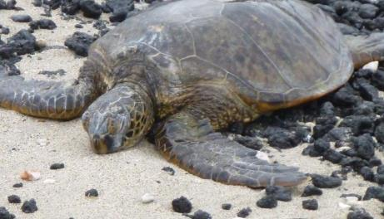
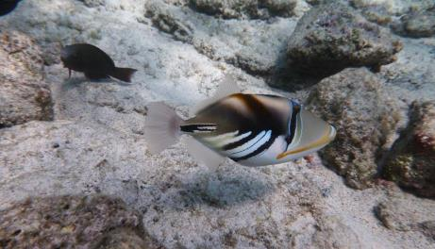
Everything down there is dead. It was shocking because the entire bottom is covered with dead fish... I didn’t see one single living thing underwater.
– Roger White, diver with video camera
This is the worst environmental damage to sea life that I have come across.
– Gary Gill, Deputy Director Hawaii Department of Health
Unlike an oil spill, which can be cleaned by skimming the surface, the molasses quickly disperses to the deepest points. It’s sucking up all the oxygen.
– Dave Gulko, State of Hawaii Biologist
Because the spill happened in a harbor there’s less circulation than in the open ocean, it could be months or possibly years before the molasses is completely washed away.
– David Field, professor, Hawaii Pacific University
Notes:
“Everything down there is dead. It was shocking…” let audience read the rest of the quote. Pause for a few moments, no need to read names or job titles.
“This the worst environmental damage to sea life…” pause for a moment.
Point at screen “it can’t be skimmed” it sinks, it does not float. In this anaerobic state, life ceases.
With no water circulation molasses won’t dissipate.

Slide 5
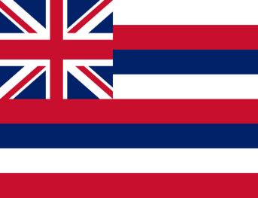
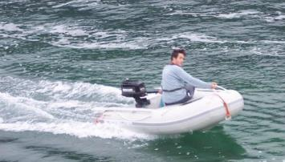
Hawaii Department of Transportation
Overall responsibility for the operations of the harbor.
US Environmental Protection Agency – not a controlled substance (it’s edible). Regulations, requirements, systems, procedures – all lacking.
Leak in the pipeline – whose pipe is it? Matson Transport says: Came with the space we rented. Not my fault.
It gets worse. Concerns and alerts were raised prior. Inspectors followed up and said it looked OK.
How long before leak was detected…
Looks good to me!
Notes:
HDOT has authority and responsibility for the harbor. US EPA either says molasses is OK or is silent on the matter.
It turns out leaky pipes don’t leak when they are empty.
It was overnight before a leak was noticed. No active monitoring of molasses out of the tank vs. what’s loaded into the boat – something which is done with more valuable cargo and more dangerous cargo (oil).

Slide 6
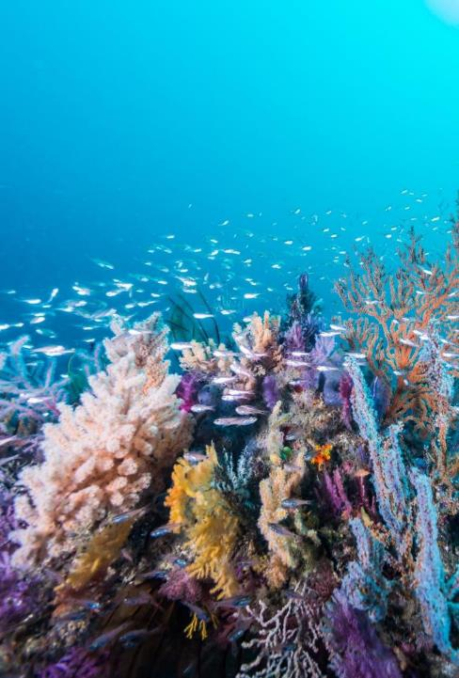
Question 1
From a science perspective, why did molasses cause significant environmental damage to Honolulu Harbor’s marine life and ecosystem?

Slide 7
Question 2
What role did poor decisions and negligence play in this disaster? Were they the major contributors to this disaster?

Slide 8
Table 1. Role that Poor Decisions and Negligence Played in the Disaster
Event/Date | HDOT | Matson, Inc.

Slide 9
Question 3
Did Matson, Inc. exercise reasonable care in managing pipeline operations that transported molasses from storage tanks to their cargo ship in the harbor?
What steps could Matson, Inc. have taken to prevent this disaster?

Slide 10
Question 4
Did Hawaii Department of Transportation (HDOT) exercise reasonable care in carrying out its public responsibility for ensuring the safety and integrity of Honolulu Harbor?
How could the government agency (HDOT) that has control over the harbor area have prevented this disaster?

Slide 11
Question 5
What role did concerns for environmental stewardship, economic interests and ethical values play in the behavior of Matson, Inc., HDOT and their personnel?
How could the government agency (HDOT) that has control over the harbor area have prevented this disaster?

Slide 13
Table 2. Summary of Decision-Making Framework Used by Matson, Inc., HDOT and Their Personnel
Framework | HDOT | Matson, Inc.
Environmental Stewardship
Economic Interests
Ethical Values

Slide 14
Three ethics approaches for decision-making
Utilitarian approach (focus on outcome or results)
Deontology approach (focus on rules or duty)
Rights approach (focus on treatment of others)

Slide 15
Question 6
What is your perception of the overall pattern of decisions and actions in the case?
What do you think is the most important lesson to take away from this case?
How will this impact your behavior in a future work situation?

Slide 16
End here
Remaining slides are optional and may be incorporated at instructor’s discretion. Instructors may pick and choose those slides that suit their needs.

Slide 17
Blame game
Notes:
OPTIONAL SLIDE (can be used after slide #3). [Just a few seconds and then next slide, unless instructor wishes to create some ‘open space’ for students to jump in.] Lots of finger pointing of course, obfuscate!

Slide 18
Cover up
Now is a good time to destroy e-mail correspondence. Circle the wagons and… discredit whistleblowers.
Notes:
OPTIONAL SLIDE (can be used after slide 4). In additional to deflecting blame, one can be proactive in preventing information from being revealed.

Slide 19
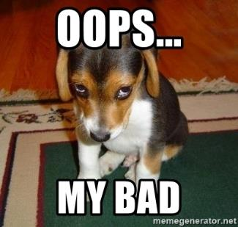
Who steps forward… and when?
cover
your
butt
Put the mid-level managers in front of the media (firing line) first.
When it doesn’t blow over… Eventually, top level people on both sides do a mea culpa.
Admit didn’t (back peddle… ahem, couldn’t) tell the truth.
Notes:
OPTIONAL SLIDE (can be used with the previous slide). From “cover your butt” to admitting you were wrong. Initially some mid-level managers were put in front of the media frenzy. When that tactic does not work…
HDOT and Matson jointly hold news conference – everyone does their best to look contrite, but they carefully stay on message.
Cannot even be truthful about telling the truth.

Slide 20
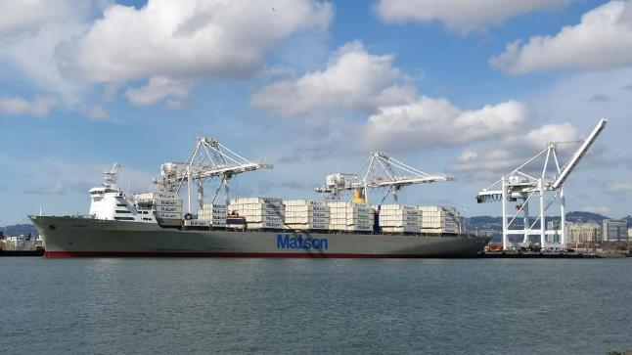
Someone has to pay, someone’s at fault.
Profits and public image are important to Matson – they are huge in Hawaii. Began in 1882, $2 billion today, 2,000 employees, HQ is Honolulu. (communications, public/community relations, trust recovery).
“Unprecedented” – no, actually this has happened a few times to Matson, not Oahu, but on other islands.
Solution, find a scapegoat – have someone else take liability for this part of the chain of operation.
Make loading molasses some other legal entity’s problem.
Notes:
OPTIONAL SLIDE (can be used with previous slide). In additional to standard Corporate Social Responsibility topics and theory, there is a field of communications (which has theory) regarding relationships and recovery - something most students have rarely heard of.
Matson began in 1882. Matson and Hawaii have grown together. They are symbiotic. Or cynically, is Matson parasitic? Matson’s headquarters is in Honolulu.
Even if loading molasses is profitable, the public exposure (downside) was likely too much. So, spin off this bad piece of the value chain.

Slide 21
Legal fees and other atrocities.
Firm that tackled the 2010 BP oil spill in the gulf of Mexico would represent the State of Hawaii for 15% of winnings or $695 per hour – whichever is higher.
Federal civil and criminal claims against Matson.
>Matson plea agreement = pay $1 million. $400,000 fine, $300,000 for coral programs and invasive algae clean up, and $300,000 to Sustainable Coastlines.
> Matson settles claims agreeing to pay $5.9 million to State of Hawaii in compensation for fish and coral. Agrees to clean up the Sand Island terminal, removing molasses tanks and risers (claiming estimated cost $5.5 million to $9.5 million – pay themselves to do the work?).
EPA could still pursue charges with the Hawaii Department of Health.
Notes:
OPTIONAL SLIDE (can be used at any point to highlight the financial/legal side)

Slide 22
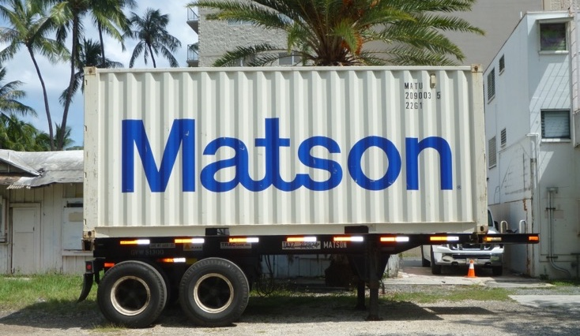
Matson no longer shipping molasses (from Honolulu, Oahu)
Molasses now being shipped directly from Kahului, Maui in a “vessel managed by a third party.”
Matson is big, real big. Pretty much everything on or off the islands goes via Matson.
Notes:
OPTIONAL SLIDE (can be used to debrief or further extend discussion). Author photo of Matson small sea can (ocean going sea container) in a residential area of Oahu. Matson is ubiquitous on the Hawaiian islands.

Slide 23
natural environment thumbs up, economics thumbs down
Hawaiian Commercial & Sugar ceases sugar cane production (burning fields and resulting air pollution was alarming locals and outsiders), molasses (a byproduct) will no longer be produced. 675 workers laid off at the end of the 2016 sugar cane harvest.
Notes:
OPTIONAL SLIDE (further debrief and costs and benefits). Things improve environmentally, but not necessarily economically.

Slide 24
Matson values - guiding principles in serving shareholders, customers, employees, and communities:
Integrity: We conduct all we do on behalf of Matson with respect, candor and honesty.
Accountability: We strive to fulfill commitments 100% of the time, and when we fall short, we acknowledge, recover and learn from our mistakes.
Teamwork: We leverage our resources and diverse talent to achieve superior results.
Achievement: We promote individual and organizational success.
Innovation: We value creativity, initiative and agility.
Safety: We make workplace safety our highest priority both on land and at sea.
Environment: We are a leader in environmental stewardship and consider the environment in all we do.
Community: We contribute positively to the communities in which we work and live.
Rich History: We have a long, proud history that we honor in all we do.
Notes:
OPTIONAL SLIDE (what organizations say vs. what organizations do). Students can dissect or at least inspect these in the classroom. Source: Matson.com mission, vision and values

Slide 25
https://www.youtube.com/watch?v=CjiBc8DSJaI Aloha!
King Kamehameha
Notes:
The above clip is from 16 September 2013; there are other clips included at the end of the Teaching Notes that could be used instead of or in addition to the above clip.
King Kamehameha statue is in front of the Hawaii’s State Supreme Court, students may recognize the statue from popular culture (e.g., tv show “Hawaii 5-0”) but likely do not know where it is located (in front of judiciary) and that it is several hundred meters from Honolulu Harbor.

Slide 26
Boston 1919 21 dead, 150 injured
10 x the scale of Honolulu
2.3 million gallons of molasses.
Class action lawsuit, was the inception of corporate liability in the United States.
Corporate social irresponsibility: discredit survivors, fabricate ‘anarchists’ as the culprit.
Businesses are above the law. Courts agree.
photo from Boston Public Library
Notes:
A bit of history; not the first catastrophic molasses spill. Tank burst, 25-foot-high wave travelled 35 mph. It has been argued that this is ground zero for modern corporate social responsibility at least in America. One person in the lower center is dressed in white.

