Slide 1
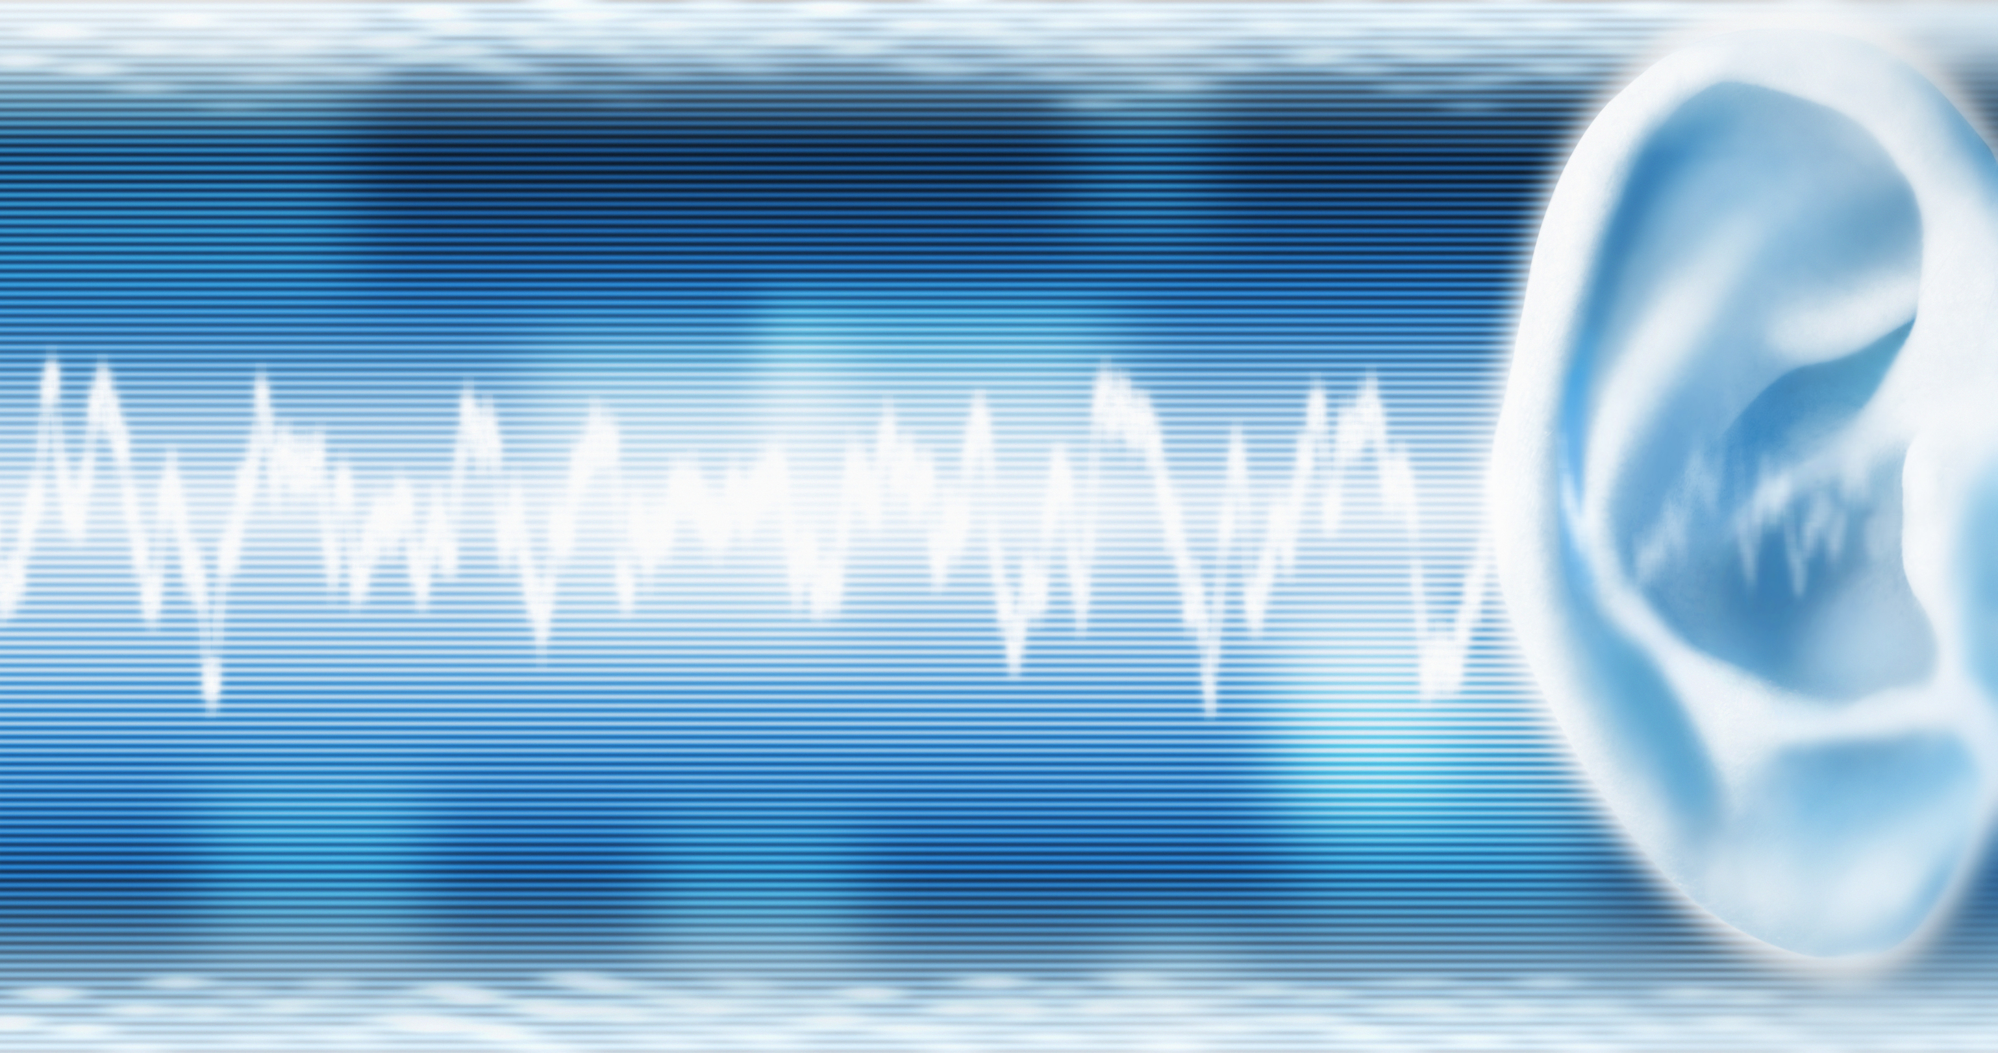
NATIONAL CENTER FOR CASE STUDY TEACHING IN SCIENCE
A Presentation to Accompany the Case Study:
^{A “Deafinite” Cause for Alarm:}
A Case Study in Hearing Physiology
by
Rebecca T. Garlinger, Patrick K. Mitrano-Towers, Kevin S. Innella, & Philip J. Stephens
Department of Biology
Villanova University, Villanova, PA
Notes:
Image credit: © Gary Cornhouse | Dreamstime.com, id 4422584, licensed.

Slide 2
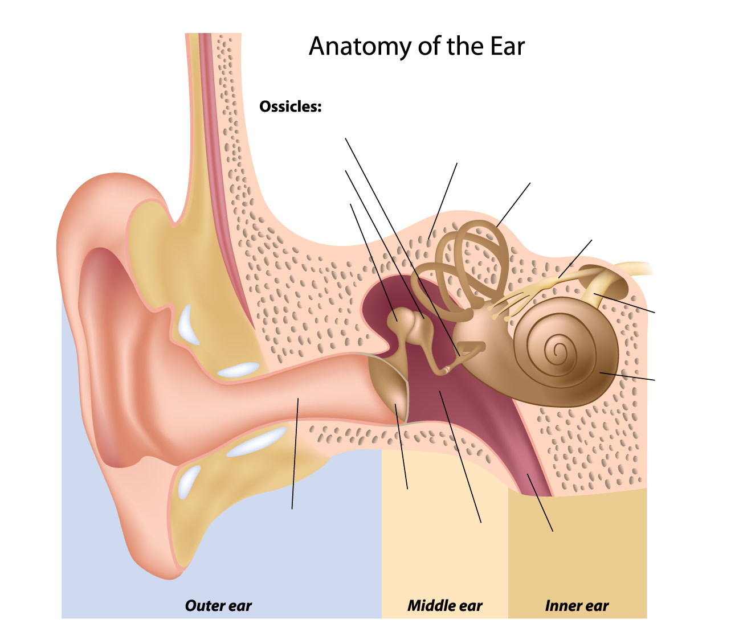
Notes:
Image credit: © Alila07 | Dreamstime.com, id 19931473, licensed.

