Slide 1
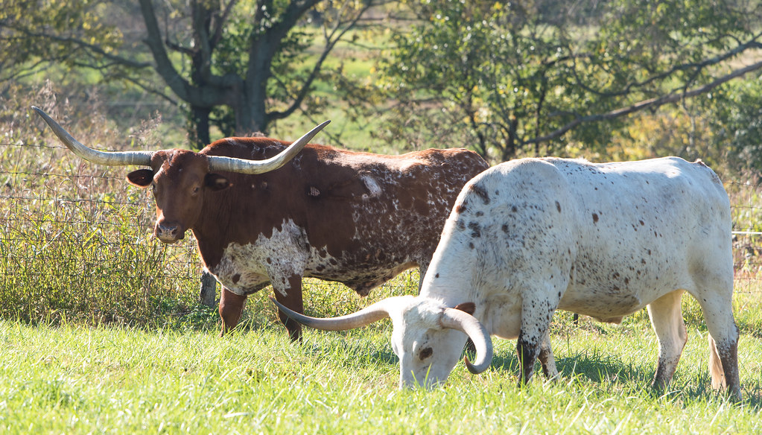
NATIONAL CENTER FOR CASE STUDY TEACHING IN SCIENCE
A Presentation to Accompany the Case Study:
The Grass is Greener in Kentucky
^{by}
^{Thomas S. Nühse}
^{School of Biological Sciences}
The University of Manchester, United Kingdom
Notes:
Longhorns grazing. Image by Anthony Neff via Flickr, CC BY-ND 2.0 Available at https://www.flickr.com/photos/26424952@N00/38219583576

Slide 2
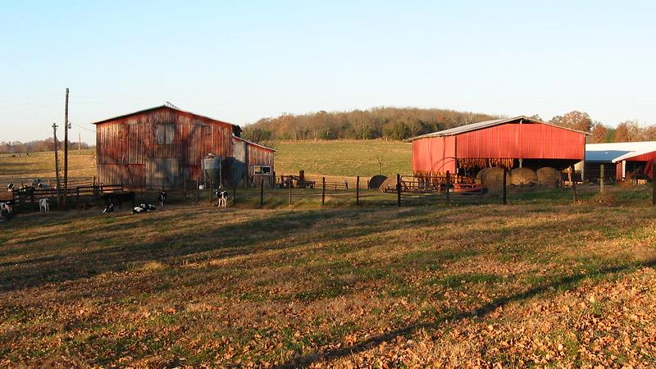
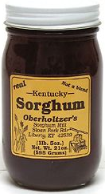
Notes:
One fine October day almost a hundred years ago, agricultural experts from the University of Kentucky went to a county fair in Frenchburg. After judging a sorghum syrup contest -Sorghum is a big deal in Kentucky! -, one of the experts was approached by a farmer who talked excitedly of a “wonder grass” growing on his neighbour Bill Suiter’s farm.
Kentucky, by Paula Soler-Moya (CC BY-NC-ND 2.0) https://www.flickr.com/photos/40351463@N00/539025874/sizes/l/
A jar of sweet sorghum syrup, by Tom Esrey (Public Domain) https://en.wikipedia.org/wiki/Sweet_sorghum#/media/File:Sorghum_jar.jpg

Slide 3
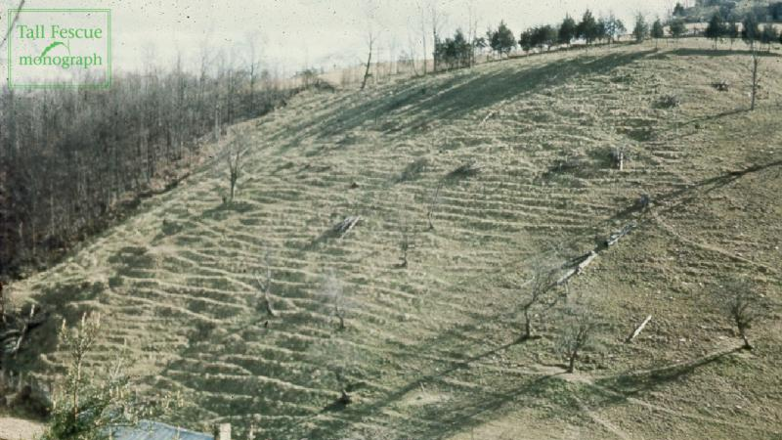
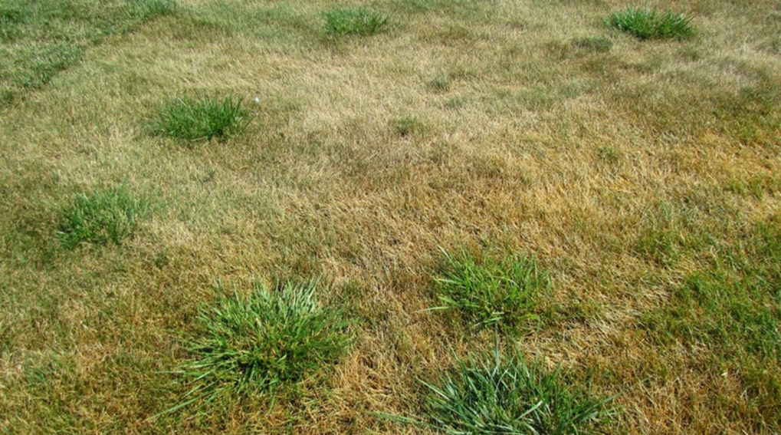
Notes:
Dr Fergus was persuaded to visit, and the wonder grass did not disappoint – growing on a steep hillside pasture, it had remained green and lush despite the severe drought that summer. Bill claimed it had even stayed green through most of the winter. Dr Fergus identified it as Tall Fescue, a grass species that originally came from Europe and had been introduced to the U.S. sometime in the 1800s.
Hillside pasture on William Suiter Farm, Manifee County, KY (Photo courtesy of International Plant Nutrition Institute, Norcross, GA; published in Southern Forages, 1996.) In: Hoveland, C. S., 2009. Origin and History. Chapter 1; In: H.A. Fribourg, D.B. Hannaway, and C.P. West (ed.) Tall Fescue for the Twenty-first Century, Online Monograph. Oregon State University; Available at https://forages.oregonstate.edu/tallfescuemonograph/figures/1-1
The online version of the Tall Fescue for the Twenty-first Century monograph, copyrighted by Oregon State University in 2009, can be accessed at http://forages.oregonstate.edu/tallfescuemonograph. Reproduction of any portions of the text, figures, graphs, tables and images is permitted for non-commercial educational purposes only, provided that proper credit to Oregon State University is given, citing the publication, its source, and the date of publication. (https://forages.oregonstate.edu/tallfescuemonograph/toc)
Tall fescue (green clumps) in a Kentucky bluegrass turf during a summer drought. © Aaron J. Patton Available at https://turf.purdue.edu/weed-of-the-month-for-march-2015-is-tall-fescue/

Slide 4
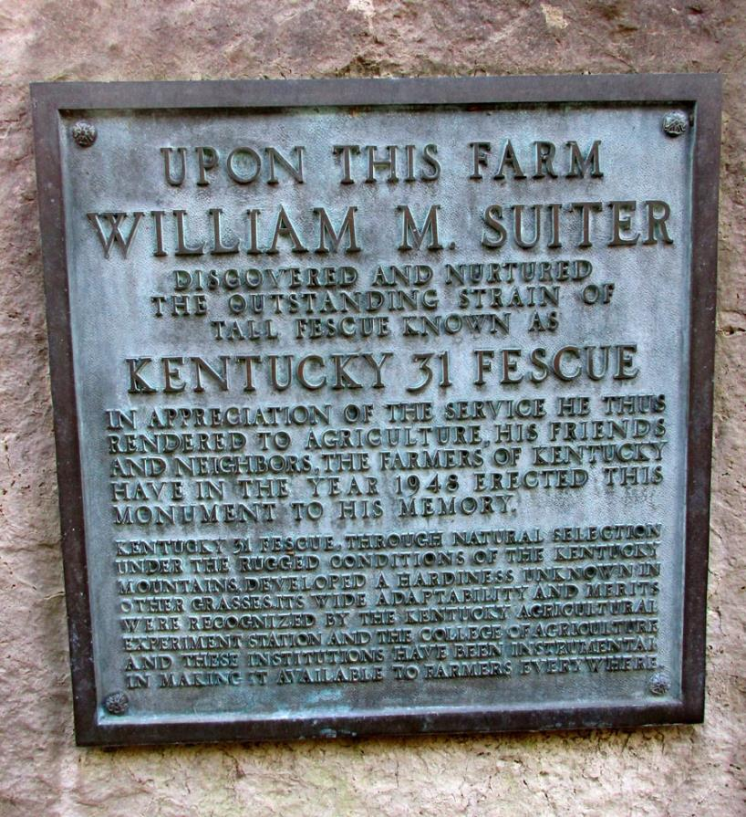
Notes:
Starting with a good handful of seed from Suiter’s farm, Fergus and colleagues developed the cultivar "Kentucky 31" and released it to farmers in 1943.
Plaque commemorating the breeding of tall fescue Kentucky 31 in Frenchburg, KY. Photo by Tom L. Byron. Available at
https://2.bp.blogspot.com/-t4rBwfG57b0/Vrd4G4y0mzI/AAAAAAAABP8/cMgpWLHIjD4/s320/plaque%2B3.jpg (from http://thekyfiles.blogspot.com/2016/01/roadside-menifee.html)

Slide 5
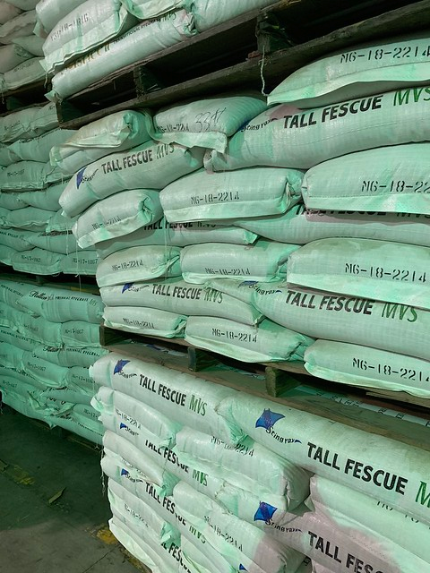
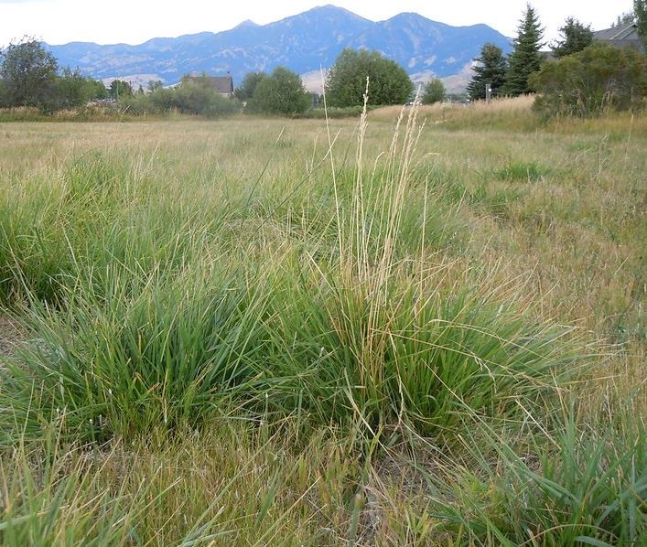
Notes:
Fescue came to be viewed as a wonder grass that grows on a wide variety of soil types, slows down erosion and resists both summer drought and winter cold. This meant nutritious fresh grass for cattle at times when it used to be in short supply. Kentucky 31 became wildly popular and is today still one of the most widely grown forage and turf grasses in the US.
Tall fescue grass seed at the Pratum Co-op seed processor facility in Salem, OR. Oregon Department of Agriculture (CC BY-NC-ND 2.0) Available at https://www.flickr.com/photos/oragriculture/46678963875/sizes/l/
Schedonorus arundinaceus (= Festuca arundinacea, Tall Fescue) rebounding more than other grasses after a late summer mowing. Matt Lavin (CC BY-SA 2.0) Available at https://www.flickr.com/photos/plant_diversity/6166354379/in/album-72157687930230546/

Slide 6
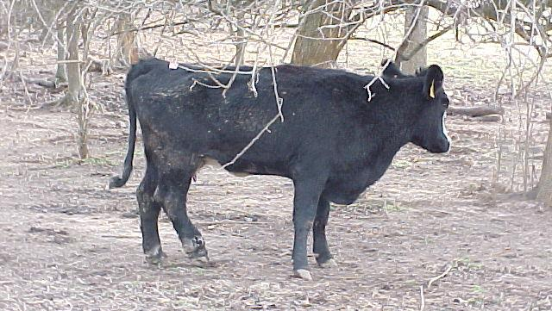
Notes:
Soon after the release of Kentucky 31, reports came in of dairy farmers who claimed it was unpalatable for their cattle. Beef producers noticed that animals who had fed on fescue were slow to gain weight. Dairy cows produced less milk. Sometimes the animals developed particularly nasty sores and ultimately a kind of gangrenous condition that came to be known as "fescue foot".
A cow with an advanced stage of fescue foot and no chance of recovery. Photo by Eldon Cole, University of Missouri Extension (CC BY-NC 2.0). Available at https://www.flickr.com/photos/muextension417/6471943377/sizes/o/

Slide 7
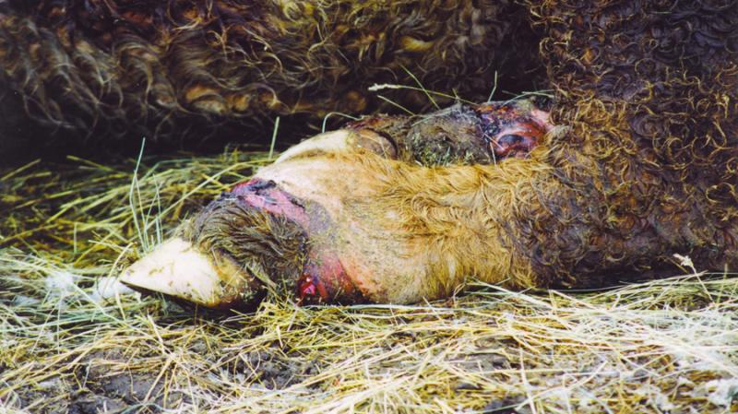
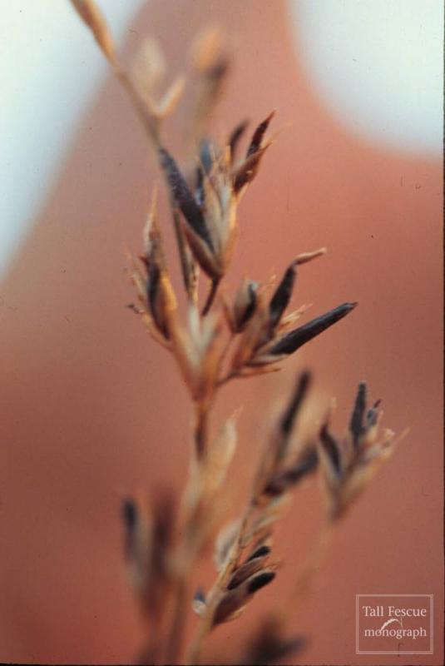
Notes:
Some experts noticed that the symptom looks a lot like Ergot poisoning, aka St Anthony's fire. Both humans and animals notoriously convulse and develop gangrene after eating grains contaminated with the ergot fungus, Claviceps purpurea. However, the ergot fungus is easy to spot even for non-experts, and there was never any outward sign of ergot or other fungi on the fescue grass that caused toxic symptoms.
Fig. 16-3. Cattle leg suffering from fescue foot. (photo: David Bohnert) This high-resolution version from https://dl.sciencesocieties.org/publications/csa/articles/61/12/4
Fig. 24-3. Fine fescue (Festuca spp.) with sclerotia of Claviceps purpurea.
Source: Waller, J.C (2009). Endophyte effects on cattle (Chapter 16) and Alderman, S.C; Pfender, W. and Ocamb, C.M. (2009). Diseases in seed production (Chapter 24); In: H.A. Fribourg, D.B. Hannaway, and C.P. West (ed.) Tall Fescue for the Twenty-first Century, Online Monograph. Oregon State University; Available at https://forages.oregonstate.edu/tallfescuemonograph/Figures/16-3 and https://forages.oregonstate.edu/tallfescuemonograph/Figures/24-3
The online version of the Tall Fescue for the Twenty-first Century monograph, copyrighted by Oregon State University in 2009, can be accessed at http://forages.oregonstate.edu/tallfescuemonograph. Reproduction of any portions of the text, figures, graphs, tables and images is permitted for non-commercial educational purposes only, provided that proper credit to Oregon State University is given, citing the publication, its source, and the date of publication. (https://forages.oregonstate.edu/tallfescuemonograph/toc)

Slide 8
The role of the U.S. federal bureaucracy adds an interesting aspect to this story. On June 13, 1973, J.D. Robbins visited the A.E. Hays farm near Mansfield, GA and observed severe fescue toxicosis signs on beef cattle in one tall fescue pasture but none in three adjacent pastures of this grass (Robbins, 1983). Reporting this exciting find to his laboratory chief at the Russell Research Center, he requested permission to return and sample the pastures […] but was denied leave to travel, as apparently this was not considered a worthwhile pursuit (correspondence from J.A. Robertson to D. Burdick, with copy to J.D. Robbins, 1973). The next day he departed without official leave in his personal vehicle and sampled the pastures on the Hays farm.
Non-toxic
Fence
Fence
Not tested
Non-toxic
Toxic
Lake
Toxic
Notes:
On some farms, two cattle herds were grazing two tall fescue pastures separated only by a fence. Only one of the herds exhibited fescue toxicity symptoms; the other was fine.
Diagram is based on Tall Fescue: The Good, the Bad, and the Ugly. Dennis Hancock, University of Georgia. Available at https://slideplayer.com/slide/13273487/ [slide 10]
Text Source: Hoveland, C. S., 2009. Origin and History. Chapter 1; In: H.A. Fribourg, D.B. Hannaway, and C.P. West (ed.) Tall Fescue for the Twenty-first Century, Online Monograph. Oregon State University; Available at http://forages.oregonstate.edu/tallfescuemonograph/history/toxicity_cause
The online version of the Tall Fescue for the Twenty-first Century monograph, copyrighted by Oregon State University in 2009, can be accessed at http://forages.oregonstate.edu/tallfescuemonograph. Reproduction of any portions of the text, figures, graphs, tables and images is permitted for non-commercial educational purposes only, provided that proper credit to Oregon State University is given, citing the publication, its source, and the date of publication. (https://forages.oregonstate.edu/tallfescuemonograph/toc)

Slide 9
More mysteries around tall fescue:
On some farms, two cattle herds were grazing two tall fescue pastures separated only by a fence. Only one of the herds exhibited fescue toxicity symptoms; the other was fine.
If you harvest fescue seeds from the “toxic pasture” and sow them, those plants are toxic again. Seeds from the non-toxic pasture produce non-toxic plants.
When seeds from toxic plants are stored for a year or more, especially in very warm conditions like a grain silo, most plants grown from them are less toxic. Hay from toxic meadows gradually becomes less toxic during winter storage.

Slide 10
How do you explain fescue toxicity?
Try to think of multiple hypotheses that explain why Tall Fescue is generally, but not always, toxic.
Consider which ones you can dismiss because they contradict one or more of the findings.
Choose your best hypothesis and outline how you would test it experimentally.

Slide 12
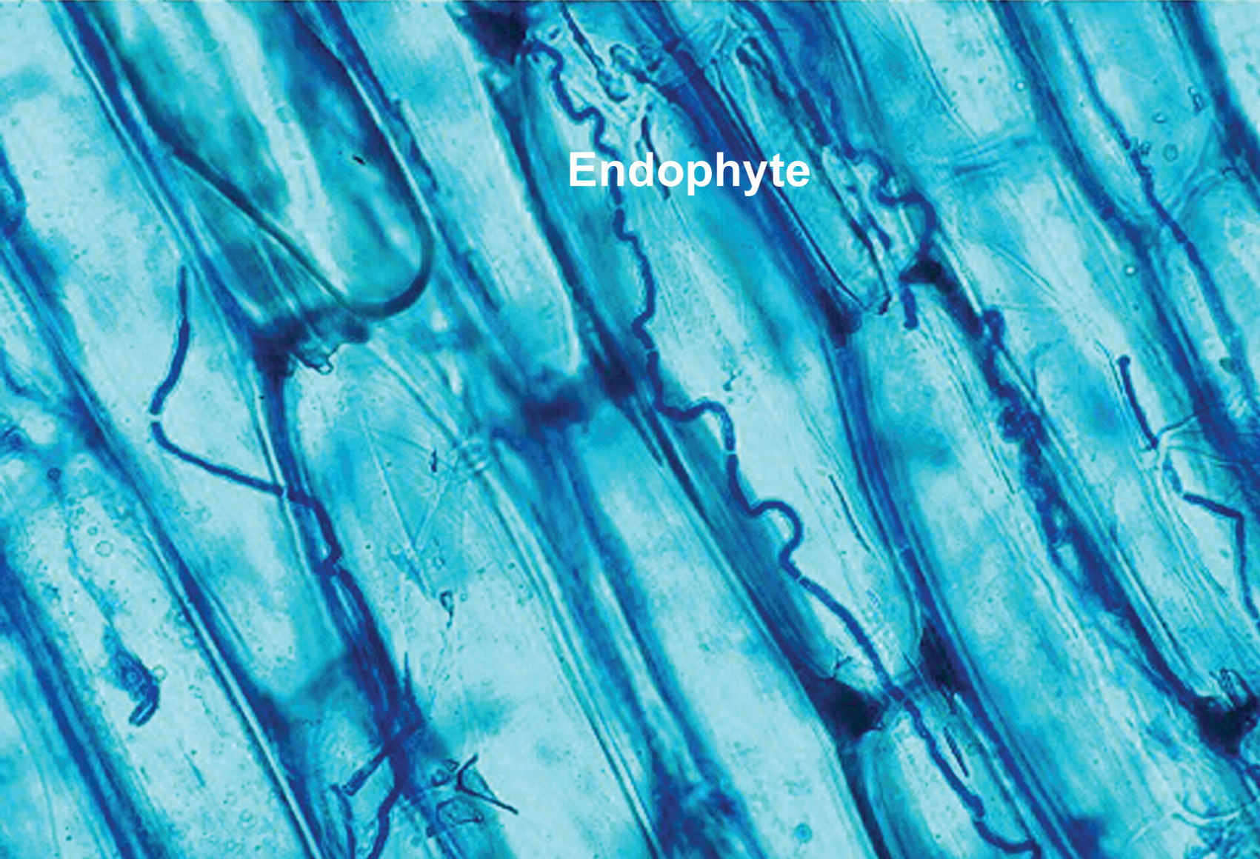
Epichloë coenophiala
Notes:
It took scientists a long time to find the answer.
Turns out that all of the symptoms of fescue toxicosis were caused by fescue infected with a fungus, Epichloë coenophiala, that grows entirely within the plant - a so-called endophyte. You can’t see it from outside.
Blue-stained serpentine Neotyphodium coenophialum mycelia inhabiting the intercellular spaces of tall fescue leaf sheath tissue. Magnified 400x
Photo by Nick Hill, USDA. Available at https://en.wikipedia.org/wiki/Epichlo%C3%AB_coenophiala#/media/File:Neotyphodium_coenophialum.jpg (Public Domain)

Slide 13
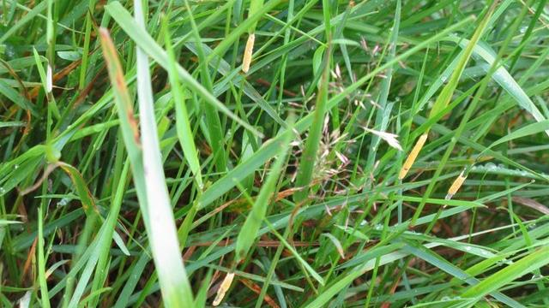
Epichloe typhina infected grass ("choke")
Notes:
This fungus is closely related to one that causes choke disease where a furry “collar” of fungal mass seems to strangle the plant.
Epichloe typhina infected grass ("choke"). Image by M J Richardson via www.geograph.org.uk (photos 1410180 and 1410230), CC BY-SA 2.0

Slide 14
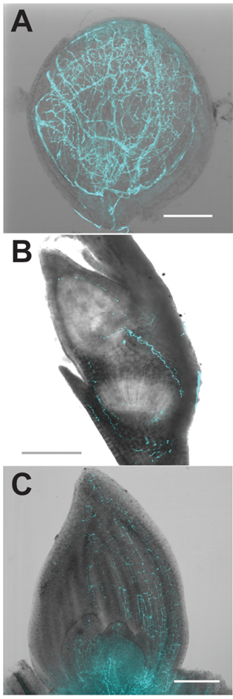
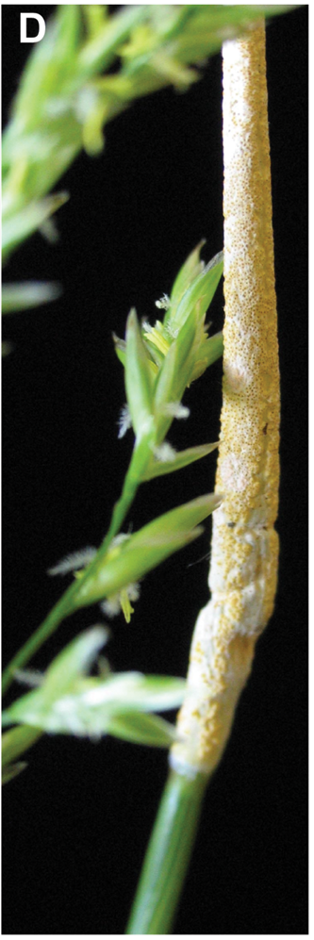
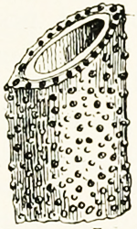
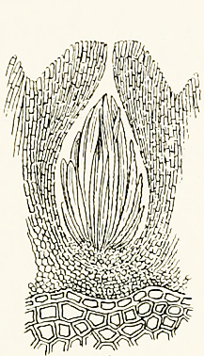
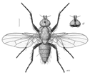
New infection
Fungus infects ovule
…and grows throughout the plant
…infects embryo and so seed
Sexual cycle
Sexual spore production
Asexual cycle
Seed germinates; fungus infects meristem…
Fertilisation
Fly carries spermatia
Notes:
The choke pathogen at first grows inside the plant without harming it, but then switches to a sexual life cycle and breaks out to form that “collar”. This attracts small flies that help with fertilisation; sexual spores form and can be spread around.
However, “our” endophyte E. coenophiala does not do that. As far as we know, it stays within the plant, causes no damage, never breaks through and never produces sexual spores. It can’t spread from one plant to another, except to the next generation via seeds.
Photos from Schardl CL, Young CA, Hesse U, Amyotte SG, Andreeva K, Calie PJ, et al. (2013) Plant-Symbiotic Fungi as Chemical Engineers: Multi-Genome Analysis of the Clavicipitaceae Reveals Dynamics of Alkaloid Loci. PLoS Genet 9(2): e1003323. https://doi.org/10.1371/journal.pgen.1003323
Figure 1. Symbiosis of meadow fescue with Epichloë festucae, a heritable symbiont.
Single optical slice confocal micrographs of E. festucae expressing enhanced cyan-fluorescent protein were overlain with DIC bright field images of (A) ovules (bar = 100 µm), (B) embryos (bar = 200 µm), and (C) shoot apical meristem and surrounding new leaves (bar = 200 µm). (D) Asymptomatic (left) and “choked” (right) inflorescences simultaneously produced on a single grass plant infected with a single E. festucae genotype. Vertical (seed) transmission of the symbiont occurs via the asymptomatic inflorescence, whereas the choked inflorescence bears the E. festucae fruiting structure (stroma), which produces sexually derived spores (ascospores) that mediate horizontal transmission.
https://doi.org/10.1371/journal.pgen.1003323.g001
Microscopic drawing of sexual cycle: Internet archives book images; Fig. 65.—Epichloe typhina from Massee (1910?) Diseases of cultivated plants and trees. New York: Macmillan. Available at https://www.flickr.com/photos/internetarchivebookimages/20940471126/
Botanophila jacobaeae, female illustrated by Des Helmore. CC BY 4.0 Available at https://commons.wikimedia.org/wiki/File:DIPT_Anthomyiidae_Botanophila_jacobaeae_f.png

Slide 15
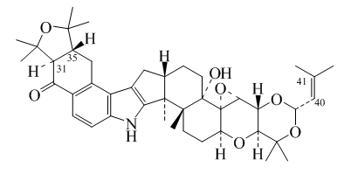
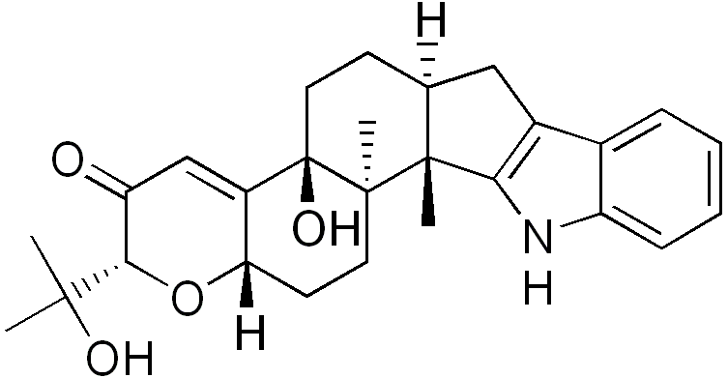
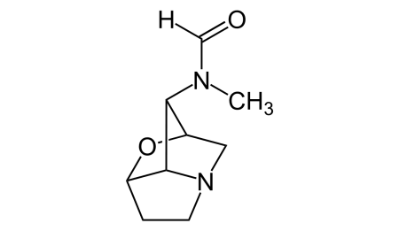
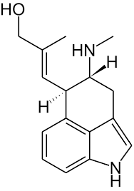
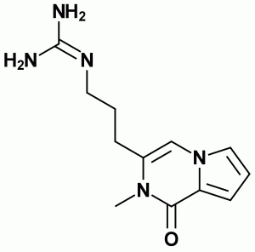
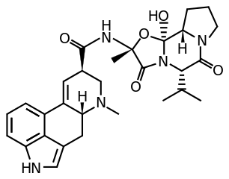
Epichloë alkaloids
Peramine
Paxilline
Lolitrem B
Toxic for mammals
Toxic for insects
Loline
Ergovaline
Chanoclavine -I
Notes:
But our endophyte does produce toxic compounds that are very similar to those of the ergot fungus C. purpurea, to which it is also related. It makes perfect sense that cattle grazing on fescue with the endophyte had symptoms of ergot poisoning.
All structures from Wikimedia Commons

Slide 16
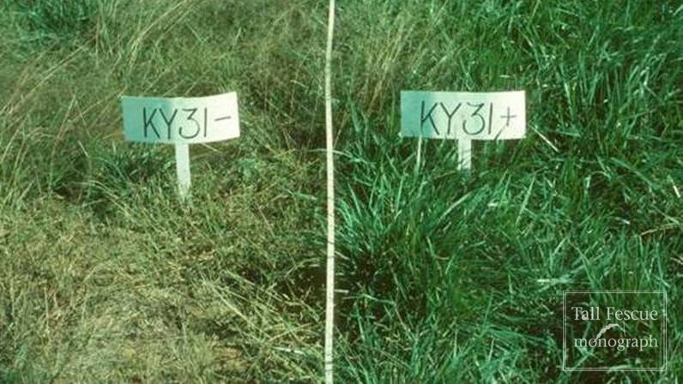
Endophyte-free Tall Fescue loses drought resistance and is not persistent in the field.
Notes:
“So, can you get rid of the fungus?”
“You can, and it’s been done- just treat the seeds or seedlings with a fungicide. People call it E- fescue, as opposed to the endophyte-infected E+ version. But E- was not a success: it was not nearly as drought- and cold tolerant as E+. Grazing cattle preferred the taste of E- fescue, but insect pests and root parasites attacked E- much more than E+. Pastures seeded with E- could easily be contaminated with E+ if farmers weren’t careful. E+ would then overgrow the pasture because it was so much more robust. It seems that most of the ‘wonder grass’ properties of Tall Fescue were due to the hidden fungus. E- was not a great success.”
Fig. 19-1. Effect of endophyte infection on stress tolerance in tall fescue. Plots were grown in the southern United States and subjected to periodic drought stress. (Left) E- KY-31; (Right:) E+ KY-31. Contrast between the two images is more vivid in the color pictures on the accompanying CD. (Photo courtesy of J.H. Bouton, The Noble Foundation.)
Source: Hopkins, A.A; Saha, M.C. and Wang, Z.Y. (2009). Breeding, Genetics and Cultivars. Chapter 19; In: H.A. Fribourg, D.B. Hannaway, and C.P. West (ed.) Tall Fescue for the Twenty-first Century, Online Monograph. Oregon State University; Available at https://forages.oregonstate.edu/tallfescuemonograph/Figures/19-1
The online version of the Tall Fescue for the Twenty-first Century monograph, copyrighted by Oregon State University in 2009, can be accessed at http://forages.oregonstate.edu/tallfescuemonograph. Reproduction of any portions of the text, figures, graphs, tables and images is permitted for non-commercial educational purposes only, provided that proper credit to Oregon State University is given, citing the publication, its source, and the date of publication. (https://forages.oregonstate.edu/tallfescuemonograph/toc)

Slide 17
Team Fungus:
Are you a pathogen (do you make the plant sick)?
Are you a parasite (do you take from the plant and give nothing in return) or a mutualist, meaning you do give something in return? If so, what is that something?
Team Plant:
Does the fungus make you sick?
What has that fungus ever done for you? Would you be better off without it?

Slide 18
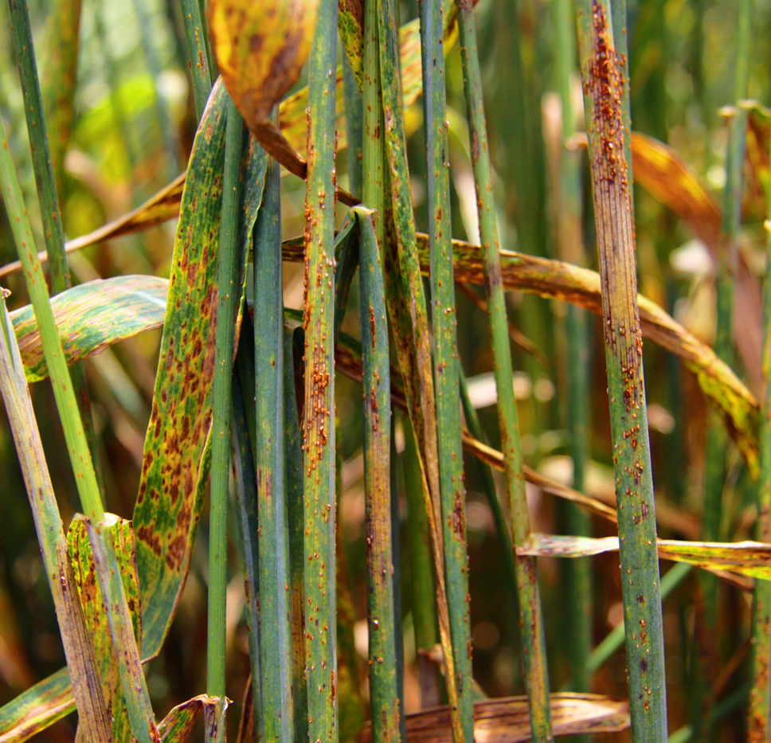
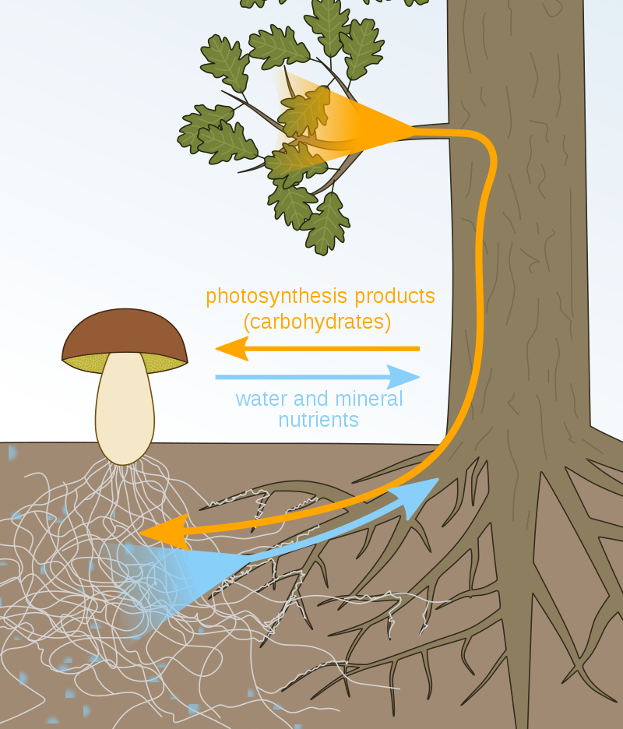
Wheat stem rust
Mycorrhiza
Notes:
With or without human intervention, both plants and fungi are under constant selection pressure to increase their own fitness: to grow better, survive and reproduce more.
When plants and fungi meet, disease is just one of several possible outcomes. Plants are in an evolutionary arms race with pathogens, each trying to defeat the other with ever more sophisticated weapons and defences. But not all fungi are enemies- some, like the mycorrhizae, are friends (mutualists), and some are a bit ambiguous.
For a fungus, both parasitic and mutualistic strategies can pay off and increase fitness in different ways. Both types of fungi grow on and in plants, make close contact and take organic carbon compounds from the plant. The fungal pathogens that devastate crops are parasitic, exploiting the plant’s resources and damaging them without returning anything. In contrast, mycorrhizal fungi can mobilise minerals from the soil and make them available to the plant in return for carbohydrates. This win-win situation means they are mutualists.
Left, Wheat stem rust disease. The fungus is an obligate biotroph, so it has to parasitise a living plant to acquire carbon compounds. It causes disease in its host and offers nothing in exchange. Image by Liang Qu / IAEA; available at https://www.flickr.com/photos/iaea_imagebank/9685492848/
Right, Within mutualistic mycorrhiza, the plant gives carbohydrates (products of photosynthesis) to the fungus, while the fungus gives the plant water and minerals in exchange. Image by Nefronus via Wikimedia Commons, CC BY-SA 4.0

Slide 19
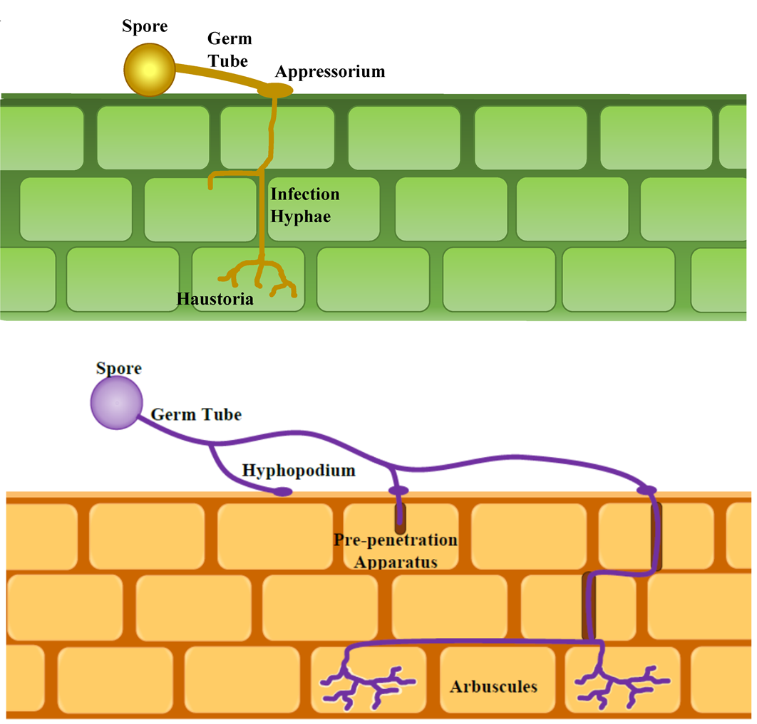
Forced entry
Parasitic fungus
(Wheat rust)
Accommodation
Mutualistic fungus
(Mycorrhiza)
Notes:
Often plants are able to detect attempted invasions by pathogens and defend themselves vigorously. If fungal hyphae do grow into the plant, it will try to limit the damage but its fitness will suffer.
The response to mycorrhizal fungi is very different: the plant actively accommodates fungal hyphae and allows them to grow between, through and into root cells instead of fighting them.
But how does a plant “know” whether friend or foe knocks on the door? Recognition is key. [play video clips]
Generalized diagram of infection and colonization patterns of biotrophic pathogens (top) and mutualists (bottom).
From Pawlowski ML and Hartman GL (2016) Infection Mechanisms and Colonization Patterns of Fungi Associated with Soybean. In: Sultan, S. (ed.) Fungal Pathogenicity. InTech Open, online, available at http://dx.doi.org/10.5772/62305 CC BY 3.0
[Note that the lower panel shows the infection pattern of an arbuscular mycorrhizal fungus (AMF) rather than the ectomycorrhizal fungus pictured on the previous slide. This was a compromise based on available images and the fact that AMF do not form the characteristic fruiting bodies (“mushrooms”) so are harder to illustrate; it is probably not necessary in an introductory course to draw students’ attention to the difference.]

Slide 20
Team Fungus:
How did you get into the plant?
How do you spread from one plant to another?
Team Plant:
How did you let the fungus get into you- did it force its way in, or did you allow it in? If the latter, how did you know this was a good guy?
How do you stop the fungus from spreading? (Or are you OK with it spreading?)

