Slide 1
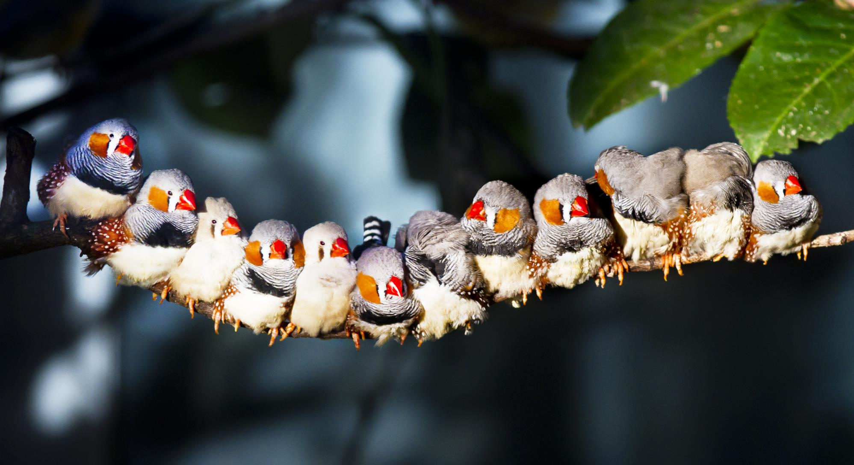
NATIONAL CENTER FOR CASE STUDY TEACHING IN SCIENCE
A Presentation to Accompany the Case Study:
A Song from the Past
Long-Term Effects of Malnutrition During Development
by
Kerianne M. Wilson
Department of Evolution, Ecology, & Organismal Biology
University of California, Riverside

Slide 2
Male Zebra Finch Song
Complex song
Simple song

Slide 3
Male Zebra Finch Song
Complex song
One song phrase
One song phrase
Simple song

Slide 4
Male Zebra Finch Song
Complex song
One song phrase
One song syllable
One song phrase
One song syllable
Simple song

