Slide 1
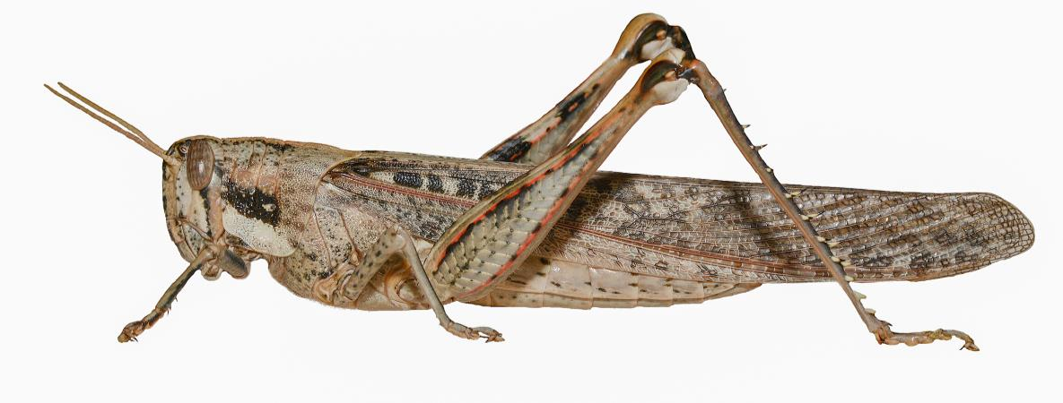
^{Do Grasshoppers Sweat?}
NATIONAL CENTER FOR CASE STUDY TEACHING IN SCIENCE
A Presentation to Accompany the Case Study:
^{by}
^{John G. Cogan and Emily Hill}
The Ohio State University, Columbus, OH
Notes:
Credit: Licensed image of Schistocerca nitens © Rachel Hopper | Dreamstime.com, ID 53135714.

Slide 2
The Molecule of Life
Water is the biological medium of life on earth.
Unique properties of water make earth suitable for life.
Water is present in high concentration on earth.
Water is present in high concentrations in living organisms.
A typical cell is approximately 70% water [55M].

Slide 3
Unique Properties of Water
Shape
Polarity
Emergent Properties

Slide 4
Polarity and Shape
Water is polar due to:
Asymmetrical distribution of polar bonds -> bent shape
Large electronegativity differences between H and O
*The polarity of water allows it to interact with other molecules and itself

Slide 5
The bent shape of water
Notes:
Credit: http://chemwiki.ucdavis.edu/Core/Inorganic_Chemistry/Molecular_Geometry/Bent_Molecular_Geometry , CC BY-NC-SA 3.0.

Slide 6
δ⁺
δ⁺
δ²⁻
Shape leads to unequal distribution of charge = polarity
Notes:
Credit: http://chemwiki.ucdavis.edu/Core/Physical_Chemistry/Atomic_Theory/Dipole_Moments , CC BY-NC-SA 3.0.

Slide 7
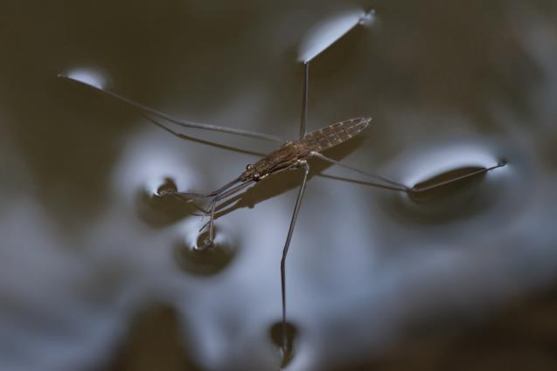
Emergent Properties of Water
H-bonding
Cohesion, adhesion
Temperature moderation
High surface tension
Evaporative cooling
Notes:
Credit: Bernd Thaller, https://www.flickr.com/photos/bernd_thaller/20989658331, CC BY-NC 2.0

Slide 8
Hydrogen-Bonding
Emergent properties stem mostly from the ability of water to form hydrogen bonds.
These form between polarized H and an unshared electron pair from an electronegative element (O, N, F).
These bonds result in increased cohesion, adhesion, surface tension and specific heat.

Slide 9
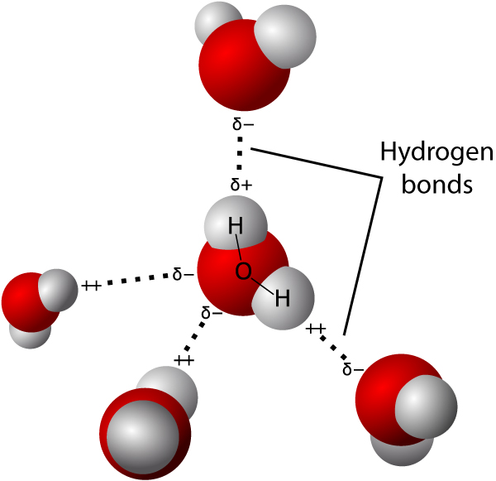
Hydrogen-bonding to neighboring atoms
Notes:
Credit: https://commons.wikimedia.org/wiki/File:3D_model_hydrogen_bonds_in_water.svg , CC BY-SA 3.0.

Slide 10
Cohesion and Adhesion
Cohesion is the tendency for water molecules to “stick” to other water molecules.
H-bonds hold water molecules together.
Enables transport of water against gravity in plants (capillary action)
Adhesion is the tendency for water to “stick” to other polar or charged substances.
Ex. proteins, carbohydrates, nucleic acids.

Slide 11
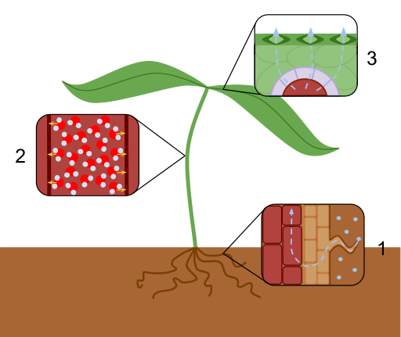
Cohesion between water molecules
Adhesion between water molecules and stem wall
Notes:
Credit: Laurel Jules, https://commons.wikimedia.org/wiki/File:Transpiration_Overview.svg , CC BY-SA 3.0.

Slide 12
Temperature Moderation
Water has a high specific heat. In other words…
When heated, water temperature (a measure of kinetic energy) rises slowly due to the need to break an extensive H-bonding network.
Likewise, when cooled, H-bonds that form give off heat and resist cooling.
Notes:
Credit: Licensed image © Ross Henry | Dreamstime.com, ID 45801896.

Slide 13
Evaporative Cooling – an emergent property
Stabilizes temperatures in bodies of water and in organisms
As heat is absorbed, water molecules gain kinetic energy
More energetic molecules evaporate (to gas)
Average kinetic energy (temperature) of molecules left behind drops
Effectively cools the surface

Slide 14
Evaporative Cooling
High energy water molecules escape the surface
Lower energy molecules remain
Notes:
Credit: Authors.

Slide 15
How do organisms stay cool?
Notes:
Credits:
Left: Bjørn Christian Tørrissen, https://commons.wikimedia.org/wiki/File:Aldabra_giant_tortoise_cooling_in_water.JPG, CC BY-SA 4.0.
Center: David Shankbone, https://commons.wikimedia.org/wiki/File:Dog_Panting_on_a_Hot_Day_2013.JPGCC BY 3.0.
Right: Трансаэро, https://commons.wikimedia.org/w/index.php?curid=7018972, CC BY-SA 3.0.

