Slide 1
Ethnomedicine in Latino Communities of Madison
National Center for Case Study Teaching in Science
Classroom Presentation
by
David S. Kiefer
Department of Family Medicine
University of Wisconsin—Madison

Slide 2
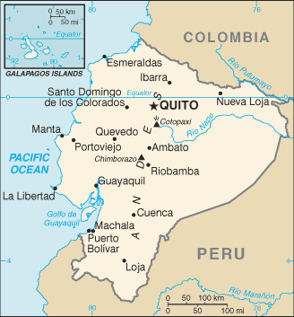
Goals
Plants
  Culture
  Healing
Layers of medicinal plant use
  Botany (Latin)
  Phytochemistry
  Evidence
Relevance to home

Slide 3
Nascent pharmacology
Conspicuousness, morphology
Ubiquity
Color
Aroma
Taste
Contact dermatitis
Lack of insect predation
Animal food
Anthropomorphic qualities
Ease of transplantation
Proximity to dwellings
Cultural taboos and spirits
Efficaciousness
Multi-purpose utility
Dreams
Intuition
Shamanic journeying
Notes:
This phrase means the “birth of pharmacology” and is the science behind how humans found medicinal plants originally. Consider review each of these and why it might have helped humans to discover physiologically active plants. Consider bringing in some branches of fresh mint; the smell (aroma) is a familiar one to most of us and is relevant to the next slide.

Slide 4
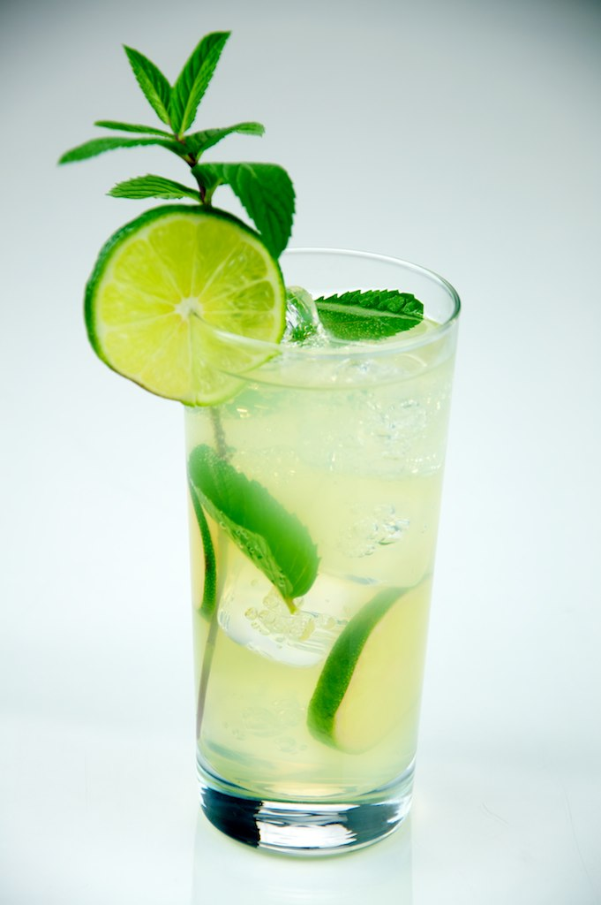
Let’s practice
Each plant family has its own characteristics
Lamiaceae
Notes:
The mint plant family contains volatile oils (such as menthol) that have medicinal activities.

Slide 5
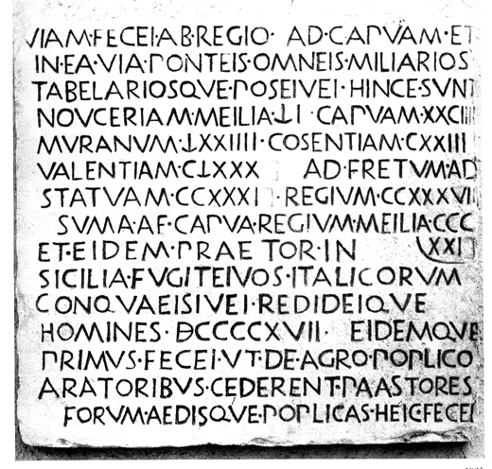
Learning plant families
Latin
Genus species
  variety
  subspecies
Family
  aceae (the suffix for plant families)
  Asteraceae is one example

Slide 6
Phytochemistry
Phtyochemical family trends
  Alkaloids: Fabaceae, Rubiaceae, Solanaceae, Berberidaceae, Taxaceae
    Non-existent: Lamiaceae, Rosaceae
  Saponins: Dioscoreaceae (diosgenin), Fabaceae (glycyrrhizin), Liliaceae, Agavaceae
  Volatile oils: Lamiaceae, Piperaceae, Apiaceae, Pinaceae, Rutaceae
Notes:
Plant families are important for many reasons, including the fact that some contain important compounds that have medicinal effects.

Slide 7
Other aspects to herbal medicine
Collecting and identifying
Correct names
  Ex: what is mentha?
Preparing the plant for an herbarium specimen

Slide 8
Collecting plants
Indentification/taxonomy
Field notes: notebook
  Location, date, conditions, ecology, companion plants, color, taste, smell
  Ethnobotanical use
Draw plant, photo
Focus on fertile specimens
  Who has a fertile specimen?
  Who has a sterile specimen?
Notes:
Consider bringing in plants to class. Fertile specimens are those with fruits or flowers and are ideal for identification purposes. Sterile plants, those without fruits and flowers are almost impossible to identify taxonomically, unless laboratory techniques are used.

Slide 9
Effective communication
Not just “echinacea”
  Echinacea pallida, E. pallida var. angustifolia, E. purpurea
Not just “ginseng”
  Asian ginseng (Panax ginseng, Family Arialaceae)
  American ginseng (Panax quinquefolius, Family Arialaceae)
  Siberian ginseng (Eleutherococcus senticosus, Family Arialaceae), now called “Eleuthero”
Notes:
Common names can be confusing: mean several different plants

Slide 10
Herbal medicine forms
Raw herb
  Eat
  Infusion (pour hot water over herb)
  Decoction (boil)
Tinctures (alcohol, glycerin)
Standardized extracts (capsule)
Drinks, combination products, etc.

Slide 11
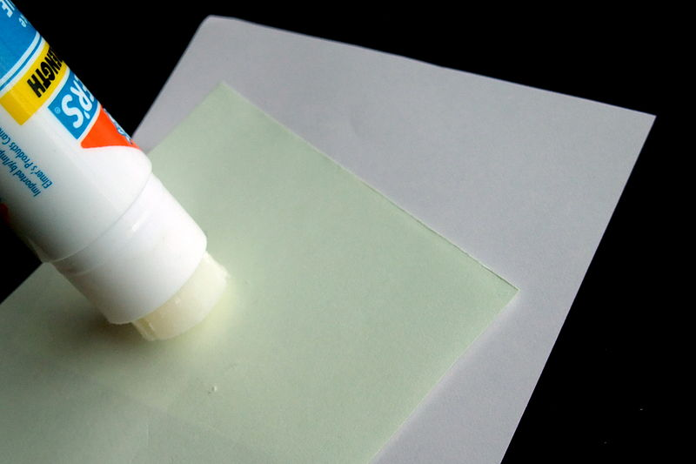
Ethnobotany
Cox: the study of uses of plants by indigenous peoples
Relationships between plants, people, and culture
Ethnomedicine = study of the dynamic relationship between people, the environment, culture, and their healing practices
  Michael Balick, Ph.D.
Notes:
This field is the glue that brings together plants, people, and culture
In this case, we are focusing on a subset of ethnobotany called ethnomedicine

Slide 12
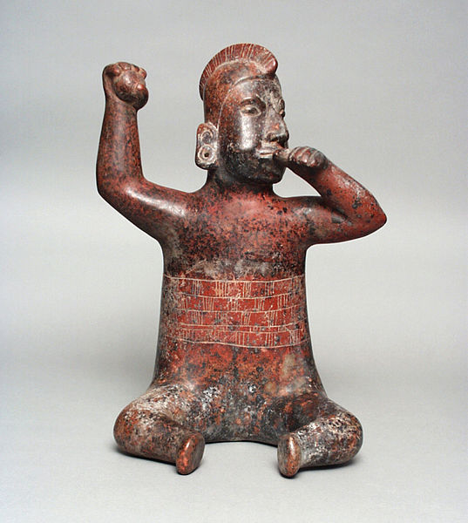
Where to start?
2100 B.C.: coastal Ecuador
  Peyote (Lophophora williamsii)
7000 B.C.: caves in Texas
  Coca (Erythroxylum spp.)
Notes:
Evidence for medicinal plant use goes back thousands of years

Slide 13
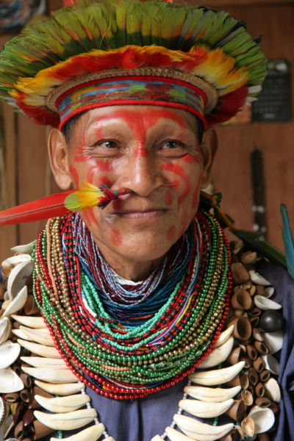
Traditional healers
Not just a “thing of the past”
Belize: powerful plants from one healer were 4X more likely to be active against HIV than were plants collected randomly
Snakebite: modern remedies have come from such purported cures
Etkin, 2001
Notes:
People with medicinal knowledge are an important part of this equation

Slide 14
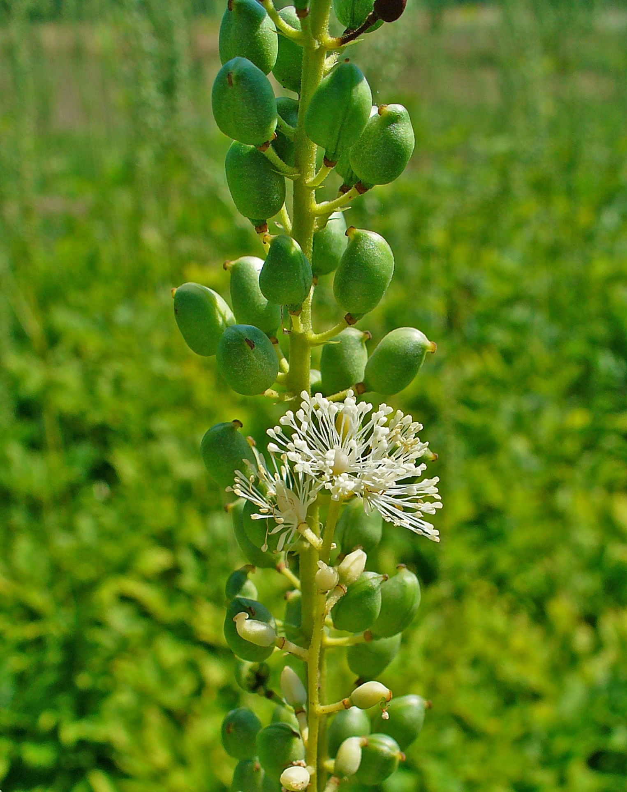
Snakebite
Echinacea spp.
  Viral infections
Black cohosh (Actaea racemosa)
  menopause
Notes:
North American plants that used to be used for snakebite

Slide 15
Traditional healers
Plant knowledge
Crucially important
  Conservation
  Human/ecological health
Notes:
In general, traditional healers hold a lot of knowledge about these topics

Slide 16


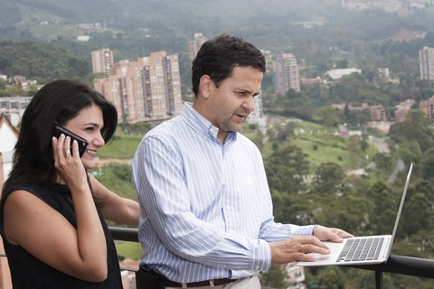
Traditional knowledge
Los Alvarez
Dr Junsy
Los Andi
Notes:
In our case, we could call these people holders of traditional knowledge.
Discuss the knowledge they have, its accuracy, relevance to modern medicine, etc.

Slide 17
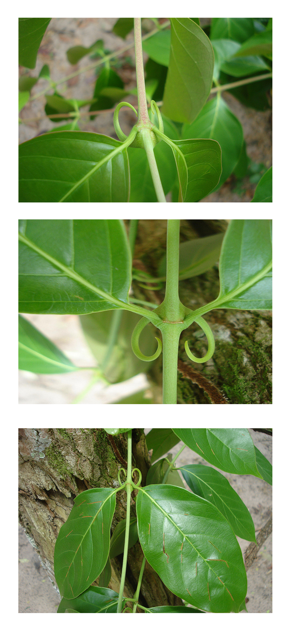
Cat’s claw (uña de gato)
Uncaria tomentosa (Rubiaceae)
Asháninka Indians in Peru
  “savéntaro,” or “powerful plant”
Oxindole alkaloids
  Pentacyclic (+ effect)
  Tetracyclic (no effect)
  Mur (2002), Piscoya (2001)
Notes:
An example of a traditional remedy, now being studied and used around the world.
A “star” plants where the traditional use helped us clinically.

Slide 18
Uña de gato
Alkaloids: immunostimulant, increased phagocytosis, anti-cancer, anti-oxidant, anti-inflammatory
Clinical trials: arthritis, enhance vaccines
Chemotypes:
  Botanically similar: botanists are unable to identify the active plants
  Healer-priests able to tell the difference and only harvest the effective plants (Pentacyclic)
Notes:
Only the traditional healer can find the active chemotype. Important to have them as part of the research team.

Slide 19
Connections to “modern medicine”
18-25% of our prescriptions are plant-derived
  Semi-synthetically made from plants
  Still extracted
  (Farnsworth, 1977; Duke, 1993; Grifo, 1997)

Slide 20
We need Nature
“…researchers could not have invented the anticancer compound taxol, taken from the Pacific yew tree. It is too fiendishly complex a chemical structure, says natural-products chemist Gordon Cragg, of the U.S. National Cancer Institute.” (Plotkin, 2000)
“Although chemists can ring many changes on a known structure, for the foreseeable future we will still rely on Nature to supply us with new structural types for investigation.” (Huxtable, 1992)

Slide 21
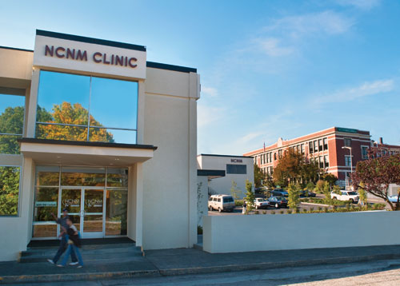
The Herbal Team
Traditional healers
Naturopathic physicians (NDs)
Herbalists
MD, NP, RN, RP (PharmD), PA
Notes:
A modern day “herbal team” has several possible members. This type of collaboration has benefits clinically, and for research and conservation. Discuss what some of these might be.

Slide 22
Respecting traditional knowledge
Herbal use
  Safe?
  Legitimate?
Retail outlets
Clinics
Next intern?
Notes:
See Discussion Notes.

Slide 23
Summary
Botanical identification (taxonomy)
Preparation techniques
  Basic herbalism
Cross-cultural nuances
  Ecuador vs. US vs. other countries vs. your experience

Slide 24
Image Credits
Slide 2: Map of Ecuador, from the United States Central Intelligence Agency's World Factbook https://www.cia.gov/library/publications/the-world-factbook/geos/ec.htm, PD.
Slide 4: Mojito made with rum, lime, sugar, mint, club soda, served in a tall glass. By Evan Swigart from Chicago, http://commons.wikimedia.org/wiki/File:Mojito_made_with_rum,_lime,_sugar,_mint,_club_soda,_served_in_a_tall_glass_-_Evan_Swigart.jpg, USA CC BY 2.0.
Slide 5: Latin text, http://commons.wikimedia.org/wiki/File:Polla_via_popilia_da_reggio_a_capua.jpg, PD.
Slide 11: Glue stick , by Malcolm Koo, http://commons.wikimedia.org/wiki/File:Elmer%27s_Office_Glue_Stick_in_action.JPG, CC BY-SA 3.0.
Slide 12: Seated figure, http://collections.lacma.org/node/182708, courtesy of Los Angeles County Museum of Art, PD.
Slide 13: Shaman from the shuara culture in Ecuador Amazonian forest, June 2006, Wikimedia Commons user PICQ, http://commons.wikimedia.org/wiki/File:Chaman_amazonie_5_06.jpg, CC BY-=SA 3.0.
Slide 14: Actaea racemosa by H. Zell, http://commons.wikimedia.org/wiki/File:Actaea_racemosa_006.JPG, CC BY-SA 3.0.
Slide 21: Photo of National College of Natural Medicine, by Jenny Bowlden, http://commons.wikimedia.org/wiki/File:NCNM_Clinic.jpg, PD.
Slide 22, 16 left: © Monkey Business - Fotolia.com, ID 17893106, licensed.
Slide 16 bottom: © Jkha | Dreamstime.com, ID 9478888, licensed.
Slide 16 right: © Photographerlondon | Dreamstime.com, ID 29663835, licensed.
Slide 17: Uncaria tomentosa by Wikipedia user Vangeliq.petrova, http://commons.wikimedia.org/wiki/File:Uncaria_tomentosa.png, CC BY-SA 4.0.

